Slide 1
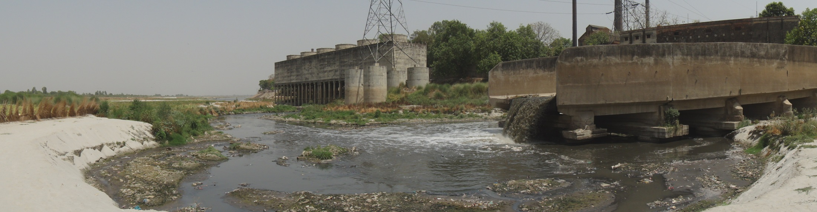
Cleaning India’s Rivers: Bringing the Global Experience to Bear
International River Symposium
New Delhi
September 13, 2016

Slide 2
Why does water quality matter?
Imposes huge burdens on society
Public health burden (health costs and preventable deaths)
Direct impacts on economic activities (e.g. tourism, agriculture)
Destruction of natural ecosystems and aquatic life
Reduction in recreation or amenity values
Increased water and wastewater treatment costs
Disproportional impact on the poor

Slide 3
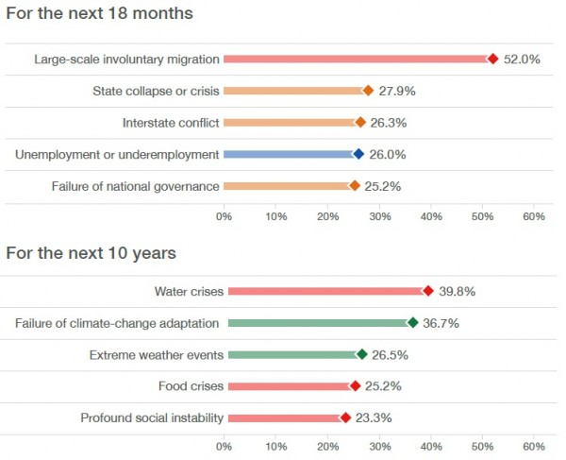
WATER AND GLOBAL RISKS
World Economic Forum:
Global Risks Report (2016)
Annual survey of CEOs, Heads of State, Leading Scholars etc…
11th Edition was released in 2016, after COP21 in Paris.
Respondents asked to rank risks, based on (1) impact and (2) likelihood.
Note water crisis risk pushed back, and visibility of quantity versus quality risks.

Slide 4
Where are india’s rivers today?
Water quality is a major environmental issue
Largest source of pollution is untreated sewage
Huge capacity and utilization gap of WWTPs
Followed by agricultural run-off and industrial discharge
Problem affects Peninsular rivers as much as Himalayan rivers
Do very badly on Fecal Coliform and BOD, better on DO
Reliability of water quality data is major issue

Slide 5
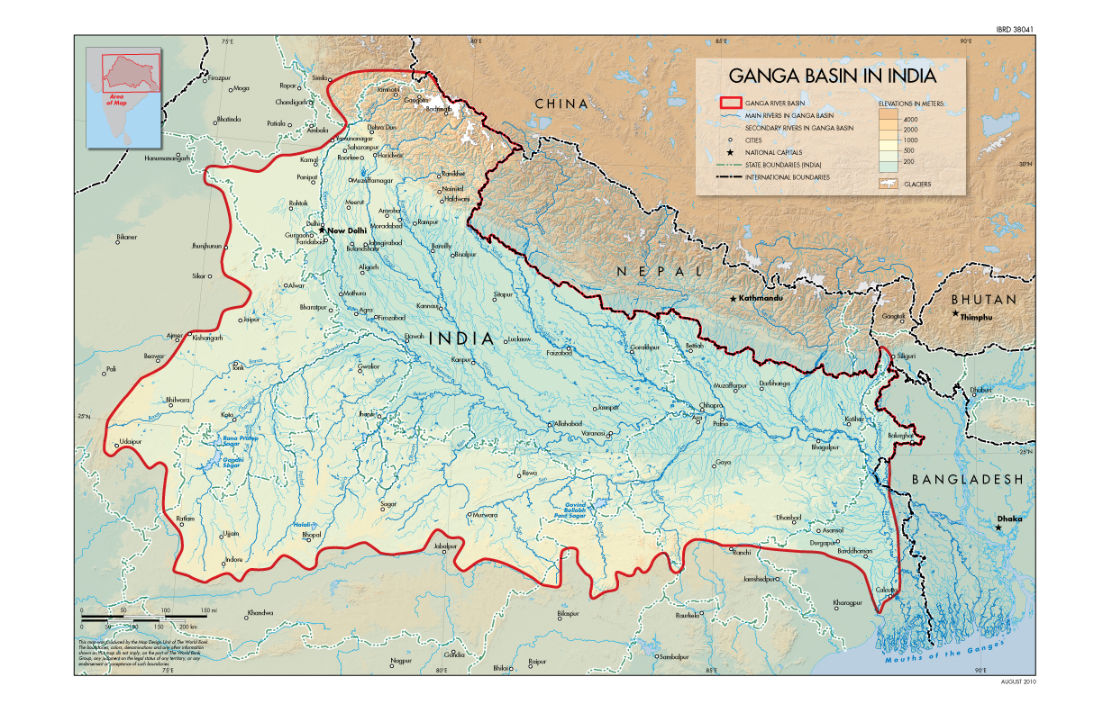

Slide 6
Scale of the Ganga River in India
2,500 km long river
5 Mainstem States
11 Basin States
Basin is 861,404 square kilometers
26% of India’s landmass, 25% of its water resources
About 400 million people, most populated in world
About 600 people per square km, 10 times the global average
More than 30 Class 1 cities with 20 million people
50% of India’s poor live in the 5 mainstem states
70% of the population lives on < $2 day
Primarily rural - 90% water consumed is for irrigation
20,000 MW hydro potential in Uttarakhand

Slide 7
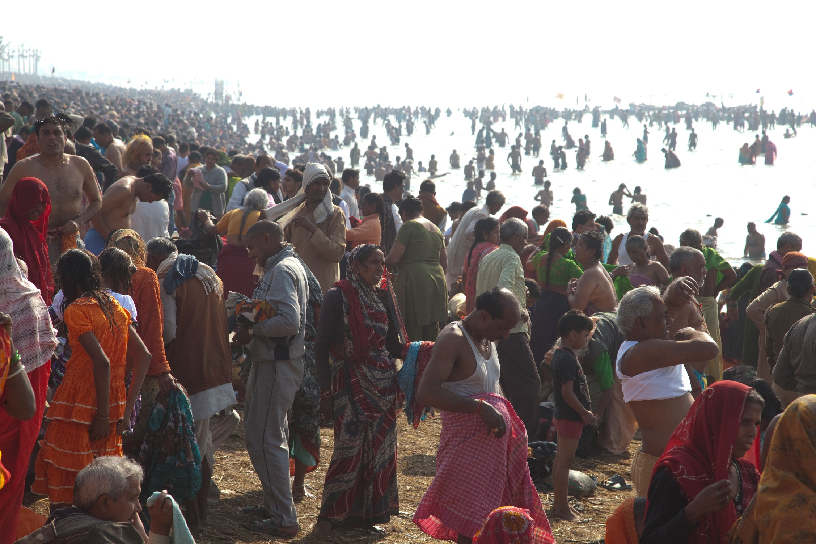

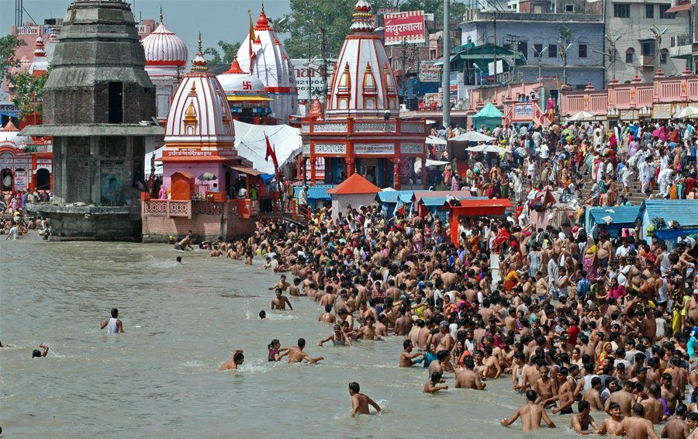
A DENSELY WORSHIPED RIVER
120 million people came to Allahabad over 2 months, incl. 30 million people on a single day
(2013 Maha Kumbh Mela)

Slide 8
Extreme Pollution Pressures
Quality has sharply deteriorated in recent years
Especially in lean flows (90% rain in 4 months)
Major impact on environmental flows
Point source: domestic (75%) & industrial (25%)
About 1/3 of urban sewage generated is treated
Industrial clusters: leather, pulp & paper, distilleries
Critical stretch: Kannauj to Varanasi
50% industrial pollution load is in UP
Major polluted tributaries: Yamuna, Ramganga, Kali
Weak capacity of Cities and of Environmental Regulators

Slide 9
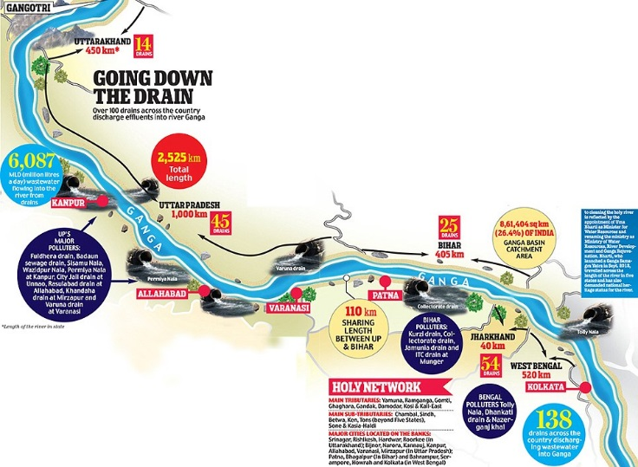

Slide 10
How does this COMPARE?
Water quality has improved in high income countries, but worsened in the majority of rivers in Latin America, Africa, and Asia. Between 1990 and 2010, pathogen pollution, organic pollution, and salinity pollution have all worsened in the rivers of these continents (UNEP, 2016).
Pressures in India are very similar to the pressures in those countries (i.e. more wastewater loadings as a result of urbanization, agricultural intensification, material consumption etc…) but exacerbated by hydrological complexity.
However, data are not standardized and water quality has not received the attention or resources needed to generate monitoring and assessments at a global scale. The MDGs, for example, did sufficiently deal with the problem of water pollution. SDGs do better, but in 3 different goals.
Water pollution will be exacerbated by major global trends, including climate change, possible impacts include:
  Higher water temperatures → algal blooms and natural organic matter, requiring more wastewater treatment,
  Sea level rise → increase the salinity of coastal aquifers,
  More monsoon variability → less water to dilute concentrations.

Slide 11
Example: FECAL COLIFORM POLLUTION has increased between 1990-92 to 2008-10

Slide 12
HISTORY TEACHES US:
Countries do not clean their rivers when they’re poor. On average, GDP per capita matters, as development trajectories free up funds (it’s expensive) and priorities/values change
Define dirty. You can’t solve a problem you haven’t defined. Pollution requires clear parameters and standards – “acceptable quality” has to be defined. Salinity? Sediment? Non point source?
Cleaning takes time. There are stops and starts and even a river like the Singapore River took 10 years.
It never stops. River cleaning never ends. Objectives change. Methods change. Actors change. Instruments change. But it’s never over.

Slide 13
Political projects: the danube and The EU water framework directive
WFD (2000) and provides a framework for the promotion for the sustainable and efficient use of water resources in the EU, and for accession countries. Contains several sub-directives that are specific to water quality, including:
The Urban Waste Water Directive, which sets minimum standards for treatment of domestic and industrial wastewater from urban agglomerations, and
The Nitrates Directive, which aims to prevent nitrates from agricultural sources polluting ground and surface waters and by promoting the use of good farming practices.
Information is king: For each water body, a range of parameters must be monitored including for biology, hydromorphology, physio-chemical, and priority and hazardous substances. Bodies need to be classified according to their “ecological and chemical status”.
Not a runaway success: 49% of surface waterways at risk of failing to achieve good ecological status by 2021 and no data available for 9%. A 2015 audit report by the European Court of Auditors concluded that implementation of the EU WFD has led to “little improvement in water quality” in the Danube.
Conducive political conditions: Relies on creating overarching water quality objectives and supporting implementation through compliance and enforcement, but also through the allocation of funding. Few regions in the world benefit from such structural conditions to improve water quality.

Slide 14
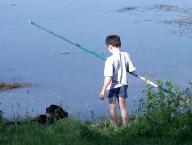
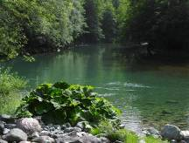
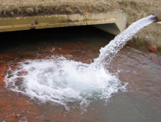
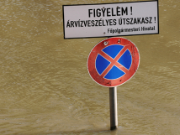

The International Commission for the Protection of the Danube River (ICPDR)
Danube River Protection Convention: June 1994
The sustainable & equitable use of water
The protection of water & ecological resources
Reduction of nutrients & hazardous subs.
Management of floods
& ice hazards
ICPDR: established (1998) to implement the Convention
ICPDR now coordinates the implementation of the EU Water Framework Directive (2000) & the EU Floods Directive (2007) in Danube Basin.

Slide 15
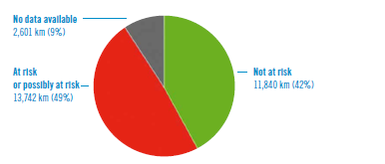
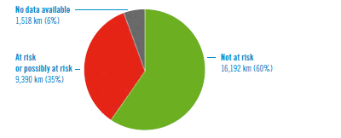
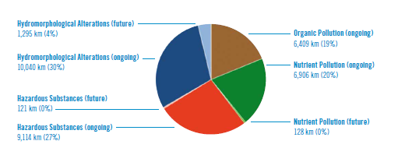
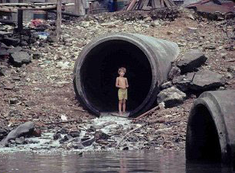
Status Assessment of the Danube River (as per the DRBMP, 2015)
Risk to fail good ecological status by 2021
Risk to fail good chemical status by 2021
Risk by pressures

Slide 16
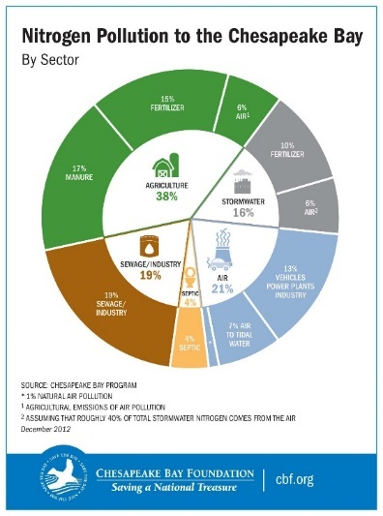
diffuse pollution: the Chesapeake bay
The watershed spans 6 states and 1 district in the US.
Drainage basin is 64,000 square miles.
Very complex ecosystem; receives half its water from 110,000 streams and 1.7 million acres of wetlands.
Suffers from intense diffuse pollution from nutrients, primarily nitrogen and phosphorous.
Largest source is ag run-off (40% of N and 50% of P).

Slide 17
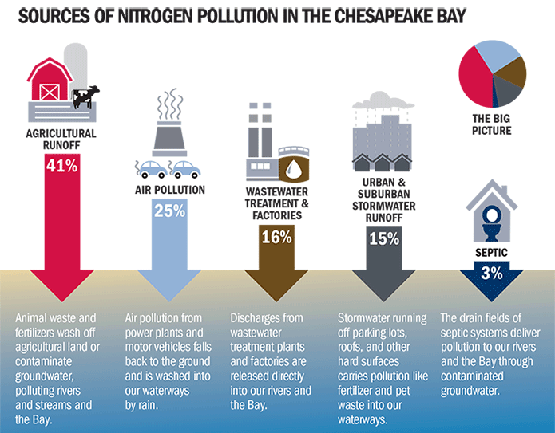

Slide 18
SAVING THE BAY, ONE DECADE AT A TIME
Clean Water Act (1972) passed and Chesapeake Bay is on US EPA’s “Dirty Waters” List.
US EPA signs first agreement (1983) with 4 states to clean up the Bay.
Second agreement signed (1987) to achieve 40% reduction in nutrient pollution by 2000.
First “State of the Bay” report card is published (1998), giving it a score of 27 out of 100.
A federal strategy, signed by the US President as an Executive Order, is released as the Blue Print 2010-2025 requiring federal agencies to act (e.g. NOAA, Interior…).
EPA is setting enforceable pollution limits to cap the loads.
The Bay is still on the “dirty waters” list.

Slide 19
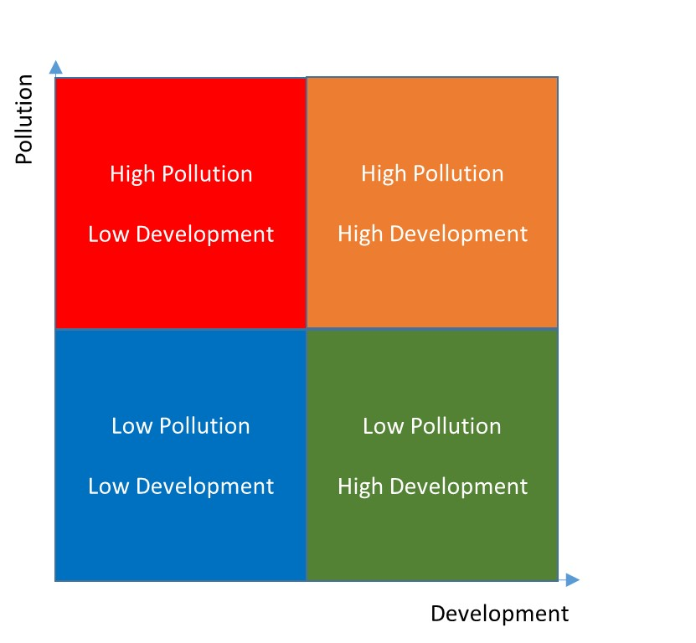
DEVELOPMENT AND POLLUTION: TRAJECTORIES OF GROWTH

Slide 20
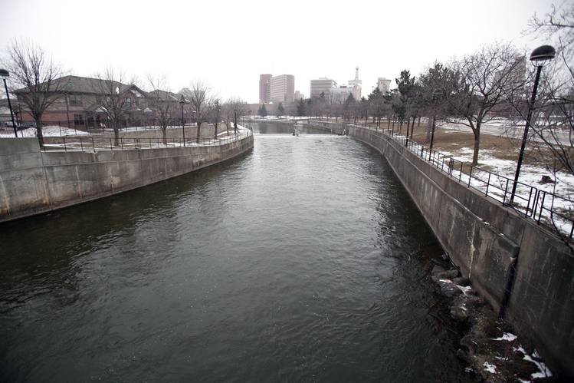
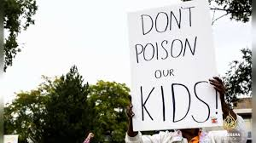
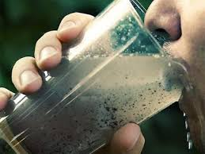
BRINGING IT TO BEAR:
Priorities have to match resources.
Pollution needs to be defined.
It takes time.
It never stops.

Slide 21
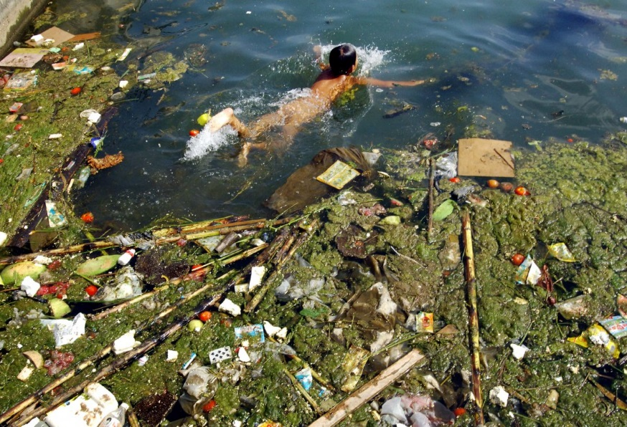
THANK YOU

