Slide 1
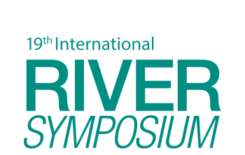
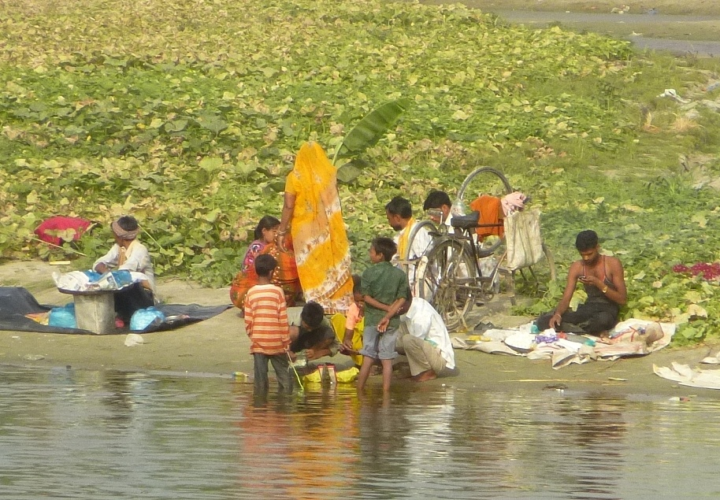
TAJ PALACE, NEW DELHI | 12 – 14 SEPTEMBER 2016
Socio-cultural and Livelihoods flow assessment for Ramganga river, India
By – Anil Gautam, Chicu Lokgariwar, Neha Khandekar
Senior Researchers
People’s Science Institute, Dehradun, Uttarakhand, India

Slide 2
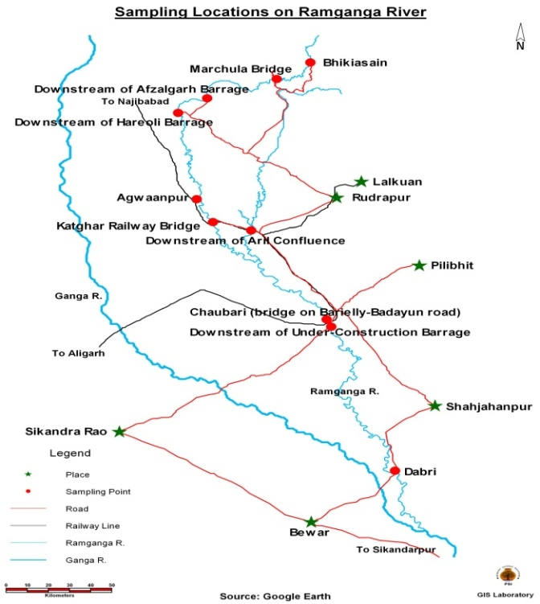
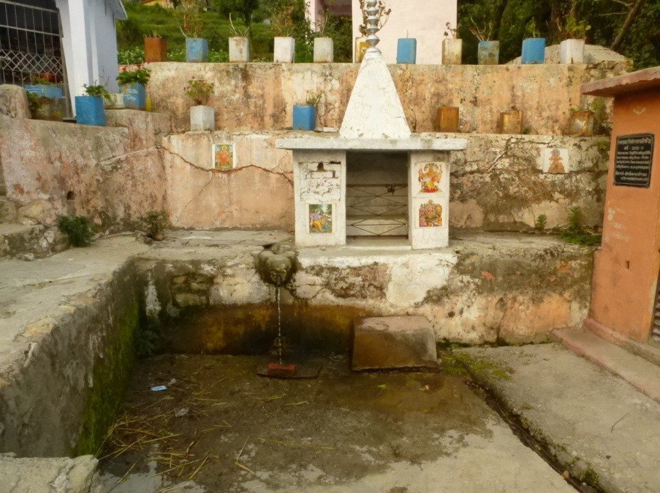
(Origin of River Ramganga – Ramnali, Gairsain)
TAJ PALACE, NEW DELHI | 12 – 14 SEPTEMBER 2016
Ramganga River
(Origin of River Ramganga –Gairsain, Uttarakhand, Northern India
Notes:
Ramganga emerges from the eastern slopes of the Doodhatoli mountain range. It flows for about 596 Km before it joins River Ganga in Uttar Pradesh. Ramganga valley is rich in biodiversity. It is famous for many fish varieties and migratory birds. But construction of barrages, mining, heavy abstraction of water for several towns in U.P and high levels of pollution from the industries are reducing the river into a polluted stream. This urgently calls for work towards assessment and implementation of adequate E-Flows in the river.

Slide 3
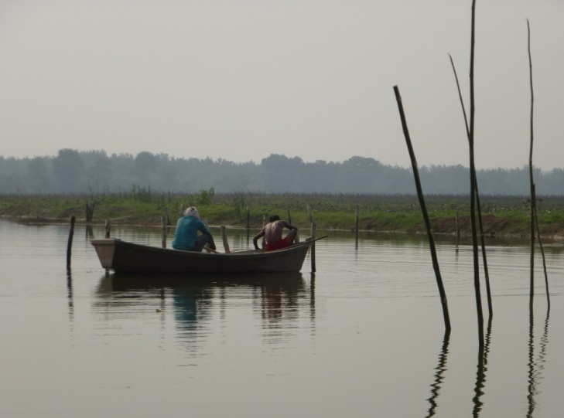
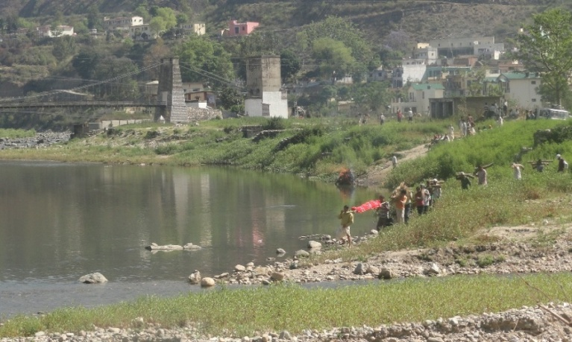
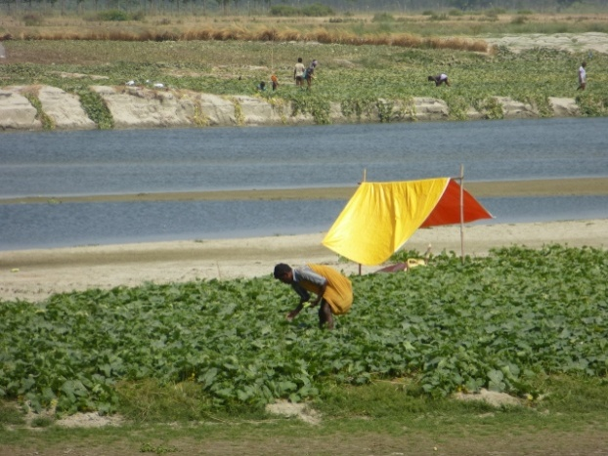
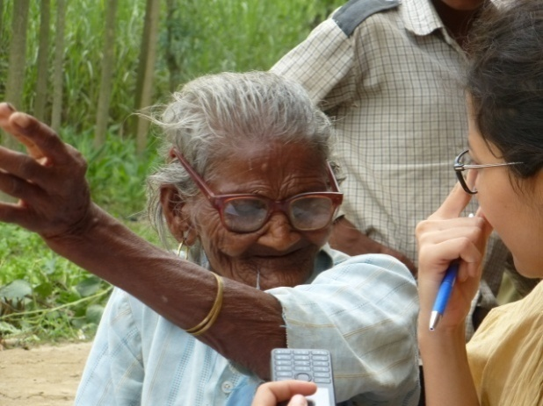
TAJ PALACE, NEW DELHI | 12 – 14 SEPTEMBER 2016
Livelihoods
Socio Cultural Flows
Religious
Historical

Slide 4
TAJ PALACE, NEW DELHI | 12 – 14 SEPTEMBER 2016
Socio Cultural Flows
If peoples' need for flows for rituals are heard and acknowledged in environmental flows management, then their support can be ensured.
It has been observed that flows requirements for rituals correspond closely with the natural flow regime of a river (Lokgariwar, Chopra, Smakhtin, Bharti & O'Keeffe, 2013)

Slide 5
TAJ PALACE, NEW DELHI | 12 – 14 SEPTEMBER 2016
Methodology
Analysis of Present, Desired and Reference flows
Cross section surveys, PRA, FGD, In depth interviews
Reference , Present and Desired flows and justification

Slide 6
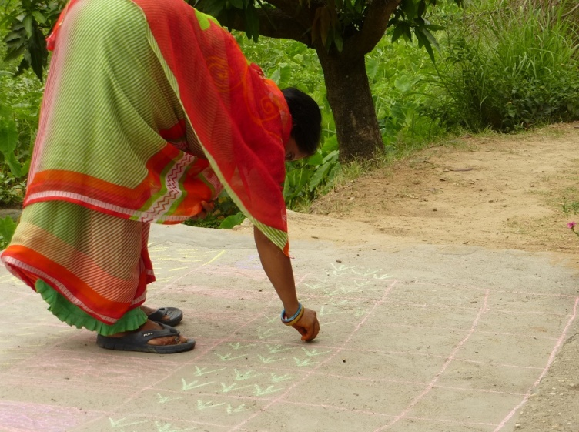
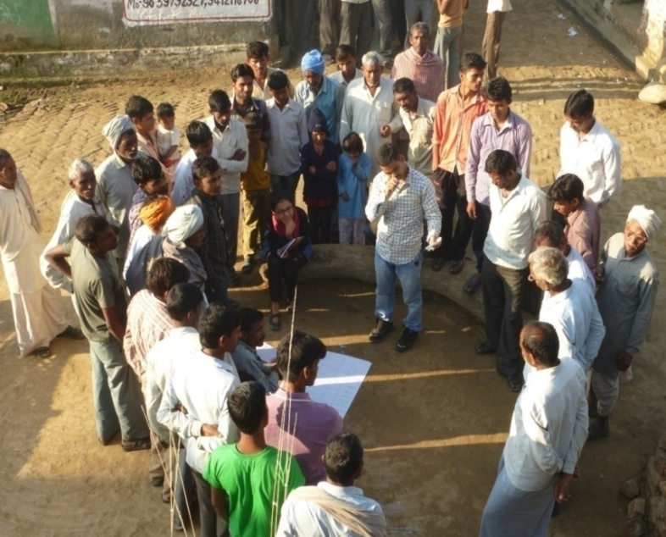
TAJ PALACE, NEW DELHI | 12 – 14 SEPTEMBER 2016
Methods
Participatory rural appraisal (PRA):
Transect walk and diagramming
Resource mapping of the area
Time Line
Seasonal Calendar
Daily Calendar
Time Trend

Slide 7
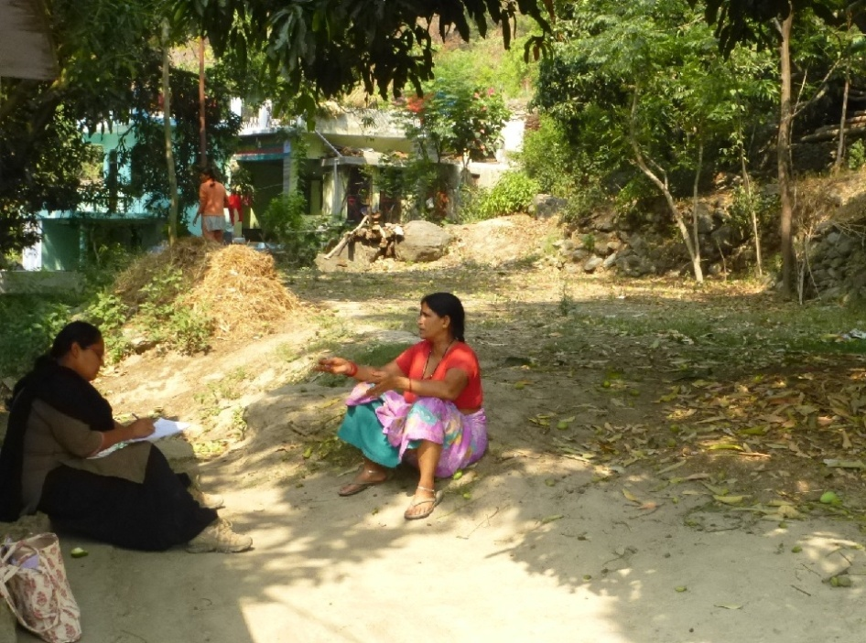
TAJ PALACE, NEW DELHI | 12 – 14 SEPTEMBER 2016
Methods
Identifying cross section
In-depth interviews
Minimum 70 interviews at each site
Purposive sampling to cover a balanced mix in terms of gender, religion and occupation
FGD with specific livelihood group, women
PSI research team member, conducting interview at a village in middle Himalayas, close to where river originates and is still in ‘near-pristine’ condition
June, 2014

Slide 8
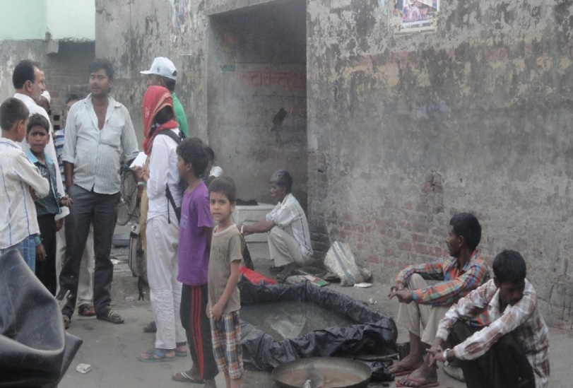
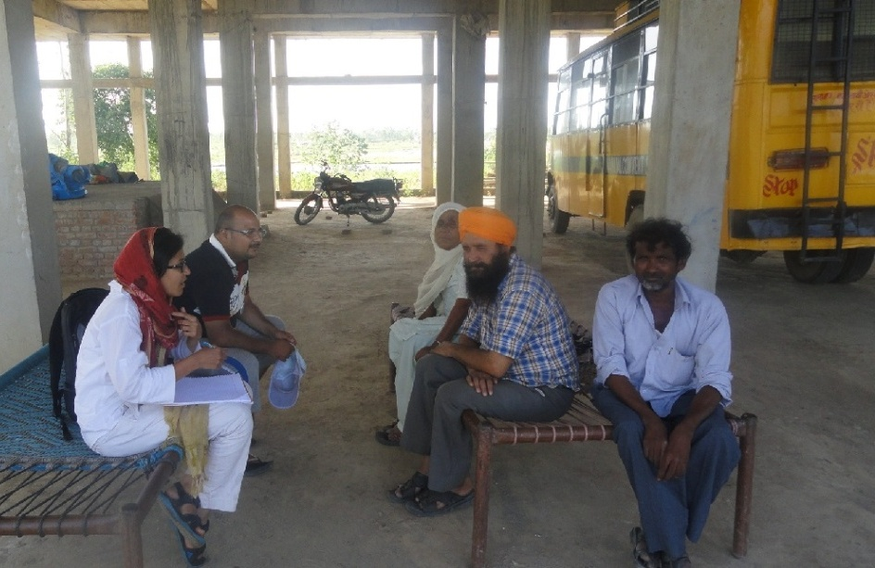
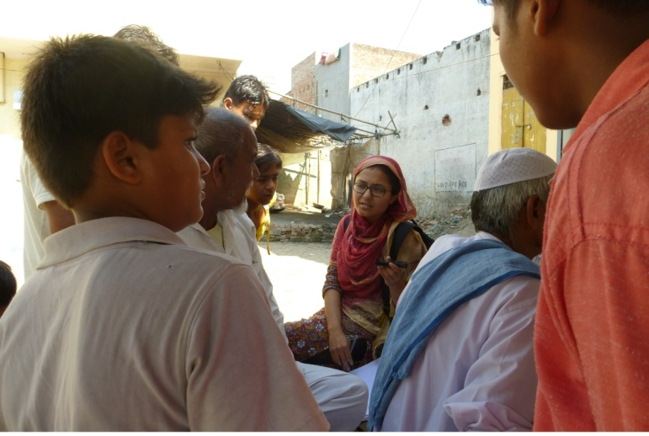
TAJ PALACE, NEW DELHI | 12 – 14 SEPTEMBER 2016
Riparian dwellers

Slide 9
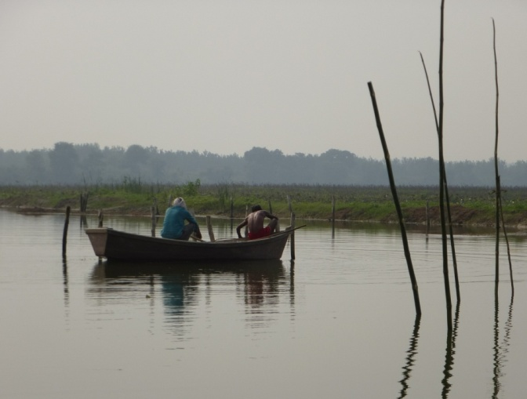
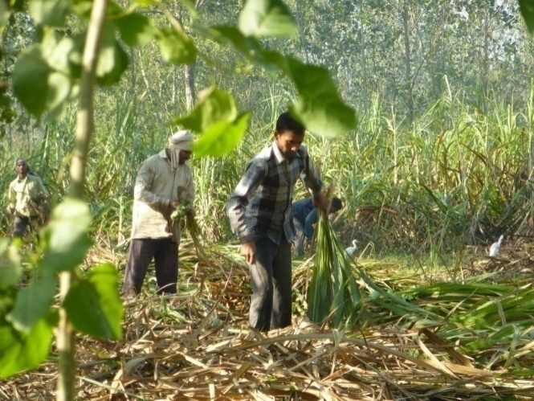
Agriculture
Largely on decline. Main crops rice, wheat, sugarcane. Earlier: maize, pulses.
Fishing
Largely for personal consumption . Some communities also catch fish for sale
Rituals
Predominantly hindu rituals such as cremation
Paleej Farming
'Paalej' is the local term for growing melons, cucumbers and gourds on the river bed. Declining at site near barrage
TAJ PALACE, NEW DELHI | 12 – 14 SEPTEMBER 2016

Slide 10
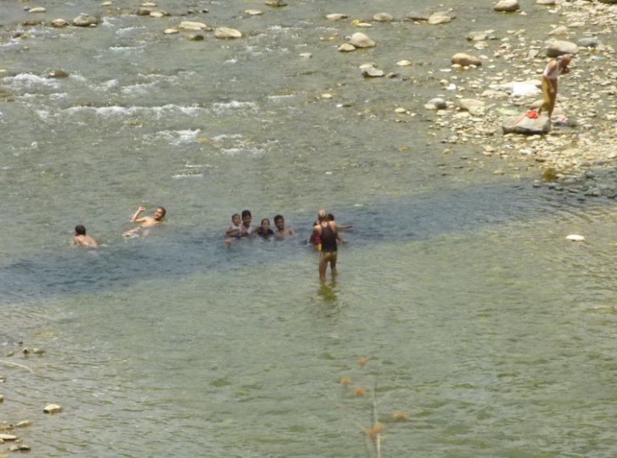
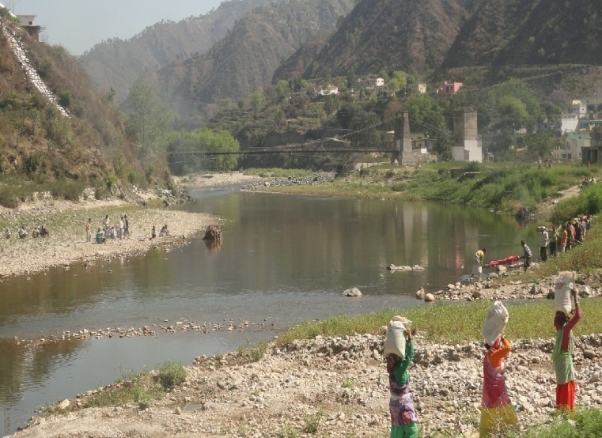
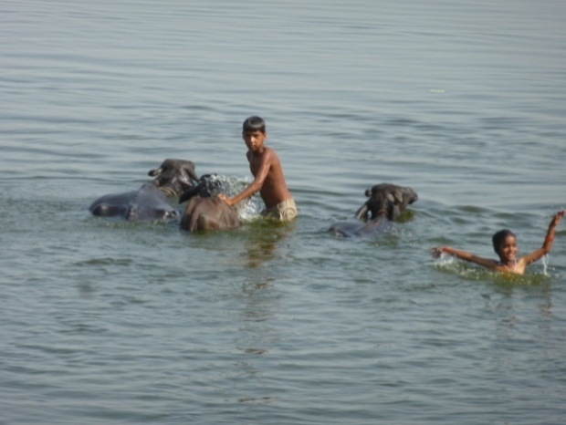
TAJ PALACE, NEW DELHI | 12 – 14 SEPTEMBER 2016
Recreation
Swimming and recreational fishing
Domestic use
washing, drinking and bathing
Cattle herding
Sandmining
Potentially harmful. Earlier done on a small scale, but commercial mining has increased.

Slide 11
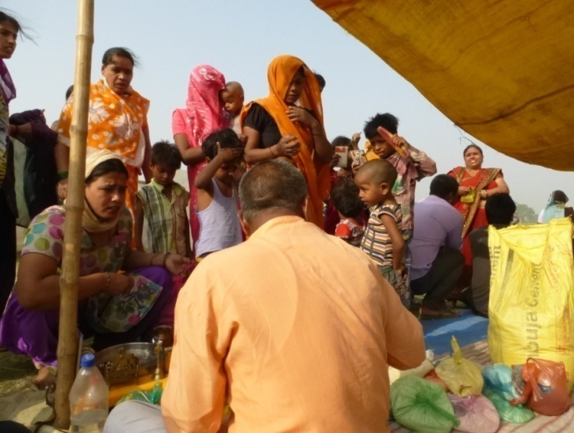
TAJ PALACE, NEW DELHI | 12 – 14 SEPTEMBER 2016
Riparian dwellers spoken to..

Slide 12
TAJ PALACE, NEW DELHI | 12 – 14 SEPTEMBER 2016
Site near origin
90% of respondents dissatisfied with present state of River
Mining a major source of dissatisfaction
Decrease in flows from historical levels attributed largely to pumping stations upstream
Category | Normal year | Normal year | Drought year | Drought year | Floods
 | Summer | Monsoon | Summer | Monsoon
Socio-Cultural & Livelihood | Knee deep flowing water, for having cremation at desired conditions Discharge: 4.5 cumec | For field inundation) Dis: 64 cumec | Cremation will still be carried out with limited desirable flow Dis: 1 cumec | inundation of fields doesn’t happen but acceptable, cultural activities Dis: 12 cumec | fields will get new silt)2-4 days in entire wet season Dis: 91 cumec
Biodiversity | Discharge: 4.5 cumec | Discharge: 64 cumec | Discharge: 1.5 cumec | Dis: 12 cumec
Geo-morphology |  |  |  |  | Dis: 91 cumec

Slide 13
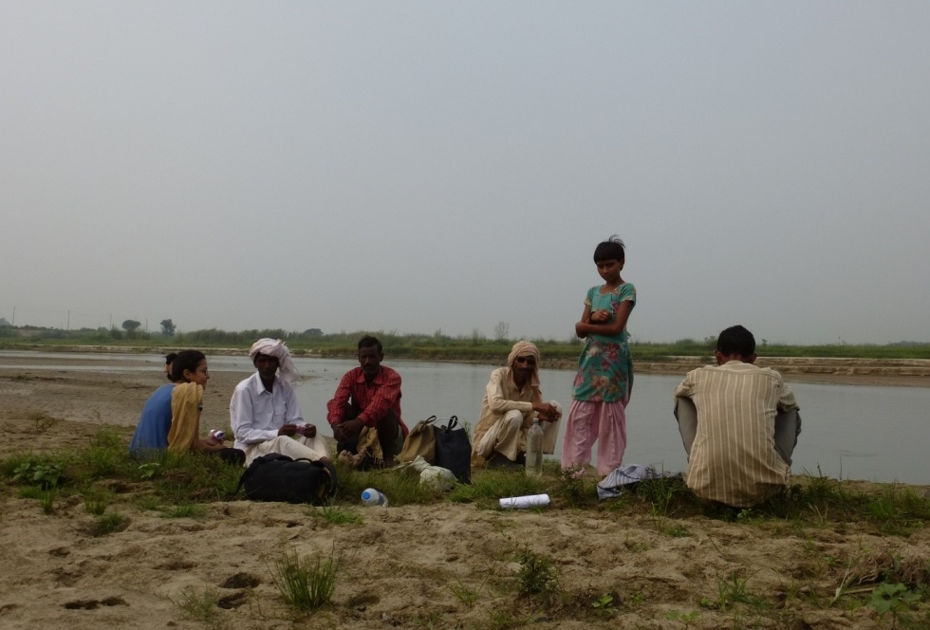
TAJ PALACE, NEW DELHI | 12 – 14 SEPTEMBER 2016
Site near barrage
Extremely low and stagnant flows downstream of the barrage. Sudden unplanned releases cause severe damage to the fields and also sometimes cause loss of life
Village upstream of the barrage is experiencing a reversal of flows. They see flooding for the months between November and March. Impoundment upstream may have created a wetland, but has impoverished farmers in the surveyed village downstream
Notion of the Ramganga being an 'unwed river' is in place. As a resident explained, 'Just like Haridwar has 'Badi Ganga', this is 'choti Ganga' and is umarried. Which is why she is angry and causes damage'. This is also reflected in a song called 'Tu kis gun kunwari rahe gayee re Ramganga'. The idea of the restless rivers being 'unmarried' is usually typical of Bihar, and so this perception applied here to the Ramganga might indicate that it was first settled by people from outside the area.

Slide 14
TAJ PALACE, NEW DELHI | 12 – 14 SEPTEMBER 2016
Site near barrage
Category | Normal year | Normal year | Drought year | Drought year | Floods
 | Summer | Monsoon | Summer | Monsoon
Socio-cultural | knee deep water to all channels, to allow cultural activities Dis: 5.5 cumec Avg. Velocity: 0.19 m/sec | allow inundation of fields close to river, above this is not desired Dis: 64 cumec Avg. Velocity: 0.33 m/sec | to have knee deep flowing water, for having cremation at desired conditions Discharge: 4.5 cumec Avg. Velocity: 0.19 m/sec | inundate the closest fields to the river) (2.36 m depth Dis: 48.5 cumec Avg. Velocity: 0.33 m/sec | the fields gets inundated to get silt Dis: 91 cumec Avg. Velocity: 0.34 m/sec
Biodiversity | Dis: 12 cumec Avg. Velocity: 0.23 m/sec | Dis: 64 cumec Avg. Velocity: 0.33 m/sec | Discharge: 1.32 cumec Avg. Velocity: 0.18 m/sec | Dis: 28 cumec Avg. Velocity: 0.31 m/sec | Dis: 74 cumec Avg. Velocity: 0.33 m/sec

Slide 15
TAJ PALACE, NEW DELHI | 12 – 14 SEPTEMBER 2016
Acknowledgement
For this study, PSI research team was a part of a larger multi-disciplinary team to assess Environmental Flows using Building Block Methodology. Besides the authors, the research team from PSI included Dr Ravi Chopra, Chicu Lokgariwar and Dr Debashish Sen as senior researchers, who guided all along the entire study with their valuable inputs. Dr Ajay Joshi trained the team and helped in conducting participatory rural appraisal exercises. Ravinder Singh and Bhuvan Joshi helped in conducting PRA, in-depth interviews and focused group discussions. The financial support for this study came from WWF-India under its Living Ganga Programme (sponsored by HSBC bank).

