Slide 1
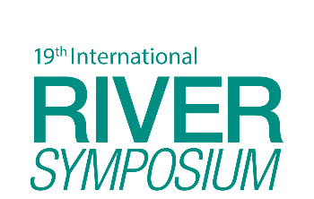




TAJ PALACE, NEW DELHI | 12 – 14 SEPTEMBER 2016
Restoring river system processes at the catchment scale for economic and social resilience
David Hetherington^{1,2}, Paul Quinn^{2,1} and Alex Nicholson¹,
¹Arup
²Newcastle University

Slide 2
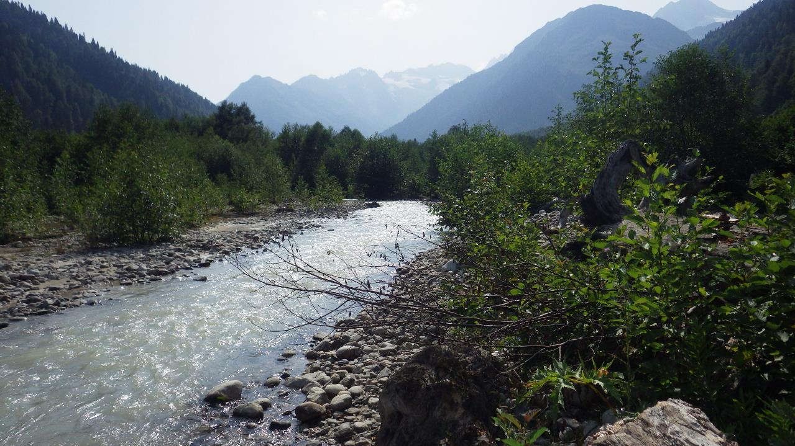
Notes:
Pristine, wilderness catchment untouched by people. For me, as about as sustainable as you can get. Evolved over geological time to produce a complex and dynamic system where geological, hydrological and ecological process interact. In this instance extreme events (floods and droughts) will serve a function allowing vegetative succession and sediment and nutrient redistribution with no damage. Then people have changed the landscape, increased run off, sediment delivery and have introduced receptors turning natural functions into problems. If we want to be sustainable, we have to be undoing some of these artificial processes, and trying to restore our catchments.

Slide 3
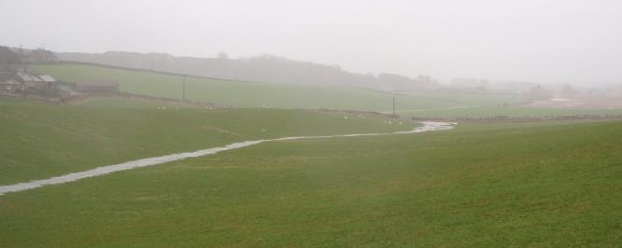
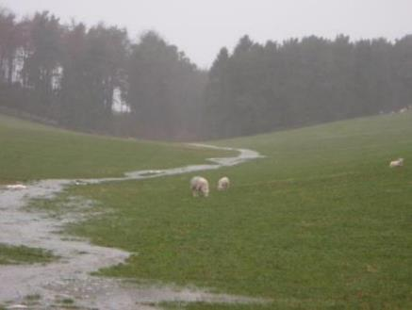
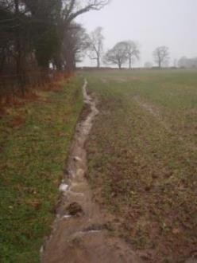
‘Artificial’ Catchment Processes

Slide 4
‘Artificial’ Catchment Processes
Our catchments processes are not working for us economically…..
We need to understand the causes of the artificial processes in order to properly restore
Notes:
The catchment is the natural unit that human activity has damaged (not just rivers)
We need to understand the causes per catchment, and these are often pretty blatant when you step back….

Slide 5
Deforestation is not the only problem….
Double-whammy of deforestation and soil compaction…..

Slide 6
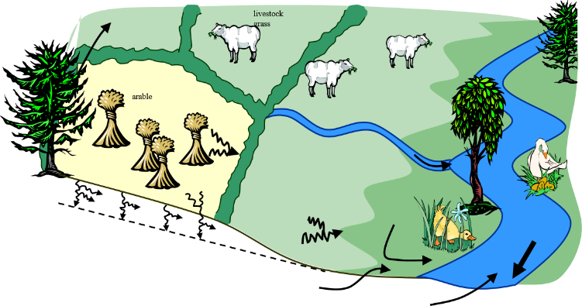
Sustainable farming….
Changes to land use will make farms more sustainable…..
Including NFM as part of overall Catchment Process Restoration

Slide 7
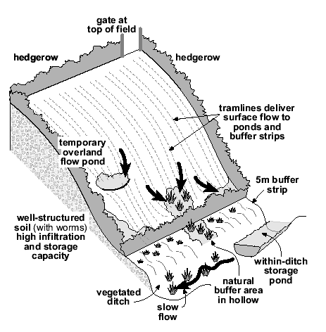
Sustainable farming….

Slide 8
Catchment Process Restoration
Creating ‘space’ that will allow natural and dynamic environmental fluxes.
Fluxes of water, sediment, nutrients, ecology…

Slide 9
A restoration target continuum?
Degree of Restoration | Scale | Target / Difficulty
Complete Catchment Rewilding (physical, ecological and chemical restoration to a pre-artificial state) | Catchment | 7
Catchment Process improvements (physical, chemical and ecological improvements that replicate / emulate pre-artificial conditions) |  | 6
Catchment hydrological process restoration (using land use change and NFM) alongside river restoration and natural recovery. |  | 5
Reach scale process restoration (with flood plain restoration) | Reach | 4
Reach scale habitat improvement (in channel improvements) |  | 3
Localised habitat improvement (gravel addition, riparian planting, fencing etc) |  | 2
Artificial structure removal | Local / unit | 1

Slide 10
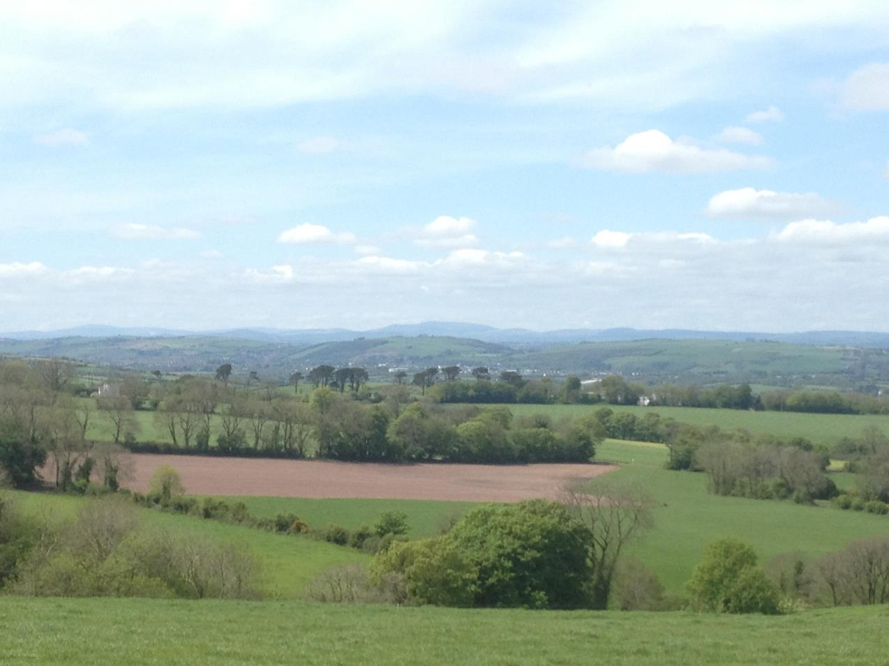
Catchment Restoration Movements
Upper Catchment
Mid Catchment
Lower Catchment (Cities)
Land use change / Agricultural management
River Restoration
Wetlands (Artificial and restored)
Blue Green Corridors
Natural Flood Management
Water Sensitive Urban Design
Coastal
Flood Schemes
Green Infrastructure
SuDS
Water Framework Directive
Ecosystem Services & Natural Capital

Slide 11
Catchment Restoration Movements
Catchment
Engineering
Upper Catchment
Mid Catchment
Lower Catchment (Cities)
Land use change / Agricultural management
River Restoration
Wetlands (Artificial and restored)
Blue Green Corridors
Natural Flood Management
Water Sensitive Urban Design
Coastal
Flood Schemes
Green Infrastructure
SuDS
Water Framework Directive
Ecosystem Services & Natural Capital

Slide 12
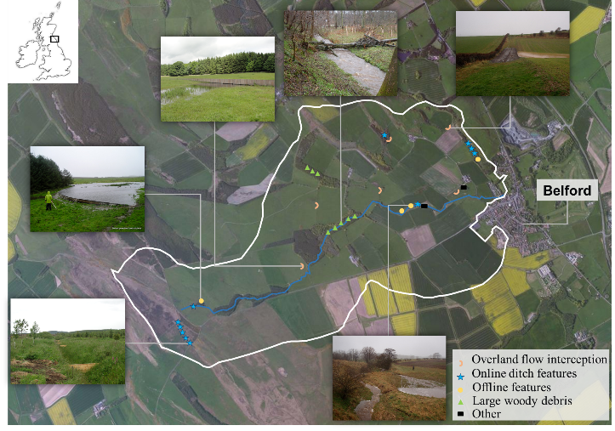
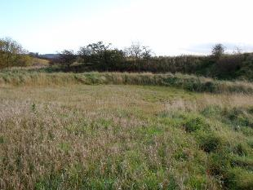
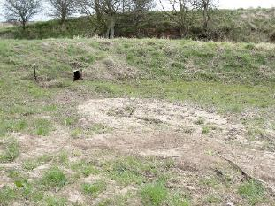

Natural Flood Management

Slide 13
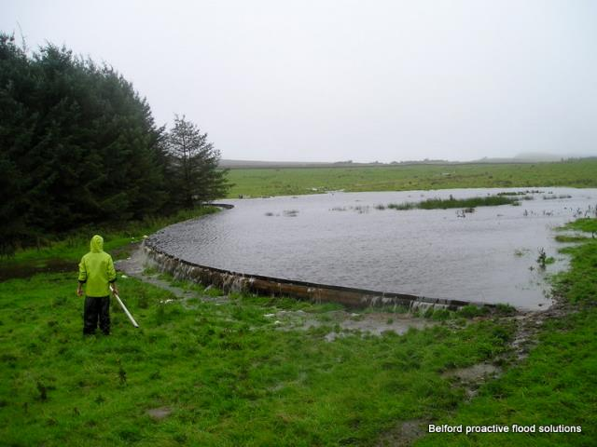
Natural Flood Management

Slide 14
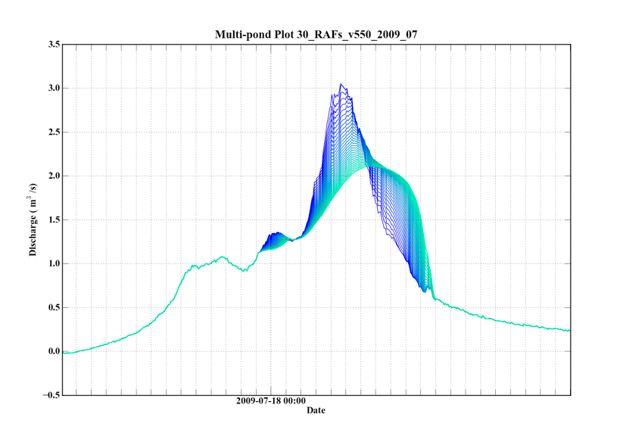
Removal of “artificial” peak for hydromorphological restoration?
>30% reduction
Addition of 5 NFM features per hydrograph iteration:

Slide 15

Mitigation
Features built in Belford and estimates of typical capacity and cost.
(Consultancy and research costs are not included)
Feature type | Number built | Typical min, max storage m³ | Estimated cost
Overland flow interception | 5 | 300-1000 | 1K-5K
Online ditch features | 9 | 50-150 | 1K-3K
Offline ponds | 5 | 200-3000 | 2K-6K
Large woody debris | 8 | 50-150 | 1K-3K
Other opportunistic sites | 3 | 100-3000 | 1K-10K
TOTAL | 30 | Estimate for Belford 8,000m³ | £70K-100K

Slide 16
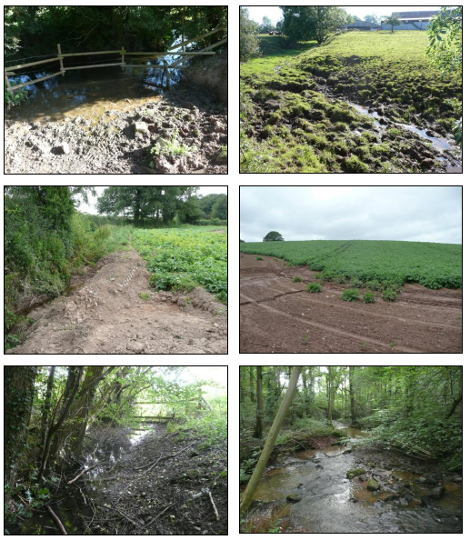
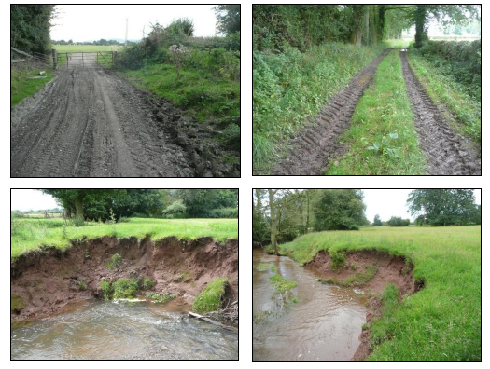
Source types – Lugg catchment
Pasture
Farm tracks
Arable
Channel banks
Woodland

Slide 17
Source types – Lugg catchment
Pasture
Farm tracks
Arable
Channel banks
Woodland

Slide 18
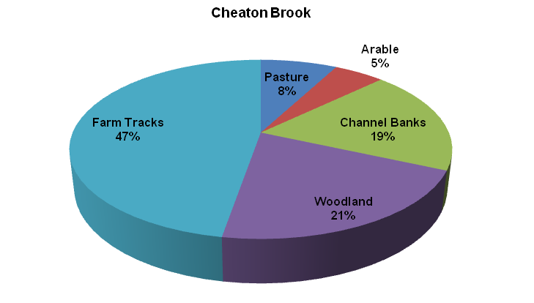
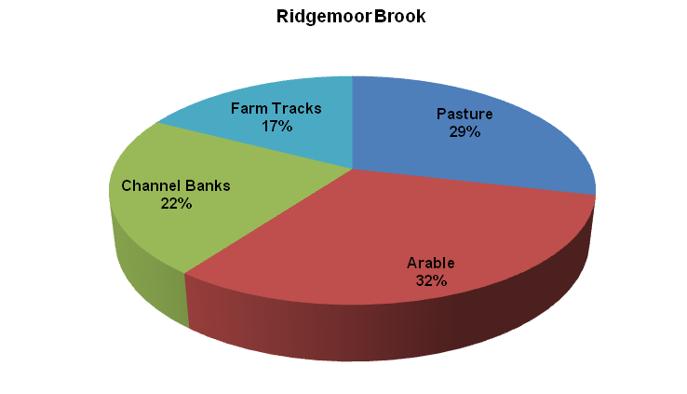
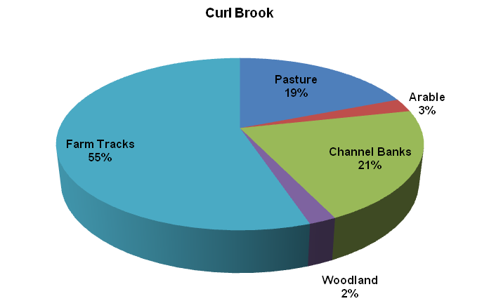
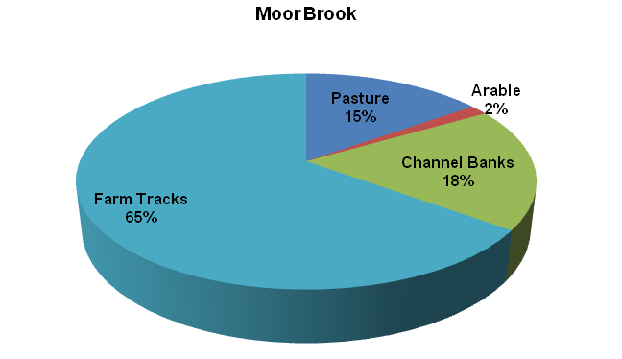
Sediment sources for ‘hot spot’ tributaries on the Lugg…

Slide 19
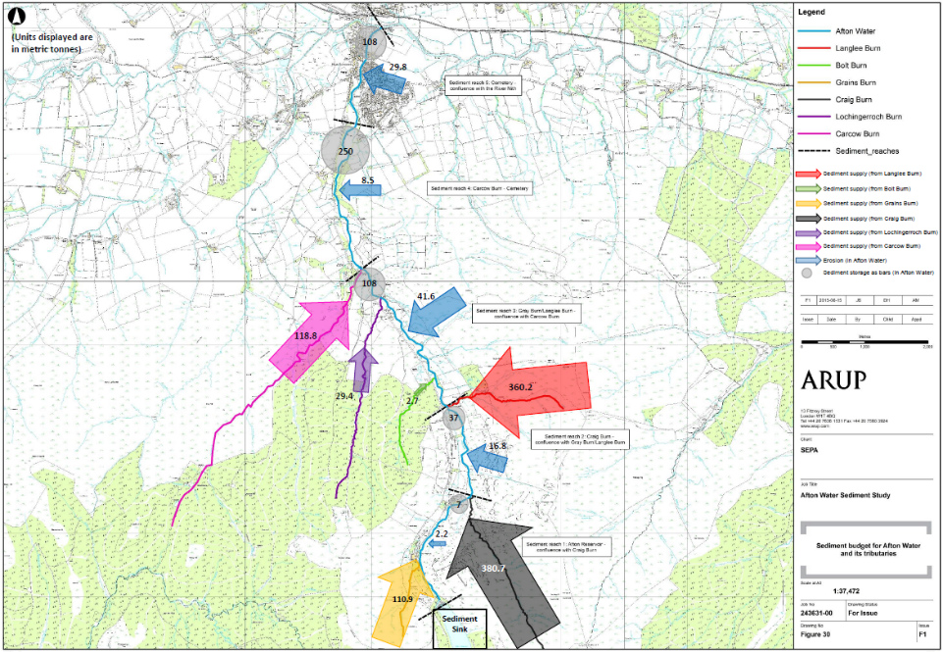
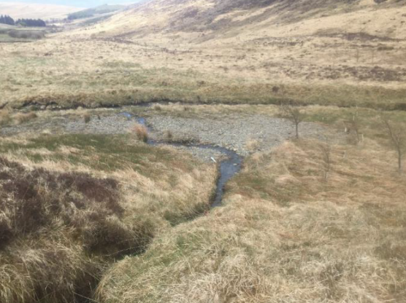

Afton Water Sediment Management
(SEPA)

Slide 20
‘Natural Flood Management’?

Slide 21
‘Natural Flood Management’?
Natural Erosion Management
Natural Drought Management
Natural Habitat Management
Natural Carbon Management
Natural Fisheries Management
Natural Forestry Management
Natural Groundwater Management
Natural Gravel Management
Natural Water Quality Management
Natural Climate Change Management
Natural Soil Management

Slide 22
‘Natural Flood Management’?
Natural Erosion Management
Natural Drought Management
Natural Habitat Management
Natural Carbon Management
Natural Fisheries Management
Natural Forestry Management
Natural Groundwater Management
Natural Gravel Management
Natural Water Quality Management
Natural Climate Change Management
Natural Soil Management
As part of Catchment Restoration…

Slide 23
Maintenance and ongoing cost reduction
Good NFM schemes can reduce costs by reducing:
  Sediment delivery (reduced dredging);
  Flood damage to infrastructure;
  Watering of crops;
  Delivery of debris;
  Drain maintenance;
  Land Maintenance - NFM via natural recovery

Slide 24
Potential wider issues
We have drained the landscape in a relatively short time…
  More water in the oceans;
  Sea level rise contribution;
  A sharp water mass & pressure change;
  Increase in ‘natural’ disasters?;
  Reduced cloud cover (loss of ‘biotic pump’)?;
  Local positive climatic feedbacks?
  Loss of the supporting ecosystem to humans?

Slide 25
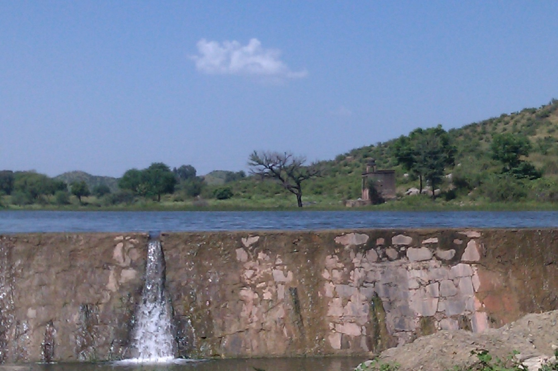
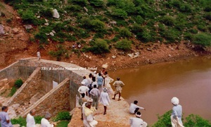
Experience in India
India (Rajendra Singh):
Could there be a bigger societal and economic advantage of not living with drought?.....

Slide 26
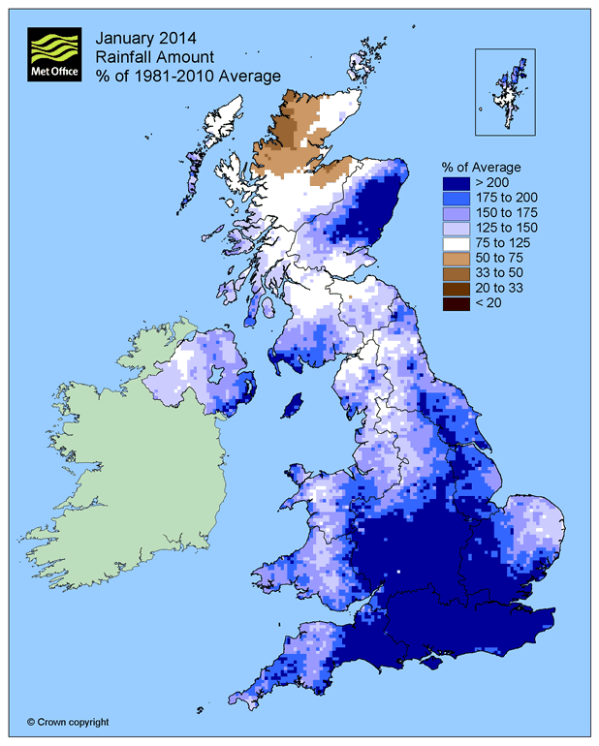
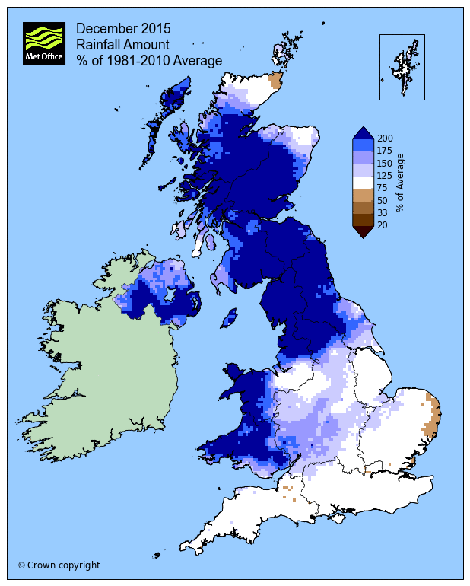
Weather anomaly maps (% of average)
Notes:
There is an increasing need to do this work.

Slide 27
Conclusions
Proven benefits (including downstream maintenance costs) & potential benefits.
Climate Change adaptation & mitigation (minimum?) &/OR major humanitarian and environmental issues (maximum?),‘what happens if we don’t?’ scenarios (similar to CC).
Drought and Water Resources Management is as important;
Monetisation is important for legislative change (but we CAN NOT afford to get hung up on this);
Lets make use of land use conflicts of interest to innovate (Partnership & innovative funding!)
Ultimately, Catchment (Process) Restoration (via Catchment Engineering) leads to economic resilience.
Notes:
The case for Catchment restoration is clear, in that we know how we can benefit from it.
Maintaining SoPs of flood schemes
Leap of faith to stimulate evidence
We can choose to meet nature head on, or embrace it as much as we need it….

Slide 28
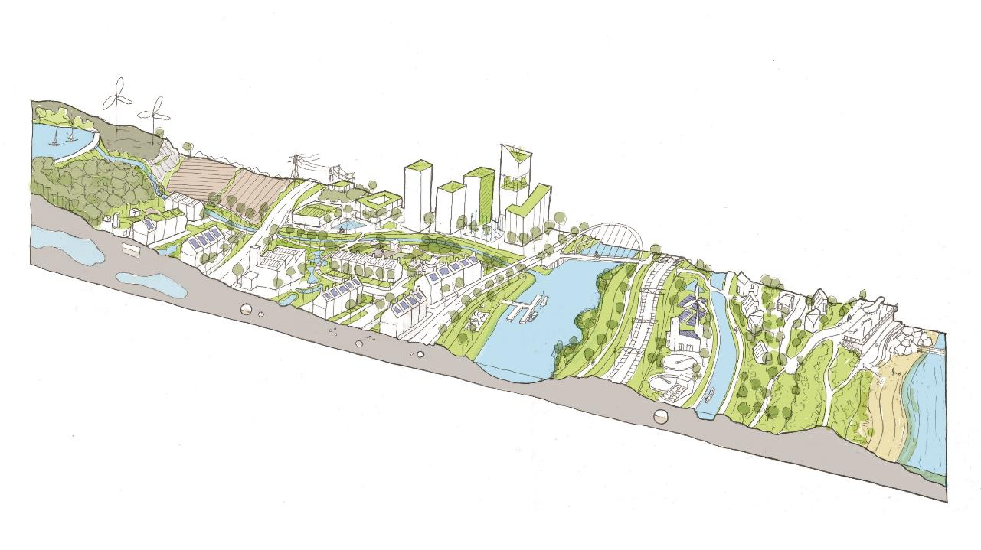
TAJ PALACE, NEW DELHI | 12 – 14 SEPTEMBER 2016
Thank You for listening….
David.Hetherington@arup.com

