Slide 1



TAJ PALACE, NEW DELHI | 12 – 14 SEPTEMBER 2016
Hydropower, Environment and Environmental Flows
September 12, 2016
ARUN KUMAR
Professor and MNRE Chair Professor
Alternate Hydro Energy Centre,
Indian Institute of Technology Roorkee,
Roorkee - 247 667, Uttarakhand, India
E-mail : aheciitr.ak@gmail.com, akumafah@iitr.ac.in

Slide 2
STATUS OF RIVERS IN INDIA
With a very few or no storage dam(s) and diversion structures for different water uses together with the absence of regulations on minimum flows, the rivers are subject to high flow variability and almost dry stretch during lean periods.
Steep slopes have high hydropower potential and at the same time unregulated flow in the diverted stretch combined with, poor governance and absence of monitoring of construction activities often being considered are in conflict.

Slide 3
Plains stretches of rivers are subjected to, high abstractions to meet water requirement for irrigation and drinking use as well as untreated and poorly treated waste water from industries, towns and cities to resulting low flows even worse.
Rapid change of land use from primitive to altered stage is leading to fast depleting ground water table.
High level of pathogens due to untreated waste water, poor interaction of river and ground water due to high ground water withdrawal, encroachment of river flood plain, floating trash requires a high level of people’ participation, cost effective treatment, stringent monitoring, effective governance and innovations together with a rethinking on storage dams.

Slide 4
RIVER WATER USE AND ENVIRONMENT
Water use and environment appears to be in conflict even though both are made for each other
Water in the hills, in plains or in delta have different utility – Consumptive or non consumptive.
Rivers have been supporting the man kind for their needs.

Slide 5
CONSTRUCTION OF SURFACE STORAGE
Construction of Tehri dam in Uttarakhand commissioned in 2006 after a lot of struggle was designed for only power and irrigation with the cost allocation in the ratio of 80:20% respectively
Presently serving additional uses of drinking water, flood protection (during 2013 due to matching of the timings of flood and availability of storage), religious fairs like Kumbha and snans, increased tourism and livelihoods in the region.
Due to unprecedented Uttarakhand flood in 2013, the focus on rejuvenation of river Ganga instead of middle reach having the main problems somehow has been shifted to upper reaches perhaps due to activism of media, individuals and few interested groups.
There are about 5200 large dams in India and only less then 10% have hydropower components

Slide 6




Evolution of Thinking
1940
Engineers
1950
1960
Economists
1970
Environmentalists
1980
Sociologists
Finally!
1990
Resettled People
2000
GHG
2010
Upstream/Downstream

Slide 7
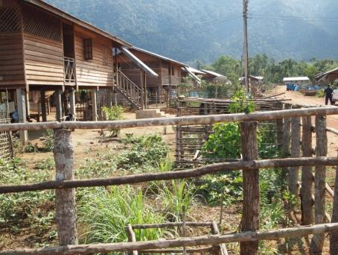
Environment Impacts
Hydrological regimes
Reservoir creation
Water quality and availability
Sedimentation
Biological diversity
Barriers for fish migration and navigation
Involuntary population displacement
Affected people and vulnerable groups
Public health
Cultural heritage
Sharing development benefits
The Multiplier effect of large hydro projects:
for every dollar of value generated – an additional 0,4 -1 USD₂₀₀₅ of indirect benefits (WB)

Slide 8
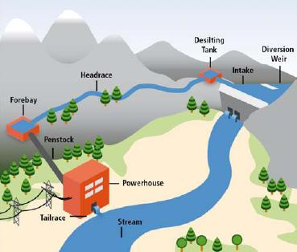
Bio-Diversity and Hydropower
Flora - Terrestrial
- Aquatic
Fauna- Terrestrial
- Avian
- Aquatic
Zone of Hydropower project – Concern for biodiversity

Slide 9
Impacts on water quality in rivers from Hydropower and other water resources projects
Water resource structures alter the water regime downstream
Often water quality deterioration is attributed to construction of water resource structures specially hydropower as many of them are owned by private sector
Impact on water quality is mainly due to muck disposal (not adequately governed) due to construction activities of water resources projects, extensive road and building construction, natural landslides, anthropogenic activities and reduced dilution

Slide 10
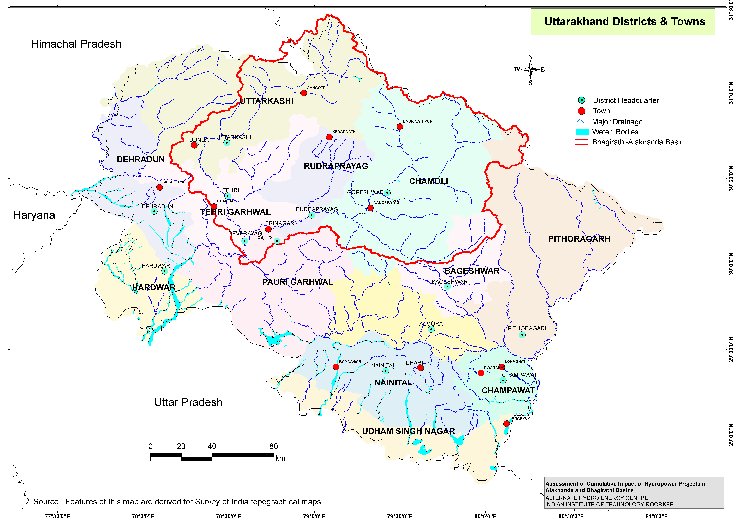
Alaknanda and Bhagirathi Rivers Basins

Slide 11
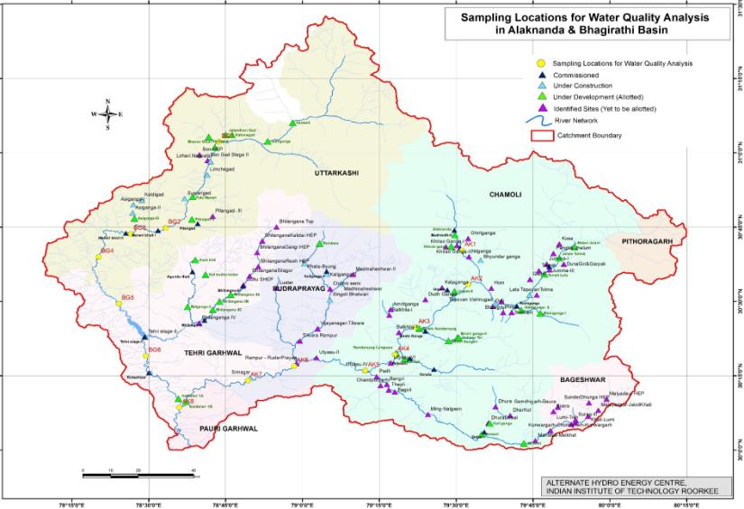
Map Showing Location of Sampling Points for Water Quality

Slide 12
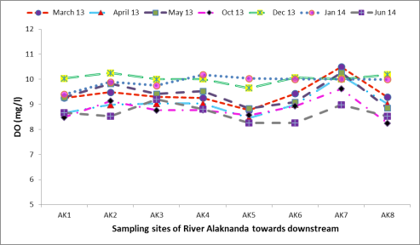
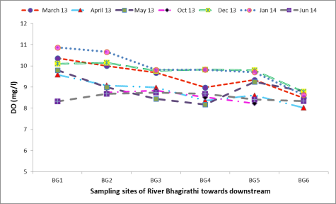
Dissolved Oxygen (DO)
Variation of DO in river Alaknanda
Variation of DO in river Bhagirathi

Slide 13
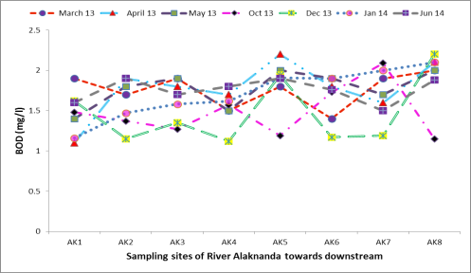
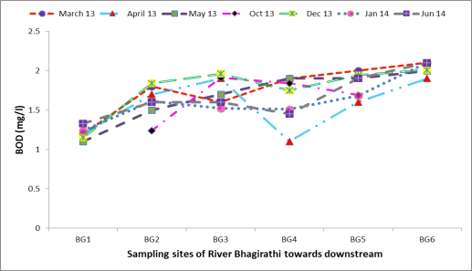
Biochemical Oxygen Demand (BOD)
Variation of BOD in river Alaknanda
Variation of BOD in river Bhagirathi

Slide 14

Processes and GHG emission pathways in reservoirs
Upstream Emissions
Downstream Emissions
CH₄, CO₂
CH₄
CH₄, CO₂
CH₄, CO₂, N₂O ?
CH₄, N₂O?
CH₄, CO₂, N₂O?
3. Drawdown
1. Bubbling/ Ebullition
2. Diffusion
C and N inputs
O₂
CH₄, CO₂
CH₄, CO₂, N₂O?
Phyto
Oxycline
4. Degassing
Sedimentation
Flooded organic matter
(soils, vegetal biomass, tree trunks)
CO₂ CH₄
5. Diffusion
Abril et al., 2005; Guérin et al., 2006, Chen et al., 2011
Guérin and Abril et al., 2007; Kemenes et al., 2007
CH₄ oxidation
Incoming and flooded carbon fuel emissions
Very few studies have included emissions from downstream and drawdown area
Little information is available on N₂O emissions
Notes:
Now I would like to present the basic understanding behind the GHG emissions from a reservoir.
GHG are produced during the mineralization of flooded OM and OM coming from watershed.
Due to the biological and chemical O2 demand during the mineralization, bottom of the reservoir becomes anoxic which favors CH4 production.
Produced GHG are diffused to the water, during the upward transportation, some part of the CO2 can be consumed during the photosynthesis activities in the upper water column whereas a major part of CH4 can be oxidized at the oxic-anoxic interface.
These gases are emitted from the drawdown area, through bubbling mainly CH4 because methane has low solubility in the water, and gases emitted through diffusion from the water surface.
And when the water is released from the turbined or from the spillway, due to drop in the pressure allows water to be degassed,
Then, remaining portion is emitted through diffusion from the downstream
Unfortunately, very few previous studies have included emissions from downstream and emissions from drawdown area
And What about N2O, which has around 300 times higher global warming potential than carbon dioxide.
And unfortunately, very little information is available on N2O dynamics in the reservoir

Slide 15
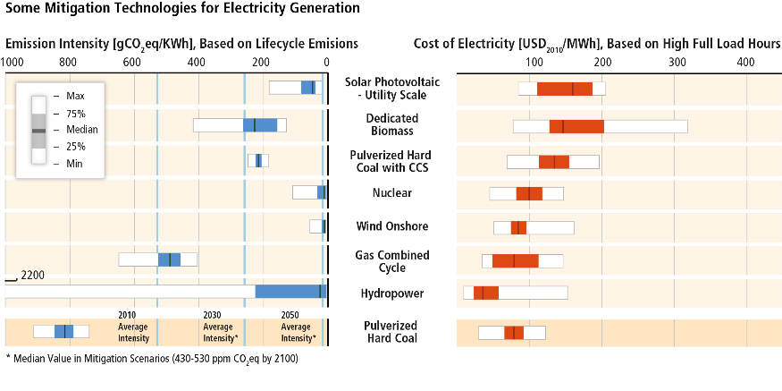
Costs of many power supply technologies decreased substantially, some can already compete with conventional technologies. (IPCC AR 2014)
Based on Figure 7.7

Slide 16
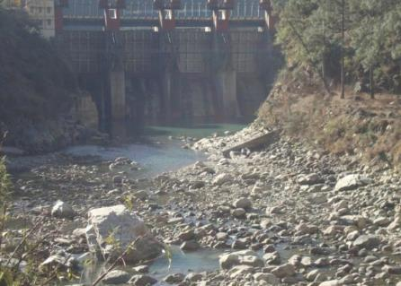
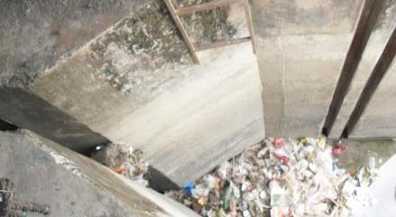
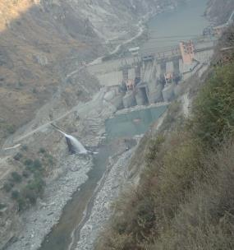
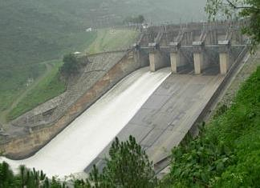
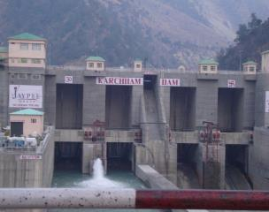
ESTIMATION AND IMPLEMENTATION OF Environmental Flow - absence of regulation
Honesty?

Slide 17
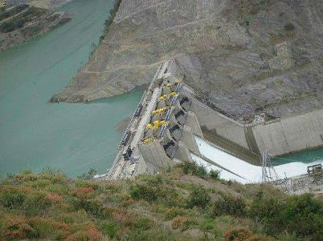
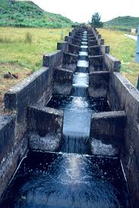
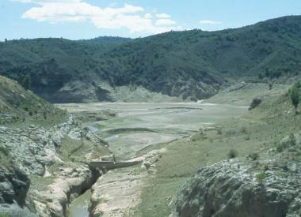
Longitudinal Connectivity
River continuum concept
Barrages / Dams disrupt continuum
Need to release
water and sediment downstream
Allow fish and other species to move upstream
Adapted from Mike Acreman Dec 2015

Slide 18
Managing Water Use
water resource
}
Present
over allocation
Environmental Flow
Drinking
Industry
Thermal-power
Irrigation
Adapted from Mike Acreman Dec 2015

Slide 20
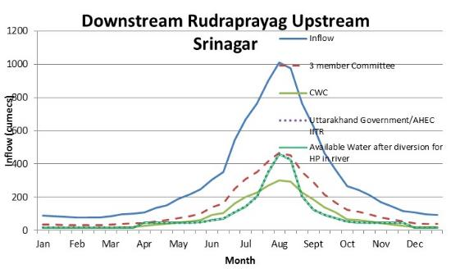
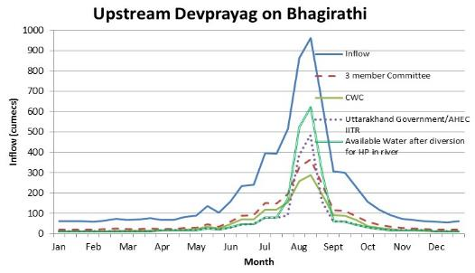

Slide 21
Mitigation
Critically Polluted Stretch: Haridwar to Allahabad suffers from low flows during lean periods. Minimum flows (Environmental Flows) need to be ensured in this stretch.
A need of storage on rivers by constructing new dams.
Fresh water may be stored by using flexible weirs (rubber dams).
Presence of high levels of Fecal Coliform: To achieve desired standards for presence of fecal coliform, treatment technologies need to be evaluated and implemented.
Integrated Approach for Conservation: Watershed development in the basin should be assigned high priority to reduce flow of sediment and other nutrients.
Optimal use of fertilisers and pesticides.

Slide 23
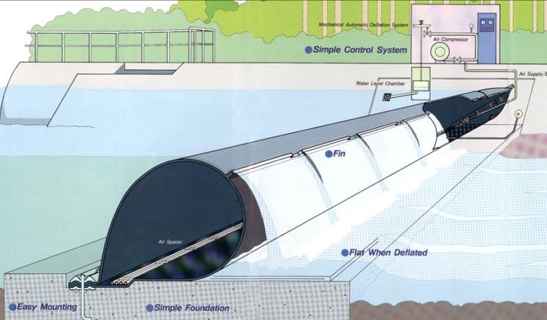
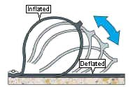
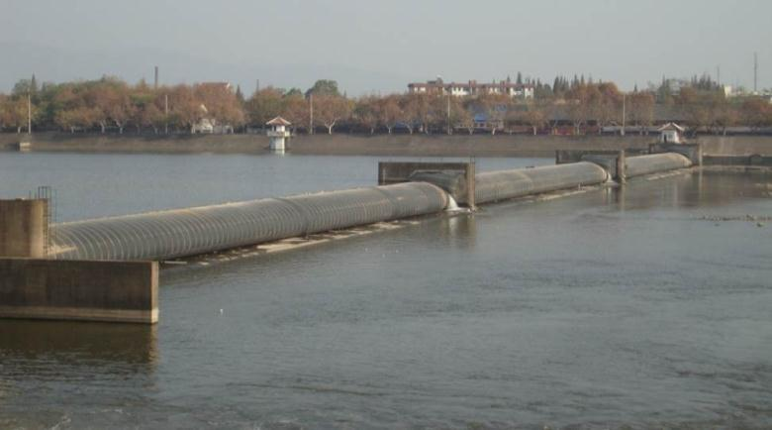
Typical Rubber Dam
Inflated
Deflated

Slide 24
MEASURES REQUIRED
Availability of financial and physical resources coupled with a strict do-able regulatory regime.
Ensuring availability of appropriately educated and well-trained manpower in required numbers for every stage of the programme
  Surveys and Investigations,
  Project Preparation,
  Implementation,
  Management
  Operation and Maintenance.
  A general awareness and participation of affected population, legal, media elected represented.

Slide 25
REGULATORY FRAMEWORK
Land use in the flood plain : strict regulation through formulation and enforcement of law
Uninterrupted Supply of Electricity for functioning of the sewer networks and sewage treatment plants
Land acquisition of sewage pumping stations and sewage treatment plants is a serious impediment in timely completion of Ganga works.
Monitoring of the parameters of performance: through automatic monitoring instruments, be online that enable round the clock monitoring. Regular analysis of the results of monitoring and taking of remedial measures in real time.
Strict enforcement of the regulatory provisions, particularly relating to industrial pollution and urban wastewater.

Slide 26
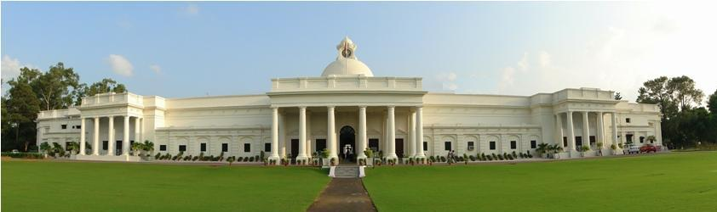
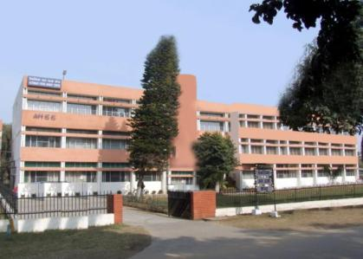
THANK YOU

