Slide 1


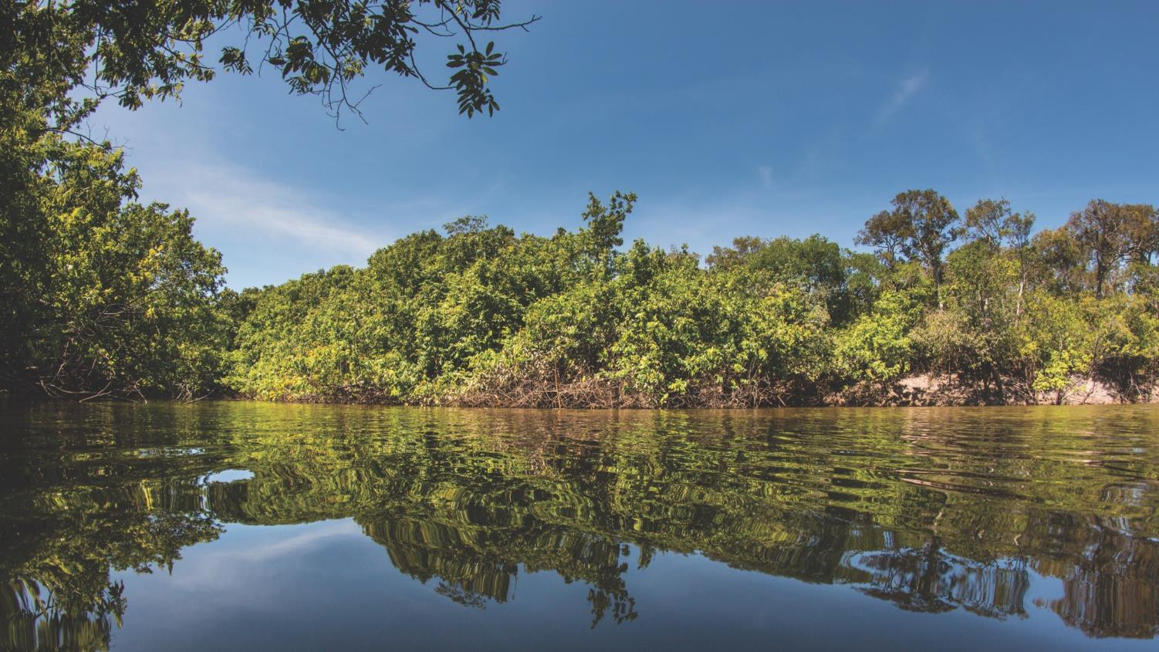



TAJ PALACE, NEW DELHI | 12 – 14 SEPTEMBER 2016
Orinoco Report Card: A Tool for Improving and Maintaining Basin Health
*Cesar Suarez
*Saulo Usma
*Luis German Naranjo
+Simon Costanzo
-Sarah Freeman
-Michele Thieme
*WWF Colombia
+Centre for Environmental Science
-WWF US

Slide 2
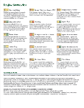
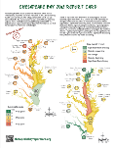
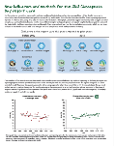
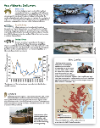
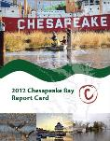
^{Orinoco River Basin}
^{Report card}
²⁰¹⁶
TAJ PALACE, NEW DELHI | 12 – 14 SEPTEMBER 2016
What is a Basin Health Report Card?
University of Maryland Center for Environmental Science
Integration & Application Network
IAN was created in 2002 to address integration and application
Now has more than a decade of experience developing report cards
Notes:
The final report card is a simple, easy-to-understand document that anyone can look to to understand the health of the basin.
It’s like a barometer. A barometer is full of these really complex parts, it takes time to create, it’s complicated, but we the user only see the face, which tells us whether it’s going to rain or not, which helps us decide whether or not we should bring an umbrella.

Slide 3
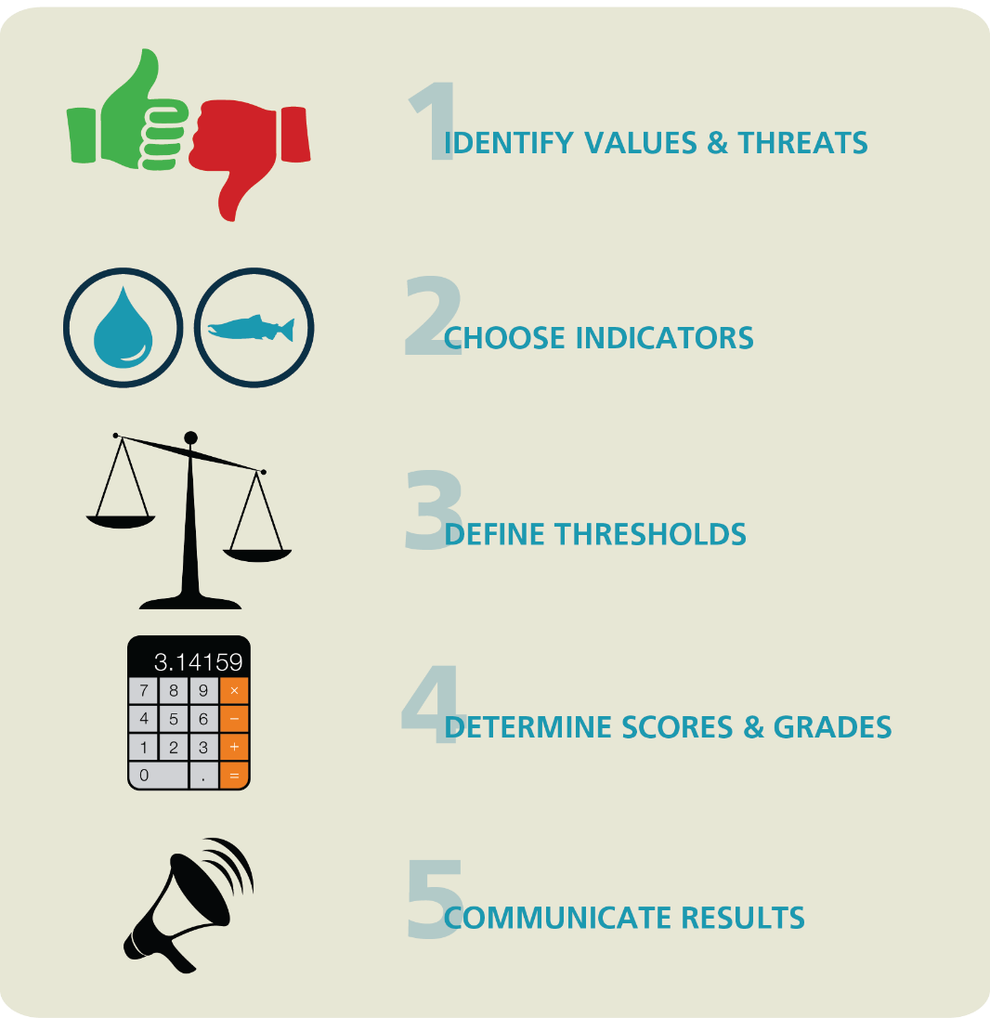
^{Orinoco River Basin}
^{Report card}
²⁰¹⁶
TAJ PALACE, NEW DELHI | 12 – 14 SEPTEMBER 2016
Report Cards:
5 Steps to Report Card Creation
Notes:
But behind this simple document is a detailed process that’s just as important as the final product.
1) Begins with gathering stakeholders that represent all areas of water use–so fishermen and farmers to elected officials to the private sector. Put them all in a room and have them identify what they value about their river and what they see as threats. Amazing how despite all the diversity, this first step already begins setting the foundation for a common vision of the basin—what is is now and what they’d like it to be.
2) Then, with more technical folks weighing in heavily, we look at the values and threats and try to assign indicators that can represent what’s important to the people who live in the basin and use freshwater resources regularly. For example, the number of river dolphins can be a good indicator to represent how biodiversity is important to people.
3) Thresholds are then assigned for the indicators. What does “good” look like? Usually based on existing standards, like PPM for water quality for example, but can also be developed with technical experts.
4) The data is crunched so the final indicators all get grades, and
5) The grades are communicated, first to partners and influencers to reality check the results and try and secure commitments. Then massively in a very public campaign, which garners support and pressure for action to be taken.

Slide 4
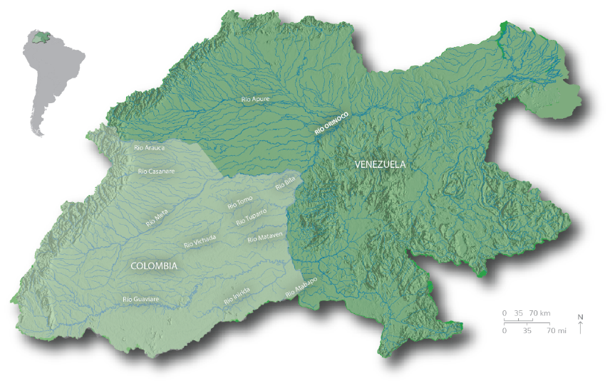
^{Orinoco River Basin}
^{Report card}
²⁰¹⁶
TAJ PALACE, NEW DELHI | 12 – 14 SEPTEMBER 2016
Orinoco River Basin
Considered to be the third most important river
system on the planet
Contains diverse array of wetlands, savannas, grasslands and forests with very high biodiversity
Colombian Orinoco region is experiencing rapid growth of agribusiness, livestock, and oil and gas activities
Increased demand for water and other ecosystem services likely to surpass natural supplies in the near future if not managed appropriately.
830,000 km²

Slide 5
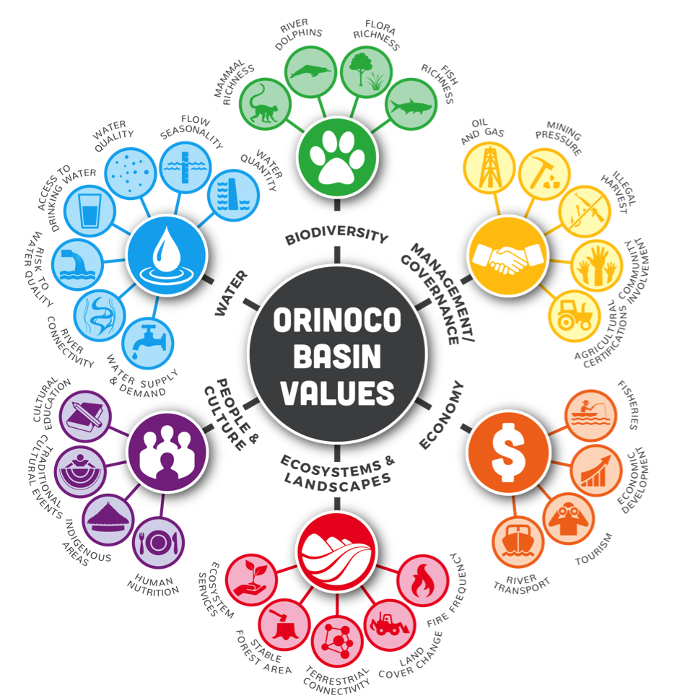

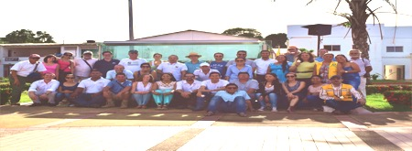
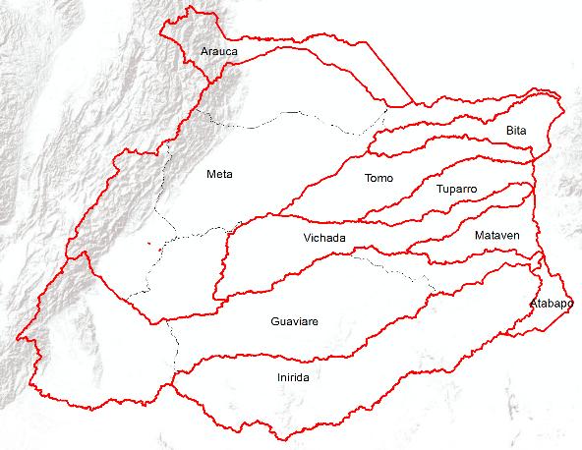
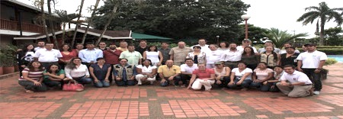



^{Orinoco River Basin}
^{Report card}
²⁰¹⁶
TAJ PALACE, NEW DELHI | 12 – 14 SEPTEMBER 2016
Basin values, threats and indicators identified by stakeholders
Notes:
Our report card process is very much a grass-roots / bottom-up exercise
Stakeholders were invited to attend a series of workshops throughout the basin
Stakeholders were facilitated through a process where they were asked to identify values of and threats to their river basin.
Stakeholders were asked to identify potential indicators that could assess and monitor these values and threats – with guidance materials on what makes a good indicator.
Over 200 stakeholders were consulted through this process from different regions of the basin….and collectively the following basin values were identified and associated inidcators were shortlisted for investigation:
Biodiversity indicators
Management and Goverence Indicators
Economic Indicators
Ecosystems and Landscapes
People and Culture, and
Water

Slide 6
^{Orinoco River Basin}
^{Report card}
²⁰¹⁶
TAJ PALACE, NEW DELHI | 12 – 14 SEPTEMBER 2016
Report Card Scoring System
Indicators are standardized and scored on a gradient of fail to excellent
% indicator values meeting objective
Grades
80 - 100%
A
5
Excellent
60 - 80%
B
4
40 - 60%
C
3
20 - 40%
D
2
0 - 20%
F
1
Fail
Notes:
An established approach for calculating scores (established by the University of Maryland Center for Environmental Science) was adopted which entails standardizing data for different indicators to a 0-100% scale.
The approach is quite simplistic and aims to assess the percentage of measurements for a particular indicator against a pre-described objectives.
Objectives can be government standards, institutional goals, historical points in time, biological limits, or based on professional judgement
Once a percentage attainment of these objectives are established they are given a Report Card Grade – Alphabetical in the US etc., and Numerical in e.g. Colombia as outlined in this figure.

Slide 7
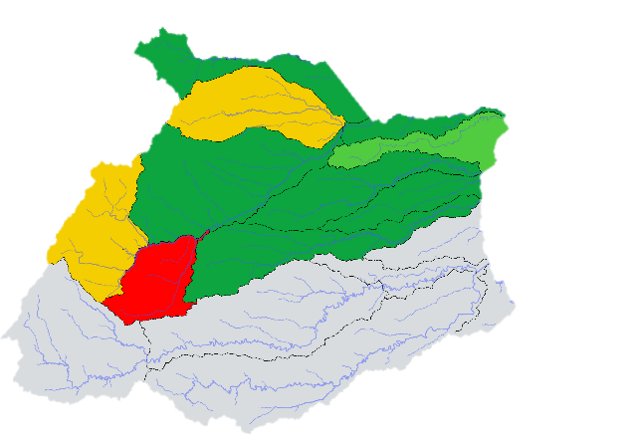
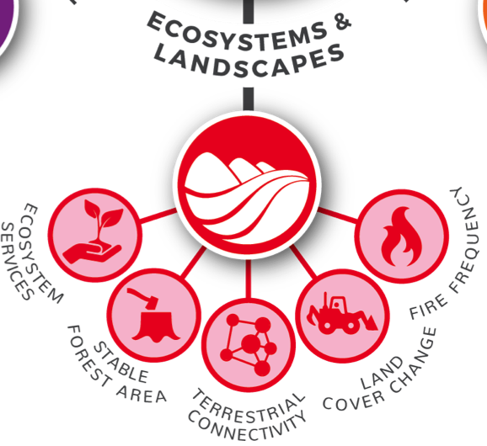
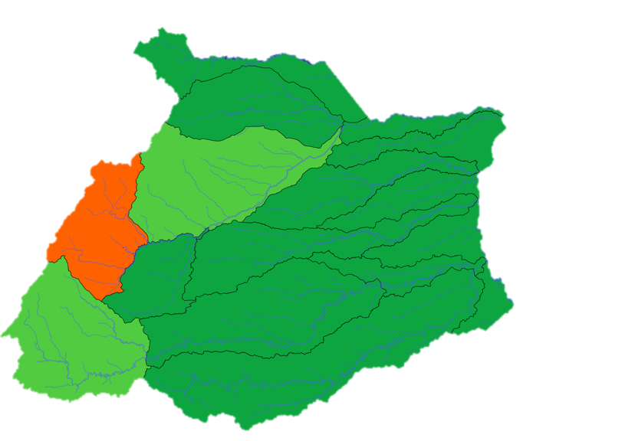
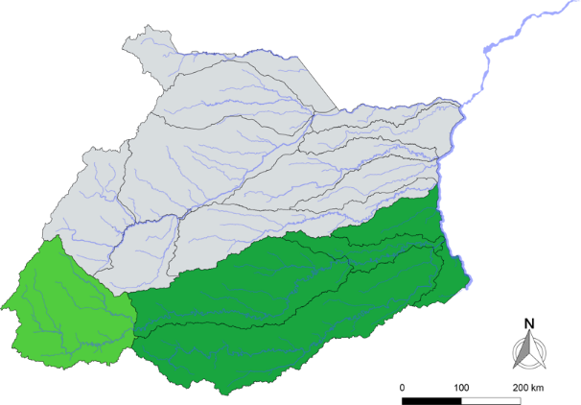
^{Orinoco River Basin}
^{Report card}
²⁰¹⁶
TAJ PALACE, NEW DELHI | 12 – 14 SEPTEMBER 2016
Indicator 4 – Land Cover Change
…and then score data against objectives for each region
Fire Frequency
Scores
A
B
C
D
E
No data
Land Cover Change
Stable Forest Area
Notes:
And as you can see with these three indicators, the relative pressures/impacts varied throughout the basin, but there was a west-east gradient in most of the 12 indicators assessed.

Slide 8
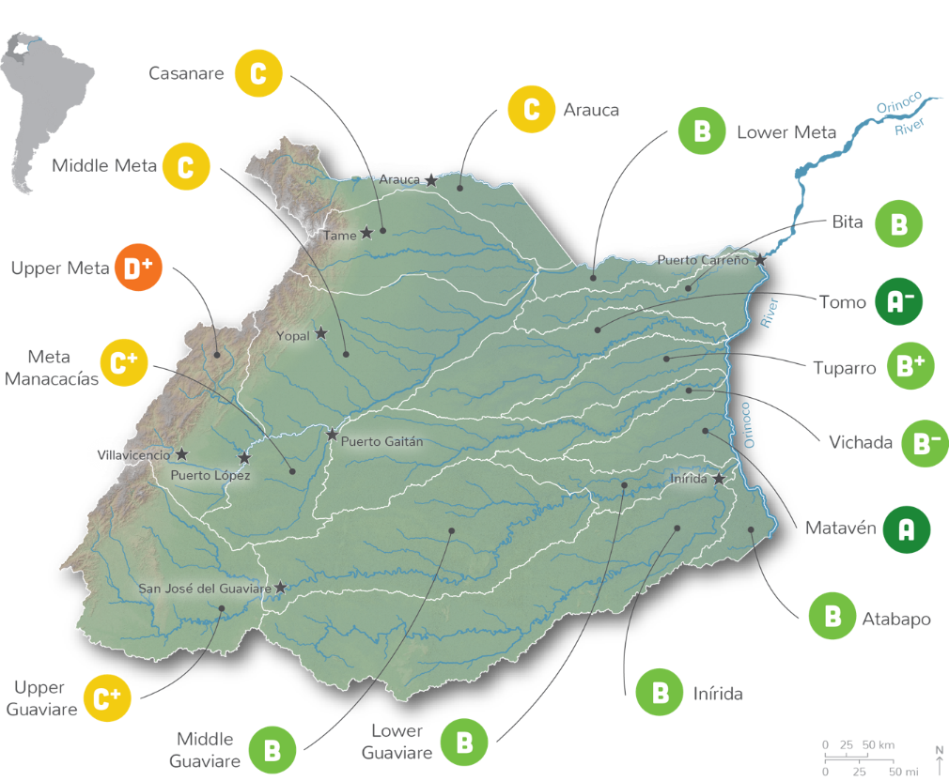
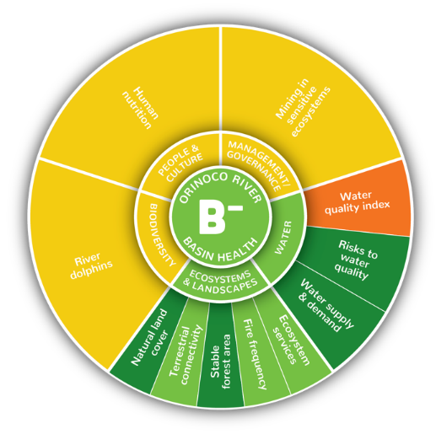
^{Orinoco River Basin}
^{Report card}
²⁰¹⁶
TAJ PALACE, NEW DELHI | 12 – 14 SEPTEMBER 2016
The Orinoco score is moderately good.
¡but could be better
Roll-up sub-basin scores by area
Notes:
And you can go one step further and roll-up the sub-basin scores to an overall basin score (in this instance it was weighted by the area contribution of each sub-basin)
Changes in these scores can be monitored over time in response to increased pressures and/or mitigation efforts

Slide 9
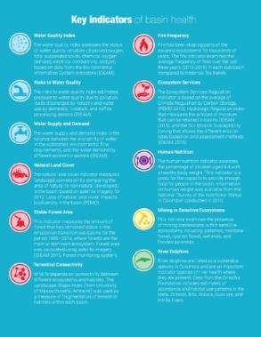
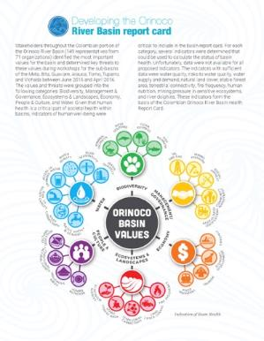
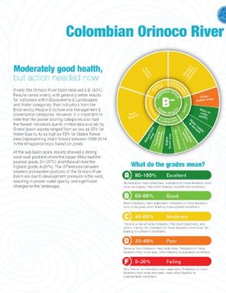
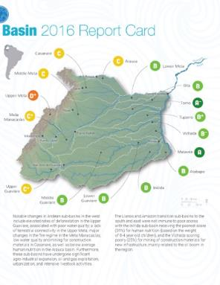
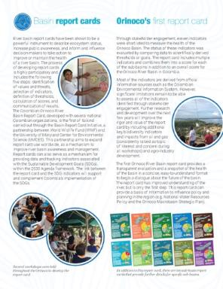
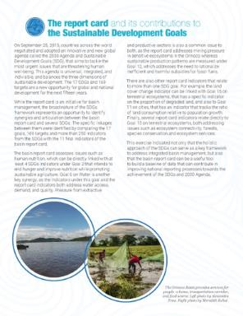
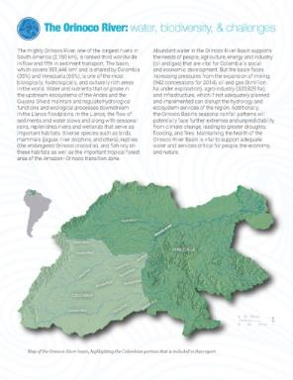
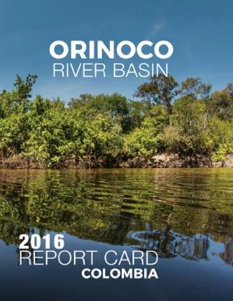
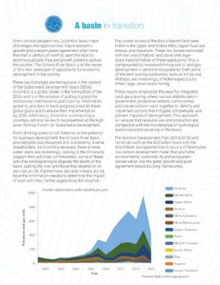
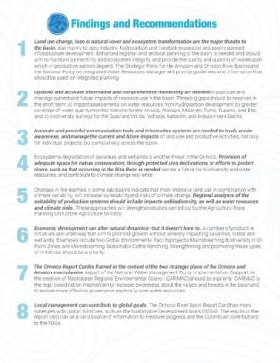
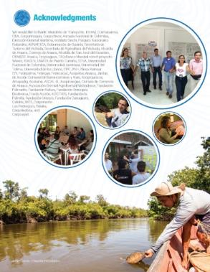
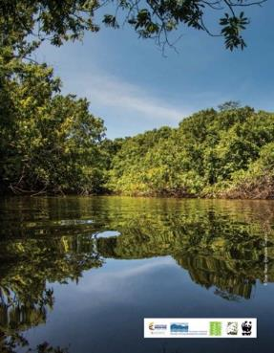
^{Orinoco River Basin}
^{Report card}
²⁰¹⁶
TAJ PALACE, NEW DELHI | 12 – 14 SEPTEMBER 2016
Overall report card:
The Orinoco score is moderately good. ¡but could be better!
Notes:
Report cards scores are generally delivered in a printed document (in our case it is an 8 age document) outlining the initiative, the approach, results, recommendations and next steps
Also have a web presence – often with a interactive website where the user can drill down to the raw data - this adds to the transparency of our approach.

Slide 10


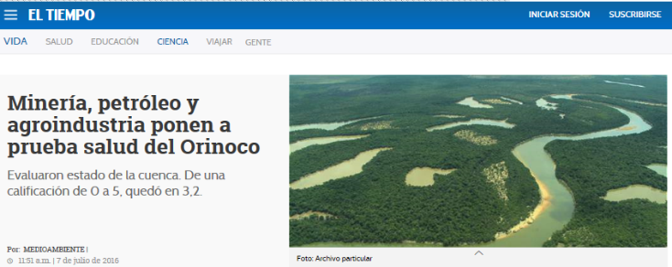
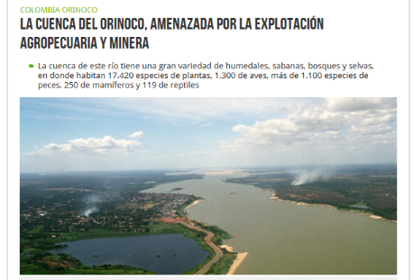
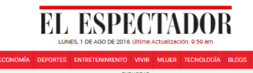
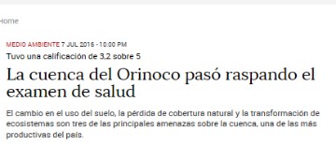
^{Orinoco River Basin}
^{Report card}
²⁰¹⁶
TAJ PALACE, NEW DELHI | 12 – 14 SEPTEMBER 2016
July 6 Launch
Notes:
Launch event held on July 6th in Bogota: About 100 people attended from government to private sector to indigenous group representatives
Up through launch of RC, wide media coverage with Over 40 articles published by local, regional or national media
campaign theme “Qué tanto sabes del Orinoco” as an engagement strategy to take the audience attention and reinforce messages.
Campaign videos with celebrities and ordinary citizens - 200.000 times has been played the campaign videos.
Awareness raising has been a big success thus far.

Slide 11
^{Orinoco River Basin}
^{Report card}
²⁰¹⁶
TAJ PALACE, NEW DELHI | 12 – 14 SEPTEMBER 2016
Findings and recommendations
Land use change, loss of natural cover and ecosystem transformation are the major threats to the basin
Lack of updated and accurate information for some indicators is the weakness of the monitoring system.
Changes in fire regimes in some sub-basins indicate that more intensive land use in combination with climate variability, will increase vulnerability and risks of climate change
The Orinoco report card is a great opportunity to inform the local management with contributions to global goals.
Adequate spaces for nature conservation to avoid wetlands and savannahs degradations, is needed.

Slide 12
^{Orinoco River Basin}
^{Report card}
²⁰¹⁶
TAJ PALACE, NEW DELHI | 12 – 14 SEPTEMBER 2016
Next steps
Discuss results and recommendations in the region.
Articulation between the report card and other initiatives: GEF, Biocarbon fund, Orinoco strategic plan, Climate change plan.
Support the conformation of the Macrobasin regional environmental council.
Provide information in terms of the SDG accomplishment at regional scale
To call the second report card version with stakeholders.

Slide 13
^{THANKS}
TAJ PALACE, NEW DELHI | 12 – 14 SEPTEMBER 2016

