Slide 1
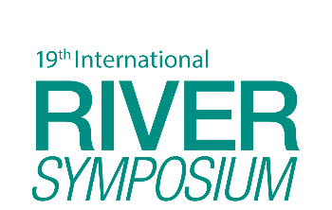
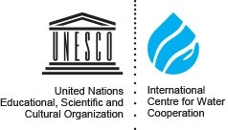
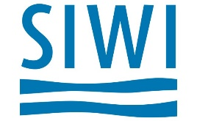
TAJ PALACE, NEW DELHI | 12 – 14 SEPTEMBER 2016
Stepping out of the ‘water-box’
- Rethinking transboundary water cooperation-
Dr. Yumiko Yasuda
Postdoctoral Researcher
The Hague Institute for Global Justice
International Centre for Water Cooperation (ICWC) Research School: Uppsala University/Stockholm International Water Institute

Slide 2
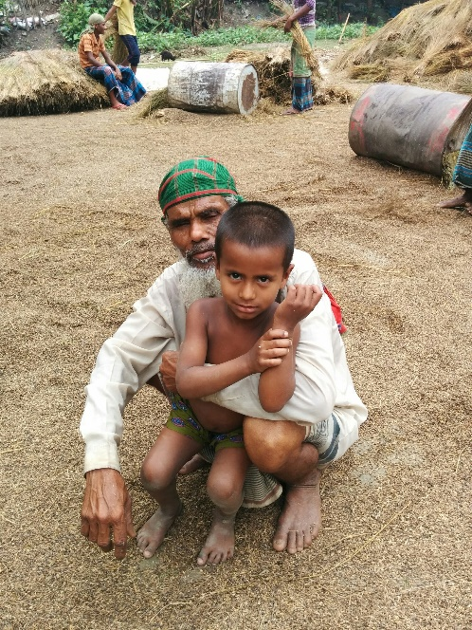
Outline of the presentation
Introduction to the Water Diplomacy Project
Multi-track Water Diplomacy Framework
Preliminary case study example from the Brahmaputra River
Conclusion

Slide 3
Water Diplomacy: Making Cooperation Work
Aims to identify key factors that affect water cooperation.
Approach: interactive process
Research: field based and desktop
Stakeholder workshop/interactions
Methodology
Development of multi-track water diplomacy framework
Unit of analysis: Transboundary river
Case studies: The Lower Jordan River, the Brahmaputra river
Research
Stakeholder interaction

Slide 4
Water Diplomacy Project: Partners

Slide 5
Multi-track Water Diplomacy Framework
Purpose:
Analysis of factors affecting water cooperation
Analysis of water cooperation at
multiple levels (from local to global)
multiple tracks
current and future
Development steps
Framework development based on existing literature
Key factors consisting effective water cooperation
Various theoretical approaches/Methods for Political Economy Analysis
Fine-tuning of the framework based on field data

Slide 6
Multi-track Water Diplomacy Framework
Problem description and scoping for the basin
Contextual factors
Institutions
Action situations
Actors/Agency
Formal
Customary
Output
Outcome

Slide 7
Example: the Brahmaputra river
Source: IUCN/IWM 2013

Slide 8
Status of transboundary water cooperation
Track I: mostly bilateral
India- China: Data sharing, Expert level mechanism, emergency response
India-Bangladesh: Joint water committee, data sharing, navigation, ongoing process for Teesta agreement
Bangladesh-China: Data sharing
India- Bhutan: Cooperation through hydropower
Track II/III
Ecosystems for Life (IUCN)
Brahmaputra Dialogue (Saci waters)
Abu Dhabi dialogue/SAWI (World Bank)
Collaboration of scientists through ICIMOD (i.e. Brahmaputra-Saleween landscape)

Slide 9
Preliminary analysis: Current China-India cooperation
Contextual factors:
Upstream hydropower development only recently.
China’s domestic energy demand, climate change, water demand.
Flood incidences in India
Disagreement over border
Institutions
Formal
Open up west (China)
Energy plan (China and India)
NE development policy (India)
Customary
Sensitivity over territory
China’s interest to be normative actor
Sensitivity over inter-state relationship (India)
Action situations
- Bilateral cooperation process between China and India over the Brahmaputra
Actors/Agency
- China and India: bilateral approach to transboundary water.
Output:
MoU on flood data sharing
Expert panel
Cooperation on emergency situation
Notes:
Open up west policy: launched in 2000
Curren hydropower dams
Zanmu （蔵木） dam: 510 MW. starting construction in 2009. First operation in 2014
3 more dams planned大古(Da gu), 街需 (Jie Xu) and 加査(Jia Cha)
In 2000, a naturally formed dam in one of the tributaries of the Yarlung-Tsangpo broke and flooded Arunachal Pradesh and Assam with 3-4 billion cubic meters of water, killing 30 people and leaving 50,000 homeless (Samaranayake, Limaye, and Wuthnow 2016, 25). This incident was catalytic in initiating the cooperation on data sharing between China and India (Samaranayake, Limaye, and Wuthnow 2016, 25). See what Brahma Chellaney talks about India’s concern
The initial MoU on provision of hydrological information on Yarlung-Tsangpo River in flood season by China to India, was signed in 2002 and expired in 2007. This MoU was renewed twice, in 2008 and in 2013 (Ministry of Water Resources 2014). Why only for flood season? See comment below

Slide 10
Preliminary analysis: Potential future cooperation at the basin level
Contextual factors:
Brahmaputra: comparatively less developed river
Regional economic cooperation initiatives/trade corridors: BBIN, BIMSTEC, BCIM
Institutions
Action situations
- Basin-wide cooperation among all the riparian countries in conjunction with economic cooperation/cross-sector cooperation
Actors/Agency
All the riparian governments
Civil society, private sector, scientists
Shift in agency, hegemon
Formal
Trade agreement Tripla-Bangladesh
Act East policy
One belt one road policy
Draft 2012 water policy (India)
Customary
China’s interest to be normative actor
Culture of harmony
Output/Outcome
Coordinated basin development and benefit sharing: i.e. hydropower and connectivity
Flood/drought management and effective release of water. Environmental flow maintained, Ecosystem approach.
Notes:
BIMSTEC
- Bay of Bengal Initiative for Multi-Sectoral Technical and Economic Cooperation
- Bangladesh, Bhutan, India, Myanmar, Nepal, Sri Lanka, Thailand. 7 countries
- Since 1997
- Economic cooperation. Free Trade Agremeent
Energy cooperation
BBIN
Bangaldesh, Bhutan, India Nepal

Slide 11
Conclusion
Importance of stepping out of sectoral approach in water cooperation.
Analytical framework for potential uses.
Analysis of current and future cooperation
As a diagnostic tool for informing decision-making
Exploring new and refining existing approaches and strategies for transboundary water cooperation
Support collaboration between different stakeholders and proactive approaches

Slide 12
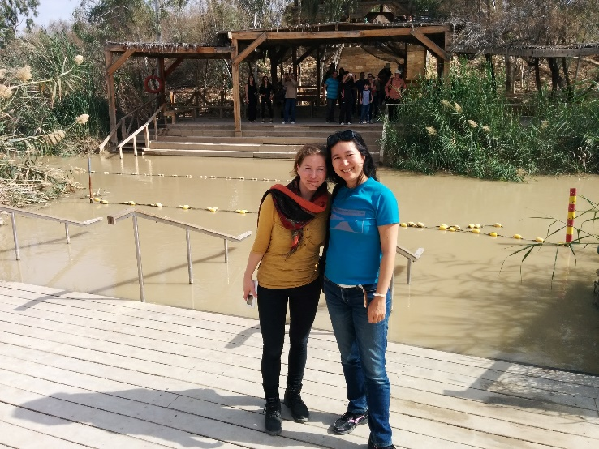
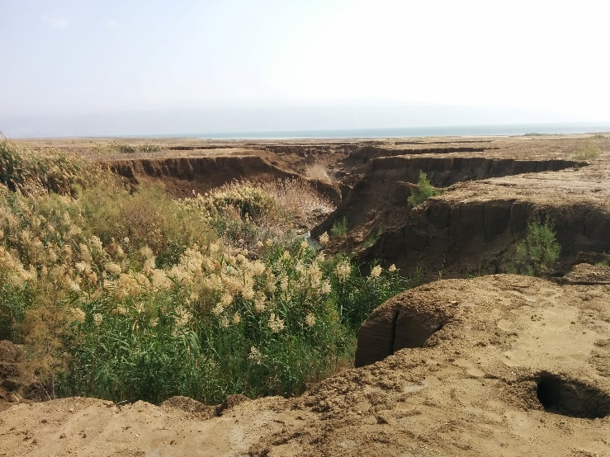
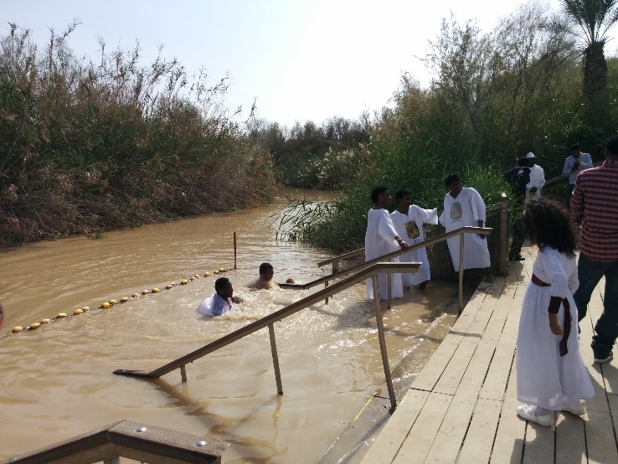
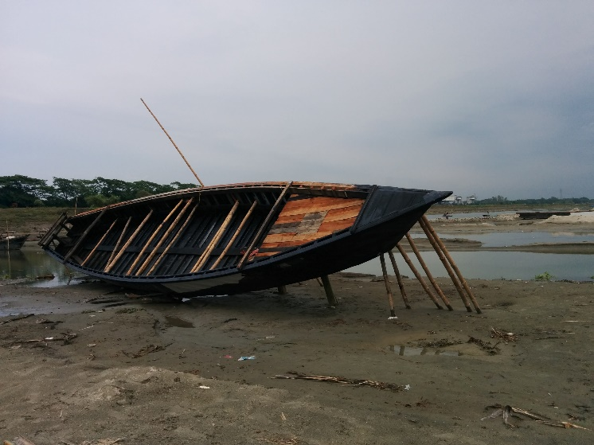
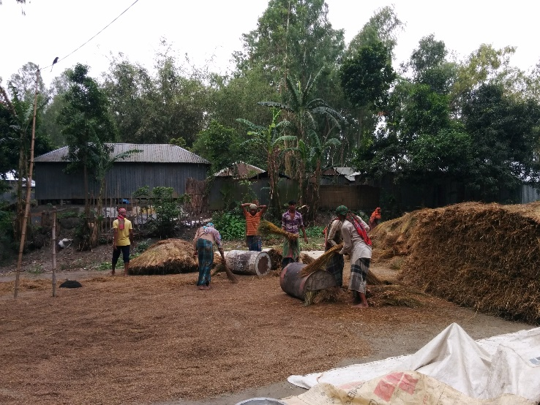
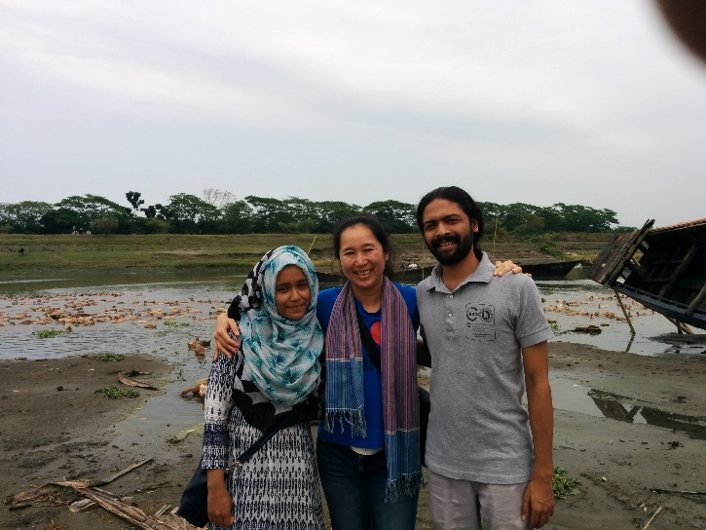
Thank you Please send any feedback to yumiko.yasuda@siwi.org

