Slide 1



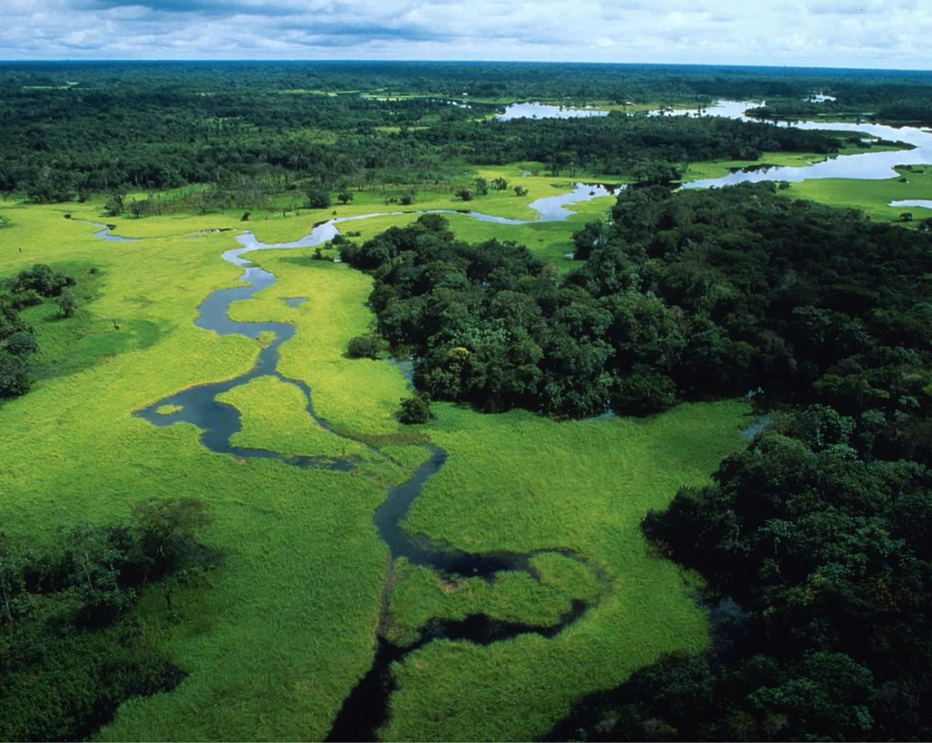

Relaunching the WWF Water Risk Filter
Using spatial water risk assessment to inform water stewardship strategy on corporate-, site and basin level
© WWF-US / James Morgan
Oliver Maennicke
Water Stewardship Specialist
WWF Australia
BRISBANE, AUSTRALIA | 18 - 20 SEPTEMBER 2017
MANAGED BY

Slide 2
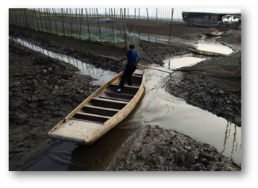

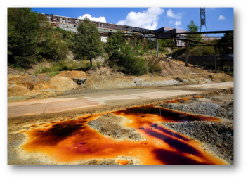
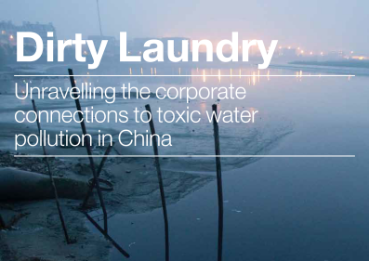
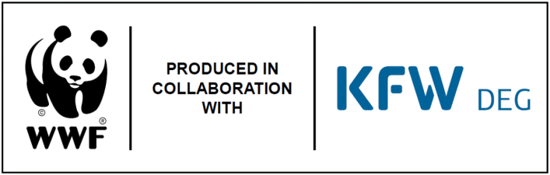
A free online tool
Assess water risk
Analyse results
Explore mitigation options & country profiles
Development started in 2010
Online since 2012
34 sectors and 120 agricultural commodities
30 basin and 30 operational indicators
>250,000 sites assessed
>3,000 unique users
Additional high-resolution data
Re-launch: November, 2017
Physical
Reputational
Regulatory
Financial Risk
BRISBANE, AUSTRALIA | 18 - 20 SEPTEMBER 2017
MANAGED BY

Slide 3
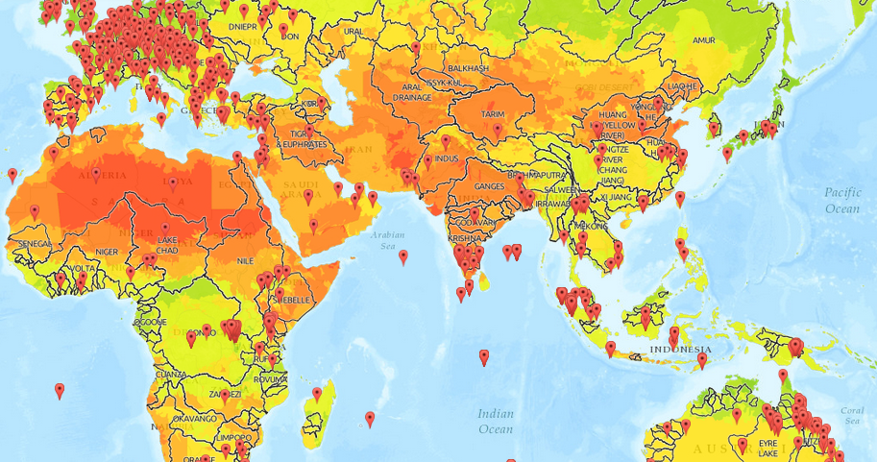
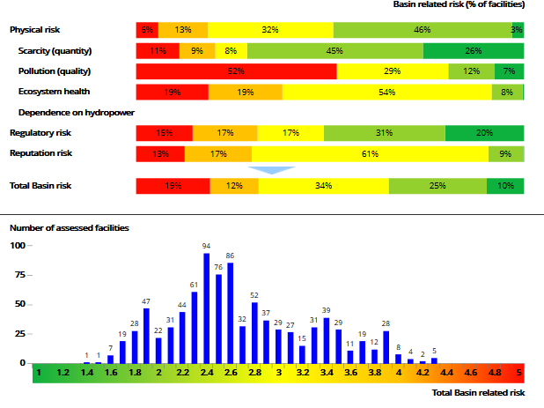
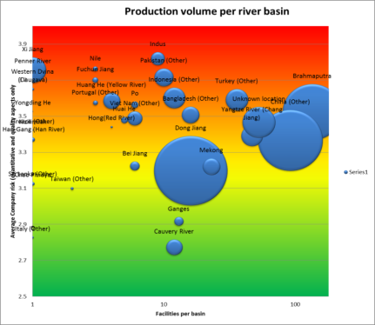
Enter locations and site information => Portfolio risk assessment
140+ country profiles with details on regulatory risk
Water risk mitigation toolbox with 100+ mitigation actions and case studies and information on agricultural commodities
High resolution data for the UK and South Africa
BRISBANE, AUSTRALIA | 18 - 20 SEPTEMBER 2017
MANAGED BY

Slide 4


How the tool is being used by companies
H&M, Clothing Retailer: “Measuring water impact and risk is vital in ensuring production is in line with sustainability strategy. This involves water risk assessments of all 500 supplier factories with wet processing. Combined with water data from suppliers, the WWF Water Risk Filter has enabled a comprehensive water risk analysis to be made.”
WWF Sweden – Guide 2015, Managing Water Risk
EDEKA, Food Retailer: “Being Germany’s largest food retailer, EDEKA is confronted with various water risks across our supply-chain. Using the Water Risk Filter, we analysed around 2300 products on water risks related to their origin. The results helped us to raise awareness on the importance of the topic and start formulating mitigation strategies to work with our suppliers and producers collectively at the river-basin level. An example is our project on sustainable banana sourcing in Colombia, where we started a multi-stakeholder water stewardship project with the aim to establish an integrated water management framework in two river-basins where production takes place.” EDEKA, 2016
BRISBANE, AUSTRALIA | 18 - 20 SEPTEMBER 2017
MANAGED BY

Slide 5


How the tool is being used by companies
Mondi, Pulp & Paper “In 2016, as part of our global partnership with
WWF, we continued to further support the development of The Water Risk Filter (including the testing of the high-resolution Water Risk Filter for South Africa). Our own water impact assessment tool is based on WWF’s Water Risk Filter and WBCSD’s Global Water Tool, but includes more detailed and operation-specific data as well as a element. ”
Mondi Sustainability Report 2016
Carlsberg, Beverage Producer: “In 2016, using WWF’s Water Risk Filter tool, the Carlsberg Group’s sites were assessed for physical risks such as water quantity (scarcity, flooding and droughts) and water quality (pol-lution). Regulatory and reputational risks were also considered. Our joint research will feed into our target-setting during the course of the year.
Carlsberg Group Sustainability Report 2016
BRISBANE, AUSTRALIA | 18 - 20 SEPTEMBER 2017
MANAGED BY

Slide 6
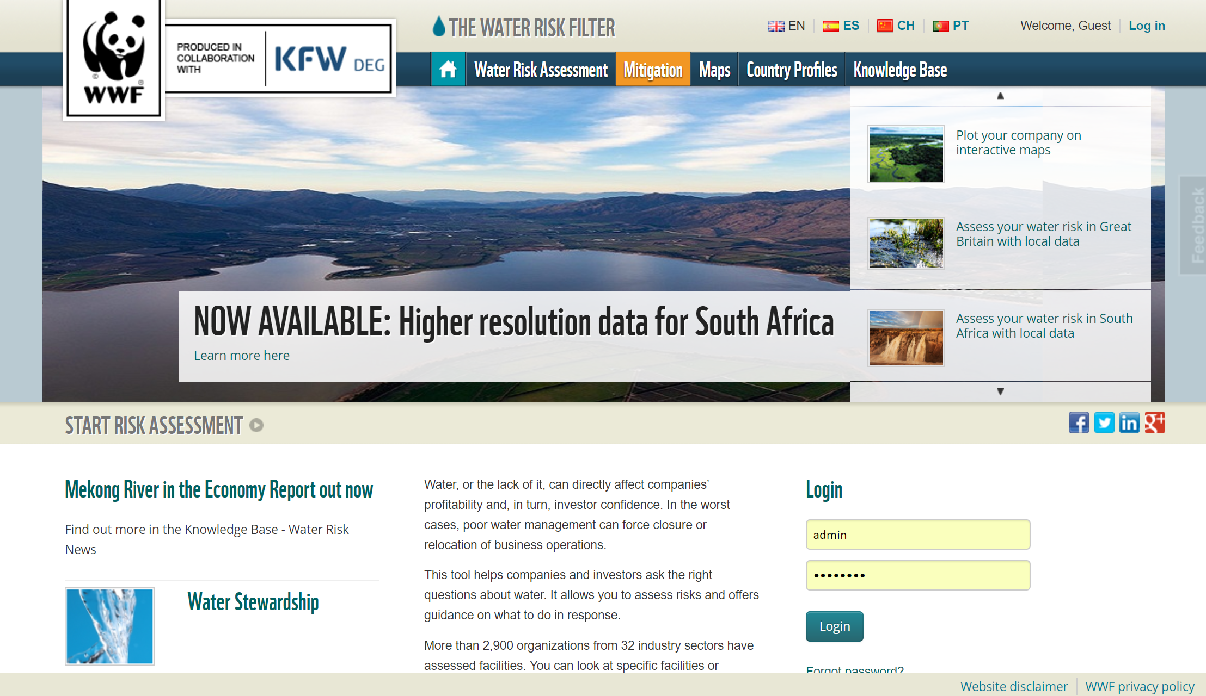
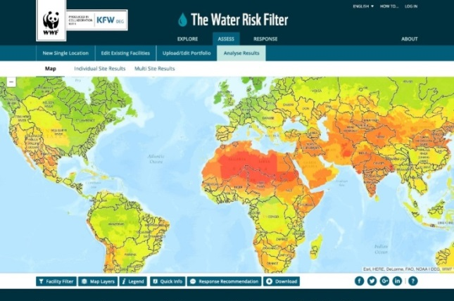
Overview of major changes
New Interface
Indicator overhaul
Mitigation toolbox update and proposed actions directly linked to risk assessment
Additional higher resolution risk data
Interactive WWF basin story maps
Valuation tool to valuate site specific water risk (under development)
BRISBANE, AUSTRALIA | 18 - 20 SEPTEMBER 2017
MANAGED BY

Slide 7
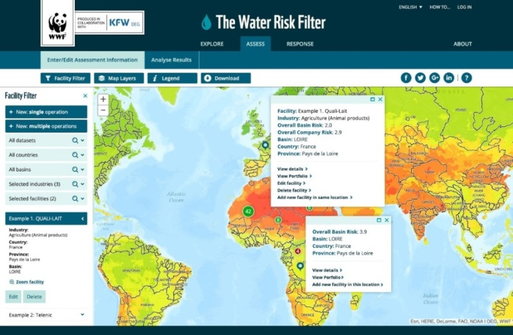

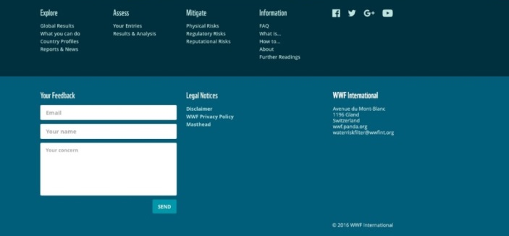
Major change #1 – New interface
Cleaner
More intuitive flow
More flexible
(expand & collapse)
Faster to input
New colours for risk maps
New branding
More ways to explore maps (crops, dams, etc.) & analyze options
In short: easier & more powerful
BRISBANE, AUSTRALIA | 18 - 20 SEPTEMBER 2017
MANAGED BY

Slide 8
Major change #2 – Indicator overhaul
Risk Type | Risk Sub-Type
Physical | Quantity – scarcity*
 | Quantity – flooding*
 | Quality*
 | Ecosystem service status*
Regulatory | Enabling environment (laws & policy)
 | Institutions & governance
 | Management instruments
 | Infrastructure & finance
Reputational | Cultural importance of water
 | Media scrutiny
 | Corporate trust
 | Water conflicts
Updated basin risk indicators
32 total basin indicators
17 existing basin indicators
15 new basin indicators
Updated operational risk indicators (questionnaire)
6 core questions (can be applied to all sites for ‘fast’ version)
39 total (optional) operational indicators
20 existing operational indicators
Valuation questionnaire
32 (optional) additional valuation-related questions
*Climate change projections (coming)
BRISBANE, AUSTRALIA | 18 - 20 SEPTEMBER 2017
MANAGED BY

Slide 9
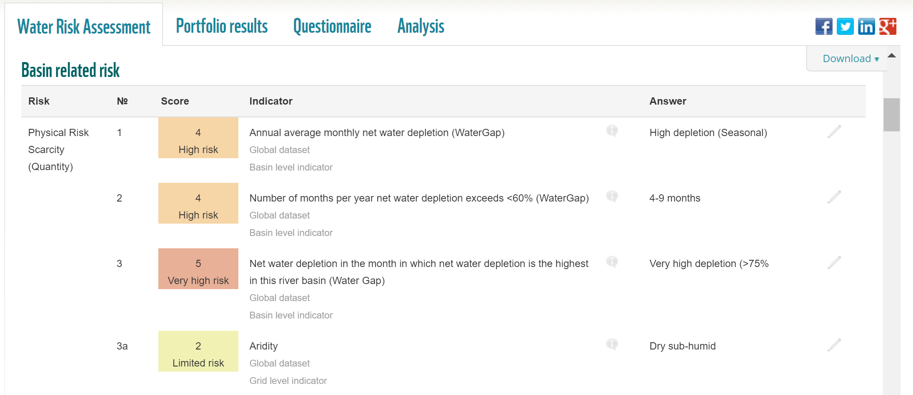
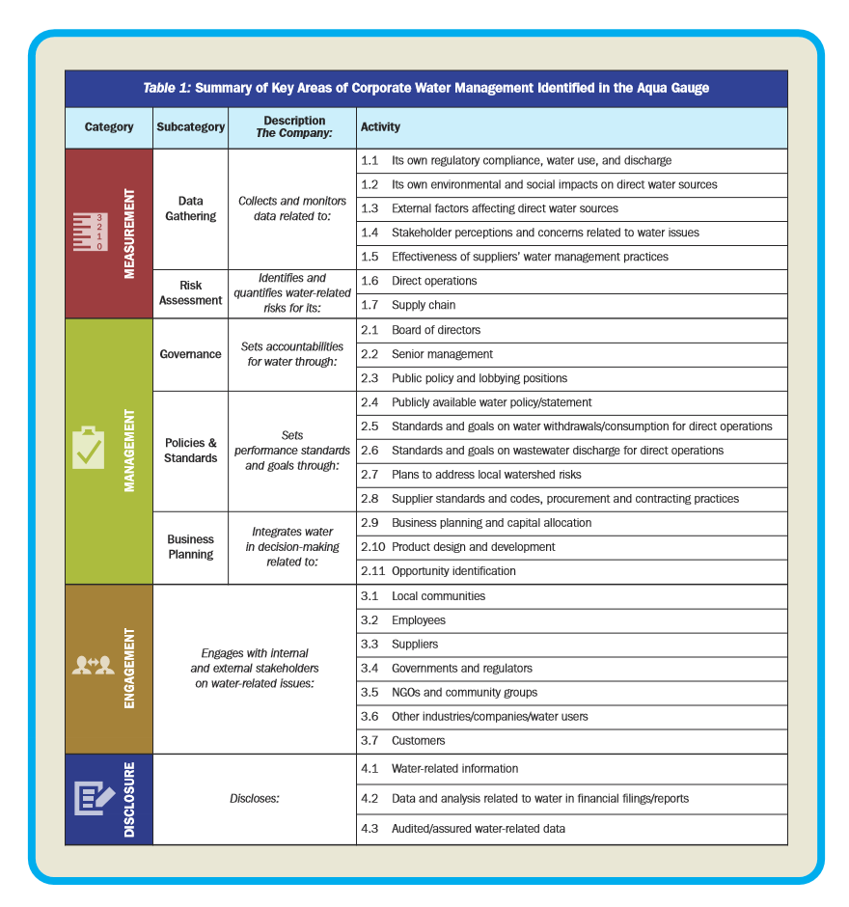



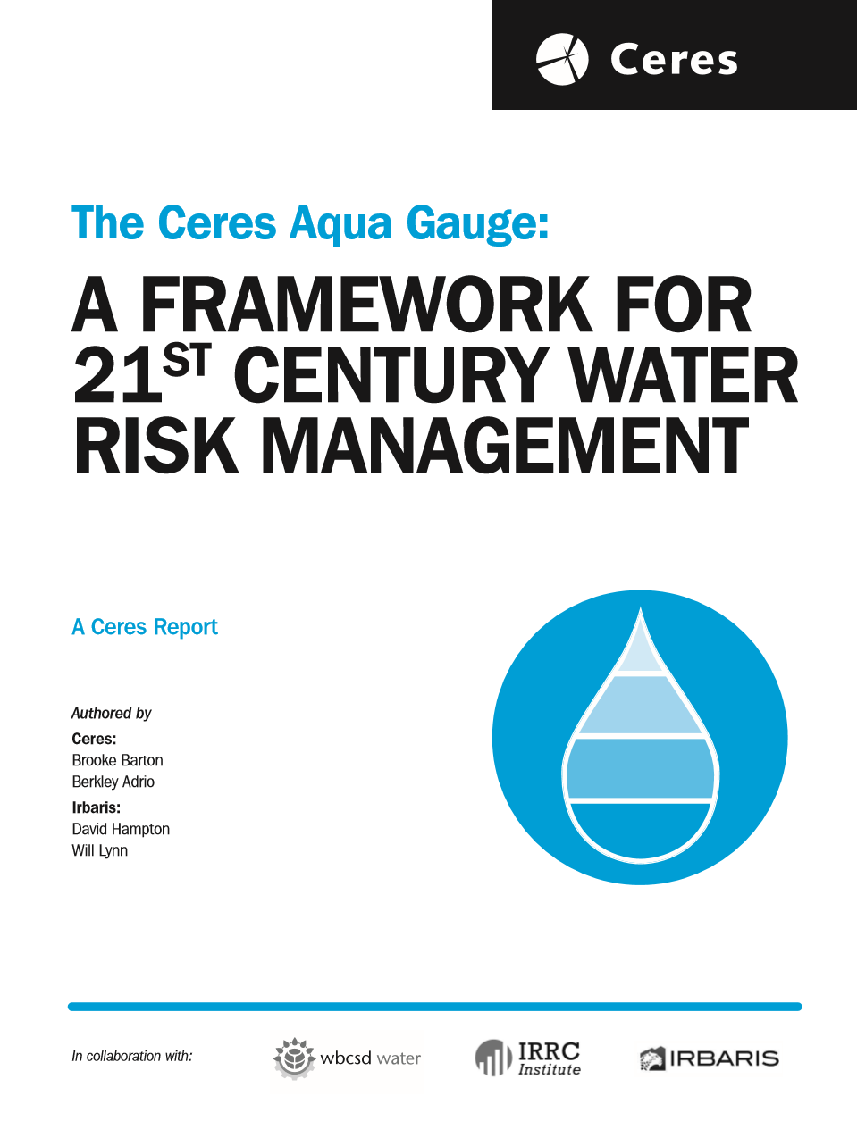
Major change #3 – Proposed action
Suggested potential water risk mitigation actions
Option A
Option B
Option C
Etc.
Comprehensive: ~125 mitigation actions (10 categories)
Linked to other frameworks & platforms (common tagging)
Sortable (filter) by
  Stewardship progression level (initial vs. established vs. advanced)
  Implementer (site vs. corporate HQ)
  Risk type (physical, regulatory, reputational)
In short, the Water Risk Filter is evolving from a water risk assessment tool to also become water stewardship guidance tool
BRISBANE, AUSTRALIA | 18 - 20 SEPTEMBER 2017
MANAGED BY

Slide 10
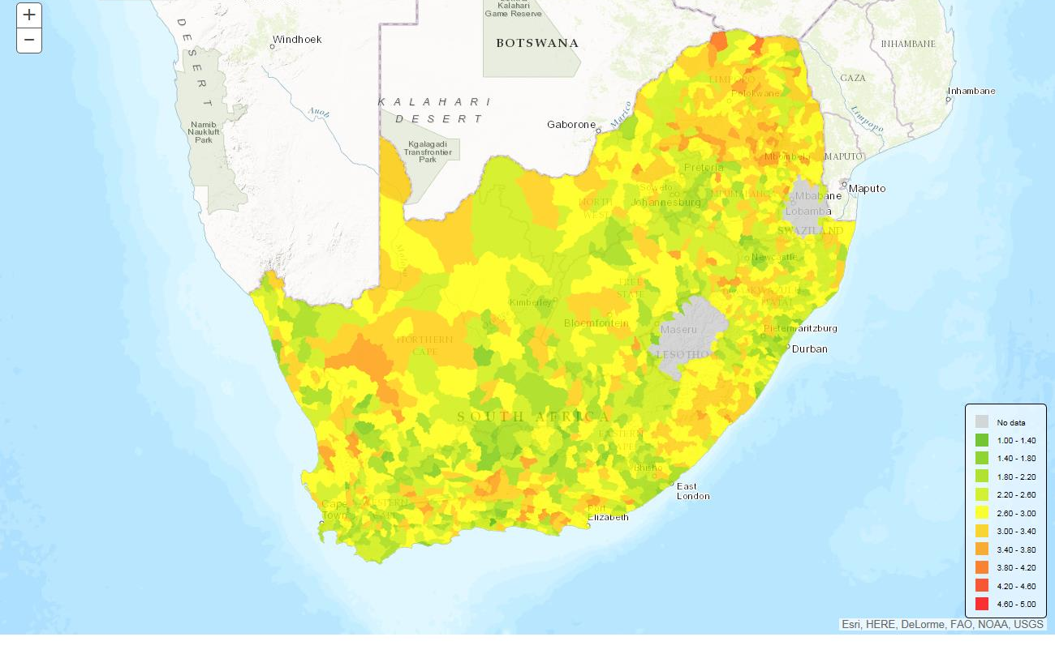

UK (242,495 km²)
South Africa (1,221,037 km²)
Colombia (1,141,748 km²)
Brazil (8,515,767 km²)
Spain (505,992 km²)
Lower Mekong (Vietnam, Cambodia, Laos, Thailand = 604,200 km²)
Total: > 12,000,000 km²
Level 7 (few thousand km²) to Level 12 (a few km²)
Major change #4 - High resolution data
BRISBANE, AUSTRALIA | 18 - 20 SEPTEMBER 2017
MANAGED BY

Slide 11
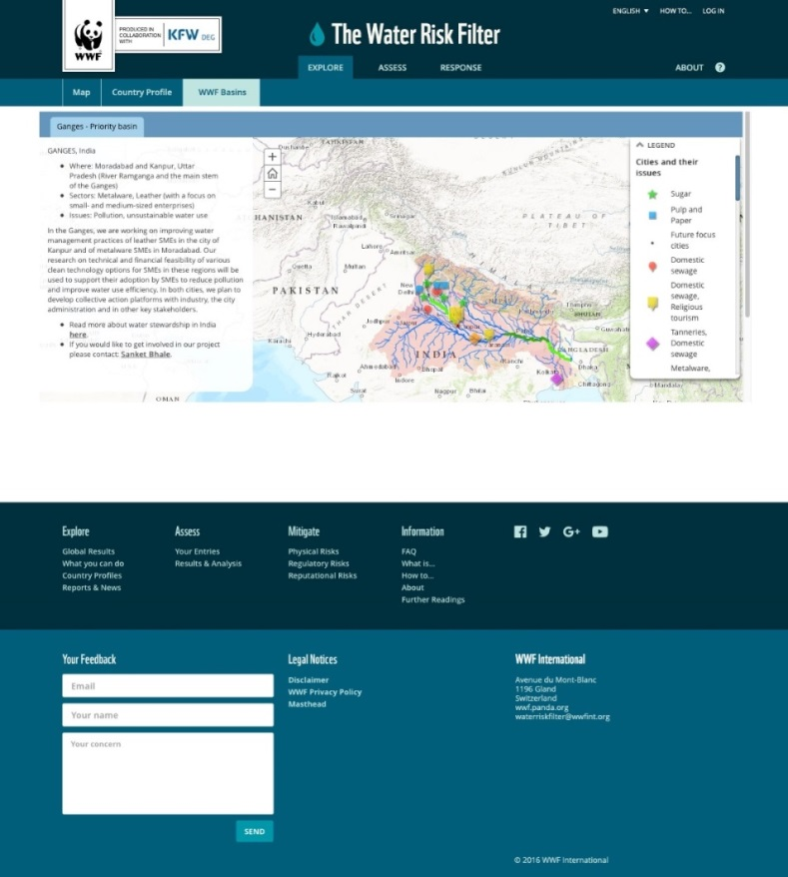
Major change #5 – WWF basins
WWF basin story maps
Details about WWF basins
Why WWF works in these places, who we’re working with, successes & challenges
Stories + pictures +videos + maps to illustrate our Freshwater work
Additional basin data
BRISBANE, AUSTRALIA | 18 - 20 SEPTEMBER 2017
MANAGED BY

Slide 12
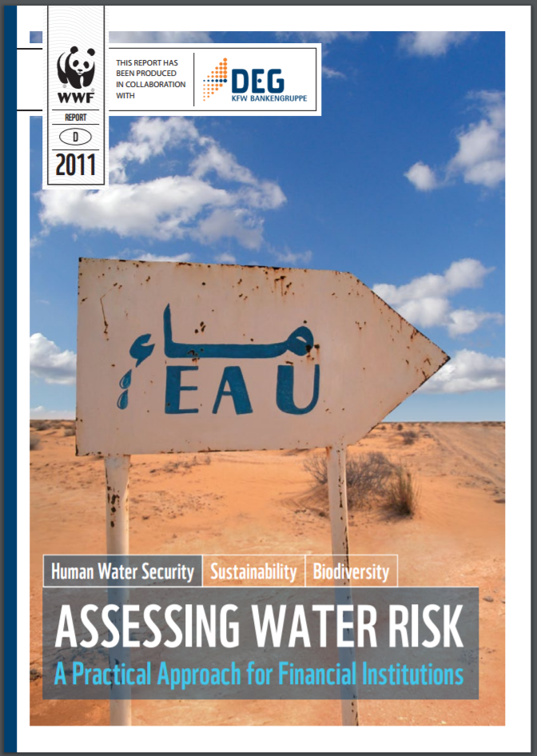
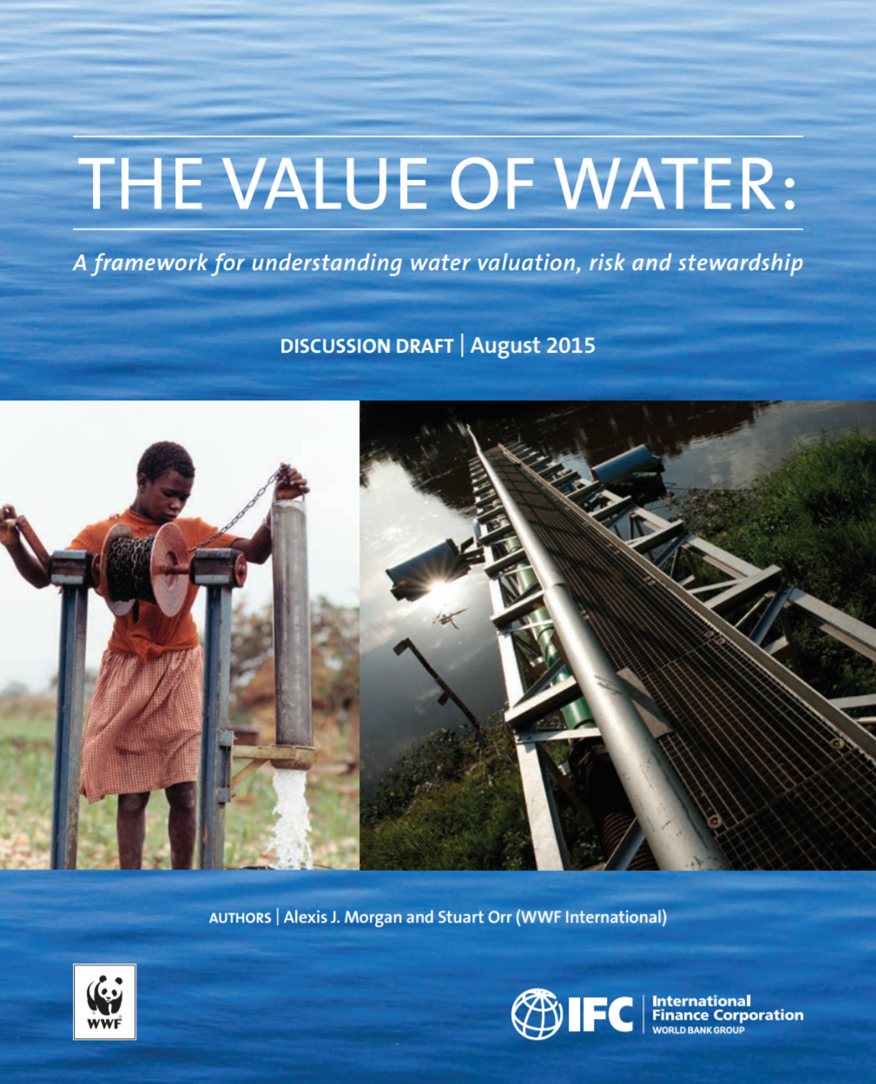
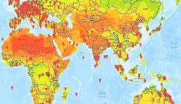
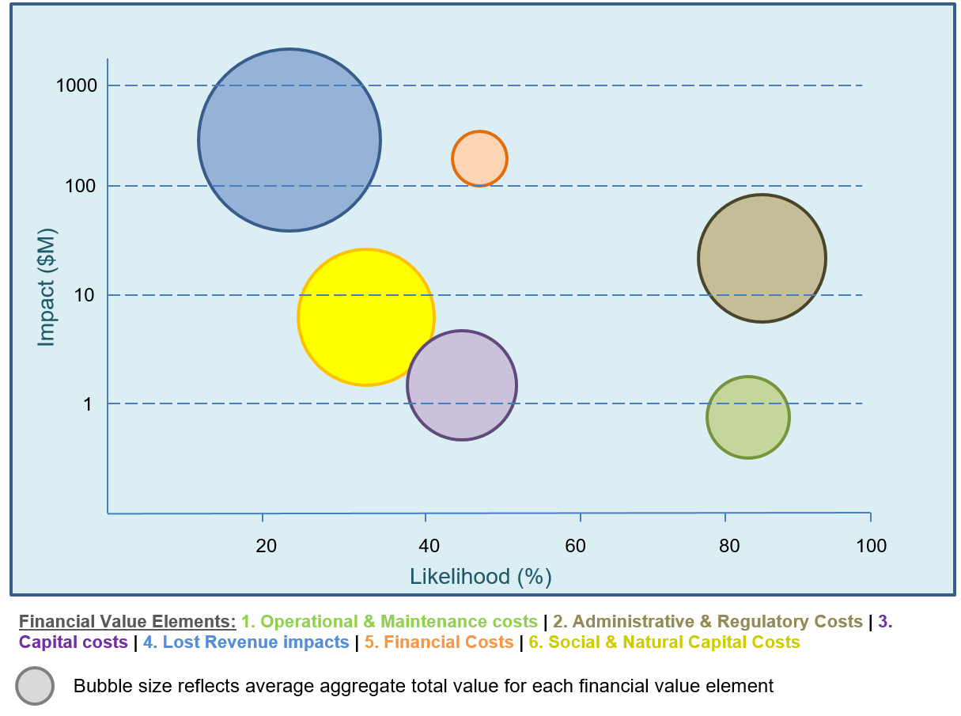
Major change #6 – Water Valuation Module
WATER RISK EVENT
FINANCIAL IMPACT
WATER RISK VALUE
Logic model to link water risk events to financial impacts (“stress testing”)
User guided
Informed by WWF, Veolia, Equarius +
Excel → Online
A new tool to more rigourously think through how water risk can affect the financial value of assets
BRISBANE, AUSTRALIA | 18 - 20 SEPTEMBER 2017
MANAGED BY

Slide 13


For more information:
Oliver Männicke – Water Stewardship Specialist omaennicke@wwf.org.au
Thank you for visiting
www.waterriskfilter.org
Follow us on Twitter
@WWFWaterRisk
BRISBANE, AUSTRALIA | 18 - 20 SEPTEMBER 2017
MANAGED BY

