Slide 1
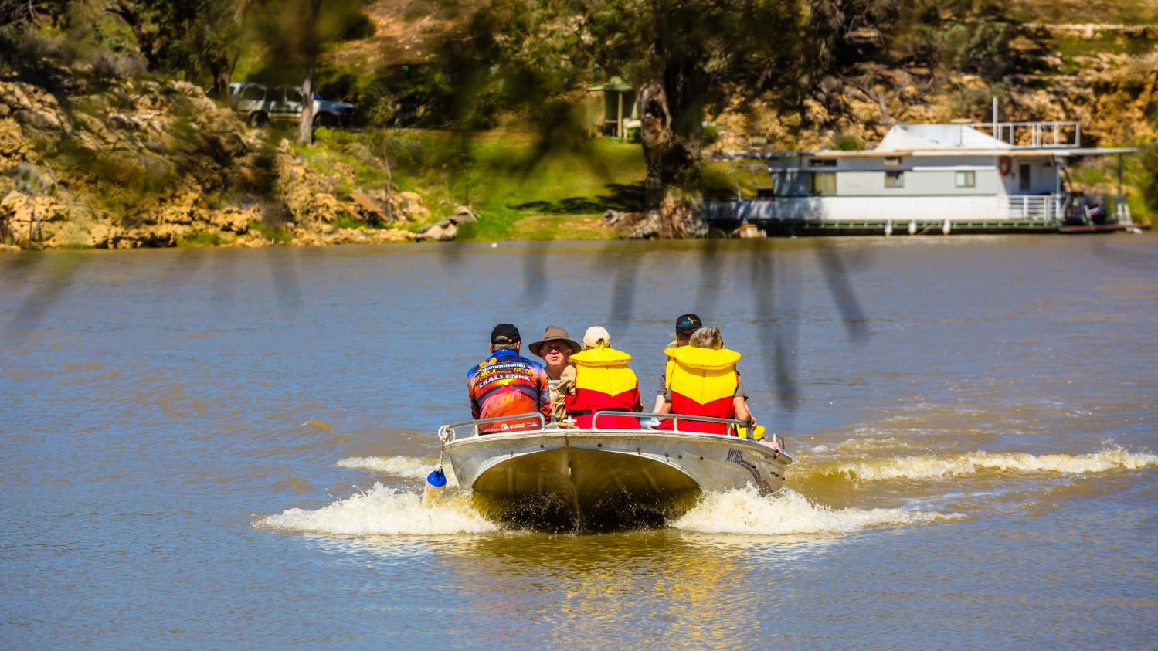
Navigating the waters towards greater support for environmental flows:
Nature Foundation SA
shares its story.
Hugo Hopton
CEO
BRISBANE, AUSTRALIA | 18 - 20 SEPTEMBER 2017
MANAGED BY
Notes:
Good afternon
HH CEO NFSA

Slide 2
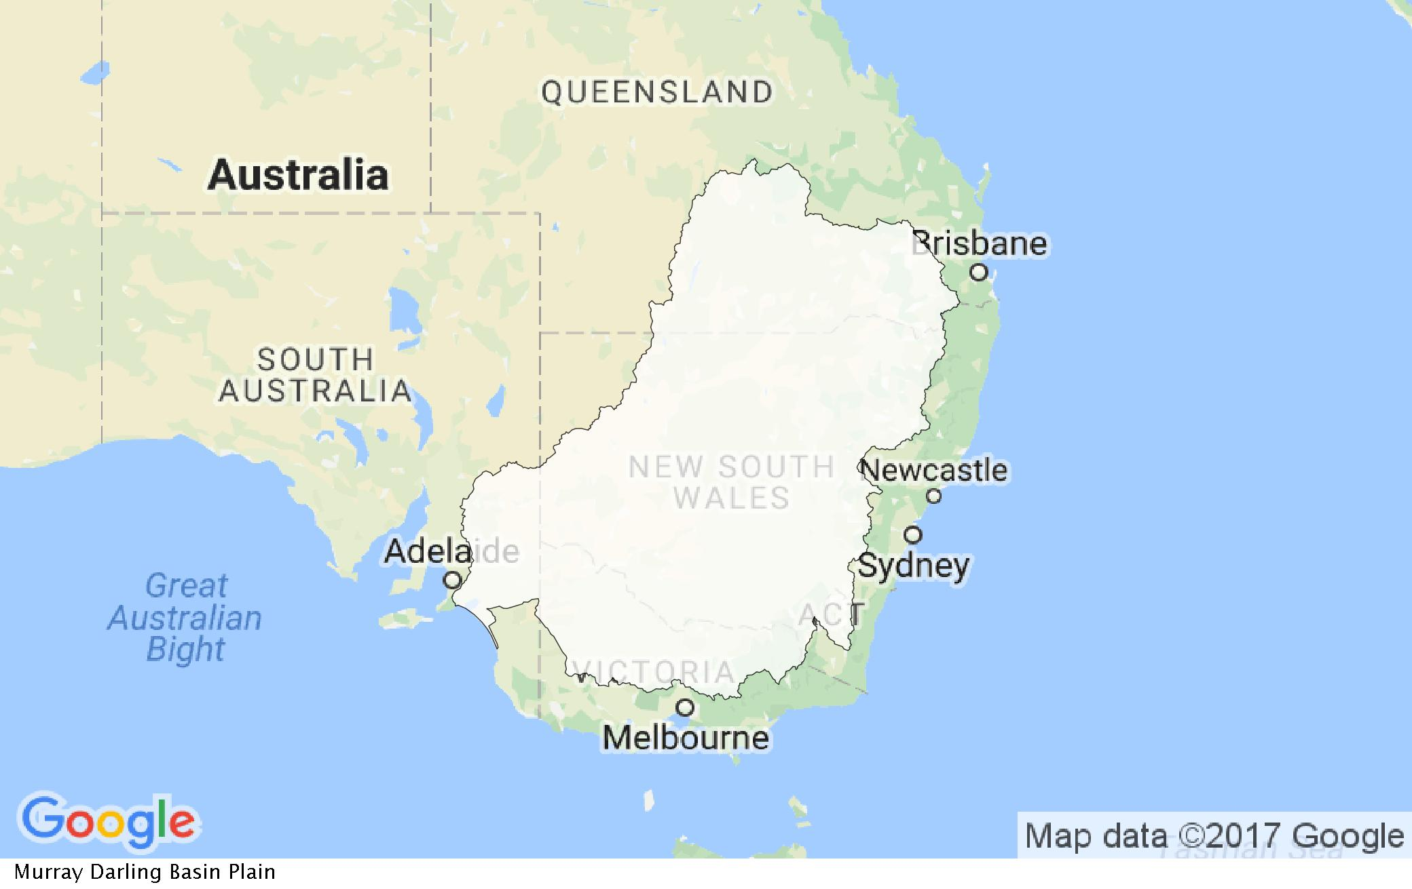
Murray-Darling Basin
Notes:
Nature Foundation – a SA environmental charity operating since 1981 to advance nature conservation
The River Murray makes the last part of its journey to the lower lakes and the sea – 440 km but 670 km of river, through extensive floodplains and terraces as well as ancient cliffs.
The River is fundamental to the people of the region, providing water for irrigated crops – citrus, almonds, wine grapes, as well as potatoes and pasture for dairy to name a few. These industries driver local employment and economy for the region, contributing to state and the national output.
The millennium drought tested not only the river itself, businesses and local economies, water dependent ecosystems and the resilience of the river communities. As with so many communities the cost was high in all these areas.
With the drought so recent and so raw, why was there an unrealised community desire to be involved in environmental watering.

Slide 3
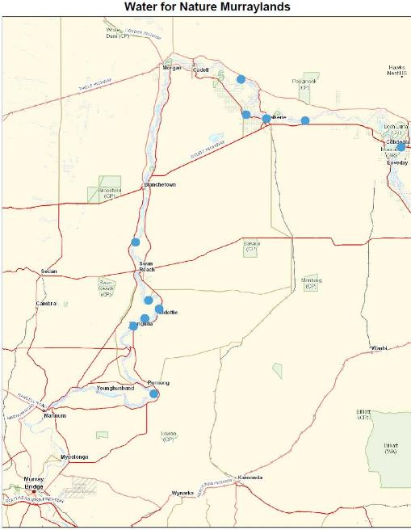
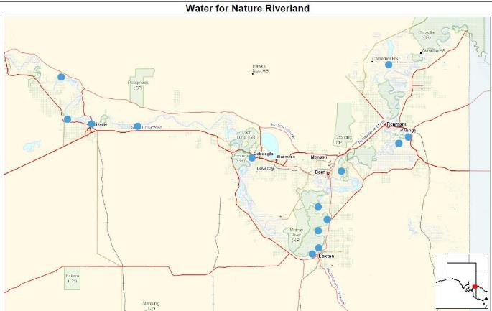
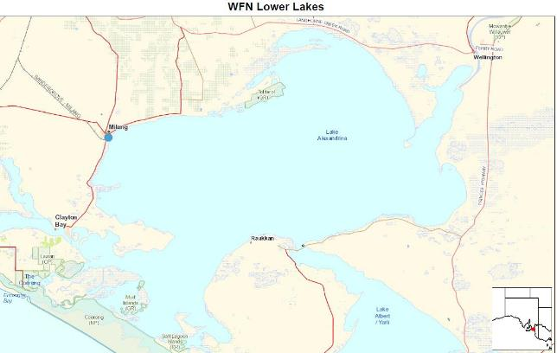
Notes:
South Australia boasts around 1100 wetlands and floodplains in the River Murray valley. The maps show where the Water for Nature sites are. The communities along the River Murray in SA see themselves as quite different communities of interests. The intense rivalry in sport is a good indicator. Their focus tends to be a local one. The hydrology, ecology and sociology differs significantly from Renmark, near the Victorian border to Mannum in the lower Murray to Goolwa in the lower lakes.
From an environment perspective, It would be a huge undertaking for any one government agency or organisation to take on restoring each of the 1100 sites, as well as inspiring and mobilising the diverse and independent local communities.
That is why our Water for Nature program is keen to foster a community of environmental water practitioners and champions.

Slide 4
Water for Nature
Notes:
Nature Foundations approach since 2008 has been to identify needs and find ways to address them. Deep in the Millennium drought, through necessity, water was denied to nearly all of the River Murray wetlands in South Australia. This put at risk the Threatened regent parrot. Our first partnership started with us going to the broader SA community to raise funds, securing water in the market, and working with the local landcare group water the vegetation of Hogwash Bend and contribute to protection of this species.
The Nature Foundation signed the first agreement with the Commonwealth environmental water holder in 2012.
Since then, the Nature Foundation has worked in partnership landholders, scientists, engineers, the three levels of government, IT specialists, to deliver 6.22 gigalitres of environmental water (1 gigalitre equals 1000 megalitres or one billion litres) to around 50 sites as part of its Water for Nature program.
The photo shows this diversity from a site visit near Waikerie.
We focus on smaller, often more challenging sites, mainly on private land. Owner include farmers, other not-for-profits, Aboriginal communities, irrigators, life-stylers and crown land.
We would not have been able to achieve what we have without the hands-on help 200 volunteers. They support the program by re-fuelling the water pumps, moving and repairing irrigation equipment, filling and stacking sandbags and helping out with our scientific monitoring program. Many of our volunteers are landholders, farmers, irrigators and students.
So how do we reach out to the community and get people involved?

Slide 5
Traditional engagement approach
Water for Nature
Communication
Engagement
Community
Industry
Notes:
Our community involvement approach has developed organically. It really was born of need. A big ambition to see the floodplain brought back to life, married with a real scarcity of resources. The vison and the drive that came from that ambiton helped people to see what was possible. This in turn inspired them and us to seek to find a way to get things done. We have encountered incredible generosity and commitment.
We could have designed a pretty standard community engagement model aiming to connect with local people within each of the communities along the river Murray using social media, mainstream media, workshops etc. This would take a significant amount of our resources and would most likely take a long time to build sufficient networks and contacts to achieve the desired result.
So this we did not do.

Slide 6
Our adopted approach
Landcare
Industry
Water for Nature
Notes:
Instead Water for Nature became connected with landholders and local organisations such as local action planning groups, Landcare groups, local government, Aboriginal business enterprises, local irrigation trusts and irrigators, and local services and supply businesses. Generated were some very unlikely alliances.
Simple as it sounds, the networks and structures existed. The shared vison gave us a basis to connect with them. The delight was in in identifying the common ground and just as importantly what each of the many parties could bring to bear. Land, water, old irrigation gear, local knowledge, DEMs, electricity, deferring grazing, pumps, time, observations. Very quickly indeed, people became connected and involved in a way that brought them energy and enabled the program to grow.
Nature Foundation must stay actively alive to what is happening at Commonwealth and Basin Scale, right down to a single wetland within one landholders floodplain. Our role is to plan, coordinate, communicate, measure, celebrate, question, learn, adapt.
Our goal is to develop and grow a strong, passionate, independent community of practice that has an increasing capacity to deliver environmental water to wetlands and floodplains …… and does as an intrinsic part of the way they plan and manage their land.
It might be worth each of you thinking what other descriptors you would add to this diagram.

Slide 7
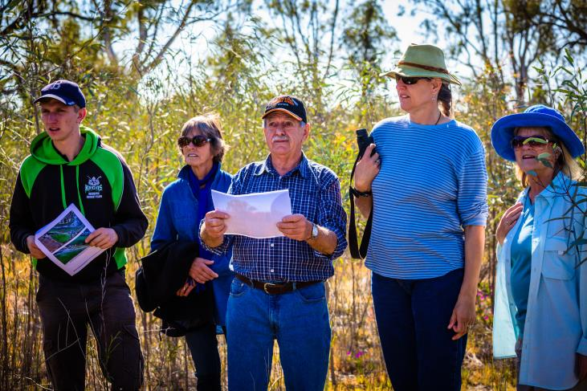
Water for Nature Exchange
An annual two day event encouraging volunteers and community groups to share their experience of environmental watering
Hopes to make caring for our wetlands common practice
Promotes citizen science; e.g. bat surveys, turtle monitoring, tree response to watering etc
Notes:
An annual muster of the keen and the curious brings together people from all walks of life. Our aim is to foster the concept of a community of practice. Environmental waterers with lived experience of what to aim for, what works and what doesn’t, managing for the wide variety of seasons and open to innovation and science.
Trust is key. When trust grows, people are more willing to be vulnerable, and share not only what went well, but what did not – so other may learn from that and grow their own experience.
The third water exchange will be 15 & 16 November this year, and we hope it will slowly grow as an exchange of ideas, experiences and inspiration. You are all invited.

Slide 8
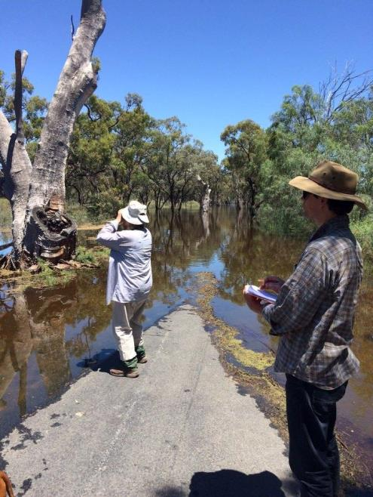
University Students
University students (honours & higher) are invited to volunteer for scientific monitoring
Students are taught field monitoring techniques by the Water for Nature Wetland Ecologist
Focus on response of native vegetation to environmental watering
Building capacity for future scientists
Notes:
More recently Water for Nature has commenced an initiative to attract university students to participate in our quarterly ecological monitoring program. The purpose of the program is to build skills in young graduates for monitoring native vegetation’s response to environmental watering, as well as to boost our capacity to monitor more wetlands and floodplains.
Nature Foundation sees students as another community. It also is very active in attracting post-secondary student to careers in nature science. It bring conncetion between young students and local people groups and environments, expanding their perspectives which will serve them so well in later employment.
The community involvement and science aspects has also proved attractive to philanthropic funders, which provide resources for planning, coordination, collaboration, on-ground work, and science and monitoring.

Slide 9
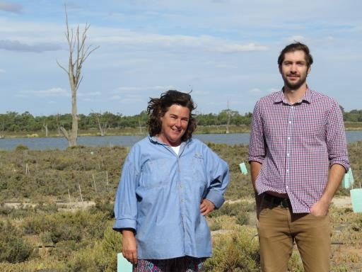
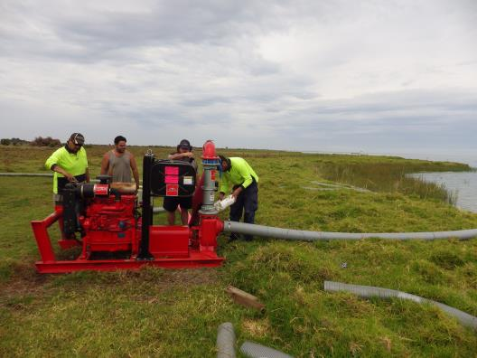
Inspiring others
Renmark Irrigation Trust – 10 site environmental watering program
Rauuken community & Ngarrindjeri Regional Authority – Lower Lakes sites
Notes:
In 2016-17 we have seen two organisations that we previously partnered on Water for Nature commence their own environmental watering initiatives. The Renmark Irrigation Trust and Ngarrindjeri Regional Authority have both previously worked with us on individual sites near Renmark and in the lower lakes respectively. Both organisations are now using the knowledge they learned and are expanding their environmental watering programs, in new agreements they have with the Commonwelath environmental water holder.
Nature Foundation SA was able to offer the organisations; access to its environmental water allocation from the Commonwealth government, assistance with state and federal government approvals, scientific monitoring, and additional equipment and funding.
This then made it easier for the RIT, for example to experiment with environmental watering and demonstrate the benefits to its irrigator members and its local community. The two organisations now have their own environmental watering programs and share their learning regularly. We are also exploring new opportunities with them, for working together as a result.

Slide 10
Values vs. Policy
Water for Nature focusses on achieving agreed environmental objectives
But the benefits are wider:
Community wellbeing
Recreation – cycling and walking
Positive economic impacts such as increased tourism and in some cases benefits for landholders, farmers and irrigators
If we better reflect the variety of values we have for water it may create more community support for environmental watering
Notes:
Our Water for Nature program uses mainly Commonwealth Environmental Water Allocations so our objectives are focused on agreed environmental outcomes.
However, we know through anecdotal evidence that by delivering environmental water there are positive social and economic impacts – how can we communicate these impacts better and have them better reflected in water policy? And can this approach win greater support within the community for environmental watering?
My opening question was: With the drought so recent and so raw, why was there an unrealised community desire to be involved in environmental watering.
The answer is many-fold. And the answer can be found within each local community, relating to their values, drivers, beliefs and needs. It is summed up in the words of Nick Stanitski, a retired irrigator when asked why he was dragging hoses, moving sprinklers, fuelling pumps and environmentally watering on his own place. “I just want to see the area back to what it was when I was playing here as a kid”

Slide 11
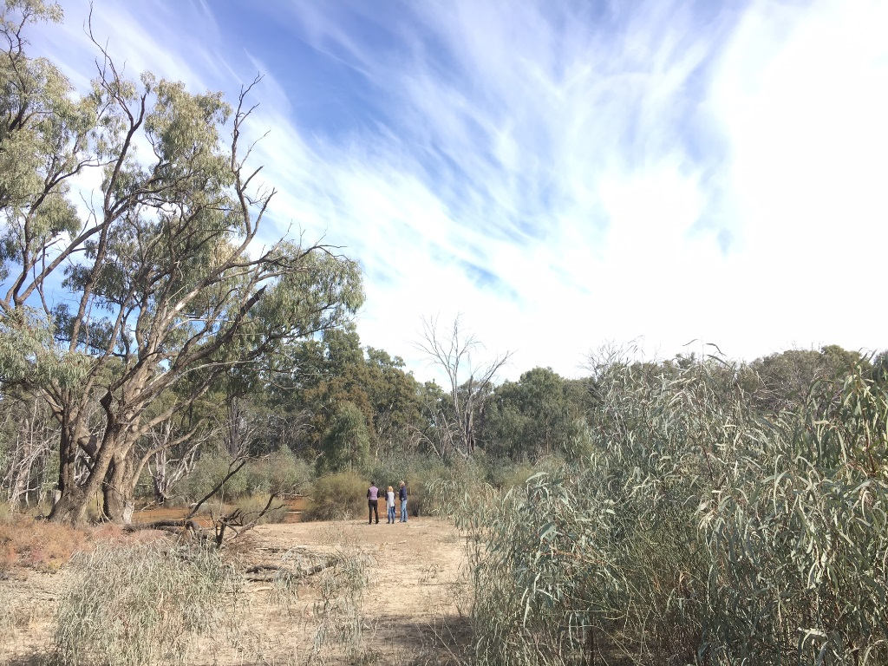
Summary: Navigating towards greater support for environmental watering
Use existing community networks
Find the common ground
Inspire and empower others to act
Partner, build trust
Offer opportunities to share stories and learning
Invest in emerging scientists and pass on knowledge
Recognise the wider benefits of environmental watering
Notes:
Thank you.

Slide 12
Partners/Sponsors
Thank you
Notes:
We are an environmental charity
We deliver environmental water in South Australian Murray Valley in partnership with the Commonwealth Government
We work with local landholders, farmers, irrigators and local government

