Slide 1



Place your
logo here
Forecasting river transmission loss in the Lower Namoi Regulated River
Priyantha Jayakody and Michael Wrathall
BRISBANE, AUSTRALIA | 18 - 20 SEPTEMBER 2017
MANAGED BY

Slide 2
Introduction
Transmission losses are significant in regulated river water deliveries
Reliable prediction of transmission loss is important for resource managers to assess
    The ability to allocate and deliver water during dry periods
    Manage the ‘cost’ of water delivery
    Long-term planning
BRISBANE, AUSTRALIA | 18 - 20 SEPTEMBER 2017
MANAGED BY

Slide 3
Introduction
  Transmission losses are reflected in Actual Unaccounted Differences (AUD).
  AUDs are the difference between known inflows, measured extractions and outflows. They comprise:
      Measurement errors
      Ungauged diversions
      Net seepage to/from groundwater
      Channel evaporation (evapotranspiration)
Q1
1
4
2
3
Q2
BRISBANE, AUSTRALIA | 18 - 20 SEPTEMBER 2017
MANAGED BY
Notes:
2013/14 example

Slide 4
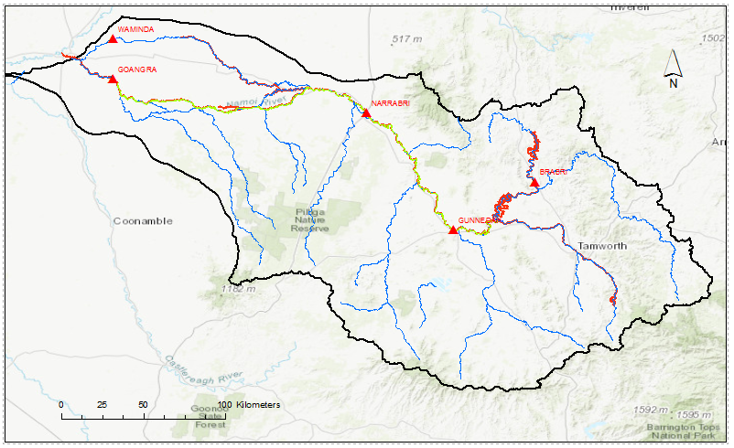
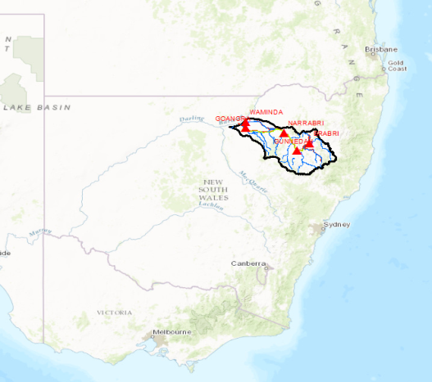
Introduction
Study area
Split Rock Dam
Keepit Dam
BRISBANE, AUSTRALIA | 18 - 20 SEPTEMBER 2017
MANAGED BY

Slide 5
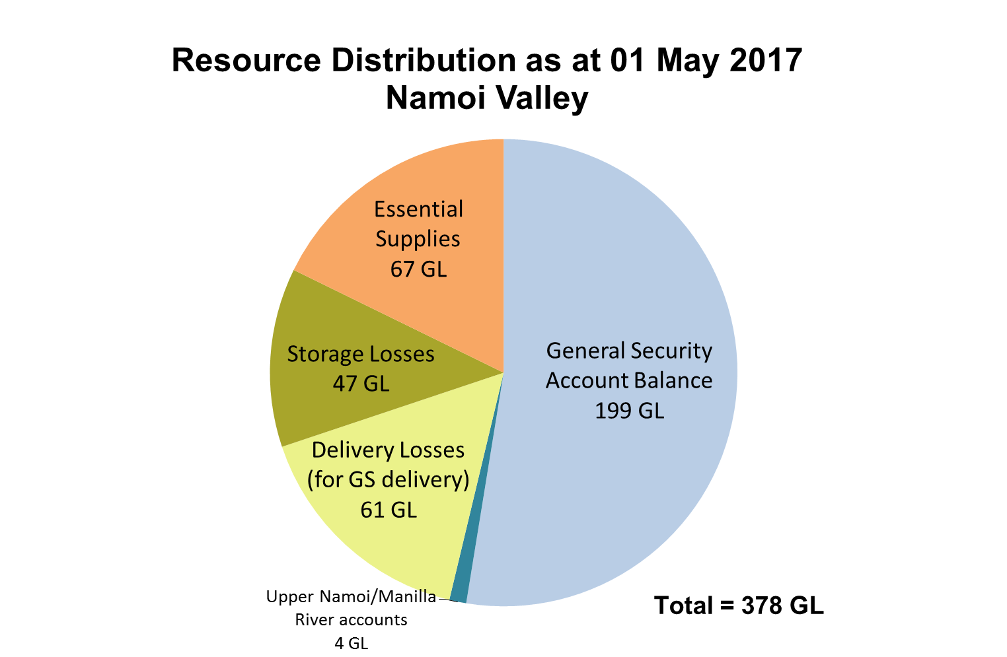
Introduction
The Namoi regulated river experiences highly variable transmission losses.
Current water management practice is to allocate an extra 30% of water for delivery – to allow for losses.
It becomes highly problematic when actual losses are greater than the 30% budget
BRISBANE, AUSTRALIA | 18 - 20 SEPTEMBER 2017
MANAGED BY

Slide 6
Main Objective
The main objective of the study is to create a regression function to reliably forecast loss from selected predictors.
BRISBANE, AUSTRALIA | 18 - 20 SEPTEMBER 2017
MANAGED BY

Slide 7
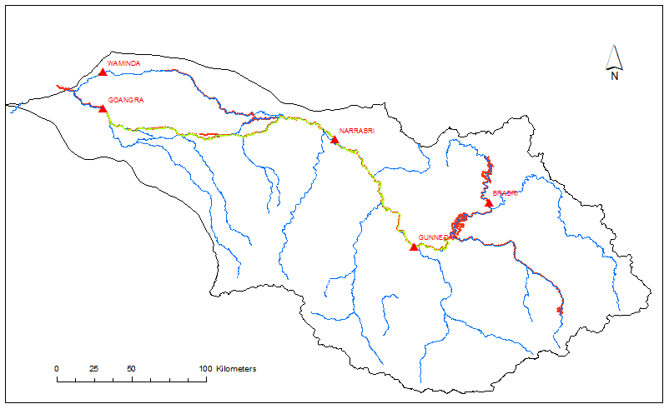
Monthly losses
Monthly AUDs were calculated for the upper river section of the Lower Namoi River.
For the period from
Jan 2005 to Dec 2016.
Reach about 200 km long.
AUD =output- input + extraction - tributary inflows
Keepit to Narrabri
BRISBANE, AUSTRALIA | 18 - 20 SEPTEMBER 2017
MANAGED BY

Slide 8
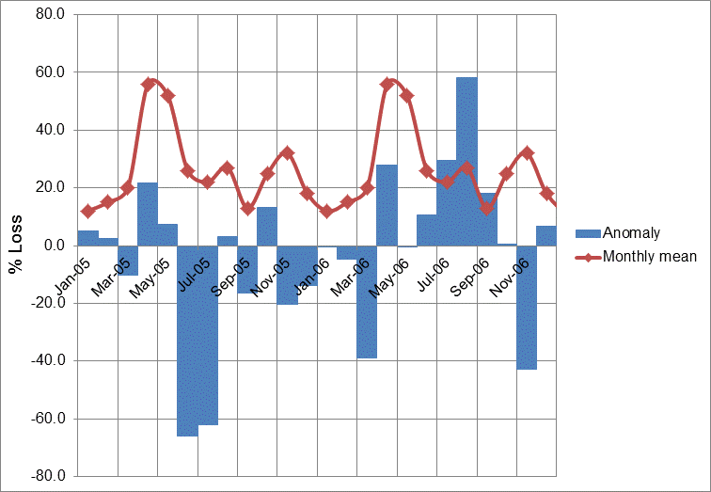
Percentage losses
AUDs were converted into percentages.
Monthly average loss percentages and respective anomalies were calculated.
A regression equation was developed to predict monthly anomalies.
Monthly % loss = Mean loss + anomaly
BRISBANE, AUSTRALIA | 18 - 20 SEPTEMBER 2017
MANAGED BY

Slide 9
Possible Predictors
Tributary inflows
  Peel inflow
  Maules Creek
Groundwater levels – 15 bores
Rainfall (Gunnedah)
  Current month
  Previous three months
Temperature
Previous month releases
Soil moisture content
Antecedent losses
  Current month
  Previous three months
Maules
RF
Peel
BRISBANE, AUSTRALIA | 18 - 20 SEPTEMBER 2017
MANAGED BY

Slide 10
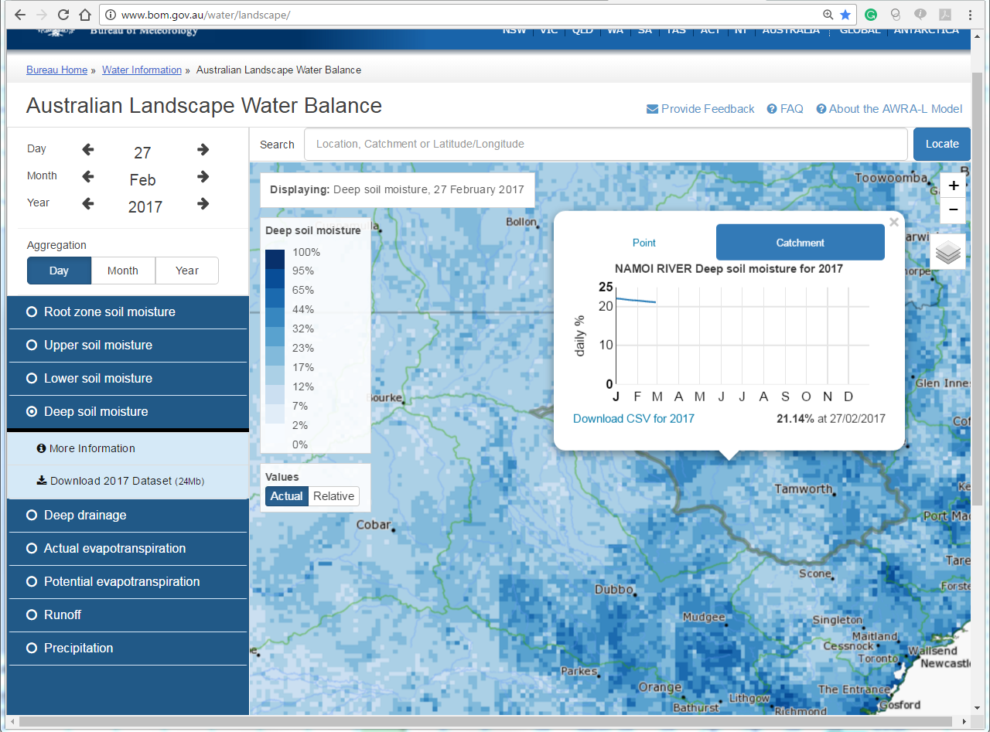
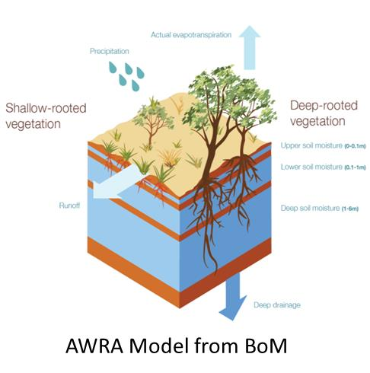

Slide 11
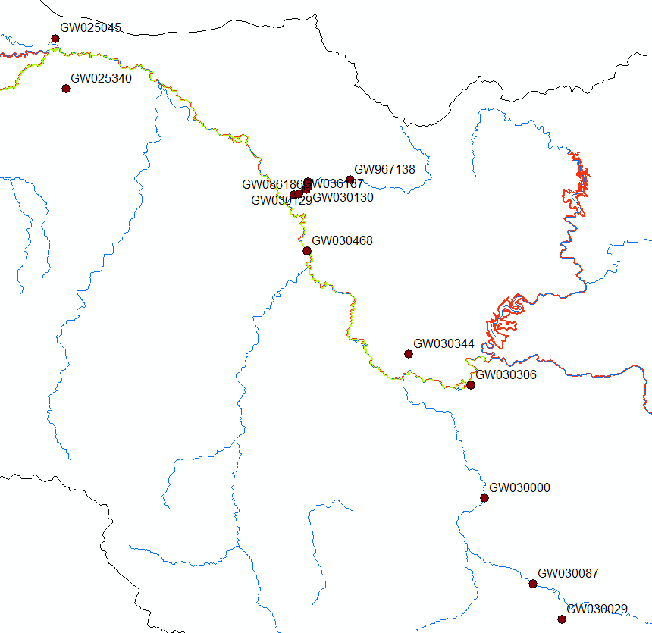
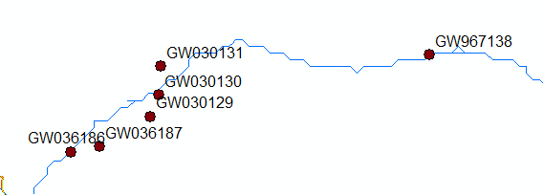
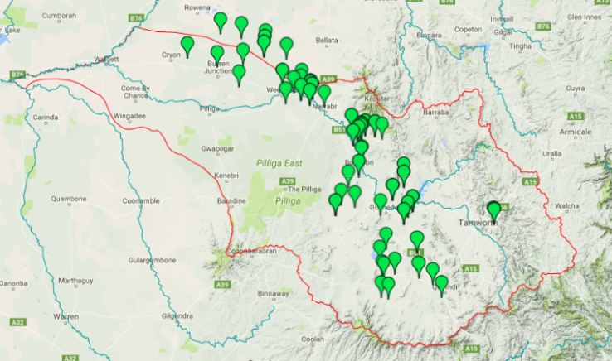
Narrabri Gauge
Narrabri Gauge
BRISBANE, AUSTRALIA | 18 - 20 SEPTEMBER 2017
MANAGED BY

Slide 12
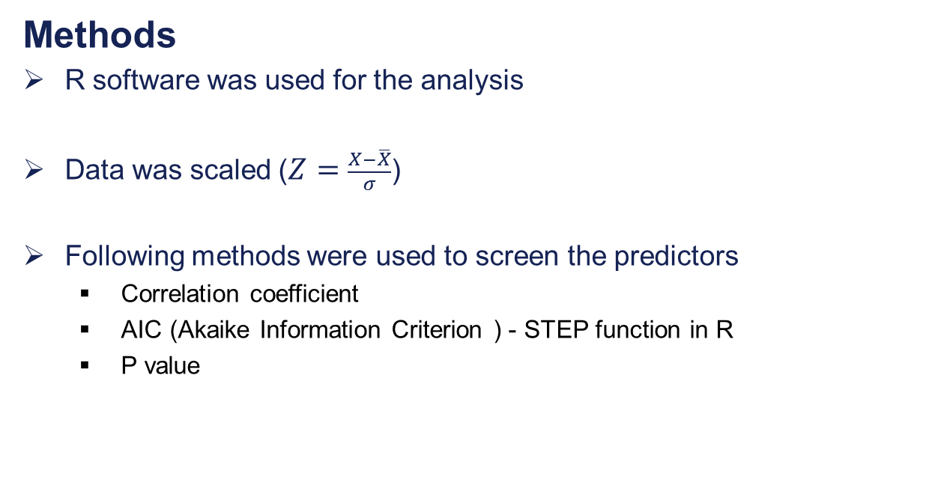
Methods
R software was used for the analysis
Data was scaled ($Z=\frac{X−\overline{X}}{σ}$)
Following methods were used to screen the predictors
  Correlation coefficient
  AIC (Akaike Information Criterion ) - STEP function in R
  P value
Anomaly _{next month} = {aX₁+bX₂+cX₃+dX₄………….}
BRISBANE, AUSTRALIA | 18 - 20 SEPTEMBER 2017
MANAGED BY
Notes:
STEP function in R used to select the best model
AIC estimates the quality of models relative to each other

Slide 13
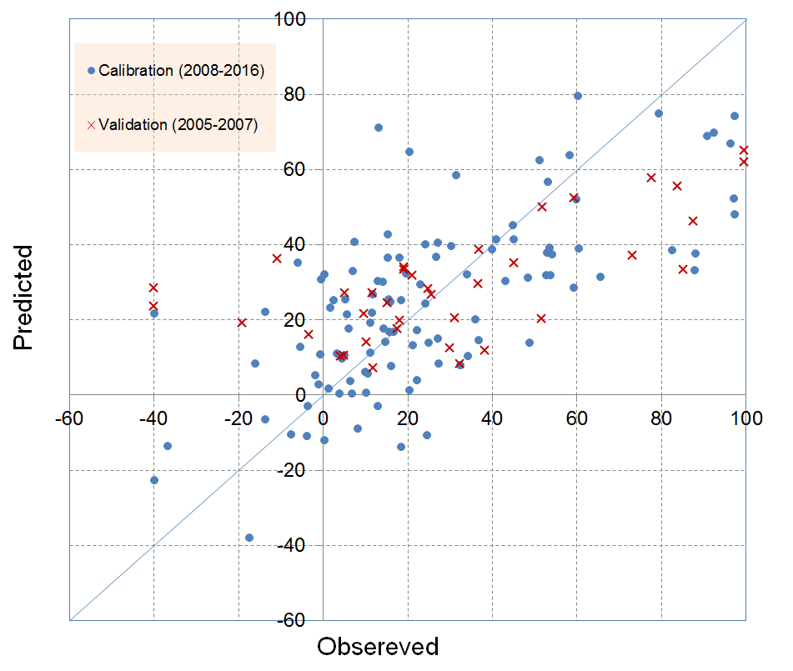
Results and discussion
Monthly prediction
Predictors | Coefficient
Water levels of GW030129 | 0.83
Water levels of GW036187 | -1.10
PEEL river inflow | -0.22
Maules 6 month Total | -0.19
R² is 0.50 for calibration and 0.45 for validation
BRISBANE, AUSTRALIA | 18 - 20 SEPTEMBER 2017
MANAGED BY
Notes:
Scaled

Slide 14
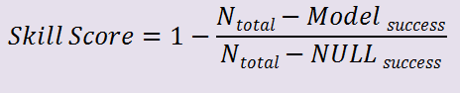
Results and discussion
How to use this equation
Convert into categorical information
Three loss levels
  Low (<30%)
  Medium (30% to 45%)
  High (>45%)
Example
Month | Observed | Predicted
Feb-05 | L | L
Mar-05 | L | L
Apr-05 | H | H
May-05 | H | H
Jun-05 | L | L
Jul-05 | L | L
Aug-05 | L | L
Sep-05 | L | L
Oct-05 | M | L
Nov-05 | L | L
Dec-05 | L | L
Jan-06 | L | L
Feb-06 | L | L
Mar-06 | L | L
Apr-06 | H | H
May-06 | H | H
Prediction | Calibration | Validation
Success | 71% | 69%
M - L or L- M | 21% | 29%
H- L or L H | 8% | 2%
SS All data | 0.16 | 0.27
SS High loss | 0.44 | 0.64
BRISBANE, AUSTRALIA | 18 - 20 SEPTEMBER 2017
MANAGED BY

Slide 15
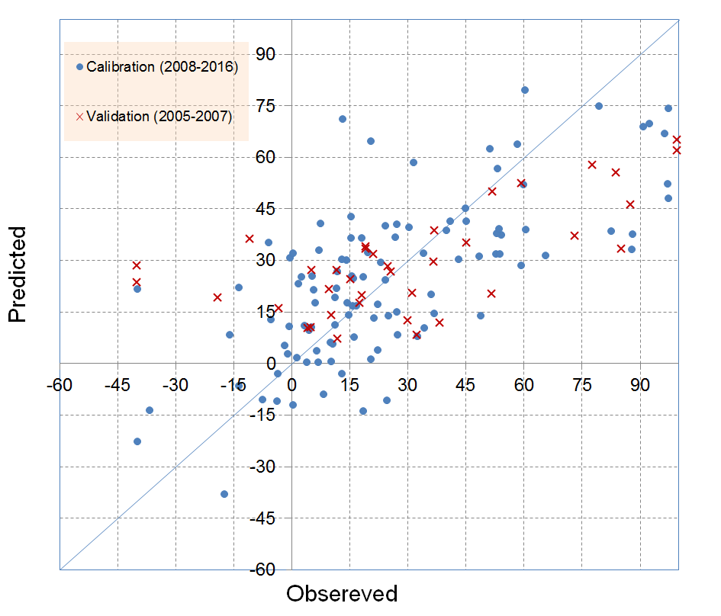
Results and discussion
Monthly prediction
Model Success
Model extreme failure
BRISBANE, AUSTRALIA | 18 - 20 SEPTEMBER 2017
MANAGED BY
Notes:
Scaled

Slide 16
Loss outlook
Due to medium flows in Mauls creek, medium groundwater levels, and declining Peel inflow next month transmission losses are predicted to be medium.
Loss levels
Current month
Low
Next month
Medium
BRISBANE, AUSTRALIA | 18 - 20 SEPTEMBER 2017
MANAGED BY

Slide 17
Conclusions
From 20 predictors, four (4) have been found that can satisfactorily describe the behavior of losses in the Lower Namoi River.
Groundwater levels and tributary flows correlated well with losses.
The regression equation is able to forecast loss categories.
Next step
Develop the regression equation for three month forecasting.
BRISBANE, AUSTRALIA | 18 - 20 SEPTEMBER 2017
MANAGED BY

Slide 18
Main contributors to this work:
  Dr. Priyantha Jayakody |Hydrologist
  Michael Wrathall | Manager Knowledge Coordination
  Dr. Shahadat Chowdhury | Senior Hydrologist
  Neeraj Maini |Hydrologist
  Rowan Murray | Hydrologist
THANK YOU
BRISBANE, AUSTRALIA | 18 - 20 SEPTEMBER 2017
MANAGED BY

