Slide 1
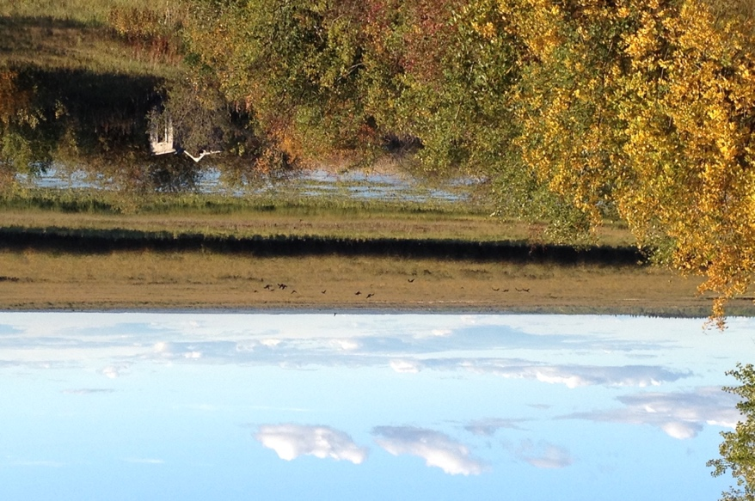
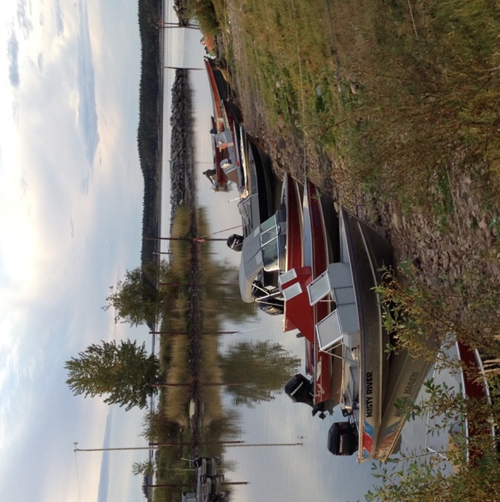
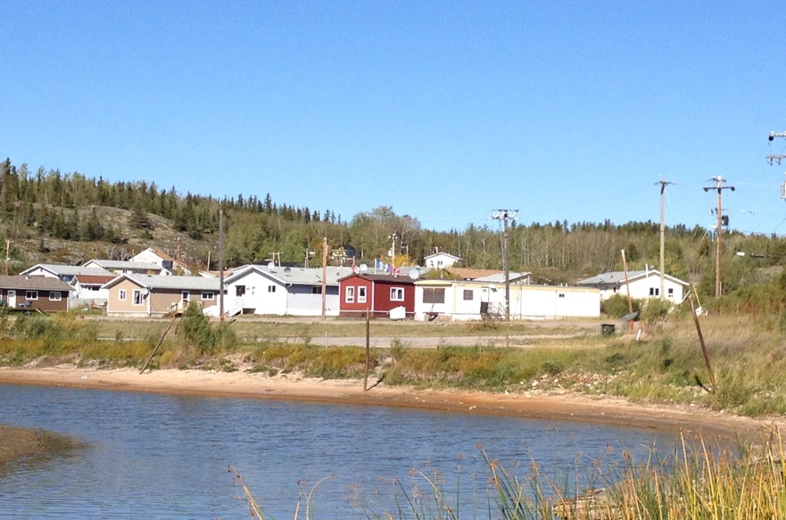
Indigenous Flows in the Lower Athabasca River, Canada: A bridging dialogue to meaningfully impact water policy innovation
Sarah Baines, MES Candidate, School of Environment and Sustainability
Supervisors: Dr. Toddi Steelman, School of Environment and Sustainability &
Dr. Lalita Bharadwaj, School of Public Health
University of Saskatchewan, Canada
BRISBANE, AUSTRALIA | 18 - 20 SEPTEMBER 2017
MANAGED BY

Slide 2
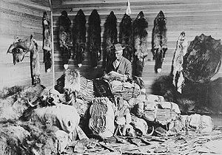
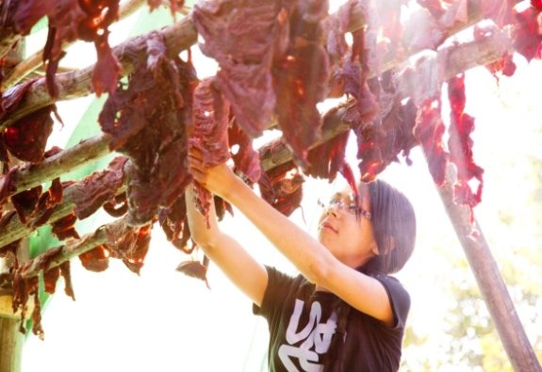
Reconciliation in Canada
Excerpts from What We Have Learned: Principles of Truth and Reconciliation
https://commons.wikimedia.org/wiki/File:Alberta_1890s_fur_trader.jpg
constructive action on addressing the ongoing legacies of colonialism (p. 3)
integrating Indigenous knowledge systems, oral histories, laws, protocols, and connections to the land into the reconciliation process are essential (p. 4)
Credit: Ryan Jackson, Edmonton Journal

Slide 3
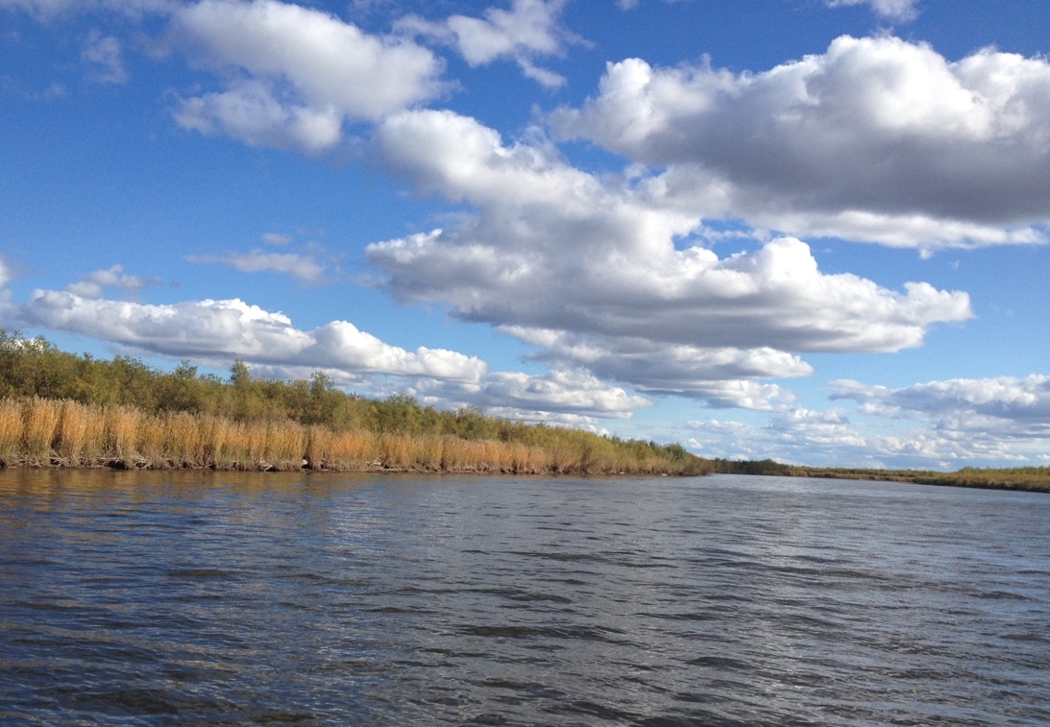
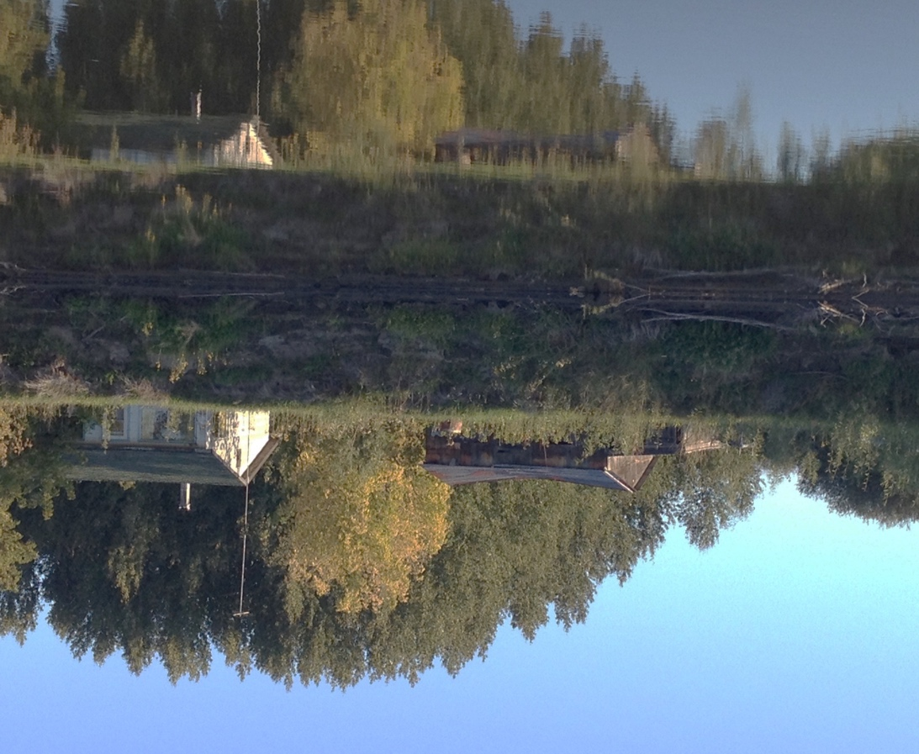
An example of a constructive solution for reconciliation within the context of surface water quantity management may come from the Lower Athabasca River
Credit: Kris Krüg, Flickr

Slide 4
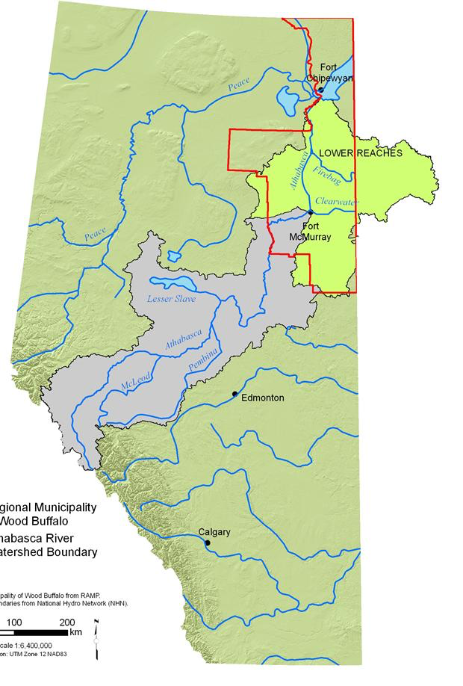
Geographical Context
Lower Athabasca River, Alberta, Canada
Treaty 8 territories of the Mikisew Cree First Nation and Athabasca Chipewyan First Nation
Source: Modified with permission from Regional Aquatic Effects Monitoring Program, http://www.ramp-alberta.org/river/geography/basin+landscape/natural+features.aspx. (Hatfield Consultants).

Slide 5
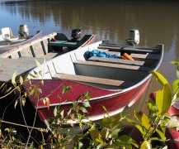
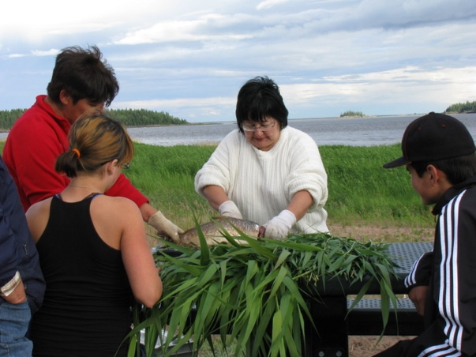
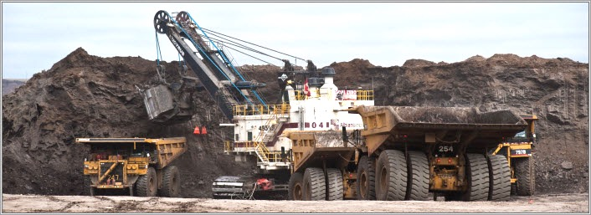
Problem Context Hydrologic Influences and Dependencies
~33% decline in summer flows (Schindler and Donahue, 2006)
http://fortchipewyanmetis.net/photo-gallery/metis-days-gallery
Credit: Alberta Energy

Slide 6
Problem Context Water Policy Development
Determining Instream Flow Needs
Surface Water Quantity Management Framework for the Lower Athabasca River (Framework) released March 2015
Learning over time expanded scope from fisheries focus to including social river uses
Sets out water withdrawal limits for oil sands industry based on river discharges
Took over 15 years to complete
Legally-binding

Slide 7
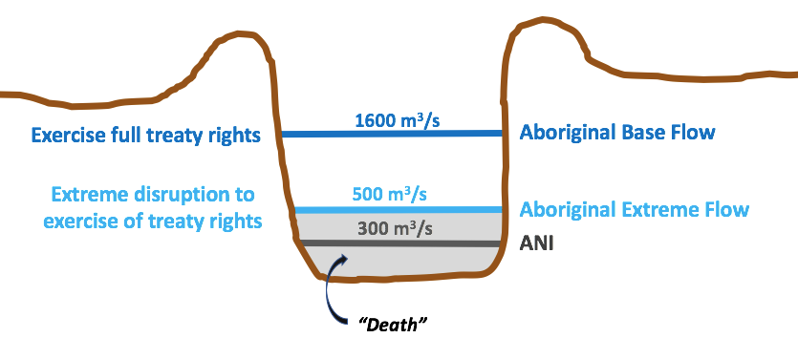
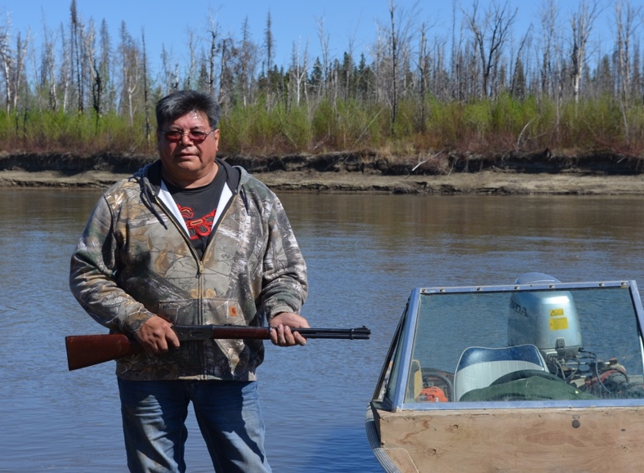
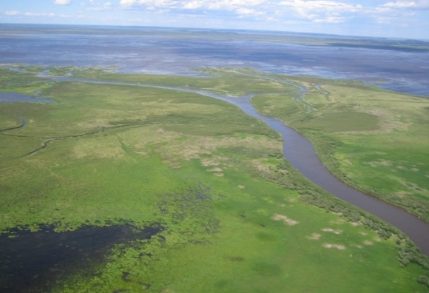
Aboriginal Navigation Flow
http://canadians.org/blog/united-nations-raises-concerns-about-impact-tar-sands-and-site-c-dam
Credit: Shawn McCarthy / The Globe and Mail

Slide 8
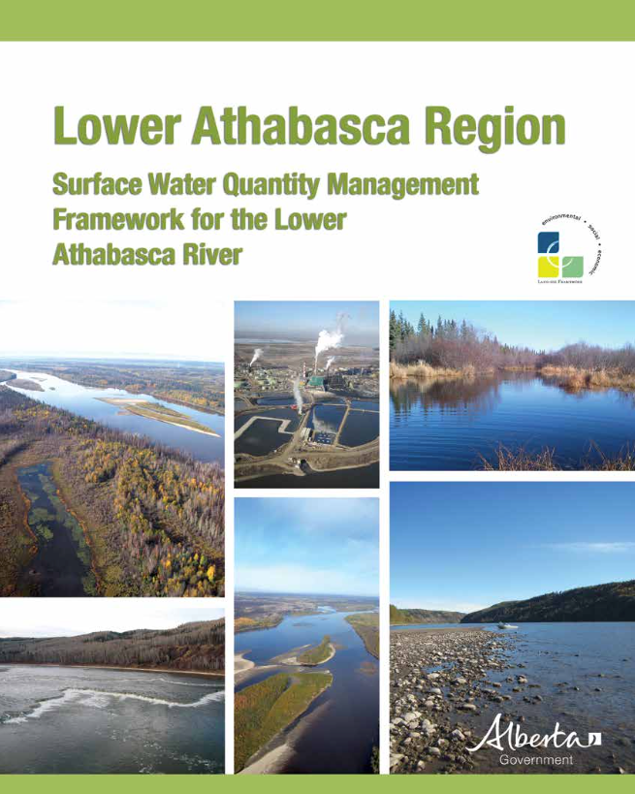
Research Question
What are the barriers and openings for water policy innovation based on Indigenous values expressed as an Indigenous flow?

Slide 9
Methodological Approach
Ethical Space
When different world views are poised to engage
Qualitative Narrative Policy Framework
Policy Subsystem Setting
Policy Subsystem =
Unit of Analysis
Advocacy Coalition 1
Advocacy Coalition 2
PN A
PN D
PN B
PN C
PN E

Slide 10
Methods: Qualitative Data Collection
Indigenous Interviews
Cultural representation
Demographic representation
Geographic representation
Government Interviews
Active in the in-stream flow decision processes
Decision-maker or supporting capacity
Document Analysis
&
Doctrinal Research
SENSITIZING CONCEPTS:
Steelman’s (2010) Innovation Implementation Theory
Cultural
Structural
Individual

Slide 11
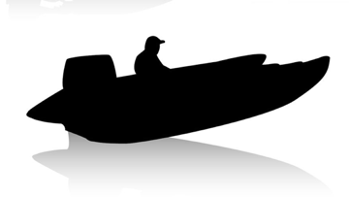
Preliminary Results
Innovation Implementation Framework | Government Coalition Narrative | Indigenous Coalition Narrative
Individual Level Incongruent meanings of zero creates a barrier
Structural Level Barrier created by legal rules partially overcome through collaboration
Cultural Level Different framings create a barrier
0
Zero, an integer and baseline
Zero is death
Collaboration between Indigenous peoples led to strengthened voices
Legislation does not recognize water withdrawals as a potential navigation interference
Water quantity management is a human health issue linked to treaty rights
Exercising treaty rights

Slide 12
Concluding Thoughts Ethical Space Remains Unbridged
“we’re still not done in pushing government, we’re still not done in trying to get them to change that framework…we don’t accept it” –Indigenous Coalition Member 23
“I guess depending on the implications of the outcomes of the [navigation] gap once it’s filled, then the framework might be revisited…So it depends on the significance, I guess, of the, of the outcomes of the study. “ –Government Coalition Member 3

Slide 13
Thank you!
http://www.usask.ca/research-groups/ddn
Credit: Ryan Jackson, Edmonton Journal
Acknowledgments
Icons: www.123rf.com

