Slide 1
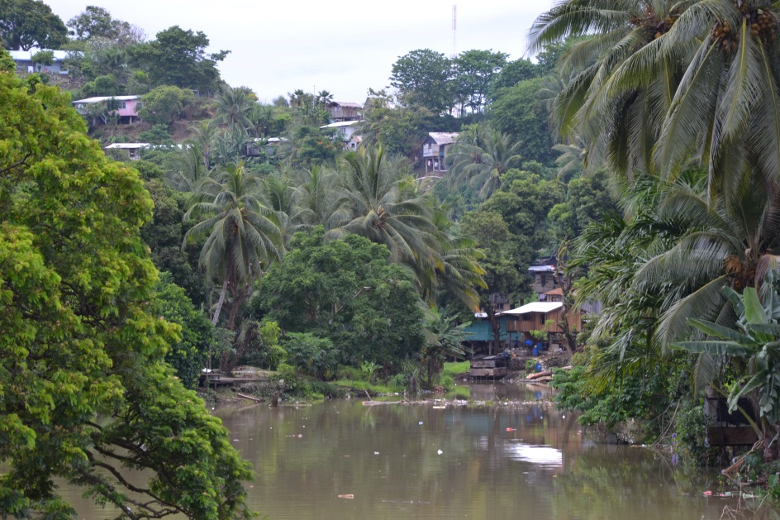
It all comes out in the WaSH – how IWRM can deliver climate-resilient and sustainable water and sanitation services.
Dr Wade Hadwen
Australian Rivers Institute
Griffith Climate Change Response Program
Griffith University
w.hadwen@griffith.edu.au
International RiverSymposium
September 20 2017
BRISBANE, AUSTRALIA | 18 - 20 SEPTEMBER 2017
MANAGED BY

Slide 2
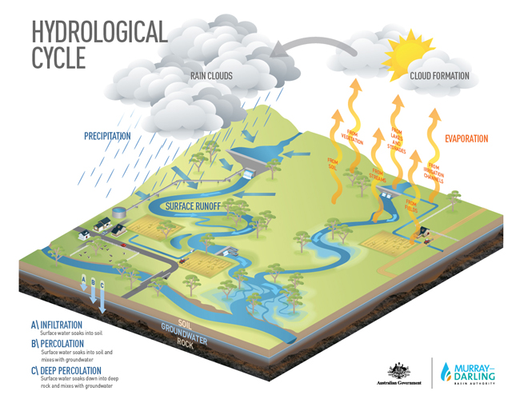
Putting WaSH in the water cycle!
Hadwen et al. 2015 Putting WASH in the water cycle: climate change, water resources and the future of water, sanitation and hygiene challenges in Pacific Island Countries J.Wash Dev 5(2), 183-191

Slide 3
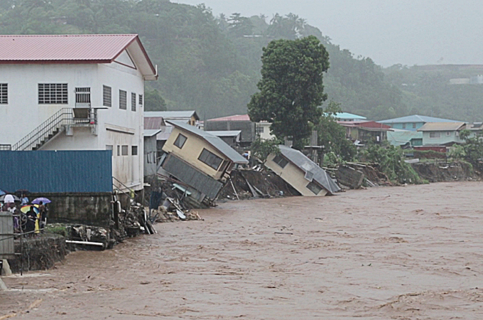
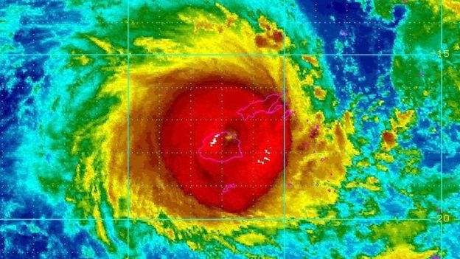
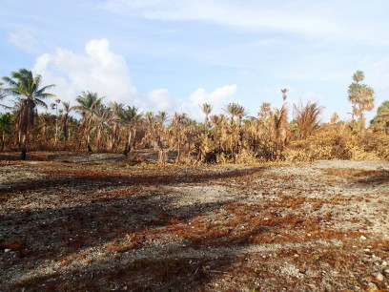
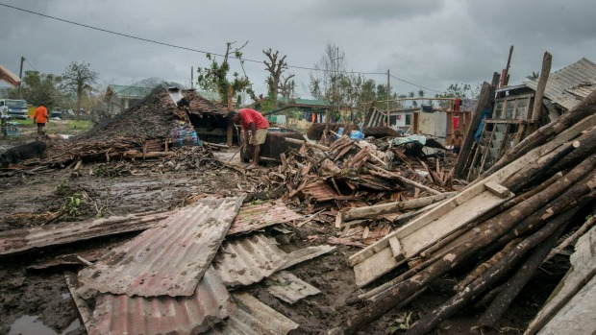
Extreme events in the Pacific Region
2013: Marshall Islands Drought
April 2016
March 2015: Cyclone Pam
February 2016: Cyclone Winston
April 2014: Solomon Island floods
Notes:
ADD CURRENT MARSHALLS DROGHT
First – map of the pacific and images from recent disasters – this is why we need to think about climate change and extreme events in the Pacific
Then:
What we are going to talk about
Comes from this project funded by DFAT

Slide 4
How will climate change affect WaSH?
Climate change is important in the WaSH sector, as it will influence where we sit along the spectrum of ‘disaster to development’ WaSH
Climate change pushes us this way
Disaster WaSH
Development WaSH
Incorporating climate change adaptation into WaSH planning should support the development of climate-resilient WaSH

Slide 5
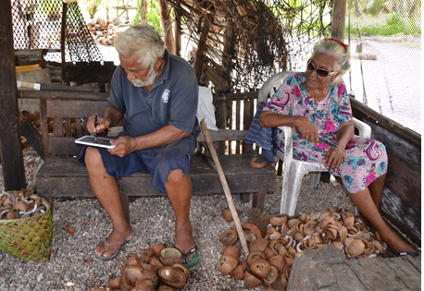
Tackling climate change and WaSH challenges
Four project aims:
1. To understand current issues relating to water
supply, sanitation and hygiene (405 household
surveys across 13 communities)
2. To understand climate change threats
throughout the Pacific (desktop analyses)
3. To learn from communities to understand their use of traditional and contemporary responses to extreme climatic events (focus group sessions across 13 communities)
4. To work with local communities and government bodies to develop adaptation options and tools (for data collection and analysis) in light of our shared understanding.

Slide 6
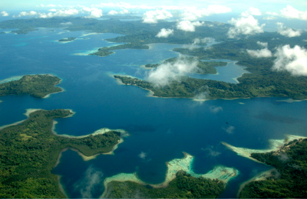
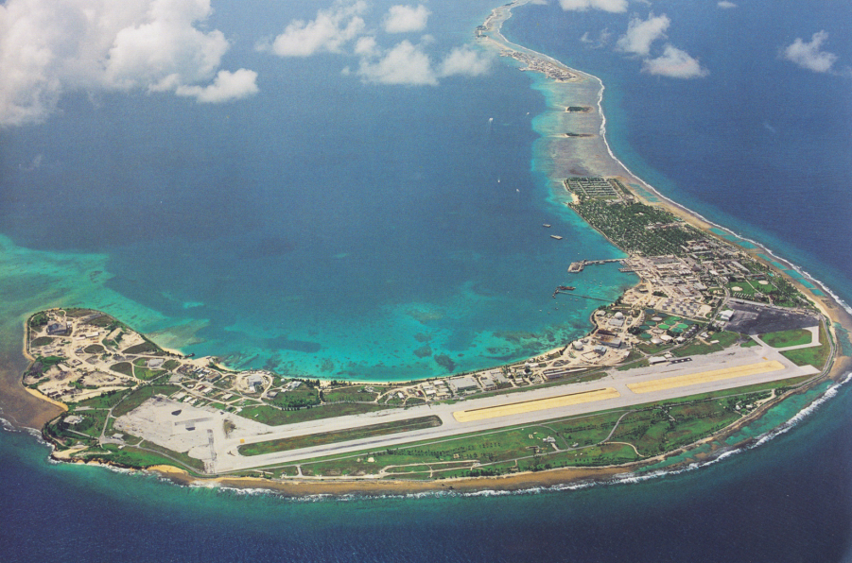
Republic of the Marshall Islands
Solomon Islands
Six major islands, 900+ smaller islands
Topography similar to Hawaii
Inland rivers and springs, lots of available surface water and groundwater
29 coral atolls
No surface water
Wider atolls have a fresh groundwater lens over seawater
Very low-lying: avg. about 2 meters above sea level

Slide 7
Snapshot of WaSH in the Solomon Islands and Marshall Islands
Households use multiple sources of water, every day
Different sources, different uses
Patterns of use change with seasons and extreme events
Wide range of sanitation practices
Highly variable between communities
Traditional approaches are gender separated
Conventional systems are not gender separated
Maintenance and waste is a problem
Households use different sources of water for handwashing at different times
Dry periods represent a challenge (water used for drinking and cooking)

Slide 8
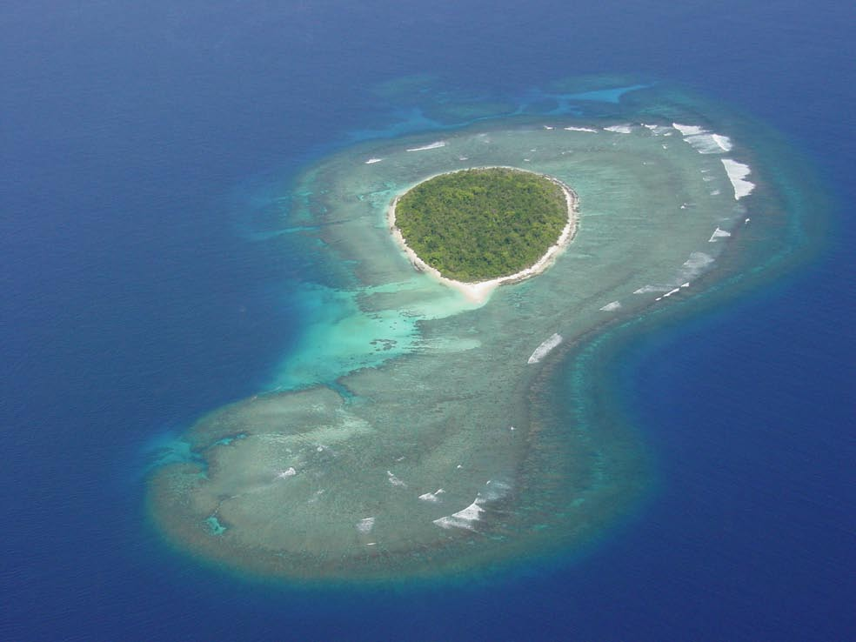
A systems approach to aid decision making
Climate change scenarios – extreme events, sea level rise, change in rainfall patterns, and
Adaptation options – evaluating the pros and cons of different adaptation approaches – e.g. provision of water tanks vs wells etc.
We used our data (household surveys + focus group discussions) to construct Bayesian Belief Network (BBN) models of rural community WaSH systems to evaluate the impacts of:

Slide 9
Systems thinking behind our BBN
Climate threats
The interactions between climatic and non-climate threats (and the resultant condition of freshwater ecosystems) will ultimately drive the delivery (or non-delivery) of WaSH services to remote PIC communities.
Seasons
Extreme events
Safe and sustainable sanitation and hygiene
Quality and Quantity of Multiple Water Sources
(Freshwater Ecosystems)
Pollution from sanitation
×
Environmental pollution from landuse
Access to safe drinking water for communities
Non-climatic threats

Slide 10
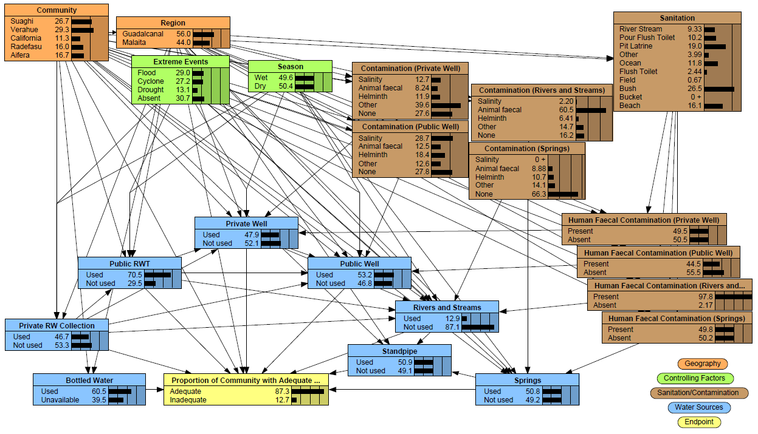
Solomon Islands BBN model
87.3%

Slide 11
A systems approach to WaSH aligns with the SDGs
Climate threats
SDG 6.5
Integrated Water Resource Management
SDG 6.2 – safe sanitation and hygiene
Seasons
Extreme events
Safe and sustainable sanitation and hygiene
Quality and Quantity of Multiple Water Sources
(Freshwater Ecosystems)
SDG 6.3 Protect water quality
Pollution from sanitation
×
SDG 6.6 Protect freshwater ecosystems
SDG 6.4
Water efficiency (includes diversification to build resilience)
Environmental pollution from landuse
Access to safe drinking water for communities
SDG 6.1
Water for all
Non-climatic threats

Slide 12
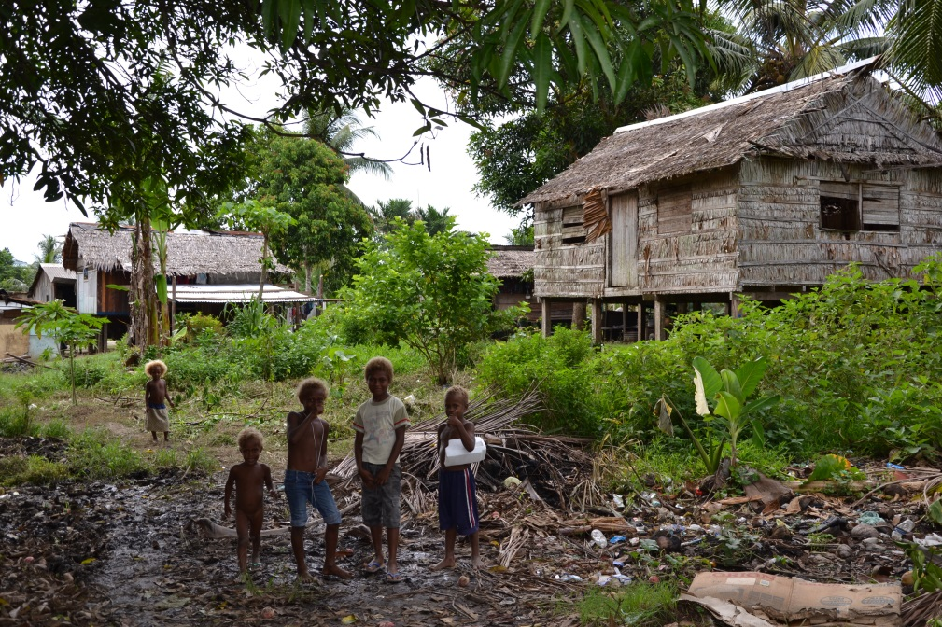
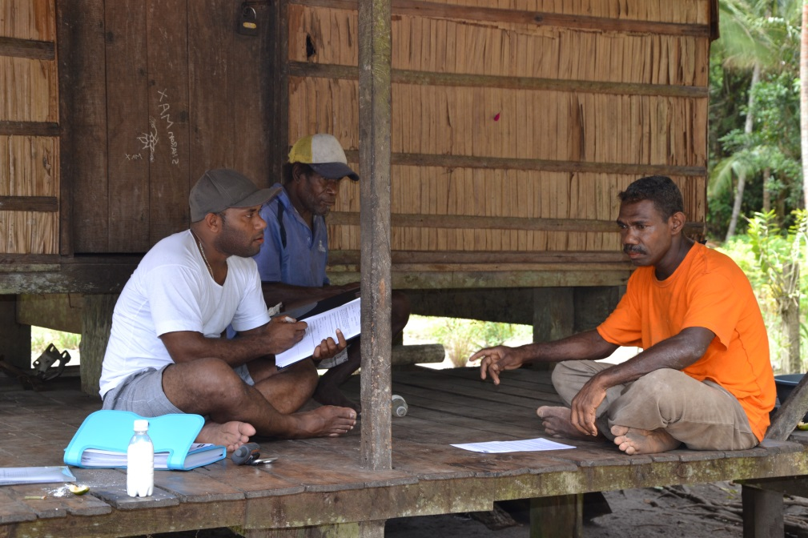
Summary
Systems models can offer great capacity to evaluate climate threats and examine adaptation options.
We need to consider human and ecosystem conditions together, in an integrated way to achieve:
Sustainable development goals
Climate resilience
An integrated (IWRM) approach to tackling SDG 6 offers a great opportunity to support development throughout the Pacific, without risking the region’s limited resources.

Slide 13
PACCWASH - Pacific Adaptation to Climate Change for WaSH Project Acknowledgements
Research team: Wade Hadwen, Principle Investigator, Griffith University Morgan MacDonald, Griffith University Terence Chan, Monash University Mark Elliott, University of Alabama Bronwyn Powell, Palladium Group/University of Queensland
Annika Kearton, Project Manager, International WaterCentre
Advisors:
Jamie Bartram, University of North Carolina Wolfgang Gernjak, University of Queensland
William Aalbersberg, University of the South Pacific
Regina Souter, International WaterCentre
A special ‘Thank you’ to the research participants.
Local research assistants: Hilda Rade Trevor Bruce Palusi Patricia Kennedy Dustin Langidrik Malynne Joseph
Research supported by the Australian Government
Australian Development Research Award Scheme

