Slide 1

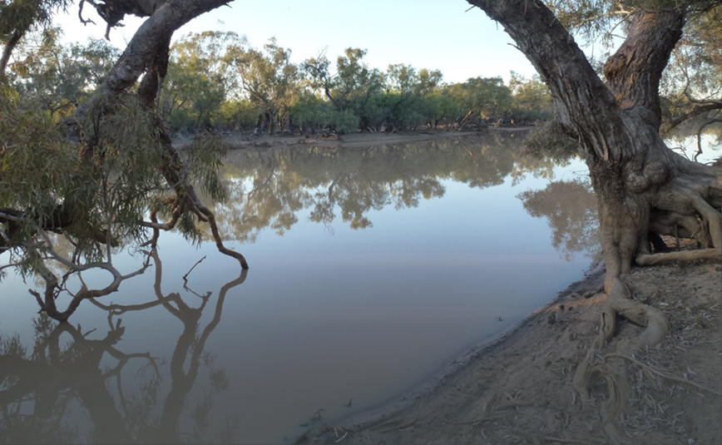

A spatio-temporal assessment of the impact of climate change on hydrological refugia in Eastern Australia using the Budyko water balance framework
Luke Kidd - BMT WBM
Dr Danielle Verdon-Kidd - University of Newcastle
BRISBANE, AUSTRALIA | 18 - 20 SEPTEMBER 2017
MANAGED BY

Slide 2
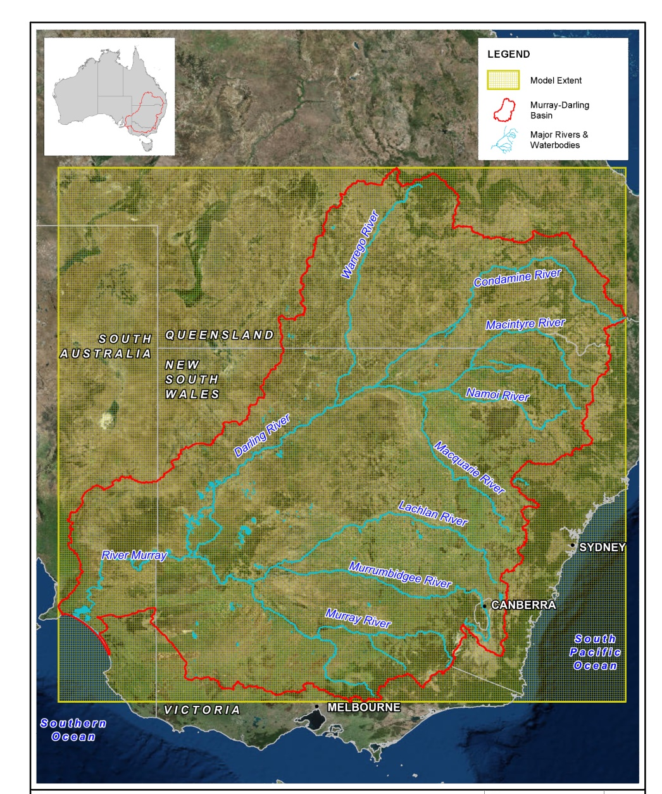
Project Background
Climate change is an important consideration for the MDB and greater eastern Australia due to its size, environmental and economic values
The spatial distribution of water availability is an important aspect for identifying hydrological refugia
Study aims:
  Characterise current and future water balance
  Identify locations with climatic and hydrological qualities predicted to remain stable under climate change

Slide 3

Methodology – Runoff Model
Runoff Model
    Budyko (1974) model
    Simulated historical and future hydrology
    Estimate of runoff and soil moisture across the Basin each month
    Model is simple but yields estimates similar to more complex hydrological models at monthly / annual scale
        SIMHYD, Sacramento, GR4J | GSSHA, LISFLOOD
    ‘Bucket modelling’ approach
    Model input/output in a spatial (raster) format
        allows for easily integration with other datasets
      Data requirements – precipitation, soil storage capacity, PET (based on temperature)

Slide 4
Methodology - Data
Climate
    AWAP
        historical (1970–2010) used as a baseline
        rainfall and temperature data
        spatially interpolated at monthly intervals
        5 km by 5 km resolution
    NARCLiM
        12 near future (2030) climate change scenarios (ensemble) run using a single, representative emissions scenario: the IPCC high emissions scenario A2
        rainfall and temperature data
        downscaled from GCM’s at monthly intervals
        10 km by 10 km resolution

Slide 5
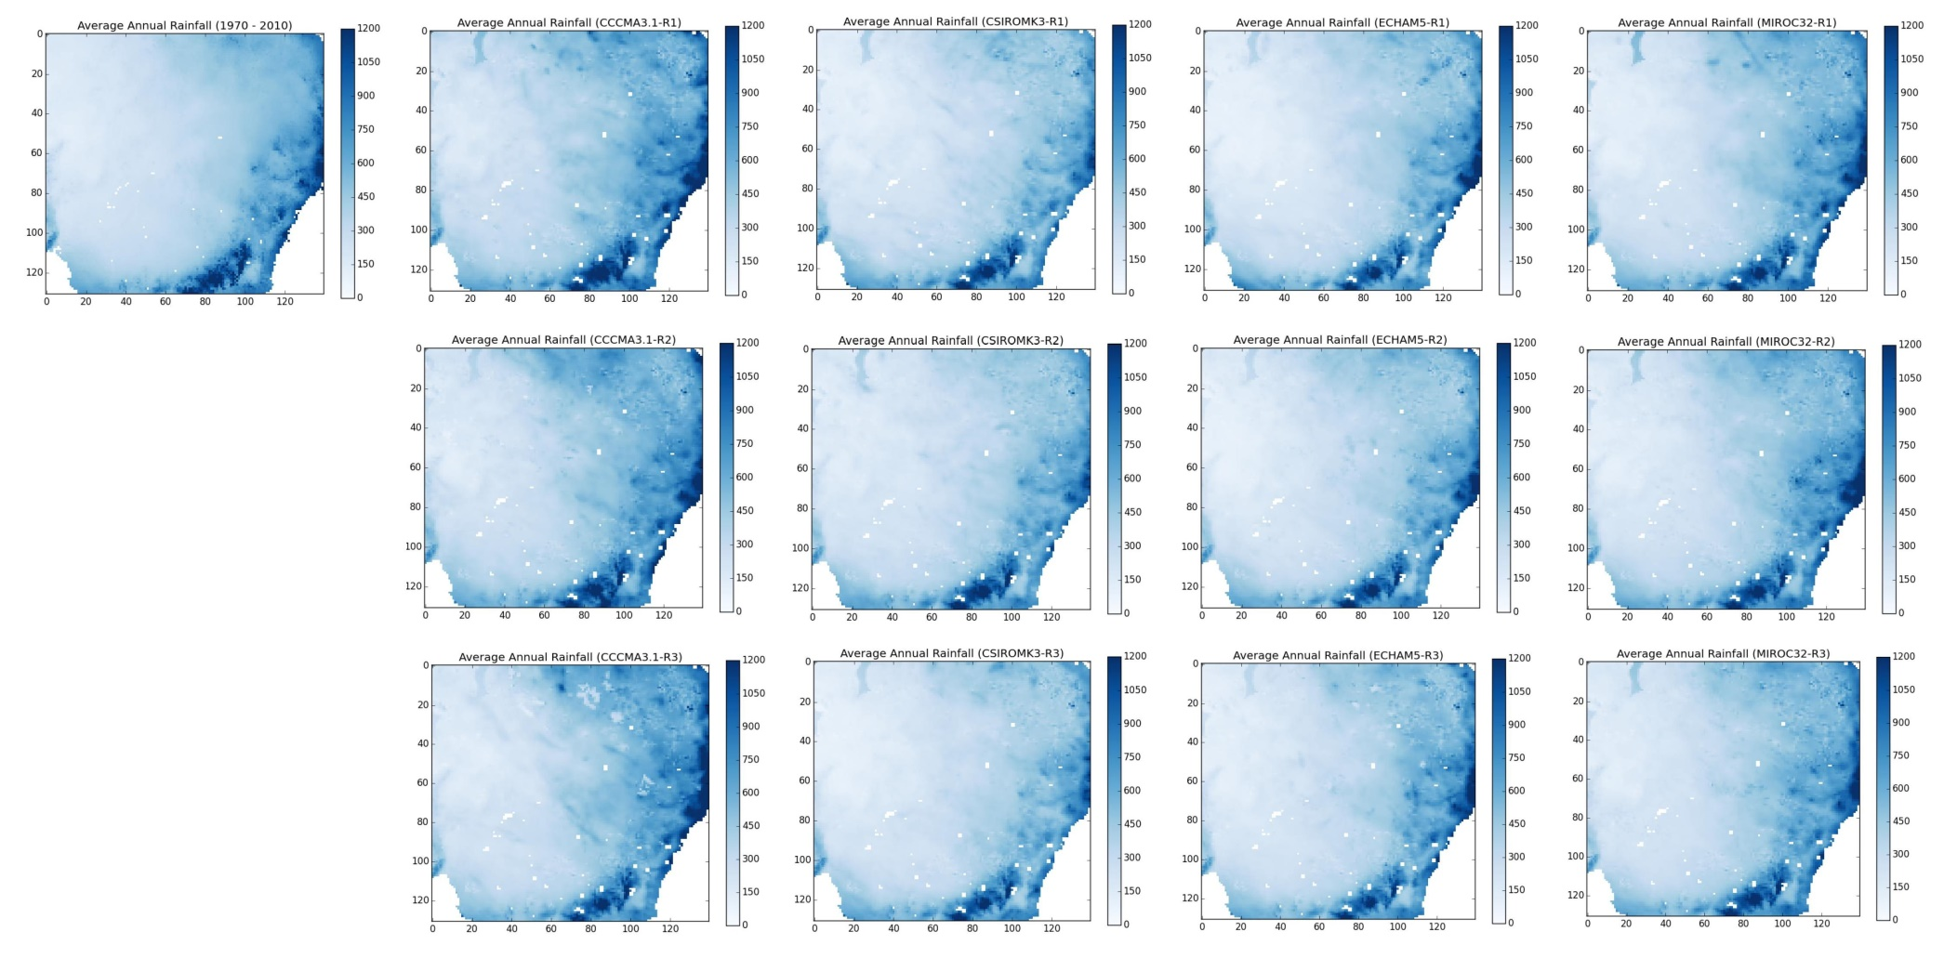
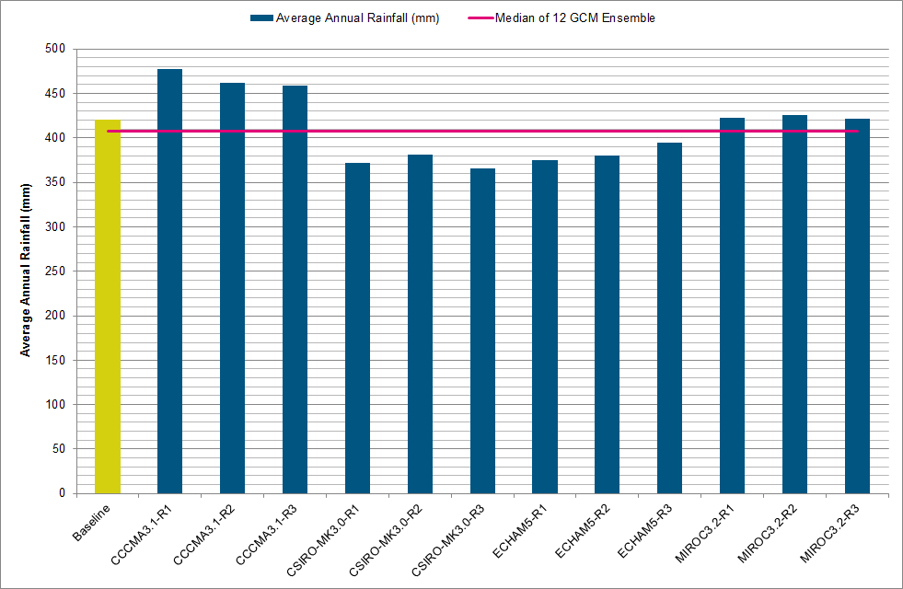
Methodology - Data
Climate forcing data (rainfall)

Slide 6
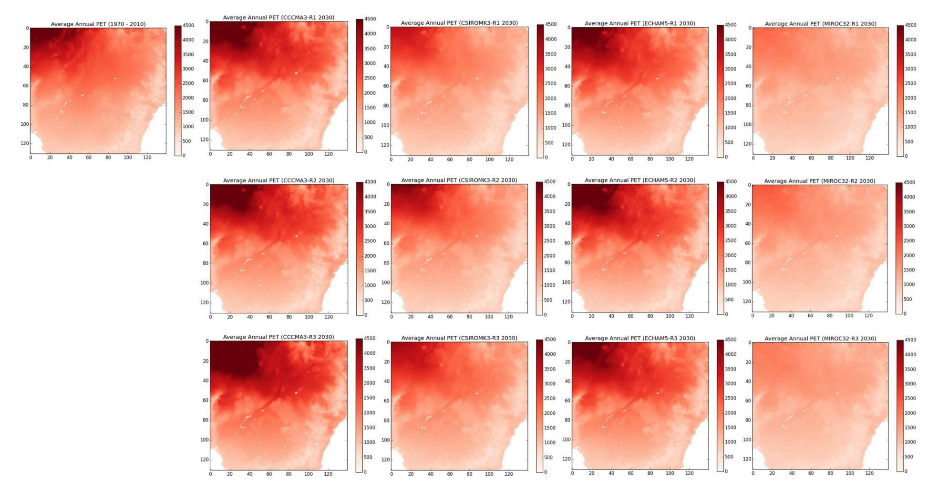
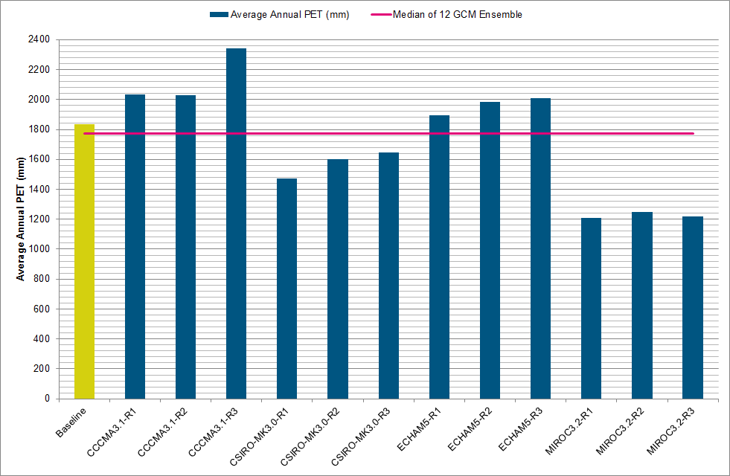
Methodology – Data
Climate forcing data (PET)

Slide 7
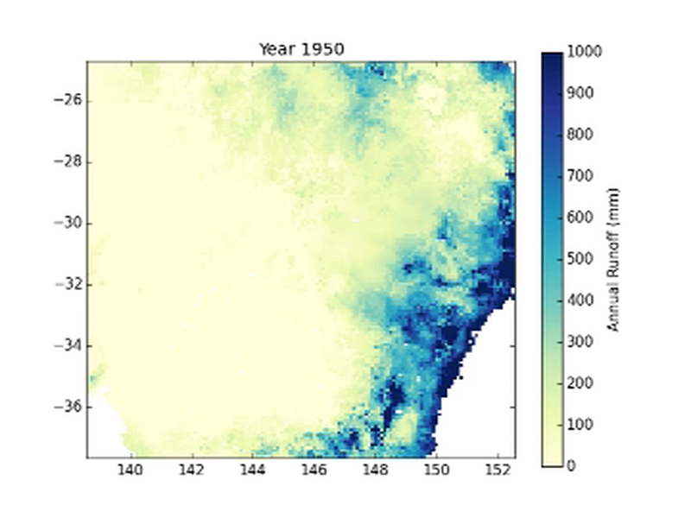
Results – Current Water Balance
    Average annual runoff estimated for historical climate

Slide 8
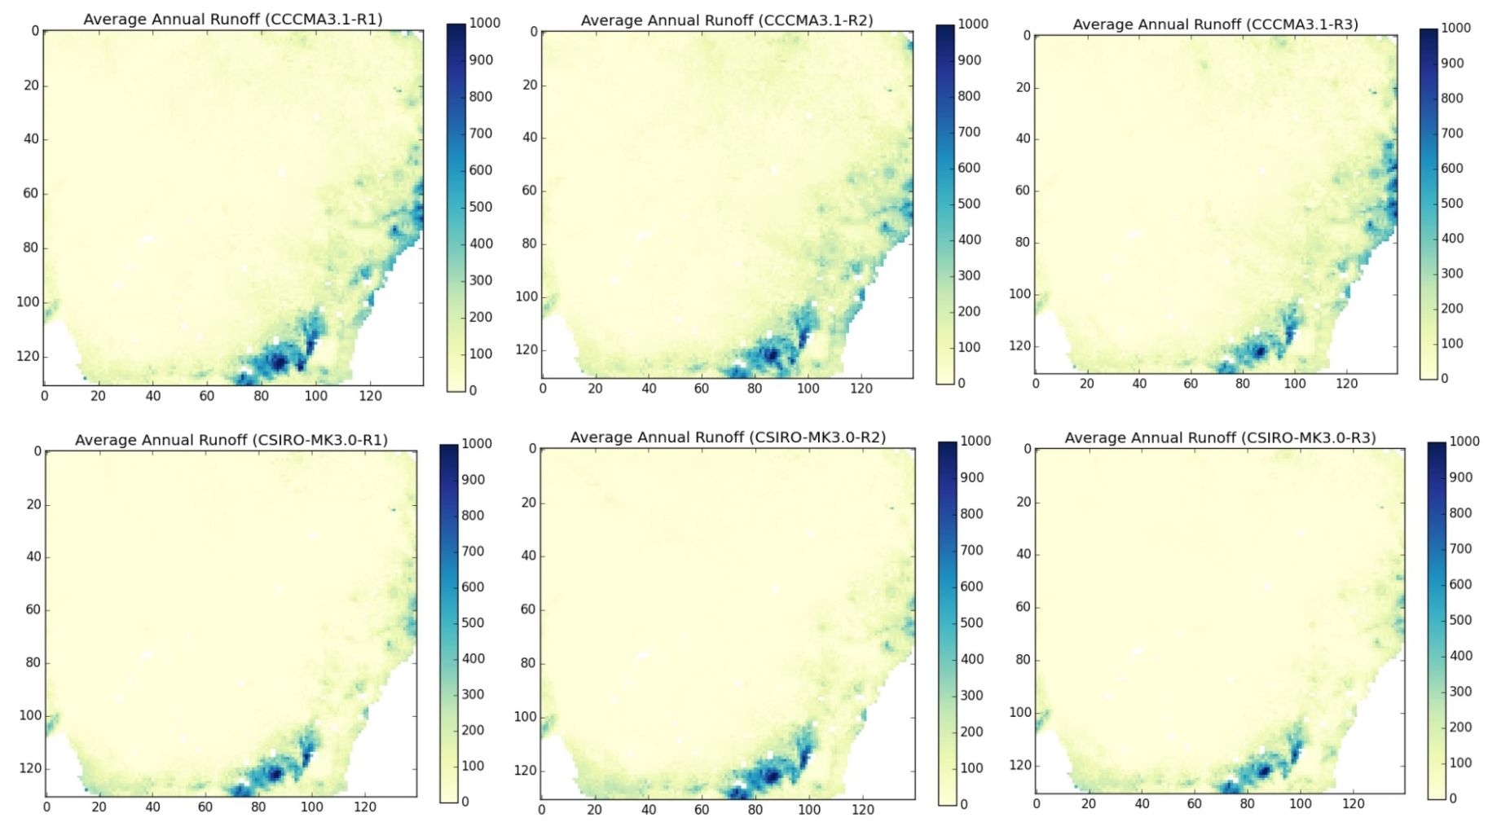
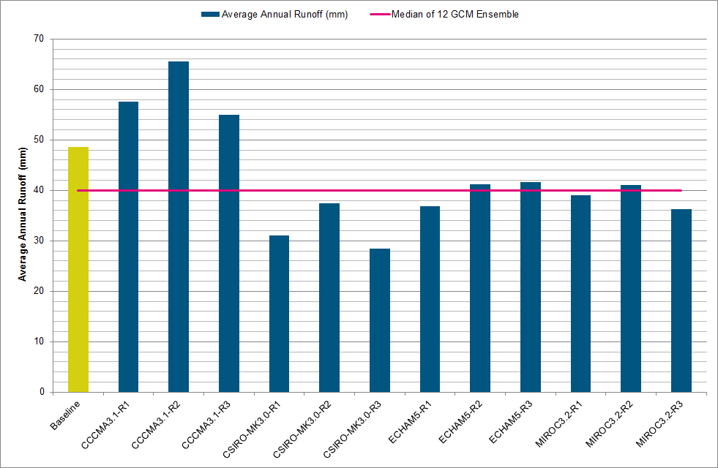
Results – Future Water Balance
Comparison of Average Annual Runoff for 2030 across models

Slide 9
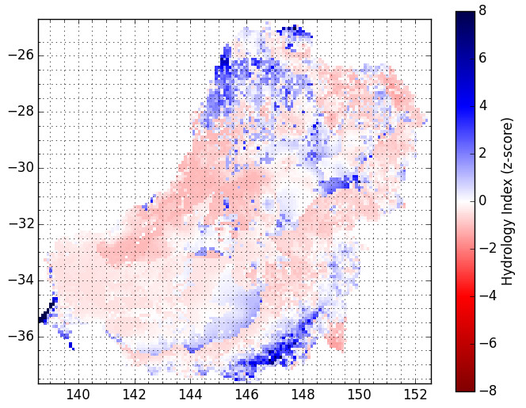
Results – Hydrologic Index
Z-scores
Average annual runoff converted to a grid of z-scores for each future scenario of the ensemble
three hydrologic index rasters calculated:
  extreme dry (10%ile z-score)
  median (50%ile z-score)
  extreme wet (90%ile z-score)
Areas with a positive (negative) index shown in blue (red)
The magnitude of the index is the number of standard deviations above (or below) the mean
Baseline Climate

Slide 10
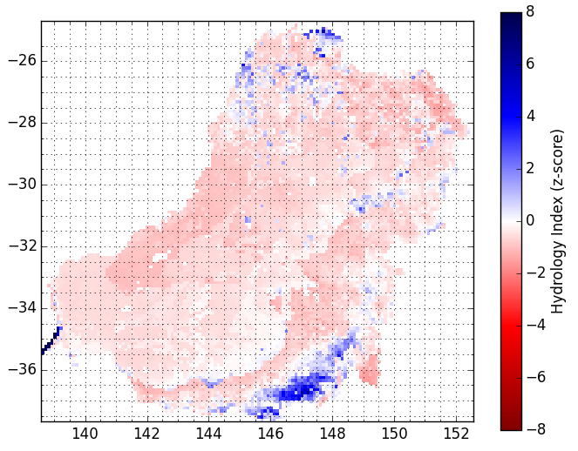
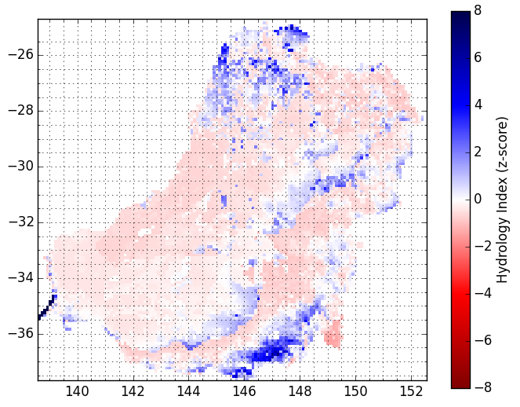
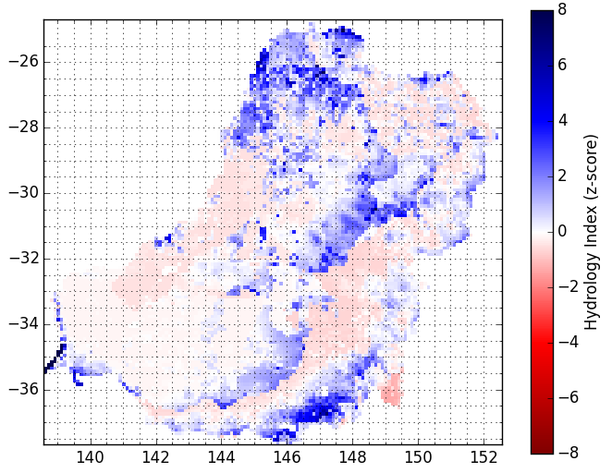
Results – Hydrologic Index
Extreme Dry (10%ile)
Extreme Wet (90%ile)
Median (50%ile)

Slide 11
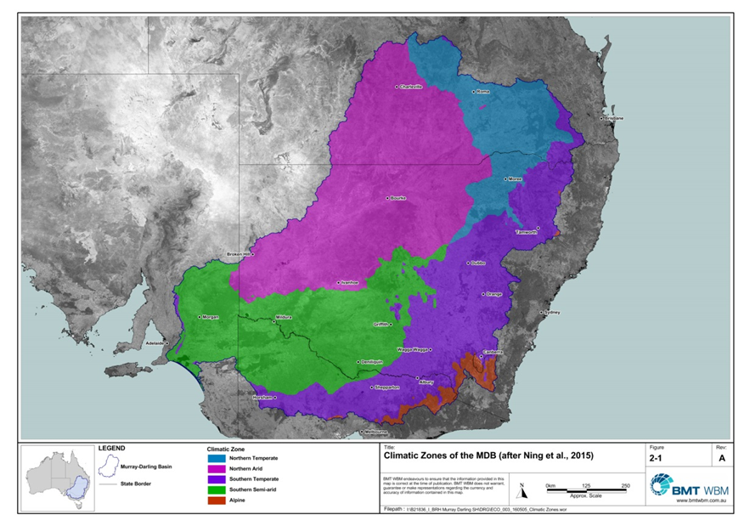
Results – Hydrologic Index
Areas of Significance
      If median climate projection were to be realised the future water balance would be similar to the historical
      If extreme dry climate was to be realised, hydrological refuges may be limited to the alpine region in the southeast and some scattered areas to the north within the northern arid and northern temperate climate zones
      If an extreme wet climate were to be realised, hydrological refuges may expand within the northern arid and southern semi-arid climate zones

Slide 12
Summary
The Budyko framework is useful for spatio-temporal modelling to identify board changes in water balance across large areas of Eastern Australia
High resolution NARCLiM data is useful for such an assessment
Potential for finer time step modelling to resolve temporal patterns
Existing modelling could be used to identify case study locations of significant change
Further catchment scale modelling would be required to investigate a broader range of potential hydrological responses important for aquatic and terrestrial ecosystems (e.g. flow regime changes)

Slide 13
Thank you

