Slide 1
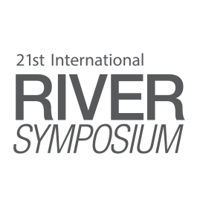

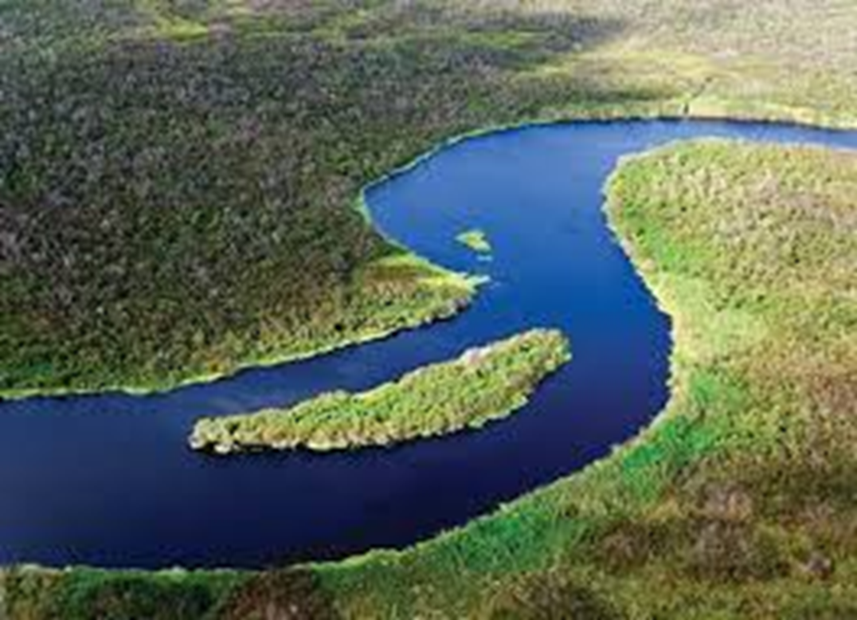

The Brisbane Declaration and Global Action Agenda on
Environmental Flows
2007-2018
Angela H Arthington
Australian Rivers Institute
SYDNEY, AUSTRALIA | 14 -18 October 2018
MANAGED BY

Slide 2
10th Annual International Riversymposium & Environmental Flows Conference, Brisbane, September 2007
750 delegates from over 50 countries produced:
The Brisbane Declaration 2007 http://riversymposium.com/about/brisbane-declaration/
A new definition of e-flows
7 e-flow principles
7-point Global Action Agenda to protect rivers globally by maintaining or restoring environmental flows
SYDNEY, AUSTRALIA | 14 -18 October 2018
MANAGED BY

Slide 3
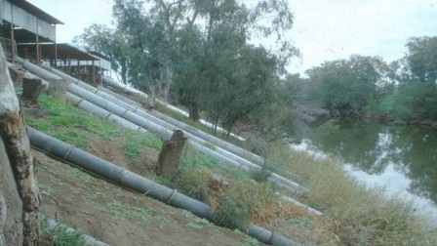
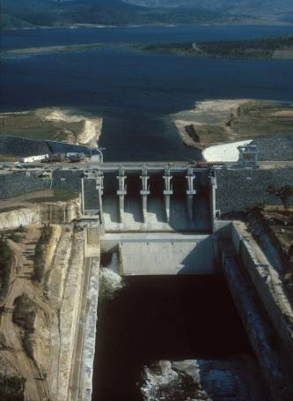
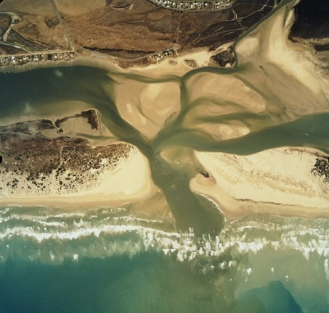
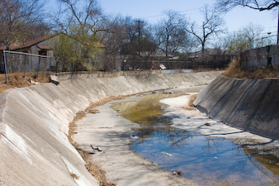
                The Brisbane Declaration 2007
                Freshwater and estuarine ecosystems have evolved with, and depend upon, naturally variable flows of high-quality fresh water
                Flow alteration imperils freshwater and estuarine ecosystems
Flaming Gorge Dam 1963
Lytle & Poff (2004). Trends in Ecol. Evol.
SYDNEY, AUSTRALIA | 14 -18 October 2018
MANAGED BY

Slide 4
Global Action Agenda 2007
Estimate and implement e-flows globally
Integrate water quality management
Integrate e-flows into land and water management
Identify a network of free-flowing rivers
Establish institutional frameworks
Actively engage all stakeholders
Build capacity and learn by doing
SYDNEY, AUSTRALIA | 14 -18 October 2018
MANAGED BY

Slide 5
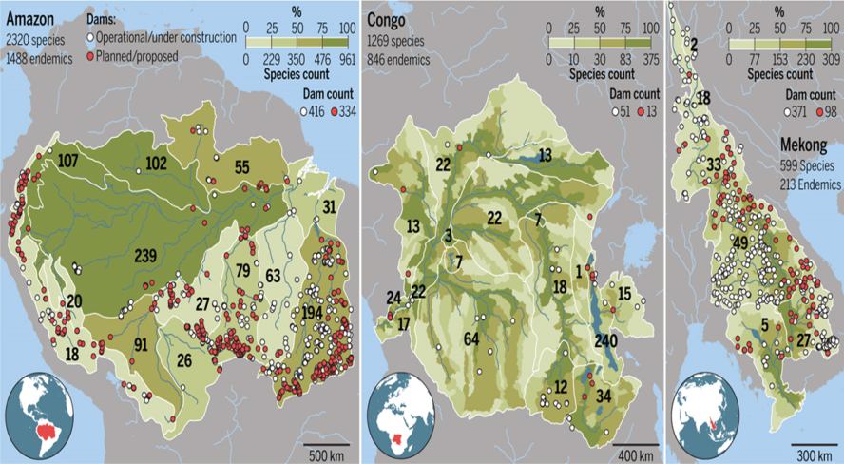
Immense progress with environmental flows yet – major challenges remain:
Renewed dam building threatens 33% of global freshwater fishes
48% of river volume is already regulated
>90% will be regulated if all dams are built
Human water demands are increasing fast
New threats are emerging from climate change –
drought, floods, fire, species shifting range,
new invasive species, and diseases
Huge demand for river restoration
Implementation of environmental flows is now
more urgent than ever
Winemiller et al. 2016. Science
SYDNEY, AUSTRALIA | 14 -18 October 2018
MANAGED BY

Slide 6

The Brisbane Declaration and Global Action Agenda on Environmental Flows 2018
A six-month consultation process with colleagues and symposium delegates before, during and after the 2017 Riversymposium produced:
a revised definition of environmental flows
a renewed declaration – 6 statements
35 actionable recommendations
an international open-access publication
SYDNEY, AUSTRALIA | 14 -18 October 2018
MANAGED BY

Slide 7
Renewed definition of environmental flows
“Environmental flows describe the quantity, timing, and quality of freshwater flows and levels necessary to sustain aquatic ecosystems which, in turn, support human cultures, economies, sustainable livelihoods, and well-being”
Aquatic ecosystems dependent on freshwater
springs, streams, rivers, riparian, floodplain and other wetlands, ponds, lakes, coastal waterbodies, lagoons and estuaries, and groundwater-dependent ecosystems
SYDNEY, AUSTRALIA | 14 -18 October 2018
MANAGED BY

Slide 8
2018 Declaration Statements
E- flows are essential to protect and restore biodiversity, aquatic ecosystems, and the ecosystem services they provide to people of for all societies
E-flows are critical to protect and safeguard the world’s cultural and natural heritage
E-flows have been compromised and today many aquatic systems around the world are at risk
SYDNEY, AUSTRALIA | 14 -18 October 2018
MANAGED BY

Slide 9
2018 Declaration Statements
Implementation of e-flows requires a complementary suite of policy, legislative, regulatory, financial, scientific and cultural measures to ensure effective delivery and beneficial outcomes
Local knowledge and customary water management practices can strengthen e-flow planning, implementation, and sustainable outcomes
Climate change increases the risk of aquatic ecosystem degradation and intensifies the urgency for action to implement e-flows
SYDNEY, AUSTRALIA | 14 -18 October 2018
MANAGED BY

Slide 10
2018 Global Action Agenda
A call for concerted action to achieve beneficial outcomes from environmental flows and wise freshwater management for people, biodiversity and ecosystems
35 actions are recommended
Leadership and Governance 13 action items
Management 12 action items
Research 10 action items
SYDNEY, AUSTRALIA | 14 -18 October 2018
MANAGED BY

Slide 11
Local knowledge and customary water management practices can strengthen environmental flow planning, implementation, and sustainable outcomes
Leadership and Governance | Management | Research
Develop and implement arrangements for full and equal participation, and respect for the rights, responsibilities and systems of governance, of all cultures and stakeholders in e-flow planning, assessment, implementation, monitoring and adaptive management | Empower and ensure the full and equal participation, and respect for the rights, responsibilities and systems of governance, of all cultures and stakeholders in e-flow planning, assessment, implementation, monitoring, and adaptive management | Co-develop best-practice models to ensure full and equal participation, and respect for the responsibilities, rights and systems of governance of all cultures and stakeholders in e-flow planning, assessment, implementation, monitoring, and adaptive management
SYDNEY, AUSTRALIA | 14 -18 October 2018
MANAGED BY

Slide 12
  Publishing the Declaration
POLICY AND PRACTICE REVIEWS ARTICLE
Frontiers in Environmental Science, 02 July 2018 https://doi.org/10.3389/fenvs.2018.00045
The Brisbane Declaration and Global Action Agenda on Environmental Flows (2018).
Angela H. Arthington^{1*}, Anik Bhaduri², Stuart E. Bunn¹, Sue E. Jackson¹, Rebecca E. Tharme^{1,2,3}, Dave Tickner⁴, Bill Young⁵, Mike Acreman⁶, Natalie Baker⁷, Samantha Capon¹, Avril C. Horne⁸, Eloise Kendy⁹, Michael E. McClain^{10,11}, N. LeRoy Poff^{12,13}, Brian D. Richter¹⁴ and Selina Ward¹⁵
SYDNEY, AUSTRALIA | 14 -18 October 2018
MANAGED BY

Slide 13
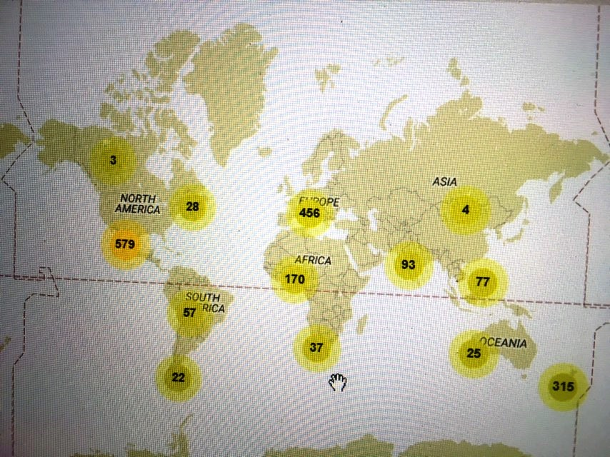
Global exposure of the Declaration
2297 views since 2 July 2018
SYDNEY, AUSTRALIA | 14 -18 October 2018
MANAGED BY

Slide 14




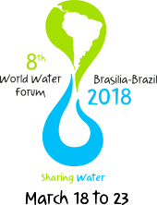
Using the E-flows Declaration
Global policy forums & processes
Regional & national policies
Local policies & programs
Basin & river-scale programs & projects
Education & training programs
SYDNEY, AUSTRALIA | 14 -18 October 2018
MANAGED BY

