Slide 1


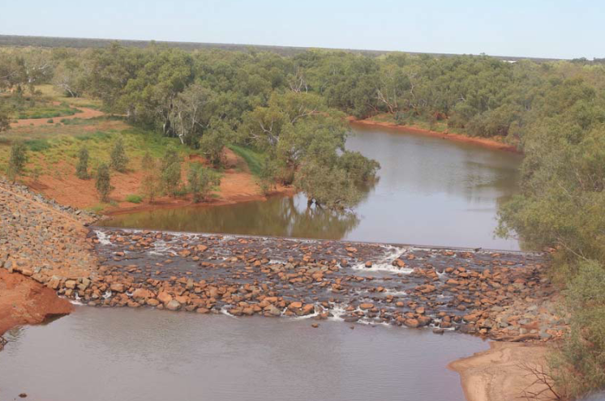

Transforming agriculture in the Pilbara through river and groundwater-fed irrigation
Kate Dowsley (Jacobs), Chris Schelfhout (DPIRD)
SYDNEY, AUSTRALIA | 14 -18 October 2018
MANAGED BY

Slide 2
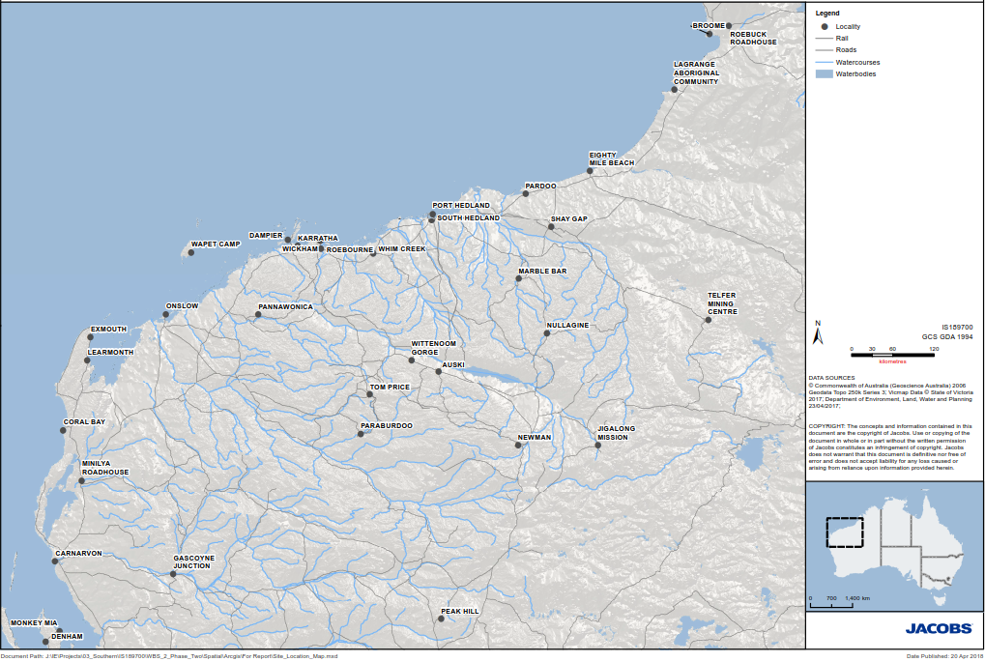
Notes:
Pilbara – NW
Looks very wet, but all the rivers are dry. Flows

Slide 3
Drivers for irrigated agriculture in the Pilbara
Economic:
  ‘monoculture economy’ (mining = 60% employment)
  need for diversification
Political – ‘growing the north’
Climate – extreme
SYDNEY, AUSTRALIA | 14 -18 October 2018
MANAGED BY

Slide 4
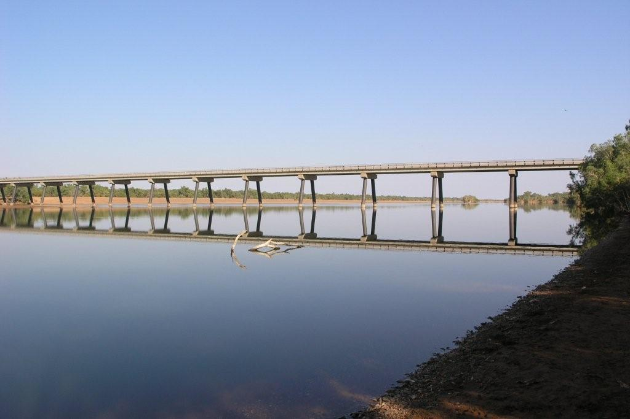
Extreme climate
Notes:
What is driving this current focus on irrigated agriculture in the North/Pilbara?
Forecast supply periods of iron ore is 50 yrs, natural gas is 80 yrs (Green et al 2014)
‘Monoculture economy’ - irrigation needed to increase the diversity of the economy in the Pilbara
WA Gov strategy is to triple GVAP by 2050.
Big rainfall deficit, even in the wettest months. Shows that a crop’s entire water requirement needs to be provided by irrigation.
River flows last for a few weeks.

Slide 5
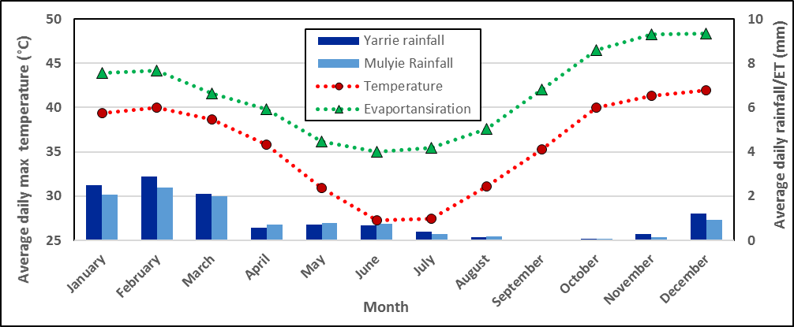
Extreme climate
Notes:
What is driving this current focus on irrigated agriculture in the North/Pilbara?
Forecast supply periods of iron ore is 50 yrs, natural gas is 80 yrs (Green et al 2014)
‘Monoculture economy’ - irrigation needed to increase the diversity of the economy in the Pilbara
WA Gov strategy is to triple GVAP by 2050.
Big rainfall deficit, even in the wettest months. Shows that a crop’s entire water requirement needs to be provided by irrigation.
River flows last for a few weeks.

Slide 6
Why groundwater?
Four key drivers for using groundwater instead of surface water:
Seasonal imbalance in water availability
Significant evaporation losses from dams
Scalability
Cost of transporting water
SYDNEY, AUSTRALIA | 14 -18 October 2018
MANAGED BY

Slide 7
Objectives
To identify a sustainable water source to support development of irrigation agriculture in the Pilbara
Focussing on the use of groundwater augmented by Managed Aquifer Recharge (using a weir)
SYDNEY, AUSTRALIA | 14 -18 October 2018
MANAGED BY

Slide 8
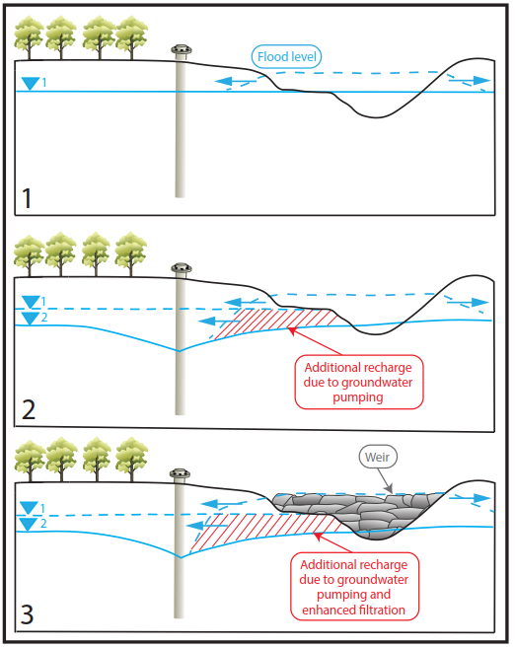
Concept for water supply
Flood flows infiltrate into aquifer
Infiltration of flood flows enhanced by lowering the watertable
Infiltration further enhanced by delaying flood using a weir
SYDNEY, AUSTRALIA | 14 -18 October 2018
MANAGED BY

Slide 9
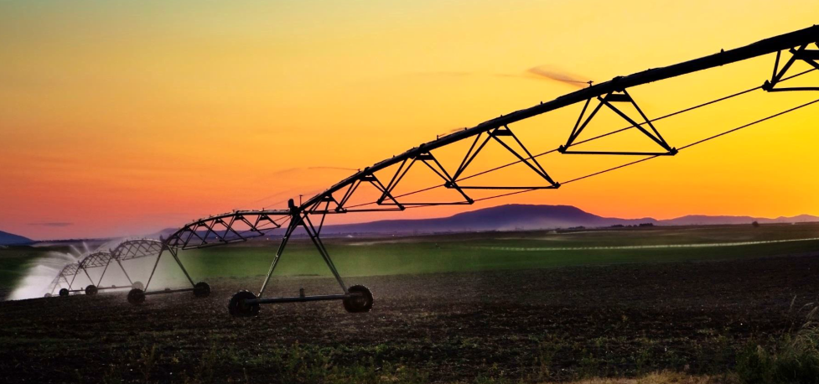
Irrigation scheme
PDC Pilbara Regional Investment Blueprint
SYDNEY, AUSTRALIA | 14 -18 October 2018
MANAGED BY

Slide 10
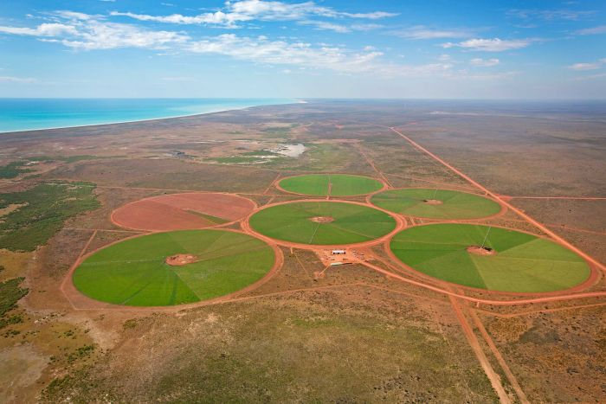
Irrigation scheme
PDC Pilbara Regional Investment Blueprint
ABC Rural 2018-10-10
SYDNEY, AUSTRALIA | 14 -18 October 2018
MANAGED BY

Slide 11
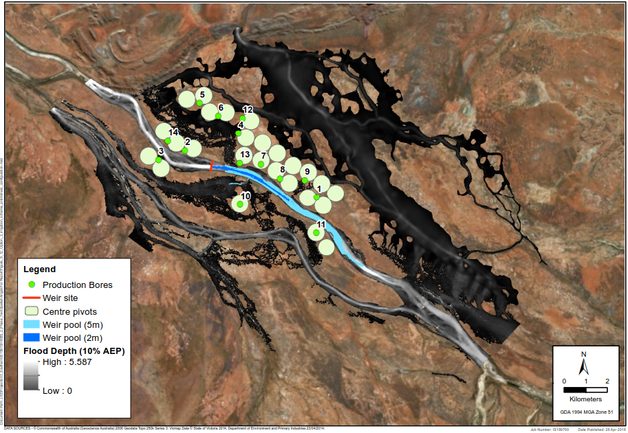
De Grey station irrigation scheme
30 GL
140 GL
28 GL
SYDNEY, AUSTRALIA | 14 -18 October 2018
MANAGED BY

Slide 12
Water supply reliability
SYDNEY, AUSTRALIA | 14 -18 October 2018
MANAGED BY

Slide 13
Cost benefit analysis
Cropping scenarios:
Mixed fodder / Sweet potatoes / Feed grain (lupins)
Findings:
Sweet potatoes are always economic
Mixed fodder is marginal – could be economic if power costs reduced
Cost of water:
Levelised cost – off farm: $120/ML
Levelised cost – on farm: $185/ML
i.e. very low
SYDNEY, AUSTRALIA | 14 -18 October 2018
MANAGED BY

Slide 14
Conclusions
Groundwater can support large irrigation enterprises
Significantly cheaper than surface water development
Surface water flows are important for replenishing groundwater = sustainability of supply
Weir is likely to be important for long-term sustainability
Economic for certain crop types
Opportunity is to find the most economic agricultural enterprise
SYDNEY, AUSTRALIA | 14 -18 October 2018
MANAGED BY

