Slide 1
SYDNEY, AUSTRALIA | 14 -18 October 2018
MANAGED BY

Slide 2
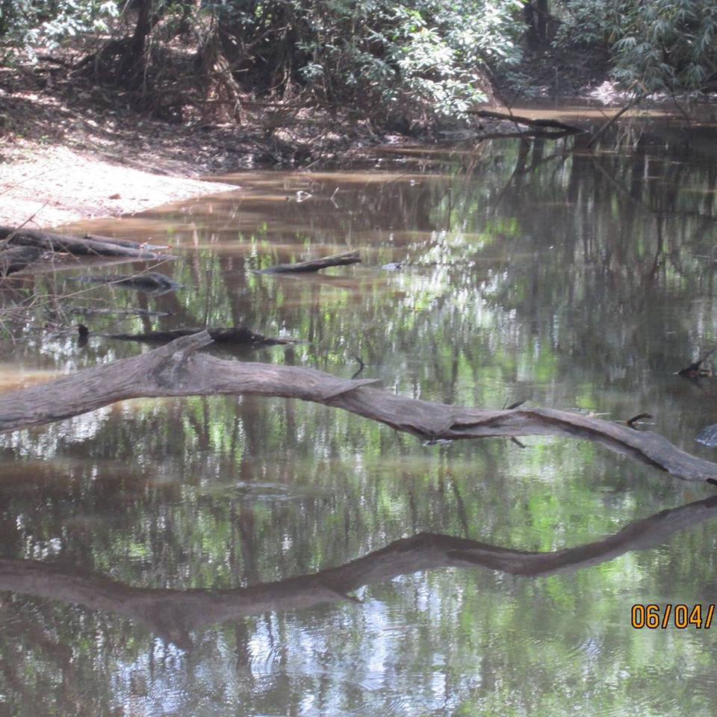
Topic:
Enhancing integrated river management for sustainable communities development,
long-term sustainability,
healthy river ecosystem,
capacity building
SYDNEY, AUSTRALIA | 14 -18 October 2018
MANAGED BY

Slide 3
Objectives
*To improve integrated river management for sustainable
development;
* To improve healthy river ecosystem;
* To improve capacity building .
SYDNEY, AUSTRALIA | 14 -18 October 2018
MANAGED BY

Slide 4
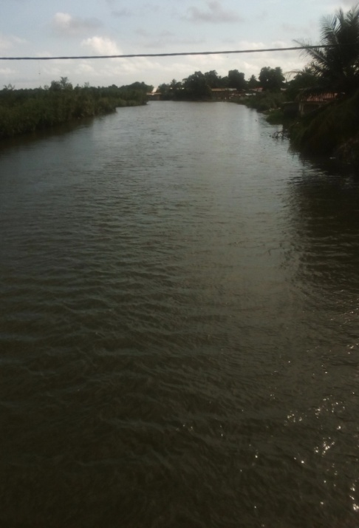
Despite the vast research in Integrated River Basin Management (IRBM) little had been known of how to manage and implement. This situation has become a major challenge today. One way to ensure integrated river basin management is through ecosystem approach.
Body of the Presentation
St. Paul River, Liberia
SYDNEY, AUSTRALIA | 14 -18 October 2018
MANAGED BY

Slide 5
Continuation OF Body
According to the World Health Organization study on the MDGS, over 1.7 billion people live in river basins where water exceeds recharge, leading to the desiccation of river, depletion of ground water and the degradation of ecosystem. Two- thirds of the world’s population will live in water – stressed countries by 2025 if the current consumption patterns continue.
SYDNEY, AUSTRALIA | 14 -18 October 2018
MANAGED BY

Slide 6
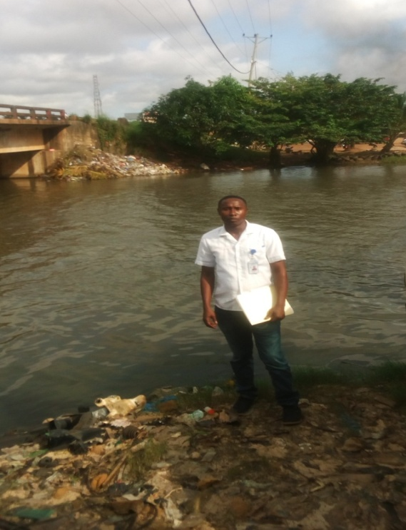
Methodology
Ecosystem approach was used as an appropriate scientific method to focus on the essential structure, processes, functions, and interactions organism and their environment. It recognizes that humans, with their cultural diversity, are integral l component of the ecosystem. The approach is also essential in guiding action in river basin management.
Du River, Liberia
SYDNEY, AUSTRALIA | 14 -18 October 2018
MANAGED BY

Slide 7
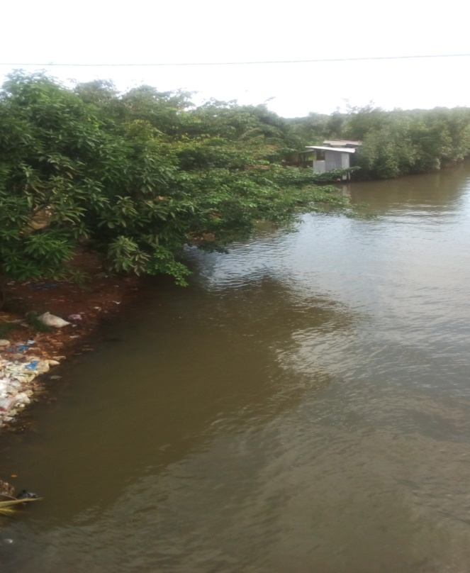
Finding
The findings have a significance impact for integrated river basin management. It shows that there is a lack of information on the plan for the protection and improvement of the environment, lack of jurisdictional and speedily intervention, poverty barriers, political implication and changing climate.
Cestos River, Liberia
SYDNEY, AUSTRALIA | 14 -18 October 2018
MANAGED BY

Slide 8
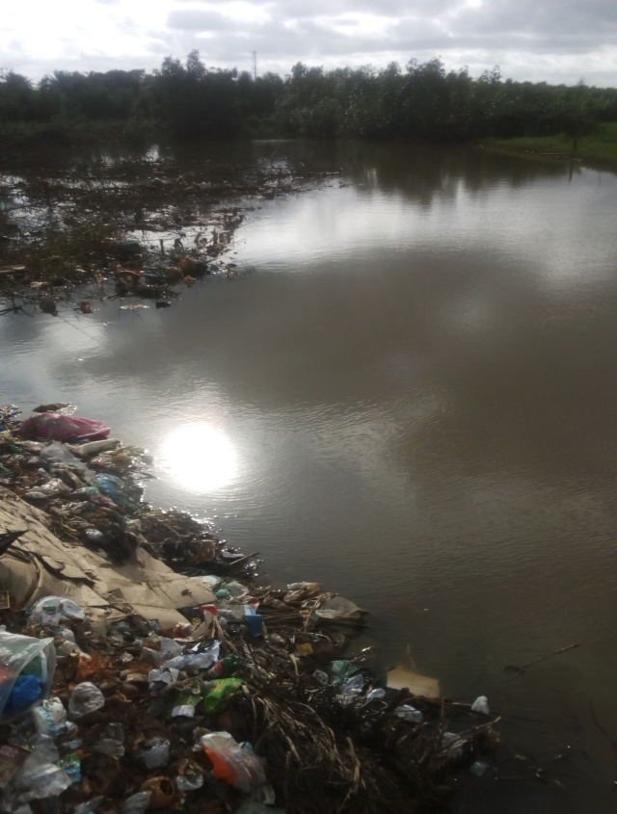
Achievements
Improve conceptual framework to facilitate the
implementation of IRBM;
Influence legislators of urbanization on water
demand and educated the public on integrated river management and it important.
SYDNEY, AUSTRALIA | 14 -18 October 2018
MANAGED BY

Slide 9
Lesson Learned
The closer the management is to ecosystem, the greater the responsibility, accountability, participation and use of local knowledge. This method of ecosystem approach represent the appropriate communities of interest, produce superior knowledge with capacity to identified particular aspects of management, ensuring that decision are nested and linked to sharing information and expertise, and good communication.
SYDNEY, AUSTRALIA | 14 -18 October 2018
MANAGED BY

Slide 10
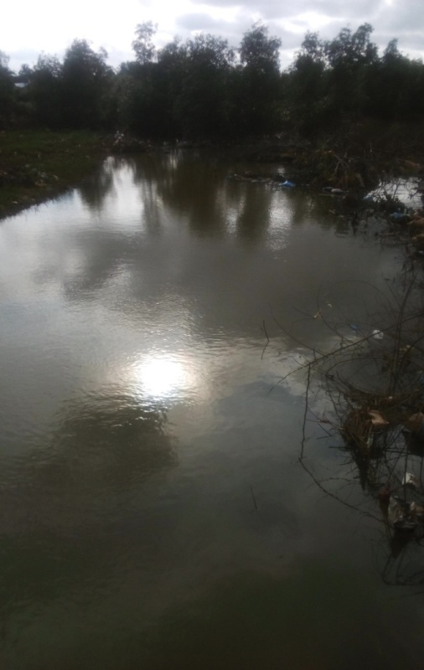
Conclusions
Conclusions
Integrated river basin management specialists should be legally strengthened, empowered and protected. Planning and decision-making should be separated; and institutional development, legislation and public participation at all level should be given credence.
SYDNEY, AUSTRALIA | 14 -18 October 2018
MANAGED BY

