Slide 1






FRAMEWORK FOR REGIONAL EVALUATIONS OF
E-FLOWS IN THE NILE BASIN.
Gordon O’Brien¹, Chris Dickens², Abdulkarim Seid³, Mohsen Alarabawy³, Sebastian Bubmann⁴ and Georg Petersen⁴
¹University of KwaZulu-Natal, College of Agriculture, Engineering and Science, School of Life Sciences, Private Bag X01, Scottsville, South Africa.
²International Water Management Institute, Private Bag X813, Silverton, 0127, South Africa.
³Nile Basin Initiative, Water Resources Management Department, P.O Box 192, Entebbe, Uganda
⁴HYDROC GmbH, AG Flensburg, HRB 10117, Germany
BRISBANE, AUSTRALIA | 18 - 20 SEPTEMBER 2017
MANAGED BY

Slide 2
Nile catchment is 3.3 million km², length >6500 km
Varying climates; e.g. rainfall decreases from 1500 to 0 mm/year
Runoff is generated at the Equatorial and Ethiopian Plateaus
11 Riparian states ~ 400mil people
River flow affected by:
  Natural variability : climate change/ climate
  Anthropogenic (Dam/Hydro development & abstraction)
NB SOCIO-ECOLOGICAL CONSEQUENCES!!!
BRISBANE, AUSTRALIA | 18 - 20 SEPTEMBER 2017
MANAGED BY

Slide 3
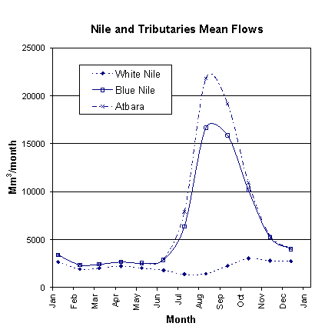
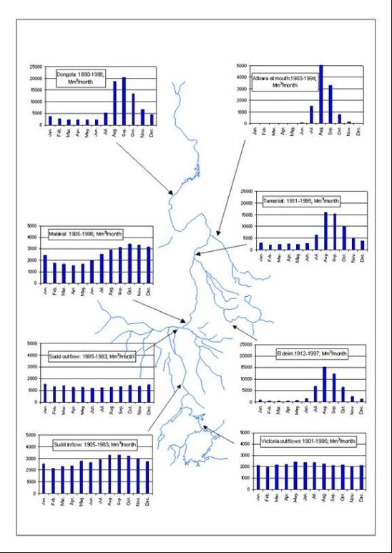
8650 m³/s
6350 m³/s
1500 m³/s
(Mean flow from 1910 to 1995, Source: Sutcliffe and Parks, 1999 )
BRISBANE, AUSTRALIA | 18 - 20 SEPTEMBER 2017
MANAGED BY

Slide 4
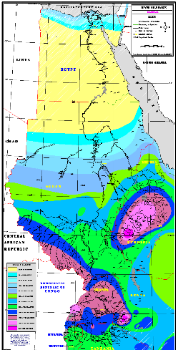
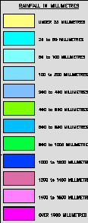
The spatial pattern of rainfall and evapotranspiration!
< 25
25 - 50
50 - 100
100 - 200
200-400
400 - 600
600 - 800
800 - 1000
1000 - 1200
1200 -1400
1400 - 1600
>1600
BRISBANE, AUSTRALIA | 18 - 20 SEPTEMBER 2017
MANAGED BY

Slide 5
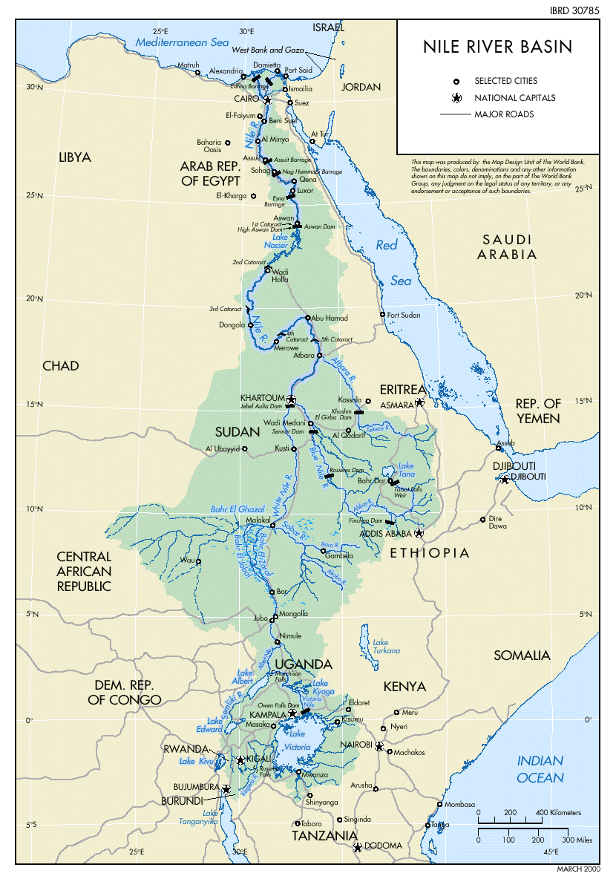
BRISBANE, AUSTRALIA | 18 - 20 SEPTEMBER 2017
MANAGED BY

Slide 6
1891 – Anglo-Italian protocol: Italian ≠ modify Nile River Flows.
1902 – Britain and Ethiopia: Ethiopia ≠ modify Nile River Flows (Blue Nile, Lake Tana, or the Sobat). Unless! Never ratified by Ethiopia.
1906 – Britain and Congo: Congo ≠ modify Nile River Flows (NB Lake Albert). Unless! Belgium signed this agreement.
1906 – Britain-France-Italy treaty to manage Nile Rifer Flow. Benefits Egypt.
1925 - Britain-Italy Re Lake Tana Recognising prior rights of Egypt and the Sudan, Ethiopia may not develop head waters of the Blue Nile and the White Nile (the Sobat). Ethiopia opposed agreement! Italy opposed agreement and proposed engagement with League of Nations.
BRISBANE, AUSTRALIA | 18 - 20 SEPTEMBER 2017
MANAGED BY

Slide 7
1929 – Egypt and Anglo-Egyptian Sudan:
  Egypt gets 48 bn m³ pa.
  Sundan gets 4 bn m³ pa.
  And flow of the Nile during January 20 and July 15 reserved for Egypt alone.
  Egypt reserves the right to monitor the Nile flow in the upstream countries.
  Egypt can develop Nile River without consent of upper riparian states.
  Egypt has right to veto other construction projects in Nile Basin
1959 - Nile Waters Agreement (Sudan and Egypt) for full control of utilization of the Nile waters including:
  Aswan High Dam (constructed 1960-1970) receives 84 bn m³ pa.
  Egypt gets 55.5 bn m³ pa.
  Sundan gets 18.5 bn m³ pa.
  Evaporation 10 bn m³ pa.
ONLY ±5 % of MAR

Slide 8

Egypt allocated ±5% of MAR of Nile River.
EWR requirements?
50% MAR lost to ET in SUDD
Massive losses from L. Victoria etc.
% of allocable flows?
BRISBANE, AUSTRALIA | 18 - 20 SEPTEMBER 2017
MANAGED BY

Slide 9
1999 - Nile Basin Initiative (NBI): Partnership among the Nile riparian states that “seeks to develop the river in a cooperative manner, share substantial socioeconomic benefits, and promote regional peace and security”.
2015 –NBI: The sustainable use of these socio-ecologically important water resources of the Nile Basin requires the coordinated management of the environmental flows (E-flows) on meaningful spatial scales. E-flows describe the quantity, quality and timing of water flows required to sustain freshwater and estuarine ecosystems and the human livelihoods and wellbeing that depend on these ecosystems (Brisbane Declaration, 2007).
To establish standards and norms for E-flows in the Nile Basin, NBI to develop a transboundary level guidance document on E-flows = Nile E-flows Framework.
BRISBANE, AUSTRALIA | 18 - 20 SEPTEMBER 2017
MANAGED BY

Slide 10
PLANNING, ALIGNMENT & GOVERNANCE SECTION
SCIENTIFIC EFA SECTION
BRISBANE, AUSTRALIA | 18 - 20 SEPTEMBER 2017
MANAGED BY

Slide 11
COLLABORATION
SHARING BENEFITS
EVIDENCE BASED
TRANSPARENCY
ADAPTABILITY
SUSTAINABILITY
REQUISITE SIMPLICITY
BEST E-FLOW MANAGEMENT PRACTICE PRINCIPLES
SCORE CARD

Slide 12
NILE E-FLOWS DATABASE
BRISBANE, AUSTRALIA | 18 - 20 SEPTEMBER 2017
MANAGED BY

Slide 13
BRISBANE, AUSTRALIA | 18 - 20 SEPTEMBER 2017
MANAGED BY

Slide 15
BRISBANE, AUSTRALIA | 18 - 20 SEPTEMBER 2017
MANAGED BY

Slide 16
Level I (Global scale)
Inland Systems
Estuarine Systems
Marine Systems
Level II (Regional)
Ecoregions
Sub-basins
Other frameworks
Level III (Landscape)
Bench
Plain
Slope
Valley floor
Level IV (Hydrogeomorphic)
Wetland flat
Seep
Depression/ open water body
Valley-bottom (Un-/channelled)
Floodplains
River
Level V (Hydrological)
Perenniality
Flooded/saturated period
Level VI (System characteristics)
Natural/Artificial
Salinity/pH
Vegetation cover type
Geology
Substrate Type

Slide 17
EFA

Slide 18
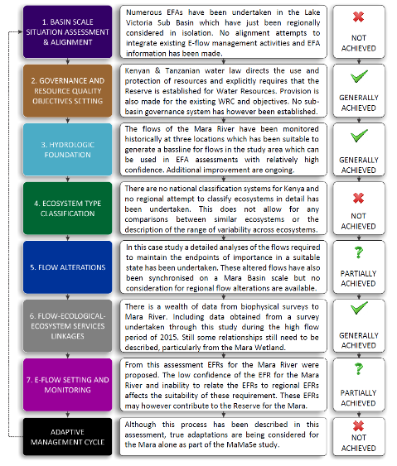
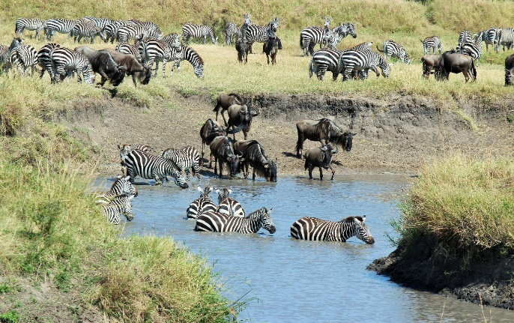
MARA RIVER BASIN EFA

Slide 19
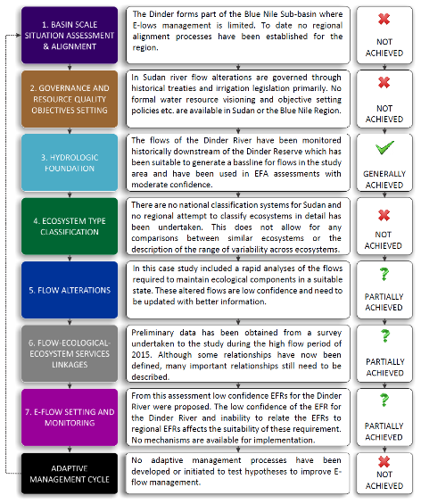
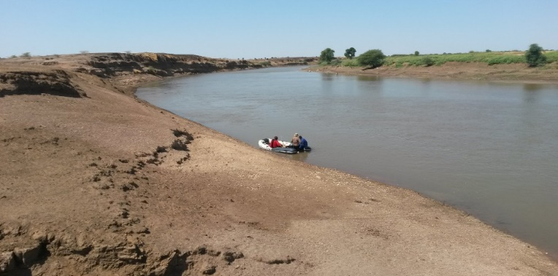
DINDER RIVER SITE EFA

Slide 20
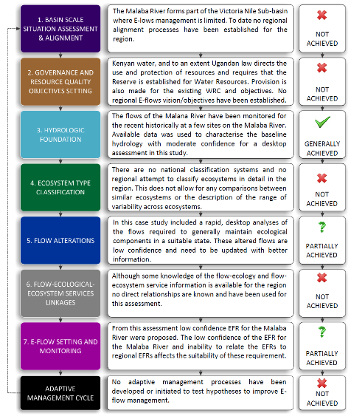
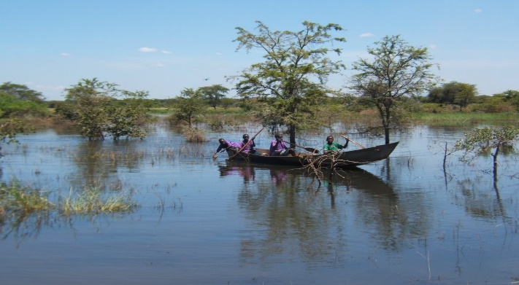
MALABA RIVER SITE EFA

Slide 21
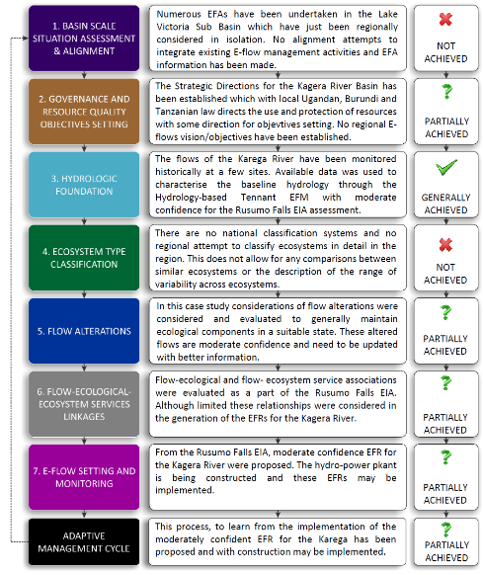
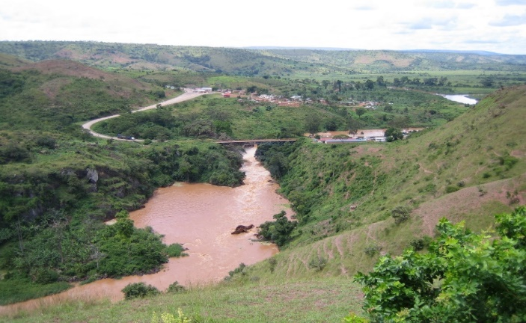
KAGERA RIVER SITE EFA

Slide 22
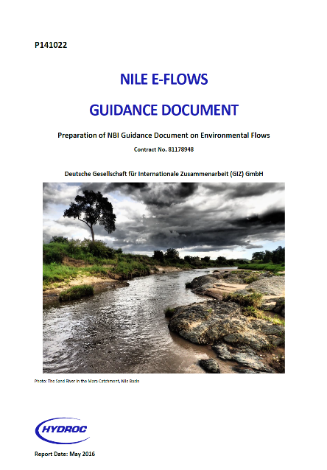
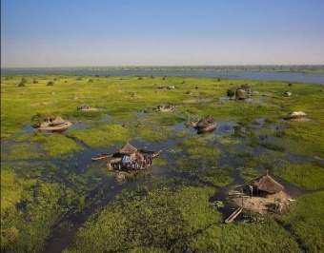
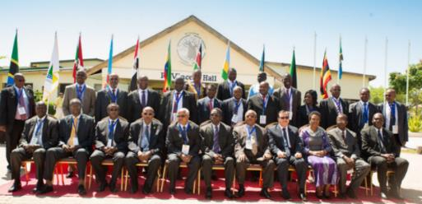

Slide 23





Mau Mara Serengeti Sustainable Water Initiative (MaMaSe).
Jay O’Keefe
Henry Busulwa
Gedion Asfaw
Yasir Abbas Mohamed
Mahomed Desai
Melissa Wade

Slide 24
FRAMEWORK FOR REGIONAL EVALUATIONS OF
E-FLOWS IN THE NILE BASIN.
Gordon O’Brien¹, Chris Dickens², Abdulkarim Seid³, Mohsen Alarabawy³, Sebastian Bubmann⁴ and Georg Petersen⁴
¹University of KwaZulu-Natal, College of Agriculture, Engineering and Science, School of Life Sciences, Private Bag X01, Scottsville, South Africa.
²International Water Management Institute, Private Bag X813, Silverton, 0127, South Africa.
³Nile Basin Initiative, Water Resources Management Department, P.O Box 192, Entebbe, Uganda
⁴HYDROC GmbH, AG Flensburg, HRB 10117, Germany
BRISBANE, AUSTRALIA | 18 - 20 SEPTEMBER 2017
MANAGED BY

