Slide 1



Making environmental water “work” as intended: aligning objectives, allocation and management
Erin O’Donnell, Avril Horne, Rebecca Tharme and Dustin Garrick
BRISBANE, AUSTRALIA | 18 - 20 SEPTEMBER 2017
MANAGED BY
Notes:
10 years on from the Brisbane Declaration
Environmental flows are:
the water flows needed to sustain freshwater and estuarine ecosystems in coexistence with agriculture, industry, and cities.
the goal of environmental flow management is to restore and maintain the socially valued benefits of healthy, resilient freshwater ecosystems through participatory decision making informed by sound science.
Critical challenge: implementation
Effective and efficient implementation requires aligning objectives, allocation and management

Slide 2
Overview
Environmental water planning
From vision to policy: choosing a policy strategy
From policy to allocation: choosing the right mechanism
  Cap
  Conditions on water licences
  Conditions on storage operators
  Environmental or ecological reserve
  Environmental water rights
From allocation to management: organisational capacity
Bringing it all together: a new approach to align environmental water allocation and management
BRISBANE, AUSTRALIA | 18 - 20 SEPTEMBER 2017
MANAGED BY

Slide 3
1. Environmental Vision/Objective
2. Environmental flow assessment
How much water does the environment need
3. Environmental flow allocation
Administrative arrangements to protect environmental water
4. Active management of environmental flow
Delivering environmental water when it is needed
BRISBANE, AUSTRALIA | 18 - 20 SEPTEMBER 2017
MANAGED BY
Source: Horne et al (in press)
Notes:
Much of the work on environmental flows is focussed on the science – how do we determine how much water the ecosystem needs? What flow regime would support the values in the river?
Ten years ago, an important bookmark for environmental flows discipline, the Brisbane Declaration on environmental flows emphasised the importance of environmental flow policies for healthy ecosystems, societies and economies, and framed the next challenge clearly as one of implementation. Most jurisdictions now have high level policies or legislation supporting protection of environmental flows. However translation into on the ground provision of environmental continues to prove challenging in many places. A key part of this implementation challenge is the legal instruments and institutional structures to support the provision of environmental water.
Many countries have committed to environmental water recovery (opportunity) but there is still a belief that water recovery must be a bespoke process to meet the context, leading to slow, ad hoc and inefficient water allocation and management (problem). There is a need for a new approach that explicitly connects (1) the vision for the river, (2) the allocation mechanisms that will best meet that vision, including under climate change, and (3) the institutional frameworks and organisations necessary to manage the allocated water to achieve maximum environmental benefits.
What we are going to lay out today is the reasons that this is as important to consider as the science.

Slide 4
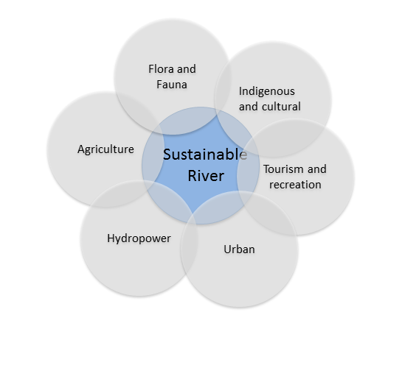
From vision to policy
BRISBANE, AUSTRALIA | 18 - 20 SEPTEMBER 2017
MANAGED BY
Source: Horne et al (in press)
Notes:
What your environmental water actually does
What we’re talking about is a sustainable river, and the water that you need in the river to meet all the functions that a particular community wants

Slide 5
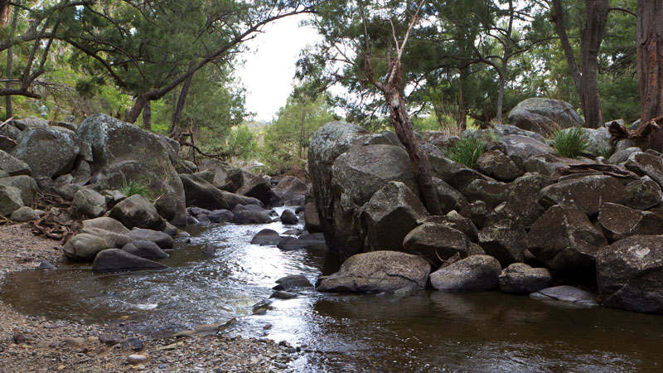
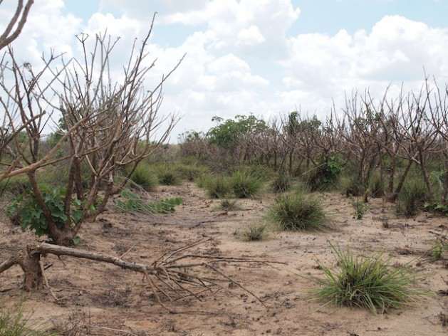
Choosing a policy strategy
1. Protection and maintenance
2. Restoration: recovery and management
BRISBANE, AUSTRALIA | 18 - 20 SEPTEMBER 2017
MANAGED BY
Source: O’Donnell and Garrick (in press)
Notes:
Two key choices of policy strategy

Slide 6
From policy to allocation: mechanisms
Conditions on other water users
Licence conditions for water abstractors
Conditions on storage operation or water resource management
Cap on water abstraction
Legal rights for the environment
Ecological or Environmental Water Reserve
Environmental water rights
BRISBANE, AUSTRALIA | 18 - 20 SEPTEMBER 2017
MANAGED BY
Source: Horne, O’Donnell, Tharme (in press)
Notes:
We use the term allocation mechanism to encompass the legal or policy mechanisms available to provide water for environmental purposes .
There are five broad categories of mechanisms for environmental water allocation. Each jurisdiction uses specific terminology, so this chapter describes these five mechanisms in broad ways. – We have identified these mechanisms based on their legal characteristics and their primary function.
2 main categories: setting limits on other water users, or creating specific legal rights for the environment

Slide 7
Conditions on other water users #1
Conditions on water licences
Best at protecting baseflows
If license issued in perpetuity – difficult to change
Relatively low level of legal security
Requires compliance and enforcement of individuals
BRISBANE, AUSTRALIA | 18 - 20 SEPTEMBER 2017
MANAGED BY
Source: Horne, O’Donnell, Tharme (in press)
Notes:
Where water licences are issued in perpetuity, it is difficult and often controversial to implement new limitations on existing users, particularly without some form of compensation. Such alterations are usually most effective when licences come up for renewal on a regular basis, creating an expectation that licence conditions can change. Changes to licences can also be achieved through the use of highly consultative approaches, but these are often lengthy and complex.
E.g. NSW and Victoria during the drought, licence conditions were changed at the water plan level to allow irrigators and D&S users to pump
Conditions on water licences that protect environmental flows can also be overridden by governments, most notably in times of scarcity. For example, during the Millennium drought in Australia, the newly established water resource management plans of New South Wales were suspended, to enable drought-stricken irrigators to continue to access water that would otherwise have been allocated to the environment (National Water Commission, 2009).
A further implementation challenge with this allocation mechanism is the requirement to check compliance and enforce licence conditions across what is potentially a large number of individual licence holders in any given river basin.

Slide 8
Conditions on other water users #2
Conditions on storage operators & resource managers
Release condition from storage
    Minimum flow
    Regime focused release such as pulse events
    Rates of rise and fall
    Release limits to address seasonality changes
Challenge of infrastructure constraints
Relatively low level of legal security
BRISBANE, AUSTRALIA | 18 - 20 SEPTEMBER 2017
MANAGED BY
Source: Horne, O’Donnell, Tharme (in press)
Notes:
Where water licences are issued in perpetuity, it is difficult and often controversial to implement new limitations on existing users, particularly without some form of compensation. Such alterations are usually most effective when licences come up for renewal on a regular basis, creating an expectation that licence conditions can change. Changes to licences can also be achieved through the use of highly consultative approaches, but these are often lengthy and complex.
E.g. NSW and Victoria during the drought, licence conditions were changed at the water plan level to allow irrigators and D&S users to pump
Conditions on water licences that protect environmental flows can also be overridden by governments, most notably in times of scarcity. For example, during the Millennium drought in Australia, the newly established water resource management plans of New South Wales were suspended, to enable drought-stricken irrigators to continue to access water that would otherwise have been allocated to the environment (National Water Commission, 2009).
A further implementation challenge with this allocation mechanism is the requirement to check compliance and enforce licence conditions across what is potentially a large number of individual licence holders in any given river basin.

Slide 9
Conditions on other water users #3
Cap on water extractions
Relatively easy to implement
Does not protect the entire flow regime –implemented in combination with other allocation mechanisms
Requires an accounting framework and monitoring and compliance of extraction
Requirement for a water market
BRISBANE, AUSTRALIA | 18 - 20 SEPTEMBER 2017
MANAGED BY
Source: Horne, O’Donnell, Tharme (in press)

Slide 10
Legal rights for the environment #1
Ecological / Environmental reserve
Legally established prior right to water
Implementation challenging
Implemented in conjunction with other allocation mechanisms
May require relicensing
BRISBANE, AUSTRALIA | 18 - 20 SEPTEMBER 2017
MANAGED BY
Source: Horne, O’Donnell, Tharme (in press)
Notes:
The South African legislation that supports the environmental reserve has been held up as an example of legal protection of environmental water because of the security it provides for the environment. However, South Africa has shown that this is a challenging mechanism to implement. As with the cap, it needs to be implemented in conjunction with other allocaiton mechanisms. It requires extensive policy procedures and planning to support this process and it may require relicensing of individual water users to align with the legislative changes.

Slide 11
Legal rights for the environment #2
Environmental water rights
Same legal right as consumptive water holders
Requires an Environmental water manager
Recovery mechanism in over-used systems
Water acquired through investment in water savings or by purchase from existing users (temporary or permanent)
Highly flexible use
Active management: a decision is required to use the water, to trade the water, to carry over water in storage, or to re-invest in temporary acquisitions
BRISBANE, AUSTRALIA | 18 - 20 SEPTEMBER 2017
MANAGED BY
Source: Horne, O’Donnell, Tharme (in press)
Notes:
Finally, the environment may also be issued with water rights of the same structure and legal properties as those of consumptive water users.
An organization of some kind is required to hold and manage these environmental water rights on behalf of the environment. We are going to talk about this in a bit more detail as this concept of active management and the level of institutional support required is important.
Two of the better known examples of environmental water rights are in the Western United States and in Australia. In both cases, environmental water rights are used as a recovery mechanism to return environmental water in a way that compensates other water users.
How it works in practice is dependent on the way the water rights are defined.
So for instance, in the USA, the environment has typically acquired rights to water in stream – so these are usually flow rights, not storage rights, and as a result, the environmental water can protect minimum flows during summer, or it can act as a type of ‘cap’ on the system.
In Australia, where the water rights are typically held in storage, the water can be used in many more ways.

Slide 12
Choosing the right allocation mechanism: lesson 1
Be explicit about sharing climate change impacts
BRISBANE, AUSTRALIA | 18 - 20 SEPTEMBER 2017
MANAGED BY
Notes:
Each EWM narrative aligns more closely with specific constructions of the environment.

Slide 13
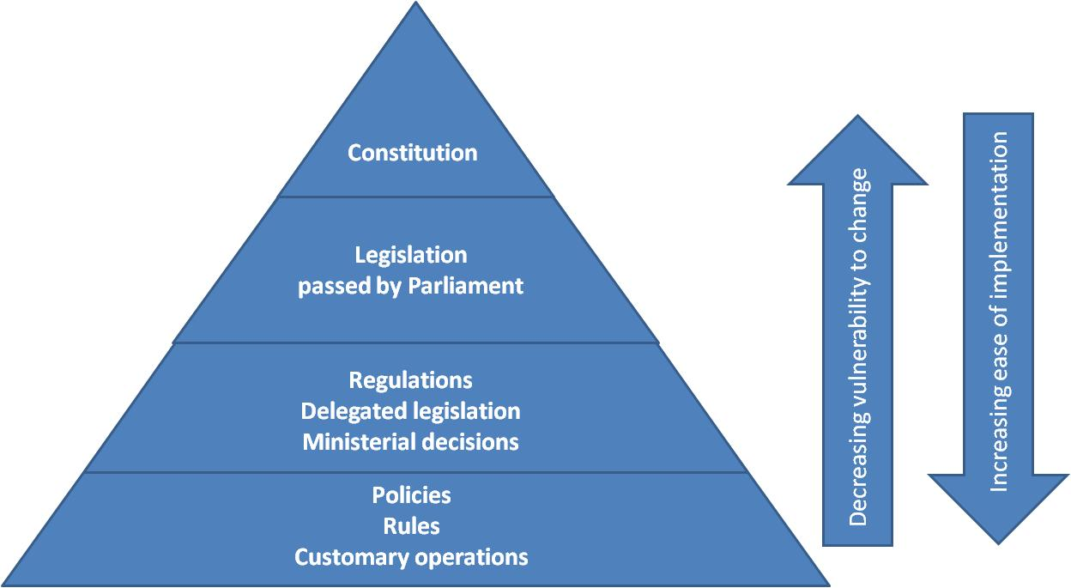
Choosing the right allocation mechanism: lesson 2
Balance vulnerability to change (political interference) with ease of implementation
BRISBANE, AUSTRALIA | 18 - 20 SEPTEMBER 2017
MANAGED BY
Source: Horne, O’Donnell, Tharme (in press)
Notes:
Each EWM narrative aligns more closely with specific constructions of the environment.

Slide 14
Choosing allocation mechanisms: lesson 3
Use more than one allocation mechanism in more than one way
MDB, Australia – cap on consumptive use plus water rights for the environment
South Africa – ecological reserve implemented through relicensing and catchment management arrangements
Columbia Basin, USA – instream flow rights plus dam re-licensing (conditions on storage operators)
Yellow River, China – cap on consumptive use plus conditions on storage operators
BRISBANE, AUSTRALIA | 18 - 20 SEPTEMBER 2017
MANAGED BY
Source: Horne, O’Donnell and Tharme (in press)
Notes:
Finally, the environment may also be issued with water rights of the same structure and legal properties as those of consumptive water users.
An organization of some kind is required to hold and manage these environmental water rights on behalf of the environment. We are going to talk about this in a bit more detail as this concept of active management and the level of institutional support required is important.
Two of the better known examples of environmental water rights are in the Western United States and in Australia. In both cases, environmental water rights are used as a recovery mechanism to return environmental water in a way that compensates other water users.
How it works in practice is dependent on the way the water rights are defined.
So for instance, in the USA, the environment has typically acquired rights to water in stream – so these are usually flow rights, not storage rights, and as a result, the environmental water can protect minimum flows during summer, or it can act as a type of ‘cap’ on the system.
In Australia, where the water rights are typically held in storage, the water can be used in many more ways.

Slide 15
From allocation to management: organisations
Organisations can be on a spectrum from:
    Passive: maintaining the legal and policy framework, sometimes ‘owning’ the environmental entitlements, or
    Active: deciding how, when and where to acquire, use (or trade) water rights
Different allocation mechanisms need different organisations: structure, capacity, expertise and funding
    Conditions on others – less flexible, less expensive to manage
    Legal rights – more flexible, more expensive
BRISBANE, AUSTRALIA | 18 - 20 SEPTEMBER 2017
MANAGED BY
Source: O’Donnell and Garrick (in press)
Notes:
A mismatch between the organisational arrangements and the allocation mechanism will mean one of two things:
Too much money is being spent on maintaining an organisation with unnecessary capacity (such as independence, decision-making ability, funding) OR
The organisation lacks the ability to flexibly manage the environmental water rights effectively and efficiently in the long term – which requires transparency, accountability, expertise, funding and the legal power to own and trade water rights

Slide 16
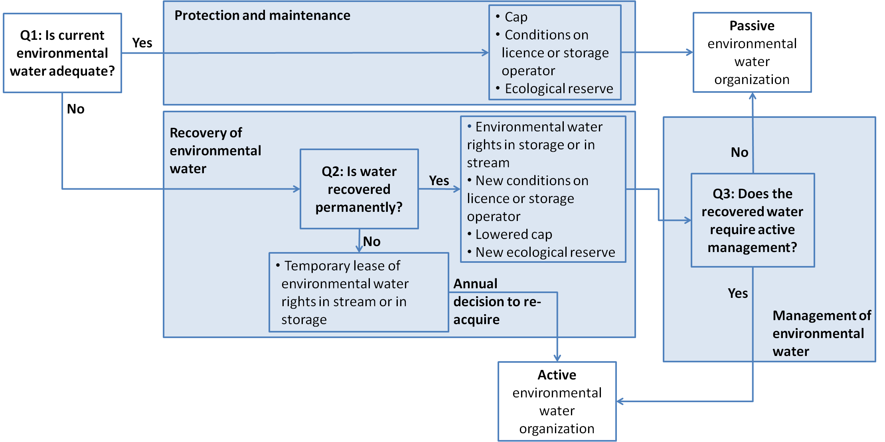
Bringing it all together: vision, policy, allocation mechanisms and management arrangements
BRISBANE, AUSTRALIA | 18 - 20 SEPTEMBER 2017
MANAGED BY
Source: O’Donnell, Horne, Tharme and Garrick (submitted)
Notes:
Again: this is not a linear approach dictating a particular path to environmental water allocation and management.
But it does demonstrate the interactions and connections between the choices made at each point in this process.
Reminder: this can be used in countries without a formal environmental water program, or as a way to refine and strengthen existing institutional arrangements.
Almost all countries have environmental water policies, and formal environmental water volumes are increasing (although informal may be decreasing). We need to strengthen institutional arrangements to manage this water efficiently and effectively: to make environmental water ‘work’.
To do so, we have developed a framework that can be applied to countries with or without an existing environmental water policy, and helps to align:
The objectives: protection or recovery?
The mechanisms for allocating water to the environment; and
The organisations required to manage the environmental water.

