Slide 1
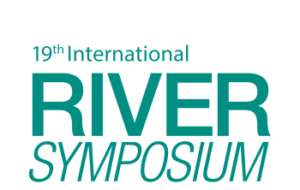
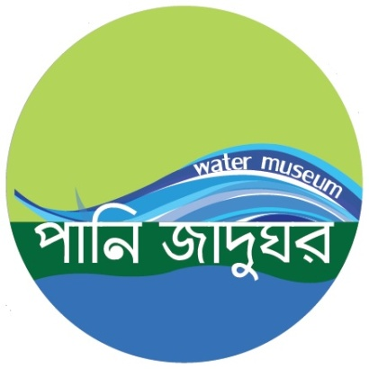
TAJ PALACE, NEW DELHI | 12 – 14 SEPTEMBER 2016
Water Museum
A journey from water dystopia to water futures
Imtiaz Ahmed^{[1]} and Farah Kabir^{[2]}
^{[1]} Dr. Imtiaz Ahmed; Professor of International relation in Dhaka University and Executive Director of Regional Centre for Strategic Studies (RCSS), Sri Lanka
[2] Farah Kabir: Country Director of ActionAid Bangladesh.

Slide 2
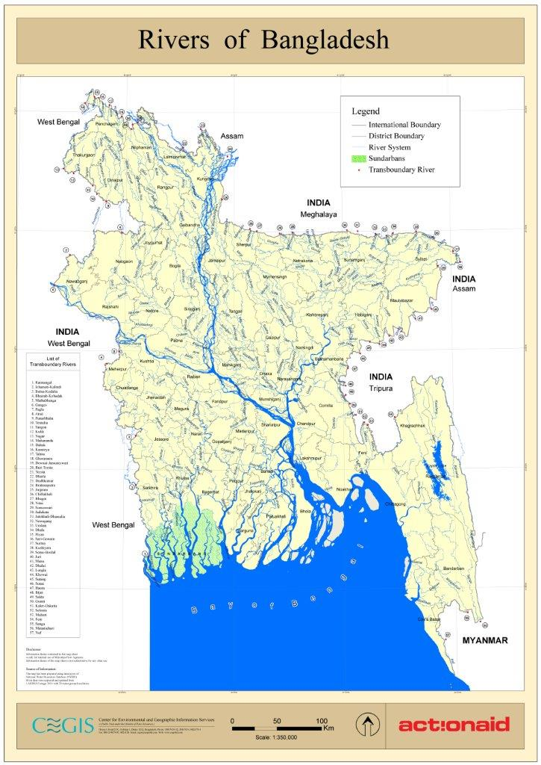
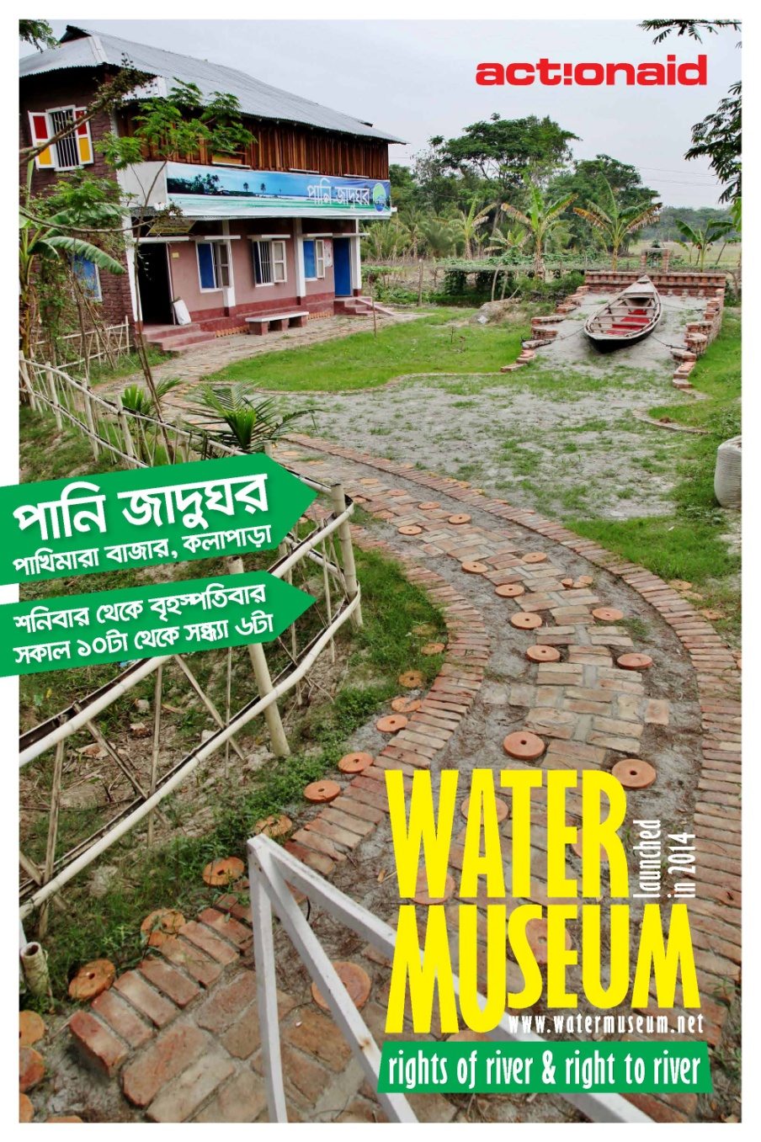
TAJ PALACE, NEW DELHI | 12 – 14 SEPTEMBER 2016

Slide 3
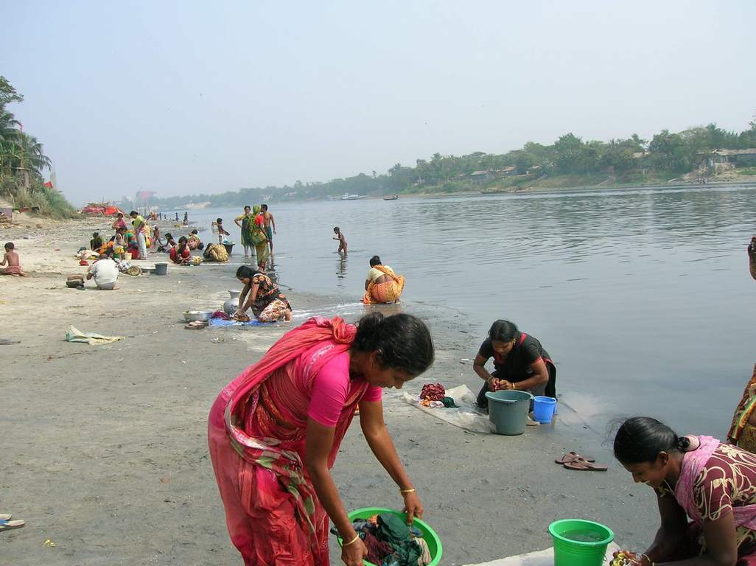
TAJ PALACE, NEW DELHI | 12 – 14 SEPTEMBER 2016
Subsistence use of river

Slide 4
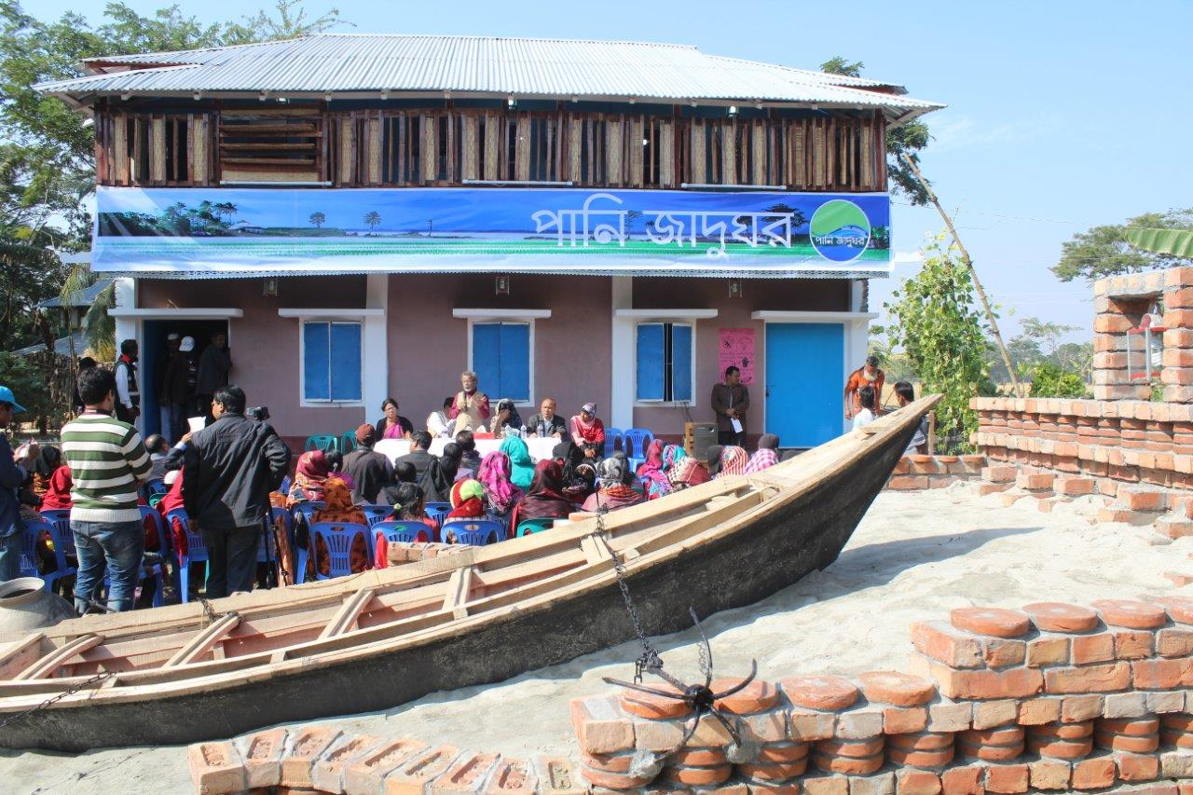
TAJ PALACE, NEW DELHI | 12 – 14 SEPTEMBER 2016
Picture: Inauguration of Water Museum

Slide 5
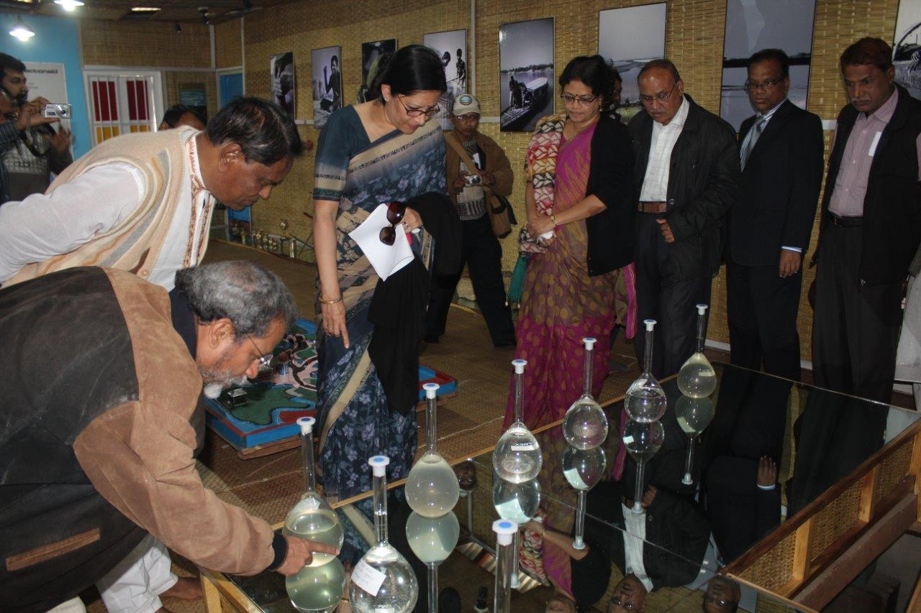
TAJ PALACE, NEW DELHI | 12 – 14 SEPTEMBER 2016
Picture: Inauguration of Water Museum

Slide 6
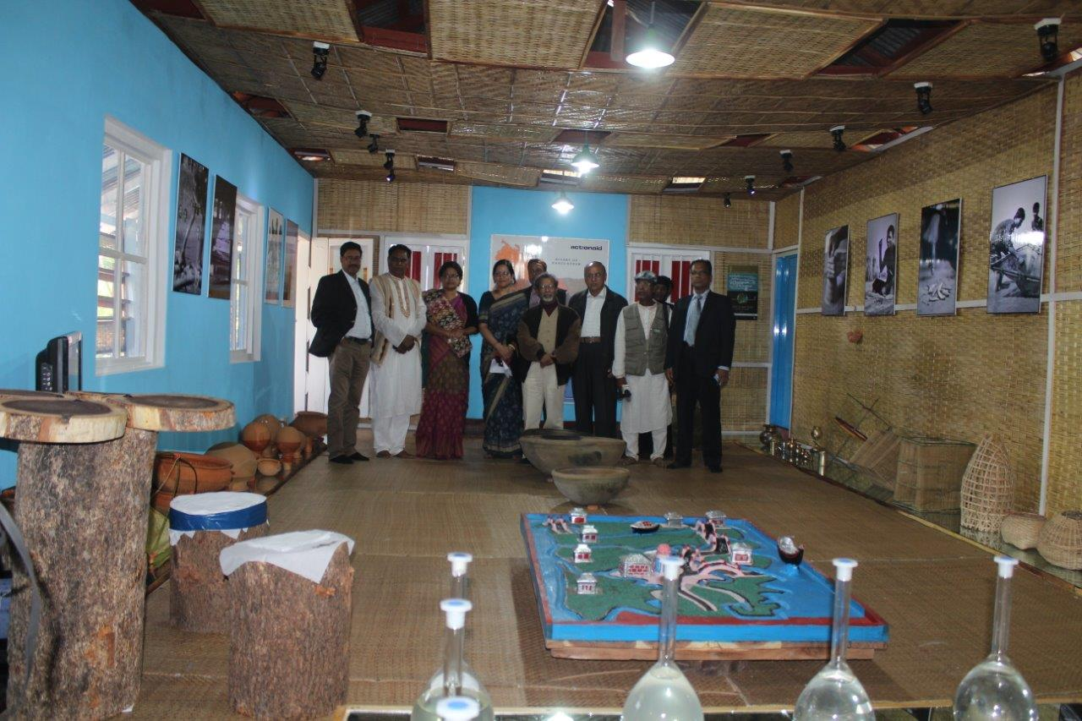
TAJ PALACE, NEW DELHI | 12 – 14 SEPTEMBER 2016

Slide 7
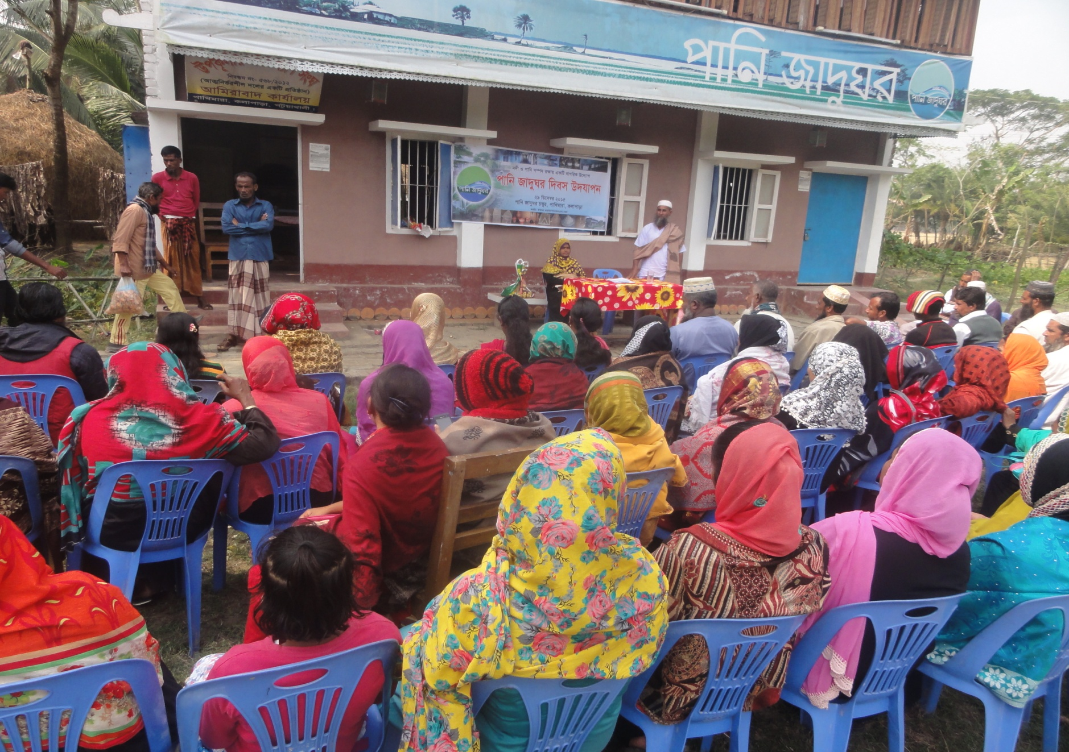
TAJ PALACE, NEW DELHI | 12 – 14 SEPTEMBER 2016
Picture: Water Museum anniversary by the community

Slide 8
TAJ PALACE, NEW DELHI | 12 – 14 SEPTEMBER 2016
Introduction:
Bangladesh is predominately a riverine country where the economy, society and culture of the people are shaped by around 800 rivers flowing through its lands. More than 100 rivers are trans-boundary; those are connected with Nepal, India, Bhutan, China and Myanmar. Numbers of river flow has disrupted due to barrage and river linking projects.
Surface water is the main source of irrigation and this water predominantly comes from trans-boundary Rivers and rain water. Unfortunately not enough attention and effort has been given towards such an important resource. Due to lack of water flow in the dry seasons, there is an increased dependency on the use of ground water for irrigation, industries and households which in turn is lowering the deep aquifer water reserves and ground water tables in Bangladesh. So, rivers including its sediment and water are equally important for not only agriculture and livelihood, but also for environment & ecological balance, aquatic life and navigation. Consistent river flow is also essential for temperature balance, rainfall, erosion control, protection from salinity intrusion, ground water recharge, vegetation, developing greenbelt, etc. World largest mangrove forest Sundarban is in threat due to salinity intrusion and lack of sediment.

Slide 9
TAJ PALACE, NEW DELHI | 12 – 14 SEPTEMBER 2016
Despite understanding the importance of rivers for Bangladesh, there is a lack of adequate initiatives by the Government, academicians, civil societies, activists and common people to govern and protect these rivers. Unplanned engineering, hard solutions without considering socio-economic and cultural contexts are failing to bring long term solutions. Even bilateral treaties and government policies on water management are highly biased towards structural interventions only and lack the vision of looking at water from more holistic point of view. Dams in upper riparian countries are also creating problems as they are controlling the water flow of the rivers.
Out of the 800 rivers more than 100 rivers have dried up and many more have been polluted through industrial wastages and chemicals. As a result, there is a negative impact on agriculture, fisheries, ecology and human health because there is not enough water in the rivers, especially in dry season. Communities are increasingly unable to use river water for their survival. Furthermore, transportation and production cost of agricultural goods increases as ground water needs to be pumped up. The Government’s inadequate water resource management is also not providing solutions to such problems and as a result people are suffering.

Slide 10
TAJ PALACE, NEW DELHI | 12 – 14 SEPTEMBER 2016
The authors firmly believe that rivers and its waters are not entities to be divided but a resource to be shared. People especially those who inhabit the river and are highly dependent on it needs to understand the changes and search for solutions. Politicians & people in power are required to comprehend the consequences of actions that harm the river and act in the best interest of the river! Without regional initiatives in South Asia however, it will not be sustainable for Bangladesh to take a standalone position on the current problems. To address this problem, AAB has started the multi-country “Water Commons” campaign with a vision to uphold the concerns of river and its waters from a common point of view which goes beyond political boundaries.

Slide 11
TAJ PALACE, NEW DELHI | 12 – 14 SEPTEMBER 2016
“Water Museum” which was inaugurated on 29th December, 2014 at Pakhimara Bazar Area of Kolapara Upazilla under Patuakhali District. The idea of creating this water museum was to disseminate information and raise awareness among the communities, stakeholders and especially policy makers about the importance and necessity of safeguarding our rivers. This establishment is working as a strong basis for policy advocacy on “Water Commons” campaign of AAB; it is acting as a strong call for actions to save rivers in South Asia. It is part of the concept of ‘shifting power’ as it is curated with the community, governed and managed by the frontline community with AAB and Dr Ahmed acting in advisory capacity mainly. The attempt to make it a people’s museum is a step towards shifting the notion that only experts in the national level can establish such institutions to affected community who inhabit the river.

Slide 12
TAJ PALACE, NEW DELHI | 12 – 14 SEPTEMBER 2016
Descriptions:
Local and environment friendly materials are used inside the museum. Below is a list of elements of the museum has exhibited-
Water sample of all 57 trans-boundary rivers of Bangladesh, including water from rivers of Nepal and Myanmar.
Photos of different Rivers, Water Body, Beels, Haors and lives dependent on these. These photos will also focus on different stage like dry season, peak season and their relation with people. These photos of different frame and size will be arranged on the walls of museum in aesthetic manners.
Different kinds of Handy crafts, Artifacts which are produced in river flood plain areas like (Tat Cloths, different clay items, fishing nets, fishing wheels, Bamboo cage, Steamer lights, Fishing instruments, etc).
A boat on Dead River and image of water transport.
Display of different Books, Flyers, Posters, Policy, Laws, Research & other Reports, International Conventions etc.
A Dummy model of a Andharmanik river system (Source, Stream flow and Destination)
A big map on the wall showing all the rivers of Bangladesh including Trans-boundary rivers.
Audio-Visuals (documentaries, song, slight show, documentaries, etc).
Dummy structure of different flora and fauna under the threat of Extinction
A opinion book or visitors comments register to record the opinions of different visitors
Water architecture

Slide 13
TAJ PALACE, NEW DELHI | 12 – 14 SEPTEMBER 2016
The following are some of the key activities of Water Museum:
Exchange Visits: River related information, Maps, Publications, river treaties, photos of different rivers and its surrounding (present and extinct);
Samples of different river water are exhibited to help us understand the texture and composition of river water;
Annual Convention on Right to Water and Defending Commons;
Interactive visual components regarding saving rivers of Bangladesh, to educate and create mass awareness among communities and relevant policy stalk holders in favor of River Rights and Right to Water;
A website has been developed with all the information of Water Museum.
Stakeholders:
To create mass awareness on Right to water and River rights; policy stakeholders, academics, activists, riverine people, water resources dependent people are main stakeholders of the water museum, in addition water resources grabber and profit makers of this resources are target audience.

Slide 14
TAJ PALACE, NEW DELHI | 12 – 14 SEPTEMBER 2016
Impacts:
Since 29 December 2014 to July 2016 around two thousand people from inside the country including school children, and abroad visited the water museum. They expressed appreciation and encouragement for the initiative. Visitors also made demands for the expansion of the area of the Museum and its contents.
Numbers of government officials visited and got impression about importance of water management and river rights. Water Museum has been continuously pushing agendas to policy makers through visitor’s online comments and media reports. Now local communities are more aware on the issue and they also part of water commons campaign.
Management:
Water Museum management is unique. Two community organizations, a local NGO, and ActionAid jointly manage this Water Museum. Participation of the local people has made a difference to this museum as ‘ownership’ of the museum rests with them.

Slide 15
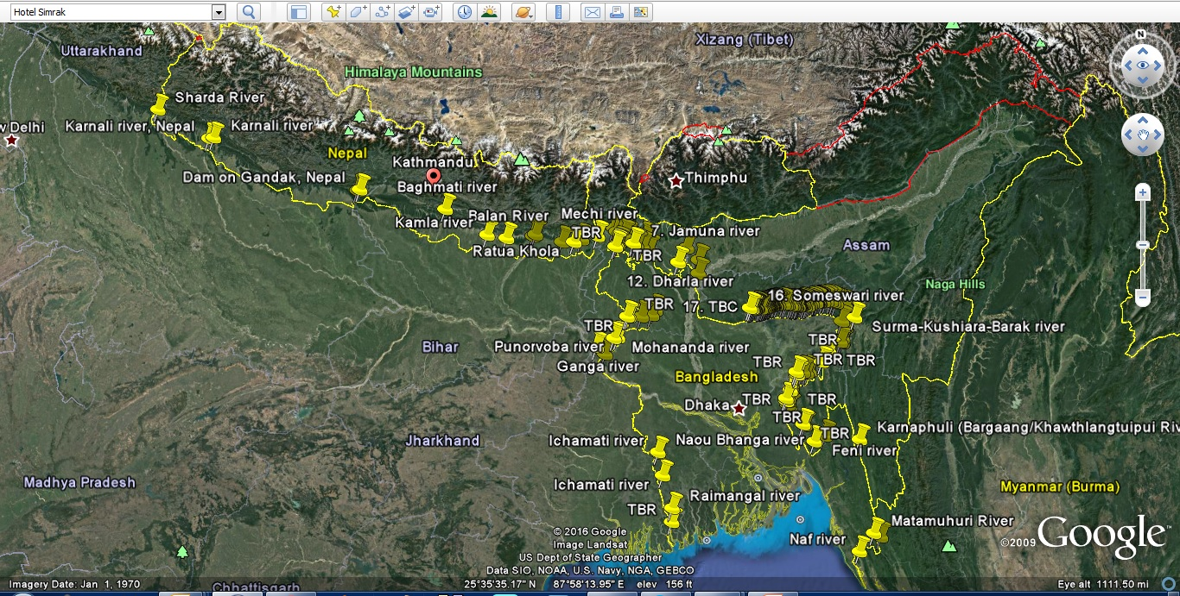
TAJ PALACE, NEW DELHI | 12 – 14 SEPTEMBER 2016
100 ⁺ Trans-boundary Rivers in Nepal, India and Bangladesh

Slide 16
TAJ PALACE, NEW DELHI | 12 – 14 SEPTEMBER 2016
Conclusion:
We started this initiative without any external support. Now we are looking for donation to install more items, posters, books, reports, etc related to water and rivers. Also have the dream to have a multi-storage building for WM and establish more WM in different parts of the country.
Through the initiative, AAB wants to scale-up the impact and set up more museums throughout strategic river centric locations in Bangladesh. Using these water museums as a platform, the initiative will generate discourse on water centric development to raise awareness (among mass people and policy stakeholders) about the ongoing man-made water crisis in South-Asia and identify new and innovative ways of solving the problem through development cooperation.
Contact:
Email: Farah.Kabir@actionaid.org
Website: http://www.watermuseum.net/
Facebook; https://www.facebook.com/pages/Water-Museum/416083565218058

Slide 17
TAJ PALACE, NEW DELHI | 12 – 14 SEPTEMBER 2016
Thanks

