Slide 1
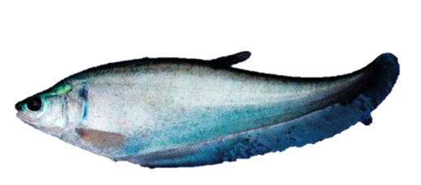
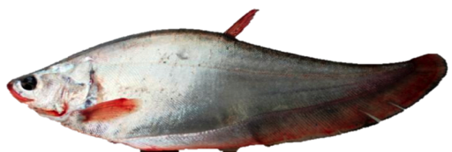
Promoting Multi-Stakeholder Partnership in Improving Water Pollution Control and Preserving Biodiversity of Brantas Watershed Indonesia
TAJ PALACE, NEW DELHI | 12 – 14 SEPTEMBER 2016
Prigi Arisandi¹,
¹ Executive Director Ecological Observation and Wetlands Conservation
The Goldman Environmental Prize Winner 2011

Slide 2
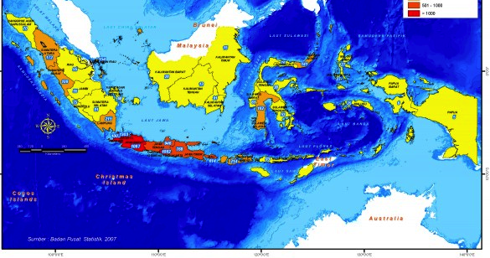
TAJ PALACE, NEW DELHI | 12 – 14 SEPTEMBER 2016

Slide 3
TAJ PALACE, NEW DELHI | 12 – 14 SEPTEMBER 2016

Slide 4
TAJ PALACE, NEW DELHI | 12 – 14 SEPTEMBER 2016

Slide 5
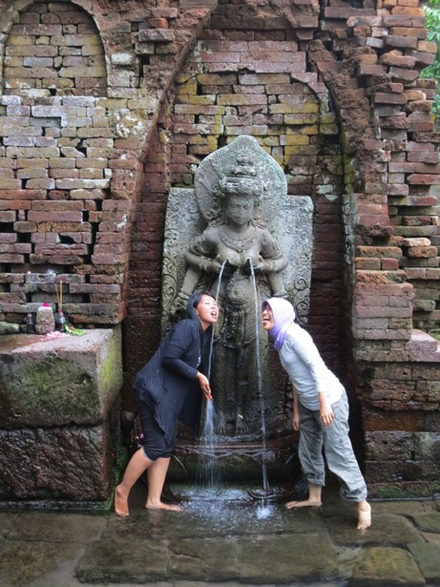
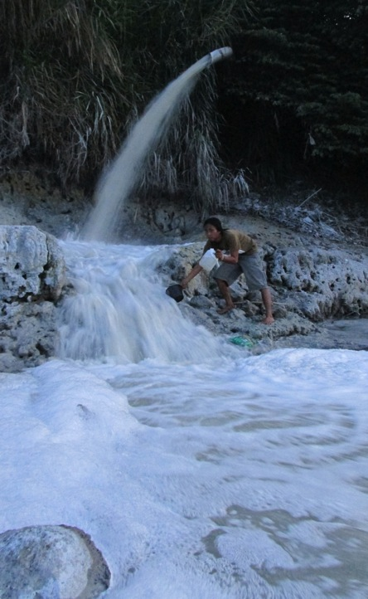
TAJ PALACE, NEW DELHI | 12 – 14 SEPTEMBER 2016

Slide 6
TAJ PALACE, NEW DELHI | 12 – 14 SEPTEMBER 2016

Slide 7
TAJ PALACE, NEW DELHI | 12 – 14 SEPTEMBER 2016

Slide 8
TAJ PALACE, NEW DELHI | 12 – 14 SEPTEMBER 2016

Slide 9
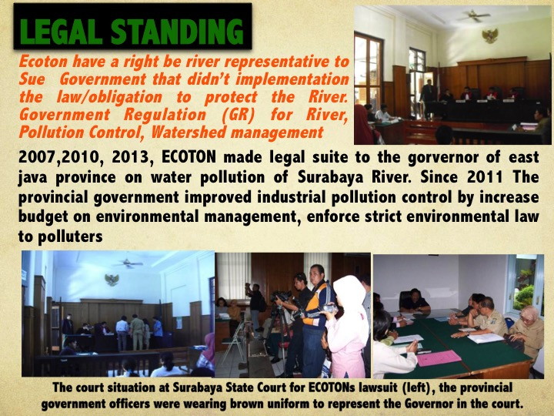
TAJ PALACE, NEW DELHI | 12 – 14 SEPTEMBER 2016

Slide 10
TAJ PALACE, NEW DELHI | 12 – 14 SEPTEMBER 2016

Slide 11
TAJ PALACE, NEW DELHI | 12 – 14 SEPTEMBER 2016

Slide 12
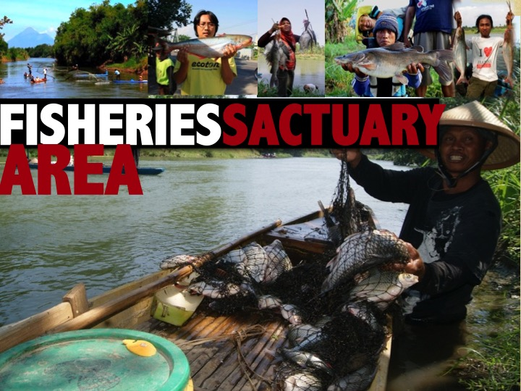
TAJ PALACE, NEW DELHI | 12 – 14 SEPTEMBER 2016
1. Extensive study on river ecology with emphasis on social and economic benefit in regard to fishing activity

Slide 13
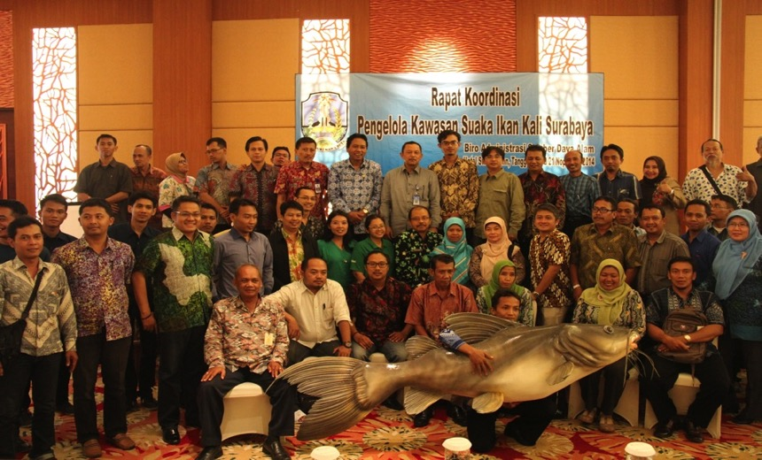
TAJ PALACE, NEW DELHI | 12 – 14 SEPTEMBER 2016
2. Build Cooperation among various stakeholders

Slide 14
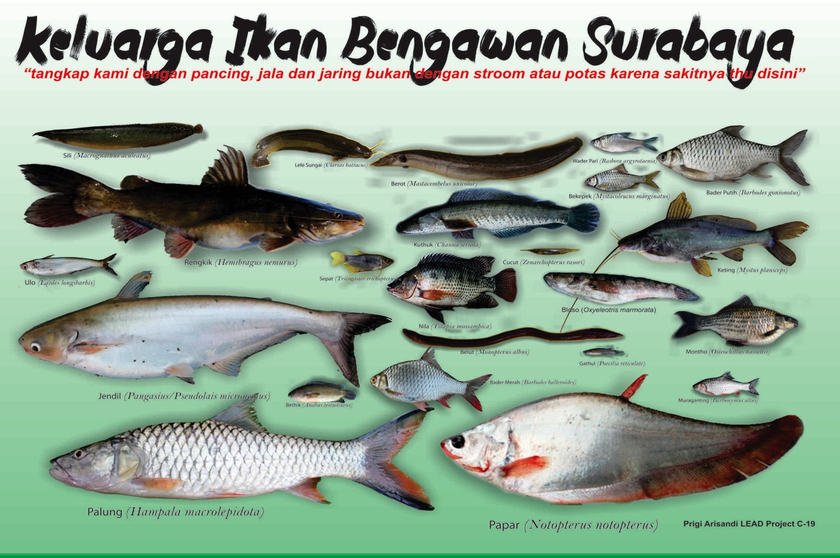
3. Widening the Network - Socialization
TAJ PALACE, NEW DELHI | 12 – 14 SEPTEMBER 2016

Slide 15
TAJ PALACE, NEW DELHI | 12 – 14 SEPTEMBER 2016

Slide 16
TAJ PALACE, NEW DELHI | 12 – 14 SEPTEMBER 2016

Slide 17
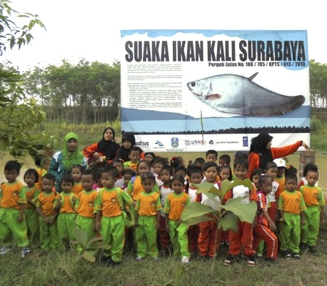
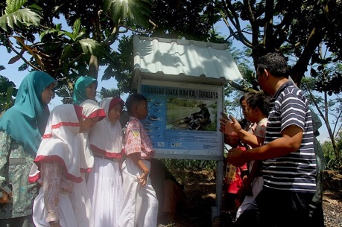
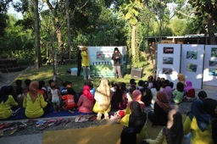
TAJ PALACE, NEW DELHI | 12 – 14 SEPTEMBER 2016

Slide 18
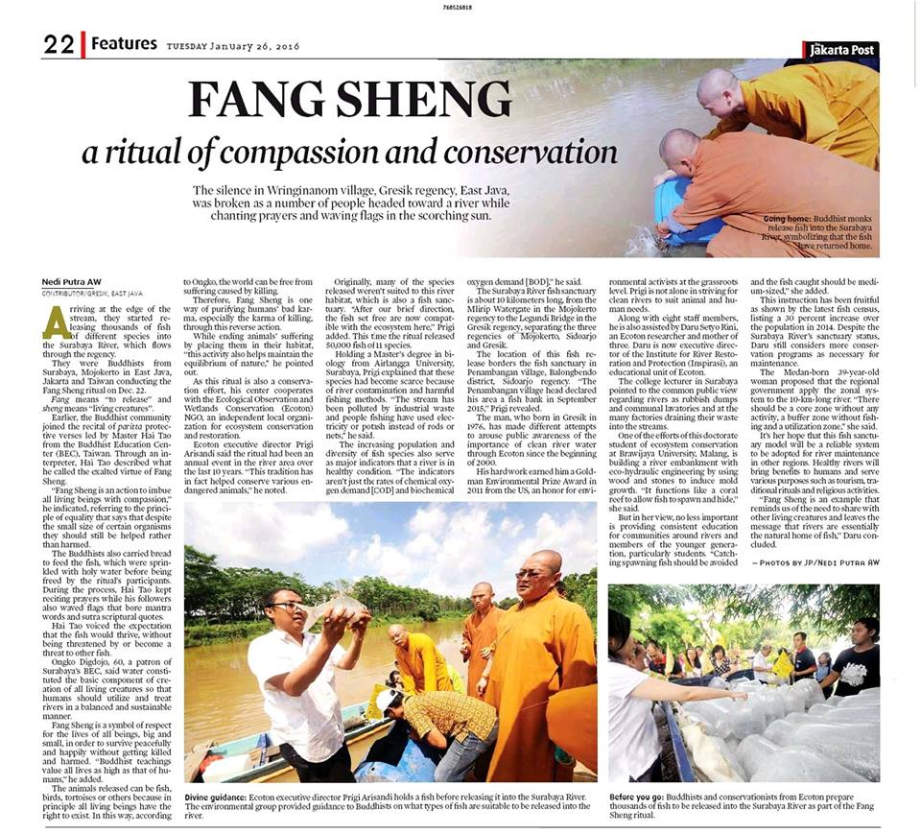
6. Impact on Rethriving Native Fish Species
TAJ PALACE, NEW DELHI | 12 – 14 SEPTEMBER 2016

Slide 19
TAJ PALACE, NEW DELHI | 12 – 14 SEPTEMBER 2016

Slide 20
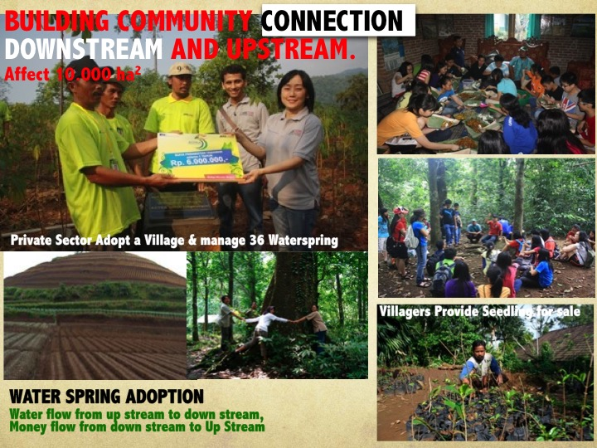
TAJ PALACE, NEW DELHI | 12 – 14 SEPTEMBER 2016

Slide 21
TAJ PALACE, NEW DELHI | 12 – 14 SEPTEMBER 2016

Slide 22
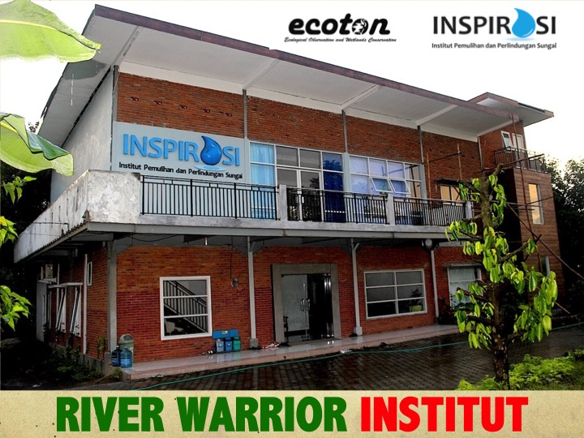
TAJ PALACE, NEW DELHI | 12 – 14 SEPTEMBER 2016

Slide 23
TAJ PALACE, NEW DELHI | 12 – 14 SEPTEMBER 2016

Slide 24
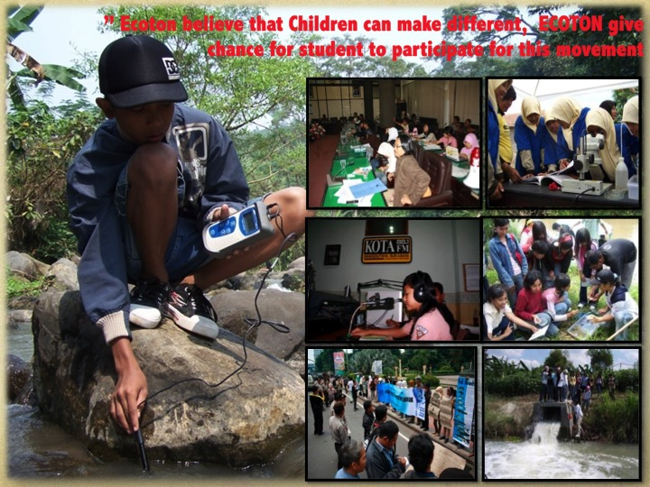
TAJ PALACE, NEW DELHI | 12 – 14 SEPTEMBER 2016

Slide 25
TAJ PALACE, NEW DELHI | 12 – 14 SEPTEMBER 2016

Slide 26
TAJ PALACE, NEW DELHI | 12 – 14 SEPTEMBER 2016

Slide 27
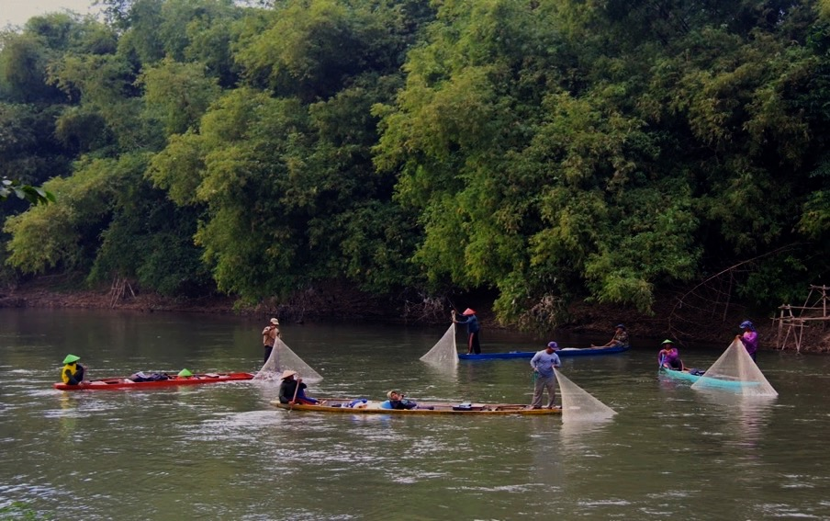
CONCLUSIONS Built A healthy Home for Fish can be initiated by grassroot movement through establishing multi stakeholder coordination platform that supported by top government leader . The platform faciliates participatory research to increase community participation and to develop awareness of local community groups and facilitates Regular meeting to build mutual understanding, develop trust and good communication among stakeholders to improve river pollution control and biodiversity conservation
TAJ PALACE, NEW DELHI | 12 – 14 SEPTEMBER 2016

