Slide 1




Towards e-flow policies for seasonal rivers through valuation of ecosystem services and biodiversity
TAJ PALACE, NEW DELHI | 12 – 14 SEPTEMBER 2016
Somnath Bandyopadhyay* and Arun M Dixit
*Associate Professor, School of Ecology and Environment Studies
Nālandā University, www.nalandauniv.edu.in, sbandyopadhyay@nalandauniv.edu.in

Slide 2
E-flows – reluctant adoption in S Asia
TAJ PALACE, NEW DELHI | 12 – 14 SEPTEMBER 2016
Policy recommendations for e-flows are based on hydrology, hydraulics, ecology;
Recent recommendations emphasize holistic, inter-disciplinary approaches;
Approaches in South Asia is for “minimal flows” if at all;
Water quality and fish/ mammalian populations are becoming important.

Slide 3
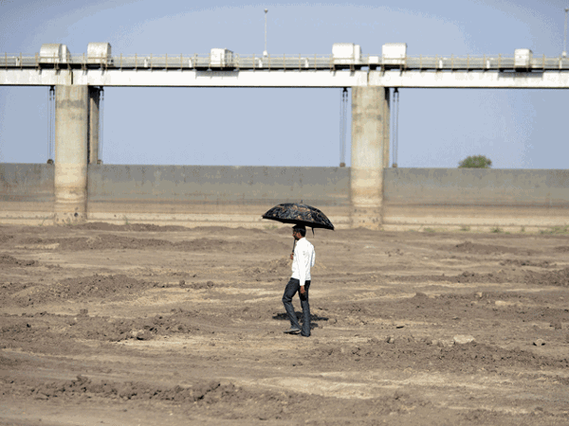
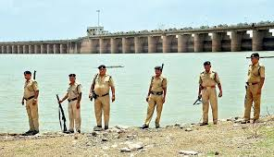
Value of flows in arid/ semi-arid areas
TAJ PALACE, NEW DELHI | 12 – 14 SEPTEMBER 2016
River regulation in arid/ semi-arid areas are based on retention, rather than flows – dams are over-designed;
Downstream ecosystems are fragile, often with unique biodiversity values;
Can the ecosystem services and biodiversity values justify e-flows in arid/ semi-arid areas?
PHOTO CREDITS:
Economic Times; Daily Mirror

Slide 4
Key references
TAJ PALACE, NEW DELHI | 12 – 14 SEPTEMBER 2016
Acreman, M. C., Overton, I. C., King, J., Wood, P. J., Cowx, I. G., Dunbar, M. J., … Young, W. J. (2014). The changing role of ecohydrological science in guiding environmental flows. http://doi.org/10.1080/02626667.2014.886019
Arthington Angela H., Robert J. Naiman, M. E. M. and C. N. (2010). Preserving the biodiversity and ecological services of rivers: new challenges and research opportunities. Freshwater Biology, 55(1), 1–16. http://doi.org/10.1017/CBO9781107415324.004
Bunn, S. E., & Arthington, A. H. (2002). Basic principles and ecological consequences of altered flow regimes for aquatic biodiversity. Environmental Management, 30(4), 492–507. http://doi.org/10.1007/s00267-002-2737-0
Creel, M., & Loomis, J. (1992). Recreation Value of Water to Wetlands in the San Joaquin Valley: Linked Multinomial Logit and Count Data Trip Frequency Models. Water Resources Research, 28(10), 2597–2606.
Dhanya, C. T., & Kumar, A. (2015). OPINION Making a case for estimating environmental flow under climate change. CURRENT SCIENCE, 109(6).
Dyson, M., Bergkamp, G., & Scanlon, J. (2003). Flow. The Essentials of Environmental Flows. Gland: IUCN.
Gopal, B. (2013). Environmental Flows : The South Asian Experience. In B. Gopal (Ed.), Environmental Flows: An Introduction for Water Resources Managers (pp. 183–197). National Institute of Ecology. Retrieved from http://www.aquaticecosystems.org/wp-content/uploads/2014/02/EFlow-Prelims.pdf
Hwan, J. L. (2015). Fragmentation of an intermittent stream during seasonal drought: intra- and interannual patterns and ecological consequences.
Kendy, E., Apse, C., & Blann, K. (2012). A practical guide to environmental flows for policy and planning with nine case studies in the United States. Nat Conservancy, 74. Retrieved from
O’Keeffe, J., Kaushal, N., Bharati, L., & Smakhtin, V. (2012). Assessment of Environmental Flows for the Upper Ganga Basin. WWF, India, New Delhi, 1–168.
Richter, B. D. (2010). Re-thinking environmental flows: From allocations and reserves to sustainability boundaries. River Research and Applications, 26(8), 1052–1063. http://doi.org/10.1002/rra.1320
Richter, B. D., & Thomas, G. A. (2007). Restoring Environmental Flows by Modifying Dam Operations. Ecology and Society, 12(1), 12. Retrieved from http://www.ecologyandsociety.org/vol12/iss1/art12/
Rodier, J. & R. (n.d.). River Flow in Arid Regions. In Hydrometry: Principles and Practices (pp. 453–472).
Tharme, R. E. (2003). A global perspective on environmental flow assessment: emerging trends in the development and application of environmental flow methodologies for rivers. River Research and Applications, 19, 397–441. http://doi.org/10.1002/rra.736

Slide 5
Study area
TAJ PALACE, NEW DELHI | 12 – 14 SEPTEMBER 2016
Latitude: 22^{O}55’-24^{O}35’N
Longitude: 70^{O}30’-71^{O}45’E
Little Rann of Kachchh (LRK)
Area: 3,570 sq km
Catchment
Area: 10,500 sq km
Rainfall: 325 - 533 mm
140 MCM water

Slide 6
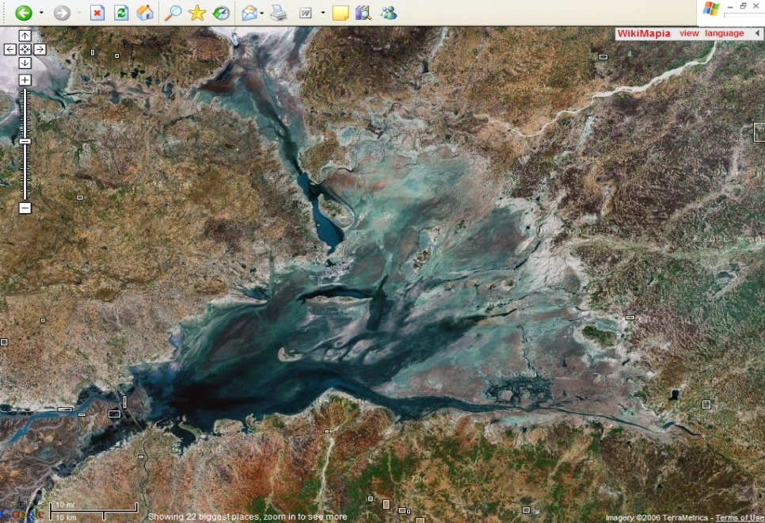
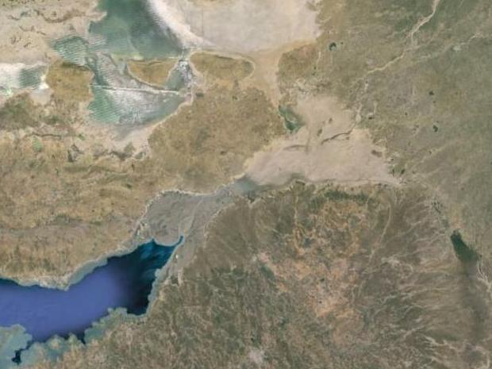
Little Rann of Kachchh (LRK)
TAJ PALACE, NEW DELHI | 12 – 14 SEPTEMBER 2016
Banas R.
GRK
LRK
Kachchh
GoK/MNP
Saurashtra
Rupen R.
Surajbari
Bambhani R.
Freshwater inflows
Brackishwater tidal flows
Direct rainfall

Slide 7
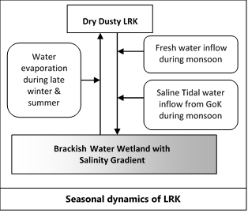
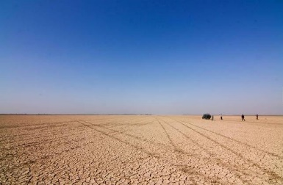
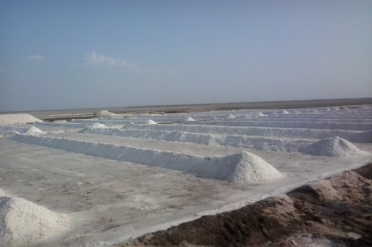
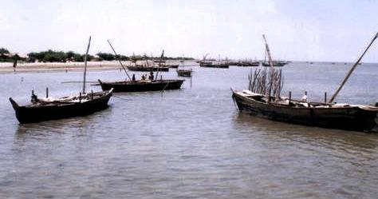
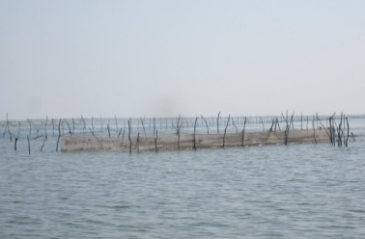
Seasonal dynamics of LRK
TAJ PALACE, NEW DELHI | 12 – 14 SEPTEMBER 2016
Unique landscape Prawn fishing
Unique biodiversity Salt farming
TOURISM

Slide 8
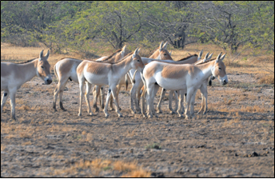
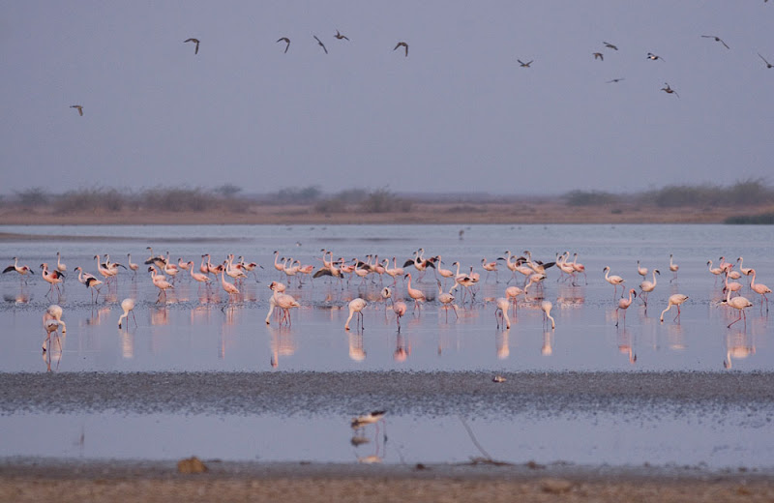
Biodiversity of LRK
TAJ PALACE, NEW DELHI | 12 – 14 SEPTEMBER 2016
Last remaining population of ~4000 Wild Asses (Equus hemionus khur)
Network of wetlands:
    large assemblage of birds, including many rare and threatened ones
    two of the total five nesting grounds of Lesser Flamingos in the world
    large congregation of cranes and other migratory bird species
Endemic prawn species – Metapenaeus kutchensis
Unique assemblage of halophytes, including grasses, in the fringe and island areas
PHOTO CREDITS:
TEEB-India Initiative

Slide 9
Hydrology of LRK
TAJ PALACE, NEW DELHI | 12 – 14 SEPTEMBER 2016
Designed freshwater retention in LRK catchment
Banas River flow reduced from 70 MCM in 1975 to 4.8 MCM in 1991
Rupen River flow reduced from 13.2 MCM in 1980 to 6.9 MCM in 1991
About 30 small and medium irrigation schemes in Gujarat and Rajasthan catchment
Total Annual Capacity = 1700 MCM
Average Annual Storage ~ 750 MCM
More than 800 check dams constructed in Gujarat part
Estimating freshwater inflow in LRK
Catchment area : 11,000 sq km
Average annual rainfall : 670 mm
Average runoff generation : (@13.3%) 980 MCM
Run-off captured : 466 MCM (10 major, 20 minor and about 8,000 check dams)
Average rainfall on LRK : 350 mm
Total rainfall on LRK : (@ 3,569 sq km) 1250 MCM
TOTAL AVERAGE ANNUAL AVAILABLE FRESHWATER IN LRK : 1,763 MCM

Slide 10
Hydroecology of LRK
TAJ PALACE, NEW DELHI | 12 – 14 SEPTEMBER 2016
Water Type | Proportion (%) | Key ecological function
Tidal creek water | 27.0 | Brings larvae of M. kutchensis and other small invertebrate species which provide food items for M. kutchensis
Direct rain water | 51.7 | Provide large amount of freshwater to maintain brackishness and depth, creating suitable habitat for prawn species
Runoff water from catchment | 21.3 | Bring nutrient & detritus materials to LRK, essential for growth of phyto- and zoo-planktons and other food items of M. kutchensis
Complete loss of Hilsa fishing
Reduced deposit of organic detritus, decline in prawn growth

Slide 11
Ecosystem services of LRK
TAJ PALACE, NEW DELHI | 12 – 14 SEPTEMBER 2016
Hydrological Dynamics…Controlled by
Inflow of - Fresh water- runoff
Inflow of Saline tidal water from Creek
Hydrological Sub-System
Formation of Brackish Water Wetland
Outflow of Brackish water through Creek
Support Ecological System
Prawn, Fish, Zoo and Phyto-plankton
Biological Sub- System
Support Habitat for Migratory Birds & Other Biodiversity
Economic Sub-System
Prawn Fishing
Nature & Wildlife Tourism

Slide 12
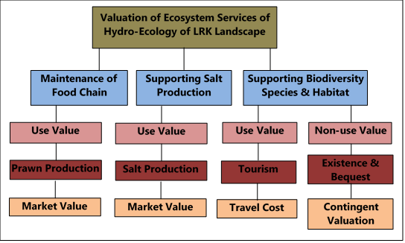
Valuation of ecosystem services of LRK
TAJ PALACE, NEW DELHI | 12 – 14 SEPTEMBER 2016

Slide 13
Valuation of ecosystem services of LRK
TAJ PALACE, NEW DELHI | 12 – 14 SEPTEMBER 2016
Sector | Method | Sample Size | Sample Distribution
Fishery | Market Analysis | 62 62 | No. of Sites/Dhasis 8 temporary migrant fishing settlements and 1 fishing village
Salt production | Market Analysis | FGD | Secondary Data
Tourists | Travel Cost | 40 | No. of Resorts covered - 6
Migratory Birds | CVM Fishers Farmers Tourists Agarias Other Public | 62 91 40 40 60 | 8 temporary migrant fishing settlements and 1 fishing village 19 farmers villages cover in 10 talukas of 5 District No. of Resorts covered - 6
Description of landscape level drivers of change
Review of secondary data & literature & consultations with subject experts; Primary survey: Satellite imagery analysis of salt works; HH survey of 91 farmers

Slide 14
Estimated Economic Values
TAJ PALACE, NEW DELHI | 12 – 14 SEPTEMBER 2016
Total estimated annual value of wetland system of LRK
Goods & Services | Method | Total Annual Value* (Million Rs.)
Prawn Fisheries | Market Revenue Analysis | 410.14
Salt production | Market Revenue Analysis | 694.30
Tourism & Recreation | Travel Cost | 276.05
Maintenance of Biodiversity | Contingent Valuation | 136.80
Total |  | 1517.29
* For Prawn production and Salt production, we estimated net annual value

Slide 15
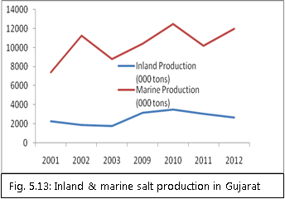
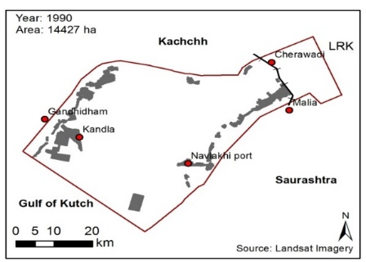
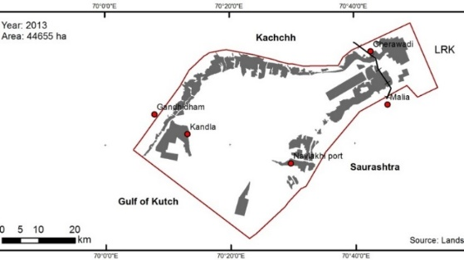
Trends in salt production
TAJ PALACE, NEW DELHI | 12 – 14 SEPTEMBER 2016
Diversion of Mud-flats and Creeks
Official Salt Lease Area: 21600 ha
Satellite Imagery based : 44600 ha

Slide 16
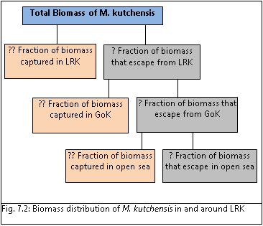
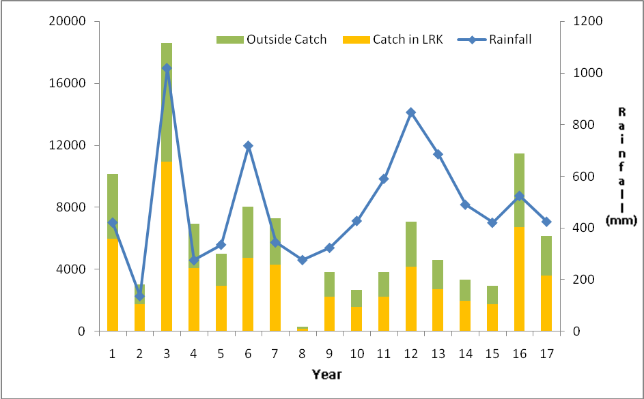
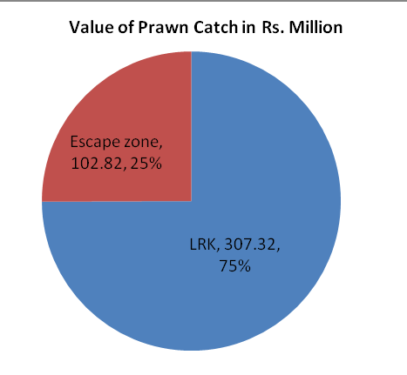
Trends in prawn production
TAJ PALACE, NEW DELHI | 12 – 14 SEPTEMBER 2016

Slide 17
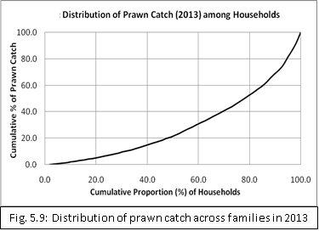
Spatial differences in prawn catch
TAJ PALACE, NEW DELHI | 12 – 14 SEPTEMBER 2016
ONLY LOCATIONAL ADVANTAGE, no additional access to fishing tools and labour
Customary norms to access to different quality fishing grounds
Higher prawn biomass capture near discharge points of seasonal rivers
Best locations are river mouths close to tidal creeks
20% fishers catch about 50% of total annual catch

Slide 18
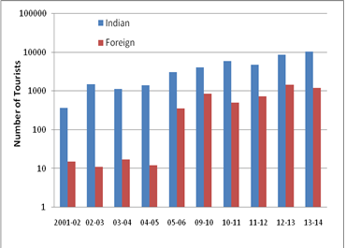
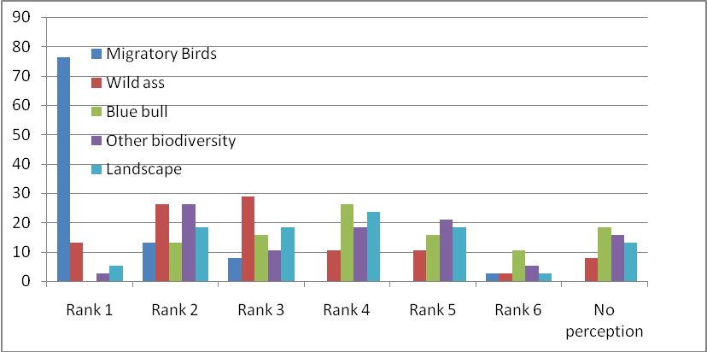
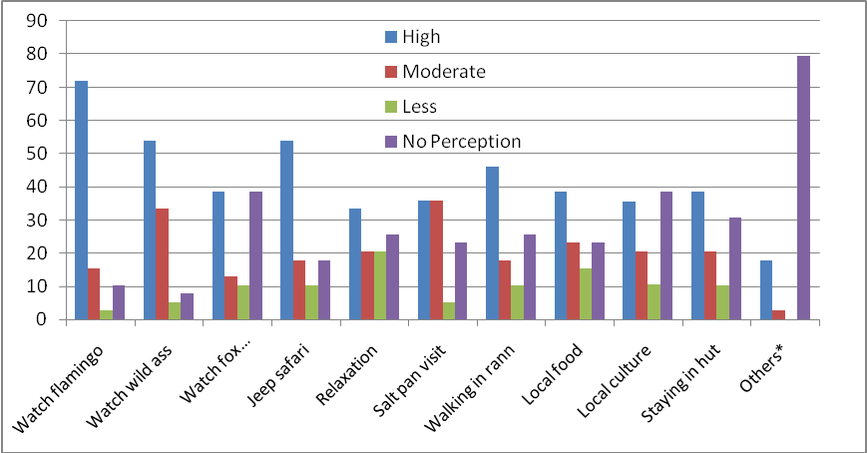
Trends in tourism
TAJ PALACE, NEW DELHI | 12 – 14 SEPTEMBER 2016

Slide 19
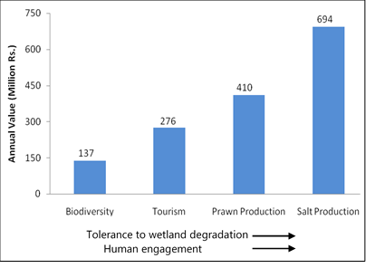
Sustainability of economic values
TAJ PALACE, NEW DELHI | 12 – 14 SEPTEMBER 2016

Slide 20
Sustainable growth of economic value
TAJ PALACE, NEW DELHI | 12 – 14 SEPTEMBER 2016
Tourists prefer flamingoes;
Flamingoes abandon nests;
Lack of adequate water;
Free catchment could increase depth of LRK by 29 cm;
Direct improvement of nesting sites;
Collateral gains in prawn fisheries.

Slide 21
Economic analysis and e-flow policy
TAJ PALACE, NEW DELHI | 12 – 14 SEPTEMBER 2016
use-value of biodiversity is growing in LRK despite natural variability and increasing disturbances,
e-flows will maintain, and restore, nesting habitats of migratory birds that are of value to tourists,
apart from depth and duration of water, LRK habitats are structured by sediment quality, nutrient transport and recruitment of biota (seeds, larvae, etc.)
tangible collateral benefit to prawn fishery in LRK, Gulf of Kachchh and beyond
protection of traditional, seasonal, high value – low volume, salt farming
flow management must be integral to overall development planning of the region
platform for negotiating allocations on the basis of hydrologic, ecologic AND economic knowledge?

Slide 22
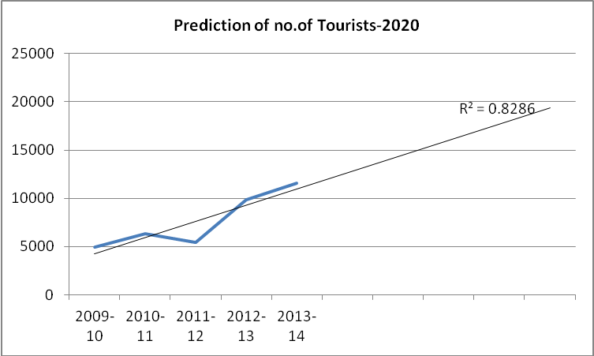
Landscape level Hydroecological trade-offs
TAJ PALACE, NEW DELHI | 12 – 14 SEPTEMBER 2016
Hydrological Dynamics…Controlled by
Inflow of - Fresh water- runoff
Inflow of Saline tidal water from Creek
Outflow of Brackish water through creek
Policy regimes and institutional capability
Alteration in Hydro-ecological Dynamics
Salt infrastructure in Creek..Changes in Water Flow and / or salinity regimes
Watershed development in catchment area - Changes in Water and Nutrient flow
Unsustainable resource use & management practices
Changes in Ecological Sub-Systems
Changes in Economic Sub-Systems

Slide 23
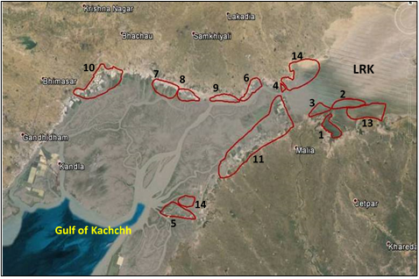
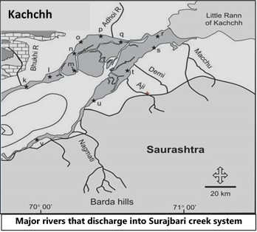
Changing hydroecology of creek;
Diversion of freshwater flows
TAJ PALACE, NEW DELHI | 12 – 14 SEPTEMBER 2016
11 reservoirs constructed on four rivers discharging into Surajbari Creek
Total water storage capacity of these reservoirs is 455 MCM water
Loss of suitable habitats for prawn breeding and thus loss of fishing grounds

Slide 24
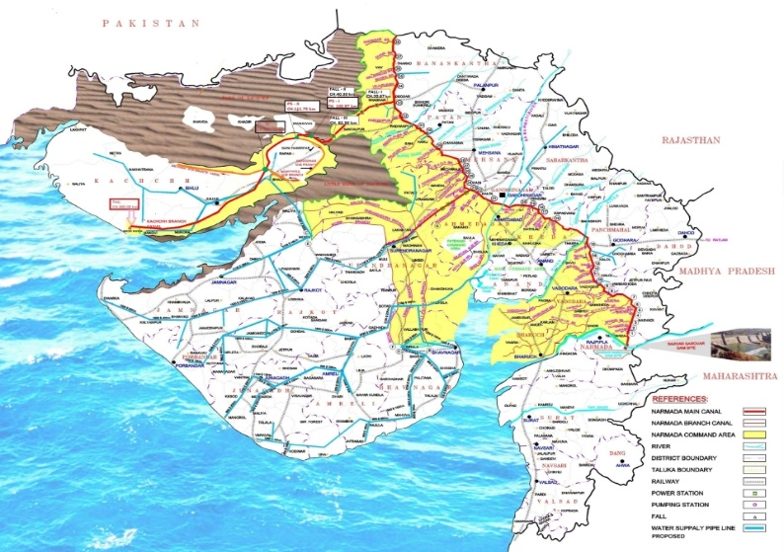
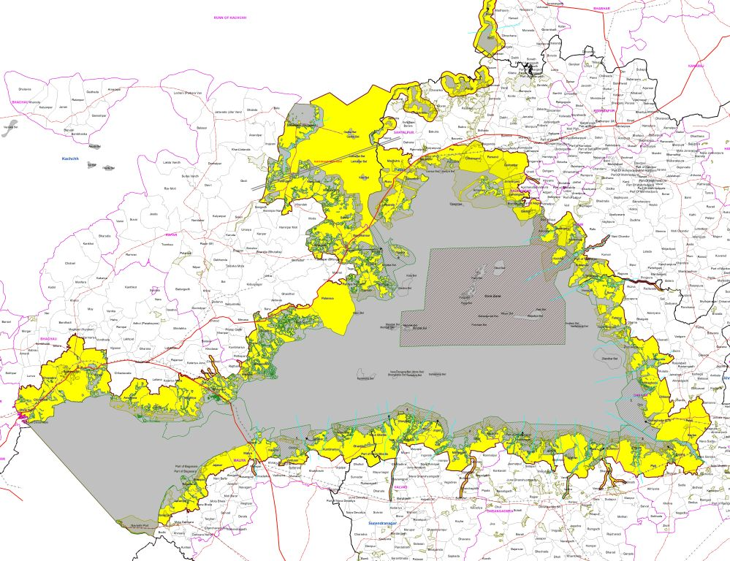
Inter-basin transfers; release in seasonal streams of LRK
TAJ PALACE, NEW DELHI | 12 – 14 SEPTEMBER 2016
Surplus canal water is presently being released in 23 streams;
Floods the fringe areas of LRK, but also spread by strong wind action;
Dry phase of the Rann affected with immediate impact on salt production.

Slide 25
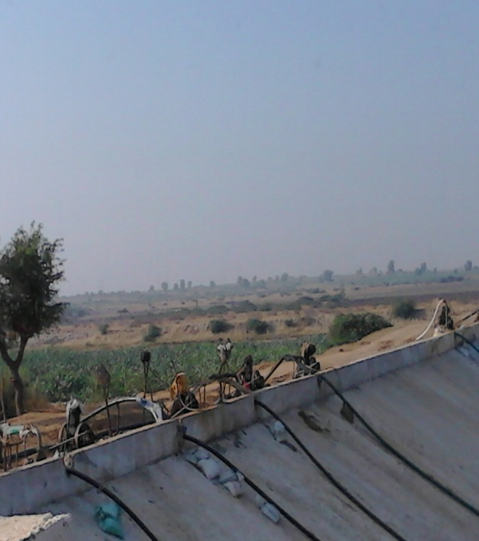
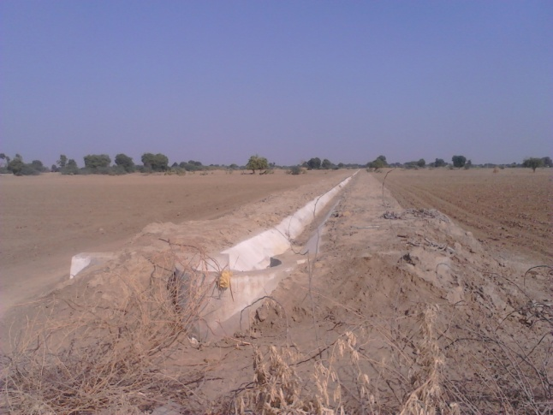
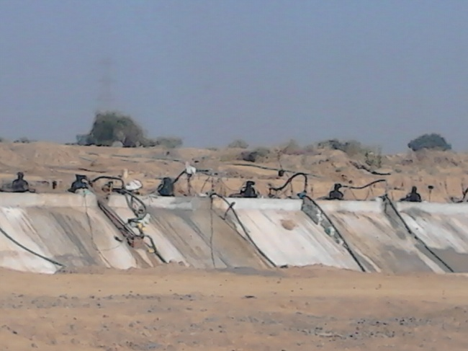
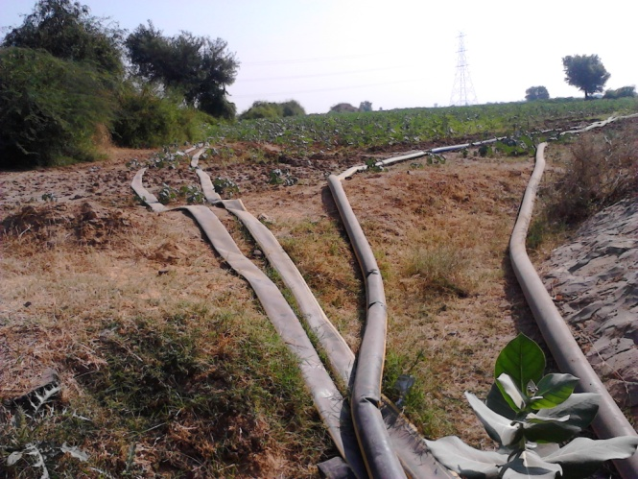
Thank you
TAJ PALACE, NEW DELHI | 12 – 14 SEPTEMBER 2016
e-flows from inter-basin transfers!
Value of e-flows in original basin compared with inter-basin transfers!

