Slide 1
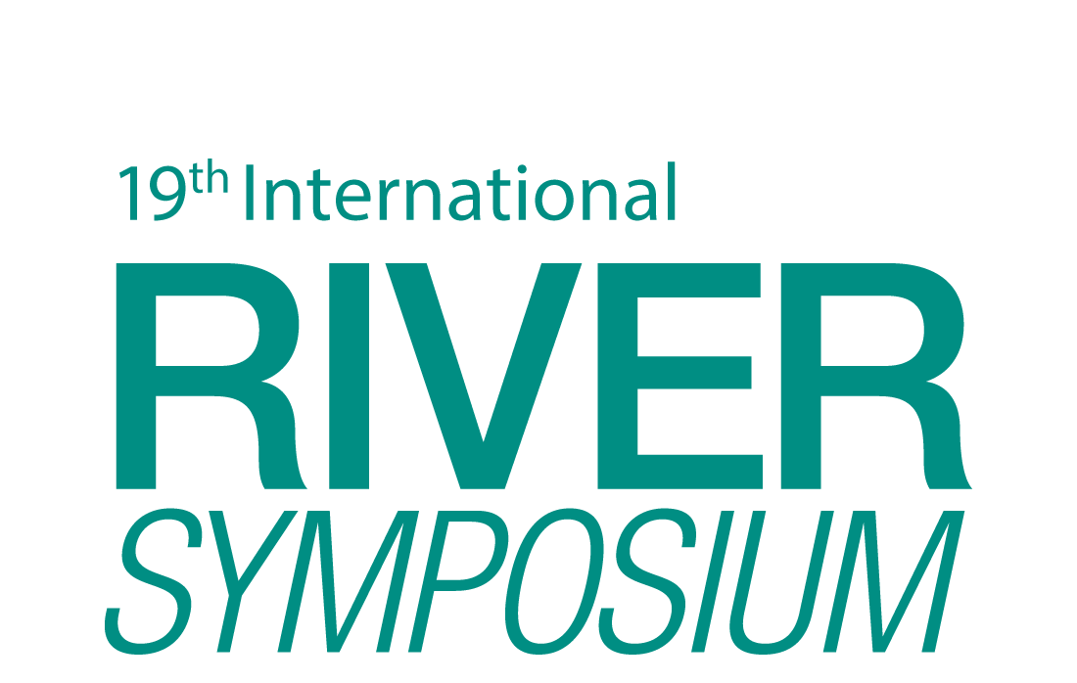
TAJ PALACE, NEW DELHI | 12 – 14 SEPTEMBER 2016
Understanding the barriers that prohibit the integrations of TWCM principles in the water strategies of urban utilities
Pritha Bhattacharya

Slide 2
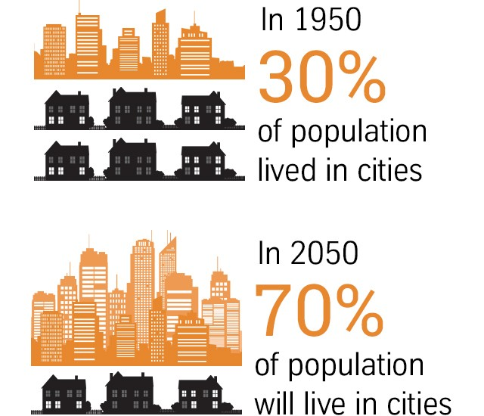
TAJ PALACE, NEW DELHI | 12 – 14 SEPTEMBER 2016
Context
Rapid pace of urbanization is a complex and an important socio-economic change of the century (Allen 2009)
Higher demand for water and sewage services in urban areas, and is compounded by increased social demands for better environmental protection of waterways and livable areas in the urban space (WSAA 2014)
http://www.urban-hub.com

Slide 3
TAJ PALACE, NEW DELHI | 12 – 14 SEPTEMBER 2016
Changes to the way people interact with the environment and manage natural resources.
Change in normative driver/ societal value that demands livable urban areas and sustainable management of natural resources
Driven the change in regulation of water resources for co- existence of centralized & decentralized systems with community and private sectors participation rather than a primitive top down engineering approach
(Brown et al. 2009)
Normative Driver
Cognitive Driver
Regulative Driver

Slide 4
TAJ PALACE, NEW DELHI | 12 – 14 SEPTEMBER 2016
Sustainable Urban Water Management
Integrated Urban Water Management
Total Water Cycle Management
Customization of IWRM for urban water management has helped in the formulation of concepts like Sustainable Urban Water Management (SUWM), Integrated Urban Water Management (IUWM), Total Water Cycle Management (TWCM)

Slide 5
TAJ PALACE, NEW DELHI | 12 – 14 SEPTEMBER 2016
Total Water Cycle Management
maintaining the natural water cycle and reducing any modification to water resources
safeguarding that extraction of water from its source is within environmental limits
exploring potential water supply sources like re-using of treated water, stormwater harvesting
promoting demand side management through encouraging minimum water use and loss and endorsing efficient water use and re-use
ensuring that the quality of water is preserved at all stages of water cycle
(Brown et al. 2009)

Slide 6
TAJ PALACE, NEW DELHI | 12 – 14 SEPTEMBER 2016
Need for data/information
Data
Hydrological
Meteorological
Information
Organization's strategic direction
Shareholder's & stakeholder's visons
Knowledge
Technological innovation
Demographic
Land use
Environmental quality
Growth trends
Climatic trends
National & international trends
Community & stakeholder knowledge
Opportunities for innovation

Slide 7
TAJ PALACE, NEW DELHI | 12 – 14 SEPTEMBER 2016
Socio Institutional Barriers
Socio Institutional Barriers
Poor collaboration between institutions
Fragmented responsibilities
Uncoordinated institutional frameworks
(Brown et. al., 2006)

Slide 8
TAJ PALACE, NEW DELHI | 12 – 14 SEPTEMBER 2016
Research Questions
Primary RQ:
What are the barriers that prohibit the integrations of TWCM principles in the water strategies of urban utilities especially of Brisbane?
Secondary RQ:
What are the barriers that impede the access of relevant data/information while developing strategies by urban utilities especially of Brisbane?

Slide 9
TAJ PALACE, NEW DELHI | 12 – 14 SEPTEMBER 2016
Process/Method
Framework: Transition Management Framework
Data collection: Semi structured interviews
Method of data analysis: Thematic analysis

Slide 10
TAJ PALACE, NEW DELHI | 12 – 14 SEPTEMBER 2016
Outcome/ Lessons Learnt
Consent on IWRM as a tool for sustainable development
Lack of capacity building on data collection and management
Challenges regarding interoperability of data
Lack of trust on the data collected
Siloism /Fragmentation of water management institutions

Slide 11
TAJ PALACE, NEW DELHI | 12 – 14 SEPTEMBER 2016
Transferrable Outcomes
Open source of data
Public funding for data collection
Collaboration between organizations for data management

Slide 12
TAJ PALACE, NEW DELHI | 12 – 14 SEPTEMBER 2016
THANKS !

Slide 13
TAJ PALACE, NEW DELHI | 12 – 14 SEPTEMBER 2016
References
Allen, A., 2009. Sustainable cities or sustainable urbanization? Journal of Sustainable Cities, pp.1–3.
Brown, R.R., Keath, N. & Wong, T.H.F., 2009. Urban water management in cities: historical, current and future regimes. Water Science and Technology, 59(5), pp.847–855.
Brown, R.R., Sharp, L. & Ashley, R.M., 2006. Implementation impediments to institutionalizing the practice of sustainable urban water management. Water Science and Technology, 54(6-7), pp.415–422.
WSAA, 2014. The role of the urban water industry in contributing to liveability. , (March), pp.1–24.

