Slide 1
A Framework for Ecological Transformation of Musi River through Geodesign
Sarat Chandra Bokka
ESRI India
Notes:
Esri Corporate Template-Light v3.2
16:9 version – April 9, 2015
For more templates, sample files, tools, and icons, see https://compass.esri.com/resources/presentations/Pages/Main.aspx
To add footer text in Windows
On the Home tab, under Insert, click Text, and then click Header and Footer.
Click the Slide tab, select the Footer check box, and then type the footer text that you want.
Click either Apply or Apply to All.
To add footer text on a Mac
On the View menu, select Header and Footer.
Select the Footer check box and then type the footer text that you want.
Click either Apply or Apply to All.
If footers don't appear on the slides
If footers don't appear on title slides, in the Header and Footer dialog box make sure the Don't show on title slide check box is not selected.
If the footers are missing from other slides, the placeholders for these items might have been removed from specific slide layouts or the slide master.

Slide 2
Agenda
ESRI India
History of Musi
Concept of Geodesign
Geoplanner for ArcGIS
Creation of purification plans
Analyzing plans from each scenario
Sharing of plans with stakeholders

Slide 4
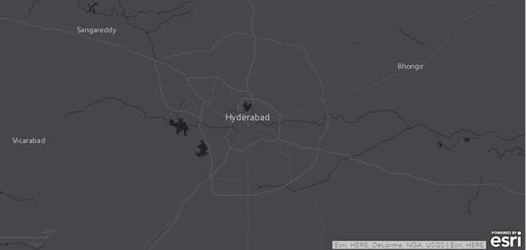
History of Musi
Tributaries of River Krishna
Originates in Ananthagiri hills near Vicarabad.
Helped in growth of Hyderabad.
Flooded during 1908
prevention measure created Himayath Sagar and Osman Sagar.
Water requirements of city are met by the Sagars.
Hyderabad is chosen as capital of united Andhra Pradesh.
Rapid urbanization and Industrialization taken place.
Changed entire phase of river Musi.

Slide 5
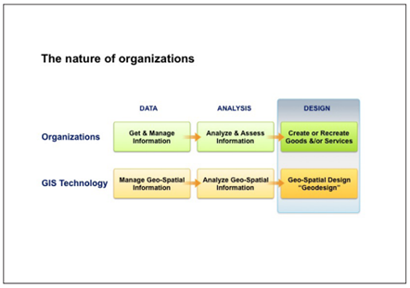
Concept of Geodesign
Concept of design defines geodesign
Importance (Science, Value, Integral)
Nature (Abductive, Iterative, Collaborative)

Slide 6
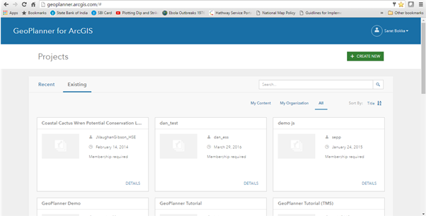
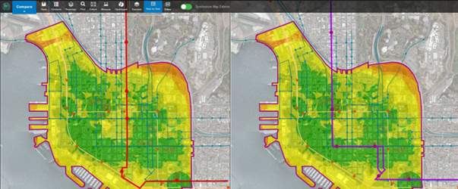
Geoplanner for ArcGIS
A framework for geodesign
This is Project centric
Ability to Explore data
Design of multiple scenarios
Evaluate each design
Share the results

Slide 7
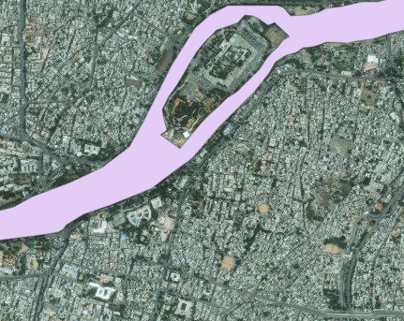
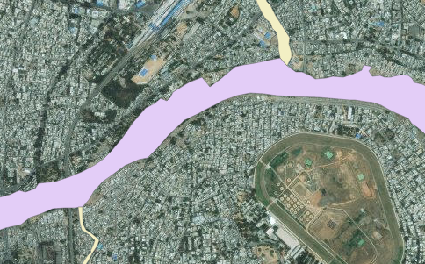
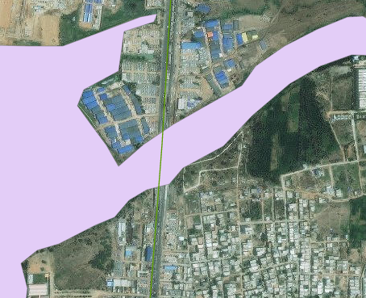
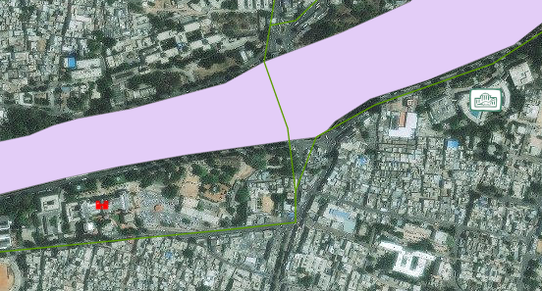
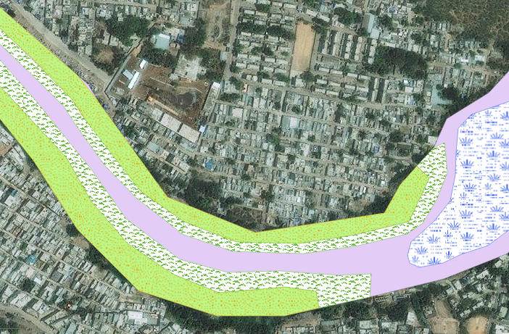
Creation of Purification Plan
Elements considered
The current course of River Musi
Major Drainages
Road network
Places of Interest
Plant species in water purification
Objective: Design of plant species placement in purifying water considering the
road network access and places of interest near banks of Musi.

Slide 8
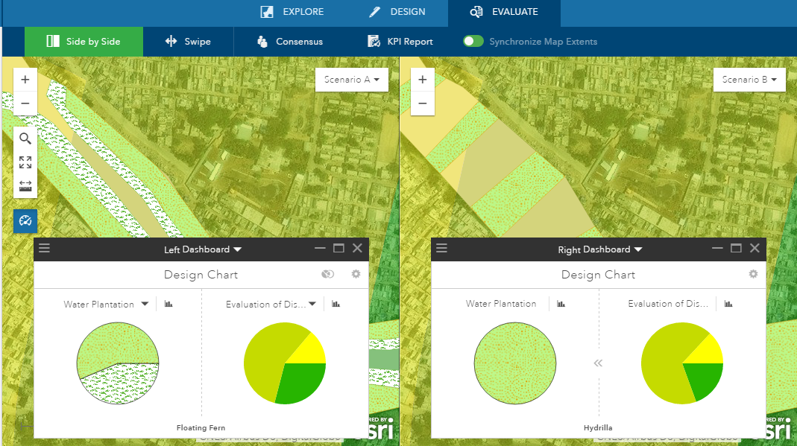
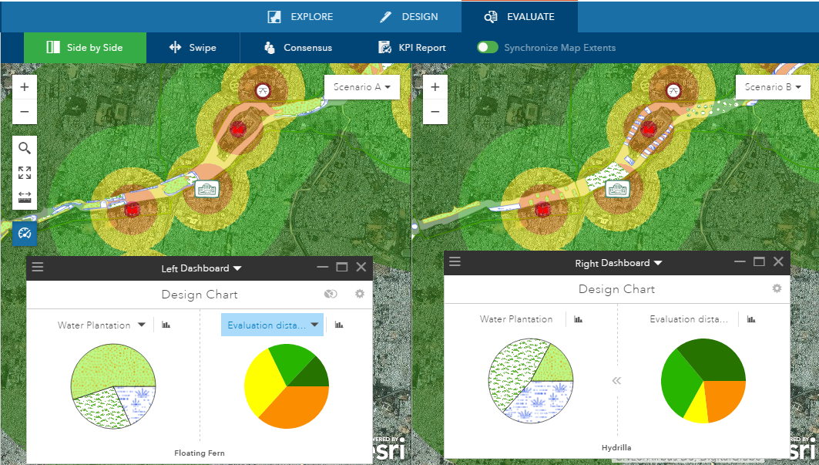
Analyzing plans from each scenario
Analyzing access to road
Analyzing distance to places

Slide 9
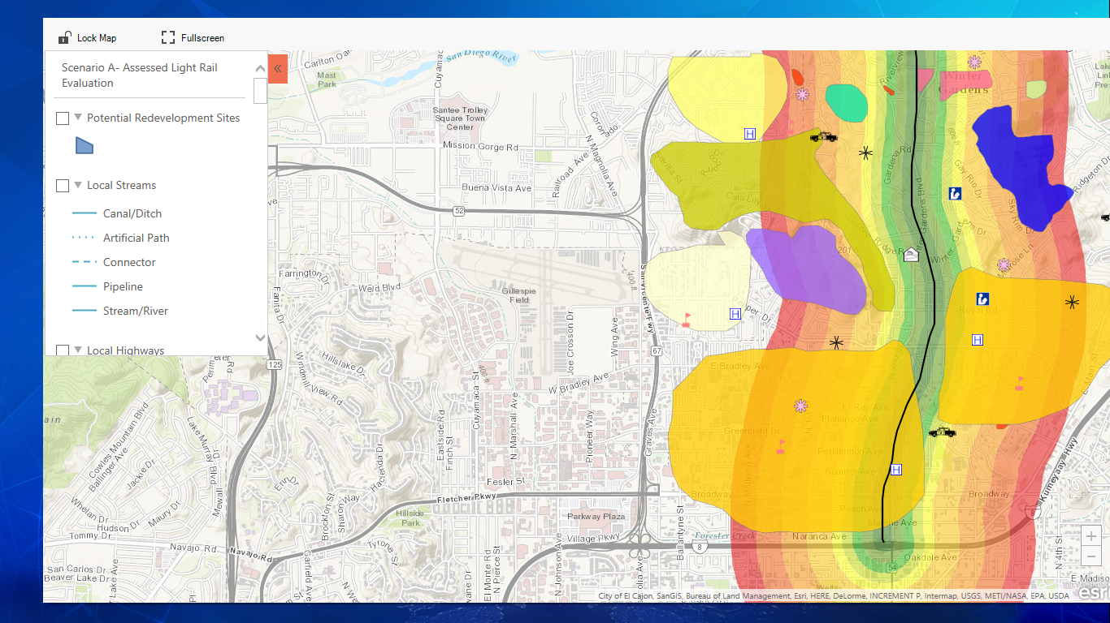
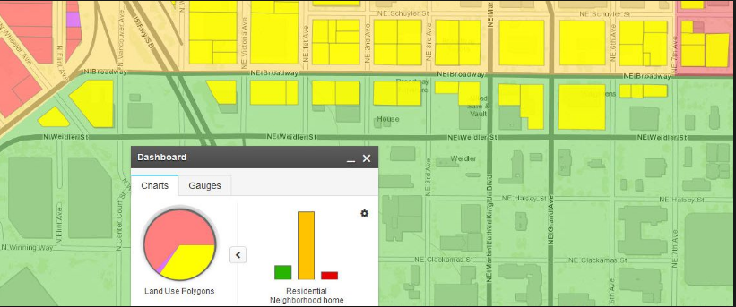
Sharing of plans with stakeholders
Presentation mode
Story map mode

Slide 10
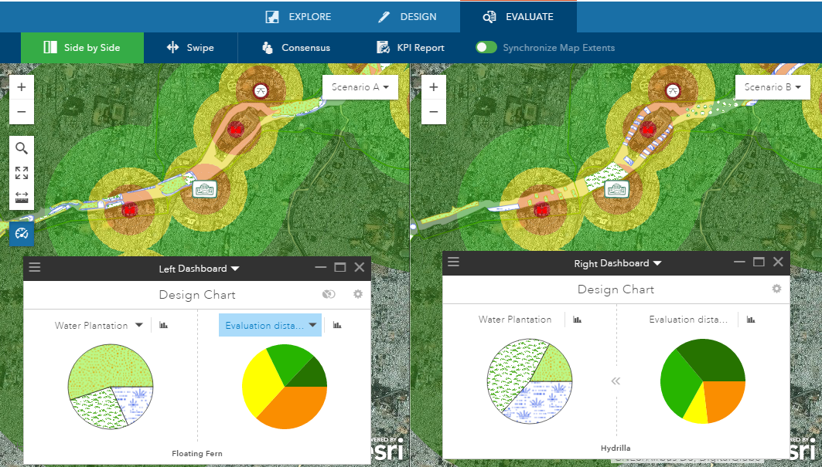
Geodesign of River Musi

