Slide 1
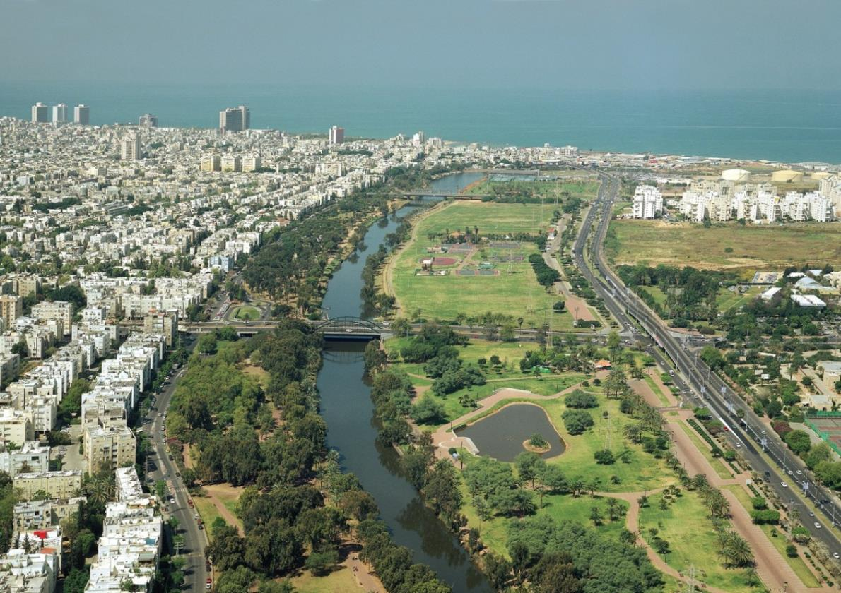
Urban River Restoration:
Cities & Water
Amos Brandeis
Ambassador of the International Riverfoundation (IRF)
Planner and Manager of River Restoration Projects
General Rapporteur of ISOCARP congress 2014 (Cities & Water)
Architect and City & Regional Planner

Slide 2
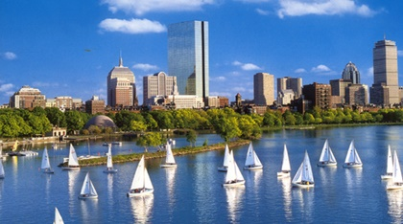
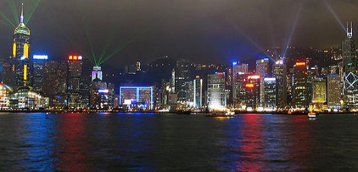
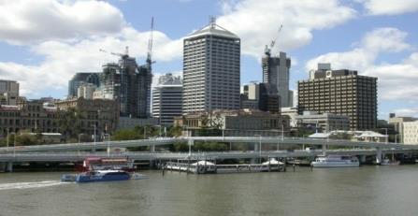
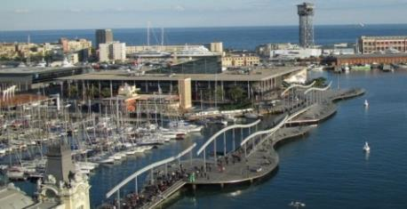
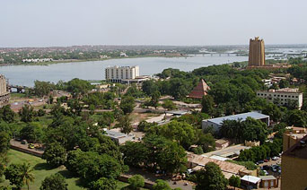
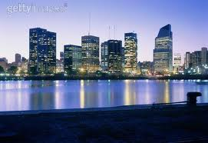
Urban Rivers are Everywhere
Almost all cities around the world were built
along rivers, or streams.
North America
Asia
Australia
Boston
Beijing
Brisbane
Europe
Africa
South America
Barcelona
Bamako (Mali)
Buenos Aires
Amos Brandeis

Slide 3
The Water Quality in the River is Crucial
The rivers are not anymore only a water source and used for transportation. We need clean, good looking, ecological rich, and not stinking water in the city, if we want the river to become an urban asset.
Amos Brandeis

Slide 4
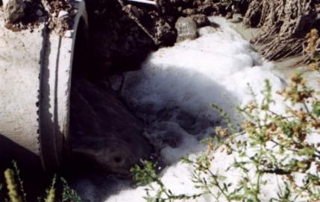
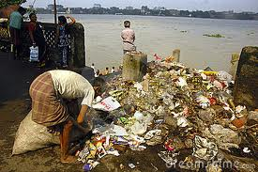
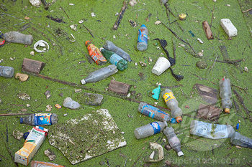
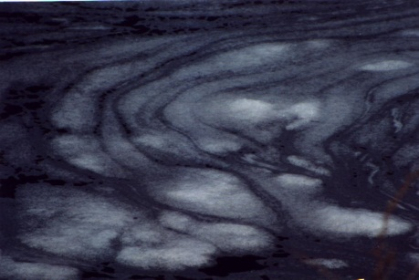
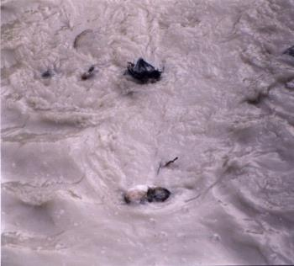
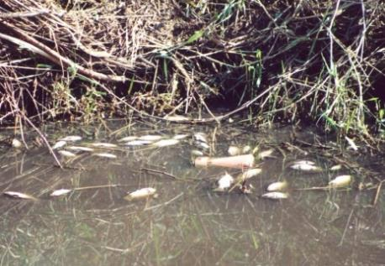
Deterioration of Rivers = Deterioration of Cities and Waterfronts
During the 20th century many of the rivers have been polluted, deteriorated, and they lost their significant roles.
Many rivers became a nuisance to the urban environment
Amos Brandeis
Notes:
Establishing Russia’s first watershed councils to restore and protect some of the world’s last remaining wild Pacific salmon populations.
Creating and coordinating a network of over 100 youth groups in Nairobi, Kenya to clean up the Nairobi River.
Providing clean water for villages in rural Kenya
Mentoring the formation of a community Landcare group in remote northern Queensland, Australia to protect and restore the Gregory River.
Hosting the first international forum on watershed management and development in arid and semiarid regions held in Cordoba, Argentina

Slide 5
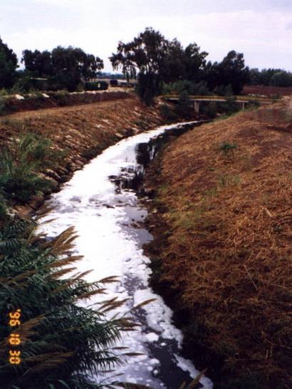
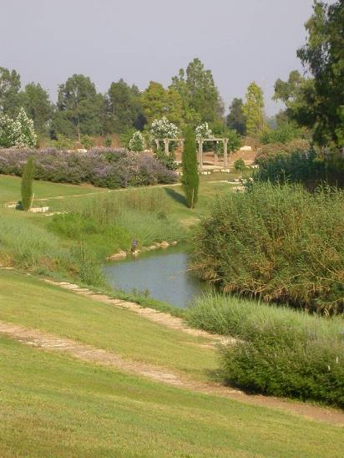
Restoration of Rivers = Revitalization of Cities and Waterfronts
In recent years, major efforts of river restoration have brought many rivers back to life. Not only the big ones. Still much work has to be done…
Winner of the 2003 Thiess International Riverprize
Before - 1996
After - 2016
Alexander River Cross border river - Collaboration between Israeli and Palestinian neighbors
Planning and Managing: Arch. Amos Brandeis
Amos Brandeis
Notes:
Establishing Russia’s first watershed councils to restore and protect some of the world’s last remaining wild Pacific salmon populations.
Creating and coordinating a network of over 100 youth groups in Nairobi, Kenya to clean up the Nairobi River.
Providing clean water for villages in rural Kenya
Mentoring the formation of a community Landcare group in remote northern Queensland, Australia to protect and restore the Gregory River.
Hosting the first international forum on watershed management and development in arid and semiarid regions held in Cordoba, Argentina

Slide 6
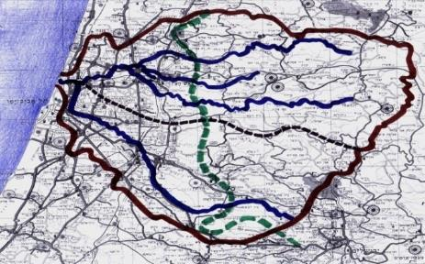
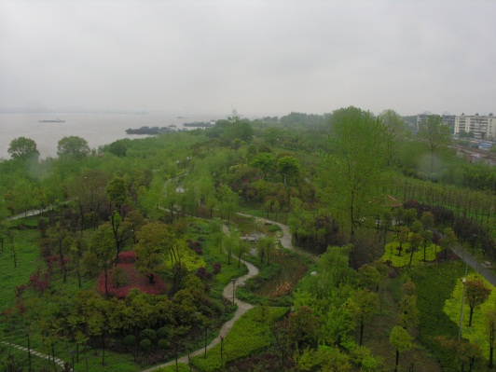
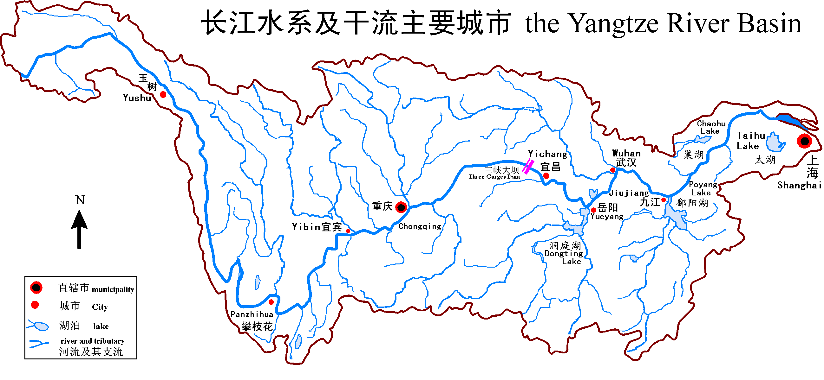
Projects on the Urban Scale cannot Restore Rivers
Cities are just a small part of water systems,
even in the case of “Urban Rivers”.
Yarqon River Catchment 1,800 km2
New York
Shanghai
Brisbane
Tel Aviv - 400,000 residents
Shanghai, Huangpu River
Brisbane, Brisbane River
Barcelona
Yangtze River Catchment 1,800,000 km2
Buenos Aires
Wuhan - 11,000,000 residents
London, Themes River
Buenos Aires, Rio de la Plata River
Amos Brandeis
Notes:
Establishing Russia’s first watershed councils to restore and protect some of the world’s last remaining wild Pacific salmon populations.
Creating and coordinating a network of over 100 youth groups in Nairobi, Kenya to clean up the Nairobi River.
Providing clean water for villages in rural Kenya
Mentoring the formation of a community Landcare group in remote northern Queensland, Australia to protect and restore the Gregory River.
Hosting the first international forum on watershed management and development in arid and semiarid regions held in Cordoba, Argentina

Slide 7
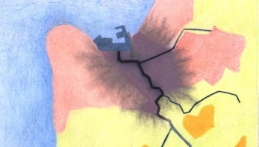
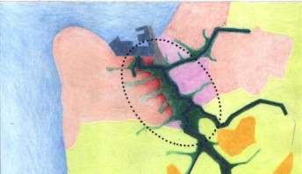
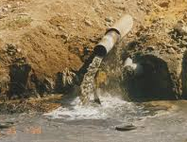
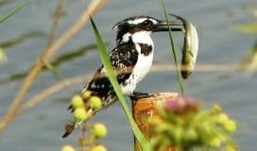
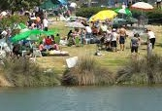
Urban River Restoration has to be Planned and Implemented on the Catchment Level
The multifaceted relationships between urban planning and water have, and still do, structure, shape and influence the development of:
Metropolitan areas
Cities and towns
Rural areas
Villages
Neighborhoods
Shanghai
Brisbane
Buenos Aires
Buenos Aires, Rio de la Plata River
Before
After
Kishon River Restoration Masterplan, Haifa, Israel
Chief Planner: Amos Brandeis
Amos Brandeis
Notes:
Establishing Russia’s first watershed councils to restore and protect some of the world’s last remaining wild Pacific salmon populations.
Creating and coordinating a network of over 100 youth groups in Nairobi, Kenya to clean up the Nairobi River.
Providing clean water for villages in rural Kenya
Mentoring the formation of a community Landcare group in remote northern Queensland, Australia to protect and restore the Gregory River.
Hosting the first international forum on watershed management and development in arid and semiarid regions held in Cordoba, Argentina

Slide 8
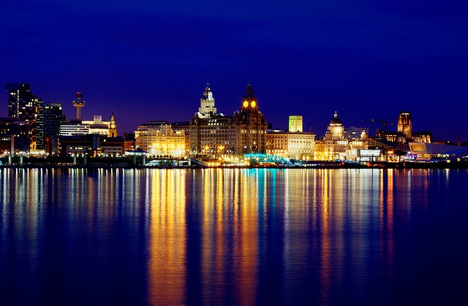
How to Restore Urban Rivers?
Winner of the 1999 Thiess International Riverprize
Liverpool on the Mersey River
Amos Brandeis
Notes:
Establishing Russia’s first watershed councils to restore and protect some of the world’s last remaining wild Pacific salmon populations.
Creating and coordinating a network of over 100 youth groups in Nairobi, Kenya to clean up the Nairobi River.
Providing clean water for villages in rural Kenya
Mentoring the formation of a community Landcare group in remote northern Queensland, Australia to protect and restore the Gregory River.
Hosting the first international forum on watershed management and development in arid and semiarid regions held in Cordoba, Argentina

Slide 9
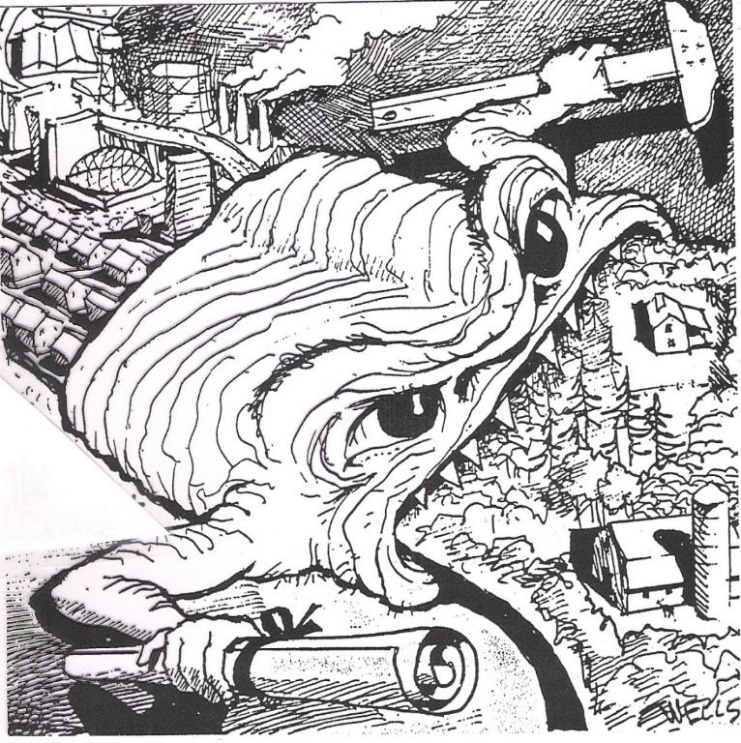
20 years ago I was very young and naive…
I thought planning is preparing drawings and reports, and things will happen
me
5
Amos Brandeis

Slide 10
10 years ago I was less young and less naive…
I thought planning is like assembling a complicated puzzle
Kishon River Masterplan. Planner: Amos Brandeis
6
Amos Brandeis

Slide 11
Now I am older and more realistic…
I think planning is like solving the Rubik’s Cube:
Public
Particip-
ation
Open Spaces
Land
Uses
Leadership
Wildlife
Tourism
Statutory
Plans
River
Banks
Urban
design
Water
Quality
Water
Quantity
River
Paths
Water
Sources
Pollution
Drainage
Cost
Financing
Ground Water
Leisure
Complicated
3d
All disciplines
All scales
One wrong move…
Landscape
Parks
Legislation
Ecology
Social aspects
Collaboration
Vegetation
Future
Structures
Maintenance
Monitoring
7
Amos Brandeis

Slide 12
The Topics of River Restoration Planning and Urban Planning, Especially need Inter-Disciplinary Dialogue
Sectors: Academic, Public and Private
Disciplines: Urban planners and designers, Architects, River restoration planners and managers, Environmentalists, Sociologists, Economists, Infrastructure planners, Landscape architects, Decision makers, Other Professionals, etc.
Politicians
The People
River Planner
Urban Planner
Amos Brandeis
Notes:
Establishing Russia’s first watershed councils to restore and protect some of the world’s last remaining wild Pacific salmon populations.
Creating and coordinating a network of over 100 youth groups in Nairobi, Kenya to clean up the Nairobi River.
Providing clean water for villages in rural Kenya
Mentoring the formation of a community Landcare group in remote northern Queensland, Australia to protect and restore the Gregory River.
Hosting the first international forum on watershed management and development in arid and semiarid regions held in Cordoba, Argentina

Slide 13
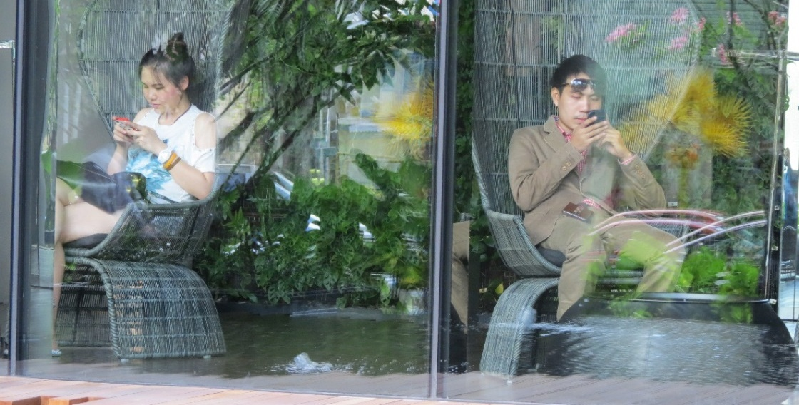
The challenge is - how we create a Real Dialogue?
River Planner
Urban Planner
Amos Brandeis
Notes:
Establishing Russia’s first watershed councils to restore and protect some of the world’s last remaining wild Pacific salmon populations.
Creating and coordinating a network of over 100 youth groups in Nairobi, Kenya to clean up the Nairobi River.
Providing clean water for villages in rural Kenya
Mentoring the formation of a community Landcare group in remote northern Queensland, Australia to protect and restore the Gregory River.
Hosting the first international forum on watershed management and development in arid and semiarid regions held in Cordoba, Argentina

Slide 14
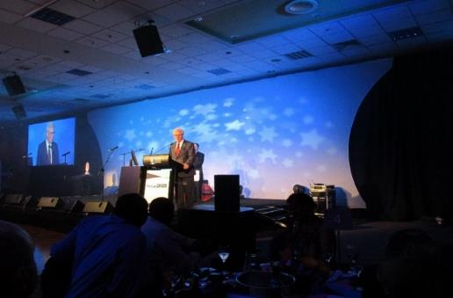
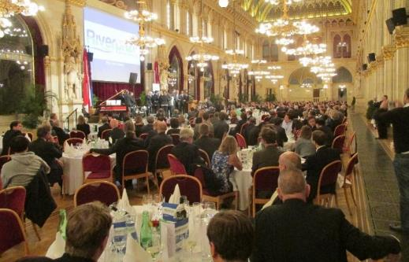
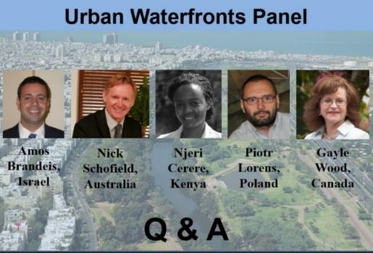
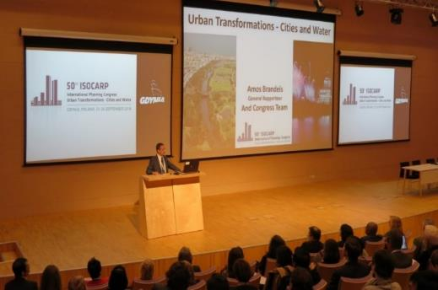
Urban River Themes became recently the Core of many Leading International Congresses and Events - but in most of them the participants are either River People, or Urban People…
IRS (International River Symposium) 2015, Australia
ECRR (European Center for River Restoration) 2014, Austria
ISOCARP (International Society of City and Regional Planners) 2014, Poland
World Town Planning Day 2013,
Virtual
Amos Brandeis
Notes:
Establishing Russia’s first watershed councils to restore and protect some of the world’s last remaining wild Pacific salmon populations.
Creating and coordinating a network of over 100 youth groups in Nairobi, Kenya to clean up the Nairobi River.
Providing clean water for villages in rural Kenya
Mentoring the formation of a community Landcare group in remote northern Queensland, Australia to protect and restore the Gregory River.
Hosting the first international forum on watershed management and development in arid and semiarid regions held in Cordoba, Argentina

Slide 15
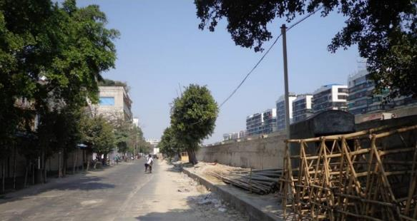
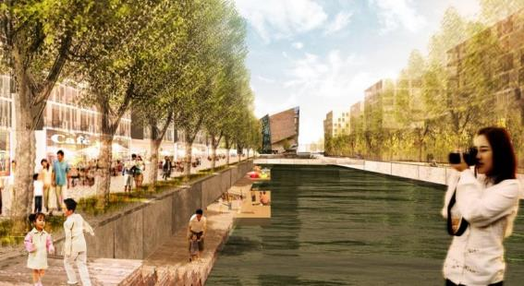
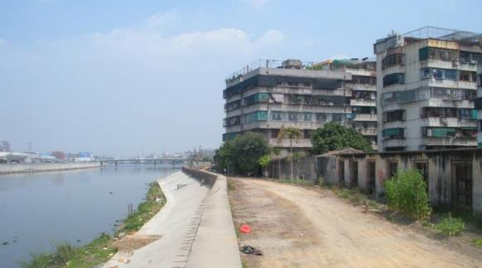
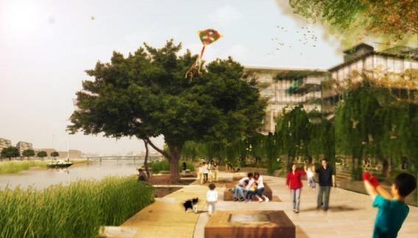
Here most Participants are River Experts
Therefore I will concentrate mainly on Urban Issues,
and especially Waterfronts
Before
After
Shantou, China planning workshop (UPAT) - ISOCARP, 2013. Team Leader - Amos Brandeis
Amos Brandeis
Notes:
15
Establishing Russia’s first watershed councils to restore and protect some of the world’s last remaining wild Pacific salmon populations.
Creating and coordinating a network of over 100 youth groups in Nairobi, Kenya to clean up the Nairobi River.
Providing clean water for villages in rural Kenya
Mentoring the formation of a community Landcare group in remote northern Queensland, Australia to protect and restore the Gregory River.
Hosting the first international forum on watershed management and development in arid and semiarid regions held in Cordoba, Argentina

Slide 16
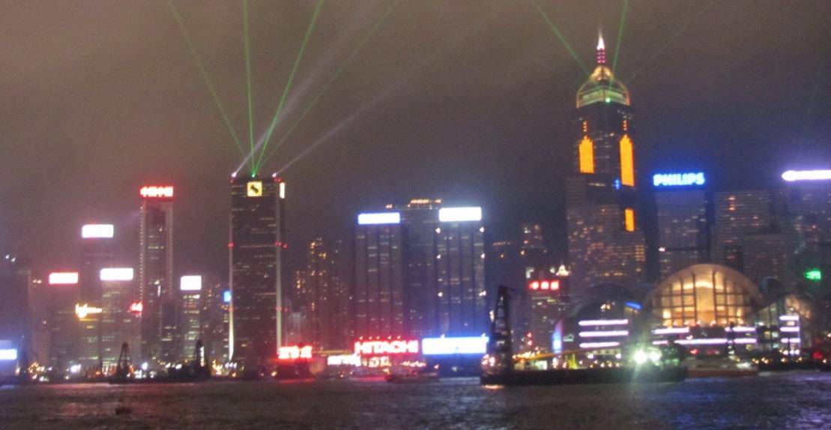
Waterfronts are the places for the people to meet and enjoy
Urban Waterfronts - “Urban Celebrations”
A huge urban asset and potential
Hong Kong Light and Sound Evening Show
Amos Brandeis

Slide 17
What Makes Waterfronts Successful?
Not only beautiful, but also alive.
Part of the urban structure and life. What makes places successful?
Derwent River Waterfront, Hobart, Tasmania, Australia
Amos Brandeis
Notes:
Establishing Russia’s first watershed councils to restore and protect some of the world’s last remaining wild Pacific salmon populations.
Creating and coordinating a network of over 100 youth groups in Nairobi, Kenya to clean up the Nairobi River.
Providing clean water for villages in rural Kenya
Mentoring the formation of a community Landcare group in remote northern Queensland, Australia to protect and restore the Gregory River.
Hosting the first international forum on watershed management and development in arid and semiarid regions held in Cordoba, Argentina

Slide 18
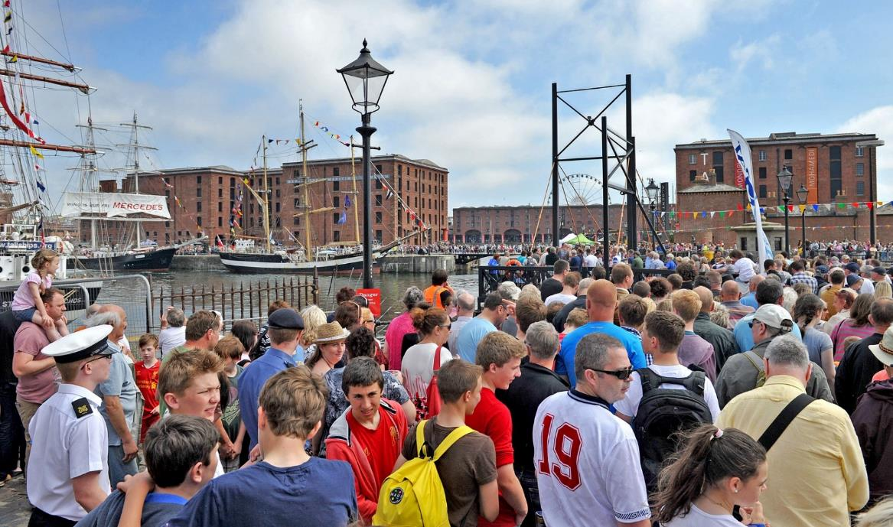
We plan for the People who live in the City
No happy people = No Successful Waterfront
Liverpool - Mersey River Festival 2014
Amos Brandeis

Slide 19
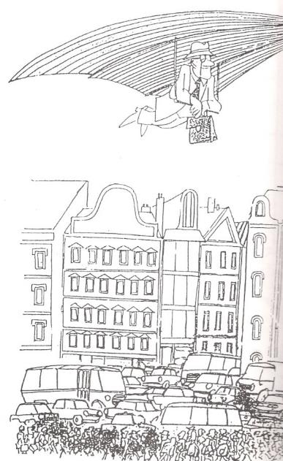
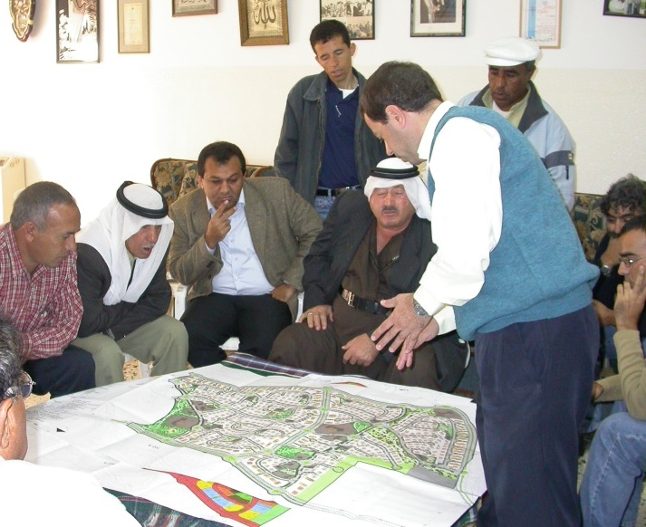
We want the People “to own” the Waterfront and to be proud of it
We need to plan together with them.
(no)
(no)
(yes)
Amos Brandeis

Slide 20
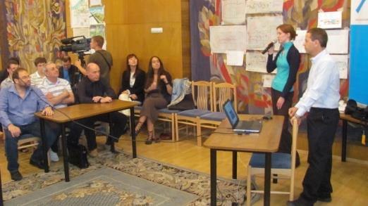
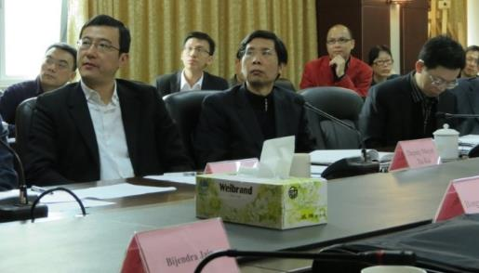
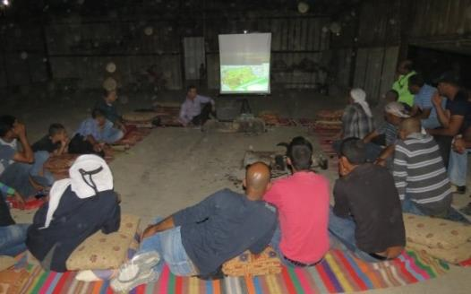
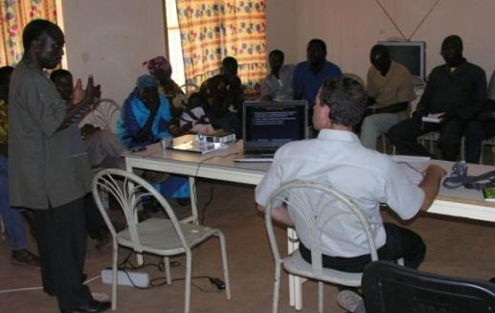
All people know what they want. We just have to ask them
The best (and only) way to plan an urban waterfront (and other projects),
is with the people who live there and use/will use the place. They can best define what they need and want & what are the key values
Shantou, China (UPAT ISOCARP)
Pushchino, Russia (YPP ISOCARP)
El Amrani Bedouins, Israel
Burkina Faso, Africa
Amos Brandeis

Slide 21
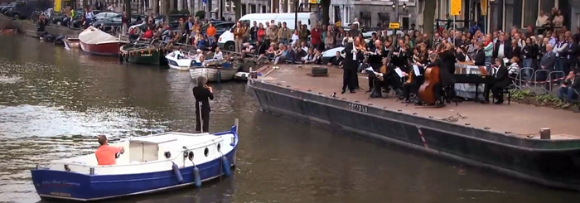
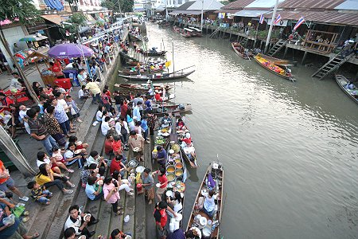
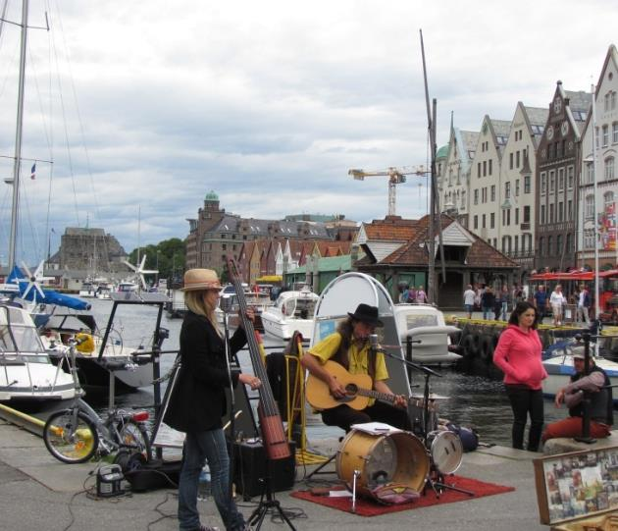
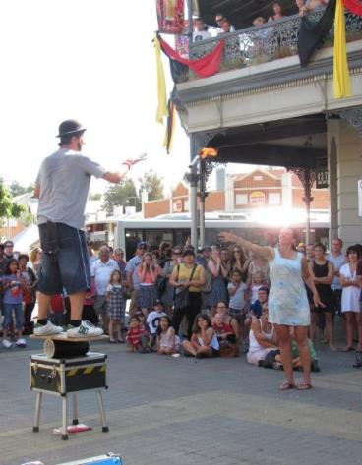
People (everywhere) want a Livelihood Waterfront
Amsterdam, Netherland
Bangkok, Thailand
Urban life…
A place to enjoy.
A liveable place
Freemantle, Australia
Bergen, Norway
Amos Brandeis

Slide 22
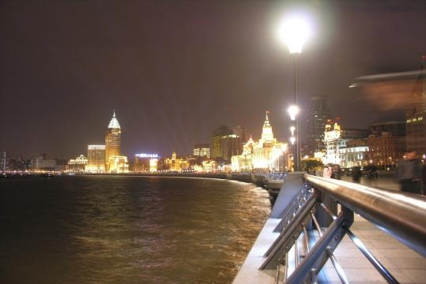
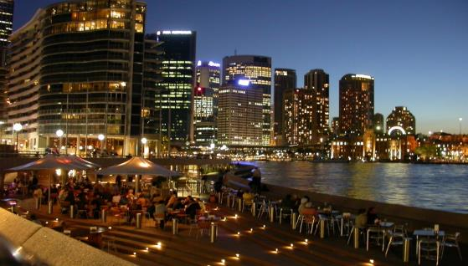
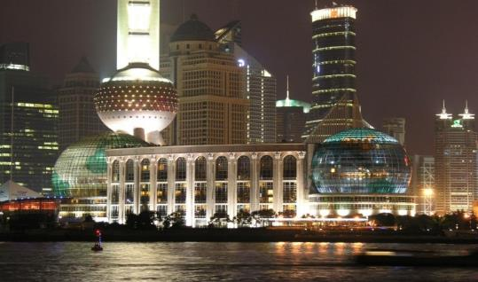
Alive 24/7
Urban celebrations start at night...
Brisbane (Riverfeast), Australia
The Bund, Shanghai, China
Sydney, Australia
Pudong, Shanghai, China
Amos Brandeis
Notes:
Establishing Russia’s first watershed councils to restore and protect some of the world’s last remaining wild Pacific salmon populations.
Creating and coordinating a network of over 100 youth groups in Nairobi, Kenya to clean up the Nairobi River.
Providing clean water for villages in rural Kenya
Mentoring the formation of a community Landcare group in remote northern Queensland, Australia to protect and restore the Gregory River.
Hosting the first international forum on watershed management and development in arid and semiarid regions held in Cordoba, Argentina

Slide 23
History, Heritage and local Cultures and Values Matter!
The respect, preservation and strengthening of local values and atmosphere, have a huge contribution to the place making
Derwent River Waterfront, Hobart, Tasmania, Australia
Amos Brandeis

Slide 24
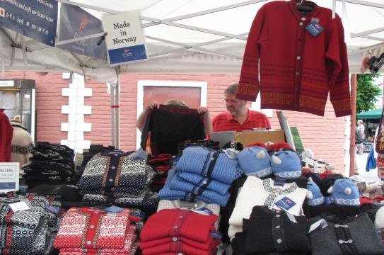
People are looking for the local flavor
Bergen, Norway
Amos Brandeis

Slide 25
The most important buildings are usually built there
To attract local people and tourists, and become lively places
London
NEMO Science Museum, Amsterdam
Maritime Museum, Perth, Australia
Amos Brandeis
Notes:
Establishing Russia’s first watershed councils to restore and protect some of the world’s last remaining wild Pacific salmon populations.
Creating and coordinating a network of over 100 youth groups in Nairobi, Kenya to clean up the Nairobi River.
Providing clean water for villages in rural Kenya
Mentoring the formation of a community Landcare group in remote northern Queensland, Australia to protect and restore the Gregory River.
Hosting the first international forum on watershed management and development in arid and semiarid regions held in Cordoba, Argentina

Slide 26
Urban Icons are often designed along the waterfront
Sydney Opera
Copenhagen Opera
Gorthenburg Opera
Oslo Opera
Amos Brandeis
Notes:
Establishing Russia’s first watershed councils to restore and protect some of the world’s last remaining wild Pacific salmon populations.
Creating and coordinating a network of over 100 youth groups in Nairobi, Kenya to clean up the Nairobi River.
Providing clean water for villages in rural Kenya
Mentoring the formation of a community Landcare group in remote northern Queensland, Australia to protect and restore the Gregory River.
Hosting the first international forum on watershed management and development in arid and semiarid regions held in Cordoba, Argentina

Slide 27
Uniqueness
People like place which are special…
Bar Refaeli
The Backstreet Boys
Rihanna
Source: Dailymail
Source: Official site
Source: Ynet
Dead Sea Protection Plan and Tourism Complex Plan.
Head of Team: Amos Brandeis. Architecture: Moshe Safdie
Amos Brandeis
Notes:
Establishing Russia’s first watershed councils to restore and protect some of the world’s last remaining wild Pacific salmon populations.
Creating and coordinating a network of over 100 youth groups in Nairobi, Kenya to clean up the Nairobi River.
Providing clean water for villages in rural Kenya
Mentoring the formation of a community Landcare group in remote northern Queensland, Australia to protect and restore the Gregory River.
Hosting the first international forum on watershed management and development in arid and semiarid regions held in Cordoba, Argentina

Slide 28
“The Economy”
No economic approach = No Successful Waterfront
Amos Brandeis

Slide 29
Public Private collaborations are powerful tools, but the public interest and space must be kept
The waterfront belongs to the public.
Open, accessible, free entrance, continuous
Kishon River, Israel
Planning: Arch. Amos Brandeis
Amos Brandeis

Slide 30
“The Infrastructures”
No overcoming of infrastructures = No Successful Waterfront
Tel Aviv
Amos Brandeis

Slide 31
Waterfronts are for people, not for Infrastructures
Not for cars to ratrun.
A place to enjoy, relax, walk, run and cycle
Northbank - Brisbane, Australia
Southbank - Brisbane, Australia
Amos Brandeis
Notes:
Establishing Russia’s first watershed councils to restore and protect some of the world’s last remaining wild Pacific salmon populations.
Creating and coordinating a network of over 100 youth groups in Nairobi, Kenya to clean up the Nairobi River.
Providing clean water for villages in rural Kenya
Mentoring the formation of a community Landcare group in remote northern Queensland, Australia to protect and restore the Gregory River.
Hosting the first international forum on watershed management and development in arid and semiarid regions held in Cordoba, Argentina

Slide 32
Urban nature - Essential Pause from the Urban Pace
Areas in the middle of a city,
where people can feel in nature. Disconnected…
Yarqon River in Tel Aviv
Amos Brandeis
Notes:
Establishing Russia’s first watershed councils to restore and protect some of the world’s last remaining wild Pacific salmon populations.
Creating and coordinating a network of over 100 youth groups in Nairobi, Kenya to clean up the Nairobi River.
Providing clean water for villages in rural Kenya
Mentoring the formation of a community Landcare group in remote northern Queensland, Australia to protect and restore the Gregory River.
Hosting the first international forum on watershed management and development in arid and semiarid regions held in Cordoba, Argentina

Slide 33
Urban Planning has to be Sensitive to Drainage and Floods
Downstream - Tel Aviv
Upstream - Or Yehuda
1:100
1:100
Ayalon River Floodplain and Waterfront Plan. Israel. Planner: Amos Brandeis
Amos Brandeis
Notes:
33
Establishing Russia’s first watershed councils to restore and protect some of the world’s last remaining wild Pacific salmon populations.
Creating and coordinating a network of over 100 youth groups in Nairobi, Kenya to clean up the Nairobi River.
Providing clean water for villages in rural Kenya
Mentoring the formation of a community Landcare group in remote northern Queensland, Australia to protect and restore the Gregory River.
Hosting the first international forum on watershed management and development in arid and semiarid regions held in Cordoba, Argentina

Slide 34
We cannot plan only the Waterfront Strip
An Urban River has to be connected and integrated deeply into the Urban Fabric
Barcelona - a real waterfront city
Amos Brandeis

Slide 35
“Green Fingers” into the depth of the urban surrounding pattern: parks, boulevards, paths, bicycle routs, axis, etc. The impact on the whole city can be huge - An “Urban River City”
How to integrate?
Rahat, Israel
Planning: Arch. Amos Brandeis
Yarkon River, Israel
Planning: Arch. Arie Rahamimoff (Arch. Amos Brandeis - part of the planning team)
Freemantle, Australia
Amos Brandeis

Slide 36
Summary and Conclusions
Water quality is crucial for successful “Urban Rivers”.
Urban River Restoration has to be planned on the catchment level.
The topics of River Restoration Planning and Urban Planning, need inter-disciplinary dialogue - collaboration between River Experts and Urban Planners is the key for success (and also the challenge…)
“The People” are our real clients. They have to be integrated in the planning process, and the result make them happy and satisfied.
Waterfront is the space where the Urban River meets the City - it has to be developed as an/the urban asset, and can/should become an “Urban Celebration”.
Waterfronts have to be integrated deeply into the urban fabric, in order to have the maximum impact on the quality of the city.
Amos Brandeis

Slide 37
Summary and Conclusions
Successful case studies champion urban development, economic growth, environmental and ecological sensitivity, integration of drainage issues, and contribute to a liveable and sustainable cities.
Excellent urban river planning represent:
Creativity, Innovation, Comprehensiveness, Sense of Place, Delicate balances, and Uniqueness.
9. Principles for successful planning of urban rivers can be defined, but should be critically examined, as every place is different.
Amos Brandeis
Notes:
Establishing Russia’s first watershed councils to restore and protect some of the world’s last remaining wild Pacific salmon populations.
Creating and coordinating a network of over 100 youth groups in Nairobi, Kenya to clean up the Nairobi River.
Providing clean water for villages in rural Kenya
Mentoring the formation of a community Landcare group in remote northern Queensland, Australia to protect and restore the Gregory River.
Hosting the first international forum on watershed management and development in arid and semiarid regions held in Cordoba, Argentina

Slide 38
Summary and Conclusions
10. What we need to plan a good waterfront is:
awareness
knowledge
knowhow and tools (integration of many disciplines)
sensitivity
passion
11. This issue proves again: Planning can make a difference!
But…
Photo at Singapore City Gallery
Amos Brandeis
Notes:
38
Establishing Russia’s first watershed councils to restore and protect some of the world’s last remaining wild Pacific salmon populations.
Creating and coordinating a network of over 100 youth groups in Nairobi, Kenya to clean up the Nairobi River.
Providing clean water for villages in rural Kenya
Mentoring the formation of a community Landcare group in remote northern Queensland, Australia to protect and restore the Gregory River.
Hosting the first international forum on watershed management and development in arid and semiarid regions held in Cordoba, Argentina

Slide 39
Finally…
12. Urban River projects require:
Optimism
Patience
Leadership
Cooperation
Quaker Tapestry, Kendal, England
Thank you!
Amos Brandeis

