Slide 1
River Management: An Australian Story
TAJ PALACE, NEW DELHI | 12 – 14 SEPTEMBER 2016
Community Based Natural Resource Management
Dr Kathleen Broderick, Broderick and Associates

Slide 2
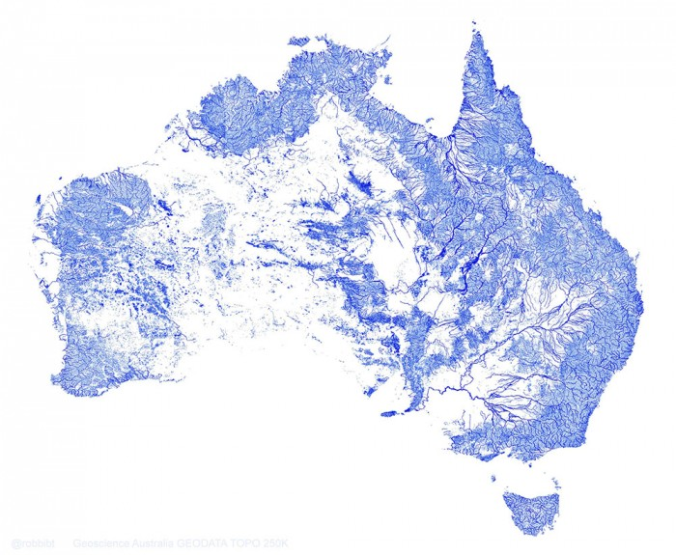
TAJ PALACE, NEW DELHI | 12 – 14 SEPTEMBER 2016
Image Credit: Sean McCoy @ GearJunkie
Notes:
Longest: Murray River 2375km
Driest continent
Diverse systems
Biodiverse
Highly Variable
Climate Change affected
State based legislation and management

Slide 3
CBNRM in Australia
TAJ PALACE, NEW DELHI | 12 – 14 SEPTEMBER 2016
Regional Plans
Strong emphasis on community engagement
Community priorities
Sub regional and local plans
Knowledge sharing
Mobilising voluntary effort
Collaborative arrangements
Leveraging resources
Delivering programs
Notes:
National Program since 2000

Slide 4
Waterway and Catchment Management Activity
TAJ PALACE, NEW DELHI | 12 – 14 SEPTEMBER 2016
Water quality
Diffuse pollution
Monitoring and Reporting
Floodplains
Works on waterways
Flood recovery
Invasive species management
Photo credit North East CMA

Slide 5
The approach for managing waterways
Guiding principles
The management approach is guided by the following principles:
• partnership approach
• community involvement
• integrated catchment management
• appropriate tools to improve waterway condition
• value for money
• Regional Waterway Strategies (RWS) to facilitate regional decision making
• evidence-based decision making
• adaptive management.
• recognising the importance of waterways with formal international, national and state significance
• implementing and maintaining on-ground works and managing environmental water in priority waterways
• fostering strong community partnerships
• using regulation (legislation and statutory processes).
Waterway Management in Victoria Fact Sheet 6

Slide 6
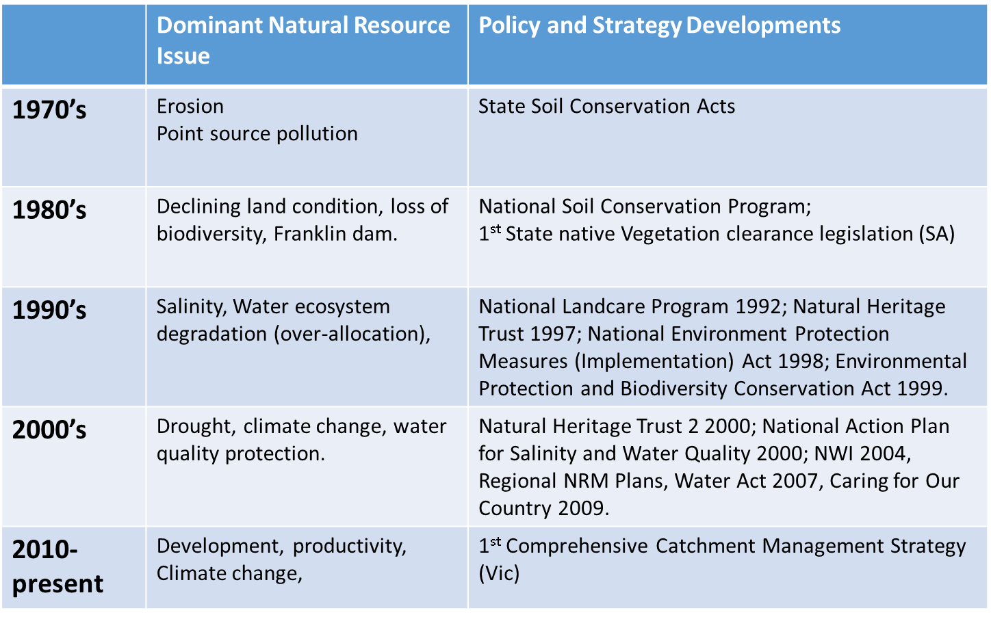

Slide 7
Growing Attention & Action
Notes:
Increases up to the mid 200o’s and

Slide 8
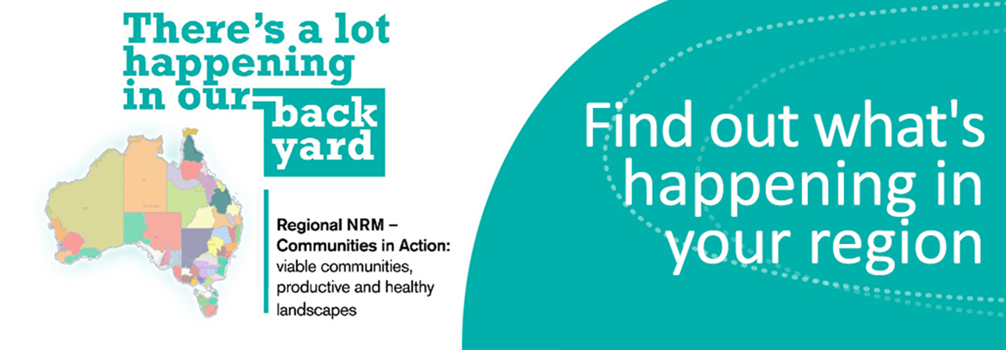
Regional NRM- Crisis in CBNRM?
Notes:
Varied arrangements in State Jurisdictions
Overall reduced funding
Difficulties in demonstrating outcomes achieved- National Environmental Accounts.
Dissatisfaction from some areas local community groups

Slide 9
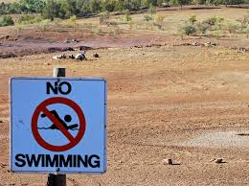
Crisis?
National Landcare Program to 2018 and beyond
Partnership arrangements with community groups in most State’s ad Regions.
Increasing collaboration with business and industry
Funding is leveraged e.g. $20M investment from the NLP into regional NRM in WA results in $40 Million +
Need to continually work at maintaining mission adjusting projects to suit current settings.

Slide 10
Lessons learned
Consistency of policy settings, allows for consistent community engagement = better outcomes
Alignment of State and National policies and programs is highly beneficial
Regional approaches must have flexibility to suit their region, waterways, and communities
Coordinating waterway management with Land Use Planning and Economic Development activity is critical to success.

Slide 11
Three Suggestions
TAJ PALACE, NEW DELHI | 12 – 14 SEPTEMBER 2016
Engaged communities want to have a say and Communities have demonstrated management capability. Let’s stick with CBNRM.
Third sector approach (with regional ‘middle ground’ organisations) and formal arrangements with government provides a solid platform for effective management.
More enduing policy settings and national cohesion would provide greater opportunity to both achieve and report on resource condition change.
Notes:
Healthy rivers are a sign of a healthy society, rivers are expected to deliver multiple benefits.

Slide 12
Three Questions
TAJ PALACE, NEW DELHI | 12 – 14 SEPTEMBER 2016
How do we increase coordination between Land Use and Development Planning and Waterway Management?
How can we develop a more enduring national regional approach to address waterway management?
How can we collaborate to share research and knowledge and more broadly -learnings- across the country and across the world?

Slide 13
References
TAJ PALACE, NEW DELHI | 12 – 14 SEPTEMBER 2016
Australia’s NRM Governance System: Foundations and principles for meeting future challenges: http://nrmregionsaustralia.com.au/
National Funding Program: http://www.nrm.gov.au/national-landcare-programme
Leadership development: http://www.petercullentrust.com.au/

