Slide 1



TAJ PALACE, NEW DELHI | 12 – 14 SEPTEMBER 2016
From liquid history to solid future
- the story of the Thames restoration
Prof. Alastair Driver
Head of Biodiversity, Environment Agency, UK
Ambassador, International Riverfoundation
Twitter: @AliDriverEA

Slide 2
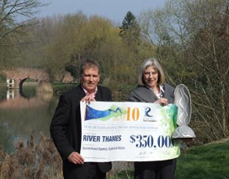
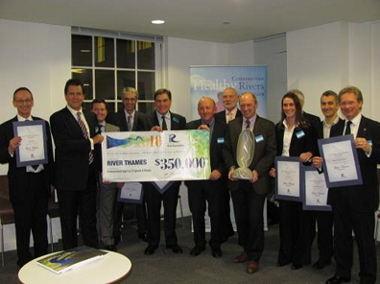
Winning the World Cup for Rivers
Celebrating with Theresa May MP in 2010
Celebrating with representatives from a few of our many partner organisations
The prestigious International Riverprize has been awarded annually since 1999. The UK winners to date are the Mersey (1999) and the Thames (2010)
Notes:
We promoted our success as widely as we could and certificates were presented to dozens of key partner organisations.
The trophy is made of 100% pure grade aluminium and the shape replicates the shape of the basal section of a palm leaf, which Australian Aboriginal peoples used for holding water, food, etc.
The trophy is retained in perpetuity and having been the focus of a Thames exhibition in the Henley River and Rowing Museum to coincide with the 2012 Olympics, it now resides in the reception area at Ergon House.

Slide 3
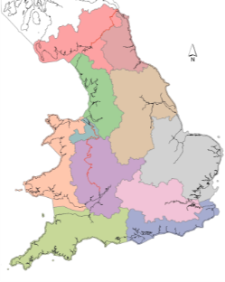
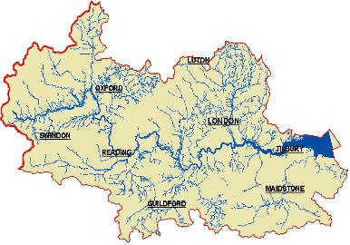
The Thames Catchment
The River Thames is the UK’s second longest river at 294 kms long.
Notes:
The River Thames is the UK’s second longest river at 294 kms long.
The Thames river basin district covers 16,200 km2, with a dense population of over 15 million people.
App 17% of the catchment is urbanised.
The River Thames flows from the green rural upper reaches of the Cotswolds, through large urban centres of Oxford and Reading and the UK’s capital’s city, London, on through the industrial heartland of Essex and Kent, and thus to the North Sea.
The Thames is non-tidal down as far as Teddington Lock in West London, and is then tidal throughout London with a tidal range of 7 metres.

Slide 4
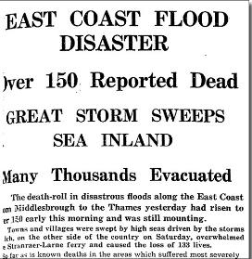
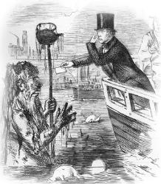
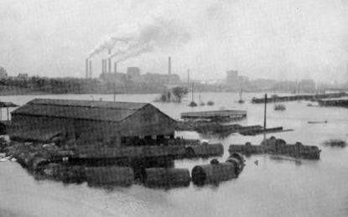
Flooding and pestilence
19th century Punch magazine cartoon: Faraday holding his nose as he hands Father Thames his business card
The 'Great Stink' of London in 1858 led to the temporary closure of Parliament due to the overpowering smell emanating from the Thames
Notes:
Photos:
Skeleton in boat on the Thames, Punch cartoon ‘Death River’, 19th Century
Faraday holding his nose as he hands Father Thames his card, Punch Cartoon 19th Century
In the past we have neglected and abused the river, and paid the price for not working with its natural processes.
Major historic events include:
Introduction of water closets to the more affluent households of London in the early 19th century.
Open drains originally intended to take rain water into the Thames then carried raw sewage – diseases such as cholera were rife.
'Great Stink' of London in 1858 - the overpowering smell from the Thames closed Parliament.
A bill was rushed through Parliament and became law in 18 days, to provide more money to construct a massive new underground sewer scheme for London
1953 Floods:
307 people died across southeast England
100,000 hectares of eastern England flooded by sea water
1950s
The quality of effluent discharges was still so bad that the Natural History Museum declares the River Thames in London a “biologically dead” river in the 1950’s

Slide 5
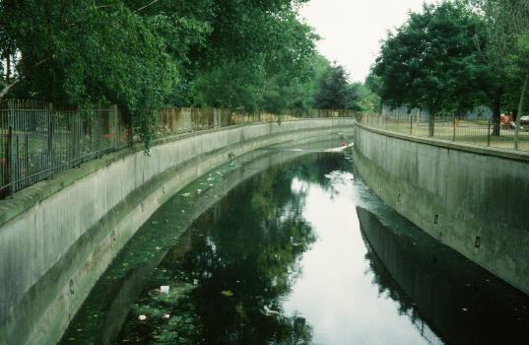
The concrete age
River Ravensbourne, London
96% of all watercourses in the Thames catchment have been modified by man in some way
Notes:
From the 1950s through to the 1970s, urban channels were being consigned to concrete straitjackets - ugly, barren, intrinsically unsafe and displacing the problem down stream
Mitigations were negligible – a few willows pollarded here, a small stone weir there, and genuine enhancements were non-existent

Slide 6
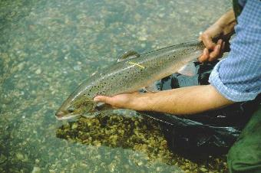
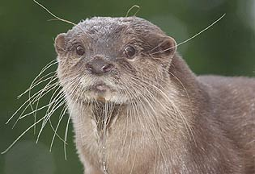
The remarkable recovery
Good water quality increased from 53% (1990) to 80% (2008)
125 species of fish
Healthy breeding Otter population
Over 1000 habitat enhancement schemes since 1990
Over 100 km of river restored since 1990
Otters were extinct in the Thames catchment in 1989. In 2009 signs were found in 53% of the survey sites.
Notes:
In the 1960’s new and improved sewage treatment works ended the regular dumping of raw effluent into the river. Tighter regulations on riverside industry helped too and by 1974 salmon were found in the Thames for the first time in 150 years.
The chemical quality of the rivers within the Thames catchment classified as ‘Very Good’ or ‘Good’, improved from 53% in 1990 to 80% in 2008.
19 species of fish, including salmonids, are found in the freshwater Thames.
Thames estuary supports viable shellfisheries and is a nursery ground for commercial sole and bass stocks. Overall fish diversity is increasing, with 125 species recorded, including internationally important smelt and shad.
Between 2005 and 2010, 400 habitat enhancement projects were delivered at a cost of £20 million. A total of 54 ha of UK Biodiversity Action Plan priority habitat has been created and 70 km of river has been restored or enhanced.
Our submission for the International Riverprize in 2010 emphasised the fact that we are not resting on our laurels and showcased 5 wide-ranging examples of innovative projects aimed at continuing this catchment-wide improvement.

Slide 7
The European Water Framework Directive - classification principle – one out - all out
Example catchment
H
G
Overall Status = moderate
M
P
B
Fish
Macro-invertebrates
National Pollutants
Supporting physico-chemical elements
Supporting physico-chemical elements
Notes:
The water body status is in effect classified by the lowest common denominator
Classification is carried out annually

Slide 8
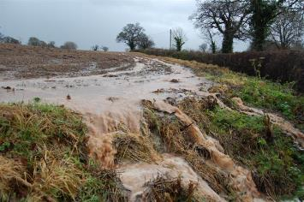
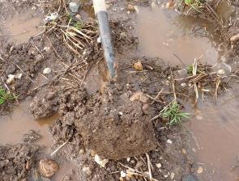
Catchment restoration through sustainable land management
Poor farming practices lead to soil -laden run-off
Soil compaction prevents infiltration
Agriculture is responsible for 25% of the phosphorus and 75% of the sediment in rivers.
Notes:
KILLER FACT from Defra Soil Strategy for England 2009: The water treatment cost of soil erosion is app. £21 million p.a. in England. Agriculture is responsible for 75% of the sediment in rivers and 25% of the phosphorus
2.2 million tonnes of silt – ie topsoil - is lost from the land each year in the UK
The total cost to society of trying to remove it from rivers and lakes is app. £45M – mainly due to the actual cost to farmers, water quality treatment costs and dredging costs.
The actual cost of purchasing 2.2 million tonnes of topsoil is app £40M if bought by the tonne!

Slide 9
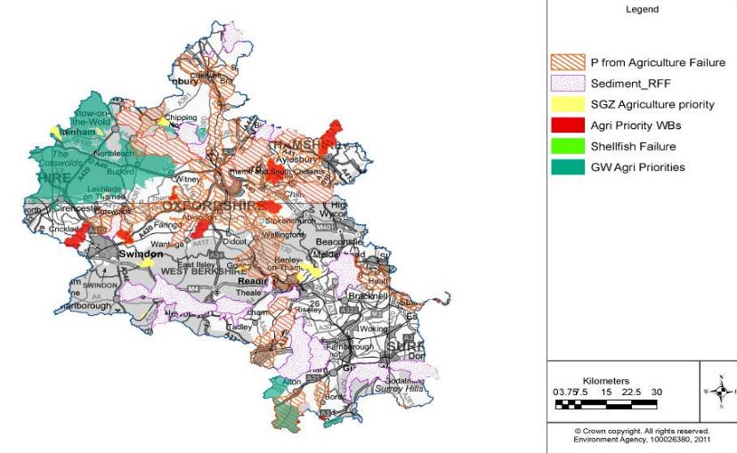
Catchment Sensitive Farming - targeting
Primary causes of diffuse pollution from agriculture in upper Thames catchment area
Notes:
Kennet catchment walkover survey example:
Catchment walkover survey carried out in Feb, over 4 days walked the banks or the river and canal looking for sources and/or potential sources of pollution.
200 sites were graded from 1 to 3 depending on their severity of impacts.
At each site, photos, grid refs and a description was recorded.
The 16 Grade 1 sites were selected for revisiting during wet weather conditions and WQ samples were taken.
Reports include a GIS tool and WQ results with hyperlinks to documents and videos of the identified sites.
The local EA Kennet+Lambourn catchment co-ordinator will now follow up on the most severe (grade 1) issues first with landowners and use photographic / video evidence to challenge and convince farmers into making changes – eg by applying for capital grant schemes.
Point source issues are also an issue – five Grade 1 sites have been logged on the Agency’s National Incident Reporting System and are being followed up by Environmental Officers locally – several are septic tanks.

Slide 10
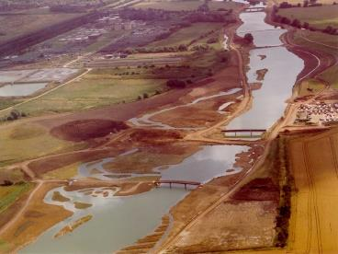
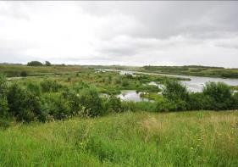
Catchment restoration through sustainable flood risk management
11 km of new river
5,500 homes and businesses protected
17 years in development
250,000 native trees planted
20 ha of wetland created
Jubilee River, Berks / Bucks
Infiltration rates are up to 60x higher under young native woodland shelter-belts on sloping ground compared to adjacent heavily grazed pasture
Notes:
The Jubilee River Flood Alleviation Scheme has led the way in sustainable flood risk management by demonstrating how it can help support both the natural environment and economic regeneration.
In the mid 1980s we started to take a more holistic approach to flood risk management.
1991 – Thames Region flood defence enhancement policy initiated
Our Jubilee River Flood Alleviation Scheme - a new 11km stretch of waterway - exemplifies how we are now working with, and for, nature.
Between 2002 and 2010 it was used for flood alleviation on 20 occasions, protecting over 5,500 homes and businesses.
We created major areas of habitat, including 193 hectares of native woodland, 38 hectares of reedbed and 326 hectares of wildflower grassland. Habitats and species have developed and colonized the Jubilee River at a steady rate since the onset of the monitoring scheme.
It has also created 14km of new public rights of way with disabled access, bridleways and cycleways that link with the UK National Cycle Network.
By 2010 the Jubilee River had become an extremely popular amenity, especially with walkers and bird watchers.
There is an image of these Dorney Wetlands at dusk, with Windsor castle beyond in the conference brochure.

Slide 11
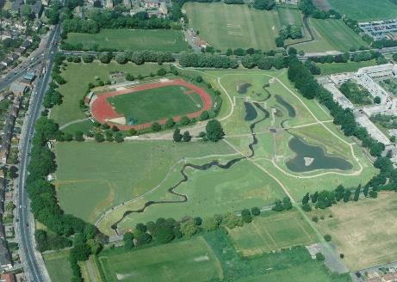
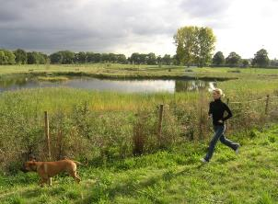
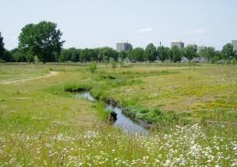
Catchment restoration through urban river restoration
R. Quaggy at Sutcilffe Park, Lewisham
“London is a concrete jungle and places like this are like your lungs of London... it’s your own little countryside.”
Roy Palmer, local resident
Notes:
Sutcliffe Park, Greenwich, is a good illustration of how the London Rivers Action Plan is delivering a range of benefits which contribute to health, wellbeing, society and the environment.
The daylighting of the river Quaggy (a tributary of the Thames) has created wetlands with cycleways, footpaths and open spaces, and has become a valuable community asset and a haven for wildlife.
Full-time public liaison officer was in post during the construction of the scheme.
These improvements have also contributed to climate change adaptation in terms of urban cooling and flood risk management.
A Mddx University socio-economic study showed for example that since opening in 2004, visits to the Park have increased by 73% and people spent more time in the park per person..
Very importantly, properties adjacent to parks like this in London cost an extra a 5-7% more than those further away.

Slide 12
Catchment restoration through reducing Combined Sewer Overflows
Oxygen levels in the tidal Thames with and without
Combined Sewer Overflows
Notes:
The London Tideway Tunnels (LTT) will improve the ecology of the river and the Thames estuary, which in turn will benefit regeneration, river recreation and tourism.
39 million tonnes of untreated sewage flushes into the Thames in a typical year – and in wetter years this figure can increase threefold.
The discharges result in unsightly detritus on the foreshore and in the river, poor water quality (low dissolved oxygen) risking fish kills and impacts on fish migration, and raised health risks to river users. Explain graph.
In west London where river use for recreation is high the problem has resulted consistent complaints from river users over potential health risks

Slide 13
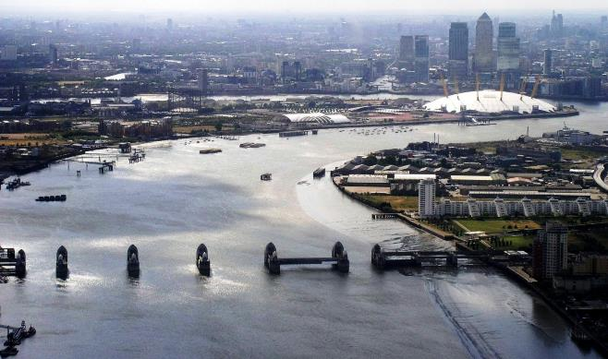
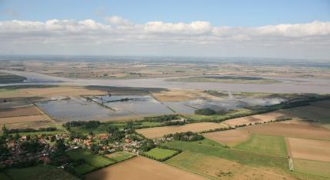
Catchment restoration through adaptation to climate change
Thames Estuary 2100 project
Thames Barrier
Coastal realignment
The Thames Barrier currently protects 350 sq kms land inhabited by 1.25M people and containing £200 Bn+ of property value
Notes:
We also used our climate change modelling to understand the potential loss of designated habitat intertidal habitat in the estuary, identifying 1200 hectares of habitat that will need to be replaced. We published our findings in the interactive web based Coastal Habitat Management Plan (CHaMP).
Sites are now being identified and where appropriate purchased for managed realignment schemes.
Assessment and appraisal methodology developed was groundbreaking because it was the first UK project to take account of the environment and society when assessing costs and benefits of flood management options.

Slide 14
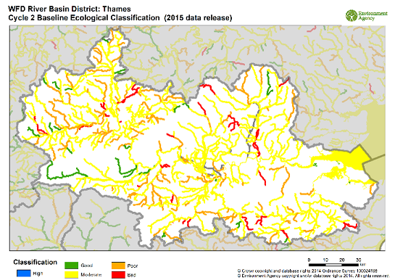
The huge challenge ahead
2015 WFD status for rivers and lakes in the Thames River Basin District
In the Thames catchment, 714 kms river and 113 ha of lake were in better condition in 2013 than in 2009
Notes:
In 2014, only 8% of river and lake water bodies in the Thames RBD (39 out of 498) were at Good Ecological Status, or Good Ecological Potential (if heavily modified or artificial)
However, despite much effort and on-the-ground work, the classification results in 2014 actually show a deterioration in status since 2009.
There are a number of reasons for this, including:
Lower natural flows in rivers as a consequence of two dry winters (2010 and 2011) and the early summer drought of 2012).
Improved and increased monitoring and data. Which has led to some water bodies have been recorded as having a lower ecological status.
Ecological status is based on the worst failing element, termed the “one out, all out‟ rule; improvements in individual elements therefore can be masked in the ecological status overall.
Clearly it will take a long time before ecological status reflects the beneficial impacts of measures being implemented (“made operational”).
In the meantime working with farmers and tackling the biggest problem facing our water environment – topsoil in rivers – continues apace through the Catchment Sensitive Farming initiative.

