Slide 1


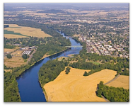
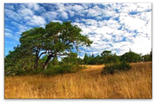
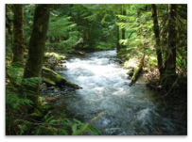
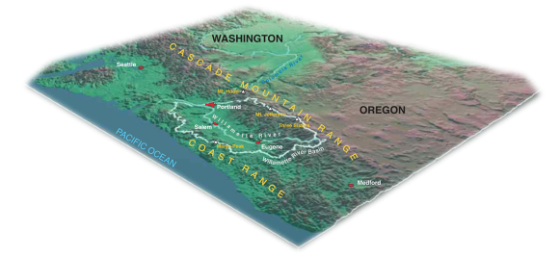
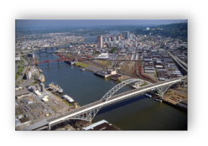
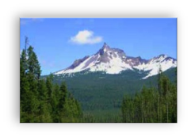

TAJ PALACE, NEW DELHI | 12 – 14 SEPTEMBER 2016
The Oregon Watershed Council Model, USA
Tara Davis, Contractor, Willamette River Initiative, Oregon, USA
RiverSymposium, New Delhi, India 2016

Slide 2
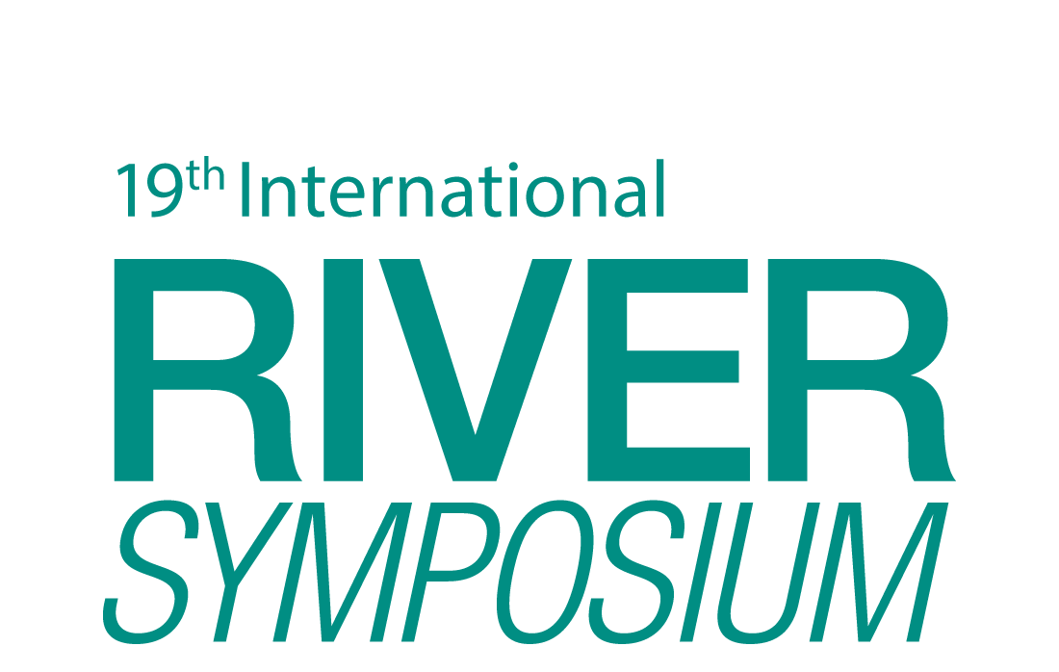

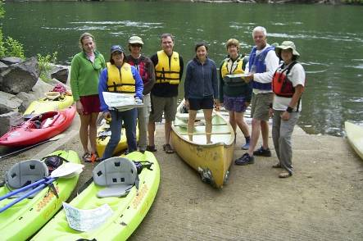
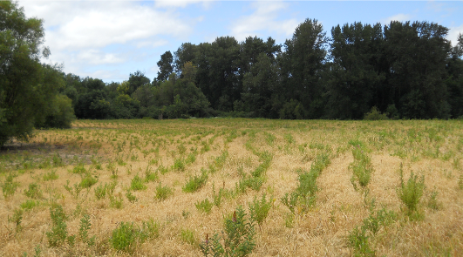

TAJ PALACE, NEW DELHI | 12 – 14 SEPTEMBER 2016
Presentation Outline
Oregon’s Watershed Councils- Foundation & Policy
Calapooia Watershed Council Example
Innovative Partnerships Example
Discussion

Slide 3
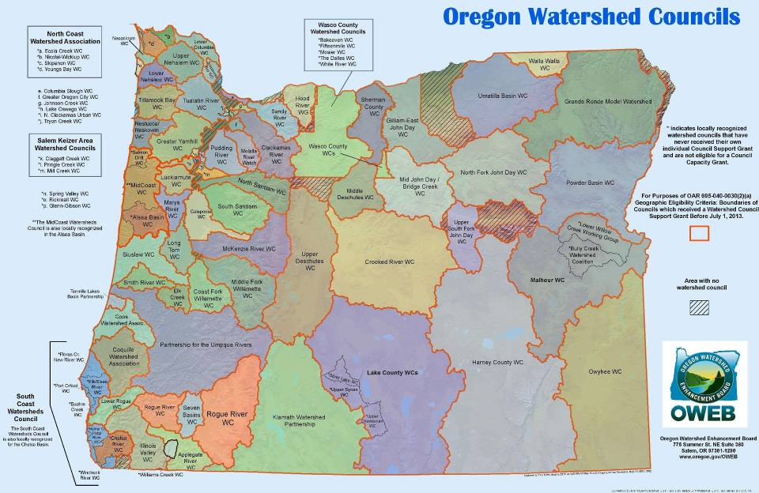
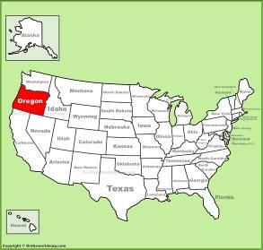

Slide 4

TAJ PALACE, NEW DELHI | 12 – 14 SEPTEMBER 2016
Policy- Watershed Councils & Oregon Plan
  1995 Oregon Legislature unanimously passed House Bill 3441 providing guidance in establishing watershed councils with local recognition (not state)
  State statute declares “The long-term protection of the water resources of the Oregon, including sustainable watershed function, is an essential component of Oregon’s environmental and economic stability and growth.” –ORS 541.350

Slide 5
TAJ PALACE, NEW DELHI | 12 – 14 SEPTEMBER 2016
  Foundation- Oregon Watershed Council Model
    Locally organized, voluntary, non-regulatory groups recognized and approved by a local government group (i.e. County or city)
    Represent a balance of interested and affected persons within the watershed
    Typically use consensus decision making process
    Alignment with the Oregon Plan and required to be performing restoration

Slide 6
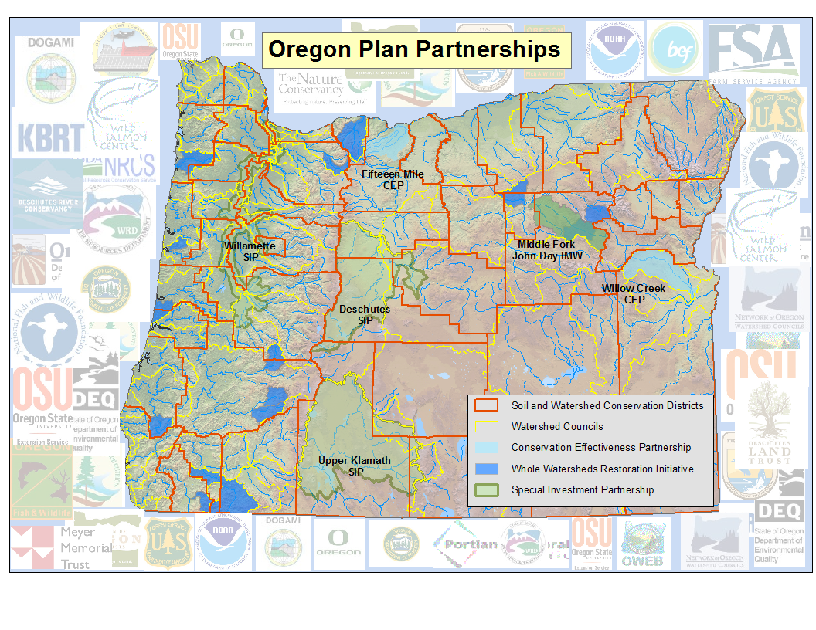

Slide 7
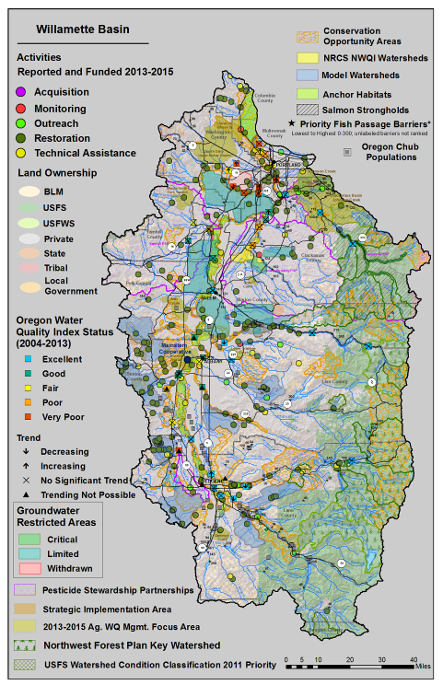
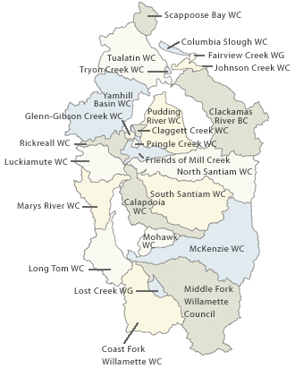

Slide 8
TAJ PALACE, NEW DELHI | 12 – 14 SEPTEMBER 2016
Oregon Watershed Enhancement Board or (OWEB)
  Diverse state board representation
  Oregon Lottery dollars- leveraged at 25% minimum
  Capacity support for
  watershed councils
2013-2015 Oregon Plan Biennial Report, www.oregon.gov/OWEB

Slide 9
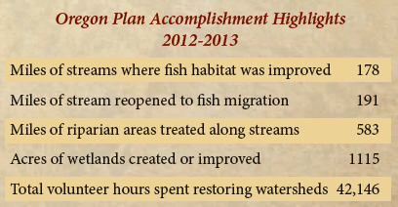
TAJ PALACE, NEW DELHI | 12 – 14 SEPTEMBER 2016
OWEB Grant Programs
Assessments
Landowner recruitment
Project Design
Restoration
  Project contracts and materials
  Plant establishment (5 years)
  Project effectiveness monitoring
Monitoring
Focused Investment Partnerships (FIP’s)
2013-2015 Oregon Plan Biennial Report, www.oregon.gov/OWEB

Slide 10
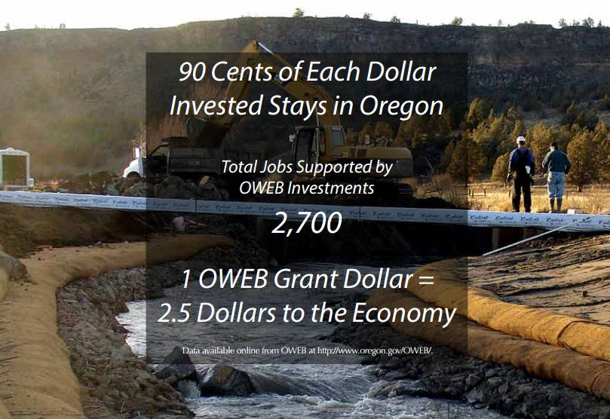
Notes:
Every million invested in habitat and clean water creates 15-20 jobs
Project managers and council staff
Engineering and construction companies
Plant nurseries
Rentals, equipment, fuel

Slide 11
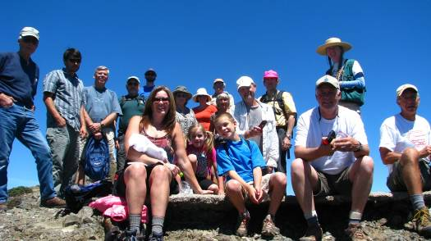
TAJ PALACE, NEW DELHI | 12 – 14 SEPTEMBER 2016
Calapooia Watershed Council
USA Endangered Species Act
  Spring Chinook Salmon
  Winter Steelhead
Oregon “listed” streams
  Temperature
Council formed by local
government in 1999; 2008 received formal non-profit status (NGO)
Rural, 95% private land, one large municipality
  10 board members: private timber, industrial farms, federal agencies, education, municipalities, recreation, other NGO’s
  6 staff: executive director, restoration project manager, monitoring technician, operations, youth education (2), plus contracted assistance
  1 million annual organizational budget- 70% contracts & materials

Slide 12
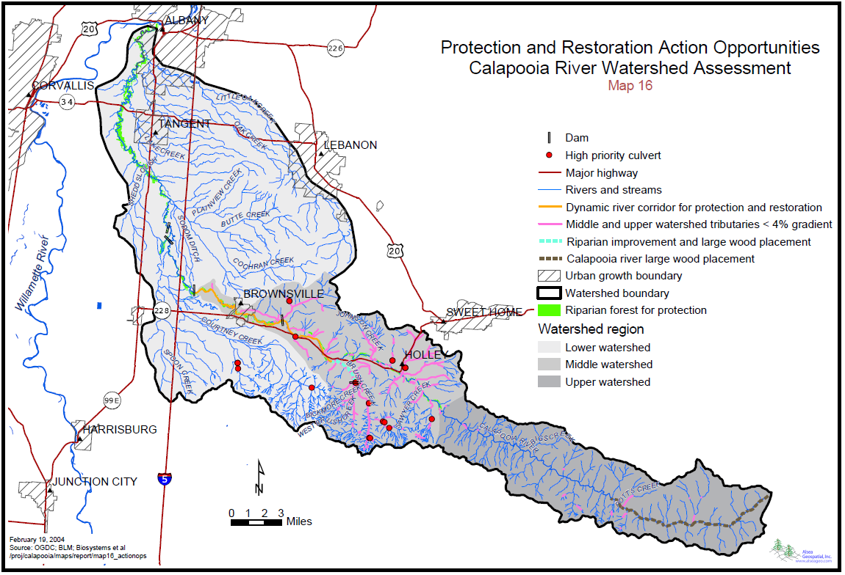
TAJ PALACE, NEW DELHI | 12 – 14 SEPTEMBER 2016

Slide 13
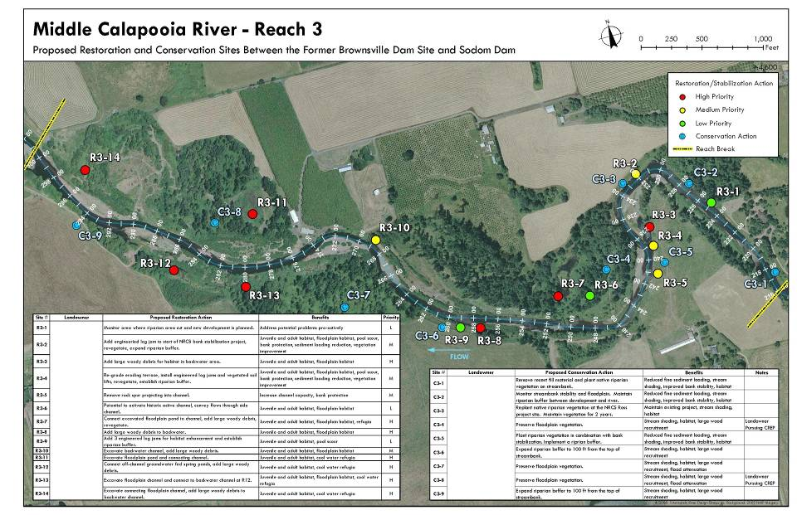
TAJ PALACE, NEW DELHI | 12 – 14 SEPTEMBER 2016

Slide 14
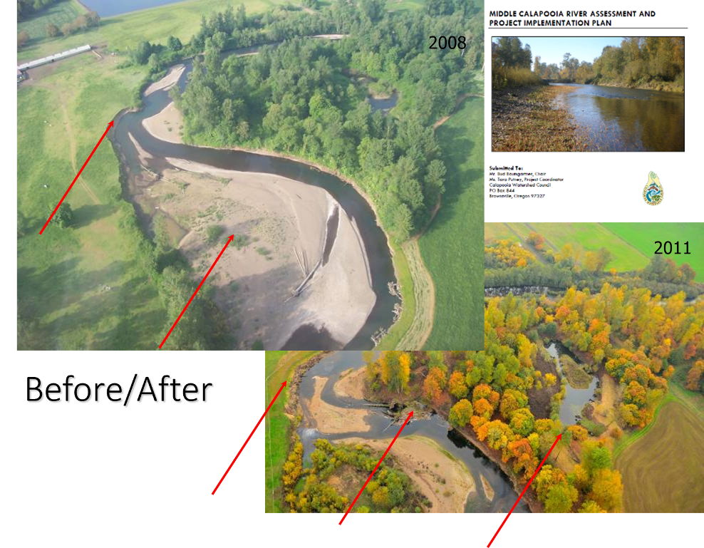
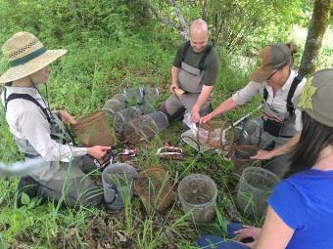
Livestock Access, Erosion
Floodplain habitat degradation
Invasive Shrub Control
Habitat Complexity
Fence, Riparian Planting
Side Channels

Slide 15
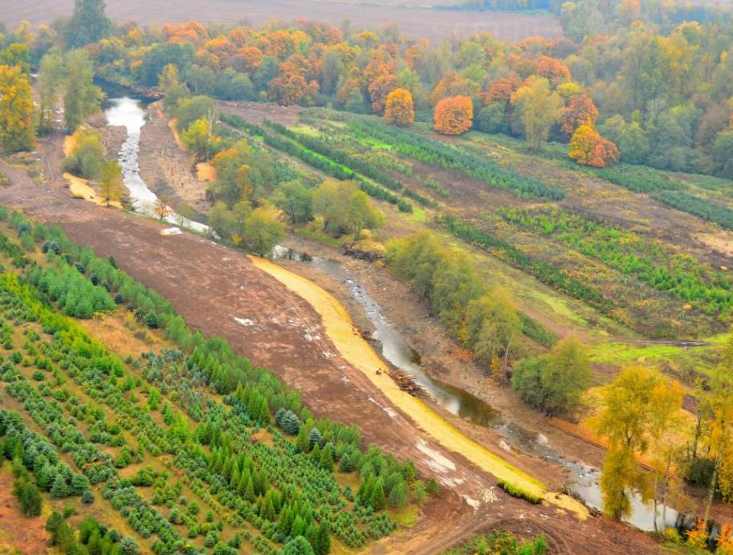
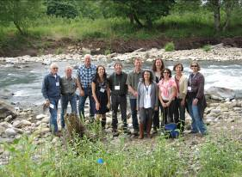
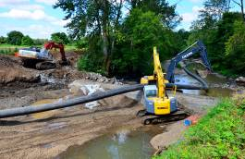
Calapooia Fish Passage Restored
November 2011
Calapooia inlet
Riffle 3
Floodplain bench
Large wood
Large wood
Riffle 2
Large wood
Riparian Planting
25 acres Floodplain Re-Vegetation
Large wood
Riffle 1
Former dam site
Large wood

Slide 16
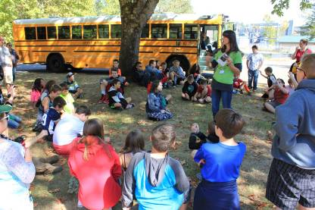
TAJ PALACE, NEW DELHI | 12 – 14 SEPTEMBER 2016
Innovative Partnerships-
Calapooia’s Youth Watershed
Education Program
  The Nature Conservancy
    1.3 million-15 years
    Leveraged with other private foundations, state and federal grants
  Universities for student stream monitoring
  Primary and secondary school teachers
  Local municipality urban stream restoration

Slide 17
TAJ PALACE, NEW DELHI | 12 – 14 SEPTEMBER 2016
Model Benefits
  Place-based river strategies
  Grassroots-driven restoration
  Nimble and dynamic
  Creation of local restoration economies
Model Challenges
Single major restoration funder, OWEB
Insularity in basins with single large owner or federal manager
Long-term monitoring
Lacking in regional networks or collective impact models

Slide 18
TAJ PALACE, NEW DELHI | 12 – 14 SEPTEMBER 2016
Calapooia Watershed Council
  www.calapooia.org
Oregon Watershed Enhancement Board
  www.oregon.gov/oweb/
Network of Oregon Watershed Councils
  www.oregonwatersheds/org
Coos Watershed Association
  http://www.cooswatershed.org/home.html
Upper Deschutes Watershed Council
  http://www.upperdeschuteswatershedcouncil.org/

