Slide 1
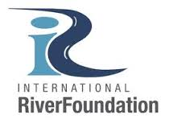
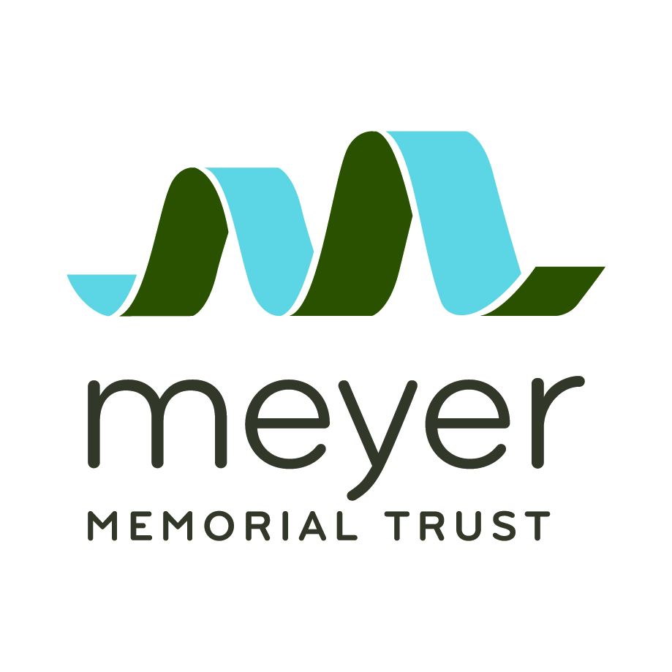


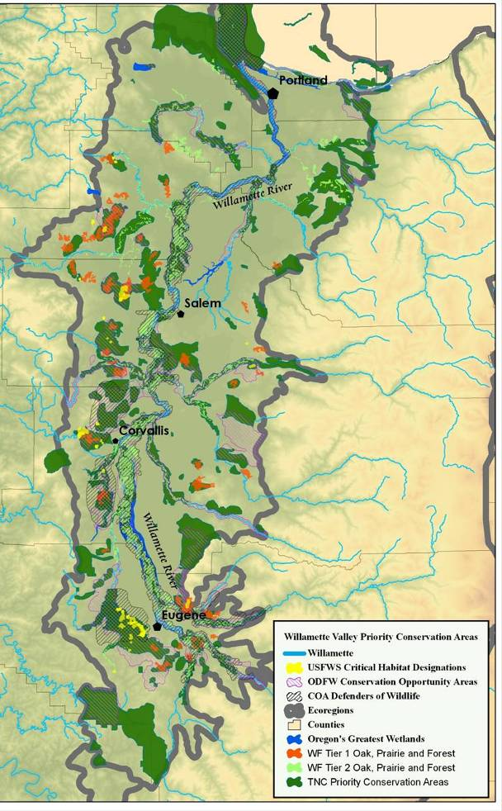
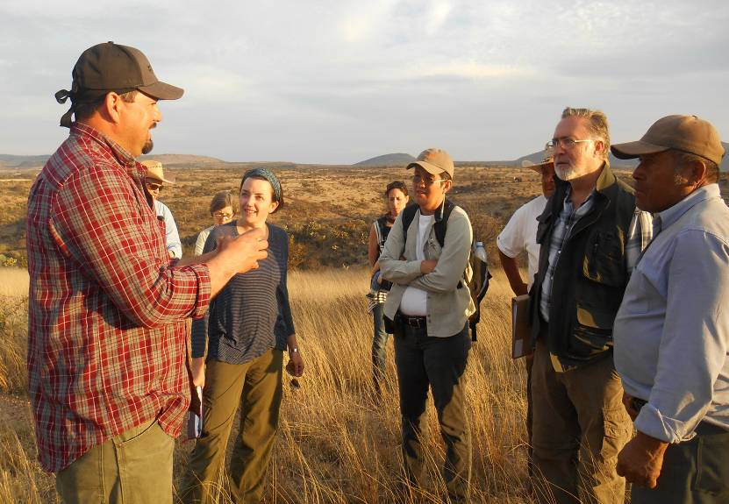
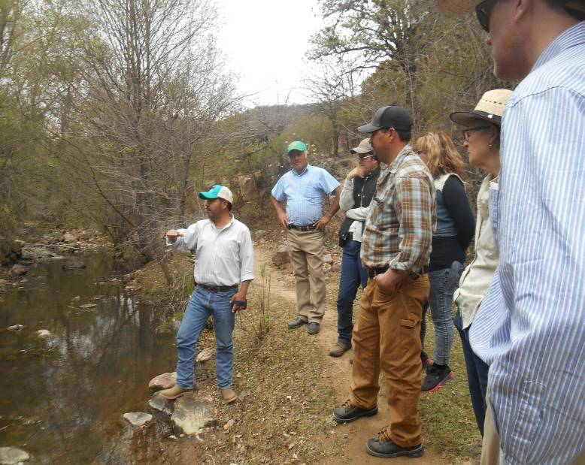
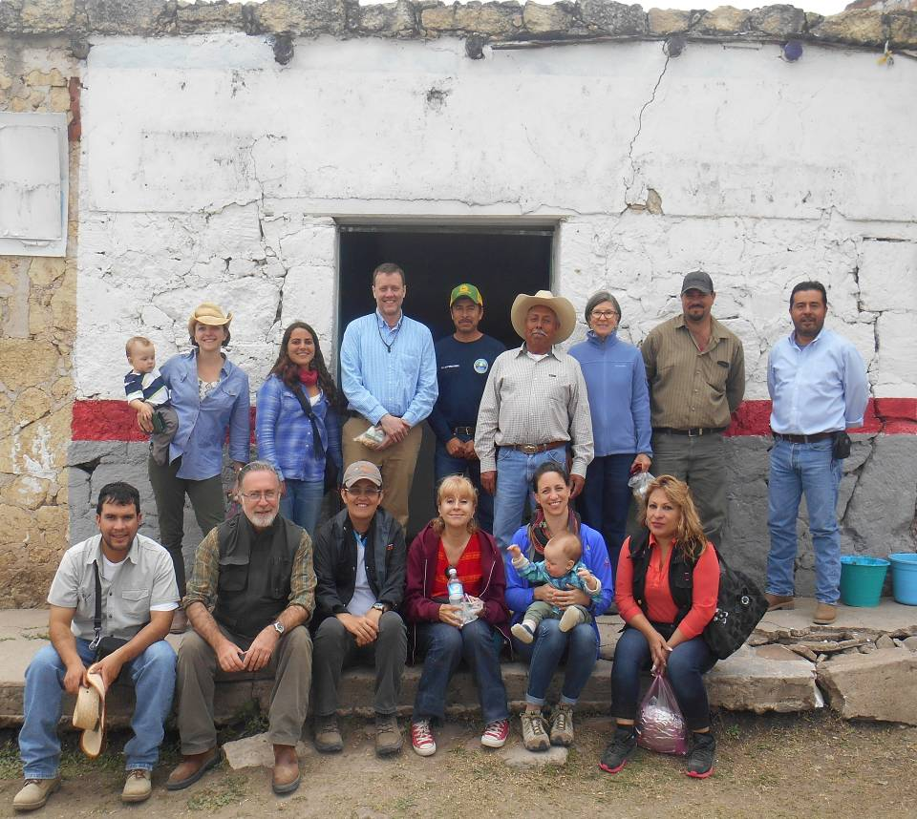
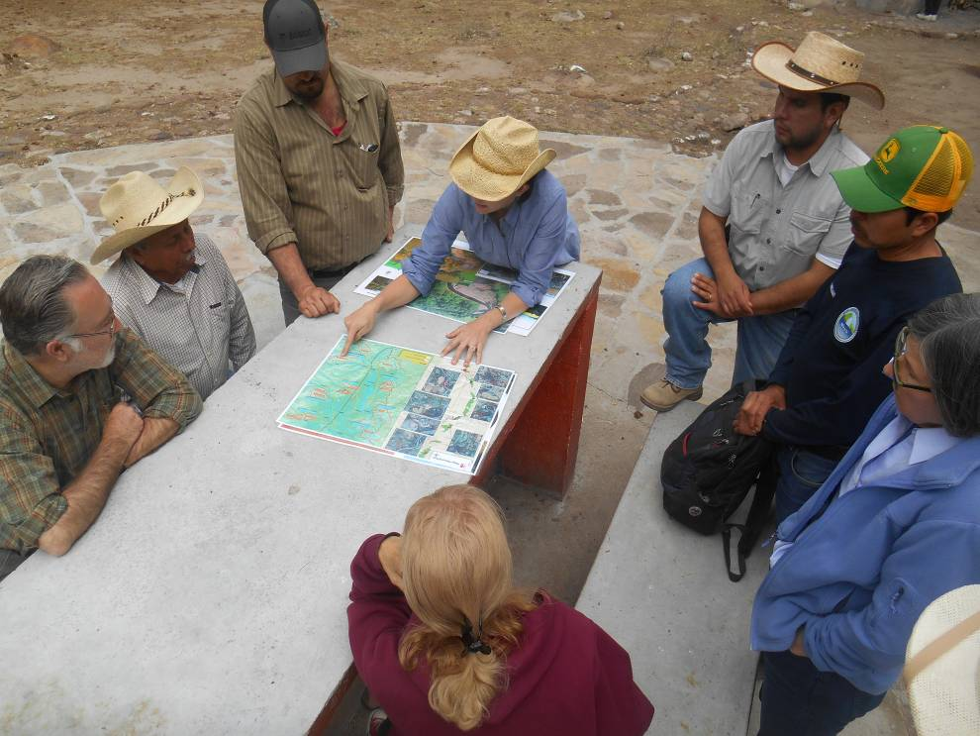
Twinning Project: Willamette River, USA and Rio Laja, Mexico
Tara Davis¹ and Selene Tripp²
¹ Twinning Project Coordinator, Contracted by the Willamette River Initiative of Meyer Memorial Trust, Email:willamette.laja@gmail.com
² Laja Partner Coordinator, Salvemos al Rio Laja, Email: selenetripp@gmail.com
Willamette River Initiative
Willamette and tributary restoration through large-scale floodplain forest re-vegetation and in-stream habitat improvement.
Permanent protection of valuable floodplain properties throughout the basin.
“Backbone” network services such as conferences, project manager trainings, native plant grow-out contracts with nurseries, organizational capacity grants, and monitoring and research.
Community engagement support for public events and innovative outreach activities.
Rio Laja Partnerships
River restoration practitioners and training in the communities.
Drinking water assistance through rain water catchment systems and locally-made water filters.
Water quality advocacy, monitoring and conservation work.
Environmental education and community engagement through recreational activities and the promotion of protected areas.
Ecological data and regional priorities provided by several local, State of Guanajuato and Mexican federal agencies.
Similar Watershed Challenges: Oak woodland destruction, livestock access and accelerated sedimentation, water quality degradation, and sand and gravel extraction.
Cross-cultural Ties: Large Mexican immigrant population in the Willamette with Latinos involved native plant nurseries and contracted river restoration and planting crews.
Complex Partnerships: Several partner NGO’s and agencies and universities performing restoration and monitoring in both basins. The complexity of these two large partnership models promotes discussion of networks, backbone services, and collective impact.
Foundation for Twinning
The Challenges
Difficulty connecting several watershed health NGO’s in the Laja with the 20+ partners in the Willamette Initiative in a meaningful way.
Limited organizational capacity and funding to advance the Twinning Project for long-lasting professional relationships.
Project Achievements
Project Achievements
Project Achievements
Twinning Steering Committee formed in September 2015 with Willamette and Laja NGO and government agency membership.
IRF Twinning Business Plan approved in December, 2015.
First Twinning “Exchange” in March 2016.
Approved proposal in June 2016 for all Laja partners to pursue a restoration action planning process with GIS data collection.
Gradual formation of the “Laja Initiative” via interviews of all Laja NGO’s and government, and collection of project and ecological priorities in GIS.
Willamette restoration practitioner visit in August 2016 for peer-to-peer learning during wet implementation season in the Laja.
Twinning Steering Committee formed in September 2015 with Willamette and Laja NGO and government agency membership.
Twinning Business Plan approved in by IRF board December, 2015.
First Twinning “Exchange” in March 2016.
Approved proposal in June 2016 for all Laja partners to pursue a restoration action planning process with GIS data collection and mapping.
Gradual formation of the “Laja Initiative” via interviews of all Laja NGO’s and government, and collection of project and ecological priorities in GIS.
Willamette restoration practitioner visit in August 2016 for peer-to-peer learning during wet implementation season in the Laja.
Planned Outcomes
Identification of a “flagship” or pilot project in the Laja that all NGO’s and government partners can agree upon based on recent action planning.
Grant writing for pilot project implementation as well as other collaborative activities.
Laja representative participates in biannual Willamette conference with presentations and planning discussions in December 2016.
Spring 2017 several Laja representatives visit the Willamette restoration sites “Exchange 2” peer-to-peer restoration training.
Participation in international forums to advance restoration partnerships, skills building, and sharing the Twinning Project.

