Slide 1
BUILDING SUSTAINABLE PARTNERSHIPS IN RIVER BASIN MANAGEMENT Report on the European River Symposium 2016 March 2 - 3, Vienna, Austria
TAJ PALACE, NEW DELHI | 12 – 14 SEPTEMBER 2016
Bart Fokkens
Chairman European Centre for River Restoration
www.ecrr.org
Notes:
Thank you Mr. Chairman
Thanks to IRF for cooperation and invitation
Good afternoon ladies and gentlemen
Who are from Europe, Asia, Ociania, Africa and Americas?

Slide 2
TAJ PALACE, NEW DELHI | 12 – 14 SEPTEMBER 2016
2013: first European Riverprize
2013 & 2014: ECRR 5th & 6th International River Restoration Conference
2016: IAWD/IRF & Partners: European River Symposium
Notes:
ECRR: Promote ecological restoration & Dissemination of river restoration information
ECRR is initiator, pioneer
River restoration conference
Established 1996

Slide 3
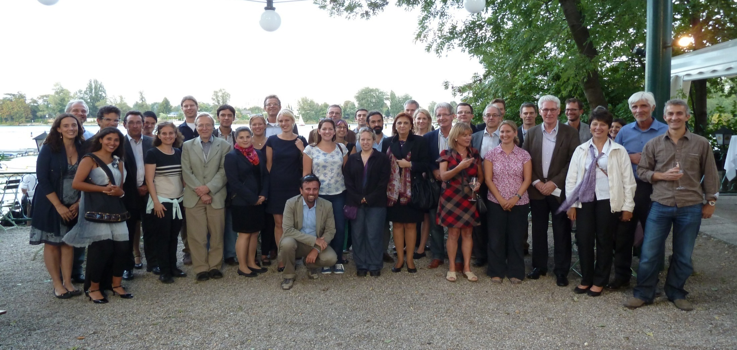
ECRR National Centres and Partners
Notes:
Centres are actually Networks like ECRR
Two EU Life projects; Start and Communication and Information
RiverWiki

Slide 4
TAJ PALACE, NEW DELHI | 12 – 14 SEPTEMBER 2016
SYMPOSIUM OBJECTIVE
Increased uptake of partnerships and cooperation amongst sectors that influence water and leading to better outcomes.
EUROPEAN WATER FRAMEWORK DIRECTIVE
Ecological restoration; good ecological status / potential
Longitudional, lateral and vertical continuity
Basin approach: International cooperation & integrated management
Stakeholder involvement & public participation
Asking for partnerships
Learning by doing, consulting and listening, awareness that success takes time
Notes:
International / transboundary cooperation
Integrated planning and management
WFD is conceptual, holistic approach
Planning cycles
Results are far behind the (national) plans

Slide 5
TAJ PALACE, NEW DELHI | 12 – 14 SEPTEMBER 2016
ADVANCING PARTNERSHIPS DISCUSSIONS
Navigation, tourism, flood protection
Hydropower and river management
Water utilities and water quality and river management
Engaging in collective action towards private sector water stewardship
Notes:
Main sectors
Not agriculture!

Slide 6
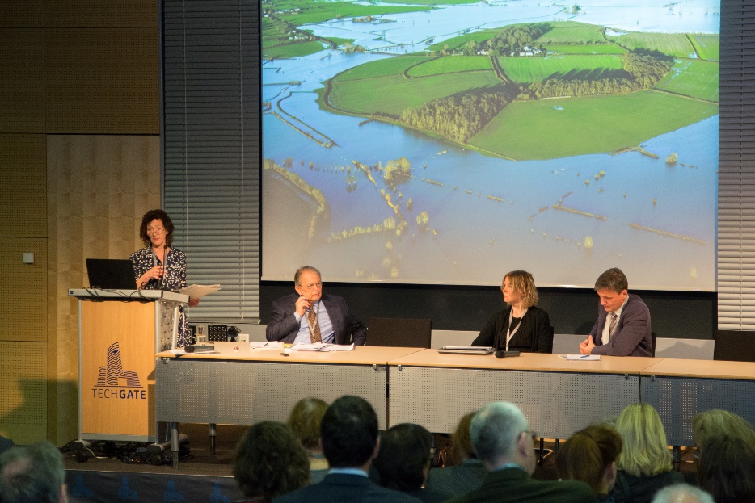
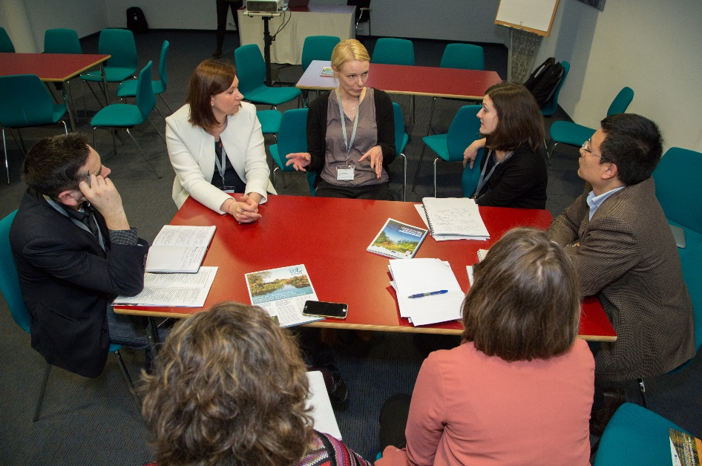
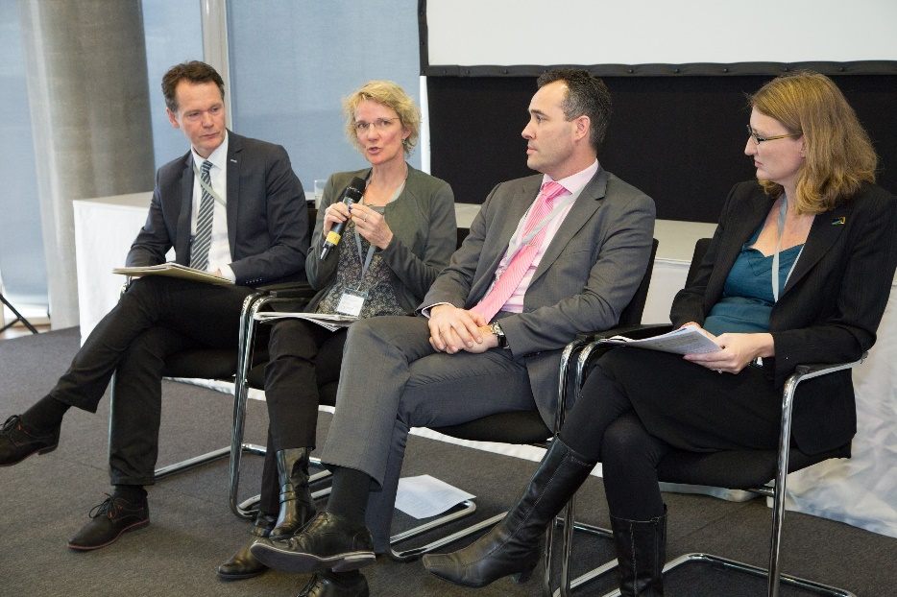
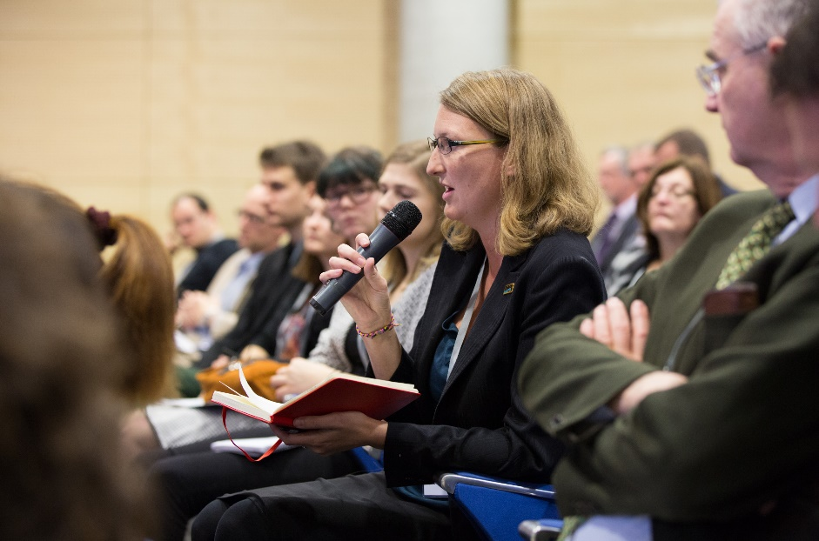
TAJ PALACE, NEW DELHI | 12 – 14 SEPTEMBER 2016
Notes:
Workshops
Extra workshops before and after the symposium
Woman and Water
WWF Europe
GWPCEE
IAWD
Technical discussions unavoidable

Slide 7
TAJ PALACE, NEW DELHI | 12 – 14 SEPTEMBER 2016
NAVIGATION, TOURISM, FLOOD PROTECTION, NATURE CONSERVATION
Priority issues: built trust, mutual acceptance of data
Identify priority issues and problems
How to measure and monitor relevant parameters
Create the right context to work on mutual acceptance of trade offs
Establish compromises and elaborate ‘win-win’ solutions
Notes:
No explanation

Slide 8
TAJ PALACE, NEW DELHI | 12 – 14 SEPTEMBER 2016
HYDROPOWER AND RIVER MANAGEMENT
Extreme positions across sectors and stakeholders have to be ruled out
There should be a political will to reinforce a dialogue
A strategic overall planning approach should back case by case decisions for new hydro power plants
River Basin Management Planning is a good tool for assessment on such investigations
Notes:
No explanation

Slide 9
TAJ PALACE, NEW DELHI | 12 – 14 SEPTEMBER 2016
Water Utilities and Water Quality and River Management
Create consensus about the first needed capacities and resources at the level of the water utilities
Utility managers should enter the political arena and even become lobbyists
A Water Utilities platform is needed for sharing information, knowledge and experiences
Twinning could be a first step
Notes:
No explanation

Slide 10
TAJ PALACE, NEW DELHI | 12 – 14 SEPTEMBER 2016
Collective action towards the private sector Water Stewardship
It is inevitable that the private sector will get more involved in water issues
Private sector interventions will take place in a wider water governance context
This context is political, messy and multi scale
Guidance and examples will be needed on how to shape water stewardship approaches
Notes:
No explanation

Slide 11
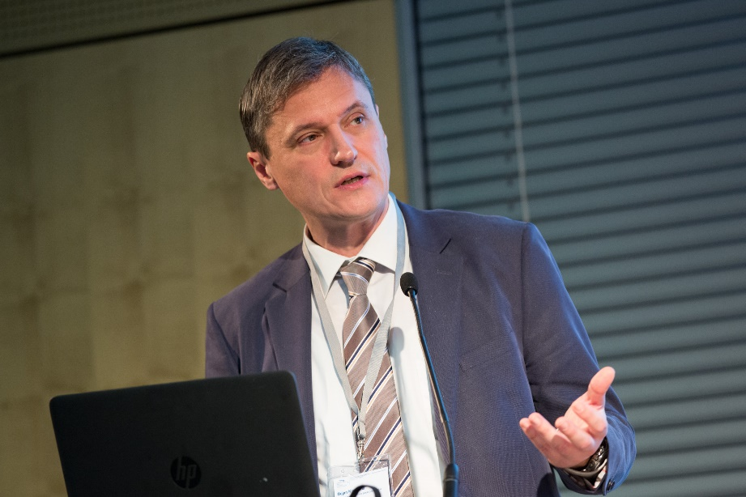
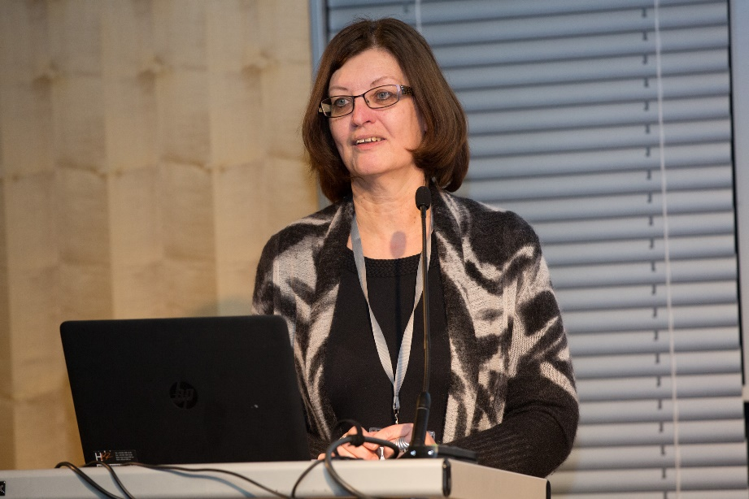
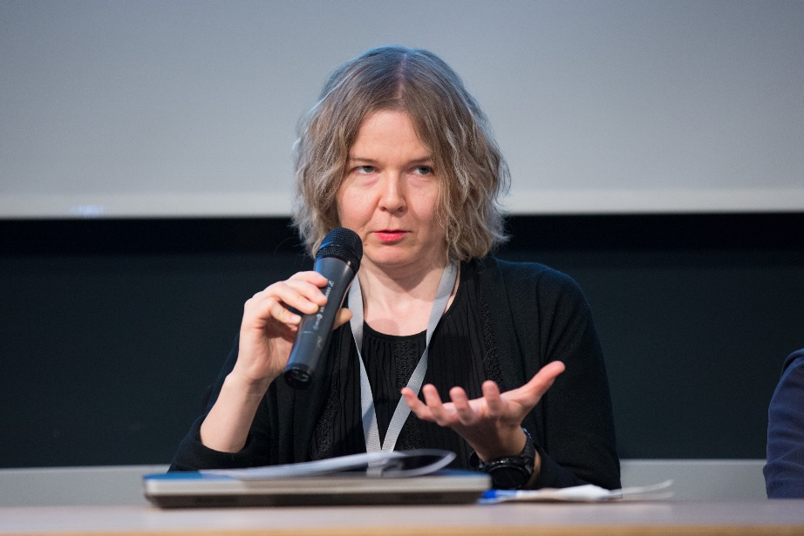
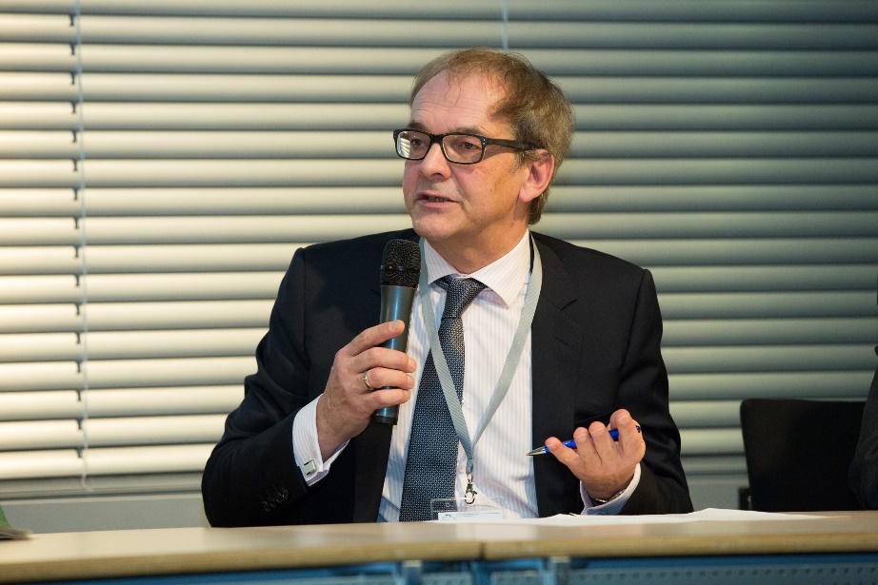
TAJ PALACE, NEW DELHI | 12 – 14 SEPTEMBER 2016
Notes:
Real debates between different (type of) organisations

Slide 12
TAJ PALACE, NEW DELHI | 12 – 14 SEPTEMBER 2016
QUOTES 1
“We want to keep our soils and not to have them flushed away; this increases the number of partnerships, but includes the need to manage the expectations”
“European energy generation is not about the more the better, as the energy policy has different components, which merge into a vision – towards low carbon emitting Europe”
Notes:
Not technical

Slide 13
TAJ PALACE, NEW DELHI | 12 – 14 SEPTEMBER 2016
QUOTES 2
“Approaching river management with a ‘technical blueprint’ is no longer feasible’’
“Not much progress has been achieved so far with integrating the agricultural sector, itself often an important driver for heavy river modifications”
“Respect and accept partners equally; do not ask technical planners to learn ecological planning but accept ecologists as equal planners”
Notes:
Not technical

Slide 14
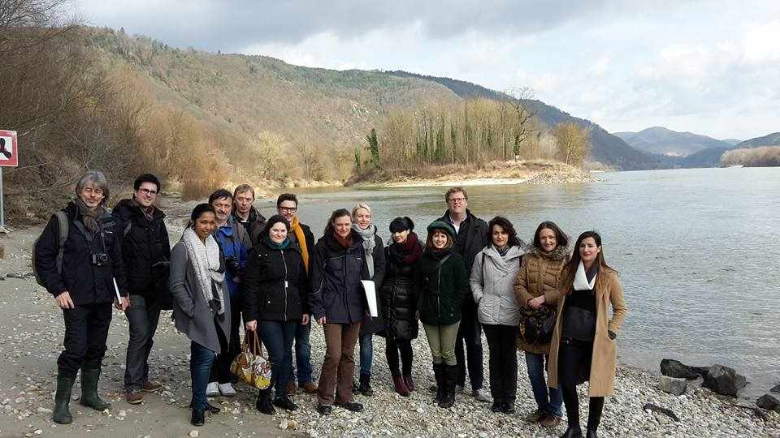
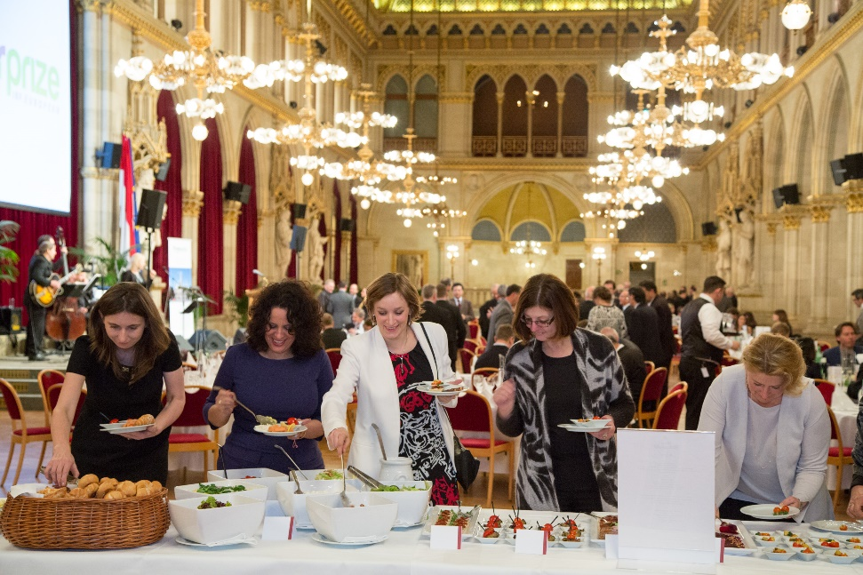
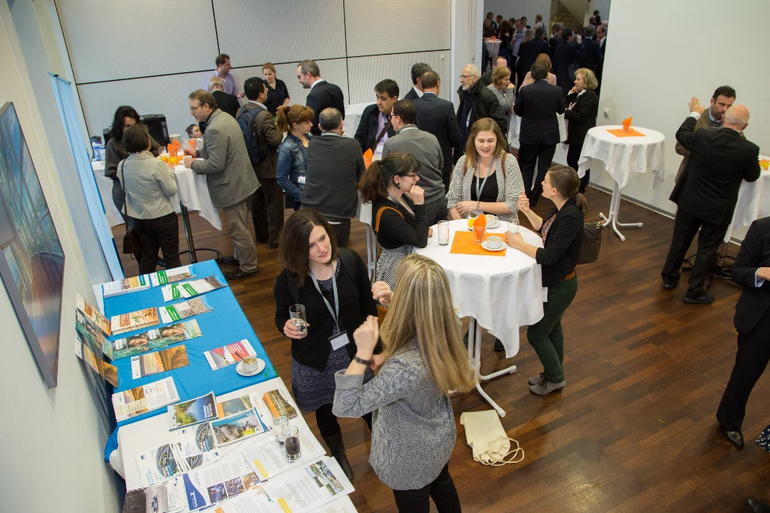
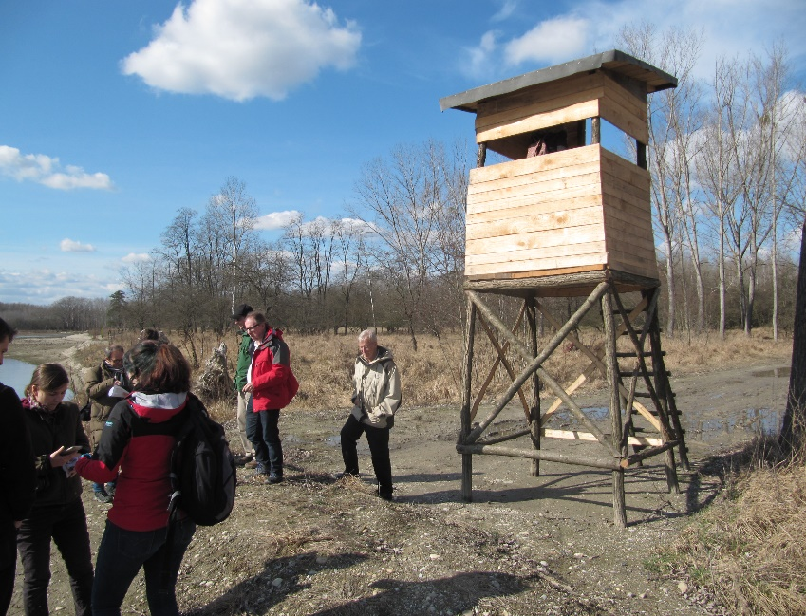
TAJ PALACE, NEW DELHI | 12 – 14 SEPTEMBER 2016
Notes:
Riverprize gala
Fieldexcursions
Breaks
Reflection and discussions

Slide 15
TAJ PALACE, NEW DELHI | 12 – 14 SEPTEMBER 2016
LESSONS LEARNT
Organisations and institutions dealing with hydropower show more and more flexibility in finding solutions
The role of water utilities is beyond water sector business towards public interest and sustainability
There is a need to strengthen the role of wetlands in water management and policies
The challenge for the future is to harmonize the objectives of agriculture and water management
To build trust, share information and communicate are the keys for a good dialogue
Notes:
Common findings

Slide 16
TAJ PALACE, NEW DELHI | 12 – 14 SEPTEMBER 2016
KEY MESSAGES
Communications should be more sexy: Good communication is a success factor implementing partnerships
Many dialogues just started and should first hit the ground to get real effective
Define milestones for and monitor the development of the cooperation to be able to see the progress
Twinning is a good concept for exchange of knowledge and experiences
Promotion of successes is often very important to get political support and funding
The water management should reach out to scientists for dissemination of results.
Notes:
Post conference communications
Newsletter report ECRR
International River Symposium
International River Restoration Symposium Poland
EUROPE – INBO France
National River Restoration Conferences (own languages!)

Slide 17
TAJ PALACE, NEW DELHI | 12 – 14 SEPTEMBER 2016
IN CONCLUSION:
CAPACITY DEVELOPMENT
UNDP DEFINITION
Capacity development is the process by which individuals, organizations and institutions develop, individually and collectively abilities to perform functions to solve problems and achieve objectives
Notes:
Partnerships building is capacity development

Slide 18
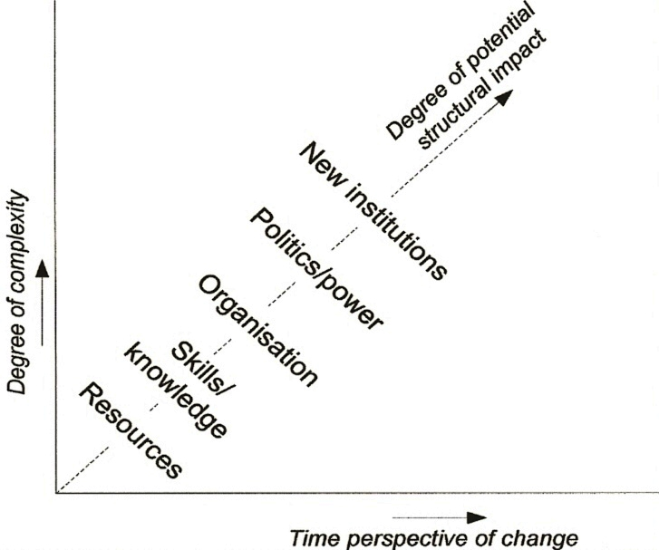
CAPACITY DEVELOPMENT FRAMEWORK
TAJ PALACE, NEW DELHI | 12 – 14 SEPTEMBER 2016
Notes:
A high structural degree of impact faces complexity and long time of change

Slide 19
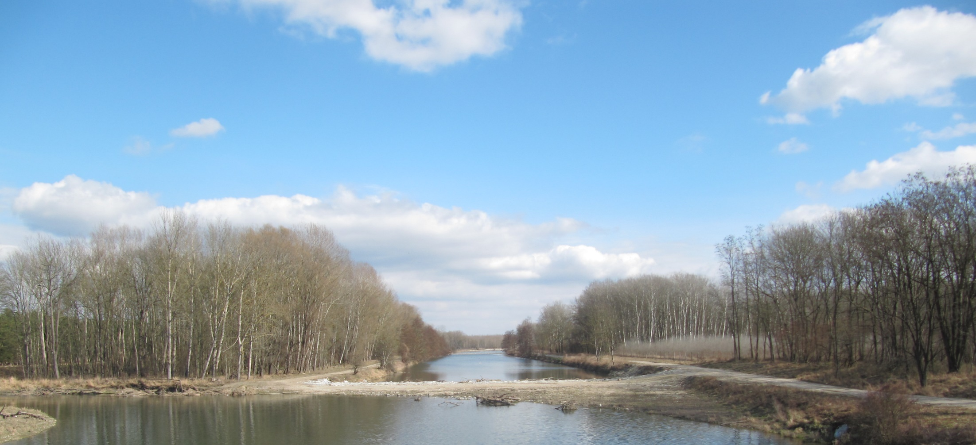
THANK YOU FOR YOUR ATTENTION
TAJ PALACE, NEW DELHI | 12 – 14 SEPTEMBER 2016
Notes:
Like to know your comments and questions

