Slide 1
TAJ PALACE, NEW DELHI | 12 – 14 SEPTEMBER 2016
Long Term Management of a Rapidly Aggrading Alluvial River
Waiho River – West Coast
New Zealand

Slide 2
General Information
Waiho river runs through a small town called Franz Josef – permanent population ~500
Entire population of West Coast of South Island is ~33,000
Very popular tourist town due to the Franz Josef Glacier.
Busiest heliport in the Southern Hemisphere

Slide 3
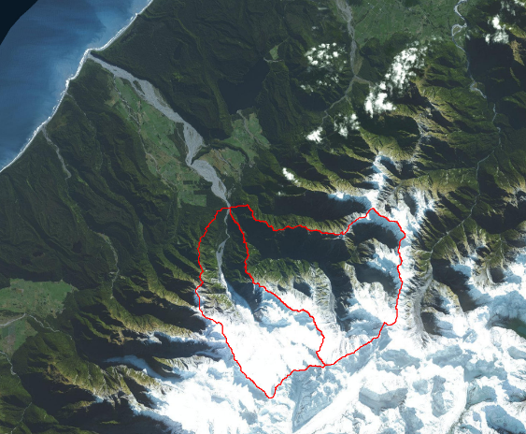
SH6 Catchments
6 to 8 metres annual rainfall
Total Catchment Area
~170 km²

Slide 4
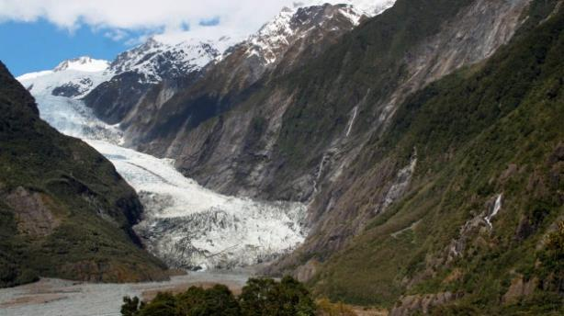

Slide 5
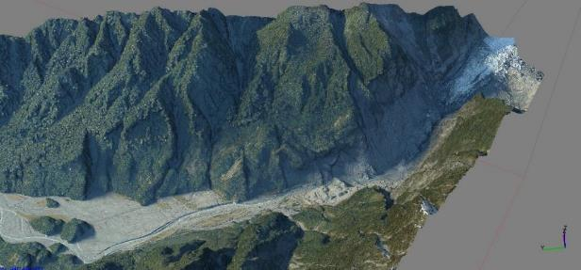

Slide 6
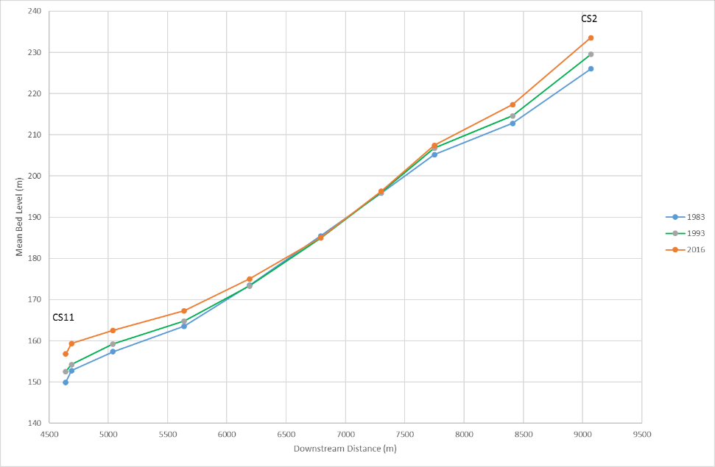
Longsection – Mean Bed Level (m)

Slide 7
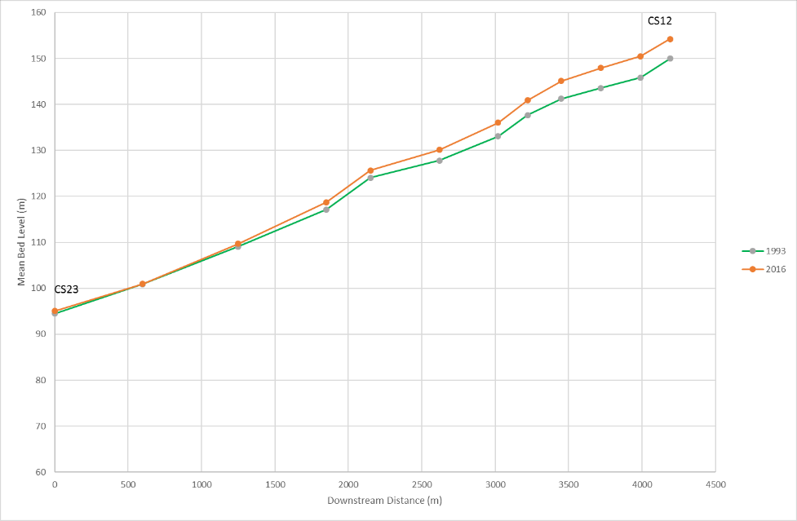
Longsection – Mean Bed Level (m)

Slide 8
Advance / Retreat of Glacier

Slide 9
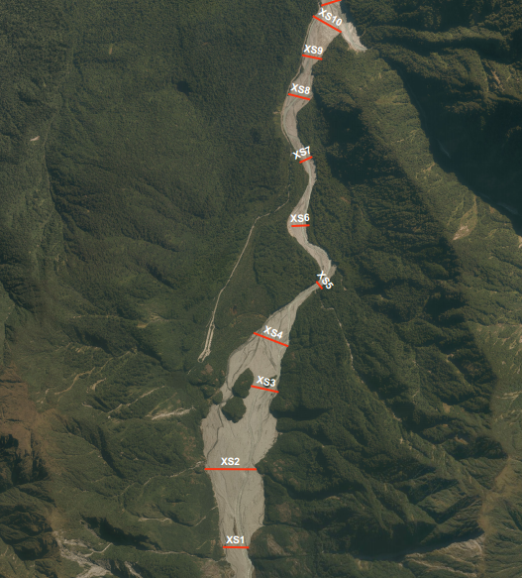
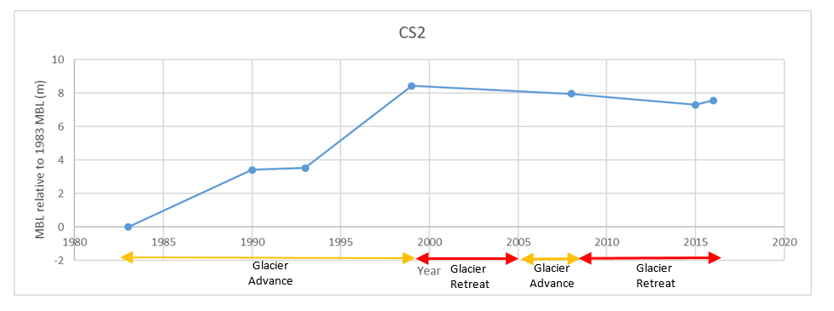

Slide 10
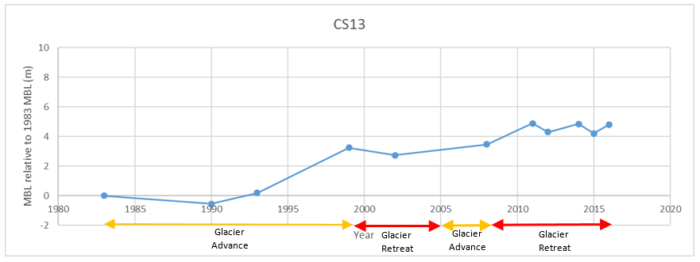
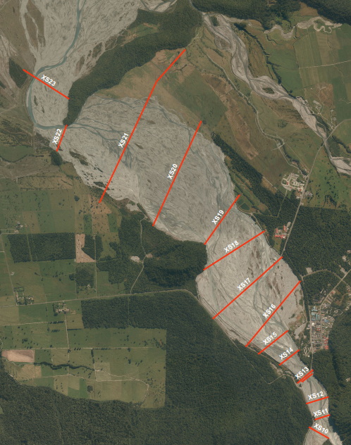
Average rate of aggradation 1m / 5 years since 1990’s!
Some years rapid aggradation of 0.5-1 m

Slide 11
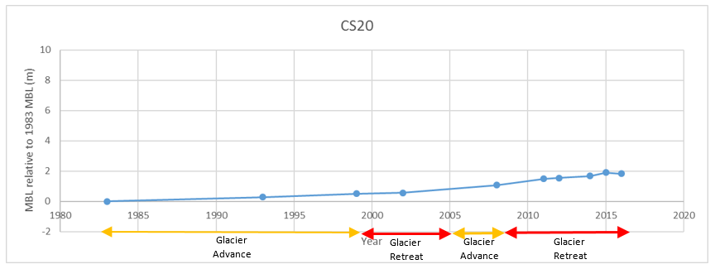

Slide 12
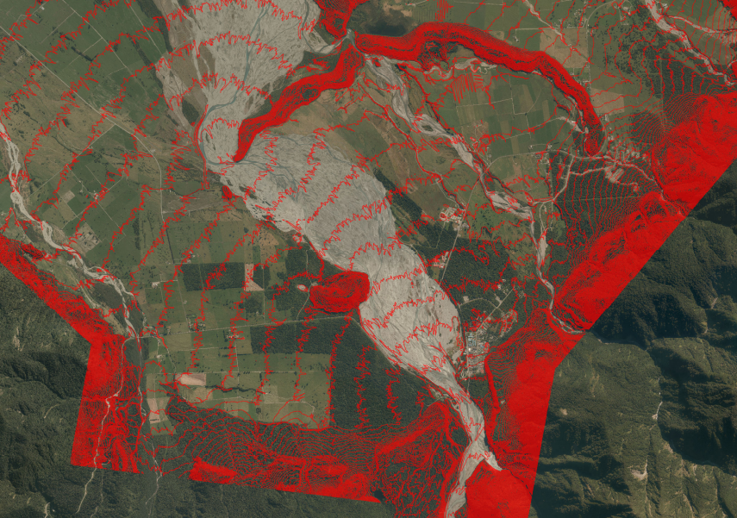
5m Contours – Natural Fan is Evident

Slide 13
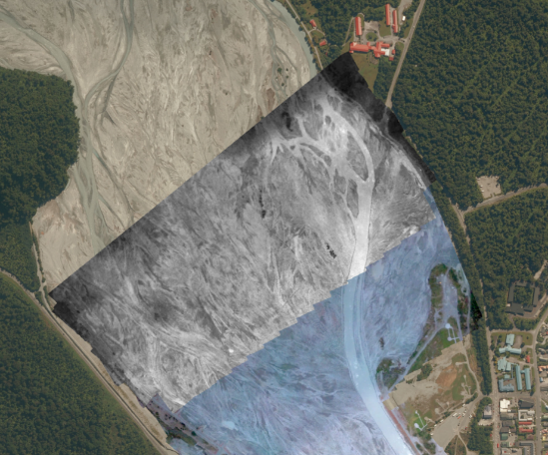
River Alignment 23-3-2016

Slide 16
Long / Short Term Options??

Slide 17
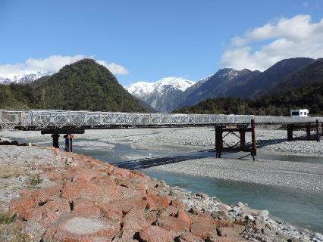
Raise bridge in short term to allow continued access to town and entire West Coast of South Island
Estimated economic impact of road closure is $1 - $1.5 Million per day

Slide 18
De-armour river in short term – recover boulders for use in rock lining

Slide 19
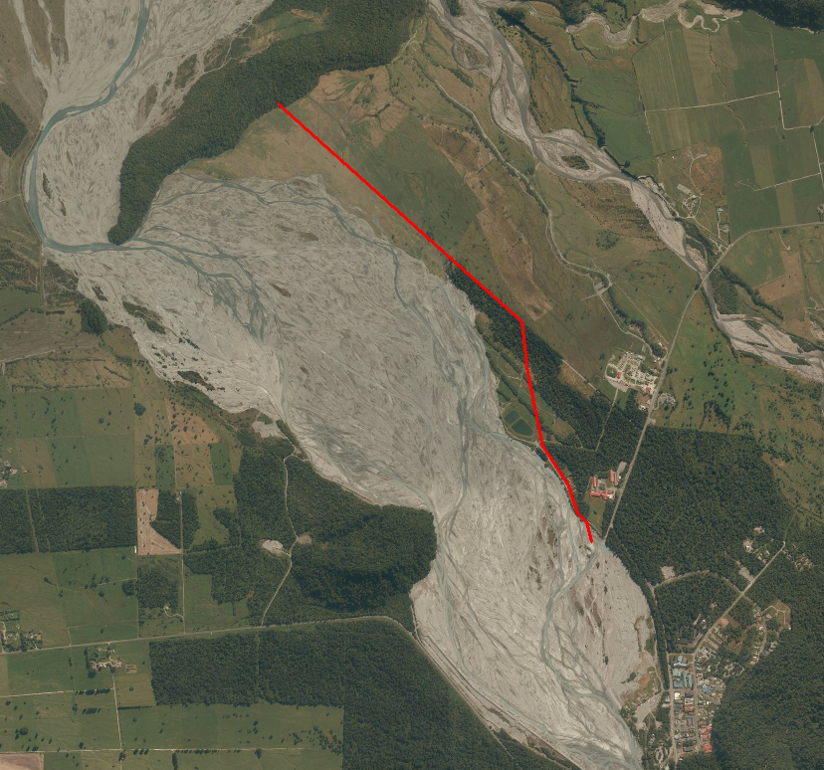
Prevent Avulsion into Tatare River
15m Terrace
Tatare River

Slide 20
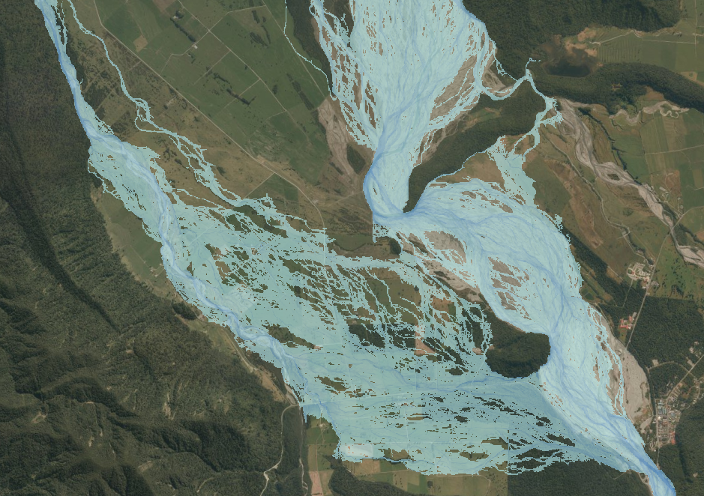
Allow river to reclaim natural fan

Slide 21
Microscale Modelling Professor Tim Davies (University of Canterbury)

Slide 22
Expensive solution
Need to buy out large amount of land
Realign state highway
Risk that desired affects won’t occur!!
However potentially inevitable that will occur with no intervention - consequences may be deadly.

Slide 23
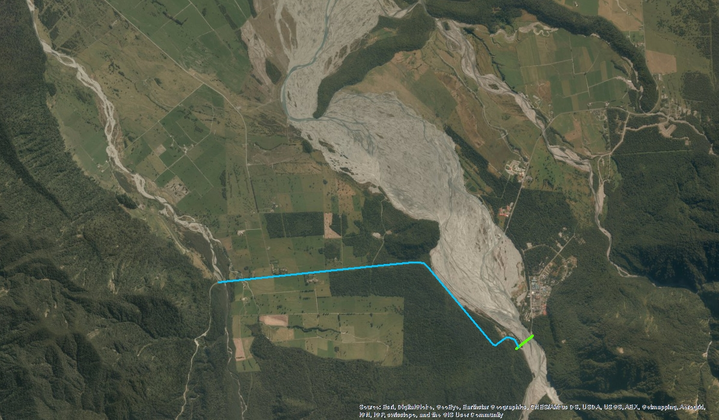
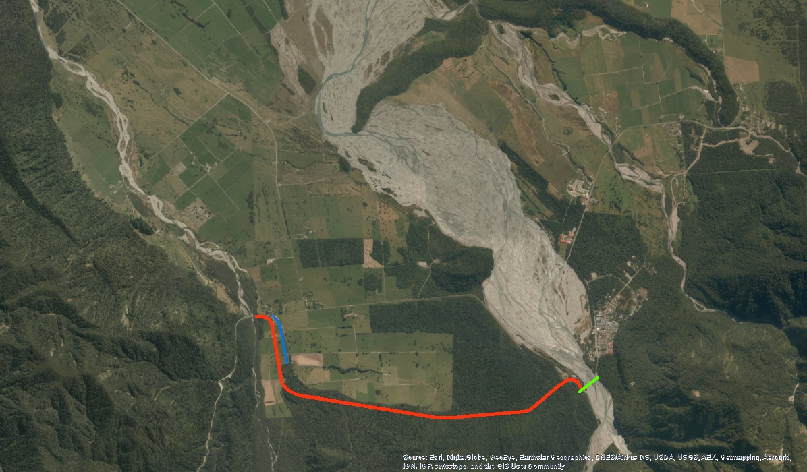

Slide 24
Further Investigations
Recommendation for 2D morphological modelling to test hypothesis and compare with microscale modelling.
Potential for full physical scale model?
Consultation / discussions with affected communities

Slide 25
Questions/Comments/Ideas?
matthew@landriversea.com
www.landriversea.com

