Slide 1
Development of River Basin Models for Investigation of Improved Water Management Options: Case Study of the Upper Godavari Basin in India
Dr A.S. Garudkar, Prof & Head, WALMI, Maharashtra
Er. C.A. Birajdar, ED, WRD Maharashtra,
eWater Solutions, Australia: Dr C.C. Daamen, Principal Hydrologist , Er K.B. Redpath Senior Hydrologist & Dr R.S. Carr, CEO

Slide 2
Outline of the Presentation
Introduction to Maharashtra and reforms in Irrigation Management Practices
Background of IWRM study of Upper Godavari Basin
Status of IWRM study of Upper Godavari Basin

Slide 3
Introduction to Maharashtra and
Reforms in Irrigation Management Practices

Slide 4
Narmada Basin 0.5%
Tapi Basin 17%
Godavari Basin 49.5 %
West Flowing Rivers
10%
Krishna Basin
23%
Basin Map of Maharashtra
4
Notes:
4

Slide 5
State Water Policy 2003
Objectives
To ensure the sustainable development, optimal use and equitable management of Water Resources.
To provide the greatest economic & social benefits of the water resources to the people.

Slide 6
Maharashtra Water Resources Regulatory Authority (MWRRA) Act, 2005
Main Objectives
To regulate water resources of the state as per State Water Policy and Integrated State Water Plan
To facilitate and ensure judicious, equitable and sustainable management, allocation and utilization of water resources

Slide 7
Background of IWRM in Upper Godavari Basin

Slide 8
Murray - Darling Basin in Australia
IWRM is successfully implemented on Murray Darling Basin in Australia
It is largest River Basin System of Australia covering 14% of land area of the continent
Rainfall variability is very high
It was observed that the situation of the basin is similar to upper Godavari Basin

Slide 9
Why IWRM of UGB
Since 1975, Paithan dam received design yield of 90.57 TMC or more in 17 years only out of 38 years.
In 2012, live storage of Paithan was 3.31 % only, on October 10, 2012.
To meet drinking water demands of Paithan reservoir, 11.50 TMC water was released from upstream dams
This caused wild uproar

Slide 10
Godavari Basin

Slide 11
Godavari River Basin
Upper Godavari study area

Slide 12
Annual Rainfall gradient in Upper Godavari

Slide 13
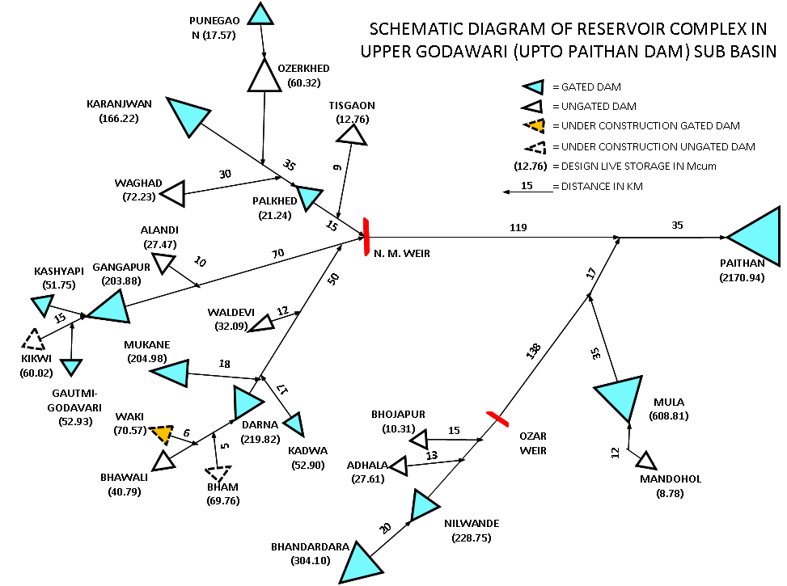
Upper Godavari Reservoirs

Slide 14
Summary of Hydrology and Water Management Issues in Upper Godavari
More variations in rainfall (upstream 2000 mm/y to 500 mm/y) across Upper Godavari sub-basin
Absence of any river basin model in use
Each storage/reservoir managed Independently – no basin-wide management strategy
Stakeholders demand that distress and water be equitably shared in the basin
Maharashtra Water Resources Regulatory Authority is trying to establish a regime of more equitable water sharing between high and low rainfall areas
Notes:
Rain shadow effects clear in centre of study area.

Slide 15
eWater Project – Progress to Date
In 2014 and 2016 training programs for river basin modelling held in Maharashtra
eWater has built a demonstration Source model of a part of the Upper Godavari basin – initial outputs
Maharashtrian hydrologists are collating relevant data and building models of other parts of the basin
Maharashtrian river basin modellers are visiting Australia for 6 weeks of intensive training (22nd August to 1st Oct)

Slide 16
eWater Project – Progress to Date
The project team is currently calibrating rainfall-runoff models within the Upper Godavari basin. These models will be evaluated for use to estimate runoff from basin areas where there is no gauged flow.
eWater working with NSW DPI Water to share knowledge of appropriate water resource allocation systems

Slide 17
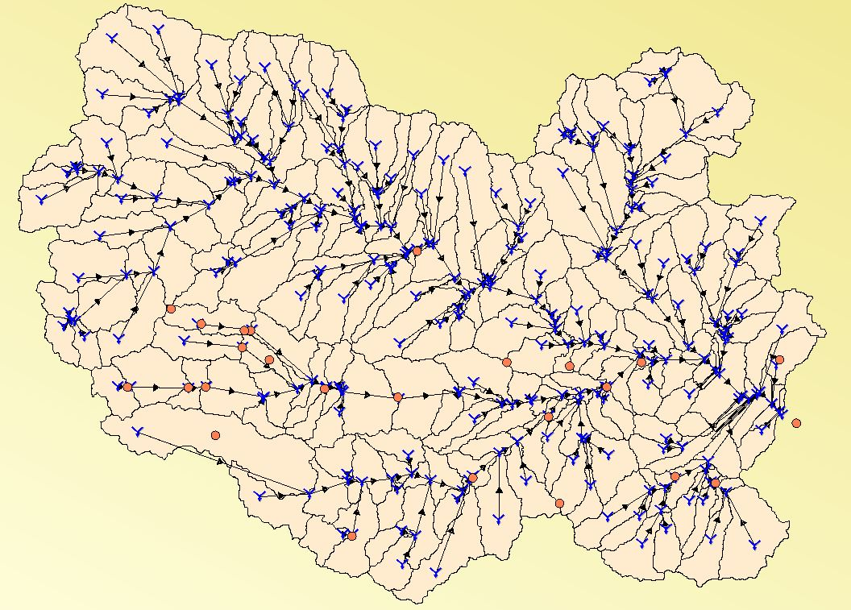
Upper Godavari River Basin Model
Notes:
Catchment model generated from a DEM and dam and gauge locations to fix some subcatchment boundary locations.
Locations of Bhandardara. Adhala, Bhojapur, Mula and Jayakwadi are shown.
Also Samangaon, Bhagur, Newasa, Panegaon and Sangamner.
Also, some Locations shown are rainfall stations.

Slide 18
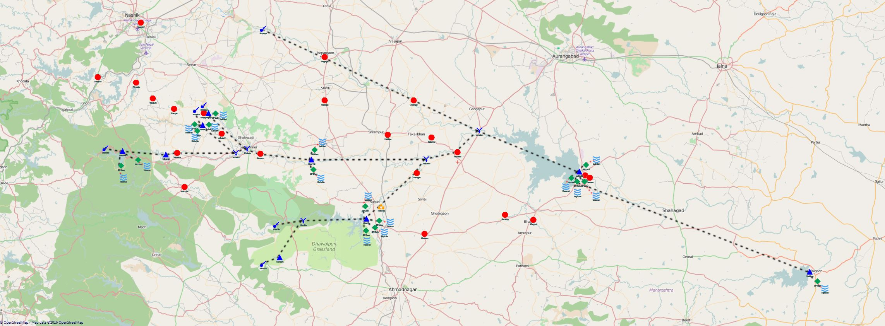
Upper Godavari model
River system model: Map View
Notes:
Assigning actual latitude-longitude coordinates is useful for comparing to local features and landmarks.

Slide 19
Applying the River Basin Model
The model will be used to:
Characterise components of a basin water balance
Document the primary processes, water control structures, and system constraints
Evaluate effects of new water management rules to improve equitable distribution of water within the basin (e.g. for water releases to downstream storage)

Slide 20
Applying the River Basin Model
The model will be used to:
Investigate effects of new construction projects:
Change in basin water balance that would be caused by new planned dams/reservoirs (e.g. Kikwi)
Effects of possible inter-basin transfer (from Konkan rivers)

Slide 21
Mula Stored Water Volume: Observed (blue) vs Modelled (red) 1985 - 2015

Slide 22
Upper Godavari Basin : Pilot Project
Key deliverables of the project will be:
Development of a science-to-policy eWater Source modelling framework suitable to support development of an IWRM plan for the Upper Godavari.
Application of the modelling process to improve equitable access to water across the sub-basin.
Facilitation of water management and governance processes
Capacity building at various levels. Water Managers and Modellers to continue learning and sharing experiences which can be applied in other Sub-Basins in Maharashtra

Slide 23
Thank You

