Slide 1


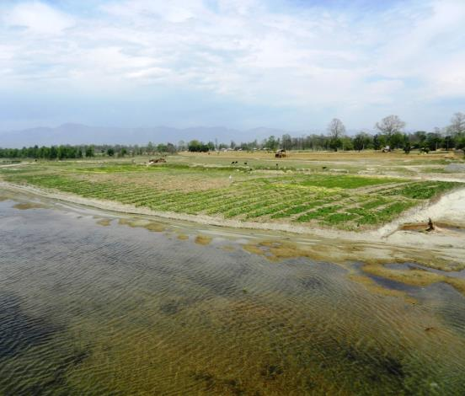

TAJ PALACE, NEW DELHI | 12 – 14 SEPTEMBER 2016
Riverbed faming Technology adoption by landless and land poor farmers of Tarai districts of Nepal
Hari Gurung
and
Juerg Merz
HELVETAS Swiss Intercooperation Nepal
River Symosium , New Delhi
12-14 September 2016

Slide 2
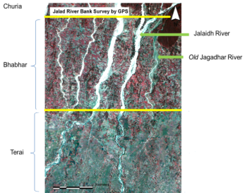
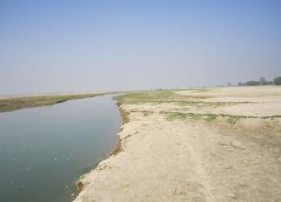
Introduction to riverbed farming
Hills (river)  narrow valley  Tarai: silt and sand deposition  dry riverbeds (November to May)  spring vegetable cultivation
  Measured 78,000 ha riverbed in 21 Tarai districts and it is in increasing trend
Landlessness is widespread in Tarai region: more than 20% households
Income sources of landless and land-poor (0.25 hectares) households are sharecropping, wage labour and seasonal migration for employment
Increasing trend of soil erosion and flooding - widening riverbed areas in Tarai region- agriculture land cut + Sand cover

Slide 3
Flood Characterizes in Tarai River

Slide 4
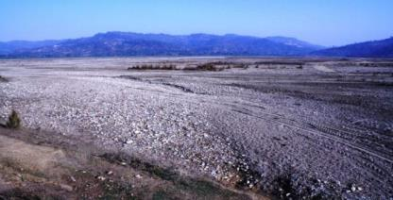
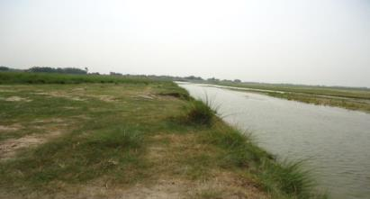
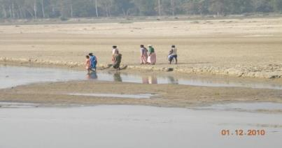
Vertical classification of rivers in Tarai
Upstream
Mid stream
Down stream

Slide 5
Sediment Composition
Clay
Silt
Sand
Gravel
Pebble
Cobble
Boulder
Down stream
Middle stream
Up stream

Slide 6
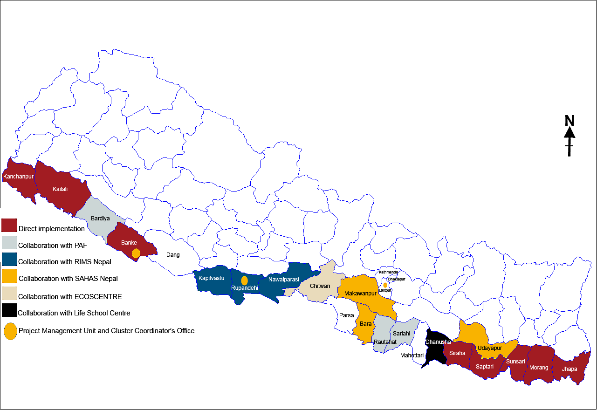
Riverbed Farming implementation working districts

Slide 7
HELVETAS Swiss Intercooperation Nepal
Swiss non-governmental organisation
Started in Nepal in 1956
Programme coverage: all 75 districts
Five working areas with more than 15 Projects
  Water and Infrastructure
  Environment and Climate
  Education and Skills Development
  Rural Economy- Riverbed farming project-
  Governance and Peace

Slide 8
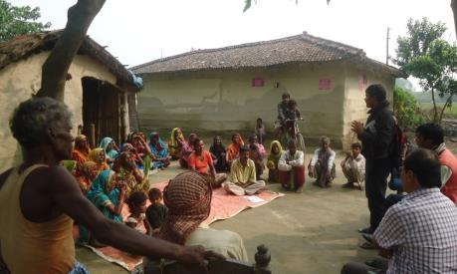
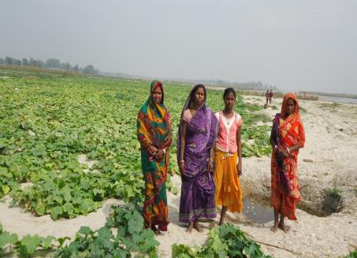
Goal:
Improved food security and incomes of landless, land-poor and severely flood-affected households in Tarai region through seasonal cultivation in the riverbeds
Outcome A:
15,000 landless and land-poor households farm dry riverbeds with the support of localized support systems
Outcome B:
The Government of Nepal implements local and national policies that enable landless and land-poor to benefit from riverbed farming

Slide 9
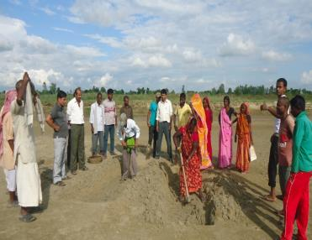
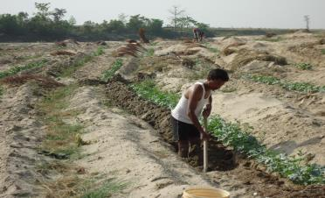
Key features of riverbed farming
Riverbeds / primary stakeholders selection, group formation, and land allocation;
Leasehold contract with the land owner (local government authorities, forest user groups and private landholders);
Agriculture input supply through private sector;
Promotion of environment friendly technology (use of organic manure and bio-pesticides; urine application);
Agriculture extension support through local resource persons;
Marketing through local marketing committees/ farmers business schools

Slide 10
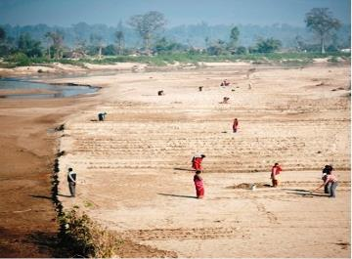
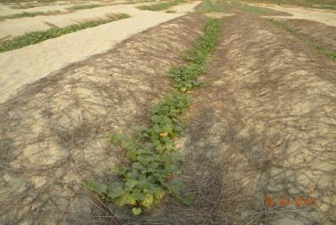
Technical aspects
Trained Local resource persons (LRP) are mobilized for providing extension services to riverbed farmers.
Riverbed of less than 1 meter soil moisture depth and fine sand mixed with silt is better for riverbed vegetable cultivation
Riverbed plots are allocated perpendicular to the river flow that allows to grow different types of vegetables by each farmers.
Mulching with thatch/dry leaf is practiced that helps maintain to moisture level, spreading of branches and protect discolouring of fruit from direct sand contact.

Slide 11
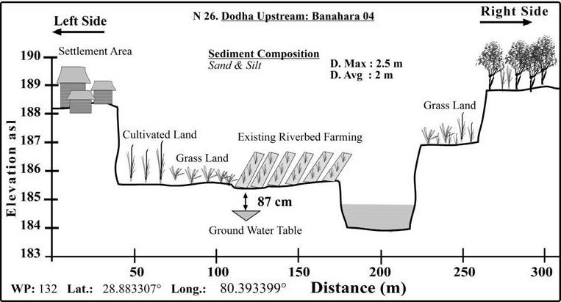
Cross section drawing

Slide 12
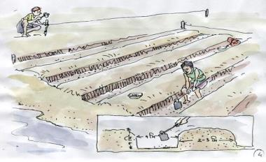
continued…..
Ditch to ditch: 2 - 3 meters and plant to plant: 0.5 - 1 meters based crop type
East west direction ditches in line wind direction and ease for sunlight for early growing stage
Pits (3 feet depth, 3 feet width and 3 feet length) and pit to pit is 1-2 metres
Appropriate vegetables- Cucurbits (Water melon, musk melon, cucumber, bottle gourds, bitter gourds
Trained farmers on environment friendly technologies (use organic manures, urine application, bio-pesticides applications)

Slide 13

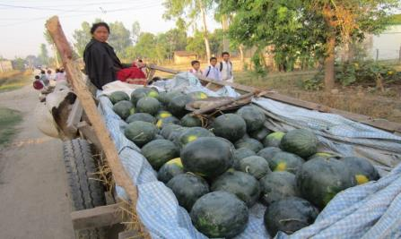
Key achievements
Utilizes unutilized land resources for market oriented vegetable production
Generates meaningful income, seasonal employment and support in food security to the primary stakeholders engaged in riverbed farming.
Local resource persons improved accessto quality extension service to the landless/land poor and severely flood affected households.

Slide 14
Riverbed farming progress trend
Year | Farming House-hold | Area (hectare) | Ha/ household | District | VDC/ Municipality | Group
2006/07 | 570 | 52.5 | 0.078 | 2 | 4 | 32
2012/13 | 4,400 | 500 | 0.11 | 6 | 36 | 202
2013/14 | 5600 | 650 | 0.11 | 12 | 72 | 310
2014/15 | 6219 | 850 | 0.13 | 17 | 182 | 430
2015/16 | 9123 | 946 | 0.11 | 20 | 192 | 506
Average Incomes
Nrs:29,000/ household (2015)

Slide 15
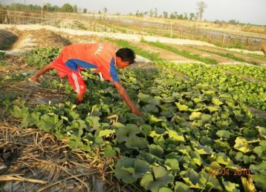
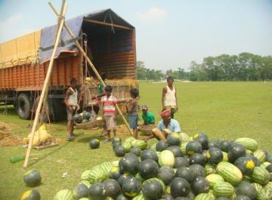
Key achievements (continued)
Riverbed incomes and learning are reinvested in arable lands for vegetable production throughout the year
Bartering of riverbed produce with food grains enhanced food sufficiency
Contributes to regeneration of riverine ecosystem by free range grazing, encroachment of sand extraction and green coverage minimizing fine sand loss from wind erosion.
Local government and agriculture department has given due priority of riverbed in their local plan.
Riverbed farming alliance functionalized to create learning sharing forum and lobbying for riverbed farming promotion policy.

Slide 16
Lessons learned
To make meaningful income, riverbed farmers need to cultivate at least 0.2 hectares. However, there should be support mechanism needed for land lease management, access to finance and entrepreneurship skills
Current contractual riverbed land leasing process is not in favour of landless/land poor riverbed farmers that demands advocacy works for lobbying landless/land poor farmers friendly local policies
Riverbed produce is negatively influenced by market influx from outside supply that demands production of lot system.
Riverbed farming is found one of the important adaptive activity for climate change vulnerable communities residing along river corridor. However, the farming is prone to climatic hazards (flood, hailstorm, cold wave), so crop security/insurance schemes needs to be effectively applied.

Slide 17
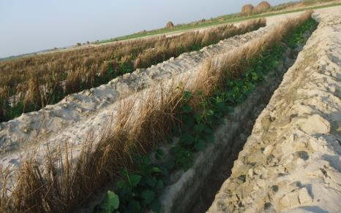
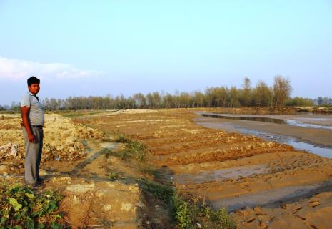
Challenges of riverbed farming
Incidence of winter flood, cold spells and drought
Thieves and wild animals (antelope, jackal, etc)
Low investment capacity of landless and land-poor farmers
Change of riverbeds by shifting the river course with monsoon floods

Slide 18
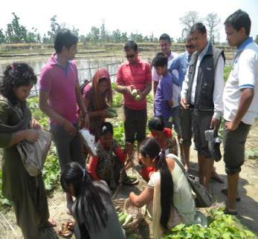
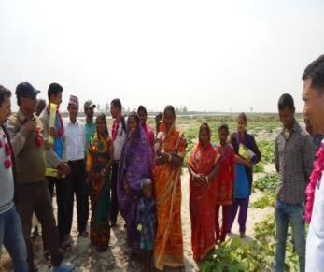
Opportunities
Increasing trend of riverbed areas (78,000 hectare) and additional larger areas of raised bed and riverbank can be productively used for benefitting larger land poor people.
Local government authorities are positive for promoting riverbed farming - incorporation in their local plans / resource sharing
“Local Riverbed Farming Promotion Policy-2070” by the Government of Nepal is in the approval process that will create enable environment for the promotion riverbed farming.
Riverbed farming technology is in the process to incorporate agriculture in university/college that could be useful for wider knowledge dissemination.

Slide 19
Conclusion
Riverbed farming is appropriate technology for landless, land poor and smallholders for improving income and food security. However, lobbying for crop security/insurance and land lease/contract system demands advocacy works with concerned stakeholders.
Seasonal riverbed farming by primary stakeholders demonstrated visible differences in income-earning, food security condition and welfare of the family from riverbed farming. Income and food security of the larger primary stakheholders can be could be improved further utilizing larger areas of riverbed along with raised and river bank
Based on the learning the Government of Nepal is willing to promote the technology and approach further as a result Riverbed Farming Promotion Policy is in the approval process.
Ministry of Agriculture has also given due priority to riverbed farming with fund leveraging initiated from for 5 districts.

Slide 20
Riverbed farming do not have negative impact on environment as it minimizes free animal grazing, uncontrolled sand extraction, top soil/sand loss due to wind erosion and improves soil formation process by organic manure application.
There is scope of transferring riverbed farming technology having similar context in other countries with exchange of knowledge.

Slide 21

Thank you

