Slide 1
Comparing incomparables in DRIFT EFlows assessments
Alison Joubert¹, Cate Brown¹, Jackie King²
¹ Southern Waters, ² Water Matters
South Africa

Slide 2
Can we compare apples and oranges?
How?
Brief outline of DRIFT EFlows assessment process
Some multi-criteria analysis notes
Examples

Slide 3
Intro to DRIFT
DRIFT : Downstream Response to Imposed Flow Transformations
DRIFT software
Flow indicators
Specialists & Response curves
Structured scoring system
Structured, consistent aggregation of results
Time-series of flow for scenarios
Seasonal time-series of indicator responses (as % of baseline)
Primary driver
Ecosystem Integrity
Social well-being

Slide 4
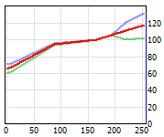
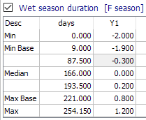
Response curves (biophysical)
Relationship between driver indicator & response indicator
e.g. Abundance of fish spp X vs duration of wet season
Severity score
% change from baseline / reference
→ percentage of baseline
Abundance (% of baseline)
~ 5% decrease →
~ 95% of baseline (100)
Duration of wet season (days)
Duration is 87 days in a particular year

Slide 5
Time series
Time-series of % change from each response curve
Sum to get seasonal response
Add to / subtract from previous season
Thus: develop time-series of abundance
as percentage relative to baseline
All indicators represented in the same way (abundance, area, concentration, etc.)

Slide 6
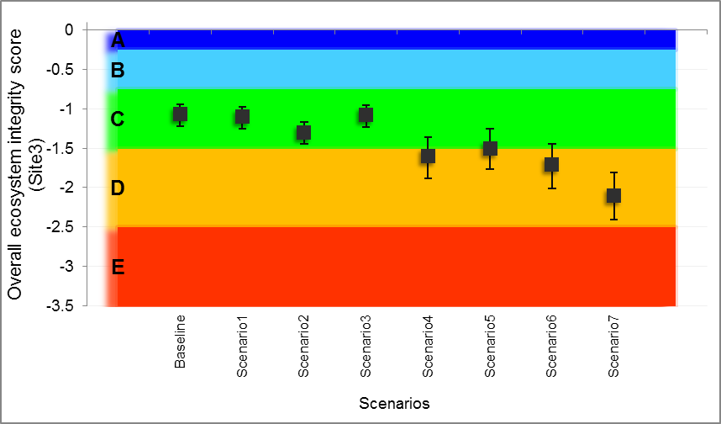
Ecosystem Integrity
Abundance translated to INTEGRITY
On a scale from 0 to -5
0 = unimpacted
-5 = critically severe; unsustainable
Integrity ratings combined → discipline Integrity
Discipline integrities combined →site Integrity
Integrities are combined with a weighted sum

Slide 7
Summing and comparing scales
Multi-criteria analysis (MCDA, MCA)
Value function approach; Weighted summation

Slide 8
Multicriteria analysis: Weighted summation
$V=\sum_{i=1}^{n}{w_{i}}v_{i}$
“Value functions” should be on interval scales
Swing weights (importance of contribution to overall value)
Judgemental independence
Site Ecosystem Integrity = wtd sum of discipline integrity
Response curves (Severity, % of baseline, Integrity)

Discipline and site integrity

Response curves


Slide 9
Multicriteria analysis: Weighted summation
Judgemental independence:
Can determine response to one input indicator without referring to the level of another indicator
In DRIFT:
Assess response to one driver “all else remaining as is”
If not possible then combine two driver indicators to create a new driver
e.g. depth of inundation of floodplain
→ Duration of inundation with depth 1 to 2 m
Response curves


Slide 10
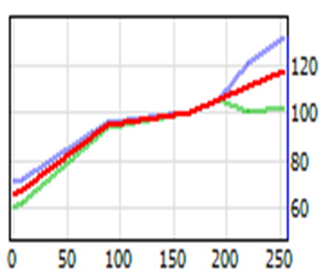
Multicriteria analysis: Weighted summation
Of the weighted sum conditions:
Assumption of linear value-function when it is non-linear - has largest effect on results
i.e. “inaccuracies” in swing weights and judgemental independence have less effect on results than assumption of linearity.
Response curve

Slide 11
Comparisons: biophysical; ecosystem
Can compare relative % abundances of different indicators
Can compare Discipline Integrity (esp. as all relative to an “A” condition)
Can compare Site Integrity (esp. as all relative to an “A” condition)

Slide 12
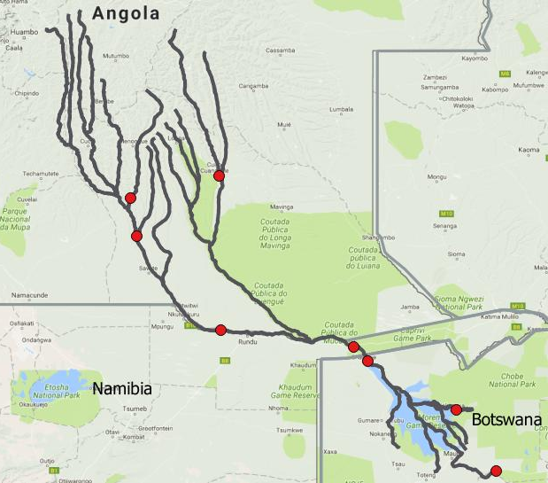
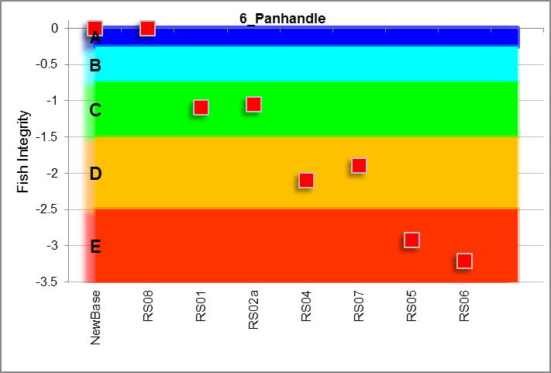
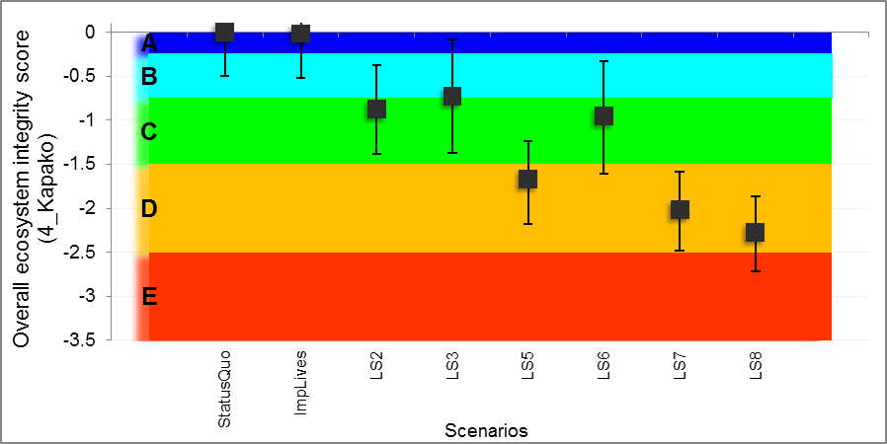
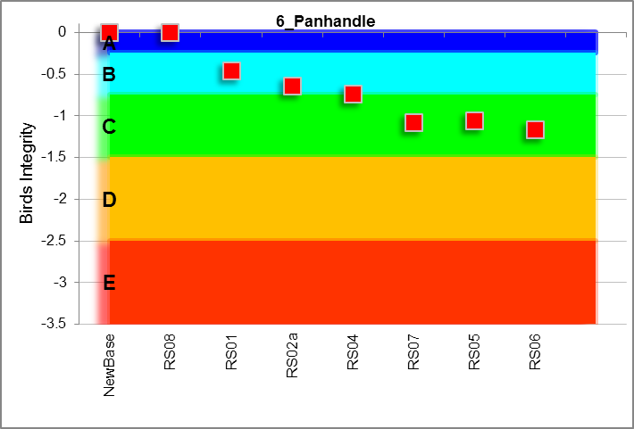
Comparisons
Disciplines
Sites
Okavango River Basing

Slide 13
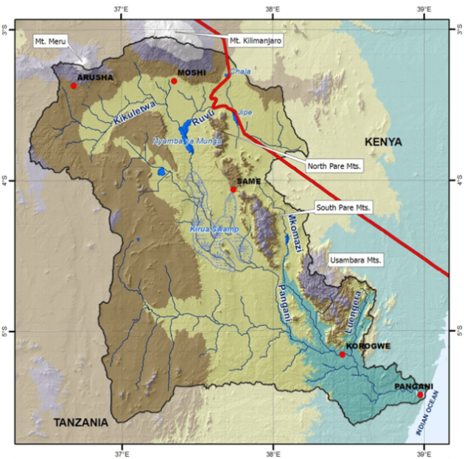
Pangani River Basin
Okavango River Basin
Pongola River

Slide 14
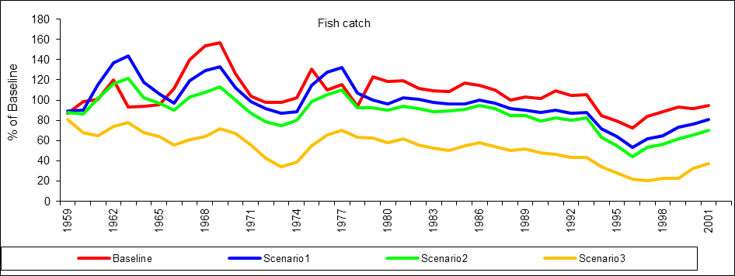
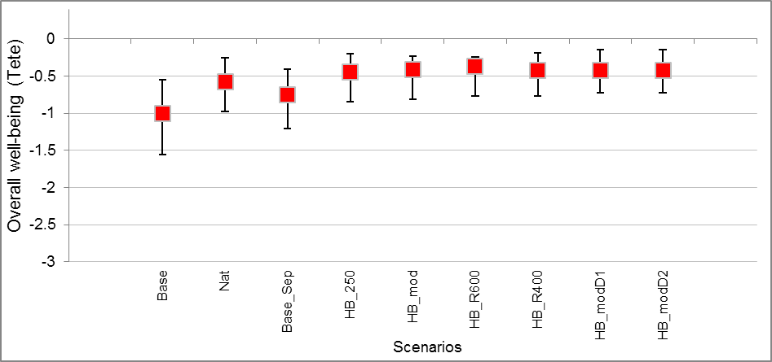
Social well-being
DRIFT does in same way:
Response curves → % “abundance” relative to baseline
Where “abundance” might be:
Fish catch
Income from fishing
Health effects from water quality
Recreational, cultural, spiritual value
etc.
And “Integrity” might be:
Livelihoods, household income
Social well-being
Etc.
e.g. Okavango river and Delta:
Indicator time-series: e.g. fish catch
e.g. Pongola River, floodplain and pans:
Site level: Livelihoods

Slide 15
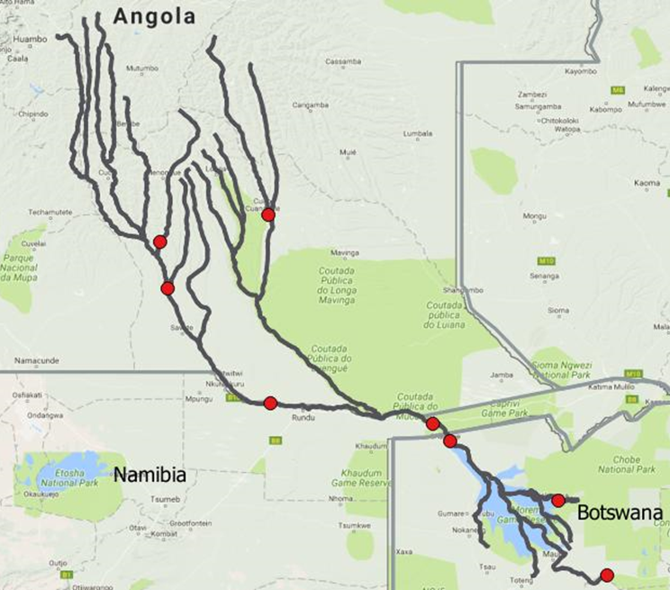
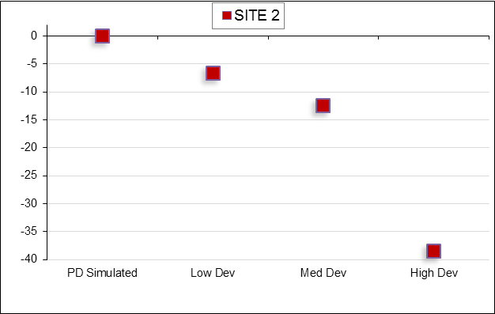
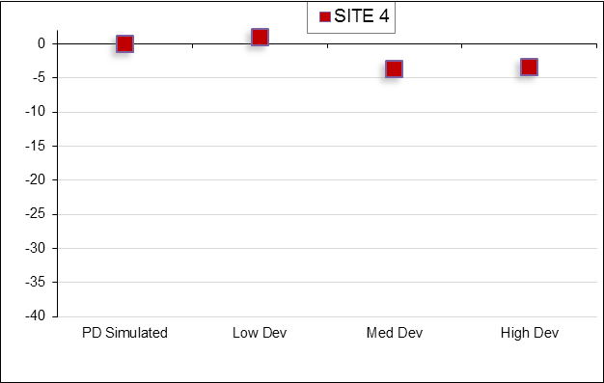
Social well-being
Can we compare % changes at different sites?
France
Botswana

Slide 16
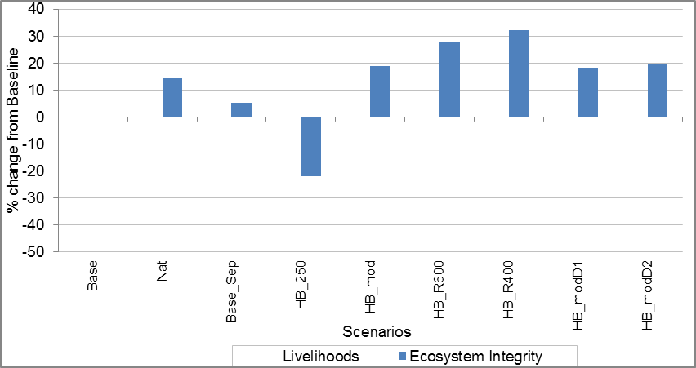
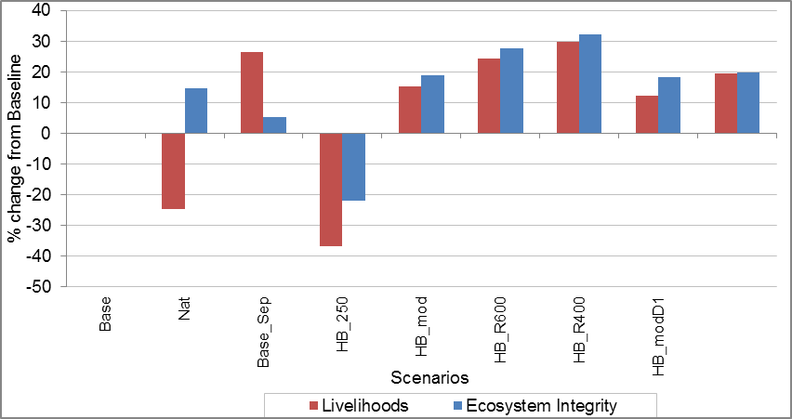
Ecosystem & Those depending on it
Percentage change from Baseline
Ecosystem Integrity
Livelihoods
But –
% point on one scale not necessarily equivalent to one on the other
e.g. Pongola River, floodplain and pans

Slide 17
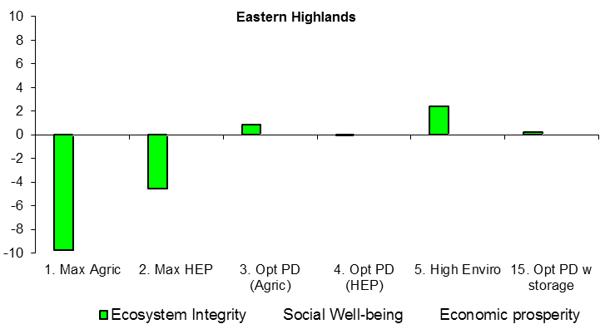
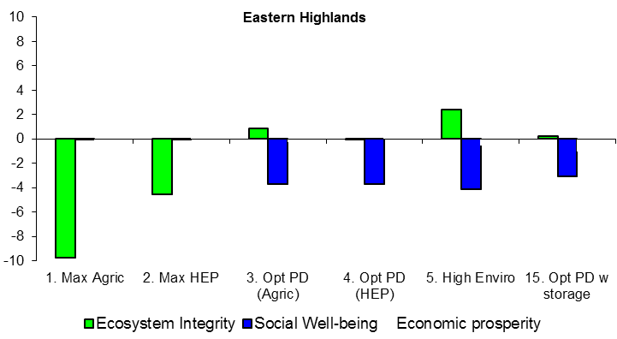
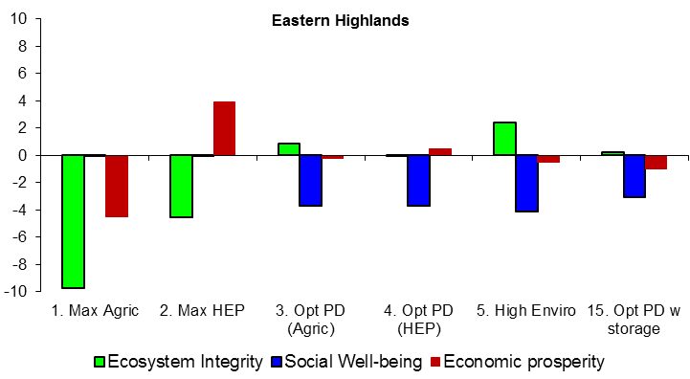
“Three pillars”
% change from Baseline gives a useful overview, but:
Scales not comparable (need swing weights to combine)
e.g. Pangani River

Slide 18
Next steps
DRIFT can provide information on ecosystem and social dimensions
Social process:
comparison of scenarios;
assessment of preferences;
Are various tools including from MCA world that can assist

Slide 19
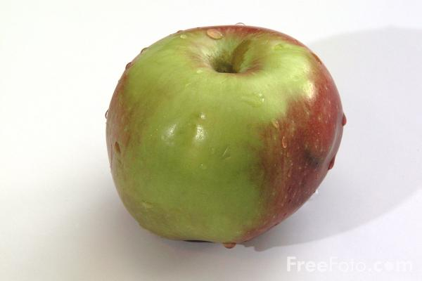
Thank you

