Slide 1
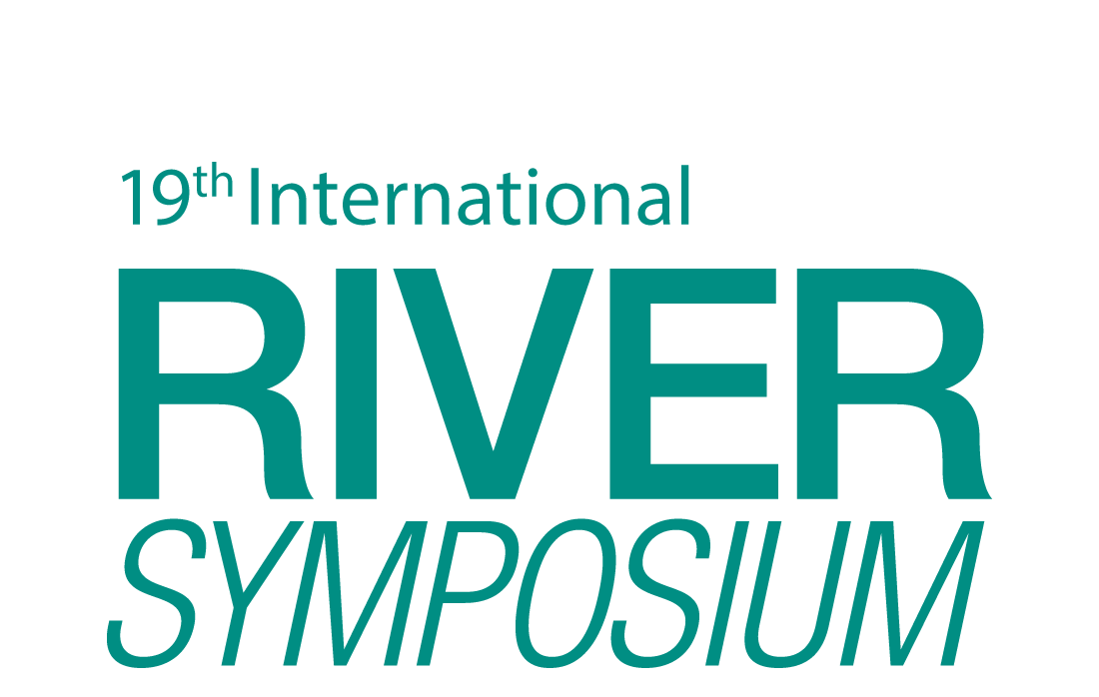
TAJ PALACE, NEW DELHI | 12 – 14 SEPTEMBER 2016
ACADEMIC DOCUMENTATION TO RESTORE RIVER: A SUCCESS STORY ON BORAL RIVER, BANGLADESH
Presented by
Nusrat Islam Khan
Director of Communications and Campaign
Riverine People

Slide 2
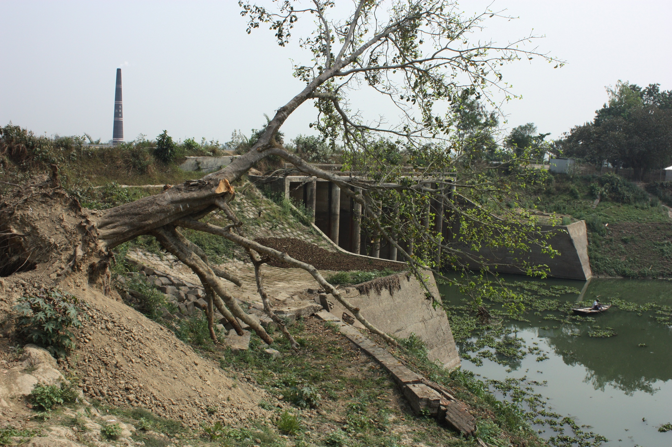
TAJ PALACE, NEW DELHI | 12 – 14 SEPTEMBER 2016
River Boral Was Almost a Dead River

Slide 3
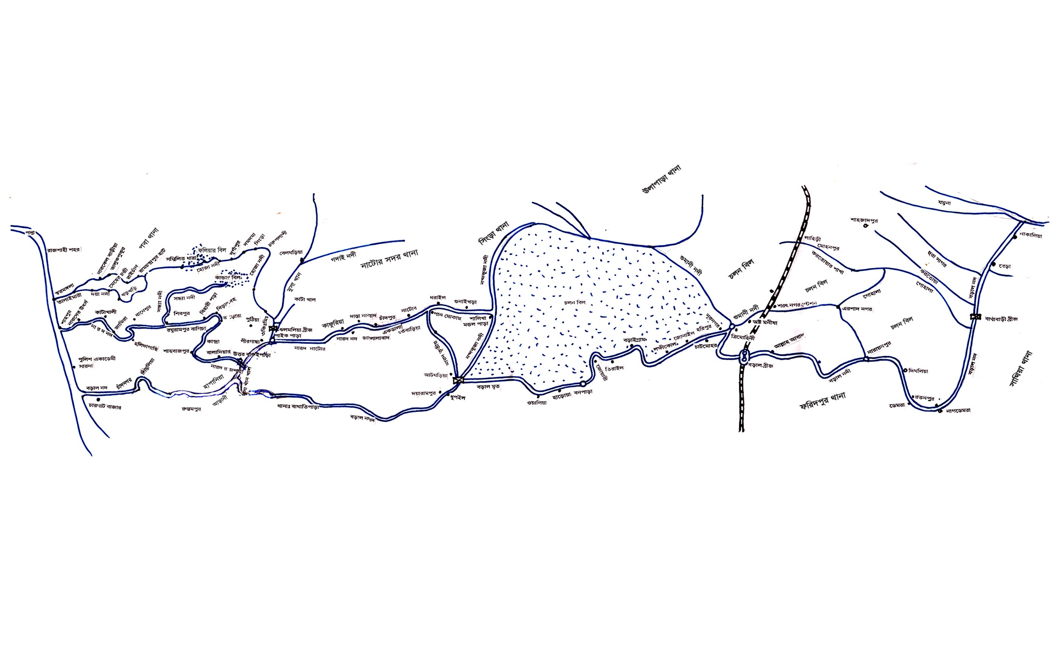
TAJ PALACE, NEW DELHI | 12 – 14 SEPTEMBER 2016
A location map of River Boral

Slide 4
TAJ PALACE, NEW DELHI | 12 – 14 SEPTEMBER 2016
Why Boral restoration became a burning issue among people
Boral is a 220 kilometer long and large river of Rajshahi and Pabna region of northwestern Bangladesh, generated from River Padma and passes through Chalanbeel
It used to an important role in communication, agriculture, environment and culture of that area
An issue never treated as national issue before raising the voice from local community
Boral was the worst victim of sluice gate and earthen cross dam by government agencies
Boral was turned into a logged water body and used as fish hatchery
The farming of cultivable fish species became a threat to local species for the benefit of politically powerful entity

Slide 5
TAJ PALACE, NEW DELHI | 12 – 14 SEPTEMBER 2016
River Boral Movement
The movement was conduct by Riverine People and the 'Boral Rakkha Andolon’ – A River Committee and Chalanbeel Rokkha Andolon
In 2008, a joint movement made a huge outcome by Boral Rokkha Andolon, Chalanbeel Rokkha Andolon, Riverine People, Bangladesh Poribesh Andolon- BAPA
Engaging community people, journalists, writers, development workers, teachers and students through developing an academic document for River Boral restoration movement
The academic documentation helped to communicate common people to involve into the movement as well as the authorities were advocate by the alternate solutions
Through the documented movement, Government agencies had removed the earthen cross roads; implemented a dredging project and decommissioning the sluice gates under process

Slide 6
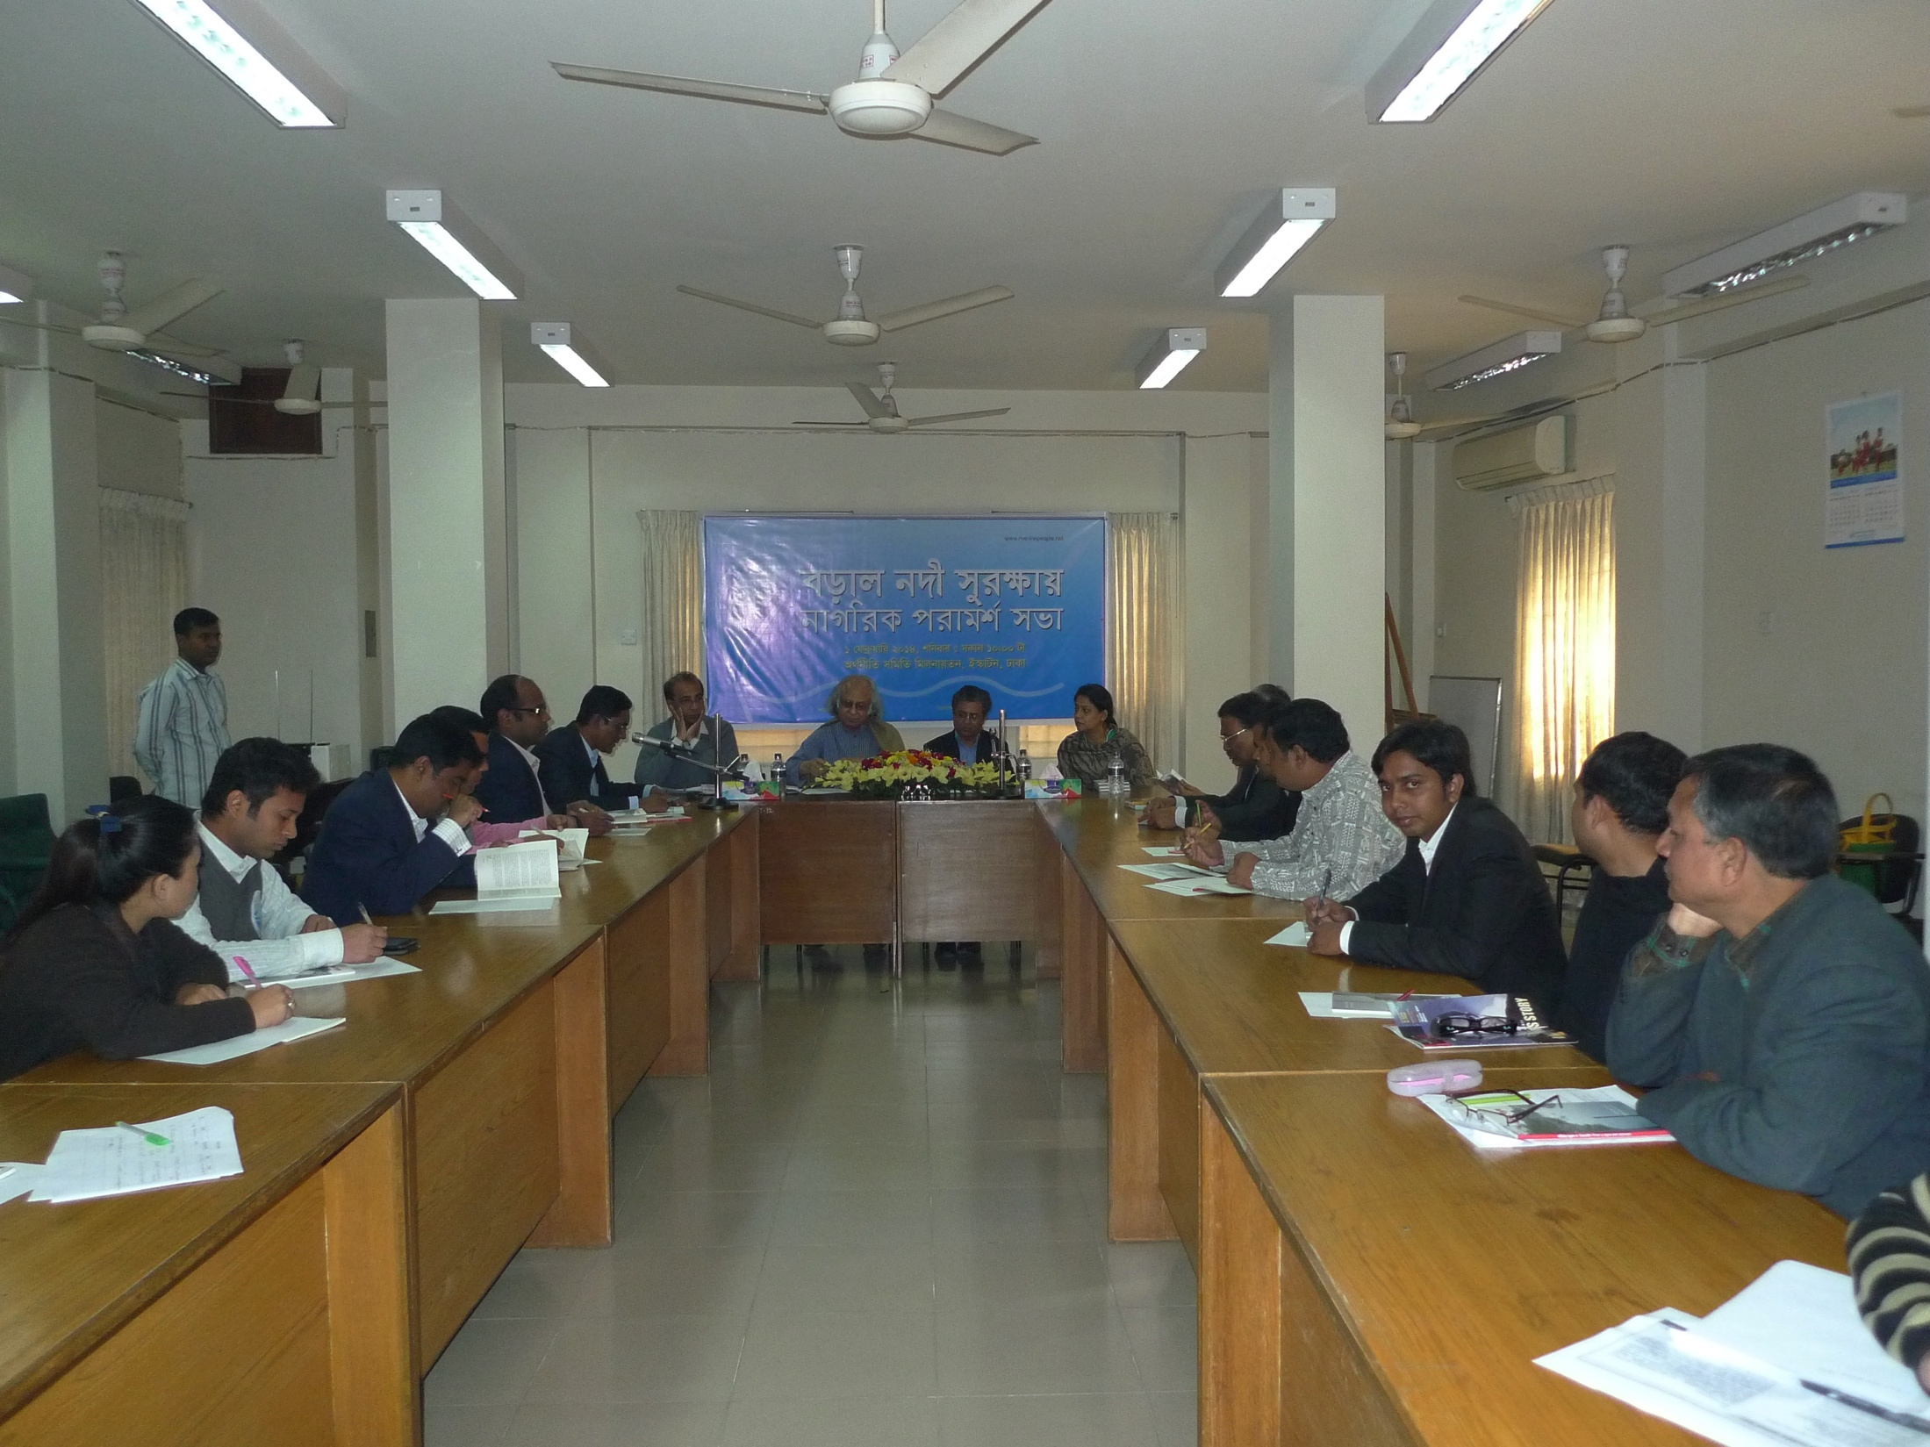
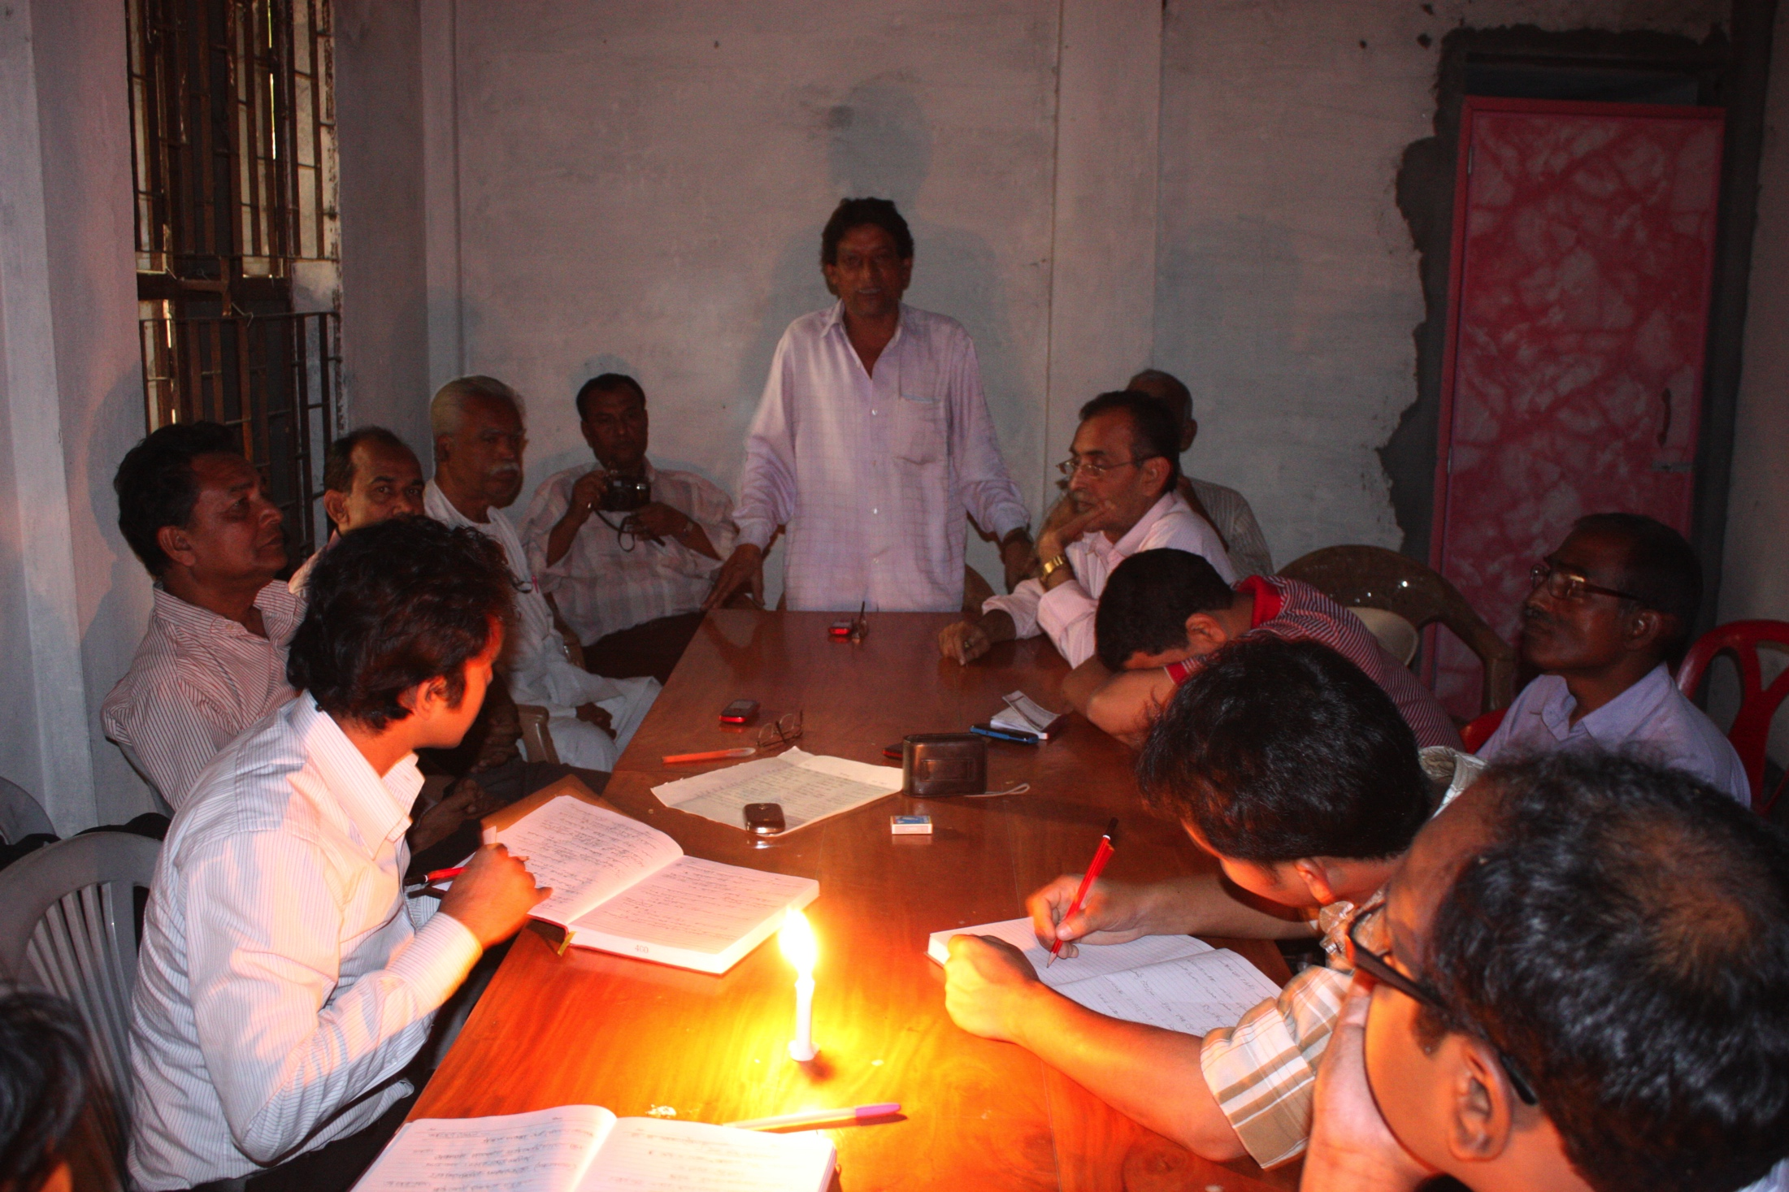
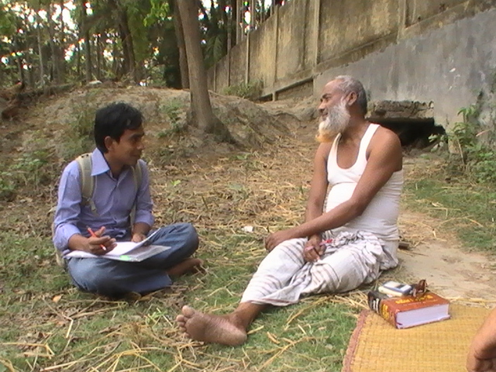
TAJ PALACE, NEW DELHI | 12 – 14 SEPTEMBER 2016
Glimpse of the movement for Boral restoration

Slide 7
TAJ PALACE, NEW DELHI | 12 – 14 SEPTEMBER 2016
Academic documentation- A model of sustainable activation for river
Four flows to believe for academic documentation-
People are the actor
Knowledge is the base
Independence is the power
Inclusion is the beauty

Slide 8
TAJ PALACE, NEW DELHI | 12 – 14 SEPTEMBER 2016
How this model worked at River Boral restoration
Academic documentation was a process to archive the past, present and potentiality of River Boral
That documentation was not any research or any fact based report but an approach to give strength to the Boral river movement
The documentation on Boral had been done by using few social research work tools
The language of this documentation was easy to readout and targeted non-academic stakeholders of river Boral
That tool was a wonderful advocacy tool to convince the Government authorities as well as to get national attention
Through this initiative for Boral River, a huge number of people engaged in the river restoration movement with own views and innovative solutions

Slide 9
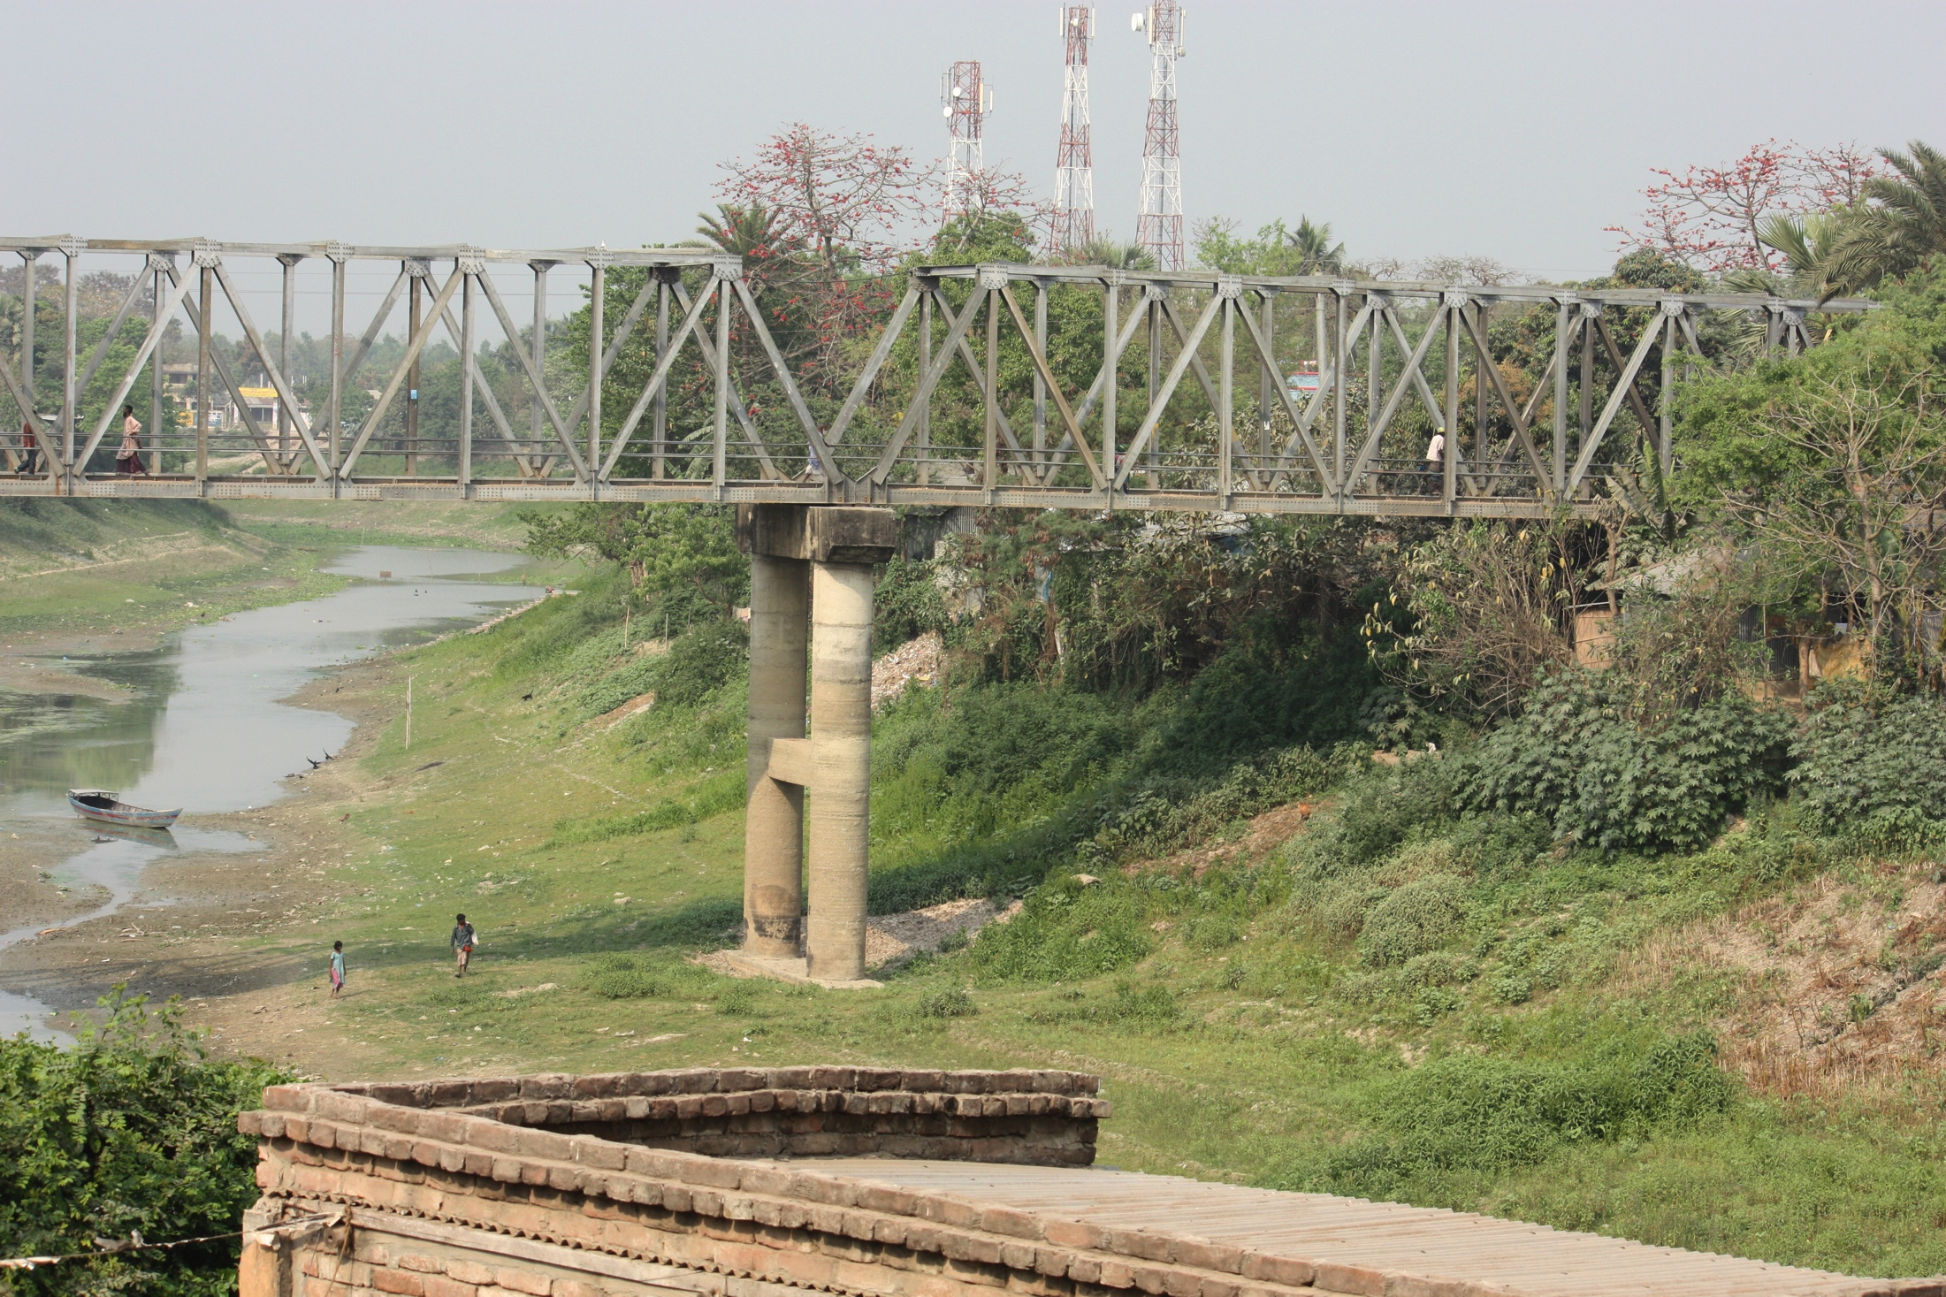
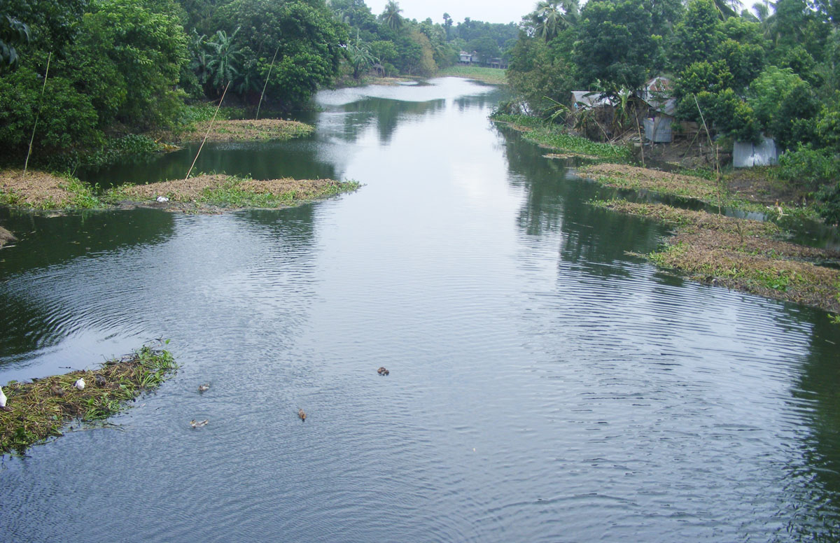
TAJ PALACE, NEW DELHI | 12 – 14 SEPTEMBER 2016
The Impact of Restoration
Before
After

Slide 10
TAJ PALACE, NEW DELHI | 12 – 14 SEPTEMBER 2016
By whom and how this model works
River Committee
University Committee
Riverine People
Strengthen the rivers and river movers

Slide 11
TAJ PALACE, NEW DELHI | 12 – 14 SEPTEMBER 2016
Benefits of Academic Documentation of a river
It is an approach to archive the present situation, glorious past and potentiality of a river
Through this documentation local peoples’ voice can be delivered to the relevant authorities
The views and actions of river practitioners can be documented time to time to change the social perspective for rivers
It is used as an advocacy material as well as help to develop a river based knowledge hub
This tool helps academicians to make their ground work for developing a research concept on rivers
Academic documentation may become a popular process through engaging the youth for restoring and re-mainstreaming rivers in our society

Slide 12
TAJ PALACE, NEW DELHI | 12 – 14 SEPTEMBER 2016
River Committee
River committees are an independent committee of youth which formed centering the local rivers
It will make a national movement for the welfare of rivers in Bangladesh
This unit is the living link between the Riverine People and other stakeholders
To undertake all possible initiatives, programs, and efforts to protect, restore, manage, and explore the respective rivers are the major activities of River Committee
To involve the riparian people of the respective rivers
To recruit and regulate members and nurture them towards a ‘riverine life’
To pledge a hand to the university committees

Slide 13
TAJ PALACE, NEW DELHI | 12 – 14 SEPTEMBER 2016
University Committee
University Committees are the center of 'Focusing Future' to expand Riverine People's commitments and programs to educational institutions
This active body of youth is the operational unit for research, documentation, campaign and mobilization in respective areas
Being a coordinator and provide intellectual support to the river-centered community movement
They act as river volunteers and apex of Riverine People
To form units at schools and colleges respective University Committees regulate the general members

Slide 14
TAJ PALACE, NEW DELHI | 12 – 14 SEPTEMBER 2016
Identity of Riverine People
Riverine People perceives that river is the lifeline of ecology, economy, culture and heritage of Bangladesh
Re-mainstreaming river in all the policies and practices is the prime aim of Riverine People
Riverine People believes in potentiality and innovation of individual and perceives that direct or indirect beneficiaries of river should personally be responsive to riverine causes
Riverine People is the confluence of river sensitive individuals to stream their excellence towards collective goals
Riverine People stands on knowledge based movement. It is commissioning own research, studies, documentations, programs as well as building information hub

Slide 15
TAJ PALACE, NEW DELHI | 12 – 14 SEPTEMBER 2016
Actions of Riverine People
Focusing Future
Concerning Community
Re-mainstreaming River
Institutional Integration
Knowledge Hub

Slide 16
TAJ PALACE, NEW DELHI | 12 – 14 SEPTEMBER 2016
Recommendations
Academic documentation of all rivers can develop a river based knowledge hub in future
Throughout the documentation process youth group can improve their river understanding
River practitioners, activists and academicians can get information about alternate solutions or common peoples’ recommendations through these documents
To unite knowledge based movement for river restoration, this is the best way to advocate people as well as authorities

Slide 17
TAJ PALACE, NEW DELHI | 12 – 14 SEPTEMBER 2016

