Slide 1
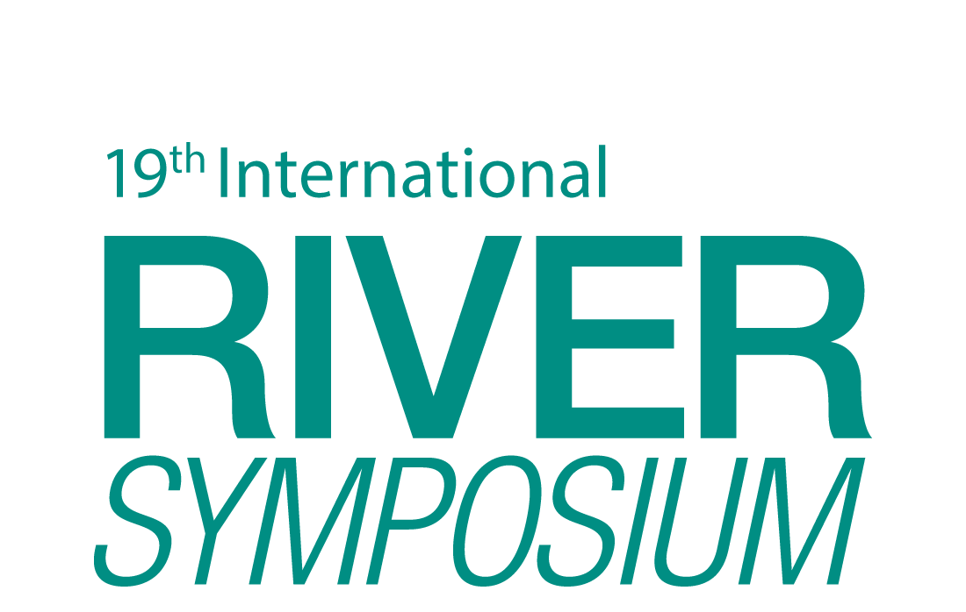
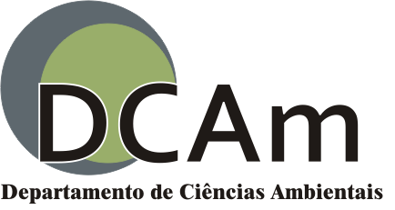
URBAN RIVERS REVITALIZATION AND STORMWATER SUSTAINABLE MANAGEMENT :
CONCEPTIONS, GUIDELINES AND ALTERNATIVES IN BRAZIL
ADAIR AMARO DE LIMA NETO
Environmental Management and Analysis - Federal University of São Carlos (UFSCar) – Brazil
netoamaroazevedo@gmail.com
FREDERICO YURI HANAI
Environmental Sciences Department (DCAm) - Federal University of São Carlos (UFSCar) – Brazil
fredyuri@ufscar.br
INTRODUCTION
The rivers revitalization in the world have currently been the focus of visionary strategic actions at urban planning and management actions for better quality of life and for recreational provision to population at riparian spaces in cities. In Brazil, several cities have suffered constantly with problems related to intense urbanization along the riverbanks (with drastic reduction of natural areas and biodiversity; pollution of water and soil; many environmental problems of health; and economic losses), demanding solutions for urban watersheds management. This current scenery has required the application of rainwater drainage alternatives and the development of new rivers revitalization technologies.
Table 2 - Rivers Revitalization Techniques
Name of the River | Location | Technics | Strenghts | Weaknesses | Opportunities | Threats
River Anacostia | Washington, DC, United States | Heaths recovery of riverbanks | Renaturalisation of the River Quality of water Recovery Biota | Not identified | -Matrix of transition. -Nursery for fish. -Contact man water. | Availability of space.
 |  | Redirection of Rainwater drainage networks. | -Avoiding diffuse pollution. -reduce flooding. | -Interruption of the hydrologic cycle. | -Reduces erosion. -Prevents silting. | -Unexpected quantity of rain.
 |  | Solid waste removal. | -Visual impact on people. -Anables recycling. | -Manpower. | Generation of Jobs. | -Proper disposal of human waste.
River Sena | Paris, France | treatment of industrial and domestic sewage | -Improvement in water quality. -Fish back. -Improves the quality of human life. | -Transport sewage to treatment. | -Enables contact man water. | -Cost of implementation
River Tâmisa | London, England | Sensors that monitor water quality. | -More eficiente controlo f water quality.. | -Cost of implementing. | Constant monitoring. | Cost of maintaining.
River Isar | Munich, Germany | Removal on concrete dikes. | -Allows the migration of fish. | -Eviromental readaptation. | Recuperation oh the natural characteristics oh the river. | -New alterations.
 |  | Removal of the concrete edge walls. | -Restore hydrological changes. | -Political support. | -Recuperation of biodiversity. | -Erosion.
 |  | Use of the concrete removed to strengthen the bed | -Replace the native componentes. | -It may not be the ideal material for use in the revitalization. | -Slows water. - Shelter for aquatic fauna. | -Waste generation. - Loss of public money invested.
 |  | Expansion of areas for full seasons | - Prevents losses from floods. | -Available space. | Maintaining biodiversity. | Oversight.
River Cheonggyecheon | Seoul, South Korea | Creating a downstream water supply station upstream. | -Always keeps the mighty river with amount of water always constant. | -Can influence the natural dynamics of the river. | -Makes beautiful scenery. | -Energy expenditure.
 |  | Lighting Landscaping. | - Promotes the approach of the man with the river. | -Can influence nocturnal animals. | -Increase nocturnal visitations. | - To make artificial river.
OBJECTIVE
This research aims to identify, study and analyze current technologies for urban rivers revitalization and sustainable stormwater management concepts, to establish elements, guidelines and alternatives applicable to the context of revitalization of Brazil urban streams, taking into account the relationship between the man in his anthropic environment and urban riparian environment.
METHODOLOGY
Methodological steps: the literature and theoretical background on river revitalization; and stormwater management; the survey and the detailed study of experiences and river revitalization projects; the identification and recognition of sustainable technologies for the stormwater management; comparative analysis of the identified technologies, that are able to be adopted and applied in the context of Brazil urban streams.
Table 1 - Sustainable Drainage Techniques
Techiniques | Strenghts, | Weaknesses | Opportunities | Threats
Green roof | Great landscape Providing spaces for social interaction and recreation | It has a high cost and skilled labor. | Planned in the early design phase replaces spending on conventional roofs | Requires periodic maintenance
Wetland | Controls the rain impact | Need spaces suitable for application | landscaped benefits. | It requires a lot of maintenance
Trenches Infiltration and detention | Decreases runoff using low-cost materials | Requires periodic maintenance and lose efficiency with increasing steepness of the terrain | It allows the recharge of aquifers | Can contaminate groundwater
Wells infiltration | Can drain areas of a few square meters to thousands of square meters | Requires periodic maintenance and lose efficiency with increasing land slope | It allows the recharge of aquifers is discreet small footprint | Can contaminate groundwater
Vegetated ditches | Low cost of deployment | The water can accumulate causing the proliferation of diseases and bad smell | It provides landscape harmony and expansion of green areas and aquifer recharge | Can contaminate groundwater
Porous or permeable paving | It allows infiltration into the soil allowing the recharge of aquifers and partially absorbs the impact of the rains | premature clogging risk is high, high costs for repair | It provides landscape harmony and expansion of green areas and aquifer recharge | Can contaminate groundwater .
RESULTS
The research aims to provide results that will assist in future urban streams revitalization projects and will contribute to the establishment of effective public actions to stablish the best use of riparian areas in cities, providing the desired contact of the residents with the urban river.
Through literature we found that in most developed countries have adopted techniques for handling stormwater, along with the rivers revitalization projects applying an integrated revitalization of the basin. One application of this project is to show that the engineering works implemented in most of the cities in Brazil that waterproofs the soil of urban centers, rectify and channel rivers are less efficient compared to methods that restore the natural features of the landscape respecting the dynamics of the hydrological cycle.
REFERENCES
MACHADO, A. T. M. et al. Revitalização de Rios no Mundo: América, Europa e Asia. Belo Horizonte, 2010, 344 p.
PINTO, N.L.S. et al. Hidrologia Básica. São Paulo: Edgard Blucher, 1976. 278 p.
TONINI, A.C.; SPÍNOLO, M. de M.; LAURINDO, F.J.B. A análise SWOT: uma nova perspectiva para aplicação do Seis Sigma no Desenvolvimento de software. In: XXVII Encontro de Engenharia de Produção, 2007, Foz do Iguaçu, Paraná. Anais... Foz do Iguaçu: ENEGEP, 2007. p.1-10.

