Slide 1
It’s more than just introducing technology:
water resources data and information management systems in a post-conflict country

Slide 2
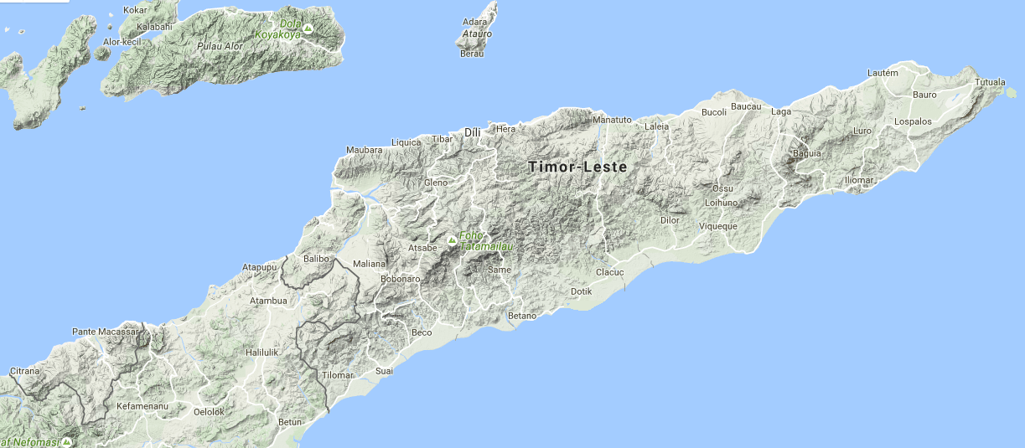
Timor-Leste
25 years of Indonesian occupation
Independence in 1999; 2002 first Government
Few hydrological records survived

Slide 3
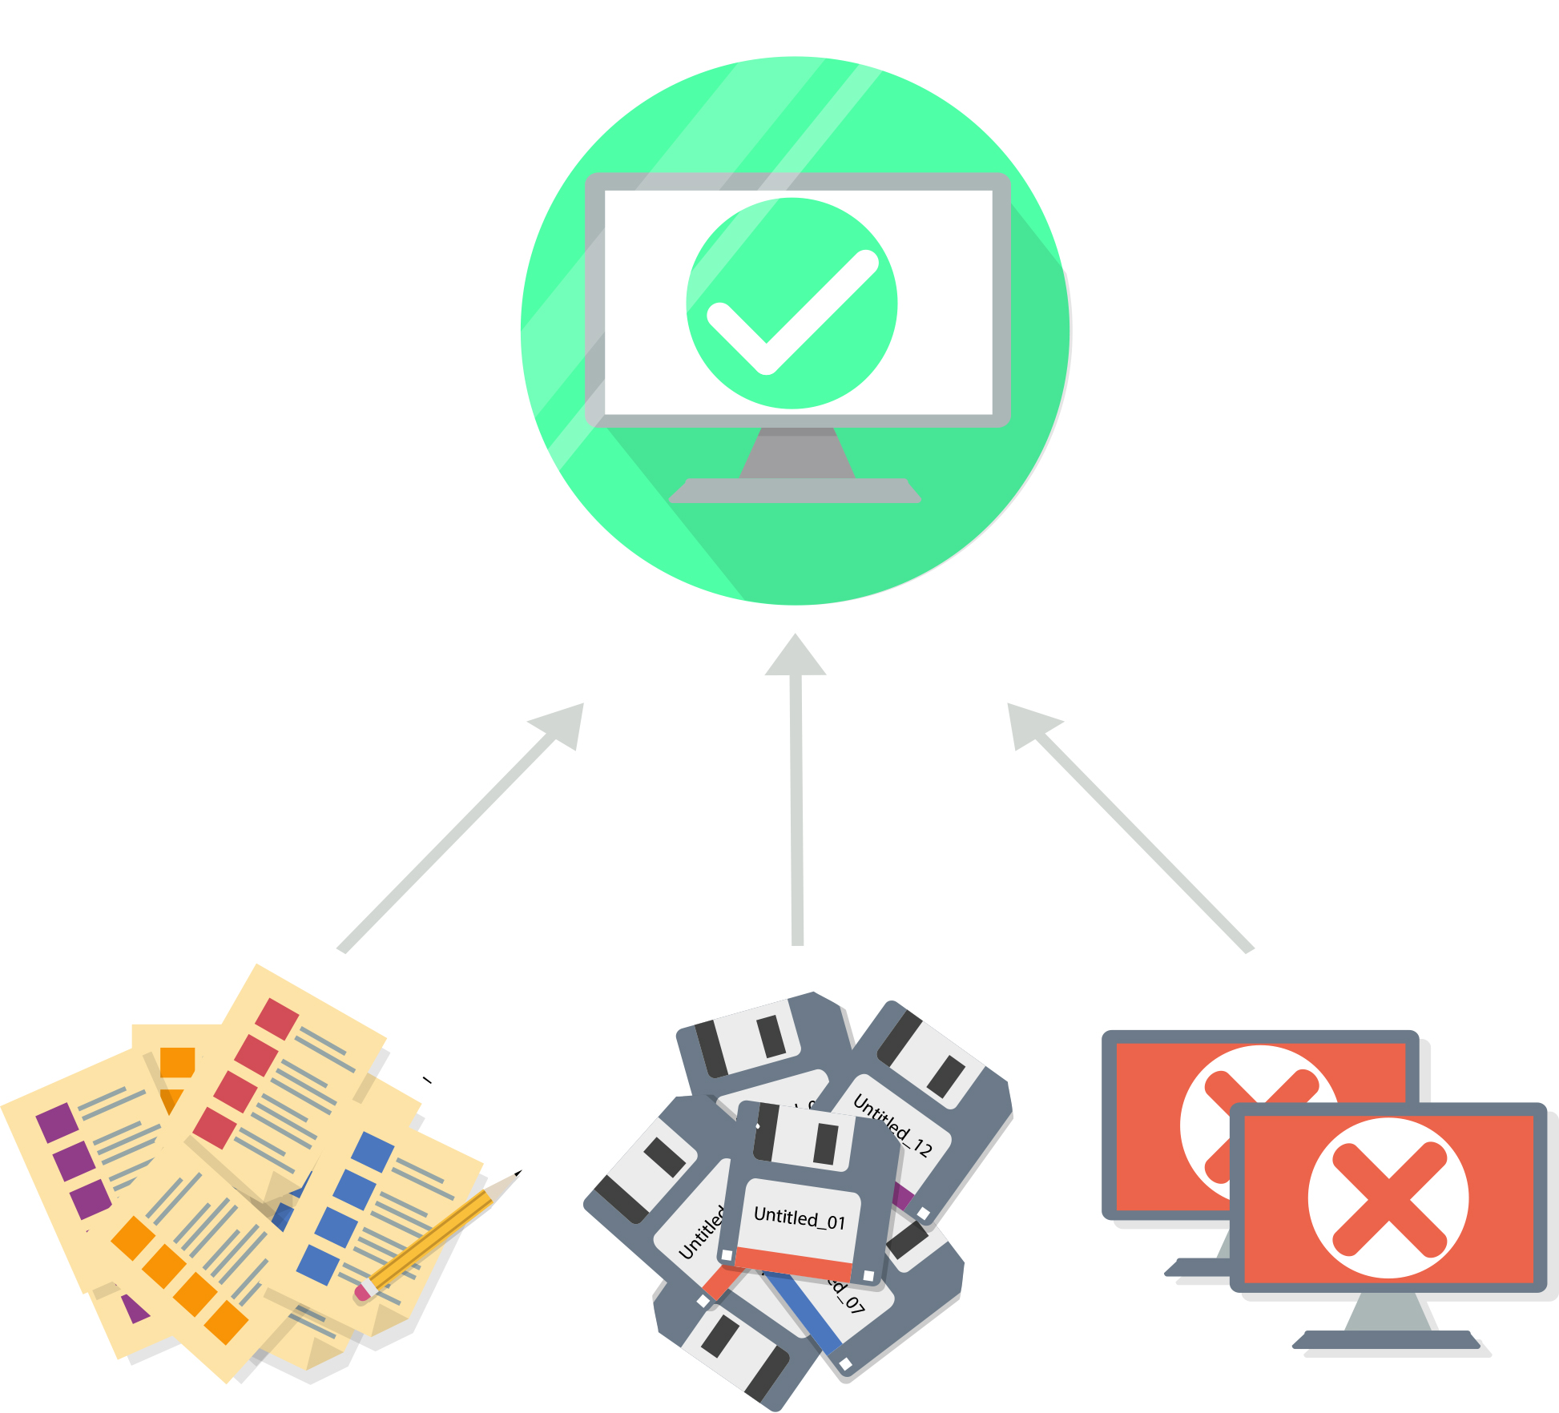
“…disorganized, duplicated, disaster”
Notes:
Water resources data & information is limited & disparate - they did have one system- Hydata. Software not supported; finished in 2008. On one old computer filled with virus. Data storage was at risk.
Limited systematic data collection
Collections mainly project related & not centrally stored
Duplication; uncoordinated advancement of water resources knowledge
Poor decision making
Disconnect between water resources, water supply & sanitation efforts
No reporting on water resources
Capacity and resourcing are low
Immature governance systems
IT infrastructure & support limited
Poor standards and standard setting processes
Limited vision; resistance to change
We were really at the starting point for water resource data and information management in TL

Slide 4
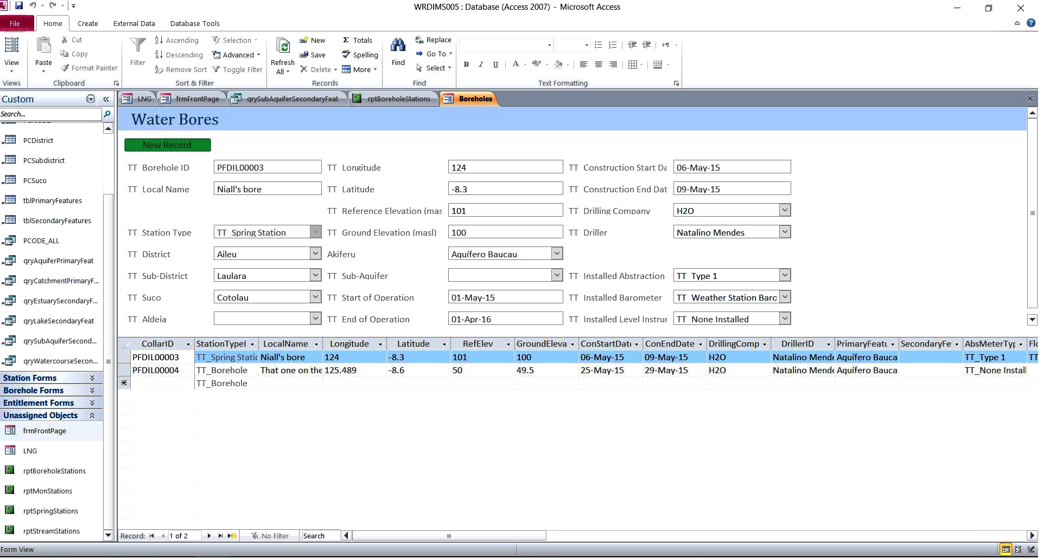
It’s a good tool, but will it be used?
Notes:
Initially database was created in MS Access to match other Government systems. We spent a lot of time scoping all the data parameters and fields and building the relationships between the data and information. This was a very important step and took a few months.
The skills we had on offer were based in MS Access and this was also what some of the systems that other areas of government were using too. So it seemed like a good approach to follow this lead.
When we had the first showing of the MS Access systems it was met with interest, but it was soon apparent that it wasn’t a platform that would be picked up by the staff.
Many had no prior experience with Access; it was just about a new place for entering data, there was a didn’t work across the network easily; difficult to have different levels of access and permissions to browse, enter and export data.
Overwhelmingly, staff found the interface too wordy, too many options at once. The logic didn’t follow there’s.
We realised that we need to re-access our approach. This initial solution was focussed on the tool, not the user!
We then developed another phase for the project where we focussed on the user experience.

Slide 5
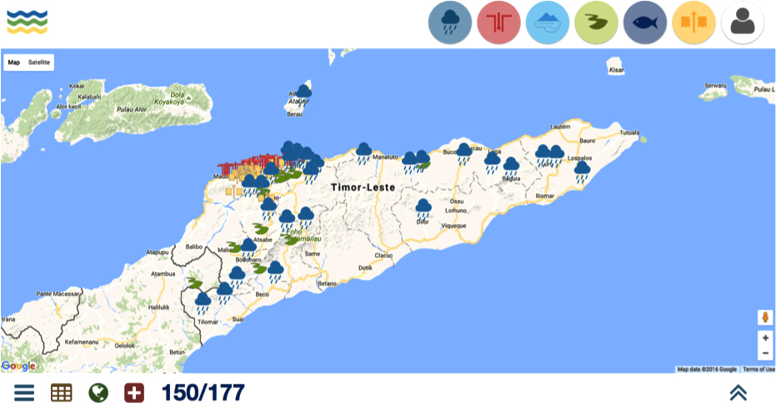
So, we focused on the user
Notes:
People were happy they liked it. By taking this step back we had great impact on the interest and adoption.
Our experience in TL and it is something that we here often is that TL people are very visual. We tried to understand this and reflect it in a way we developed the interface. We drew on the similie experience of working in software development in the E-Learning sector to understand that simplicity in design communicates effectively.
Building on the iconography we used colour themes and repeated processes to create familiarity at any location within the database. Data is entered in the same way for any type of data. Data is viewed, edited and exported in the same too.
We also address the language issue by making it multilingual and users could swap between Tetum, the local language, Portuguese and English at anytime. We also built into workflows so that it was more than just a system that staff looked at from time to time; they needed to interact with it more frequently.
We built on powerful, robust, modular open source software so that there are no ongoing licence fees and that it can always be upgraded.
And as a big step in the advancement of the way in which these systems operate we linked all the data to other areas of the WaSH sector.
We hit a little hiccup at one point though which impacted on the up take and adoption. There was some resistance to the new system.
Looks great only problem rainfall

Slide 6
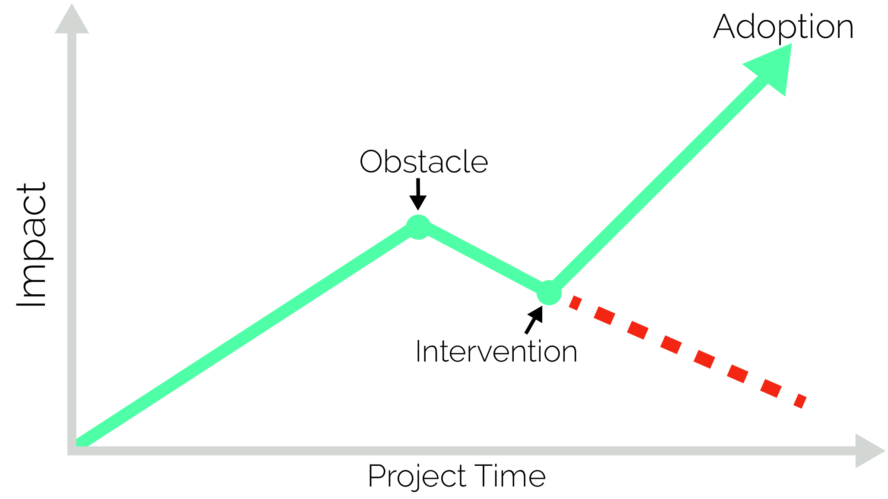
A 80/20 paradigm hiccup
Notes:
Spoke to people and the key barrier was that it didn’t look like the original thing (20/80 rule). By making a small change we had a great impact on the staff and how they didf there work and what they were about to provide there manager with. We thought we had scoped these issues out completely earlier and had dealt with these issues with staff, but no.
We went back to the listening stage and heard what the key issues were for the staff and then offered them a way forward to address the issue.
The basic issue was that they werent able to get exactly the same output as they were before form the old system; which was important for them as it was these outputs that they submitted to their managers monthly
So what happened?
After addressing the problem, ther result was:
Increased engagement
Increased motivation
System better suited to their needs
then listened and recreated the output.
We sloweed and listen to understand the root cause of the limited uptake. One small change – one or two days of work – resulted in greater up take. The system didn’t change the.
To familiarity we mimmiced the old system. Less foreign; easier to understand. A small tweak so that it became more familiar and more inclined to use the system.

Slide 7
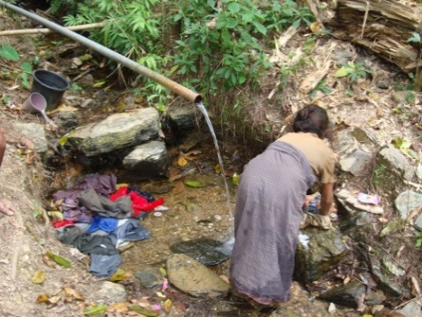
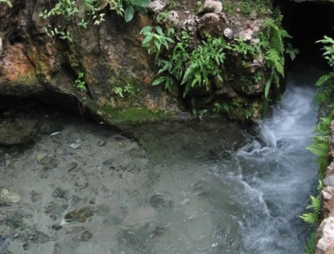
What can be taken from this?
Customized solutions are needed over off-the-shelf solutions
It is how you work with people that matters
The user experience is key to adoption
New technology provides great opportunity
Notes:
Approaches to address these issues are not always universal and solutions cannot always be transferred from one country to another.
Correct use of new technology can have an impact on the capacity of low resourced, capacity Governments to managed there water resources.
So the lessons for you in the WASH sector are these things.
Tech: not as scary; theres more than just access

Slide 8
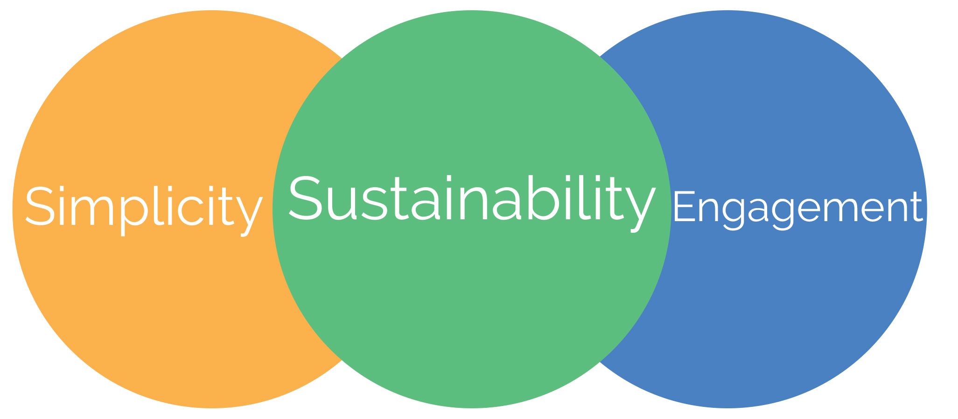
SSE
Notes:
And this is the philosophy that Similie takes to its projects.
At the core of the lessons from the development of the water resources data and information system is that the success of any new system is: simplicity of the system; sustainability of the adoption; and engagement of the those impacted by the changes along the way.

Slide 9
Similie.inc
Mobile:
Fax:
Email:
Website:
Facebook:
+1 415 992 7651
+1 844 774 0503
info@similie.org
https://similie.org
@similie.org

