Slide 1
“Monitoring River Ecosystems Through Citizen Science and Mobile Application”
Pradeep Mehta
PhD, MSc (Forestry)
Earthwatch Institute India

Slide 2
To monitor freshwater bodies including rivers through Citizen Science approach.
Use of digital medium for monitoring and data collection related to freshwater.
Crowd sourcing of data on FreshwaterHub website.
To analyse and get feedback through smartphone and online tools

Slide 3
Notes:
The FWW is a citizen science platform that has been developed to help scientists, agencies, corporations and trusts to engage their local communities in monitoring and manage

Slide 4
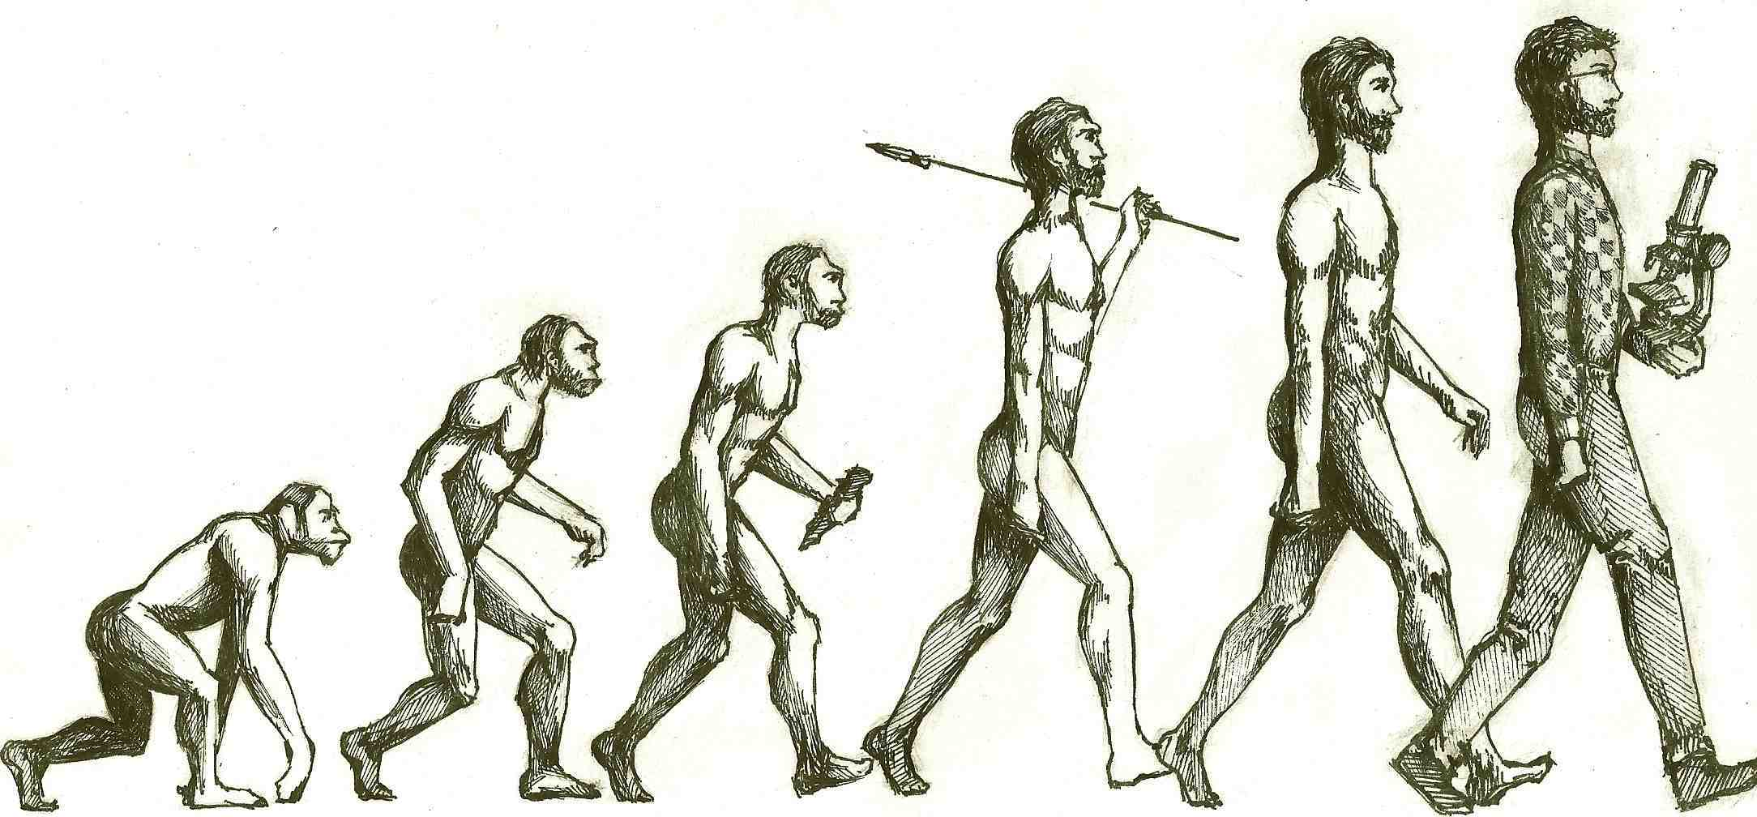
Why Citizen Science
Lack of field data for monitoring, earth observation, early warning, project validation
Active and knowledgeable communities support science to policy nexus
Citizen Observatories as support for environmental monitoring and catchment management
Notes:
Citizen science is increasing in importance and in opportunity – there are many causes, new IT, increasing awareness, the EU Water Framework Directive requirements, ..
The reasons to include CS as part of your research, monitoring and management are multiple, they are usually focused on improving our understanding of the conditions of the environment, but other major benefits include improving the public’s understanding and appreciation of the what we are trying to accomplish as scientists or catchment managers

Slide 5
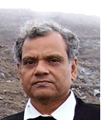
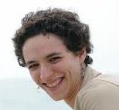
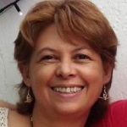
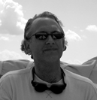
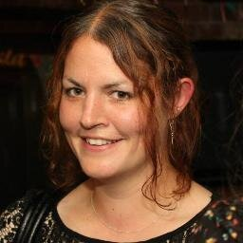
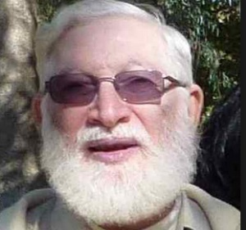
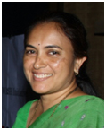
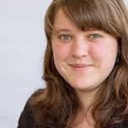
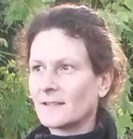
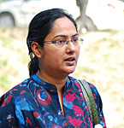
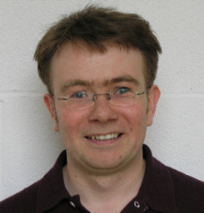
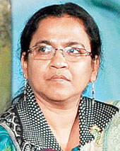
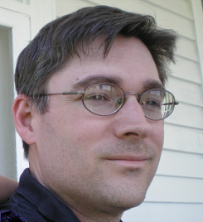
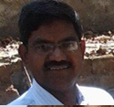
A network of leading freshwater scientists working with a global community of citizen scientists
Notes:
The FWW platform is being used by a large number of researchers and trusts across the UK and across the globe to bring communities and citizen scientists into their monitoring and research activities

Slide 6
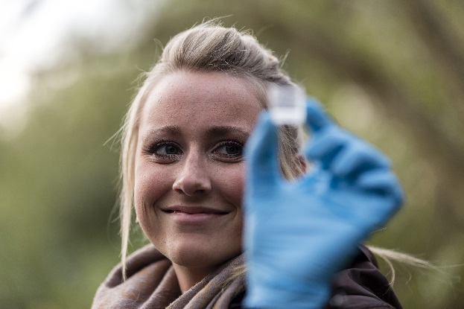
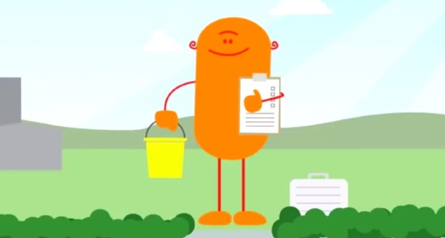
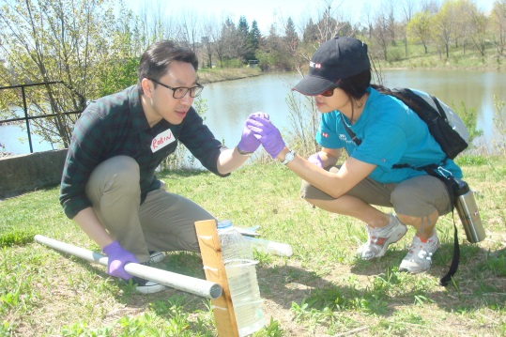
Learning, field data collection, creating community
Discover
Learn about the freshwater challenge, compare your results to your local area and the global network
Collect
Gather scientific data following globally consistent methods, upload to online database
Discuss
Take part in forums, blogs and social media, encourage colleagues, family, students and friends to join
Notes:
The FWW is not a data acquisition only. For CS to work there needs to be multiple strands that wind together. This includes continuous learning processes, communication and community building and the scientific aspects, obtaining data in a robust, consistent and safe manner.

Slide 7
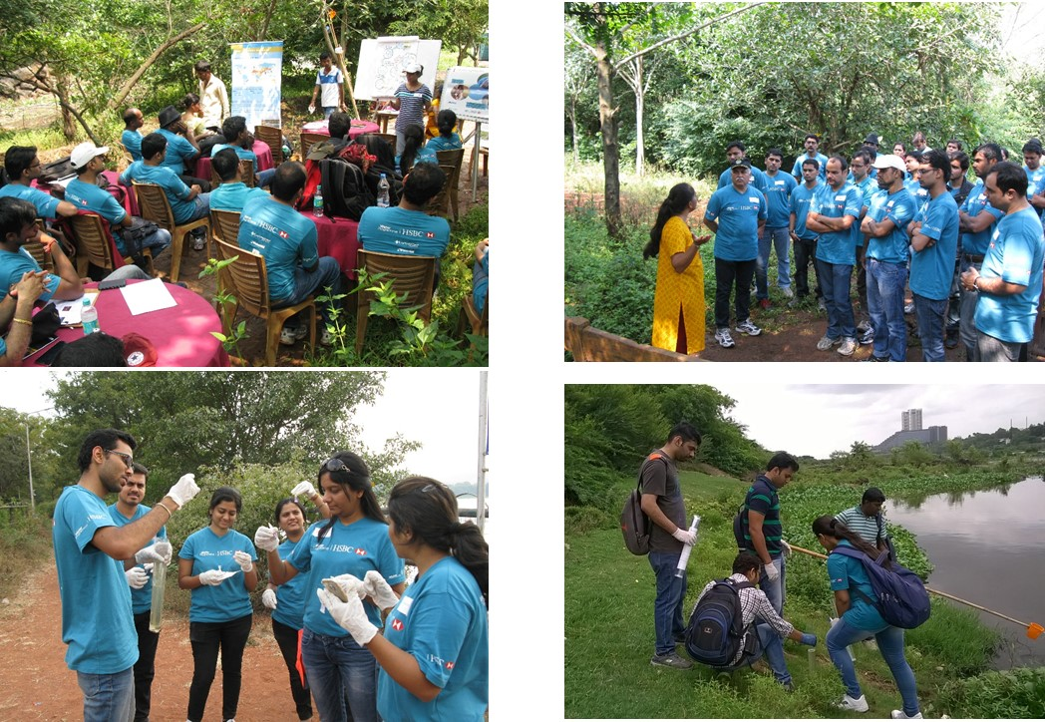
Citizen Science Leaders (CSL) Programme

Slide 8
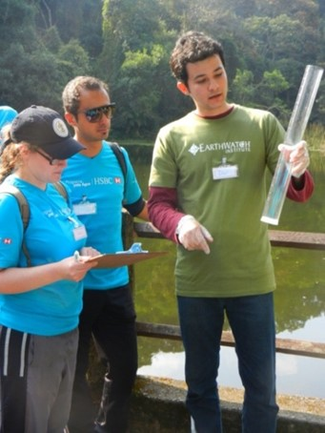
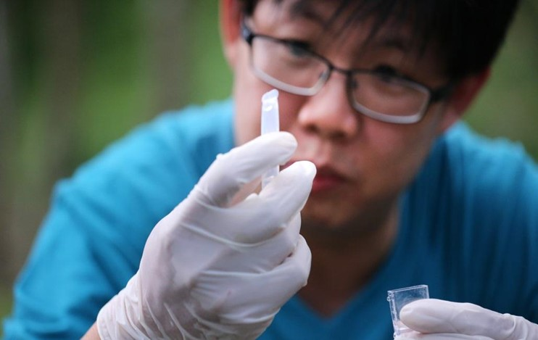
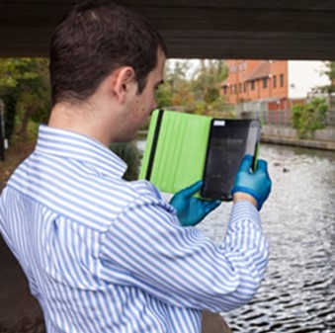
Collect - consistent measurement methods (+)
20 minute data acquisition and upload via mobile App
Same methods across the globe
Photographic documentation
Additional variables added to meet local research objectives

Slide 9
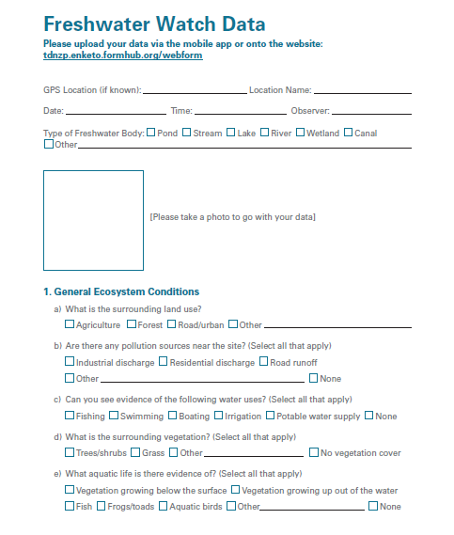
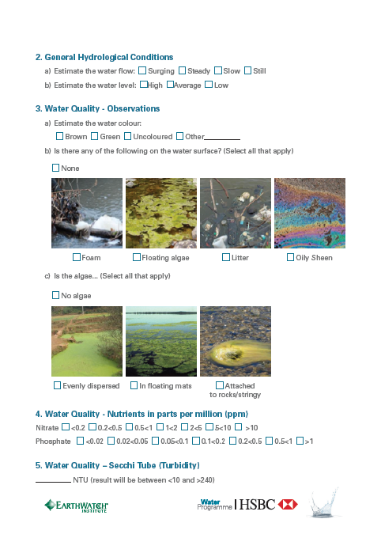
Research Techniques Research Techniques

Slide 11
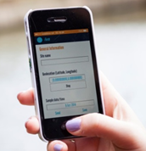
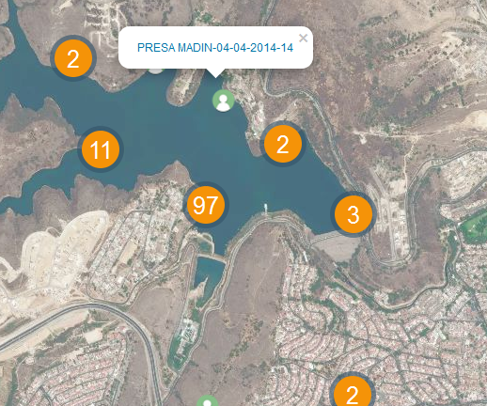
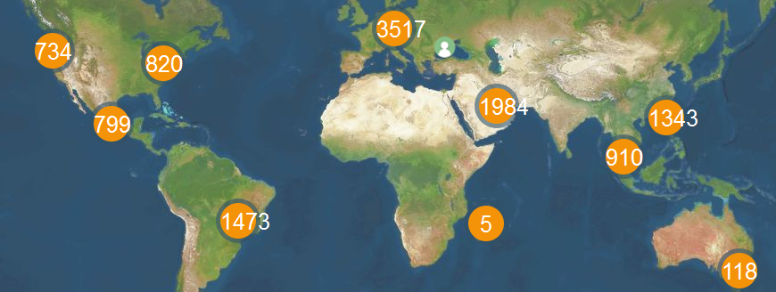
Collect - consistent measurement methods (+)
Geo-coded time stamped data uploaded to a global online database
Local and automatic quality control
Notes:
Data is uploaded automatically to a central database and displayed on local and global maps. These maps can be queried by the participants and the public at large

Slide 12
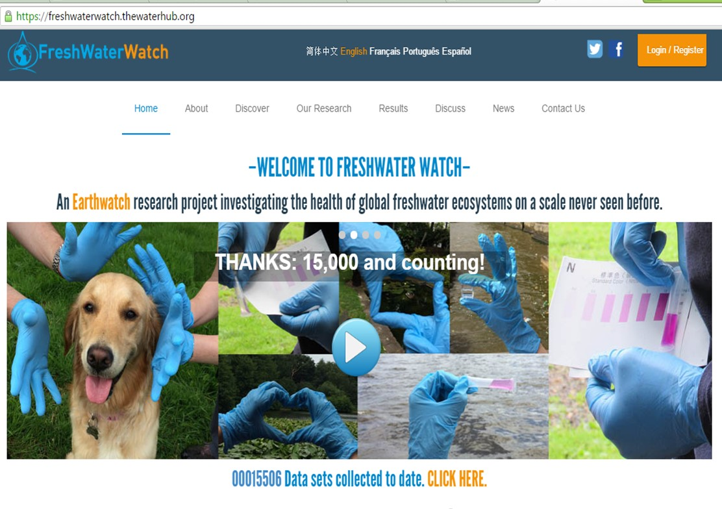
Crowd Sourcing of Data

Slide 13
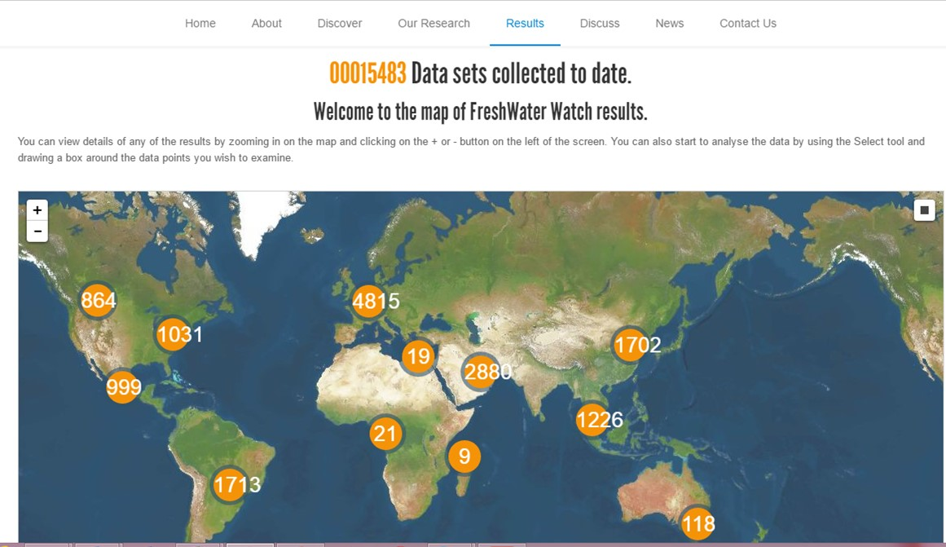
>7500 citizen scientists trained
1500 waterbodies being studied
36 areas under study
15000 hours of sampling activity
Notes:
There have been a wide range of experiences and types of citizen scientists trained and engaged. This has allowed us to identify key aspects related to creating an interesting learning experience, keeping participants engaged and supporting agency/researcher objectives.

Slide 14
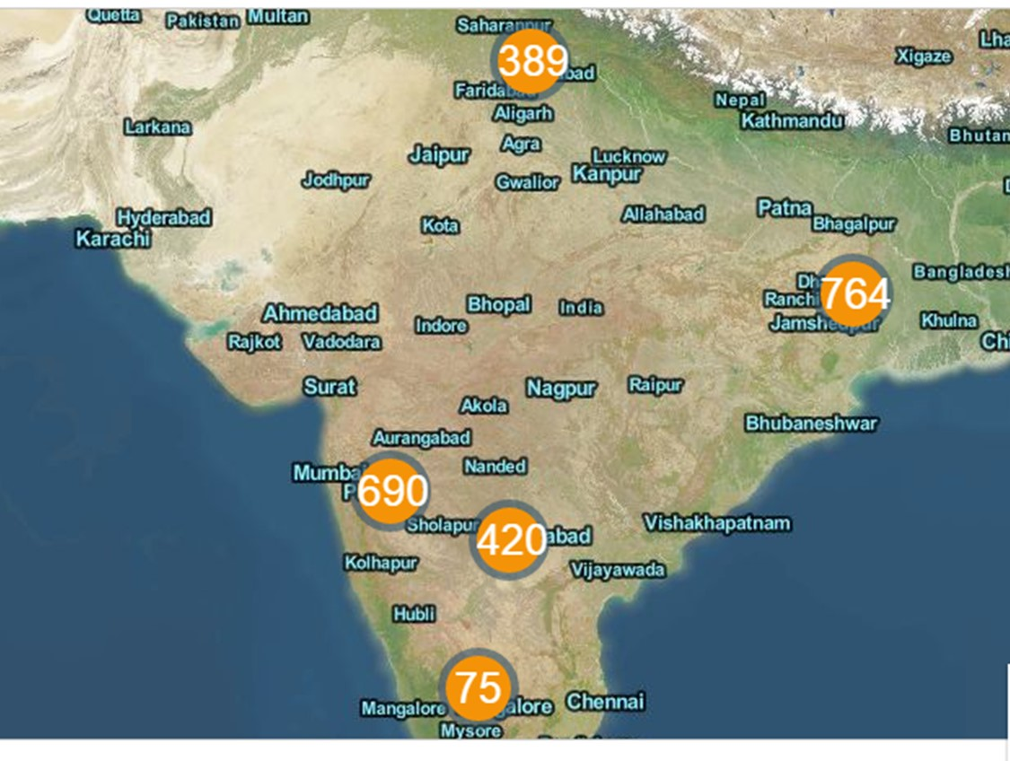

Slide 15
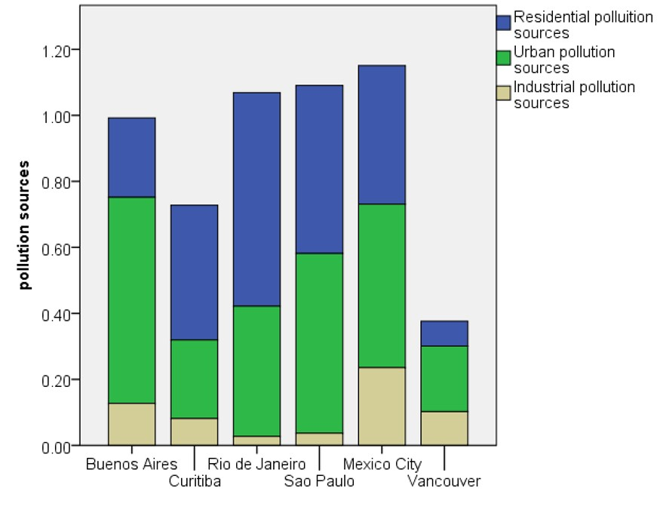
Collect – microscale observational data (support for Earth Observation and catchment modelling)
Local microscale pollution sources
Notes:
Gathering information on the local context and local point sources is proving to be very helpful in the analysis

Slide 16
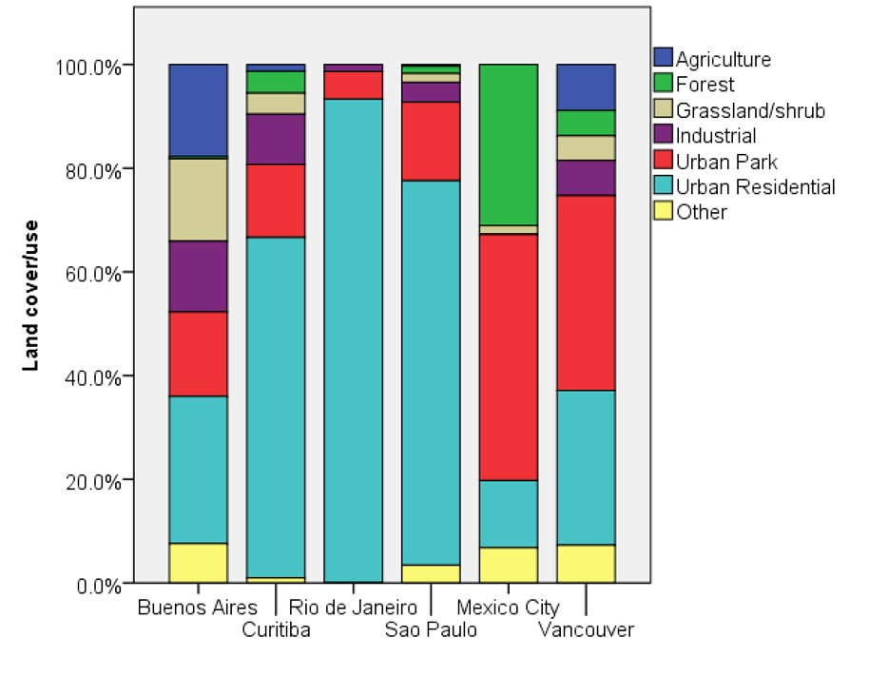
Collect – microscale observational data (support for Earth Observation and catchment modelling)
Local microscale land cover and bank vegetation
Notes:
Gathering information on the local context and local point sources is proving to be very helpful in the analysis

Slide 17
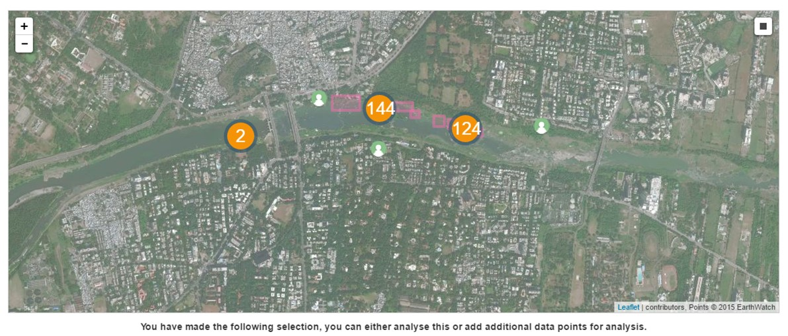
Discover & Collect
Analysis and feedback through smartphone and online tools
https://freshwaterwatch.thewaterhub.org/content/data-map
Notes:
As soon as the data is uploaded, there is a immediate (and automatic) feedback about what the data are showing, for example, the possible causes and consequences of elevated phosphate concentrations. There is also a feedback that puts the measurements in context of all the other measurements taken in the same geographic area. All part of the learning and engagement process.

Slide 18
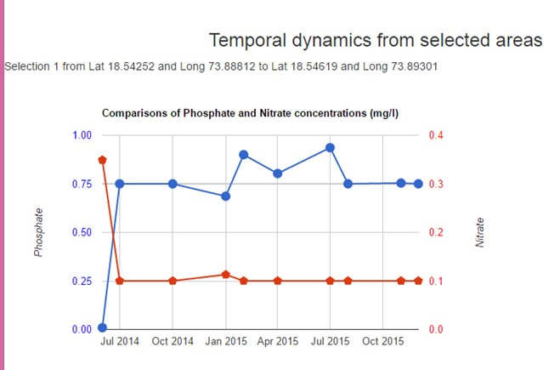
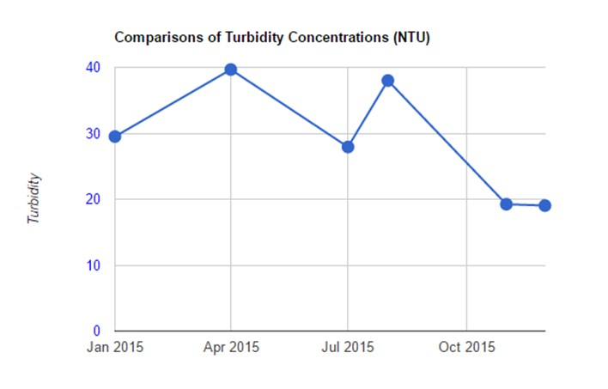

Slide 19
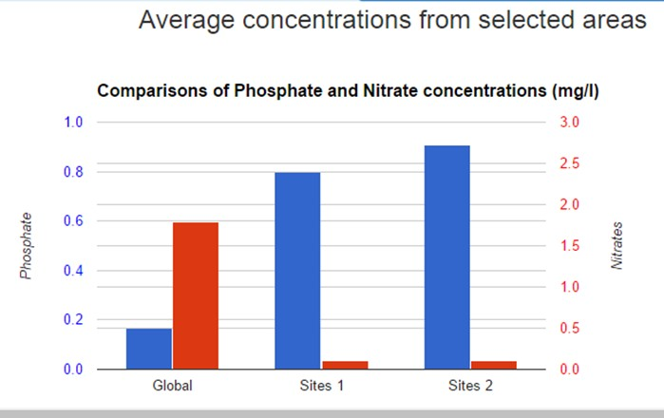
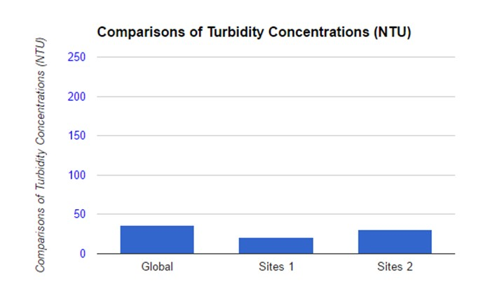

Slide 20
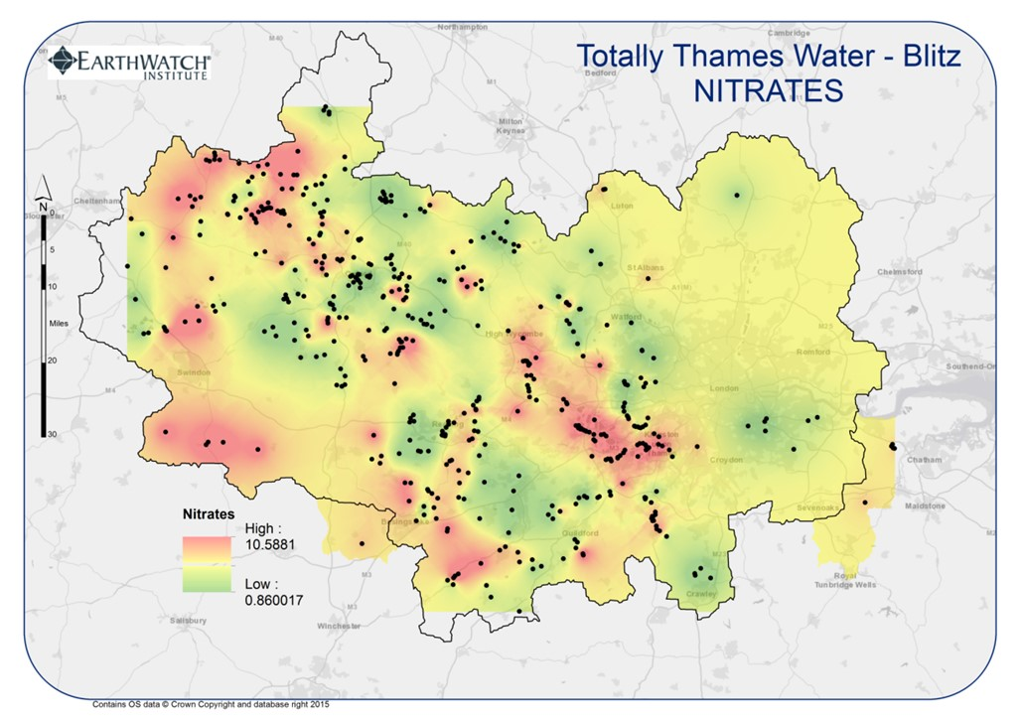
Monitoring and management benefits
Catchment mapping and prioritisation of sub-catchments
Notes:
One of the more interesting approaches that we are using to support river trusts, catchment partners, water companies is the Water Blitz.
This was set up to support an analysis of the conditions of a particular catchment, taking a large number of measurements on a single day or a single week, engaging a large number of people for a single event. For example, the September Water Blitz in the Thames catchment acquired nearly 700 measurements of nitrate and phosphate concentrations across the Thames basin, making it possible to identify baseline diffuse pollution conditions, hotspot areas, and potential pollution point sources. The partners were CEH, EA, Wild Oxfordshire and a number of river trusts. It was an incredibly powerful tool that is being used by all partners to better understand/model and manage the conditions of the catchment. We will be doing another in Bristol Bath Blitz in the early summer (with river trusts and Wessex Water)

Slide 21
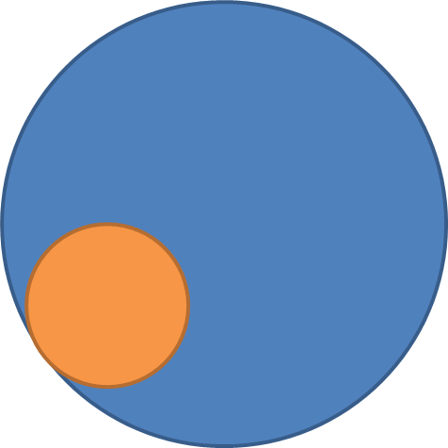
In the end…
Does it work?
For the participants
93%
More committed to
personal action
89%
Improved understanding of water issues
92%
Engaging research experience
In the end…
Does it work?
For the scientists?
1 hour of training and feedback equates to a volunteer ‘sampling’ time (5.7hrs)
Volunteer time
Trainer time
Notes:
From an engagement point of view, the participants on the on-site training have reported:
93% increase in their commitment to personal action
89% increase in their understanding of freshwater issues, both local and global
92% favourable review of the field research experience

Slide 22
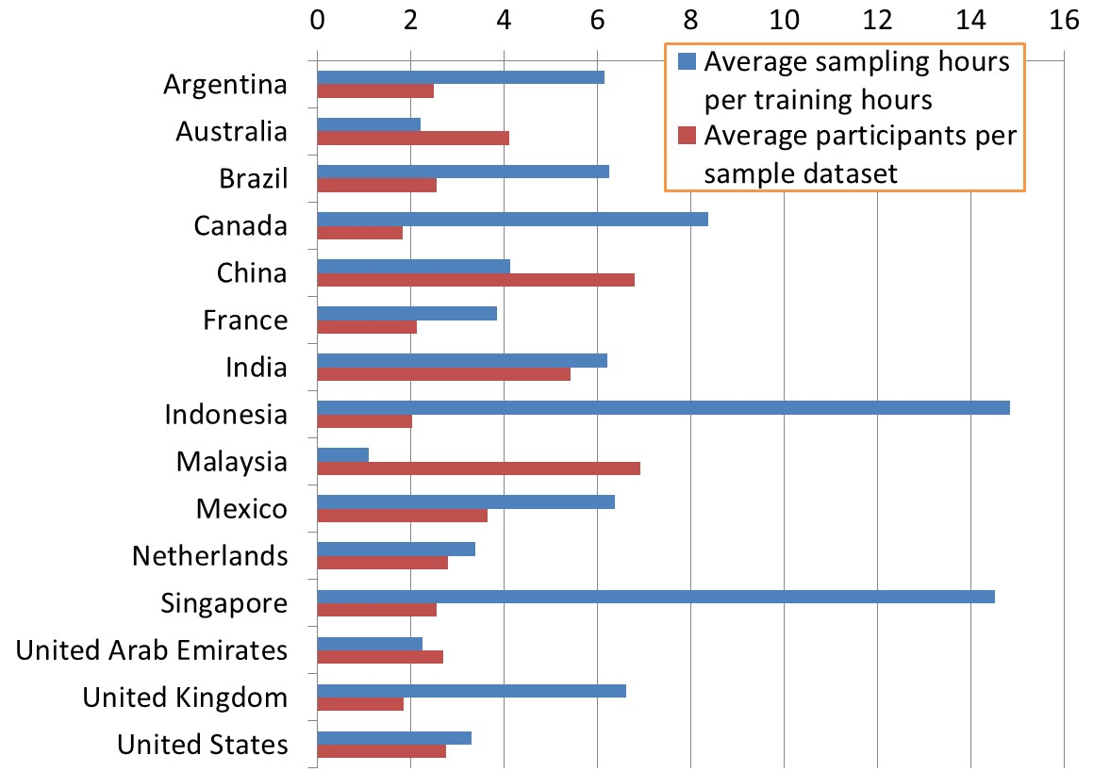
Regional
differences
Country averaged return on time invested in training and average number of participants associated to each dataset uploaded on the FreshWater Watch database
Notes:
This is regionally different

Slide 23
Conclusion
Regular monitoring of river ecosystems is a mammoth task. Bust citizen science model can help scientists to do long term monitoring of rivers to influence policy decisions. Simple scientific kits and digital tools can play an important role in bridging the gap between citizens and scientists by crowd sourcing of the data.

Slide 24
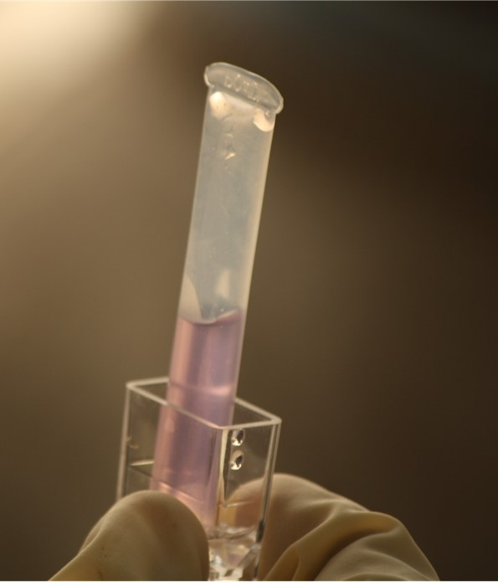
Keep Monitoring
Thanks

