Slide 1




TAJ PALACE, NEW DELHI | 12 – 14 SEPTEMBER 2016
Contribution to Dietary Intakes of Selected Trace Minerals from Potable Water in Bangladesh
Nashid MIRZA, Tahiya TARANNUM and Dr. Tanvir AHMED
BANGLADESH UNIVERSITY OF ENGINEERING & TECHNOLOGY , BANGLADESH

Slide 2

TAJ PALACE, NEW DELHI | 12 – 14 SEPTEMBER 2016
Water is another name of LIFE

Slide 3
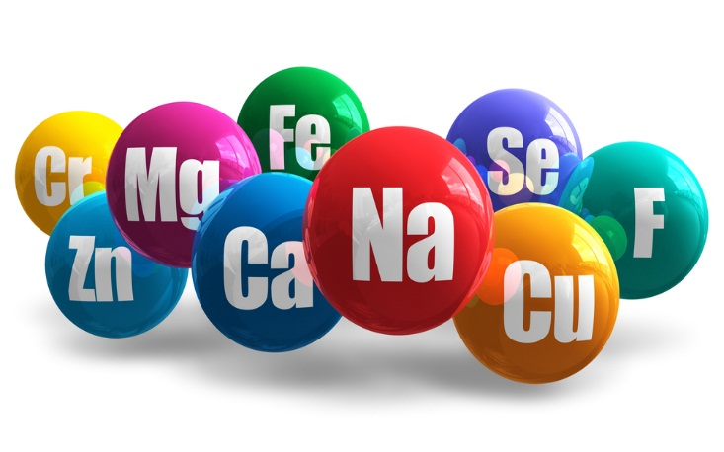
TAJ PALACE, NEW DELHI | 12 – 14 SEPTEMBER 2016
Water not only QUENCHES our thirst but also contains provides MINERAL NUTRIENTS such as:
  Calcium
  Magnesium
  Iron
  Copper
  Manganese
  Molybdenum
  Phosphorous
  Nickel
  Potassium
  Selenium
  Sodium
  Zinc

Slide 4
TAJ PALACE, NEW DELHI | 12 – 14 SEPTEMBER 2016
OBJECTIVES:
Evaluate the share of drinking water in fulfilling nutrition requirements by comparing with Dietary Reference Intake (DRI).
Determine SPATIAL DISTRIBUTION of mineral intakes of the population over Bangladesh.

Slide 5

TAJ PALACE, NEW DELHI | 12 – 14 SEPTEMBER 2016
Dietary Reference Intakes (DRIs) developed by Institute of Medicine, 1997.
Estimated Average Requirements (EAR)
Recommended Dietary Allowances (RDA)
Adequate Intakes (AI)
Tolerable Upper Intake Levels (UL)

Slide 6
TAJ PALACE, NEW DELHI | 12 – 14 SEPTEMBER 2016
Dietary Reference Intakes

Slide 7
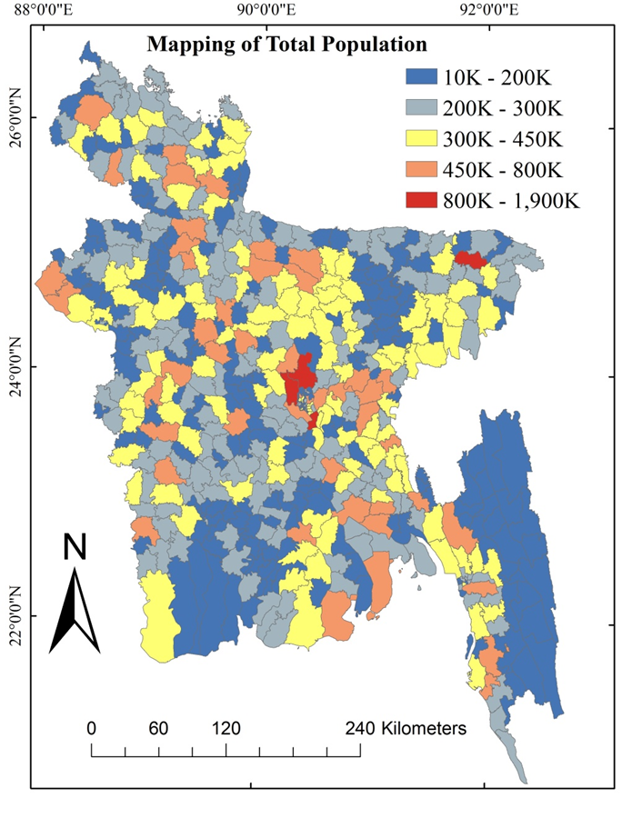
TAJ PALACE, NEW DELHI | 12 – 14 SEPTEMBER 2016
Data Collection
Population census, 2011, Bangladesh Bureau of Statistics (BBS)
Bangladesh National Drinking Water Quality survey, 2009 , UNICEF & BBS
Figure: Geographic distribution of total population over the Upazilas of Bangladesh as per BBS, 2011.

Slide 8
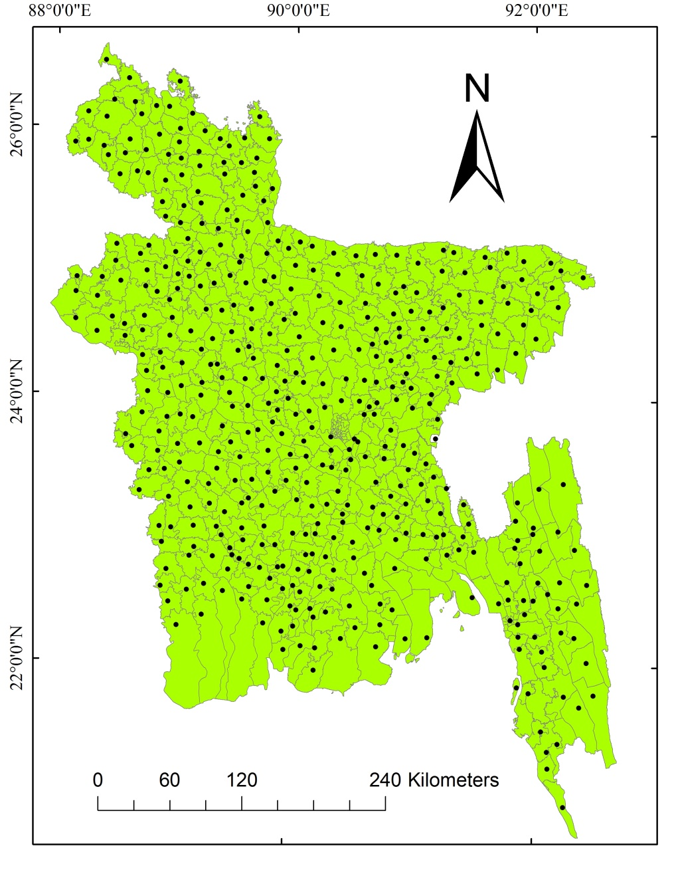
TAJ PALACE, NEW DELHI | 12 – 14 SEPTEMBER 2016
Geographic distribution of sample collection points over Bangladesh. (UNICEF 2009).

Slide 9
TAJ PALACE, NEW DELHI | 12 – 14 SEPTEMBER 2016
Summary of household drinking water quality in Bangladesh

Slide 10
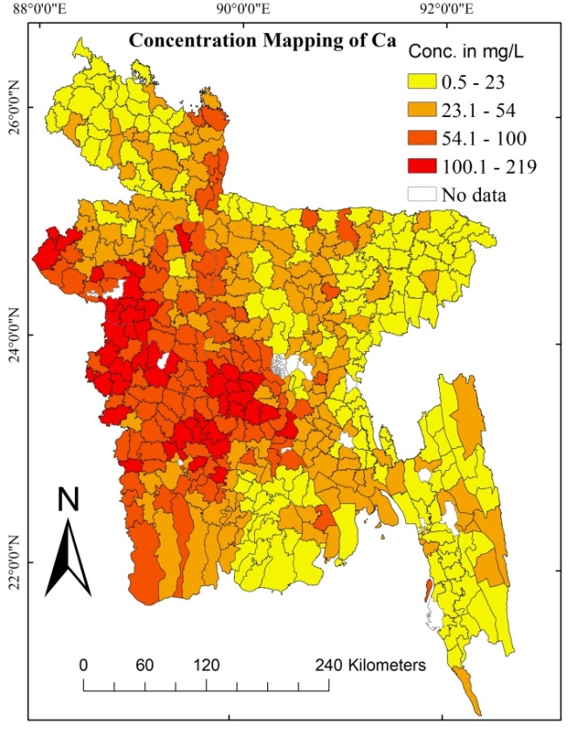
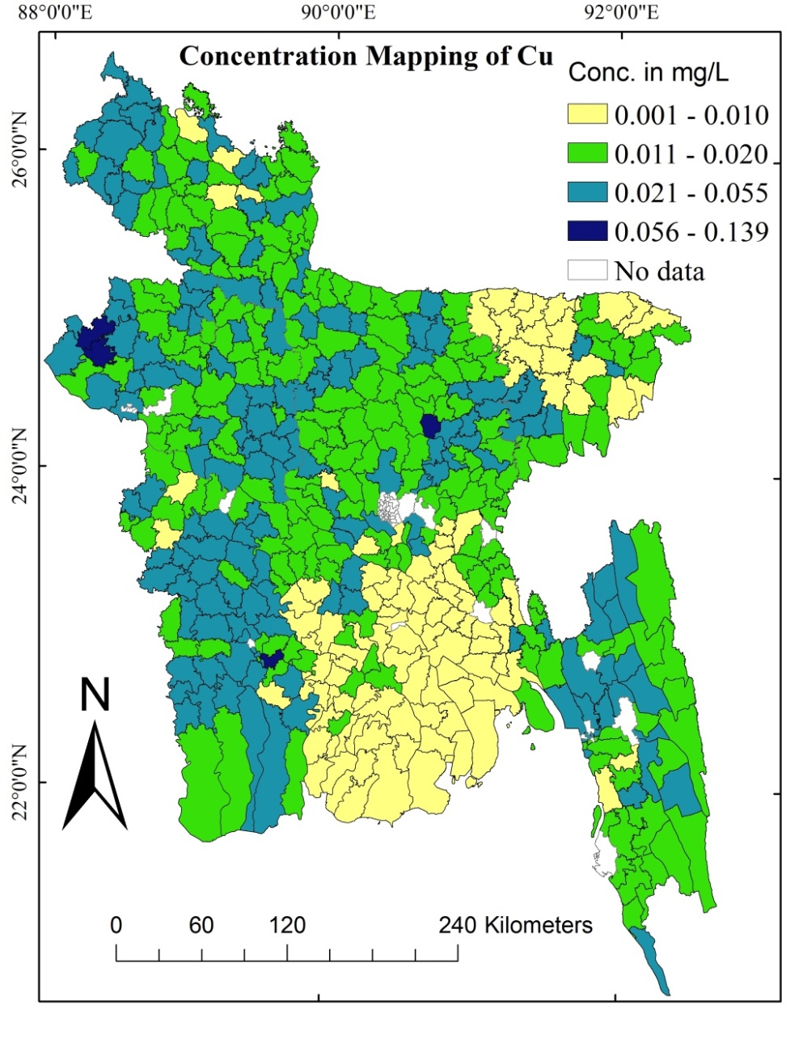
TAJ PALACE, NEW DELHI | 12 – 14 SEPTEMBER 2016
Figure: Geographic distribution of the concentrations (mg/L) of Ca and Cu over the Upazilas of Bangladesh as per UNICEF 2009.

Slide 11
TAJ PALACE, NEW DELHI | 12 – 14 SEPTEMBER 2016
Data Analysis
DRI Fulfillment
%
Nutrition Intake
mg/day
Water Intake
2 L/day
RDA/AI
mg/day
Concentration of Nutrients
mg/L
We prepared
Calculation on MS Excel
Graphs using MATLAB
Maps using Arc GIS 10.3

Slide 12
TAJ PALACE, NEW DELHI | 12 – 14 SEPTEMBER 2016
Calcium
Figure: Cumulative Population Exposure(%) to calcium Concentration (mg/L)

Slide 13
TAJ PALACE, NEW DELHI | 12 – 14 SEPTEMBER 2016
Figure: Cumulative Male (left) and Female (right) Population (%) Exposure to Ca Concentration (mg/L)

Slide 14
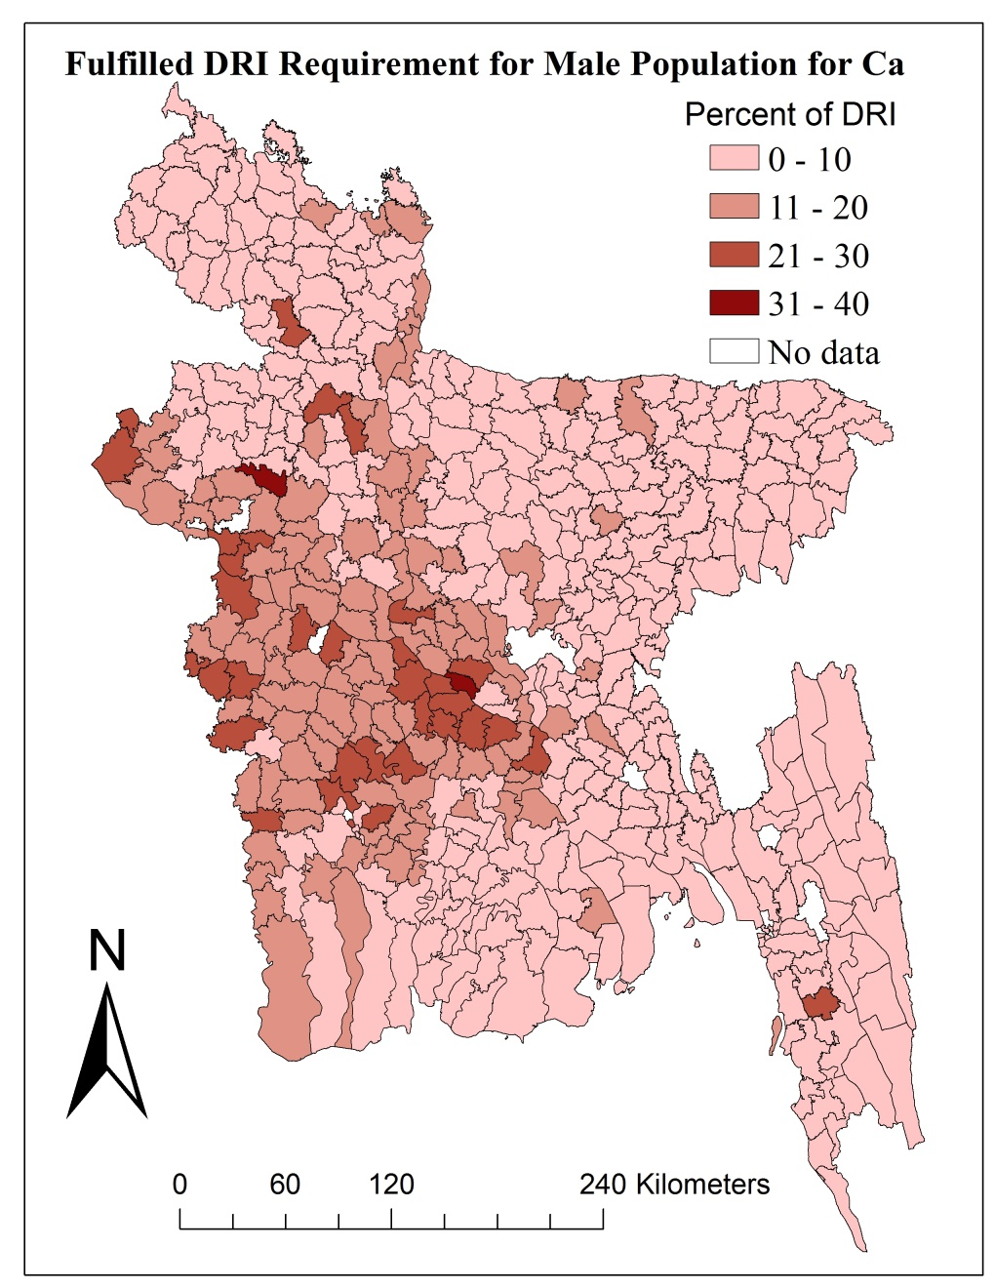
TAJ PALACE, NEW DELHI | 12 – 14 SEPTEMBER 2016
Figure: (left) Cumulative Male Population (%) Exposure to DRI Fulfilled (%) for Ca, (right) Geographical Distribution of Fulfilled DRI (%).

Slide 15
TAJ PALACE, NEW DELHI | 12 – 14 SEPTEMBER 2016

Slide 16
TAJ PALACE, NEW DELHI | 12 – 14 SEPTEMBER 2016

Slide 17
TAJ PALACE, NEW DELHI | 12 – 14 SEPTEMBER 2016

Slide 18
TAJ PALACE, NEW DELHI | 12 – 14 SEPTEMBER 2016
Comparison among the Nutrients

Slide 19
TAJ PALACE, NEW DELHI | 12 – 14 SEPTEMBER 2016
Comparison among the Nutrients

Slide 20
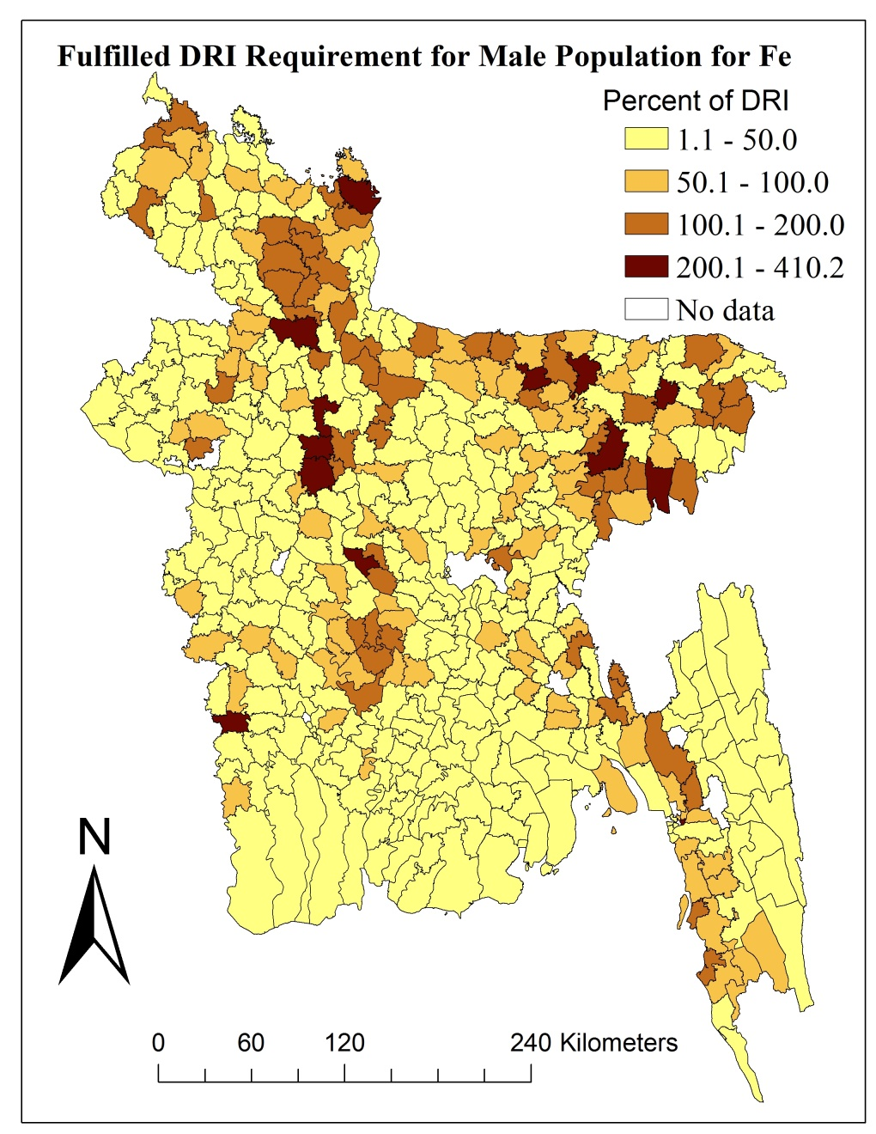
TAJ PALACE, NEW DELHI | 12 – 14 SEPTEMBER 2016
Figure: (left) Cumulative Male Population (%) Exposure to DRI Fulfilled (%) for Fe, (right) Geographical Distribution of Fulfilled DRI (%).

Slide 21
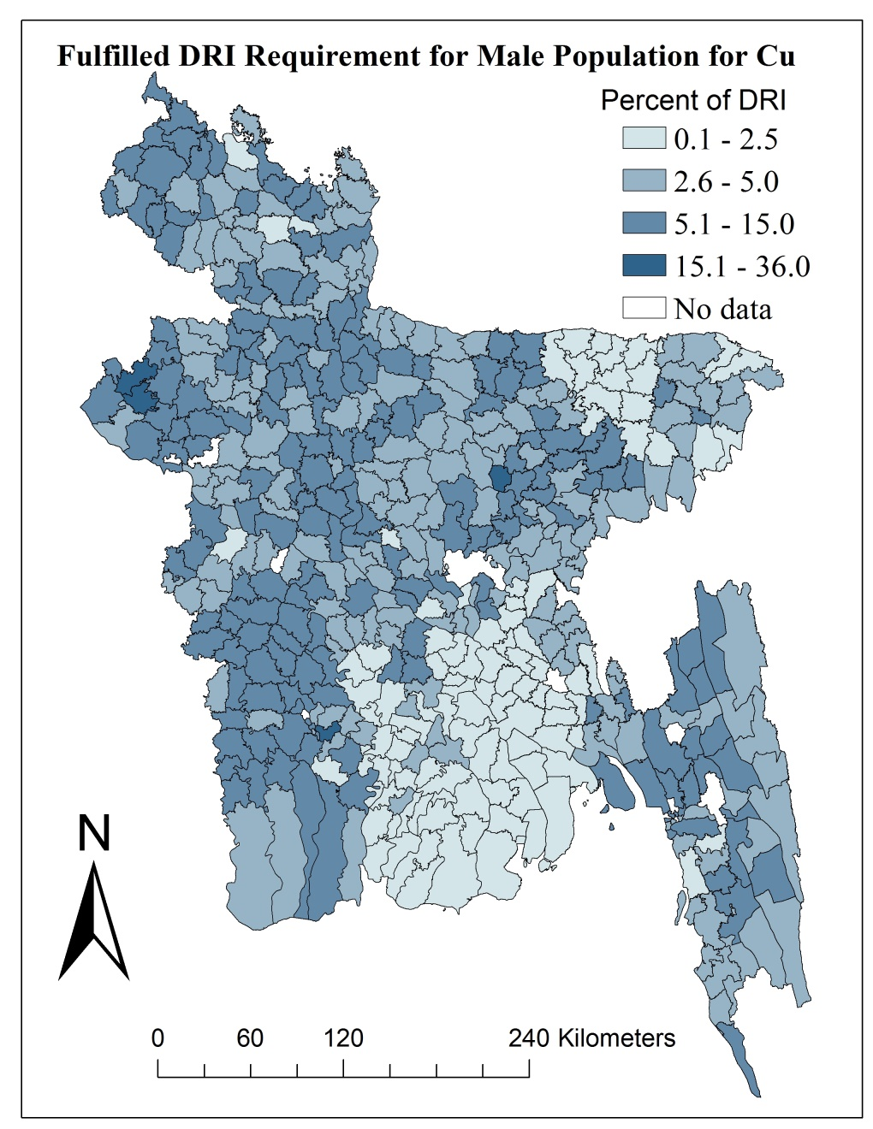
TAJ PALACE, NEW DELHI | 12 – 14 SEPTEMBER 2016
Figure: (left) Cumulative Male Population (%) Exposure to DRI Fulfilled (%) for Cu, (right) Geographical Distribution of Fulfilled DRI (%).

Slide 22
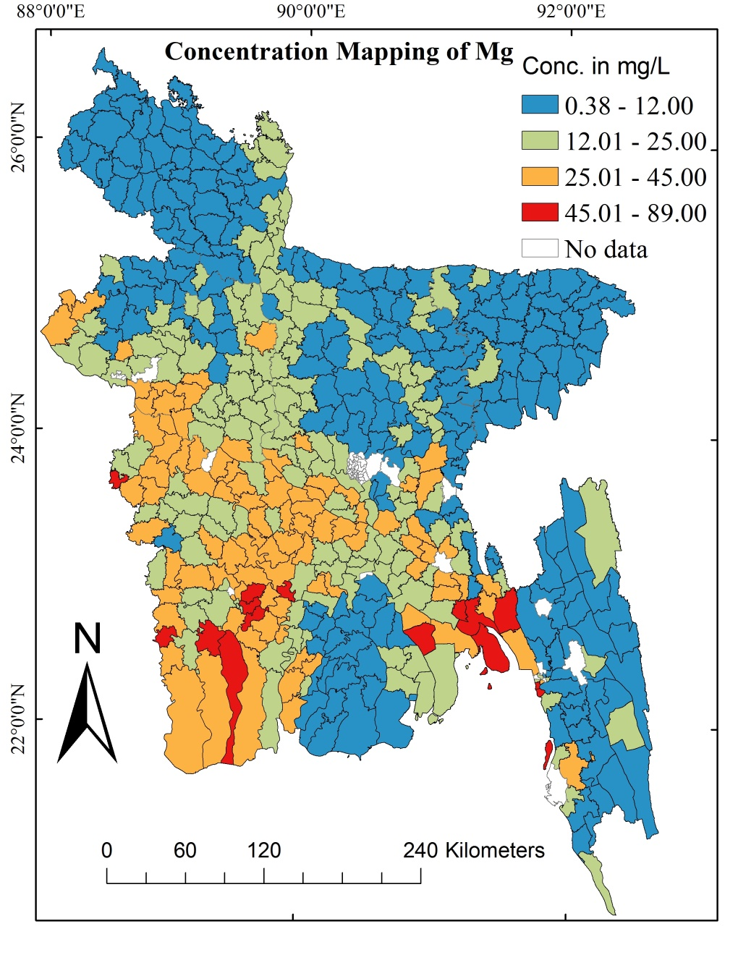
TAJ PALACE, NEW DELHI | 12 – 14 SEPTEMBER 2016
Figure: (left) Cumulative Male Population (%) Exposure to DRI Fulfilled (%) for Mg, (right) Geographical Distribution of Fulfilled DRI (%).

Slide 23
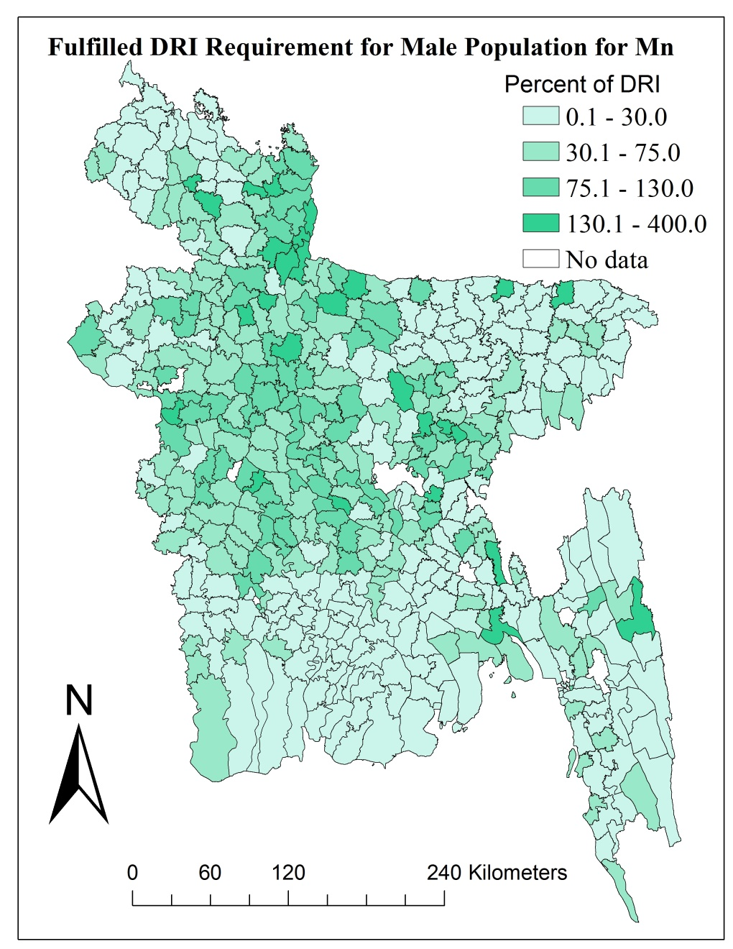
TAJ PALACE, NEW DELHI | 12 – 14 SEPTEMBER 2016
Figure: (left) Cumulative Male Population (%) Exposure to DRI Fulfilled (%) for Mn, (right) Geographical Distribution of Fulfilled DRI (%).

Slide 24
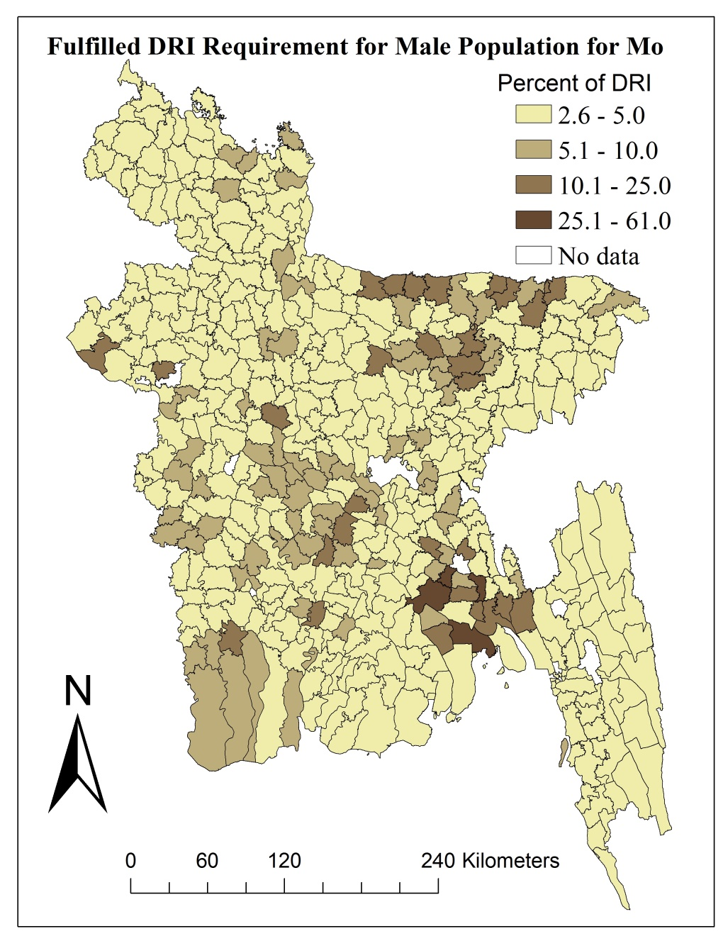
TAJ PALACE, NEW DELHI | 12 – 14 SEPTEMBER 2016
Figure: (left) Cumulative Male Population (%) Exposure to DRI Fulfilled (%) for Mo, (right) Geographical Distribution of Fulfilled DRI (%).

Slide 25
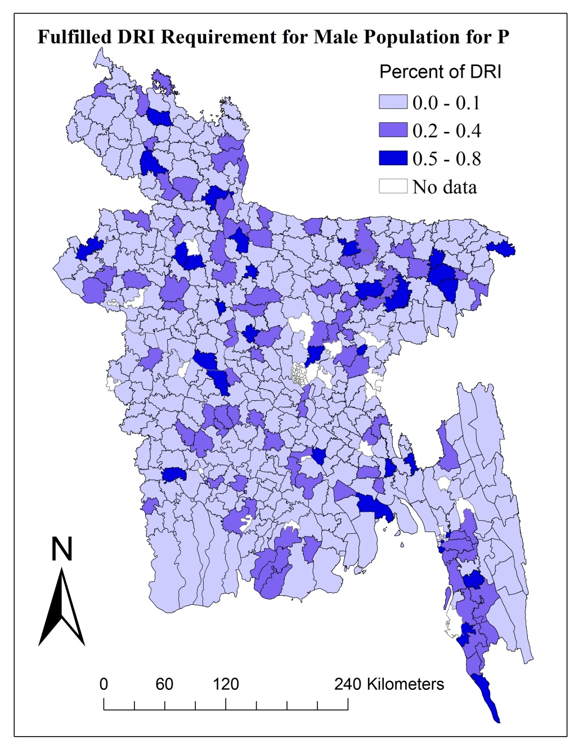
TAJ PALACE, NEW DELHI | 12 – 14 SEPTEMBER 2016
Figure: (left) Cumulative Male Population (%) Exposure to DRI Fulfilled (%) for P, (right) Geographical Distribution of Fulfilled DRI (%).

Slide 26
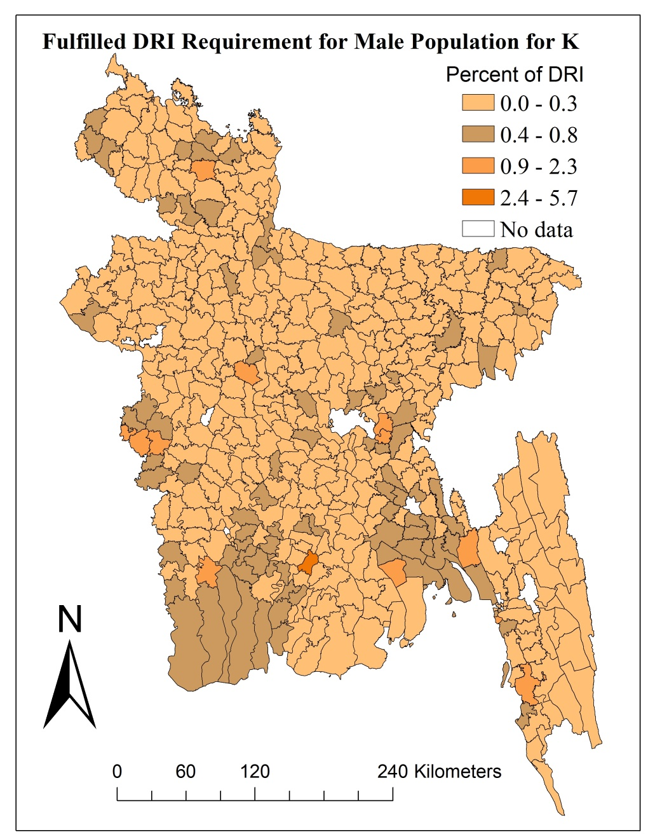
TAJ PALACE, NEW DELHI | 12 – 14 SEPTEMBER 2016
Figure: (left) Cumulative Male Population (%) Exposure to DRI Fulfilled (%) for K, (right) Geographical Distribution of Fulfilled DRI (%).

Slide 27
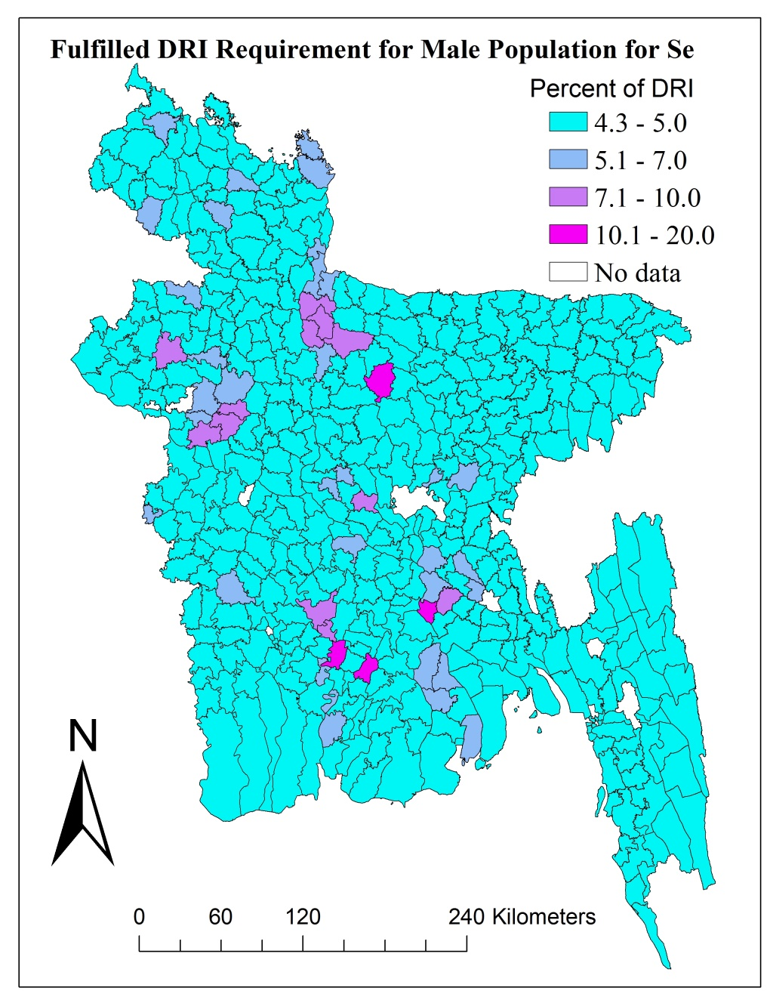
TAJ PALACE, NEW DELHI | 12 – 14 SEPTEMBER 2016
Figure: (left) Cumulative Male Population (%) Exposure to DRI Fulfilled (%) for Se, (right) Geographical Distribution of Fulfilled DRI (%).

Slide 28
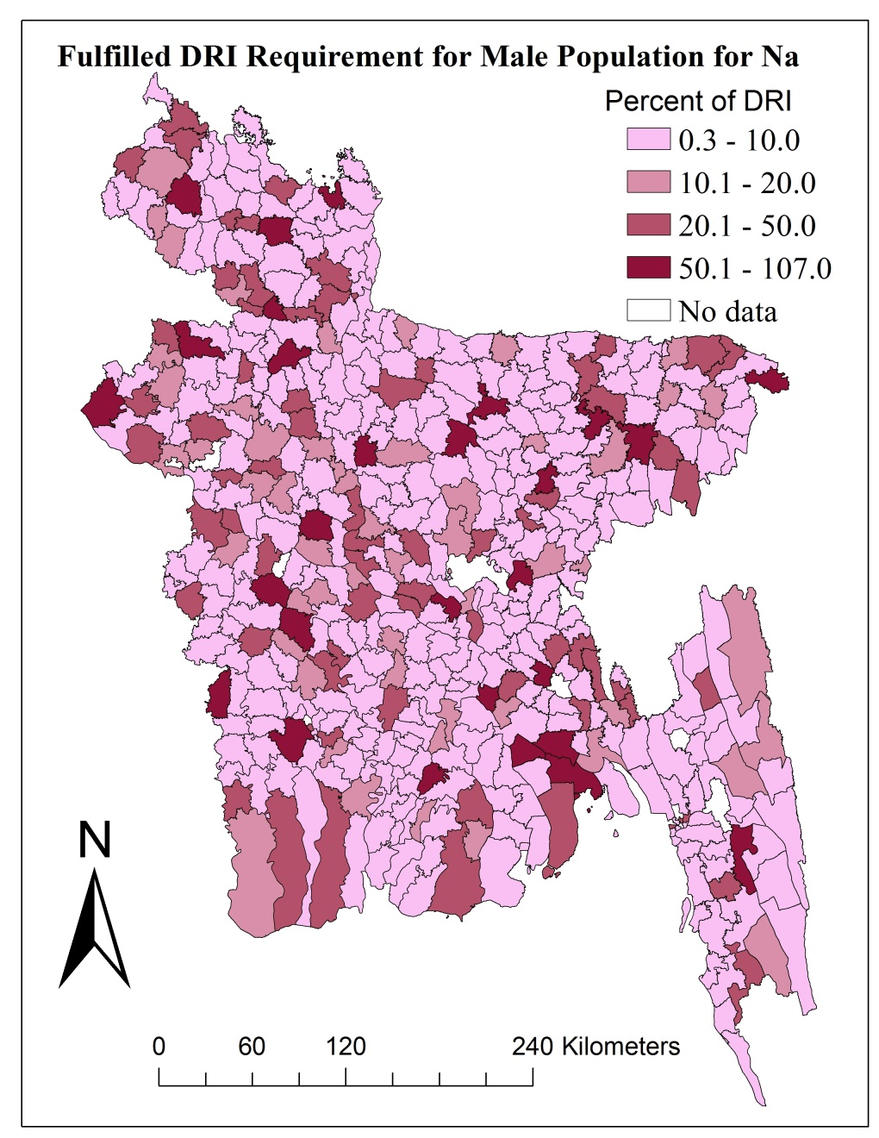
TAJ PALACE, NEW DELHI | 12 – 14 SEPTEMBER 2016
Figure: (left) Cumulative Male Population (%) Exposure to DRI Fulfilled (%) for Na, (right) Geographical Distribution of Fulfilled DRI (%).

Slide 29
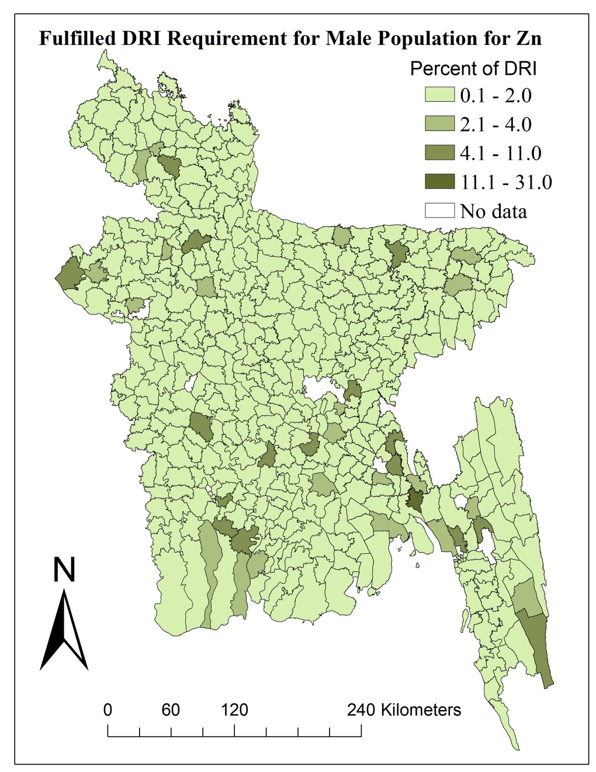
TAJ PALACE, NEW DELHI | 12 – 14 SEPTEMBER 2016
Figure: (left) Cumulative Male Population (%) Exposure to DRI Fulfilled (%) for Zn, (right) Geographical Distribution of Fulfilled DRI (%).

Slide 30
TAJ PALACE, NEW DELHI | 12 – 14 SEPTEMBER 2016
Conclusion
Fe, Mn, Na are consumed considerably
P, K, Zn intakes are low
Mn may pose health risk
Fe and Mn are in critical condition

Slide 31
TAJ PALACE, NEW DELHI | 12 – 14 SEPTEMBER 2016
Recommendation
Assessment considering activities and age
Relationships to various diseases, of deficiency
Treatment without altering beneficiary levels of nutrients .

Slide 32
TAJ PALACE, NEW DELHI | 12 – 14 SEPTEMBER 2016
THANK YOU

