Slide 1
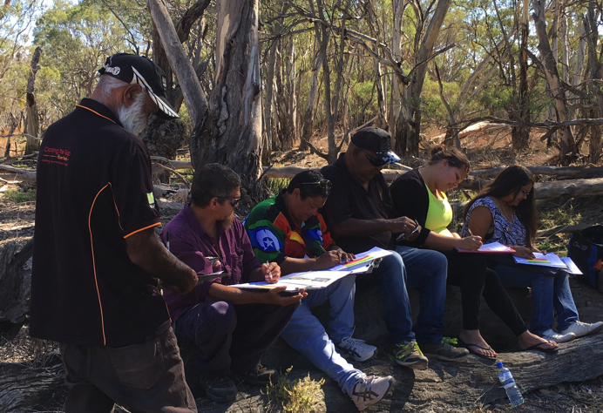
TAJ PALACE, NEW DELHI | 12 – 14 SEPTEMBER 2016
Aboriginal waterway assessments:
new tools for realizing shared benefits in the Murray Darling Basin
Rene Woods – Nari Nari Nation, Deputy Chair, MLDRIN
Will Mooney – Executive Officer, MLDRIN

Slide 2
Overview
TAJ PALACE, NEW DELHI | 12 – 14 SEPTEMBER 2016
How to fulfill cultural objectives in water planning and achieve shared benefits?
The Aboriginal Waterways Assessment (AWA)
National Cultural Flows Research Project
An evolving toolkit
Notes:
This work is driven by the question how do you support cultural objectives in the management of environmental water? Increasing acceptance of the concept of shared benefits.
There are new tools being put in place to try and answer these questions.

Slide 3
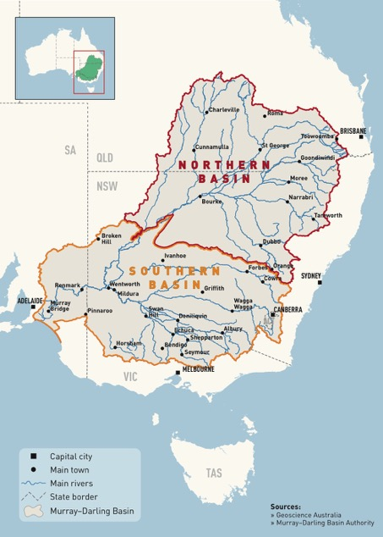
The AWA tool
TAJ PALACE, NEW DELHI | 12 – 14 SEPTEMBER 2016
A tool to assess the cultural health of waterways and river Country
Cultural objectives in water planning
Traditional Owner led
Consistent
Collaborative
Inclusive

Slide 4
Development and application
TAJ PALACE, NEW DELHI | 12 – 14 SEPTEMBER 2016
Adapted from the Maori Cultural Health Index
Participants assess the cultural value and environmental health of sites on Country, using a scoring mechanism.
Scores and qualitative data are used to define objectives for water management and NRM.

Slide 5
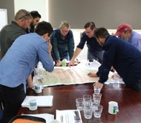
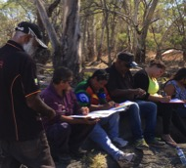
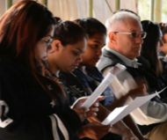
TAJ PALACE, NEW DELHI | 12 – 14 SEPTEMBER 2016
Scoping and planning
Learn the tool
Fieldwork
Assessment team and facilitators
Reports, maps and data
Held by Nations
Identify sites
Assemble team
Partnerships
Water Planning
Community deliberations
Informs
Generates
Define objectives
Identify flow requirements
Input to

Slide 6
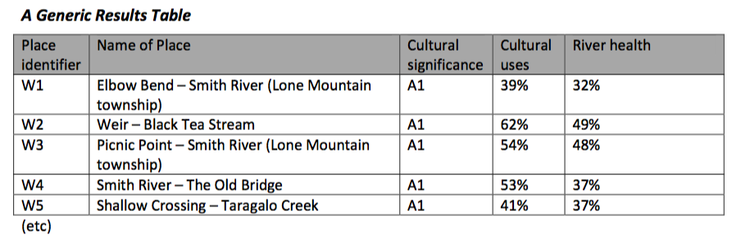
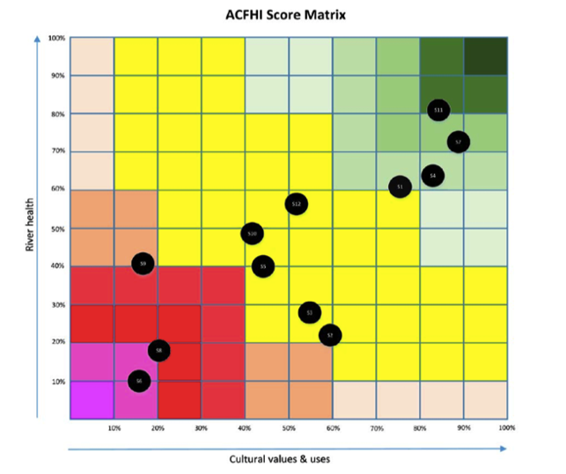
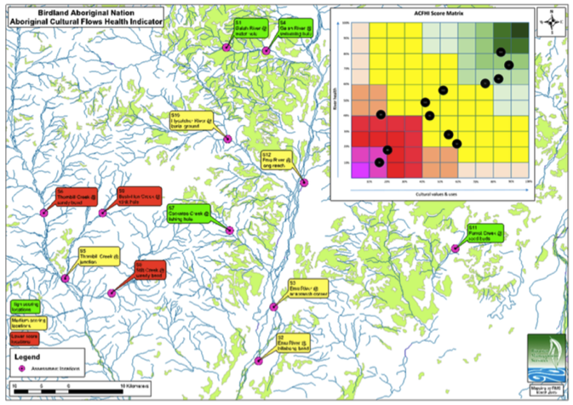
TAJ PALACE, NEW DELHI | 12 – 14 SEPTEMBER 2016

Slide 7
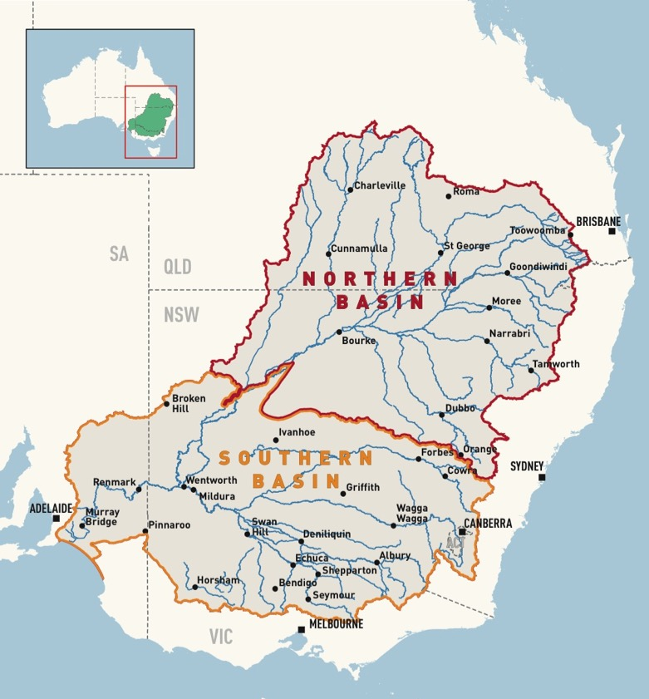
TAJ PALACE, NEW DELHI | 12 – 14 SEPTEMBER 2016
Gamilaraay
Barwon River
RMAC
Chowilla region
Wamba Wamba Werrai Forest
Ngunnawal
ACT
Gunditjmara et al
Glenelg River
Dhudhuroa/Waywurru
Alps region

Slide 8
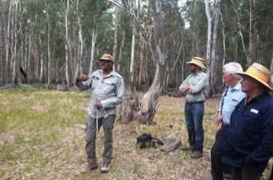
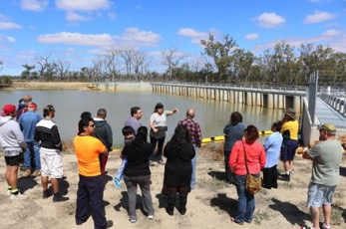
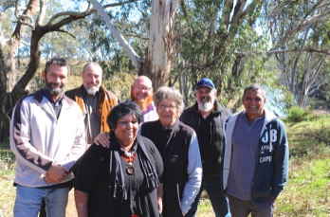
Learnings and next steps
TAJ PALACE, NEW DELHI | 12 – 14 SEPTEMBER 2016
AWA generates diverse outcomes
AWA is the start of a process
Partnerships are crucial
One size doesn’t fit all
Victorian State Government funding
Meaningful inputs to water planning

Slide 9
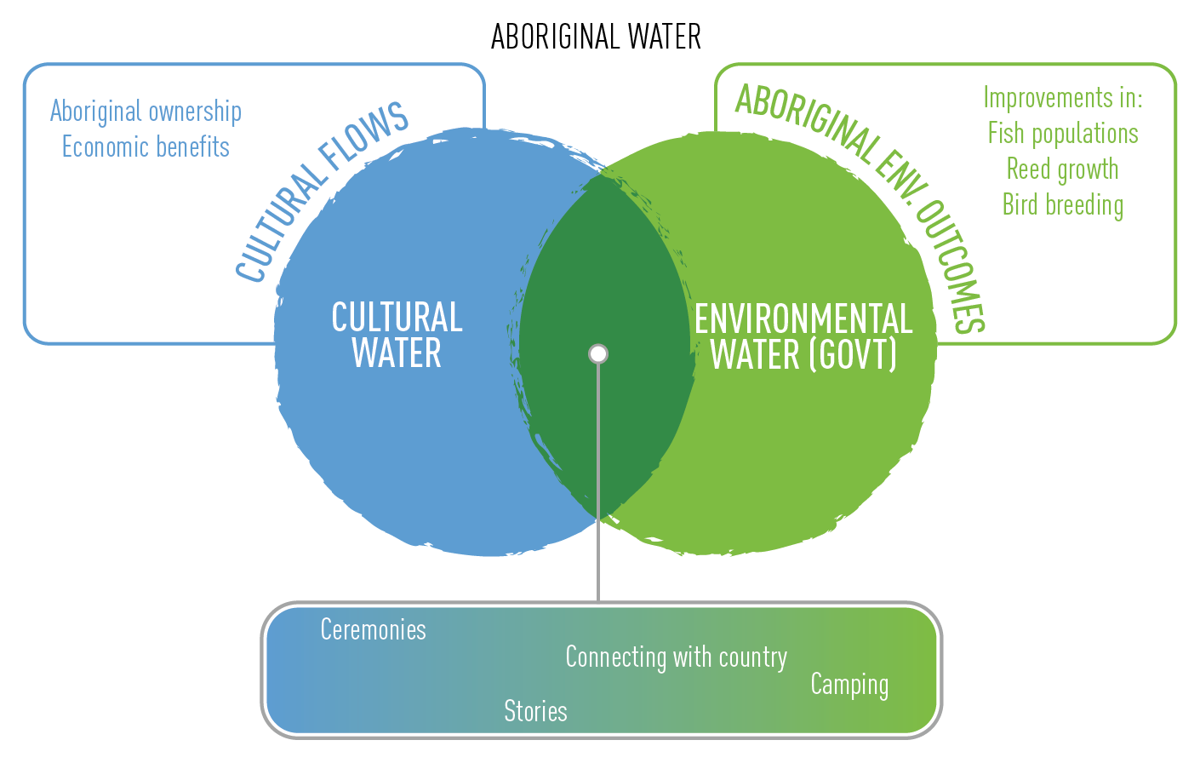
Cultural Flows Research Project
TAJ PALACE, NEW DELHI | 12 – 14 SEPTEMBER 2016

Slide 10
Cultural Flows Research Project
TAJ PALACE, NEW DELHI | 12 – 14 SEPTEMBER 2016
‘Cultural Flows are water entitlements that are legally and beneficially owned by the Indigenous Nations and are of a sufficient and adequate quantity and quality to improve the spiritual, cultural, environmental, social and economic conditions of those Indigenous Nations. This is our inherent right.’
The Echuca Declaration, September 2010

Slide 11
Cultural Flows Research Project
TAJ PALACE, NEW DELHI | 12 – 14 SEPTEMBER 2016
Project Vision:
A future where Aboriginal water allocations are embedded within Australia’s water planning and management framework, delivering cultural, social, spiritual, environmental and economic benefit to communities across Australia.

Slide 12
Cultural Flows Research Project
TAJ PALACE, NEW DELHI | 12 – 14 SEPTEMBER 2016
Literature review
Values and aspirations
Modelling and watering trials
Analyse impacts
Investigate policy, legal and institutional reforms
Capacity building
Communications
Project management

Slide 13
Research outcomes
TAJ PALACE, NEW DELHI | 12 – 14 SEPTEMBER 2016
Rigorous basis for articulating value and importance of cultural flows
Methodologies for defining cultural values and quantifying water required to meet them
Monitoring and indicator frameworks that can be applied to other sites
Identified opportunities for policy, legislative and governance reform
Notes:
This work is driven by the question how do you support cultural objectives in the management of environmental water? Increasing acceptance of the concept of shared benefits.
There are new tools being put in place to try and answer these questions.

Slide 14
An evolving toolkit
TAJ PALACE, NEW DELHI | 12 – 14 SEPTEMBER 2016
A range of tools, reflecting the priorities and capacities of different First Nations
Aboriginal Waterways Assessment
Ngarrindjeri Yanarumi index
Use and Occupancy mapping
NSW AWI ‘Asset Collection’
Cultural Flows project methodology
Notes:
This work is driven by the question how do you support cultural objectives in the management of environmental water? Increasing acceptance of the concept of shared benefits.
There are new tools being put in place to try and answer these questions.

Slide 15
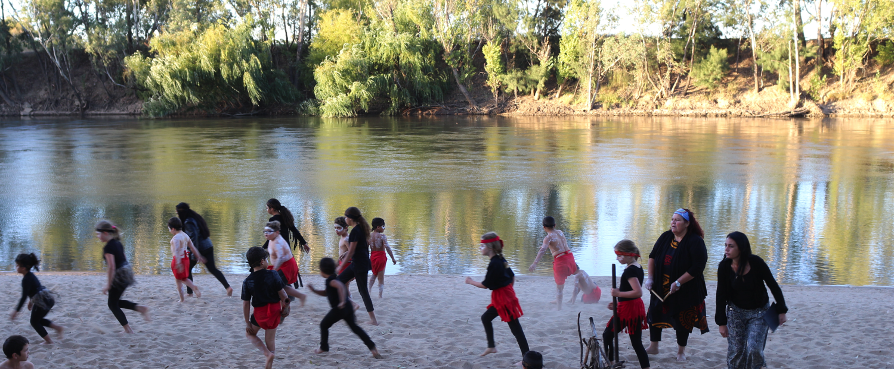
Thank you!
TAJ PALACE, NEW DELHI | 12 – 14 SEPTEMBER 2016
Questions?

