Slide 1
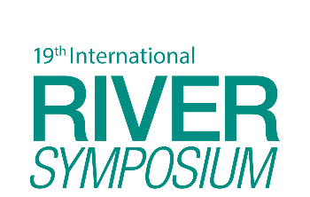
TAJ PALACE, NEW DELHI | 12 – 14 SEPTEMBER 2016
Speciation of Lead and Cadmium in the Water of Various Rivers in Masara, Maco, Compostela Valley
C.P.Martinez and L.M. Porticos

Slide 2
TAJ PALACE, NEW DELHI | 12 – 14 SEPTEMBER 2016
Order of Presentation
Introduction
Significance of the Study
Objectives of the Study
Methodology
Findings
Conclusion
Recommendation

Slide 3
TAJ PALACE, NEW DELHI | 12 – 14 SEPTEMBER 2016
Introduction
Lead (Pb) and cadmium (Cd) are trace metal contaminants highly regulated in water
Sources of heavy metals in surface water (US EPA, 2005)
Natural
Anthropogenic – paint, gasoline, pipes
These metals are highly toxic (Mello, et, al n.d.) to human and animals when ingested at low concentration
Toxicity of these metals depend on the form thse metals occur in the environment (Capodaglio G., Kenneth H. Coale and Kenneth W. Bruland, (1990).
WHO 2006 cited toxicity of heavy metals in the environment depends on the bioavailability and bio-accessibility

Slide 4
TAJ PALACE, NEW DELHI | 12 – 14 SEPTEMBER 2016
Introduction
Toxicological effect is affected by its speciation in the aqueous system (Goncalves, et. al., 1985)
Speciation is the determination and quantification of specific form of element (Ashraf, M.A., M.J. Maah, and I. Yusoff, 2012).
Species not bioavailable and bio-accessible are considered health hazard.
Common assumption metal contaminant in an environmental medium is 100 % bioavailable
Leading to over-estimating the ecological risk
Philippine regulatory standard (DAO 34) is based on the total concentration.

Slide 5
TAJ PALACE, NEW DELHI | 12 – 14 SEPTEMBER 2016
Significance of the Study
Improve regulatory standards
Assess ecotoxicological hazards of lead and cadmium in the water of the rivers in Masara Compostela Valley
Understanding the reactivity, bioavailability and toxicity of lead and cadmium

Slide 6
TAJ PALACE, NEW DELHI | 12 – 14 SEPTEMBER 2016
Objectives of the Study
This study is aimed to determine the lead and cadmium contamination of the water in the rivers and creeks Masara, Maco, Compostela Valley. Specifically it is directed to:
Determine the total lead and cadmium concentrations in the water and sediment in the rivers in Masara, Maco, Compostela Valley;
Measure the bioavailability and toxic fraction of dissolved lead and cadmium in the water of the rivers in Masara, Maco, Compostela Valley

Slide 7
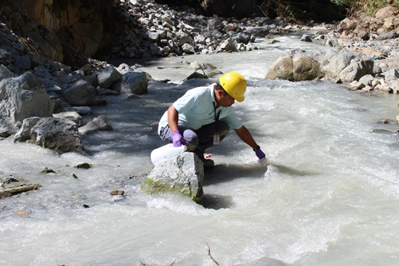
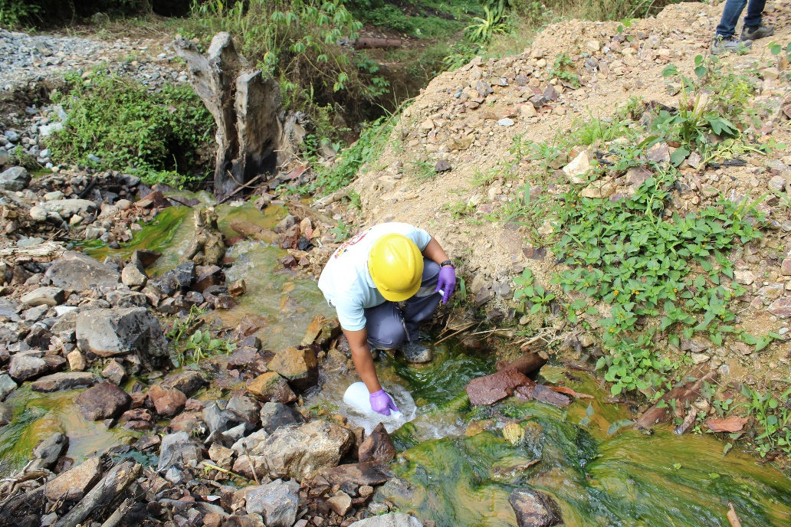
TAJ PALACE, NEW DELHI | 12 – 14 SEPTEMBER 2016
Methodology

Slide 8
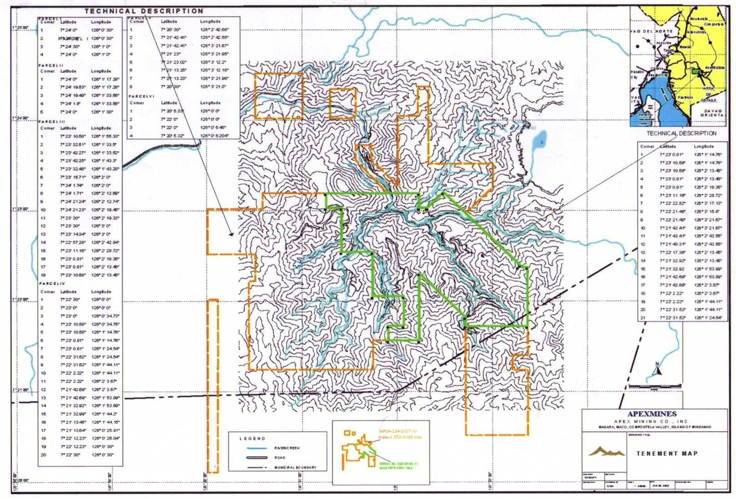
TAJ PALACE, NEW DELHI | 12 – 14 SEPTEMBER 2016

Slide 9
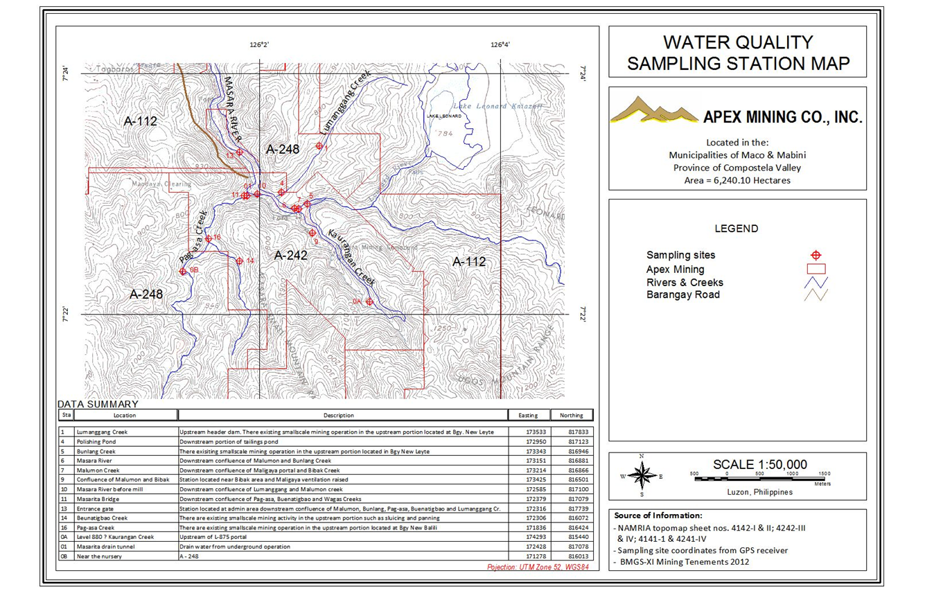
TAJ PALACE, NEW DELHI | 12 – 14 SEPTEMBER 2016

Slide 10
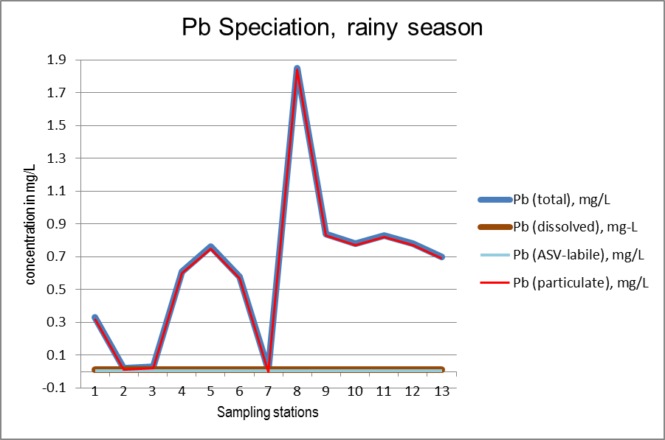
TAJ PALACE, NEW DELHI | 12 – 14 SEPTEMBER 2016
Findings
Notes:
Lead and cadmium were detected in the water of various rivers and creeks in Masara, Compostela Valley
These metals occur in different species
The mean average of the total lead (Pb) concentration is 0.354 mg/L which is 7 times higher than the DAO 34 standards of 0.05 mg/L
The ASV-labile species (toxic form) is 0.0075 mg/L which is way below the DAO 34 standards but this concentration is a little higher than the USEPA guidelines of 0.0058 mg/L.
Most of the lead detected is in combined form.

Slide 11
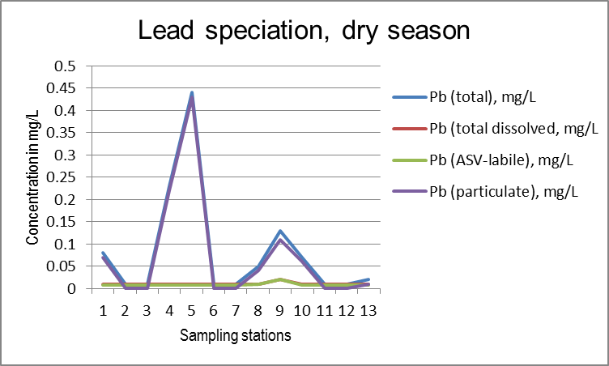
TAJ PALACE, NEW DELHI | 12 – 14 SEPTEMBER 2016

Slide 12
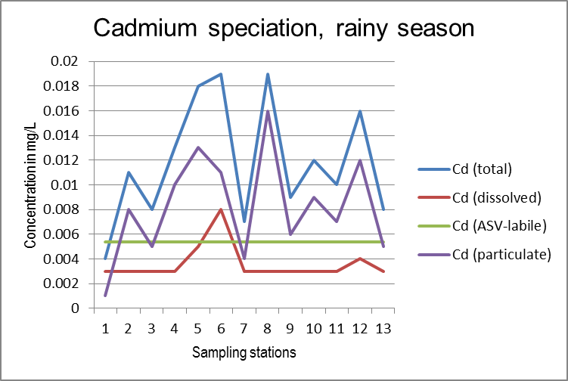
TAJ PALACE, NEW DELHI | 12 – 14 SEPTEMBER 2016
Notes:
Mean average of total cadmium concentration of 0.0102 mg/L slightly exceeded the DAO 34 standard of 0.01 mg/L
The ASV-labile species of 0.0054 mg/L is way below the DAO 34 standard but higher compared to the USEPA guideline value of 0.002 mg/L

Slide 13
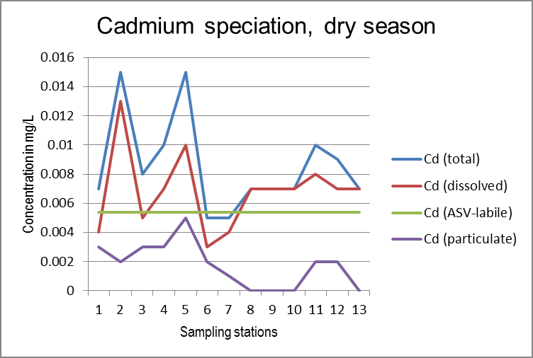
TAJ PALACE, NEW DELHI | 12 – 14 SEPTEMBER 2016

Slide 14
TAJ PALACE, NEW DELHI | 12 – 14 SEPTEMBER 2016
Conclusion
Speciation add new dimensions in the area of water quality monitoring
Based on the speciation, the fractions of the Pb and Cd concentrations that are bio-available and therefore toxic are favorably much lower than the corresponding maximum tolerable levels set by EMB-DENR (DAO 34)
The total concentrations are considerably high which should be monitored because these represent the proportion that can be remobilized by changes in environmental conditions such as pH, temperature, salinity, etc.

Slide 15
TAJ PALACE, NEW DELHI | 12 – 14 SEPTEMBER 2016
Recommendation
Conduct speciation of lead and cadmium in the river sediment
Conduct study on the mobility of lead and cadmium in water with the existing condition
Mining companies operating in the area together with local government units and national agency to develop a system for the complexation of bio-available lead and cadmium to reduce toxicity
Propose amendments to DAO 34 for lead and cadmium and base on the toxic level instead of total concentration.
Develop a system to arrest the remobilization of particulate lead and cadmium

Slide 16
TAJ PALACE, NEW DELHI | 12 – 14 SEPTEMBER 2016
Acknowledgment
Special Tanks to:
the Mine Rehabilitation Fund Committee for the funding,
APEX Mining Corporation for the logistics
the staff of USeP for the technical assistance during the sampling,
Safety, Health and Environment (SHE) office of APEX for the help during the field work

