Slide 1




TAJ PALACE, NEW DELHI | 12 – 14 SEPTEMBER 2016
From Grey to Green
Management of Nutrient Discharges
International River Symposium
12-14 September 2016
Delhi, India
Partha Susarla
Unitywater
Queensland
Australia

Slide 2

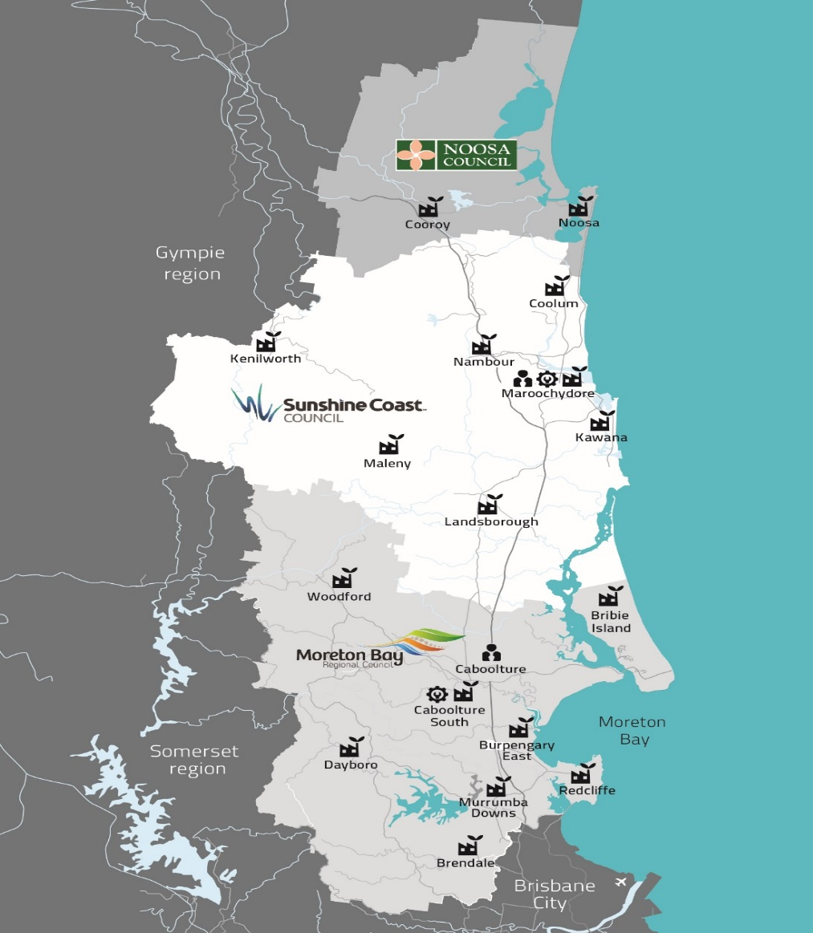
TAJ PALACE, NEW DELHI | 12 – 14 SEPTEMBER 2016
Unitywater supplies water and sewerage services to approximately 750,000 residents for almost 306,000 accounts across a 5,223km2 geographical spread from Cooroy in the North to Kenilworth in the west, Samford in the south and Bribie Island in the east.

Slide 3

TAJ PALACE, NEW DELHI | 12 – 14 SEPTEMBER 2016
749 staff (approx.)
266,604 sewerage connections
11.200 km of water and sewerage mains
777 sewage pump stations
17 sewage treatment plants
297,266 water connections
79 water pump stations
114 water reservoirs
Total >$3 Billion of Infrastructure

Slide 4
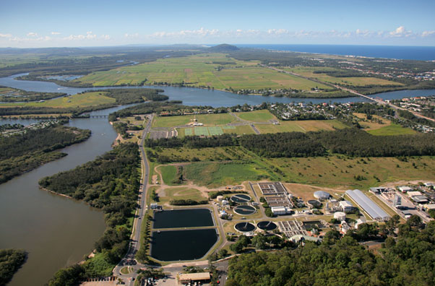
TAJ PALACE, NEW DELHI | 12 – 14 SEPTEMBER 2016
Five major River systems
  Pine Rivers and Bramble Bay
  Caboolture River and
  Pumice Stone passage
  Mooloolah River
  Maroochy River
  Noosa River
10 Urban sewage treatment plants discharge to the above river catchments

Slide 5
TAJ PALACE, NEW DELHI | 12 – 14 SEPTEMBER 2016
Treatment plants discharge TN:TP of 5:1 and 3:1
Almost at the limit of economical treatment technology
Pressures of increasing growth in the catchment
Tightening of environmental discharge conditions

Slide 6
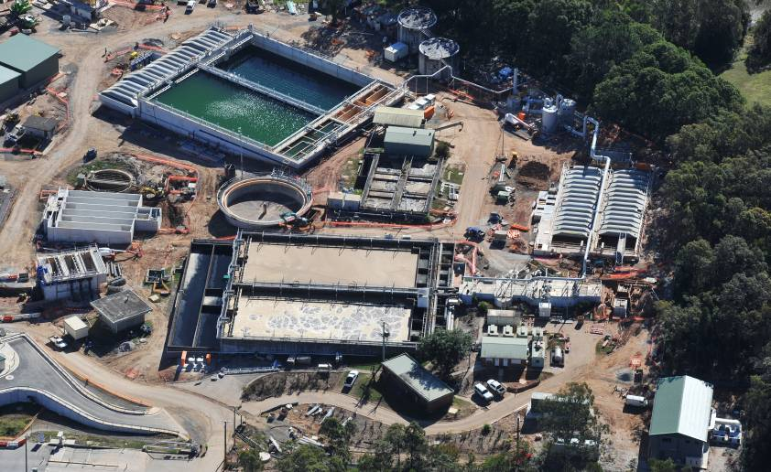
TAJ PALACE, NEW DELHI | 12 – 14 SEPTEMBER 2016
Invested more than $700M in the last six years in water and sewerage infrastructure
  Sewage treatment plants
  Pumping stations
  Water and sewer networks
  Maintaining water quality
  SCADA system
The focus now is on how we can reduce financial burden for our customers

Slide 7
TAJ PALACE, NEW DELHI | 12 – 14 SEPTEMBER 2016
To reduce charges Unitywater is investing in efficient and alternative treatment systems:
  Total Water Cycle Management Planning
  Wetlands and forestry (Maleny STP) – Won UN Award
  Catchment management to reduce nutrient load on rivers
  Riverbank rehabilitation to offset nutrients from STP discharges
  Irrigation schemes to recycle treated water
  Green Infrastructure costs 20% of hard infrastructure solution on an equivalent basis

Slide 8
TAJ PALACE, NEW DELHI | 12 – 14 SEPTEMBER 2016
Total Water Cycle Planning
Understand catchment as a whole
Diffused source pollutants
Point source Pollutants
Erosion and sediment
Identify best management practices
Management of three waters

Slide 9
TAJ PALACE, NEW DELHI | 12 – 14 SEPTEMBER 2016
Qld State Government introduced Mechanism in 2014
Facilitates management of point source pollutant discharges by implementing catchment solutions
Provides flexibility for STP operators
Environmental Licences for a period of 5 years for the activity – with renewals once the offset is proven

Slide 10
TAJ PALACE, NEW DELHI | 12 – 14 SEPTEMBER 2016
Caboolture River Nutrient Offset Project
Increasing load at Burpengary East STP
Increasing population
Caboolture River – overall poor water quality & ecological health (Report Card C+, D+)
TN removal $200/kg offset vs $800-1,000/kg STP upgrade

Slide 11
TAJ PALACE, NEW DELHI | 12 – 14 SEPTEMBER 2016
Caboolture River Nutrient Offset Project
4 Sites in total
Most of the land in private ownership
To be completed early 2017

Slide 12
TAJ PALACE, NEW DELHI | 12 – 14 SEPTEMBER 2016

Slide 13
TAJ PALACE, NEW DELHI | 12 – 14 SEPTEMBER 2016
Typical Design detail of bank stabilisation

Slide 14
TAJ PALACE, NEW DELHI | 12 – 14 SEPTEMBER 2016
Pine River
Completed desktop assessment of nutrient management opportunities in Pine River
Physical works programmed for 2017-19
Planning and design in 2016-17

Slide 15
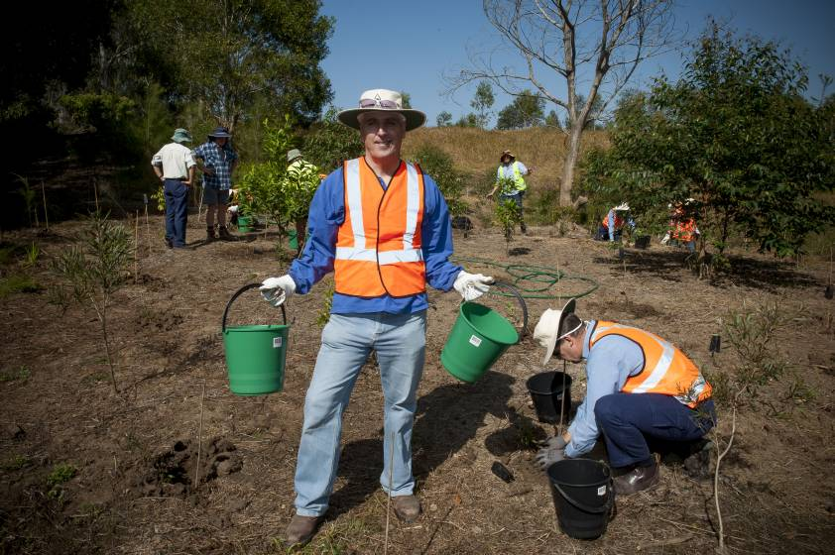
TAJ PALACE, NEW DELHI | 12 – 14 SEPTEMBER 2016
Pine River Initiatives
Creek Side greening program to reduce erosion of stream banks
Shows the change in bank position between 1955 (blue line) and 2009 and 2015 (yellow and green lines)

Slide 16
TAJ PALACE, NEW DELHI | 12 – 14 SEPTEMBER 2016
Regional Collaboration
Resilient Rivers Initiative
Regional Stewardship
Upper Brisbane Catchment Management and Improvement
Erosion and Sediment Control
Whole of custodian approach
  Three Levels of Government support
  Water Service Providers and Utilities
  Other key contributors – Port of Brisbane

Slide 17
TAJ PALACE, NEW DELHI | 12 – 14 SEPTEMBER 2016
Thank You
For more information
Partha Susarla
Partha.Susarla@Unitywater.com
Mobile:+61488719561
Direct: +61733852256

Slide 18
TAJ PALACE, NEW DELHI | 12 – 14 SEPTEMBER 2016

