Slide 1
Impacts and outcomes of water policy reform for irrigation intensive regions A grass-roots look at the implementation of the Murray-Darling Basin Plan
TAJ PALACE, NEW DELHI | 12 – 14 SEPTEMBER 2016
Perin Davey, Corporate Affairs, Murray Irrigation Limited
September 2016

Slide 2
Discussion
TAJ PALACE, NEW DELHI | 12 – 14 SEPTEMBER 2016
The Murray-Darling Basin Plan
The NSW Murray region
NSW Murray water management
Maturing water market
Business adaptation
Agriculture and Ecology
September 2016

Slide 3
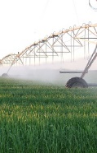
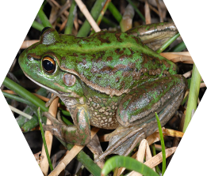
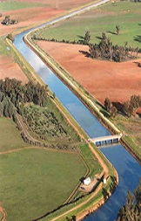
The Murray Darling Basin Plan
TAJ PALACE, NEW DELHI | 12 – 14 SEPTEMBER 2016
Resource planning
2,750GL water recovery
Integrated management
Water quality
Sustainable Diversions
Shared resource
September 2016

Slide 4
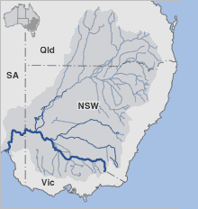

Slide 5
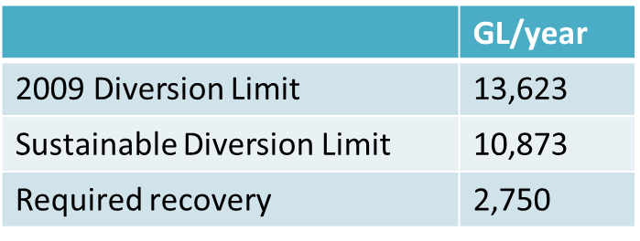
Murray-Darling Basin Plan
Identifies Sustainable Diversion Limits
Government committed to “bridge the gap”
Basin Plan implemented
2012
Long-term watering plans
Final SDLs implemented
2024
Water resource plans
10 year review Basin Plan
Constraints management
strategy
SDL adjustment review
SDLs implemented
2019
Review SDLs

Slide 6
Murray-Darling Basin Plan Impacts & Concerns – NSW Murray
Available water entitlement down by over 30%
Increase in water delivery costs estimated up to 30%
Increase in temporary water trade market of 25%
Initial estimates 20% decline in regional productivity
A 20% decline in GVIAP = $125 million
= $3,788 per person at current value.

Slide 7
Murray-Darling Basin Plan
Water recovery – Murray Irrigation
76%
73%
62%

Slide 8
Murray-Darling Basin Plan Adverse outcomes – NSW Murray
Less product in a fixed cost business
Unsustainable infrastructure
New technology = higher maintenance and depreciation
Lower revenue for infrastructure operators

Slide 9
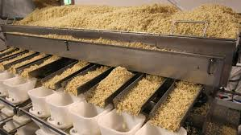
The NSW Murray Regional profile
TAJ PALACE, NEW DELHI | 12 – 14 SEPTEMBER 2016
$625M GVIAP
90% business depend on irrigation
$1,535M
GVAP
Largest river redgum forests
Largest private irrigation company
Largest rice mill
September 2016

Slide 10
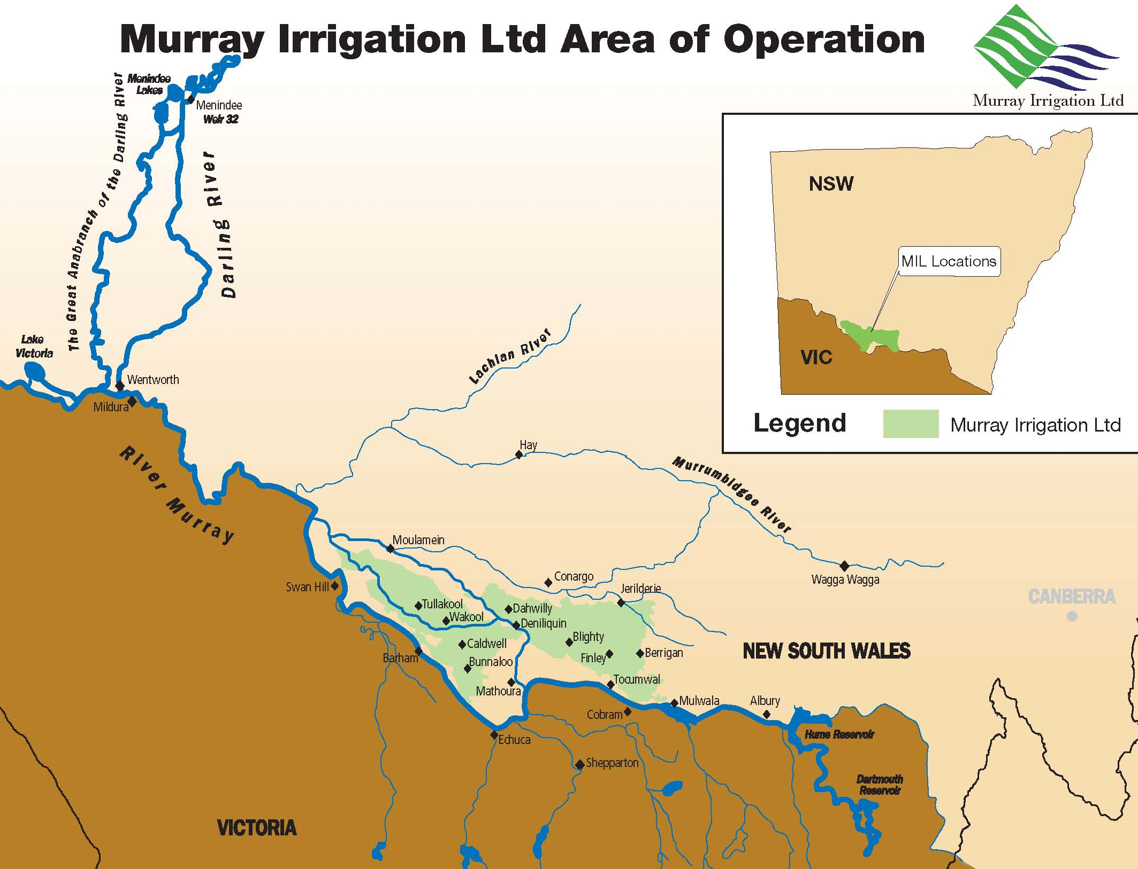

Slide 11
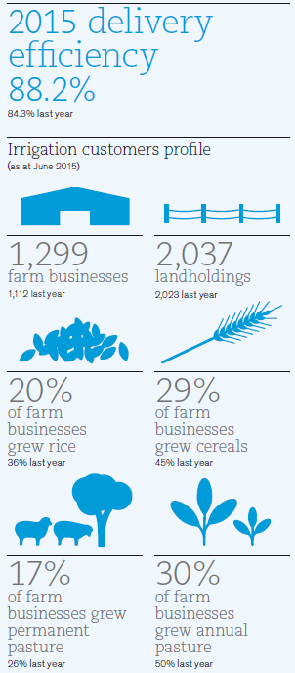
At a glance 2015 Murray Irrigation Annual Report
Corporate structure
Established 1995
Unlisted public company
Offices
Deniliquin, Finley, Wakool
Staff
154
Regional population
33,000
Area of operations
748,000 ha
Five-year average
water use
738GL
GVAP
Over $500m (farm gate)
Infrastructure replacement
Valued over $800m
Network
Gravity fed earthen channels
2,944km supply channel
1,421km drainage channel
25,000ha sub-surface drainage
Supply points
2 Offtakes (Mulwala and Wakool)
3,303 irrigation outlets
1,489 small or S&D outlets
4 accredited escapes
Water Access Licences
NSW Murray
1,029,417 units general security
297,060 units conveyance
121,704 units supplementary
3,287 units high security

Slide 12
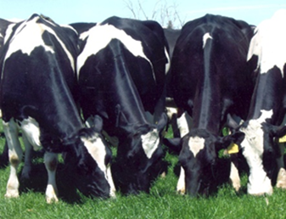
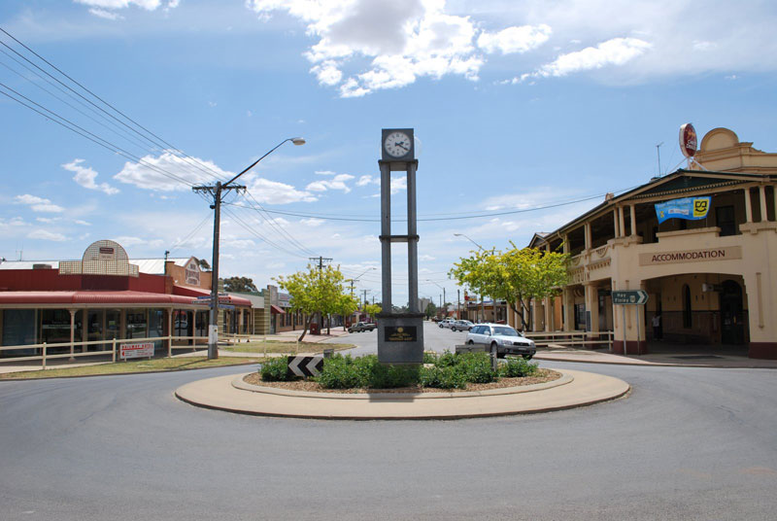
Water management:
NSW Murray
TAJ PALACE, NEW DELHI | 12 – 14 SEPTEMBER 2016
Stock and Domestic
Allocating water
River needs
Environment
Irrigation
Towns
September 2016

Slide 13
Water sharing plans
Water sharing plans establish rules for sharing water between the environmental needs of the river or aquifer and water users, and also between different types of water use such as town supply, rural domestic supply, stock watering, industry and irrigation.
Establish the rules to distribute water via available water determinations

Slide 14
Entitlements and allocation
Water Entitlements
Delivery Entitlements
Specific to an irrigation infrastructure operator
Allocation
Announced by State authority
Stock and Domestic
Reviewed fortnightly until 100% is reached
Allocation can be traded on the annual market
High Security Town
High Security Irrigation
General Security
The right against which water is allocated 1WE = 1ML
At 100% availability
Cannot be traded outside irrigation district
The right to have water delivered
1DE = 1.2ML delivered at standard fee
Irrigation and General security can be traded
First announcement 1 July

Slide 15
Resource distribution
Environment
Basic landholder rights
Stock and domestic
Carryover
As per formula
Native title rights
High Security
Conveyance
General Security

Slide 16
Murray Irrigation
Water use and allocation

Slide 17
Maturing market
TAJ PALACE, NEW DELHI | 12 – 14 SEPTEMBER 2016
Lease products
Water trade
Future trade
Temporary
Flexibility
Invest
September 2016

Slide 18
Business considerations
Irrigators’ business environment has changed
Government allocation policy is risk adverse
Irrigators need to manage their own risks
Irrigators operating in dynamic environment
Information helps inform decisions

Slide 19
Market products
Permanent entitlement trade
Temporary allocation trade
Leases
Short-term Futures
Carryover products

Slide 20
Understanding risks
Water availability
Announced allocation
Farm management decisions
Irrigators attitude to risk
Carryover
Crop types
Customer behaviour
Returns per ML
Market variability
Price according to demand and availability
Demand influence by season and allocation

Slide 21
Market variations

Slide 22
Business adaptation
TAJ PALACE, NEW DELHI | 12 – 14 SEPTEMBER 2016
New technology
Farm evolution
Increased efficiency
Operating costs
Watering wetlands
Water market products
September 2016

Slide 23
Murray Irrigation – part of the solution
Technology driven change
Increase efficiency
Increase utilisation – business and environment
Lower operating cost model

Slide 24
Landholders – Joint custodians
Technology driving change
Environmental awareness
Improving water use efficiencies
Water as a commodity

Slide 25
TAJ PALACE, NEW DELHI | 12 – 14 SEPTEMBER 2016
Agriculture and
ecology
Soil quality
On-farm ecology
Cooperation
Water quality
Wetlands
Native vegetation
September 2016

Slide 26
Private Wetlands Watering
Operating since 2001
Cooperative management Environmental agencies and landholders
Evident ecological outcomes
Delivered via irrigation infrastructure

Slide 27
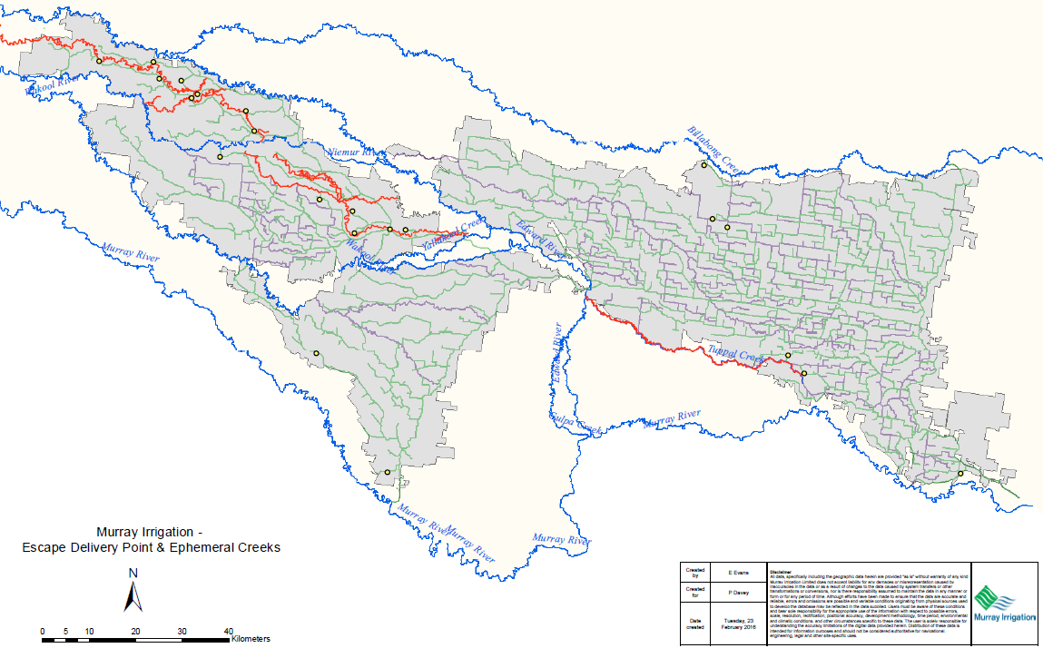
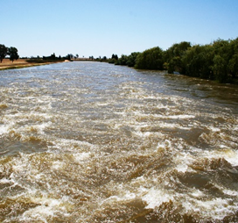
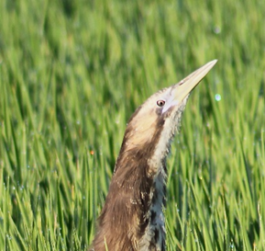
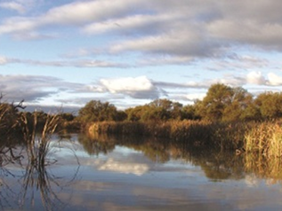
Ephemeral creeks and streams

Slide 28
Industry initiatives
Ricegrowers Environmental Champions accreditation program
Bitterns in Rice partnership
Ongoing varietal research
Soil mapping and water use efficiency

Slide 29
TAJ PALACE, NEW DELHI | 12 – 14 SEPTEMBER 2016
Conclusions
Outcomes
Working together
River needs
Environment
Irrigation
Towns
September 2016

Slide 30
Working together
Water reform is hard
Agriculture and the Environment must be partners
Optimise use of existing infrastructure and programs
Community resilience =
Environmental custodians
Use local knowledge

