Slide 1
Application of Ecohydraulic Approach in Bank Protection Model to Reduce Bank Erosion and to Improve Fish Habitat at Lower Brantas System Indonesia
TAJ PALACE, NEW DELHI | 12 – 14 SEPTEMBER 2016
Daru Setyo Rini¹, Soemarno², Donny Harisuseno³, Endang Arisoesilaningsih⁴
¹ Postgraduate Program Magister of Environmental Engineering ITATS Surabaya
² Department of Soil Science Brawijaya University Malang
³ Department of Water Engineering Brawijaya University Malang
⁴ Department of Biology Brawijaya University Malang

Slide 2
OUTLINE PRESENTATION
TAJ PALACE, NEW DELHI | 12 – 14 SEPTEMBER 2016
Description of Brantas River Basin
River Bank Erosion in Surabaya River
Application of Ecohydraulic Approach in River Bank Stabilization Model
Impact on Stabilizing Eroded Bank Morphology
Impact on Native Fish Species
Conclusion

Slide 3
1. BRANTAS WATERSHED
TAJ PALACE, NEW DELHI | 12 – 14 SEPTEMBER 2016
Total catchment area +11,800 km2
Main river length 320 km
A clockwise watercourse starts southeastward around the Semeru volcanic zone to the west and north at the foot of Mount Wilis and Mount Kelud to reach Surabaya, discharge into the Madura Strait.
The main river flows into 9 regencies and 5 municipalities in East Java Province
(Subiyanto et al., 2013)
Source : JICA,2013

Slide 4
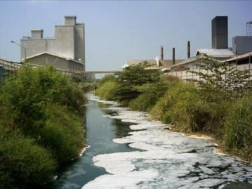
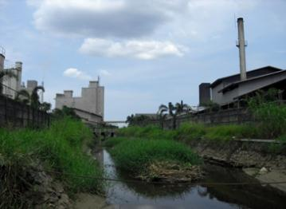
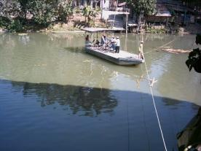
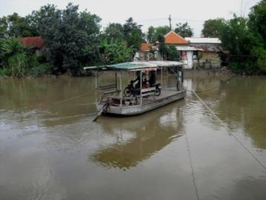
1. BRANTAS RIVER; Water Quality is Improving
TAJ PALACE, NEW DELHI | 12 – 14 SEPTEMBER 2016

Slide 5
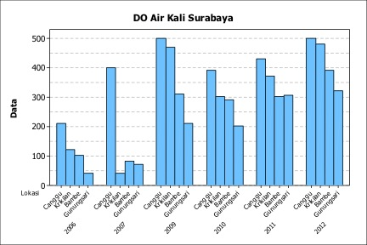
1. BRANTAS RIVER; Water Quality is Improving
TAJ PALACE, NEW DELHI | 12 – 14 SEPTEMBER 2016

Slide 6
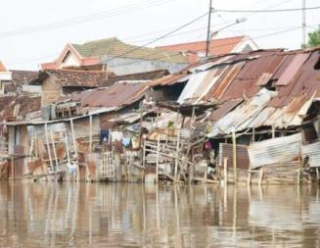
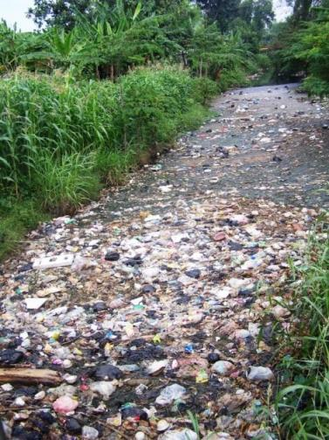
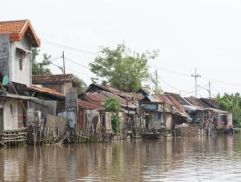
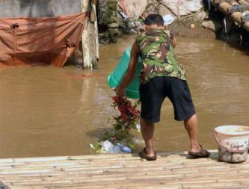
1. BRANTAS RIVER; Riparian Habitat is Degrading
TAJ PALACE, NEW DELHI | 12 – 14 SEPTEMBER 2016

Slide 7
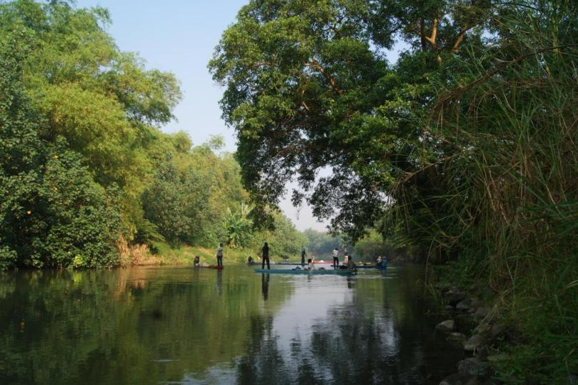
1. BRANTAS RIVER; Riparian Habitat is Degrading
TAJ PALACE, NEW DELHI | 12 – 14 SEPTEMBER 2016

Slide 8
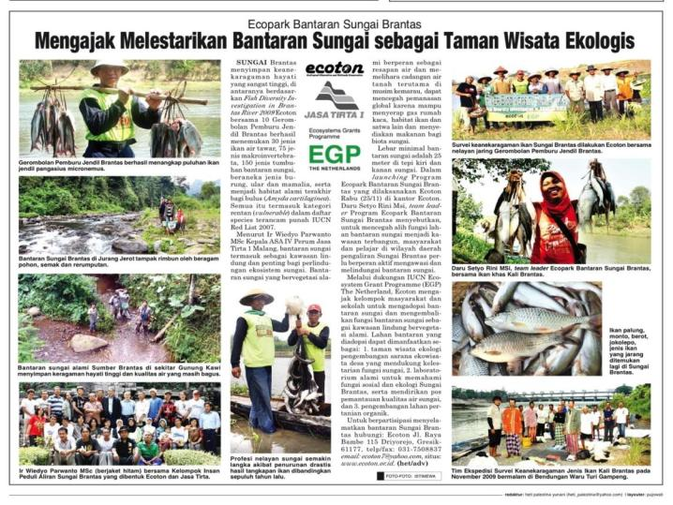
TAJ PALACE, NEW DELHI | 12 – 14 SEPTEMBER 2016
RIPARIAN HABITAT
CONSERVATION PROGRAM
was started in 2009 to preserve natural riparian area as native fish habitat and ecotourism parks or Riparian Ecoparks of Brantas River

Slide 9
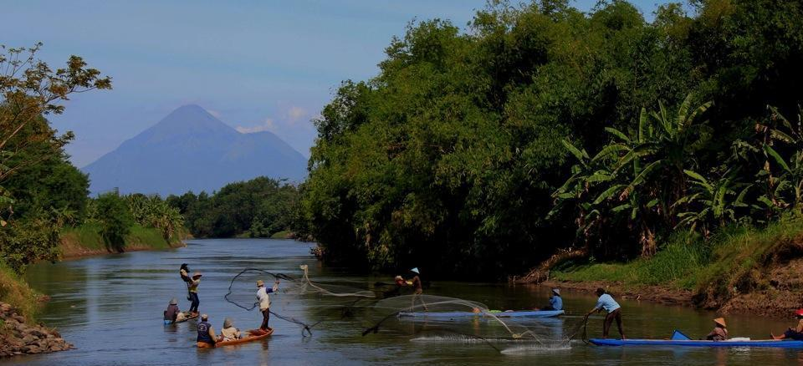
TAJ PALACE, NEW DELHI | 12 – 14 SEPTEMBER 2016

Slide 10
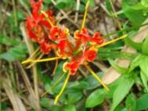
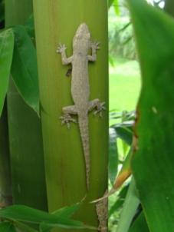
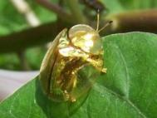
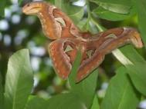
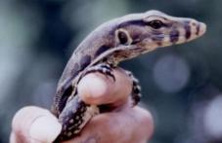
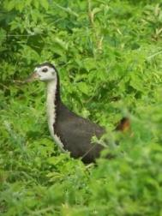
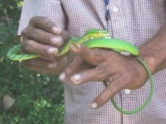
BIODIVERSITY
TAJ PALACE, NEW DELHI | 12 – 14 SEPTEMBER 2016

Slide 11
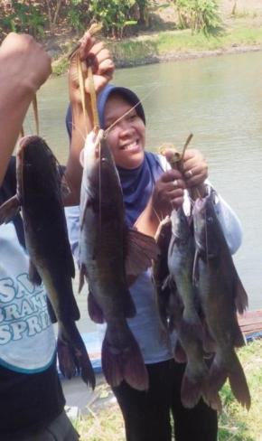
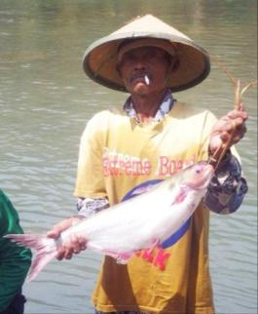
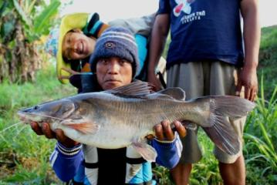
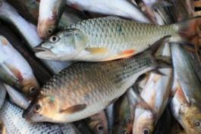
TAJ PALACE, NEW DELHI | 12 – 14 SEPTEMBER 2016
NATIVE FISH DIVERSITY

Slide 12
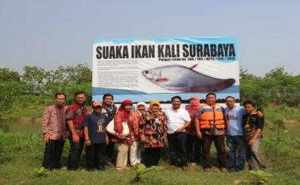
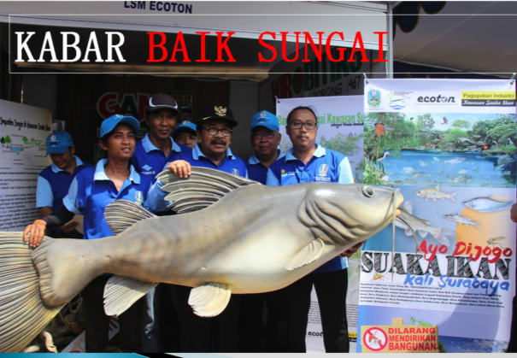
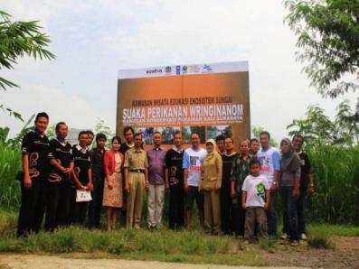
TAJ PALACE, NEW DELHI | 12 – 14 SEPTEMBER 2016

Slide 13
RIPARIAN HABITAT CONSERVATION
TAJ PALACE, NEW DELHI | 12 – 14 SEPTEMBER 2016
Riparian Area
Riparian Area
River
Channel
Land use regulation of river bank area in Indonesia

Slide 14
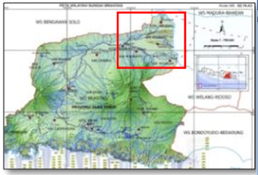
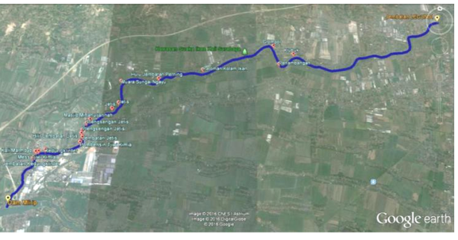
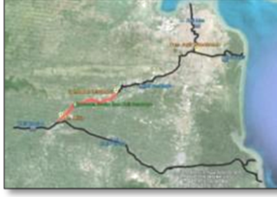
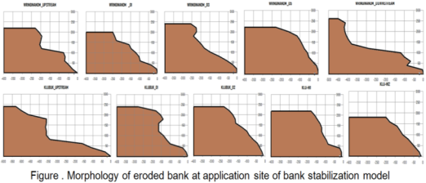
2. RIVER BANK EROSION IN SURABAYA RIVER
TAJ PALACE, NEW DELHI | 12 – 14 SEPTEMBER 2016

Slide 15
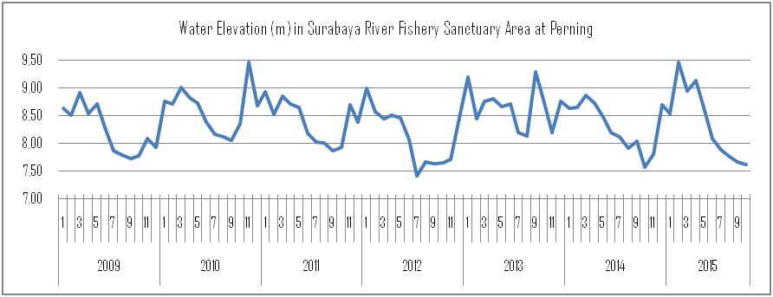
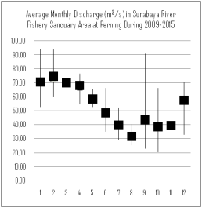
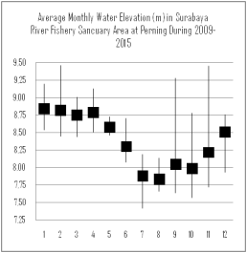
2. RIVER BANK EROSION IN SURABAYA RIVER
TAJ PALACE, NEW DELHI | 12 – 14 SEPTEMBER 2016

Slide 16
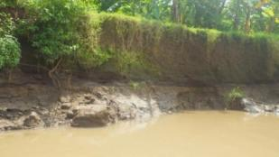
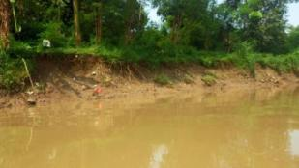
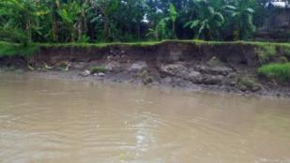
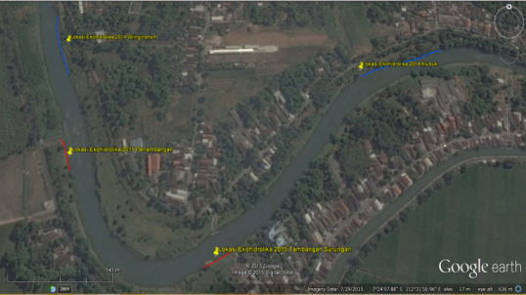
2. RIVER BANK EROSION IN SURABAYA RIVER
TAJ PALACE, NEW DELHI | 12 – 14 SEPTEMBER 2016

Slide 17
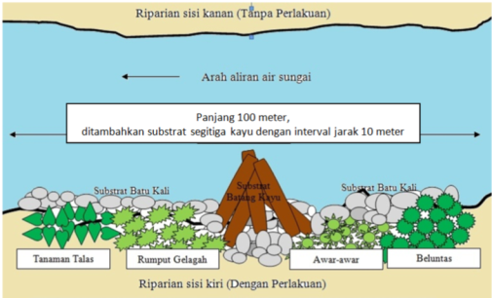
3. Application of Ecohydraulic Approach in River Bank Stabilization Model
TAJ PALACE, NEW DELHI | 12 – 14 SEPTEMBER 2016
Ecohydraulic approach was applied to construct a model of bank protection at two eroded sites in Wringinanom and Klubuk. The design was combination of reprofiled and revegetated bank with rock toe reinforcement, and addition of log spur dykes (Brisbane City Council, 2000; McCullah and Gray, 2005). Native plant species were planted to establish multistrata littoral vegetation structure.

Slide 18
3. Application of Ecohydraulic Approach in River Bank Stabilization Model
TAJ PALACE, NEW DELHI | 12 – 14 SEPTEMBER 2016

Slide 19
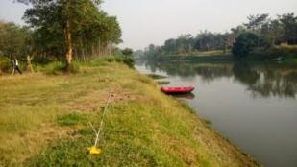
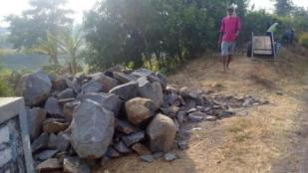
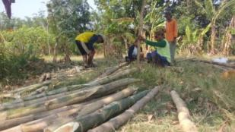
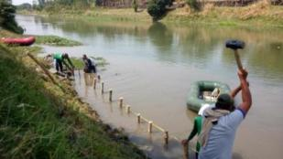
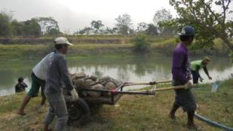
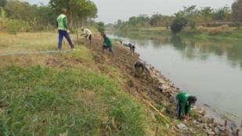
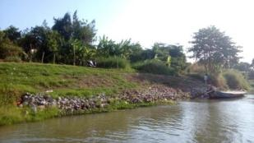
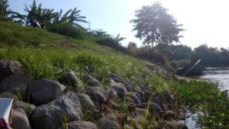
3. Application of Ecohydraulic Approach in River Bank Stabilization Model
TAJ PALACE, NEW DELHI | 12 – 14 SEPTEMBER 2016

Slide 20
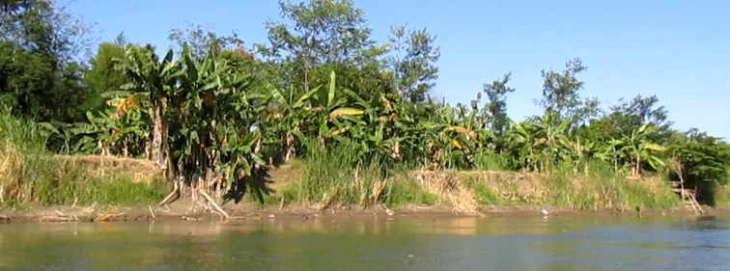
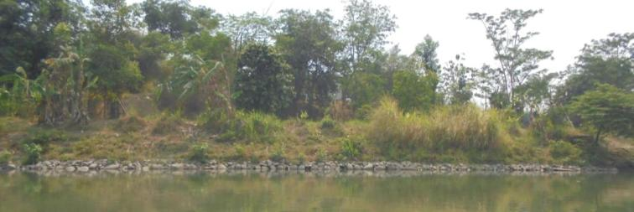
TAJ PALACE, NEW DELHI | 12 – 14 SEPTEMBER 2016
4. Impact on Stabilizing Eroded Bank Morphology

Slide 21
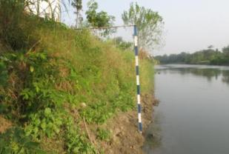
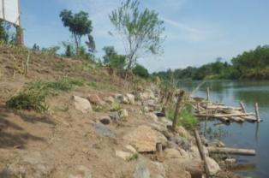
4. Impact on Stabilizing Eroded Bank Morphology
TAJ PALACE, NEW DELHI | 12 – 14 SEPTEMBER 2016

Slide 22
TAJ PALACE, NEW DELHI | 12 – 14 SEPTEMBER 2016
4. Impact on Stabilizing Eroded Bank Morphology

Slide 23
TAJ PALACE, NEW DELHI | 12 – 14 SEPTEMBER 2016
4.Impact on Stabilizing Eroded Bank Morphology

Slide 24
TAJ PALACE, NEW DELHI | 12 – 14 SEPTEMBER 2016
4.Impact on Stabilizing Eroded Bank Morphology

Slide 25
5. Impact on Native Fish Species
TAJ PALACE, NEW DELHI | 12 – 14 SEPTEMBER 2016
USULAN ZONA INTI
SUAKA IKAN

Slide 26
5. Impact on Native Fish Species
TAJ PALACE, NEW DELHI | 12 – 14 SEPTEMBER 2016

Slide 27
5. Impact on Native Fish Species
TAJ PALACE, NEW DELHI | 12 – 14 SEPTEMBER 2016

Slide 28
6. Conclusion
TAJ PALACE, NEW DELHI | 12 – 14 SEPTEMBER 2016
. The results suggest that bank stability at application sites in Wringinanom and Klubuk was improved. Bank reprofiling reduced bank steepness to less than 40 degrees and bank erosion was shift to bank sedimentation at both sites. The rock toe enforcement and log spur dykes reduce flow velocity at the bank base and reduce toe erosion.
The multistrata vegetation also reduce near-bank velocity that reduce bank erosion along the application sites. The tree species which grow well at application sites, that withstand to several days of inundation and months of long drought period, are Ficus glomerata, Bambusa sp., Ficus benjamina, Psidium guajava and Muntingia calabura.
The application of ecohydraulic model has created new habitat for native fishes. The juveniles of rare fish species bloso and berot were found to rest under the boulder and log spurs. The fish abundance in Wringinanom to Klubuk reach was increased 24% after a year application. The abundance of native fish Pangasius pangasius after the application was increased significantly in Wringinanom to Klubuk reach.

