Slide 1
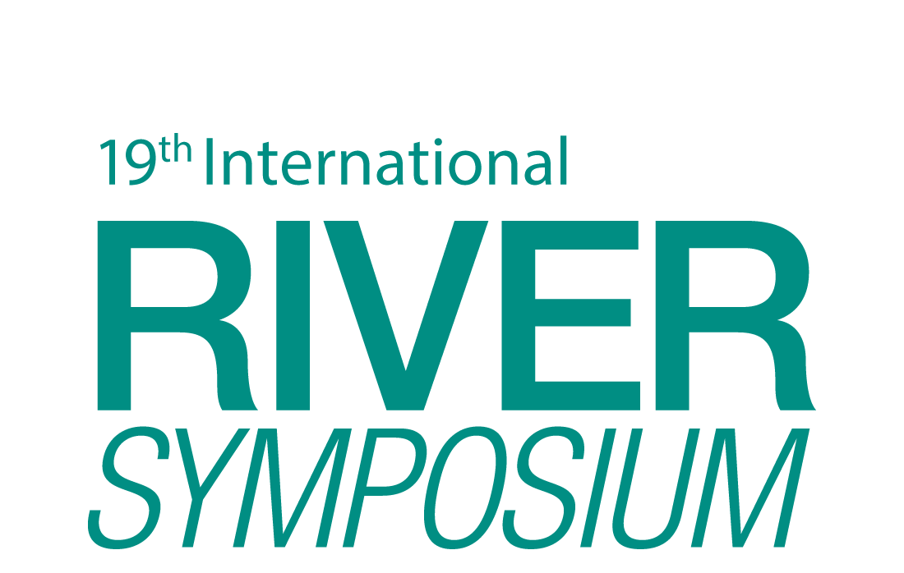
Multi-stakeholder Tributary approach to River Restoration
Insights from the field
TAJ PALACE, NEW DELHI | 12 – 14 SEPTEMBER 2016
Rajesh Ramamoorthy

Slide 2
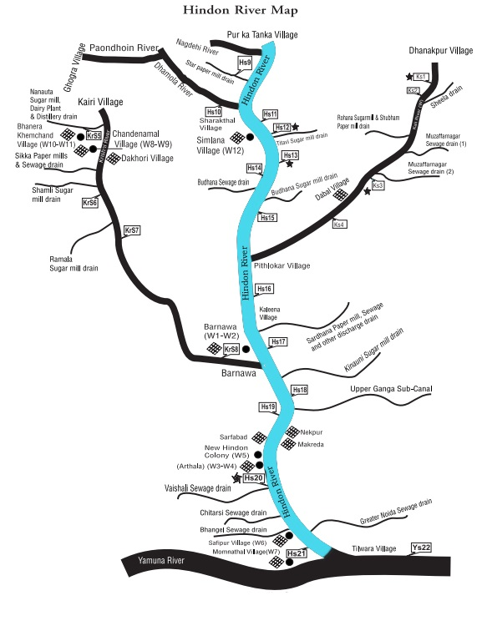
Hindon River, tributary of the Yamuna
300 kms
Flows in Western UP
2030 Water Resources Group pilot
Map Source :
Janhit Foundation

Slide 3
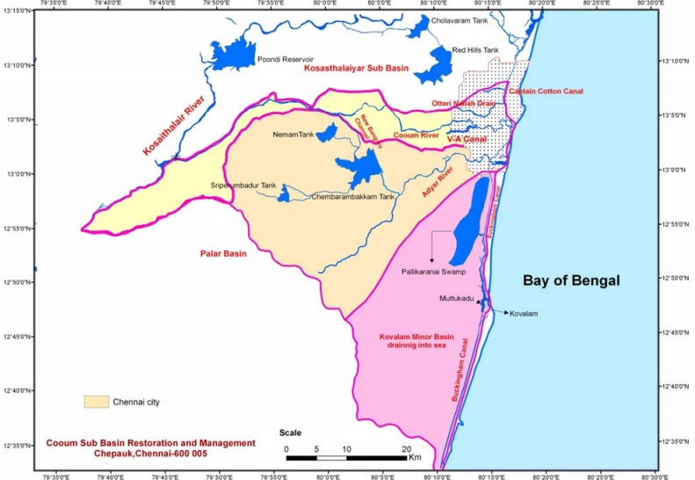
Adyar (42 kms) Cooum (72 kms) & Kosasthalaiyar (136 kms) Chennai and neighbouring districts of Kanchipuram & Thiruvallur
CSO movement Map Source: Cooum Sub Basin Restoration & Management

Slide 4
Establishing Multi-stakeholder groups at the local level
Trust is fundamental to establishing multi-stakeholder groups
Goal is common, approaches adopted may be different
Need to understand local dynamics and historical context
Important to stay non-partisan and spell out role clearly

Slide 5
Actors in the state of Uttar Pradesh
Nagar Nigam / Palika
Divisional Commissioner
Pollution Control Board
City Development Authority
District Magistrate
Jal Nigam
Local Academia
ADM - Finance & Revenue
Irrigation department
Local CSO / NGO / Farmers
ADM - Executive
Agriculture department
Industry / Industry associations
Forest department
MP / MLA
Urban / Rural Development
City level
District level
State level

Slide 6
Challenges
District / City administration - Decision making or Implementation bodies?
Enforcement of existing acts / policies
Lack of transparent and accurate data
Politics and Conflicts
How do you sustain groups in the long run?

Slide 7
Way forward
State leadership is key
Explore methods of engagement with government such as Steering committees at the District level, leverage contacts in Departments / Authorities
Local issues such as Solid Waste Management can be dealt with relatively easier
Short term objectives rather than ambitious targets
Strong Citizen’s movement / Local leadership
Employ legal route as necessary

Slide 8
Thank you for your attention
TAJ PALACE, NEW DELHI | 12 – 14 SEPTEMBER 2016
Rajesh Ramamoorthy
rajesh.ramamoorthy@gmail.com

