Slide 1


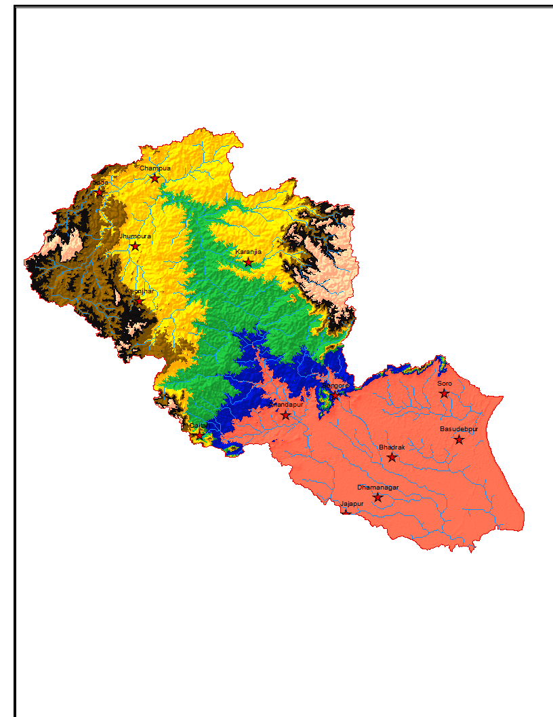

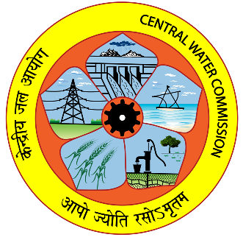
MODELLING OF BAITARANI SUB-BASIN
USING RIVER SYSTEM APPROACH THROUGH SOURCE SOFTWARE
BASIN PLANNING & MANAGEMENT ORGANISATION, CENTRAL WATER COMMISSION
MINISTRY OF WR,RD & GR
GOVERNMENT OF INDIA

Slide 2



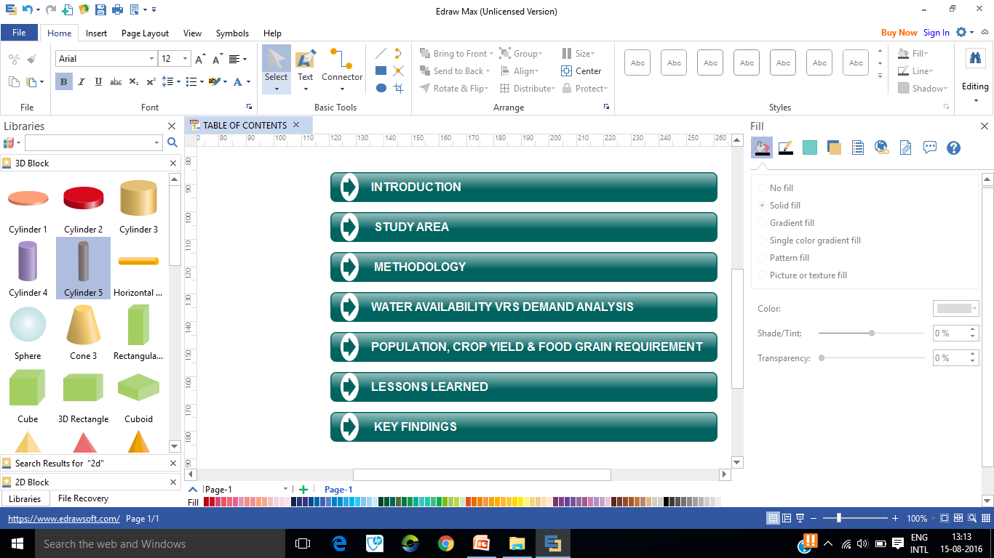

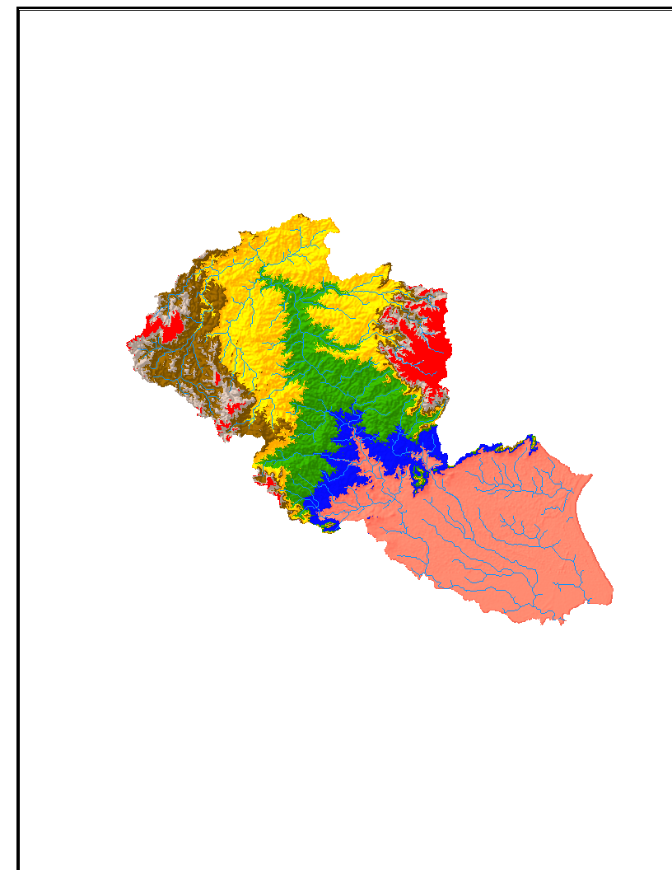
ELEVATION

Slide 3
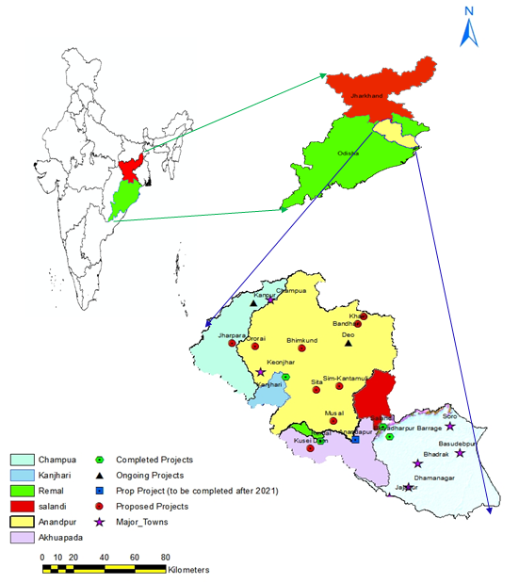
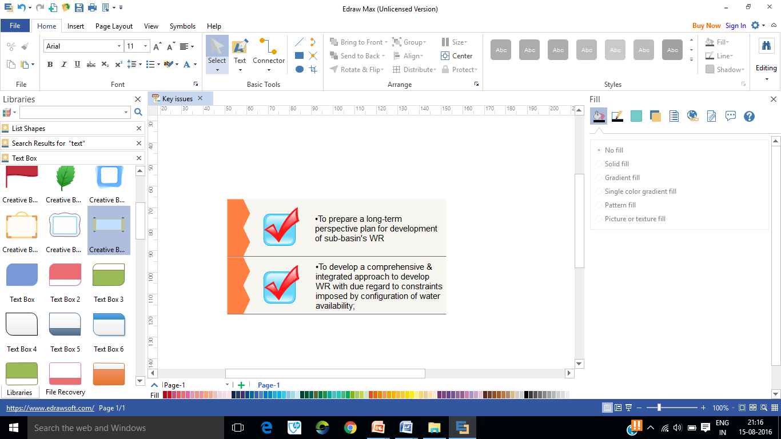
Total area: 14,218 km²
Odisha- 13,482 km² (94.83%),
Jharkhand- 736 km²(5.17%)
Modelled area of 6 sub-catchments 10,363 km²
15% Urban population
Objectives

Slide 4
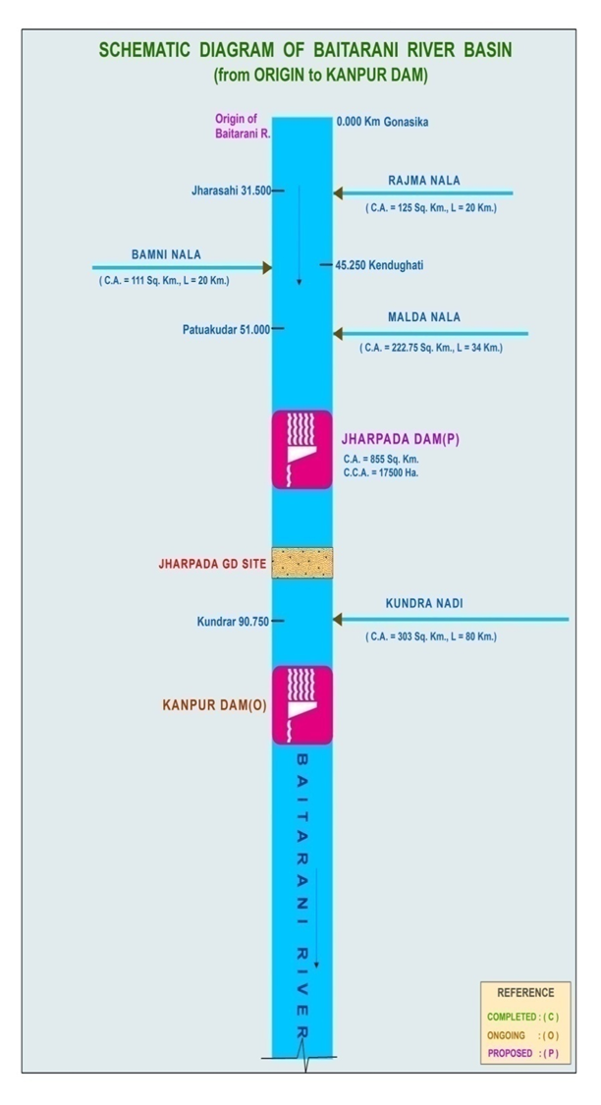
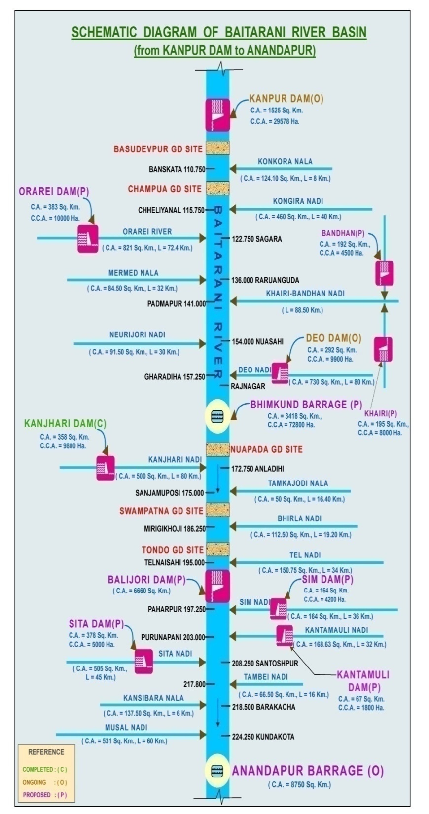
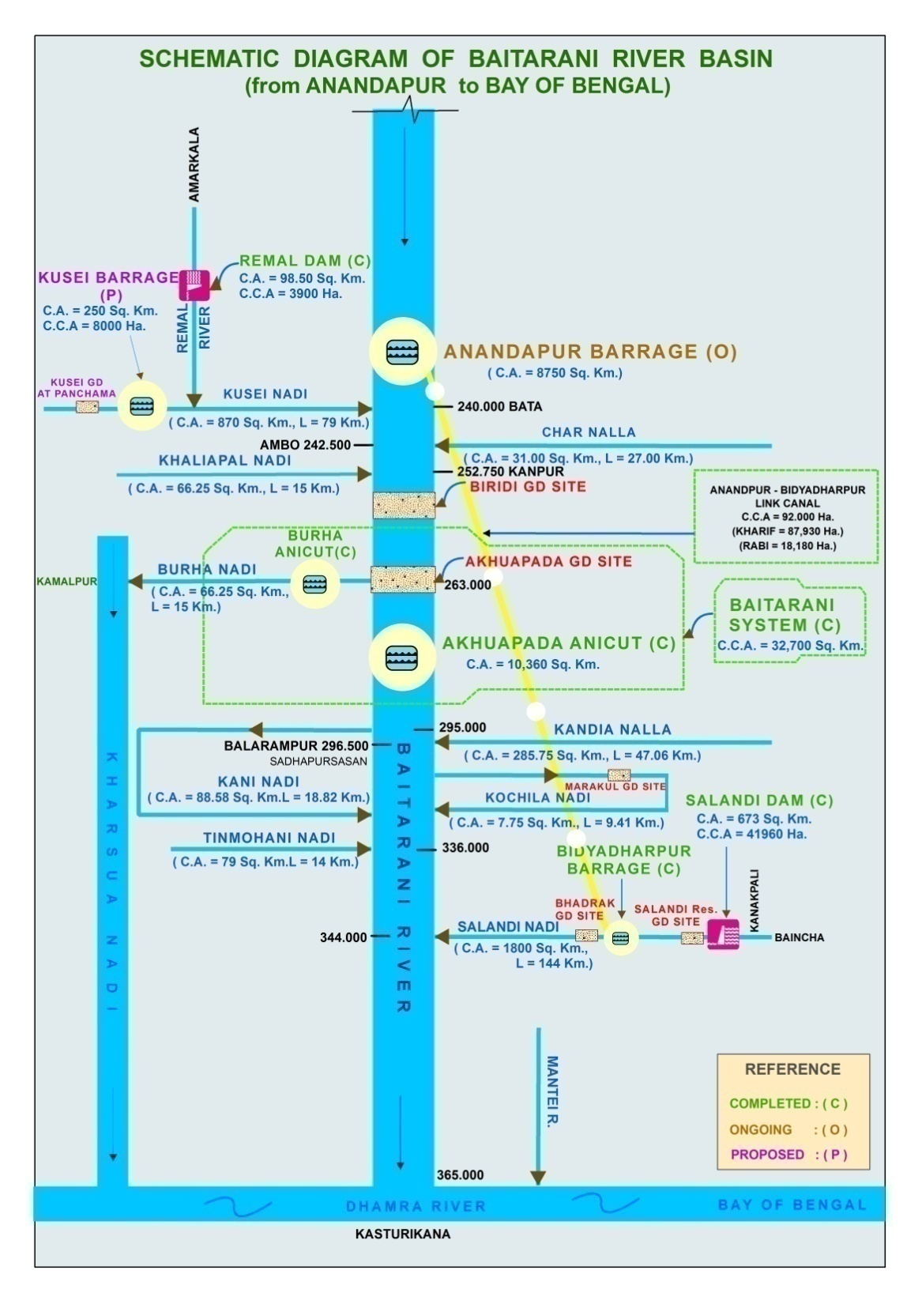

Slide 5

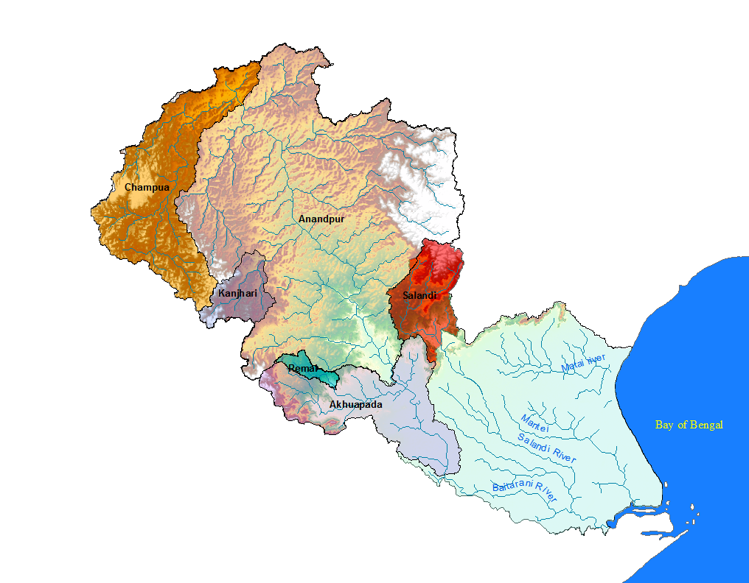
















Multiple Issues of Multiple Stakeholders
Baitarani Sub-Basin
WUA/ Farmers
Water Scarcity
GW Management
Water Pollution
(Waste Dumps, Industries,
Domestic, Fertilizer/Pesticide)
Lift/Canal/GW Irrigated Agriculture
Competing Water Uses
Water Res Dept
Agriculture Dept
Forest Dept
Industry/Mining Dept
Livestock & Fisheries Dept
Env. dept
Urban & Rural Water Supply & Sewerage
Water Harvesting
Catchment Degradation

Slide 6
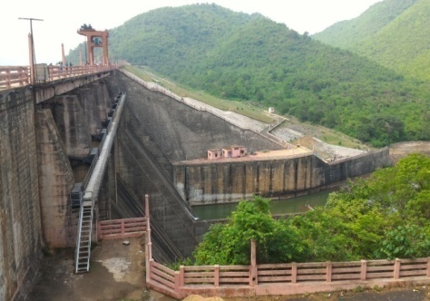
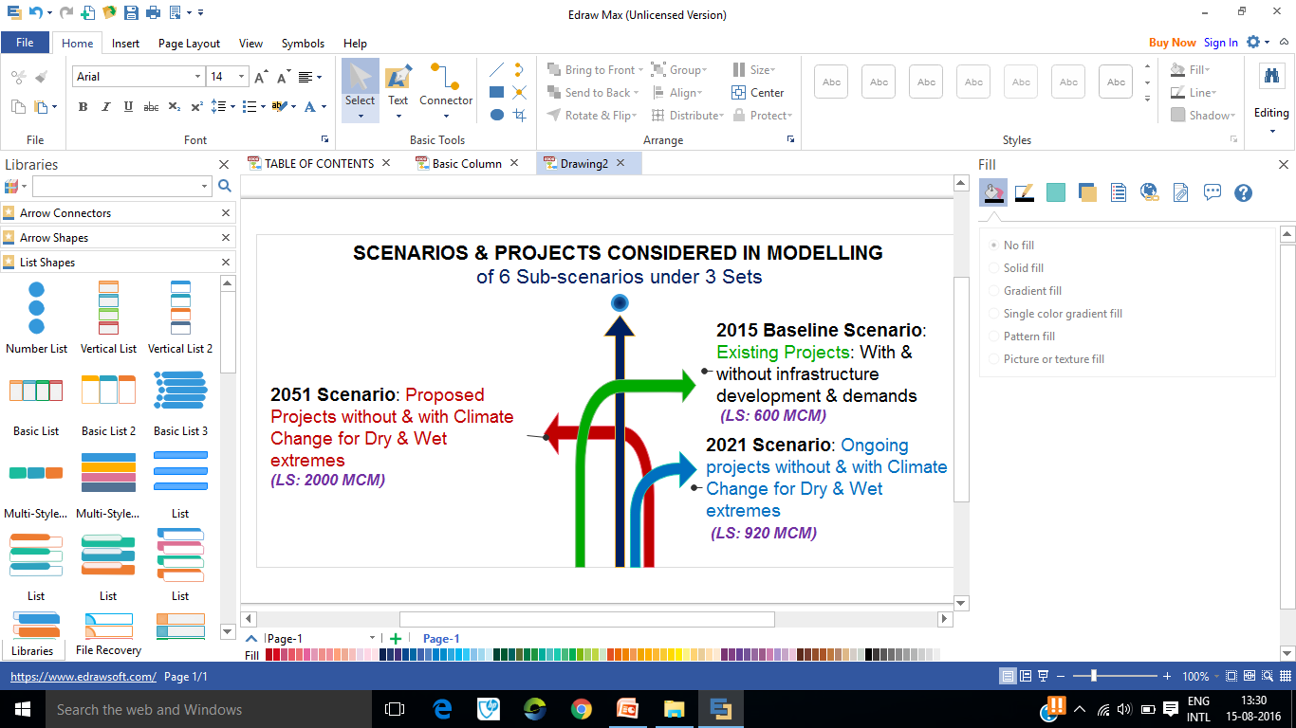
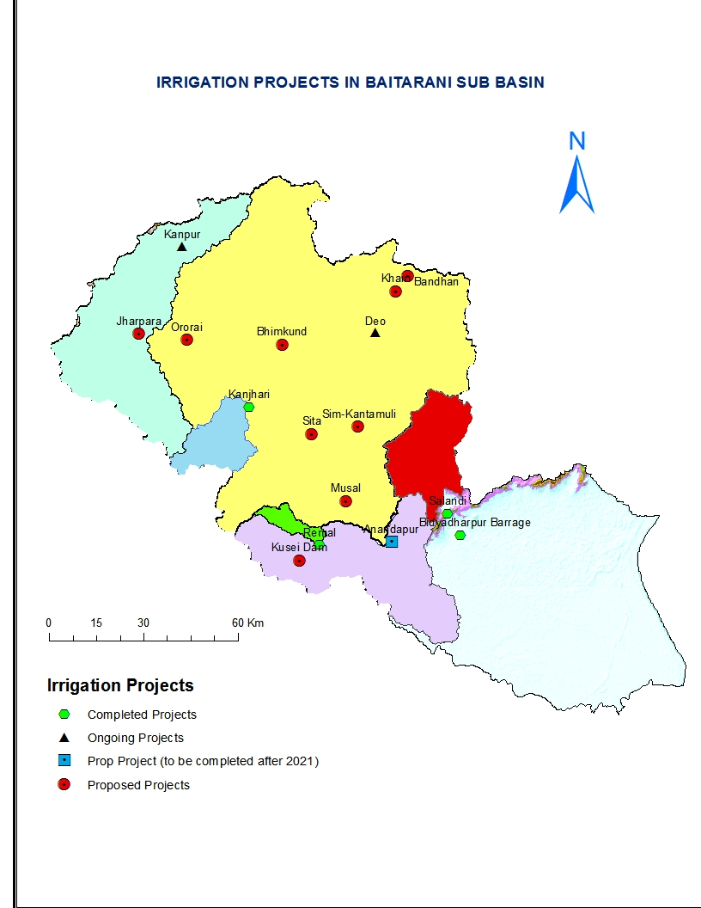
E_Flow:
20% in Monsoon(Jun-Oct), 25% in Non-Monsoon(Nov-Feb), 30% in Lean(Mar-May)
Total annual = 1158 MCM
(% of Average flow)

Slide 7
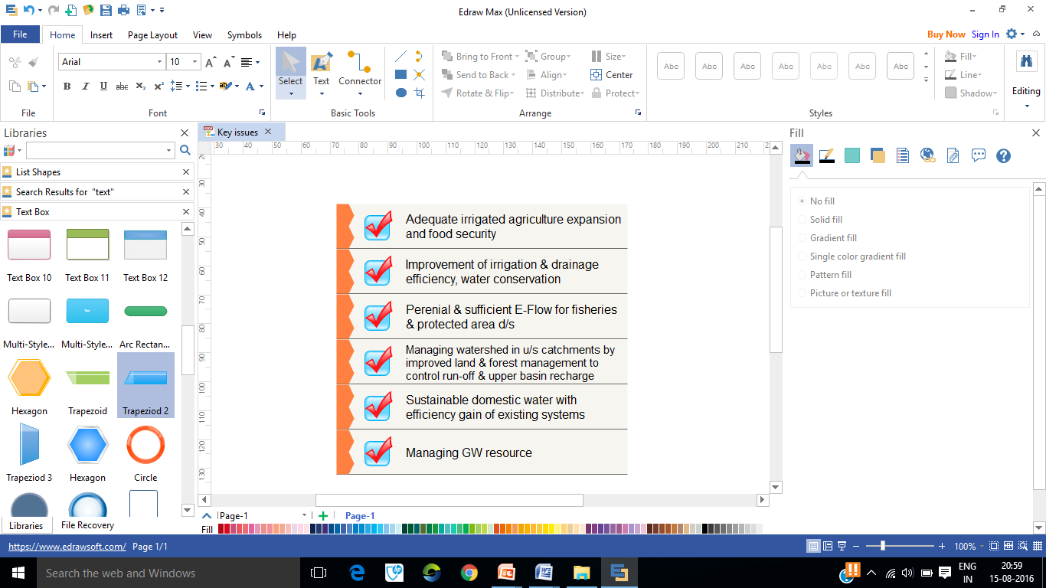
Irrigation in Major, Medium, Minor & Lift Irrg Projects
& Rainfed areas
Key issues

Slide 8
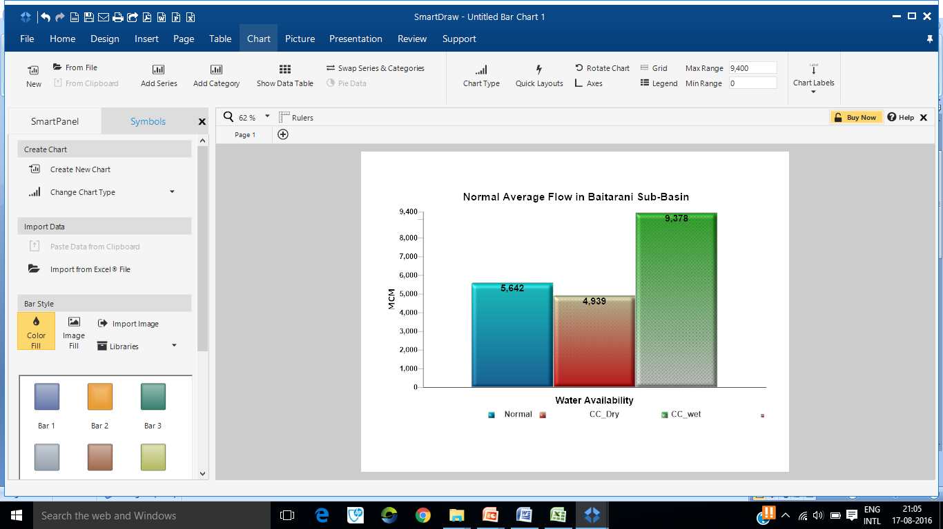
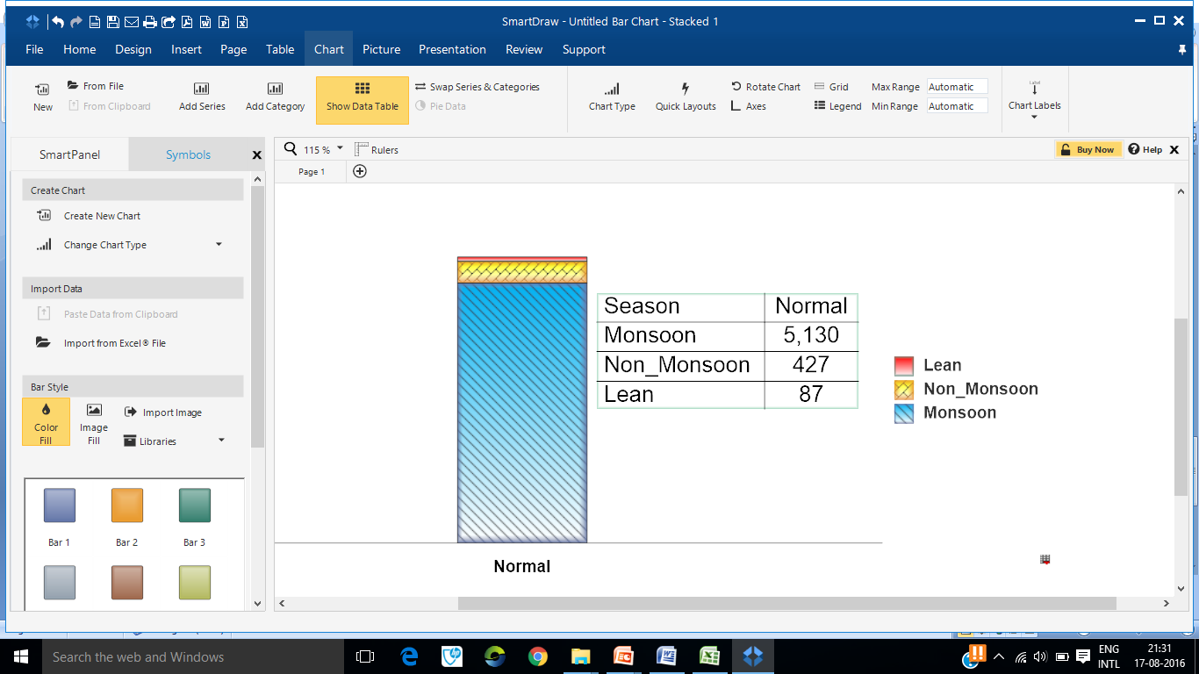
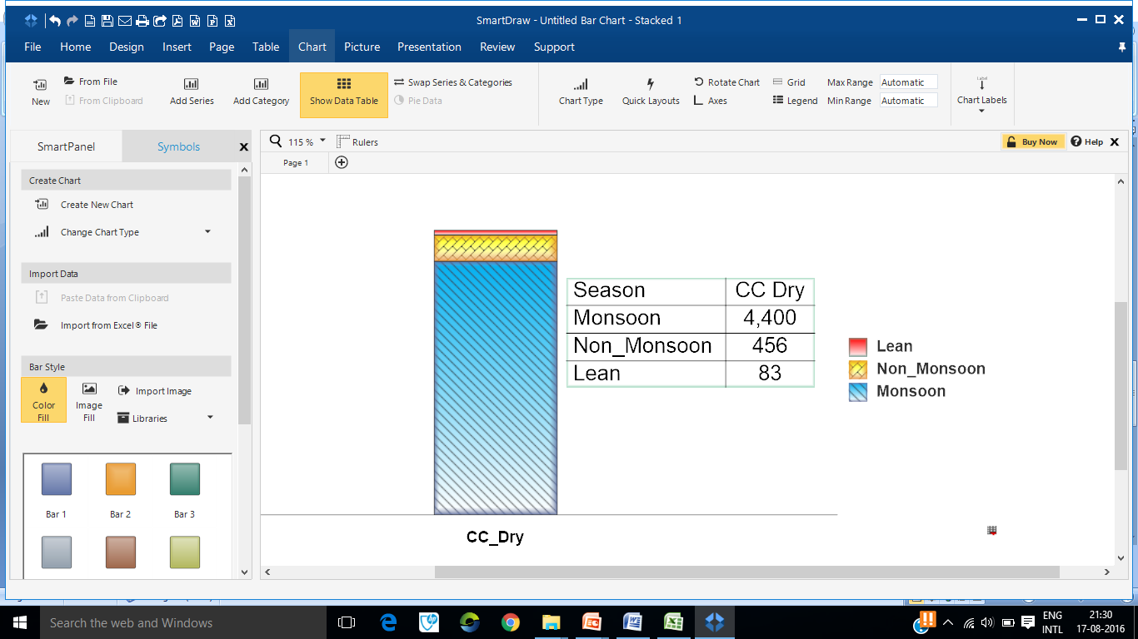

Slide 9
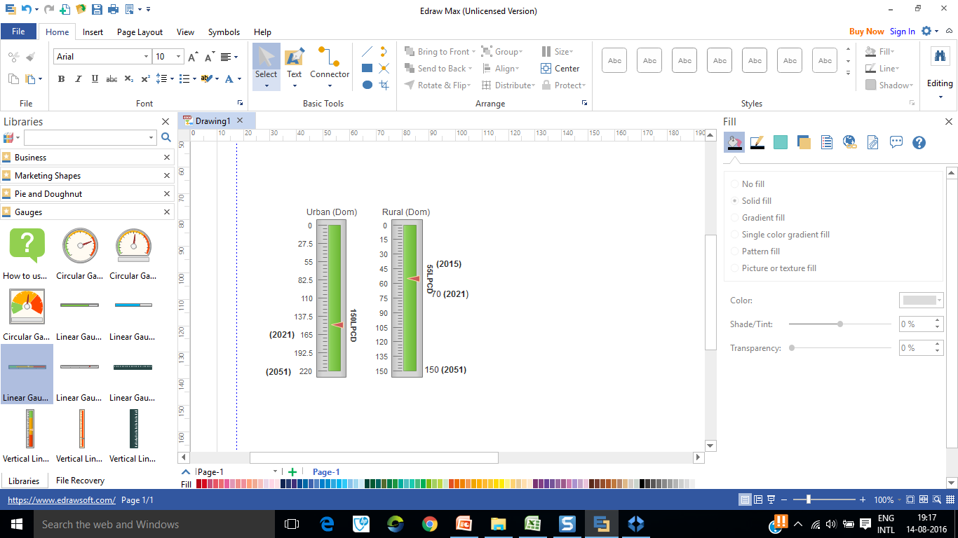
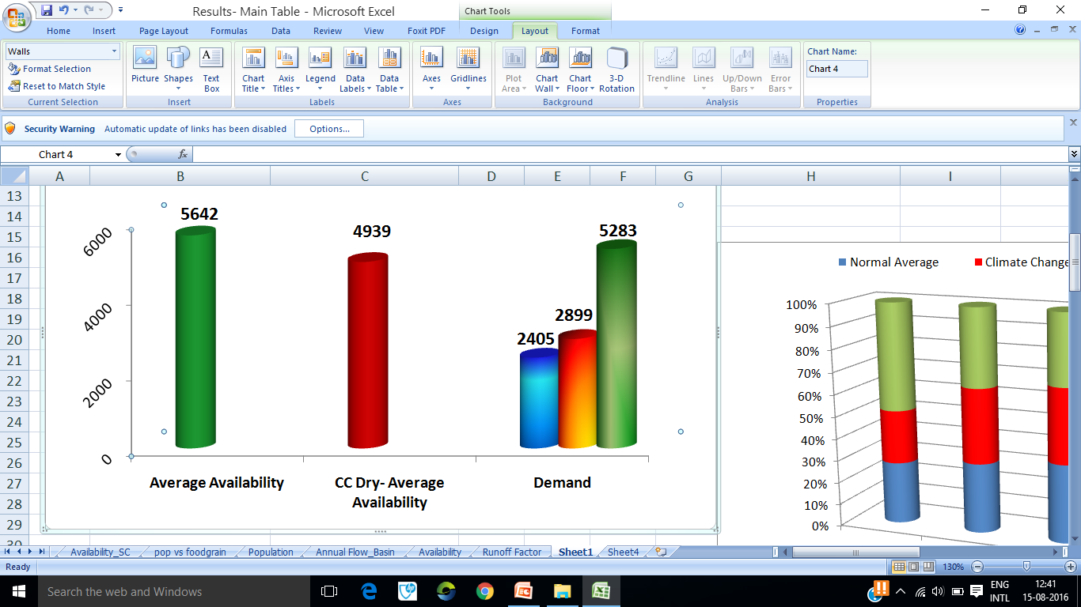
Water Availability vrs demand (MCM) in sub-basin
Demand

Slide 10
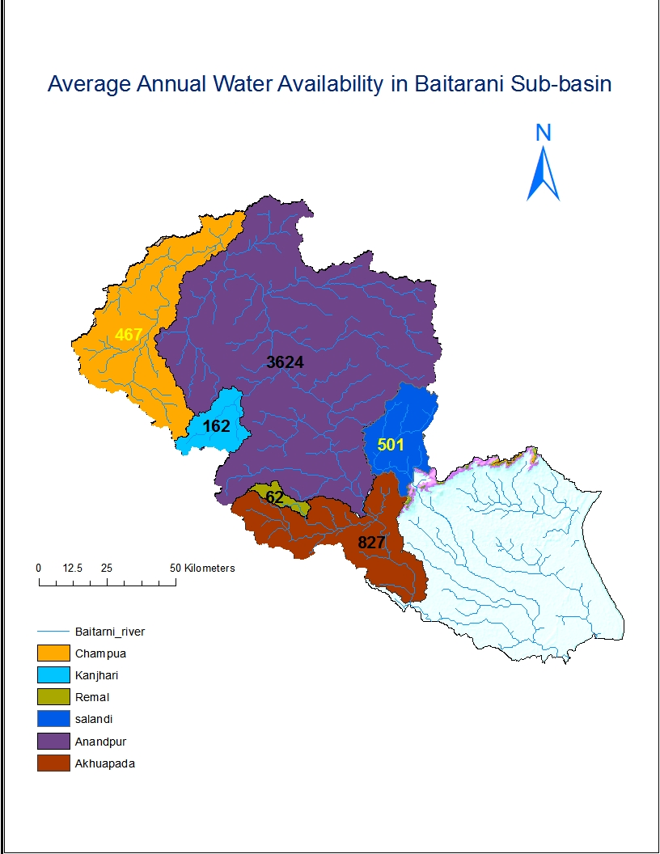
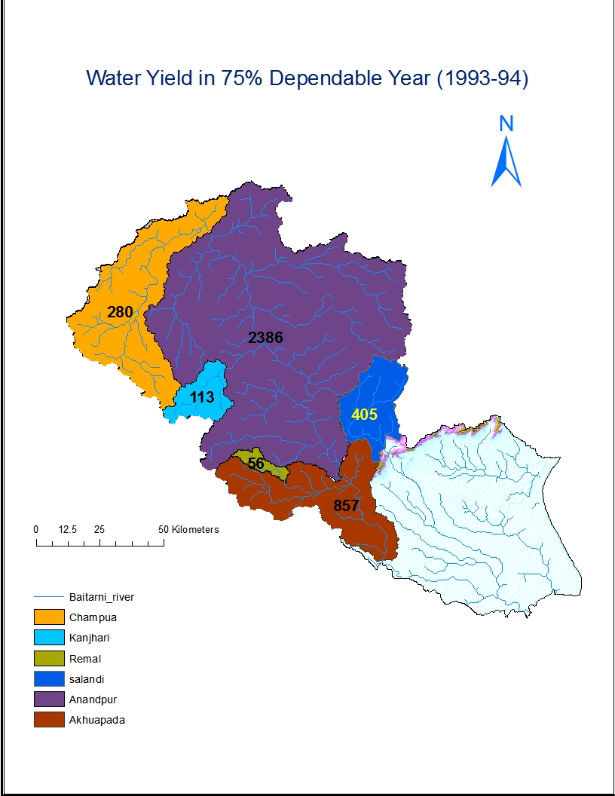
Average Annual SW availability & in 75% dependable year

Slide 13
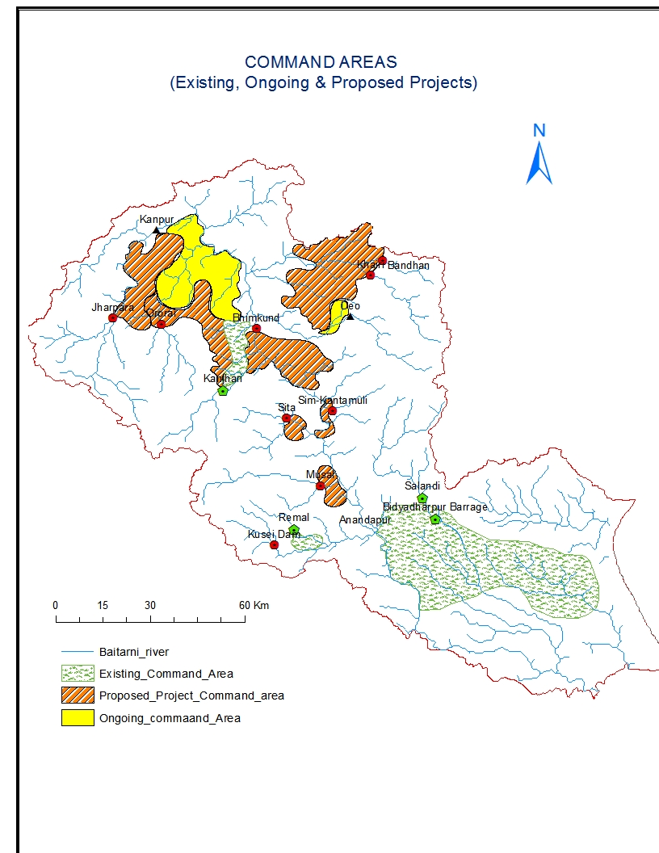
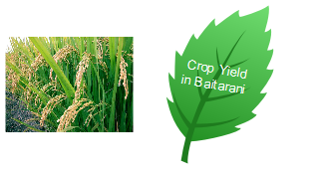
Command Areas – Existing, Ongoing, Proposed Major & Medium Projects
313 Th Ha
(2051)
144 Th Ha (2021)
110 Th Ha (2015)

Slide 14
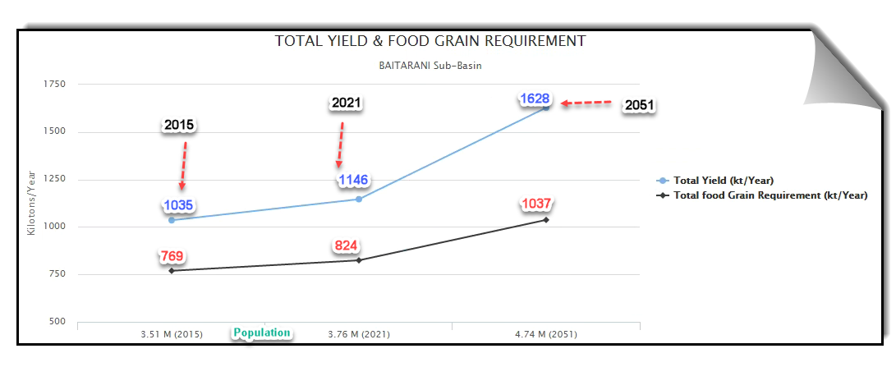

Slide 15
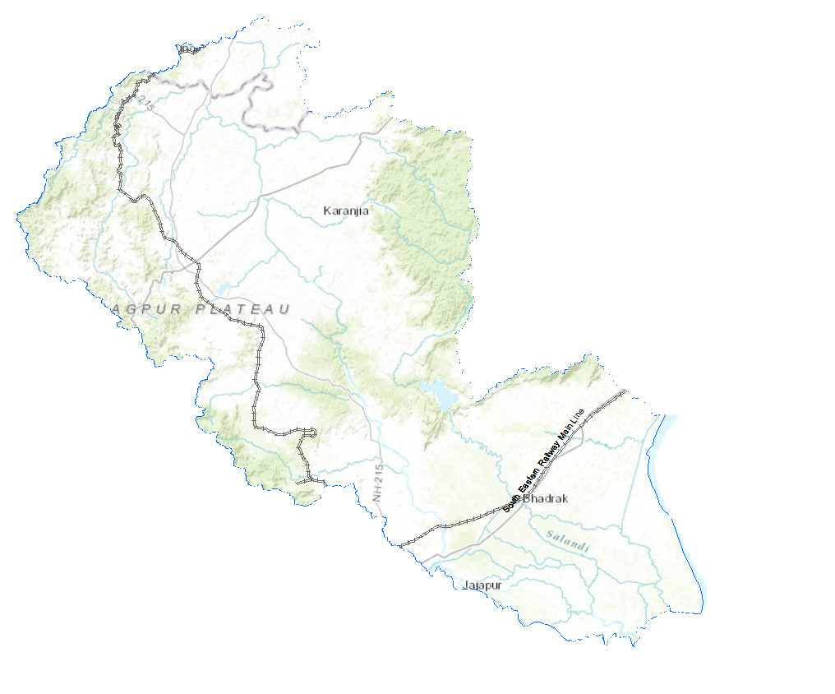
Key Findings
Proposed projects will even out flooding in monsoon & drying of river in lean season due to spatio-temporal variation of RF & increase the utilisability of water in the sub-basin
Coming up of large no of industries would create water stress in Upper parts of sub-basin (Champua) in 2051 as total water use (606 MCM) overrides average availability (467 MCM). The water stress enhances further in Dry_CC scenario as water availability reduces to 412 MCM.
Sound water budgeting for industry, agriculture in especially Champua, Anandpur and Akhuapada sub-catchments can trade-off water demand to a considerable extent.
Under climate change, wet years are expected to be wetter & dry years are expected to become drier. In order to combat the challenges of possible climate change effects on water resources availability, ET and crop productivity, it is suggested to speed-up the creation of new water storage mechanism. So, there is need to store water available in wet years in appropriate sized storages, including groundwater for later use in drier months.
E-Flows need to be determined in various reaches based on the evidence-based EIA studies.

Slide 16
Key Findings……
After development in 2051, sub-basin is expected to have water surplus of about 1250 MCM
Under CC_Dry scenario (2051), if about 1000 MCM is met from GW & 10% enhancement of irrigation WUE may alleviate shortages
Lessons learned
Water productivity remain very low due to lack of maintenance of the infrastructure, inappropriate delivery services & users low awareness leading to substantial wastage

Slide 17



