Slide 1
How can learning be enhanced in water policy, governance and institutions? Jess Schoeman PhD Candidate Charles Sturt University Albury, New South Wales, Australia Supervised by Dr. Catherine Allan and Prof. Max Finlayson
TAJ PALACE, NEW DELHI | 12 – 14 SEPTEMBER 2016
Notes:
Good afternoon.
My name is Jess, and I’m here to tell you about part of my phd research, which explored the social and institutional dimensions of learning in water governance.
I undertook this research in the Murray-Darling Basin, Australia over the last few years, and I’m very excited to share some of my findings with you today.

Slide 2
What if we assumed that learning is as much a part of our human nature as eating or sleeping, that it is both life-sustaining and inevitable, and that - given a chance - we are quite good at it?
Etienne Wenger (1998, p. 3)
Notes:
I was inspired to pursue this research based on this apparent paradox in human nature: if we do have this deeply ingrained, innate ability to learn and adapt, as described by Wenger in this quote, why are we often so bad at acting collectively to solve our water problems? And why do people often have such vastly different views of reality when presented with the same information?

Slide 3
July 2013: Moon Moon Swamp off the Lachlan River: environmental flow at approximately peak level
Photo: Paul Packard
Notes:
Today I want to share a story about something amazing that happened in Australia which I understand as a successful example of learning and collective action.
What you are looking at in this picture is a human-made flood generated with environmental water, which was purchased from irrigators in the catchment. This was the first time a flow of this magnitude had been achieved in the Lachlan in 2013.
The environmental flow involved the release of 90 000 ML of water, mostly owned by the Commonwealth government, with some owned by the State Government. To put this in perspective that amounts to 36 000 Olympic swimming pools of water that was released from storage.
This water contributed to improving the ecological condition of around 620 km of the river system, including wetlands in the lower Lachlan with large stands of iconic river red gums and nationally important bird breeding sites.
Total: 90 000 ML = 36 000 Olympic pools
1 ML = 1 million litres of water
2.5 Megalitres to fill an Olympic pool

Slide 4
We put the water down and got a better result than we expected. No one complained. No one was disadvantaged. The environment got what it needed…
That was the biggest success… being able to put the water down, but that’s only an indicator of the actual big achievement, which was the social acceptance that it was worth doing. (Environmental water manager, 2014)
Photo: Paul Packard
Notes:
This is a quote from an environmental water manger, pointing out that this flow was really an indicator of a much greater success, which was achieving a level of social learning and acceptance that this was worth doing.

Slide 5
Research process
Single, in-depth case study: qualitative data creation
Semi-structured stakeholder interviews (n=19)
Content analysis of key water legislation and policy (n=190)
In-depth analysis using adaptive governance framework
Thesis
Notes:
My presentation today is based on two major sources of information: interviews and document analysis.
I completed a series of interviews in 2013 and 14 with farmers, water and catchment managers and policy-makers from local, regional, state and Commonwealth levels of governance to investigate how the institutional arrangements were influencing learning through adaptive management.

Slide 6
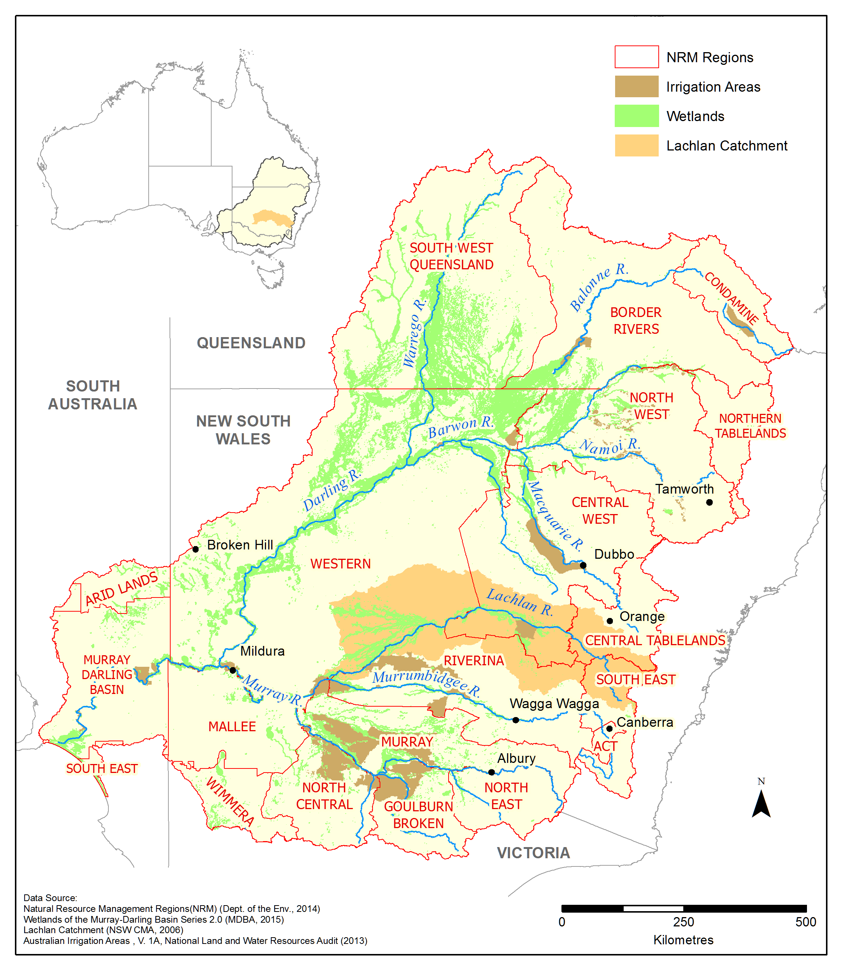
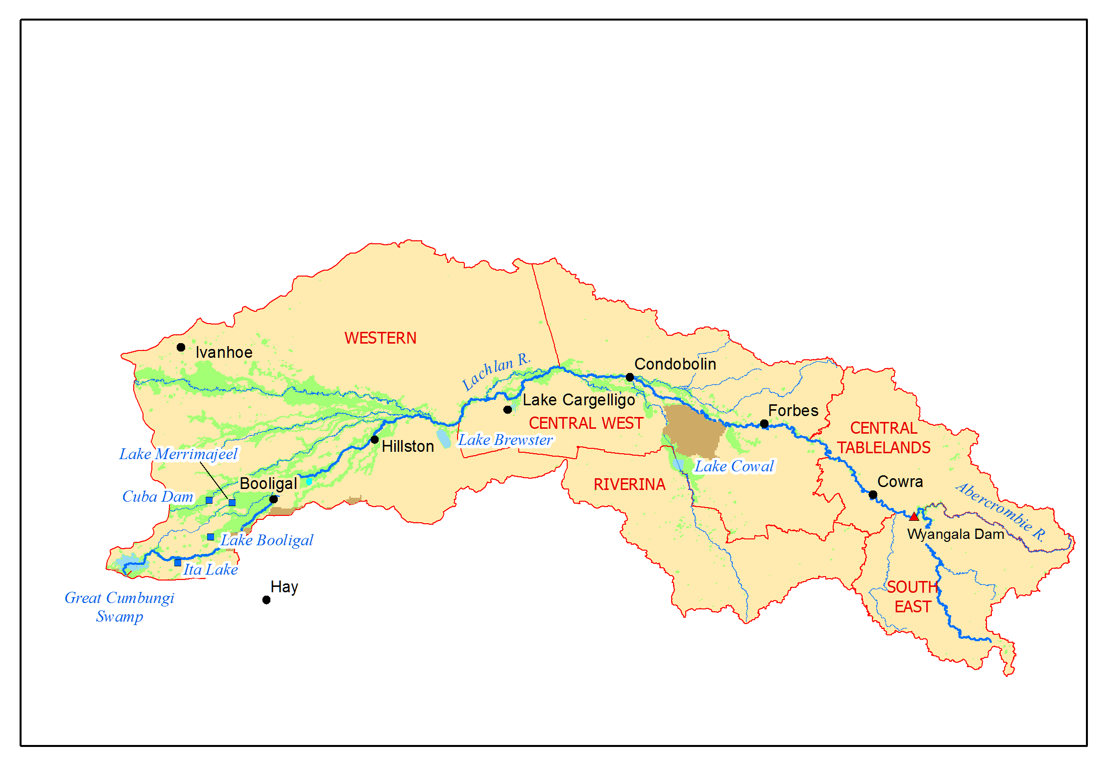
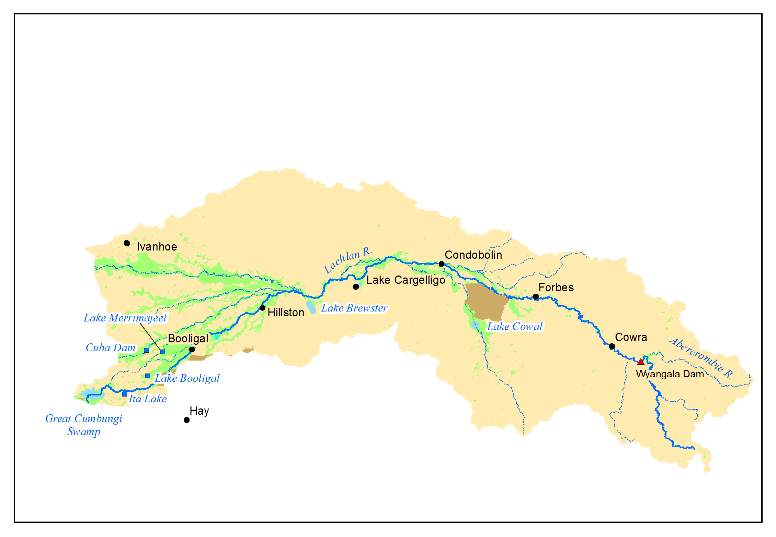
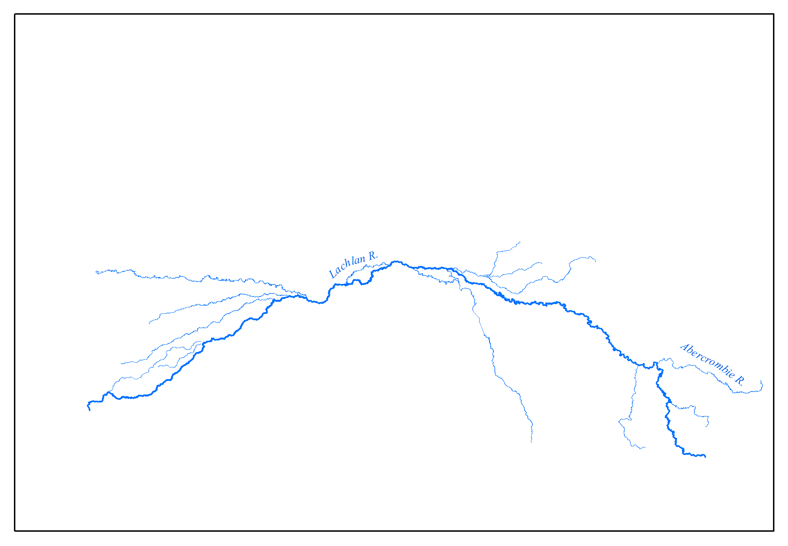
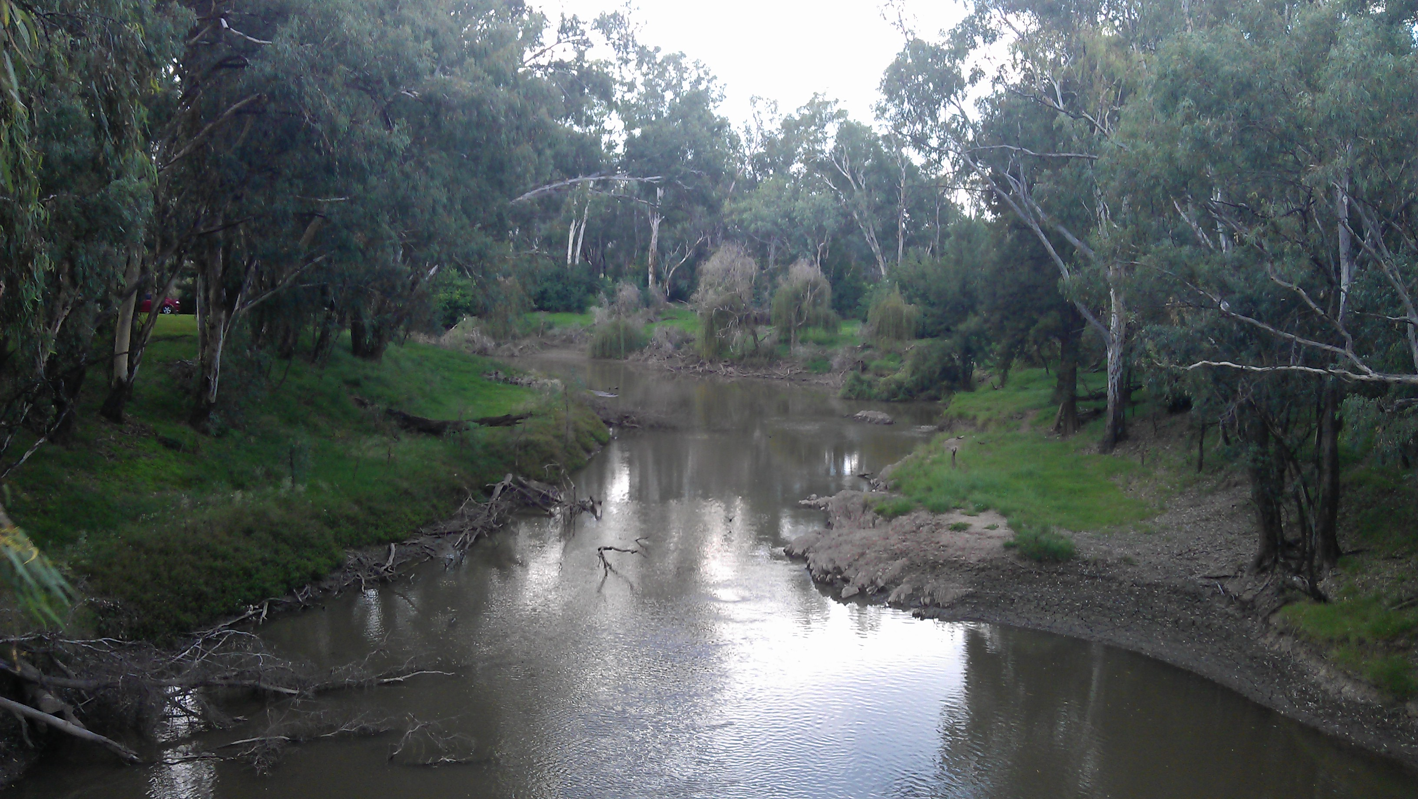
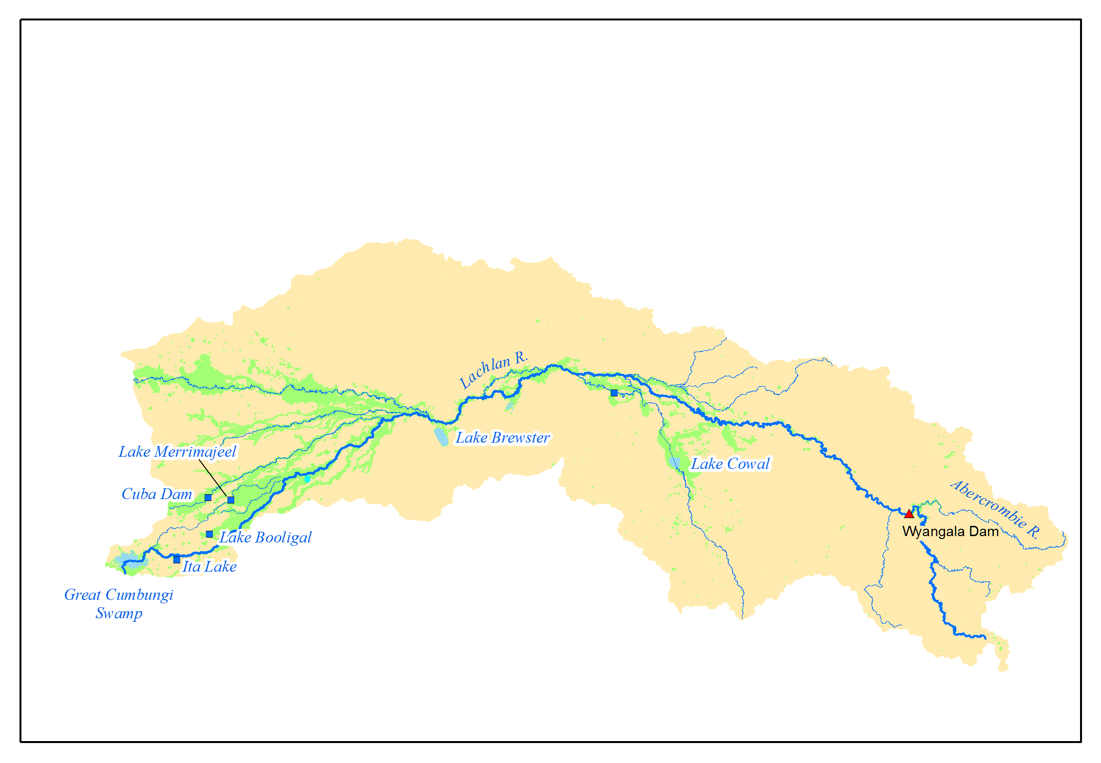
Complex institutional arrangements
Notes:
Nested Water Governance levels:
Commonwealth
Basin
State
Region
Local

Slide 7
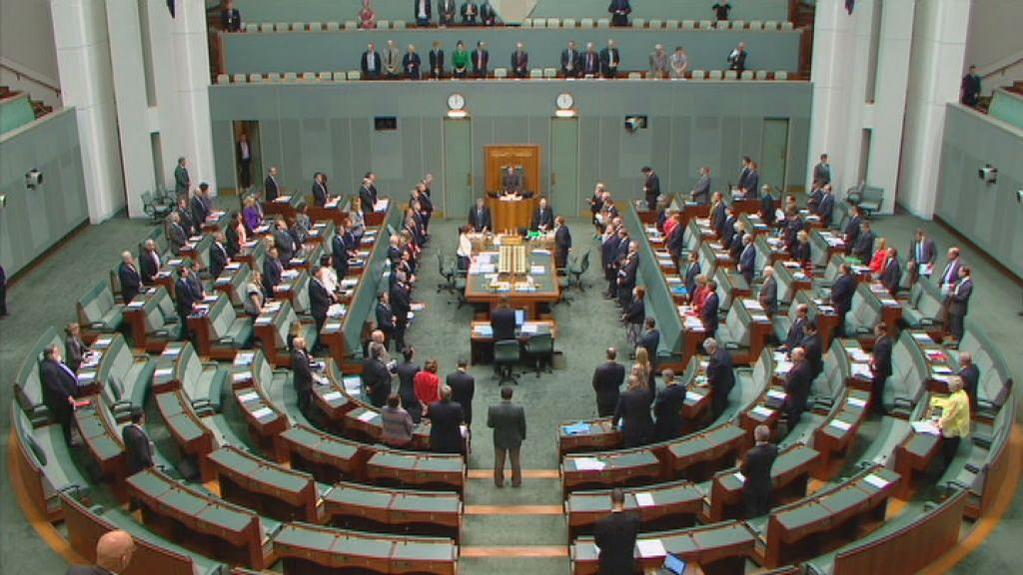
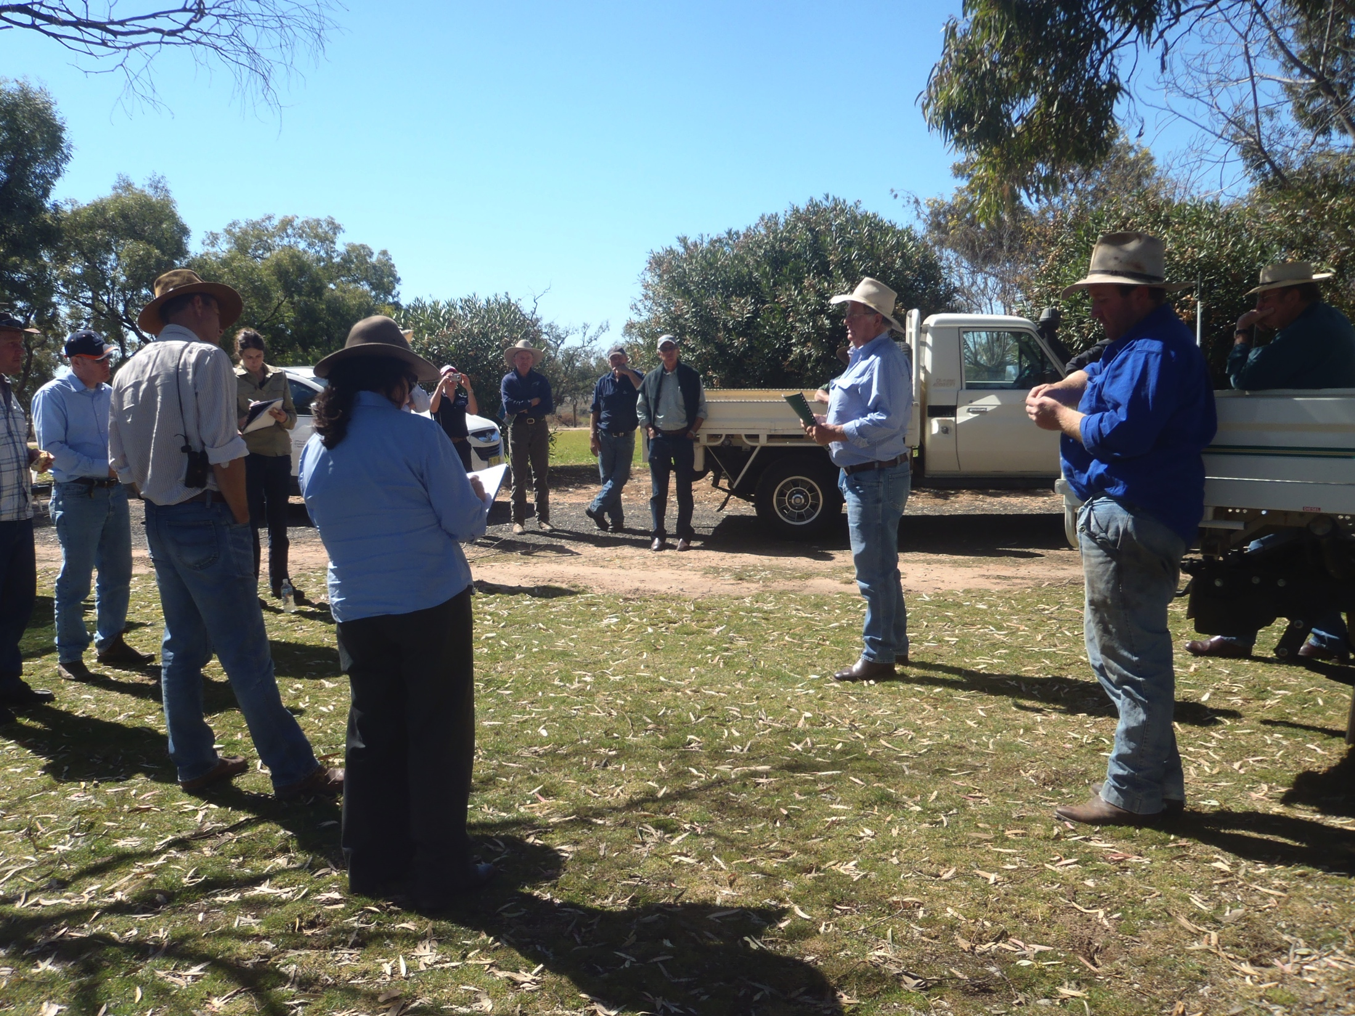
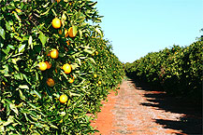
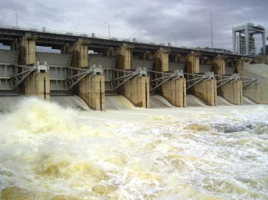
Managing water is a “wicked” collective action problem
Shifting understanding of the problem
Multiple drivers of change, perspectives, values and objectives
Complex social-ecological interactions
High levels of uncertainty and ambiguity
Ultimately no optimal, permanent solution

Slide 8
“Bones of contention” between stakeholders
Whether or not the Lachlan is over-used; the volume of water that should be set aside for the environment
How to prepare for future droughts
Whether changes in ecological condition are primarily due to human activities, or “natural” fluctuations in climate
The accuracy of rural media reporting on the third-party impacts of water buy-backs
Notes:
Just to illustrate the “wickedness” of this situation, within the Lachlan catchment, water stakeholders have quite divergent understandings of the problem and perspectives about what should be done
In a case where local knowledge and scientific knowledge are in conflict, landholders will question the credibility of the science, and scientists will dismiss landholders as “uninformed”

Slide 9
Water was purchased as a feel-good political exercise, and we don’t have much faith in a lot of the environmental science that’s behind it.
There’s a lot of argument with the science, and when they did the Sustainable Rivers Audit it was in the middle of the drought and they said the Lachlan was a disaster case because there was no fish. Well of course it was a bloody disaster, they took it in the middle of a drought! [Landholder, 2014]

Slide 10
Collective Action Theory
Hardin (1968) : “Tragedy of the commons” | Ostrom (1990, 2005): Self-organisation of resource users
Problems of over-exploitation will not be solved unless an external authority determines appropriate actions to be taken, monitors behaviour and imposes sanctions Governance response: Centralized governmental control and private property | Local resource users often come up with complex social arrangements to avoid over-exploitation when individuals are well-informed about the problem, know who else is involved, and if trust and reciprocity can develop Governance response: Foster self-organisation, intrinsic motivation and adaptive governance
Notes:
Imposing external solutions erodes intrinsic motivation of local users to solve their own problems
locals have often come up with solutions to the commons problem themselves.^{[40]} For example, it was found that a commons in the Swiss Alps has been run by a collective of farmers there to their mutual and individual benefit since 1517, in spite of the farmers also having access to their own farmland. In general, it is in the users of a commons interests to keep the common running and complex social schemes are often invented by the users for maintaining them at optimum efficiency.^{[3][4]}

Slide 11
Principles of Adaptive Governance
Iterative learning
Generating, processing and applying knowledge through adaptive management
Flexibility – Stability
Willingness and capacity to adjust to changing conditions and new information, balanced with stability
Connectivity
Connections and networks across sectors and scales for mobilisation, cooperation and collaboration
Subsidiarity
Implementation of policies and provisions at lowest or most suitable level
(adapted from Clarvis et al. 2014)

Slide 12
Social learning
Convergence of goals and knowledge. Trusting and respectful relationships. Agreement on concerted action.
Co-creation of knowledge, group framing of problems and solutions.
Mutual understanding of issues, shared actions, change in behaviours and norms.
(Blackmore, 2007)
Notes:
Start with your thesis statement/ argument upfront
Never use less than 24 point font. If you use smaller font, people will not be able to see your information and you will have too much information on the slide.
Use bullet points. PowerPoint slides do not need full sentences, and should never have a paragraph full of information.
Use images effectively. You should have as little text as possible on the slide. One way to accomplish this is to have images on each slide, accompanied by a small amount of text.
Never put your presentation on the slides and read from the slides.
Do not have too many slides. Definitely do not have more than one slide per minute of presentation.
If you are giving a 15-minute presentation, by the 6th minute, you need to be discussing your data or case study.
Introduction/Overview/Hook
Theoretical Framework/Research Question
Methodology/Case Selection
Background/Literature Review
Discussion of Data/Results
Analysis
Conclusion

Slide 13
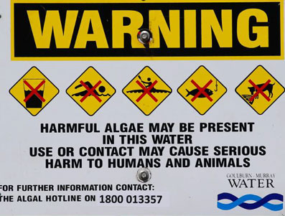
Rising environmental concern – 1990s
1992 – Rivers showing signs of ecological stress; blue-green algal blooms in Murray-Darling
1992 - National Strategy for Ecologically Sustainable Development
1994 – COAG agreement on water reforms
1995 – Cap on surface water extractions introduced by the Basin Ministerial Council
Notes:
Start with your thesis statement/ argument upfront
Never use less than 24 point font. If you use smaller font, people will not be able to see your information and you will have too much information on the slide.
Use bullet points. PowerPoint slides do not need full sentences, and should never have a paragraph full of information.
Use images effectively. You should have as little text as possible on the slide. One way to accomplish this is to have images on each slide, accompanied by a small amount of text.
Never put your presentation on the slides and read from the slides.
Do not have too many slides. Definitely do not have more than one slide per minute of presentation.
If you are giving a 15-minute presentation, by the 6th minute, you need to be discussing your data or case study.
Introduction/Overview/Hook
Theoretical Framework/Research Question
Methodology/Case Selection
Background/Literature Review
Discussion of Data/Results
Analysis
Conclusion

Slide 14
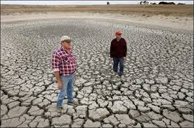
Increasing role of the Commonwealth 2000s
Millennium Drought worsens
2000-2004 – Stakeholder committees develop water sharing plans in New South Wales, including rules-based environmental water
2004 – National Water Initiative
2007 – Water Act (Commonwealth)
2007-2011 – Water buy-backs
Notes:
Start with your thesis statement/ argument upfront
Never use less than 24 point font. If you use smaller font, people will not be able to see your information and you will have too much information on the slide.
Use bullet points. PowerPoint slides do not need full sentences, and should never have a paragraph full of information.
Use images effectively. You should have as little text as possible on the slide. One way to accomplish this is to have images on each slide, accompanied by a small amount of text.
Never put your presentation on the slides and read from the slides.
Do not have too many slides. Definitely do not have more than one slide per minute of presentation.
If you are giving a 15-minute presentation, by the 6th minute, you need to be discussing your data or case study.
Introduction/Overview/Hook
Theoretical Framework/Research Question
Methodology/Case Selection
Background/Literature Review
Discussion of Data/Results
Analysis
Conclusion

Slide 15
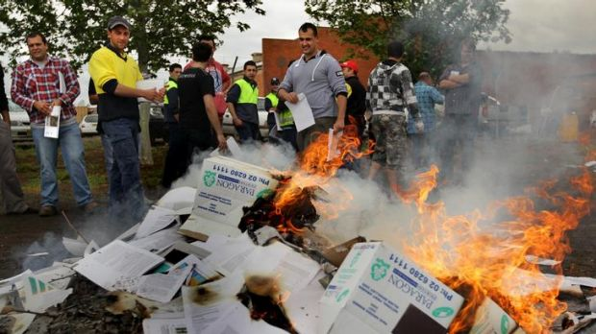
Timeline of key events – Basin Plan
2010 – Drought breaks; flooding rains
2010 – Guide to the Basin Plan
2012 – Watered down version of the Plan becomes law
2019 – Sustainable Diversion Limits
In the Murray-Darling Basin Plan what do we find? Bugger-all consultation when it first emerged, that big row in Griffith… Yeah, it was a huge row! It should never have been called consultation, because it wasn’t consultation, it was a one-way message. [Regional interview respondent, 2014]
Notes:
Start with your thesis statement/ argument upfront
Never use less than 24 point font. If you use smaller font, people will not be able to see your information and you will have too much information on the slide.
Use bullet points. PowerPoint slides do not need full sentences, and should never have a paragraph full of information.
Use images effectively. You should have as little text as possible on the slide. One way to accomplish this is to have images on each slide, accompanied by a small amount of text.
Never put your presentation on the slides and read from the slides.
Do not have too many slides. Definitely do not have more than one slide per minute of presentation.
If you are giving a 15-minute presentation, by the 6th minute, you need to be discussing your data or case study.
Introduction/Overview/Hook
Theoretical Framework/Research Question
Methodology/Case Selection
Background/Literature Review
Discussion of Data/Results
Analysis
Conclusion

Slide 16
Key events in the Lachlan catchment
The environmental water advisory group (EWAG) is a bridging group for stakeholders
2009 – Seven small scale e-watering events for waterbirds, veg. and frogs
2010 – Widespread natural flooding as Millennium Drought breaks
2011 – Two medium scale e-watering events
2013 – Large-scale overbank flow to improve resilience in the lower Lachlan wetland systems
Lower Lachlan wetlands with environmental water, 2013
Notes:
Start with your thesis statement/ argument upfront
Never use less than 24 point font. If you use smaller font, people will not be able to see your information and you will have too much information on the slide.
Use bullet points. PowerPoint slides do not need full sentences, and should never have a paragraph full of information.
Use images effectively. You should have as little text as possible on the slide. One way to accomplish this is to have images on each slide, accompanied by a small amount of text.
Never put your presentation on the slides and read from the slides.
Do not have too many slides. Definitely do not have more than one slide per minute of presentation.
If you are giving a 15-minute presentation, by the 6th minute, you need to be discussing your data or case study.
Introduction/Overview/Hook
Theoretical Framework/Research Question
Methodology/Case Selection
Background/Literature Review
Discussion of Data/Results
Analysis
Conclusion

Slide 17
Factors enabling learning and adapting
Regimes: nested, polycentric governance regimes; culture of learning; more or less local autonomy?
Regime
Relationships: TRUST; networks; social platforms and bridging groups; long-term involvement of key individuals
Rules
Relationships
Rhetoric
Routines
Rules: tradeable property rights for water; planning and regulation; environmental water entitlements
Routines: Institutionalise adaptive management; long-term funding for monitoring and evaluation; local and scientific knowledge
Rhetoric: Political recognition of problems and solutions in water policy

Slide 18
Adaptive management: emphasis on planning, monitoring and accountability
Percentage of documents where the search term is present (%)
Notes:
Interview findings suggested that learning was the most important factor for being adaptive.
This is not well reflected in policy – there’s much more emphasis on planning and monitoring, than learning and evaluation.
Most of the references to adaptive management were vague, with no definition of what it is, or how to do it. Only a few documents, including the Basin Plan, had a clear definition of adaptive management in it’s more active form.

Slide 19
Subsidiarity is contested
The local communities and local people on the ground don’t have a big role in determining how we use [environmental] water. So, that’s the truth. We determine how to use water. We draw on the expertise of the States, and the local groups [Commonwealth government respondent, 2014]
I think, ‘ah bugger them’ [the Commonwealth] because there’s a bit of good will, but then you turn around and they’re gone again. [Landholder, 2014]
Notes:
Local and regional stakeholders do not have the knowledge to make the “right” decision and cannot look beyond local interests to the Basin scale

Slide 20
Centralised control stifles local innovations
Certainly part of it is just the Commonwealth Environmental Water Office’s high handedness. They’ve just gone out to the [catchment] and said they’re doing it wrong…
You’ve got people from the Commonwealth coming in and actually being quite maladaptive because what they’ve said to the [catchment] is, ‘you’re not doing it like other people, so you’re not doing it properly’. What they’re trying to do is get a standard approach. Whereas… these river valleys are all different, so they might actually take a little bit of time to learn how it operates. [Environmental water manager, 2014]
Notes:
Bureaucratic, risk averse, unwilling to relinquish control
Commonwealth interview participants maintained that they needed to retain tight control to be able to make the necessary trade-offs at the Basin scale and remain accountable for the significant public investment in environmental water.

Slide 21
Lessons about learning
Transformative learning occurred following ‘crisis’ during the Millennium Drought, which created political impetus for water reforms
Stakeholders construct knowledge in ways that reinforces their identity. Our innate ability to learn and adapt is bounded by our worldview, culture and the web of social interactions in which we are embedded
Stakeholders with divergent knowledge can act collectively if there is high-level political support, and platforms for sustained social interaction, relationship building and conflict resolution, such as the EWAG
Regimes, rules, relationships, routines and rhetoric were key factors influencing learning in this case study

Slide 22
Lessons about learning
Heavily top-down and standardized approaches to environmental water management stifle local innovations and adaptations
Social learning is restricted when people are not included in the process (e.g. the Guide) and their identity is threatened
Local and regional stakeholders exert influence through their local knowledge and networks; however, some expressed cynicism about the increasing centralization of water management and erosion of local autonomy
There is a cultural change needed in government agencies to move beyond risk avoidance and standardization to a more contextual and adaptive approach to environmental water management

Slide 23
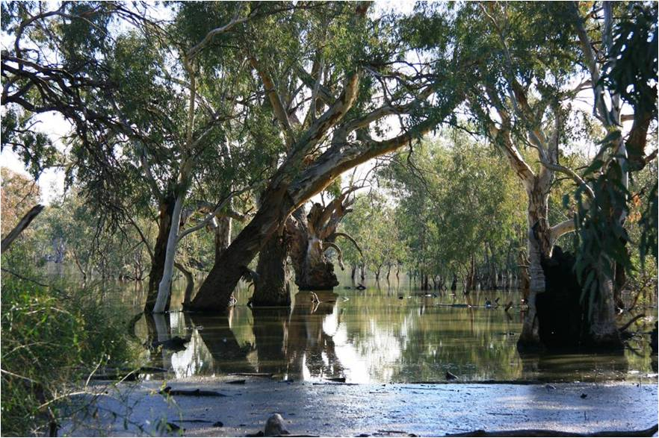
Acknowledgements
Supervision from Dr. Catherine Allan and Prof. Max Finlayson
Interview participants who donated their time and energy
Scholarship funding from the CSU Faculty of Science
Support from the Central Tablelands LLS

Slide 24
The scientists came in as critical scientists and people have rushed out and made these snap decisions because they take a snapshot view. So scientists have a very in depth knowledge of a narrow subject range. But we have a very broad knowledge, but a very shallow depth in the knowledge. So we don’t know the life cycle of every duck and bird and that sort of stuff, but the thing is I think we’ve got a broader vision where we can sort of tie all these different things together. [Ag2]

Slide 25
Great Cumbungi Swamp – first rise 2013

Slide 26
Lower Lachlan wetlands - 2013

Slide 27
Results – Water policy promotes efficiency, optimisation and sustainability, more than “adaptability”

Slide 28
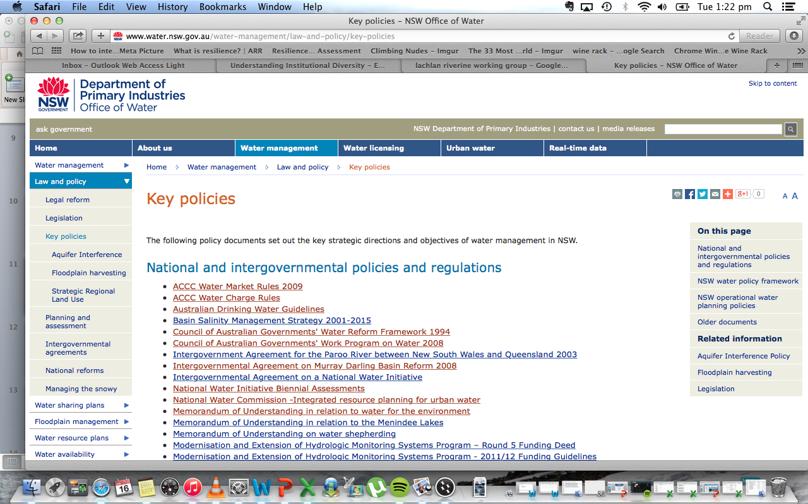
Content analysis of Commonwealth, State and catchment water policies
190 documents sourced from government agencies:
National Department of Environment
State water management agency
Catchment management agency

Slide 29
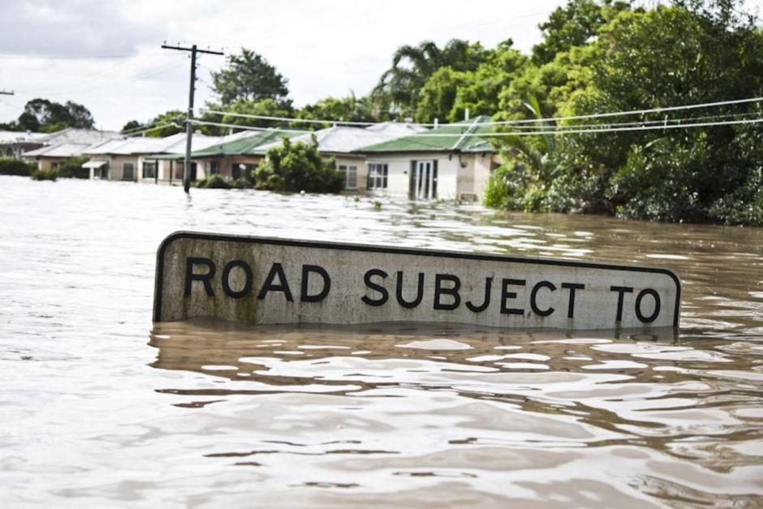
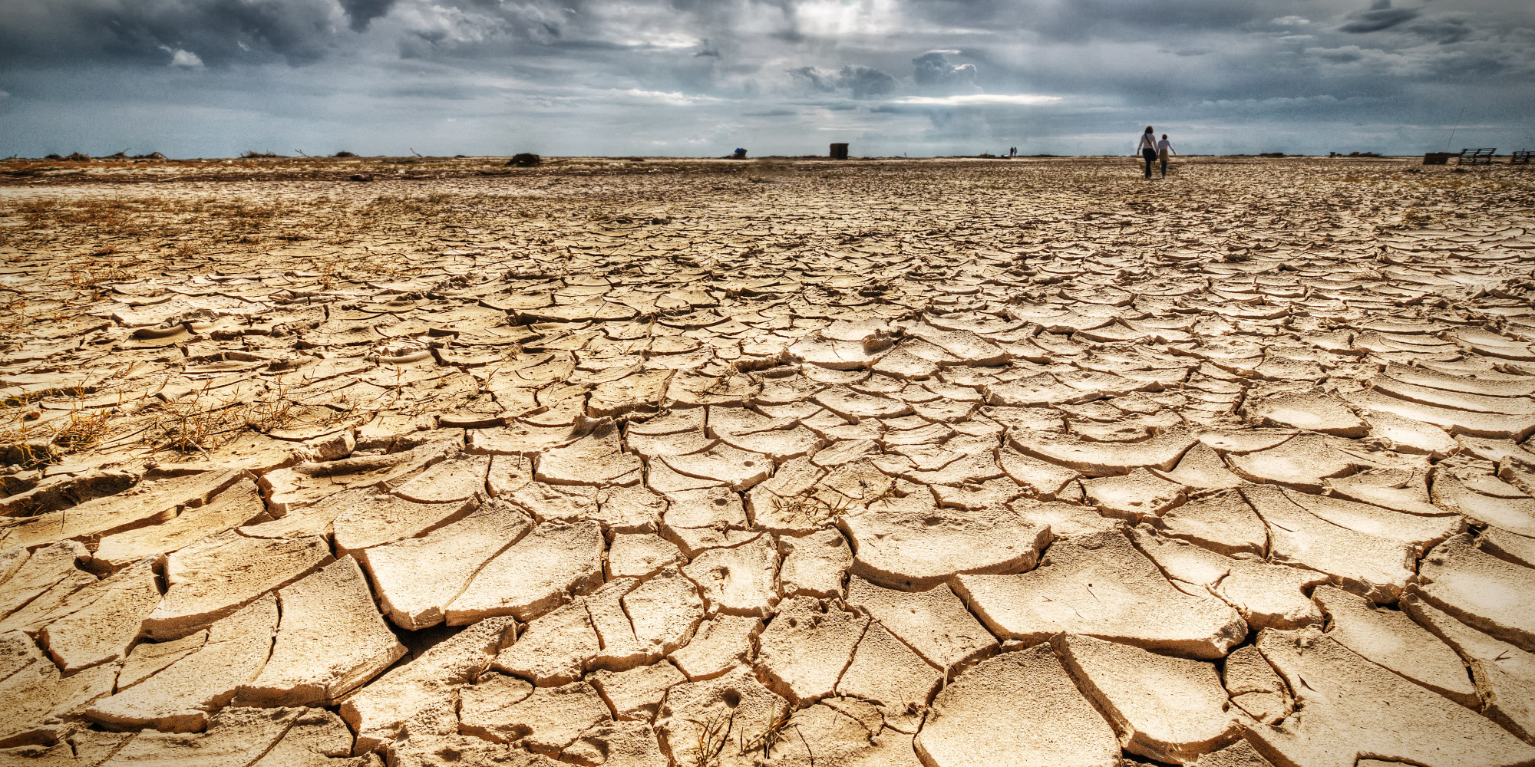
Low level of climate change policy integration across the water documents
Notes:
Actually only 16% of the documents mentioned climate change or global warming directly.
Droughts and floods are more frequently discussed, but there’s not a strong political signal that droughts and floods are becoming more frequent and severe under climate change.

Slide 30
(Less overt) climate change adaptation in Australian water policy
Australia is a global leader at dealing with climate variability in a legal context through the National Water Initiative:
Time-bound review periods
Sharing of risk between multiple actors
Tiered water rights represent a share of the available water
Legal rights for the environment
Water trading facilitates adaptation of water-dependent industries
Notes:
Although references to climate change adaptation are not common in the documents, Australia is a world-leader in terms of coping with climate variability.
The question I’ll be asking in my thesis is - is this incremental adapting or reactive adapting through planning cycles – is this enough to cope with the rapid changes in the Anthropocene?
So you might be wandering at this stage, what are the solutions that are being promoted in the water documents?

Slide 31
Adaptive management: emphasis on planning, monitoring and accountability
Percentage of documents where the search term is present (%)
Notes:
Interview findings suggested that learning was the most important factor for being adaptive.
This is not well reflected in policy – there’s much more emphasis on planning and monitoring, than learning and evaluation.
Most of the references to adaptive management were vague, with no definition of what it is, or how to do it. Only a few documents, including the Basin Plan, had a clear definition of adaptive management in it’s more active form.

Slide 32
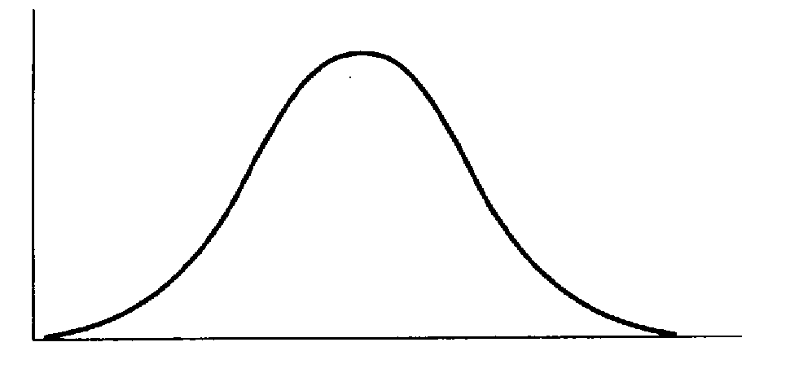
“Institutional arrangements can be understood as responding to a world in which there are some sociopaths and some saints, but mostly regular folks who are capable of both kinds of behaviour”
(Colin Camerer, 2003: 117 cited in Ostrom 2005)
People following rules and norms
Socio-paths
Saints
Human behaviour
Notes:
Why bother studying institutions?
To grossly simplify human behaviour, this quote describes the world as containing a small number of your Nelson Mandela’s and Mother Theresa’s on the right; a few sociopaths on the left, but the vast majority of humans are capable of good and bad behaviours depending on the social norms and rules guiding the situation they’re in.
My research is all about working out which processes in the water governance system (so which rules and norms) are promoting more adaptive behaviours?

