Slide 1
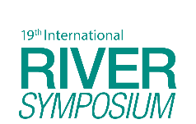
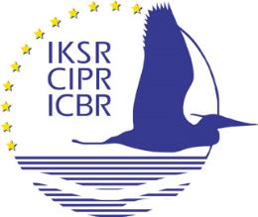
TAJ PALACE, NEW DELHI | 12 – 14 SEPTEMBER 2016
The Rhine and its water quality
Dr. Tabea Stötter
International Commission for the Protection of the Rhine (ICPR)

Slide 2
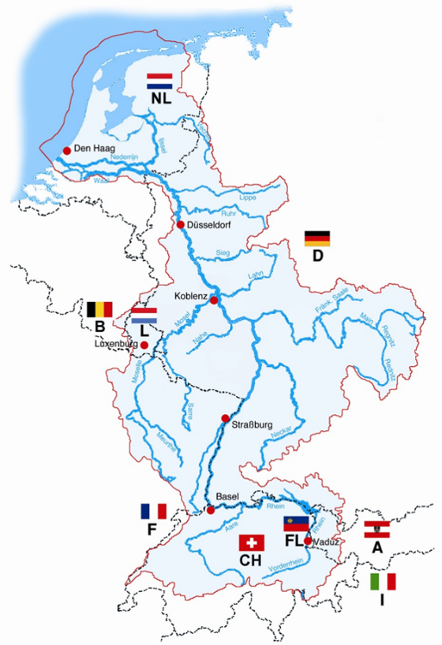
The Rhine catchment
Main stream
1233 km, navigable on 825 km
9 countries
Inhabitants: 60 million
Drinking water supply
for 30 million people

Slide 3
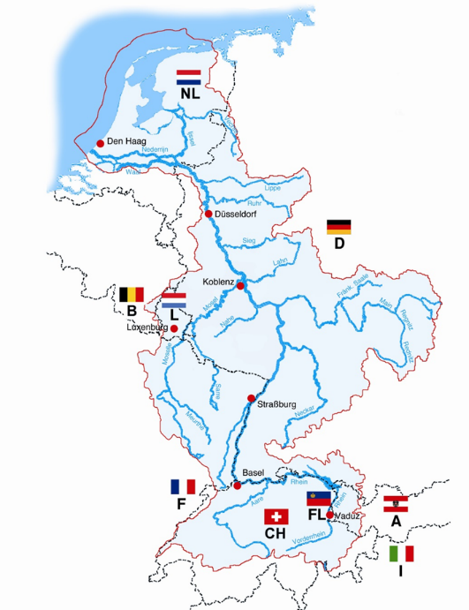
ICPR (founded in 1950)
The Netherlands
Germany
France
Luxembourg
Belgium/Wallonia
Switzerland
Austria
Liechtenstein
Italy
European Union
(Members of the ICPR are underlined)
Since 1995 Stakeholder involvement, NGOs with observer status
Notes:
Different national authorities working together.

Slide 4
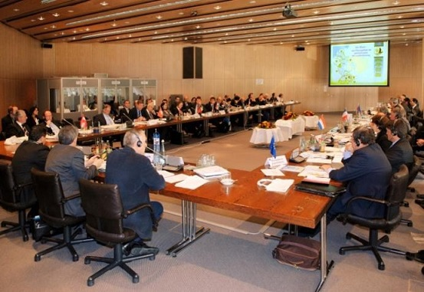
ICPR: Co-operation rules
De-centralized organization
National delegations
political mandate
technical know how
annual budget 1.2 Mio €
Unanimity / consensus
Decisions are recommendations
Obligation to report about implementing measures
Political trust, no sanctions
Interpretation into French, German and Dutch
Legal framework: Rhine Convention, Rules of procedure, financial regulations; EU Directives (WFD and FD), national legislations

Slide 5
ICPR: Landmarks
First Phase 1950 – 1970/80: Monitoring network (CH -> NL), building trust and mutual understanding; convincing society; wastewater treatment plants
1986 Accident at Sandoz (CH)
1987 Rhine Action Program
1993 + 1995 „Century floods“ on the Rhine
1998 Action Plan on Floods
2000 - Program Rhine 2020
2000 - EU Water Framework Directive
2007 - EU Floods Directive
Notes:
The work of the ICPR has triggered water policy in the European Union. Today basin-wide and trans-boundary approaches in water management and the required co-operation between all countries in a catchment is a European obligation. Integrated river basin management was developed within the ICPR step by step: The ICPR is dealing with the reduction of water pollution since 1950, with Ecosystem improvement since 1987, with water quantity issues since 1995 and with groundwater issues since 1999. Now all is integrated in the two European Directives and several daughter directives.

Slide 6
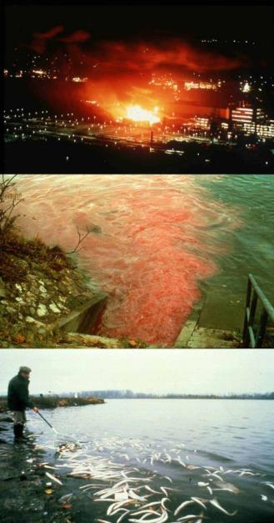
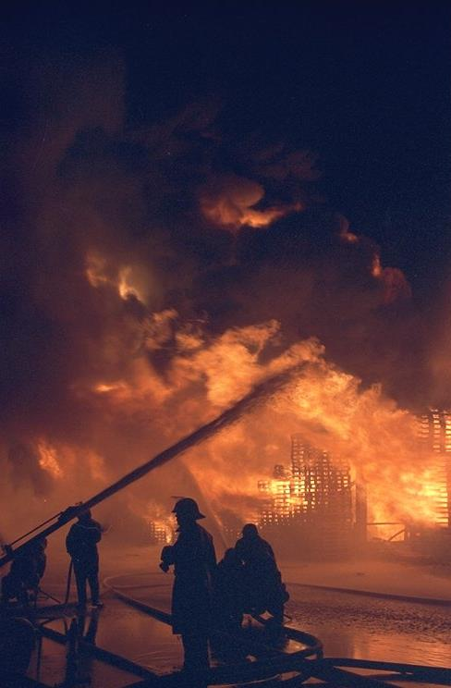
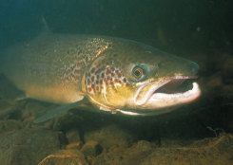
The turning point 1986:
Fire at Sandoz, Basel (CH)
„Rhine action program“
(1987-2000)
„Salmon 2000“

Slide 7
Rhine Action Program - Goals
Guarantee drinking water production
Reduce direct inputs of toxic substances by 50% - 70% (1985 - 1995)
Reduce accidental spills for example by constructing collecting basins for fire extinction water
Improve warning and alert systems
Improve ecosystem: Reintroduce vanished fauna species (salmon)

Slide 8
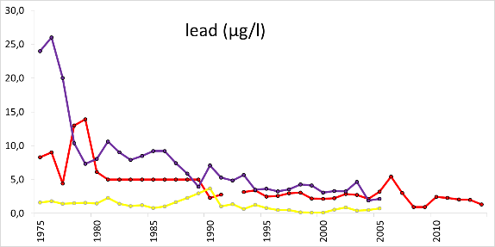
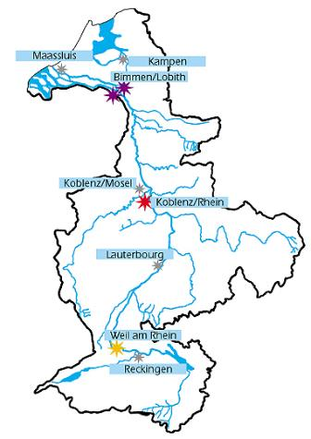
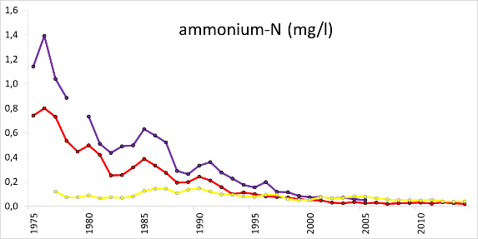
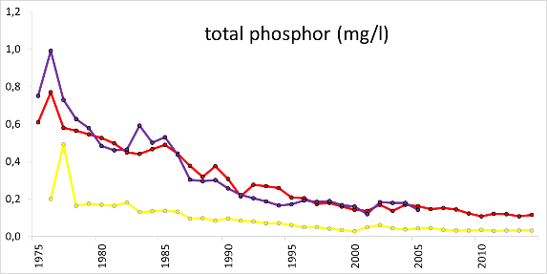
Water quality improvement

Slide 9
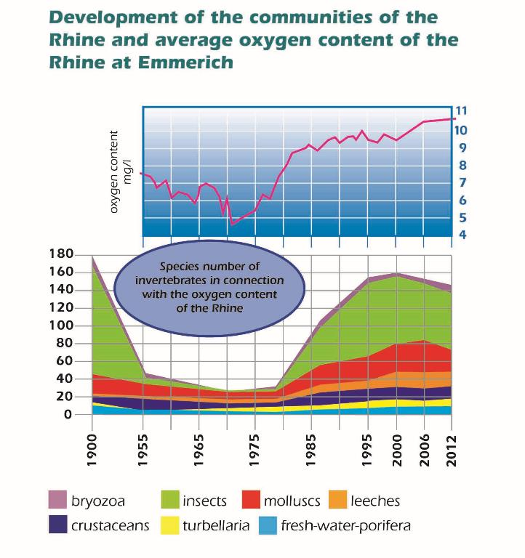
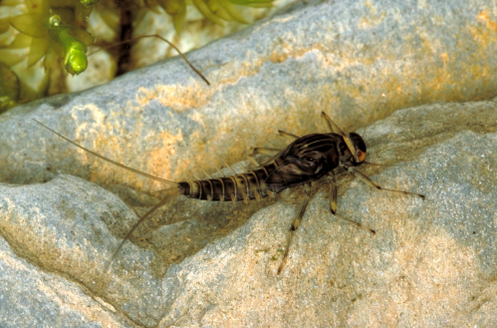
Results
Linking water quality and ecology
Authochthonous Rhine-dayfly (larva)
Atlantic Salmon

Slide 10
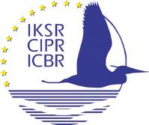
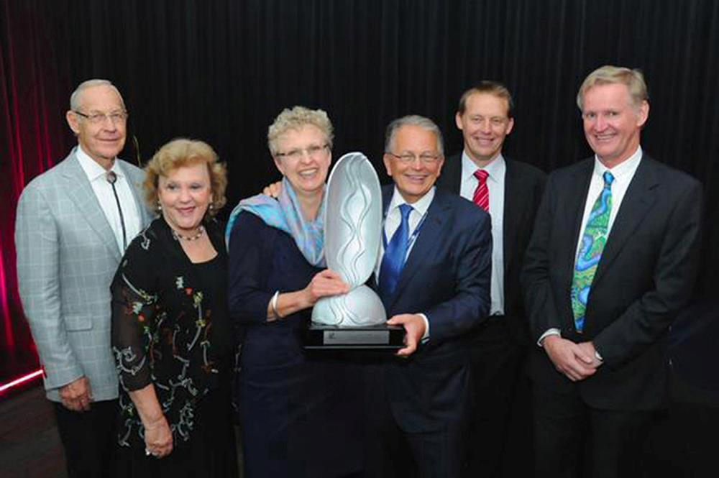
European Riverprize 2013, Vienna (Austria)
&
International Riverprize 2014, Canberra (Australia)

Slide 11
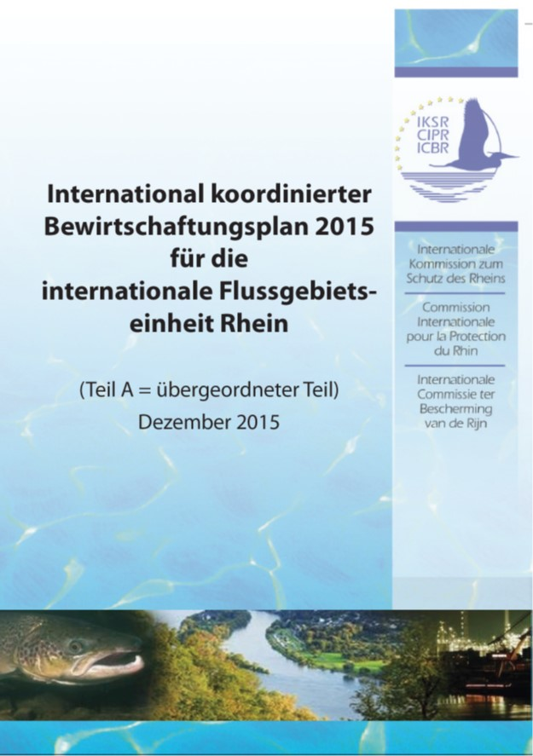
EU Water Framework Directive (WFD) Coordination unit: river basin
Target: „good status“ of rivers
→ 1st River basin management plan 2009-2015
→ 2nd River basin management plan 2016-2021

Slide 12
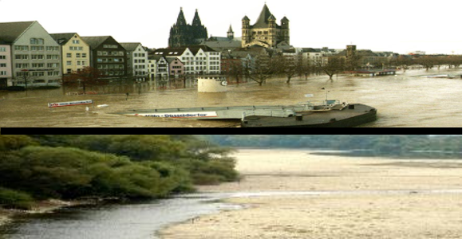
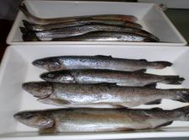
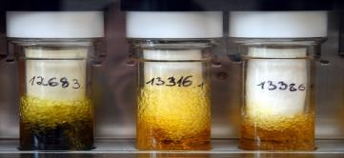
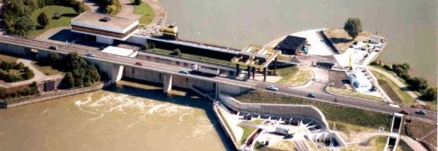
Future challenges
Climate change: Changes in runoff and temperature
Water quality: New substances (micropollutants), new methods, microplastics
Contamination of fish: Coordinated measuring programme 2015
Ecological continuity:
Migration of fish up- and downstream

Slide 13
Micropollutants – mandate
Conference of ministers October 2007:
„to develop a joint and comprehensive strategy for reducing and avoiding micro-pollutant inputs from urban wastewater and other sources into the Rhine and its tributaries by improving knowledge on emissions, eco-toxicological reactions in nature and to draft suitable treatment methods“

Slide 14
Strategy micropollutants
Approach:
Selection of substances / groups of substances
Inventory of data and information
Assessment of information for each substance / group of substances
Synthesis of assessments
Decisions for measures and action: Conference of ministers 2013
Diffuse sources – example pesticides 2016

Slide 15
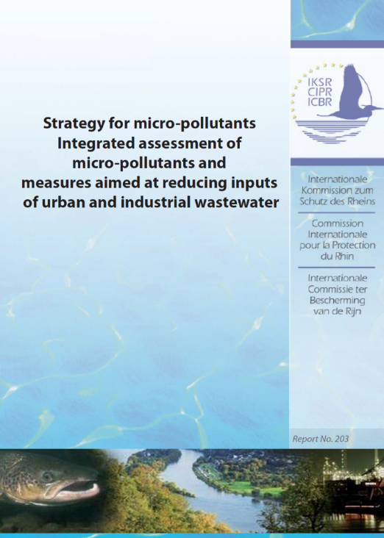
Strategy micropollutants - publications
Assessment reports:
Medicinal products for human use (Report 182)
Biocidal products and anti-corrosive agents (Report 183)
Estrogens (Report 186)
Radiocontrast Agents (Report 187)
Odoriferous Substances (Report 194)
Complexing agents (Report 196)
Industrial chemicals (e.g. flame retardants, Bisphenol A, Diglyme and Nonylphenol) (Report 202)
Integrated assessment of micropollutants (Report 203)

Slide 16
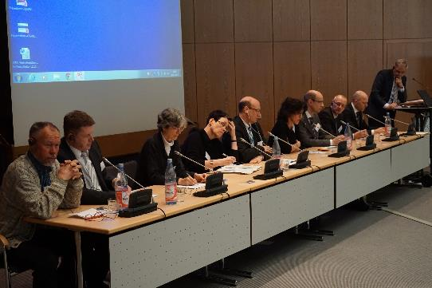
In progress / planned
Workshop micropollutants in 2017
exchange of knowledge, innovative techniques and national developments in the Rhine catchment regarding micropollutants
synthesis report of the ICPR strategy for micropollutants
&
discussion about common measures in the Rhine catchment to reduce the inputs of micropollutants

Slide 17
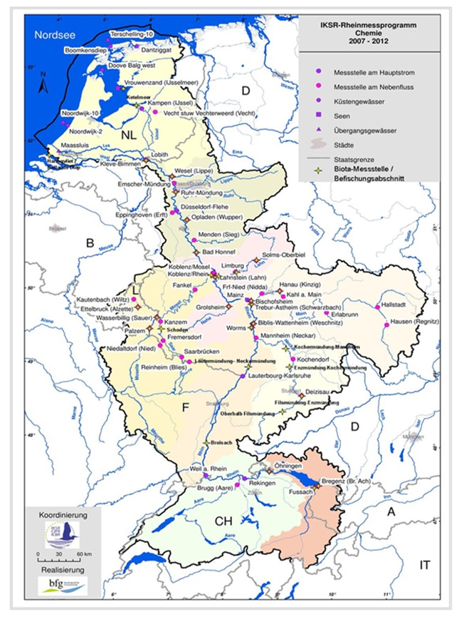
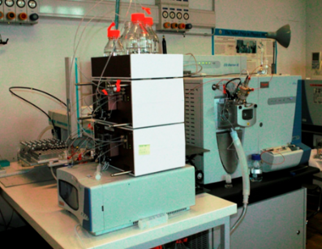
In progress / planned
Biota contamination
First joint analysis programme 2014 – 2015
Results in 2017
Regular monitoring starting in 2018
Special monitoring including non-target analysis
new ICPR expert group
special monitoring programme including a list of target substances (also micropollutants), and non-target analysis in 2017
LCMS/MS
Notes:
on the pollutant contamination of biota (fish) in the Rhine catchment [2]. The goal is to form a basis for catchment wide comparable results.
A network of representative monitoring stations or river sections in the Rhine catchment should be established analogous to the Rhine monitoring programmes "Biology" and "Chemistry" for a coordinated monitoring.
Special monitoring including non-target analysis
new ICPR expert group to provide comparable procedures and results along the Rhine, and to develop synergies where possible
special monitoring programme including a list of target substances (also micropollutants), and non-target analysis in 2017

Slide 18
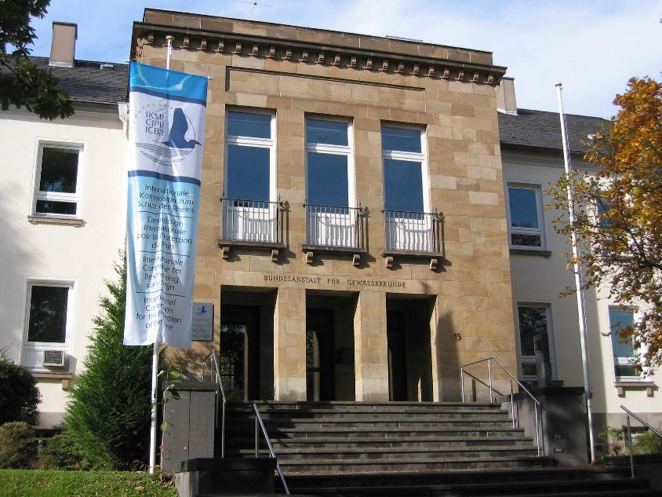
TAJ PALACE, NEW DELHI | 12 – 14 SEPTEMBER 2016
Thank you for your attention
www.iksr.org
tabea.stoetter@iksr.de

