Slide 1
Water Sensitive Growth, Not Water Intensive Growth in the North – Western Indian States
19th International Riversymposium
New Delhi, India
Dr. Ranvir Singh
Environmental Hydrologist
Massey University, Palmerston North, New Zealand

Slide 2
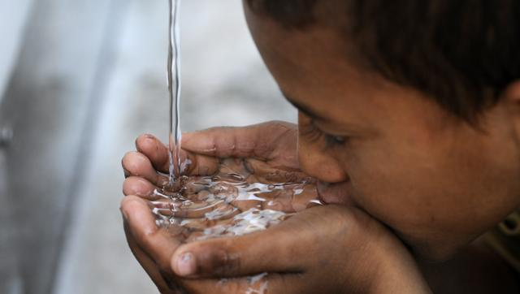
Photo: Sunil Ghosh/HT Photo, March 9 2016

Slide 3
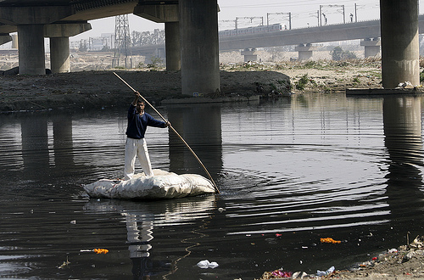
THE HINDU (January, 2009)

Slide 4
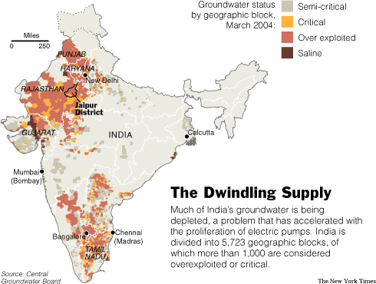
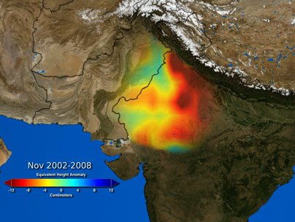
NASA Satellites Unlock Secret to Northern India's Vanishing Water

Slide 5
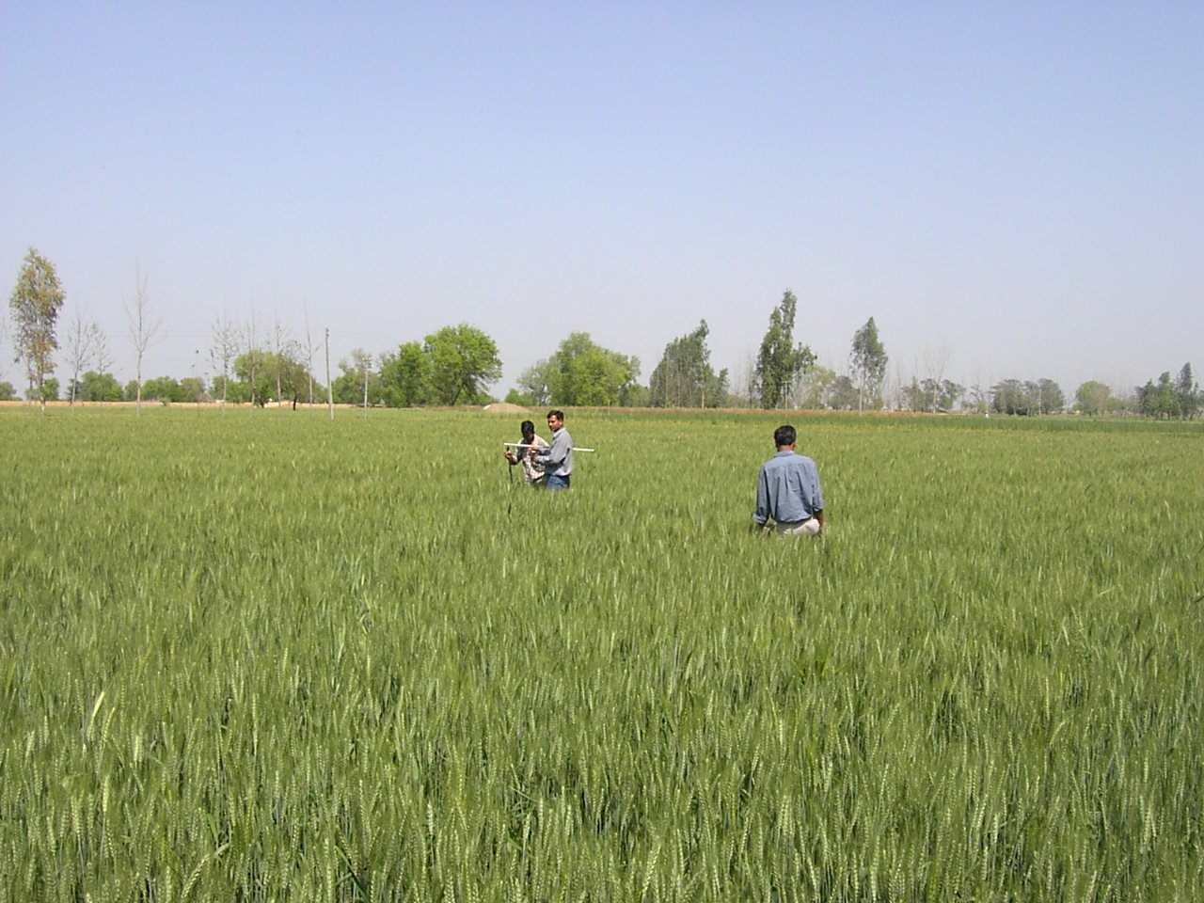
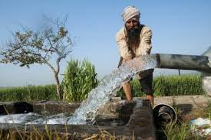
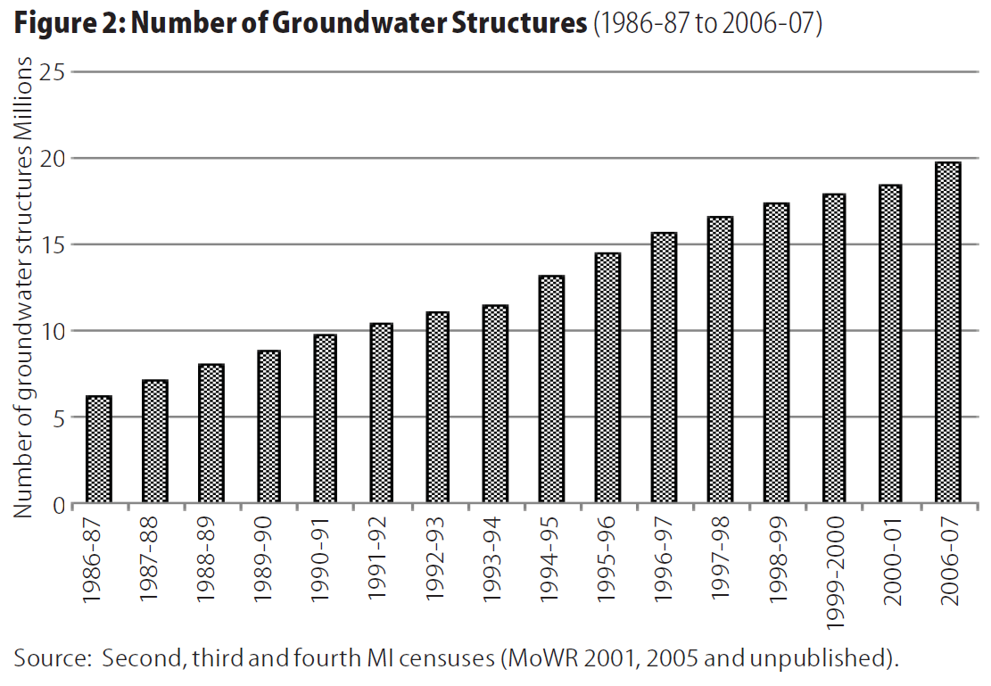
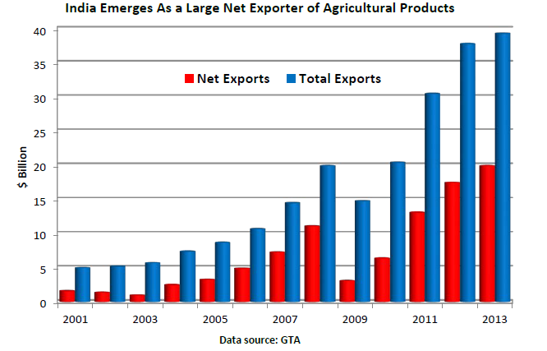
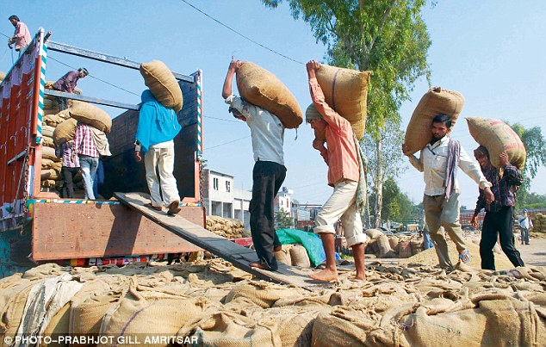
Irrigated Agriculture
Source: Mukherji et al., 2013. Major Insights from India’s Minor Irrigation Censuses: 1986-87 to 2006-07. Economic & Political Weekly, June 2013.
Source: USDA FAS International Agricultural Trade Report, August 2014

Slide 6
Virtual Water Export
India exported about 9.56 million MT of Rice and 3.57 million MT of Wheat (in 2013/14)
This equates to roughly ~ 90 cm* of groundwater level all over the area of Haryana and Punjab combined (~95 thousand sq. km)
It’s gross returns about 0.015 INR per litre* of ‘virtual’ water exported, without accounting labour and other input costs!
*based on the back of envelope calculations

Slide 7
Productive water use requires
a shift to high-value water efficient horticulture production in the region
investment in science, technology, training, capability building and infrastructure to help develop productive and profitable agribusiness supply chain solutions

Slide 8
Poor Irrigation Practices

Slide 9
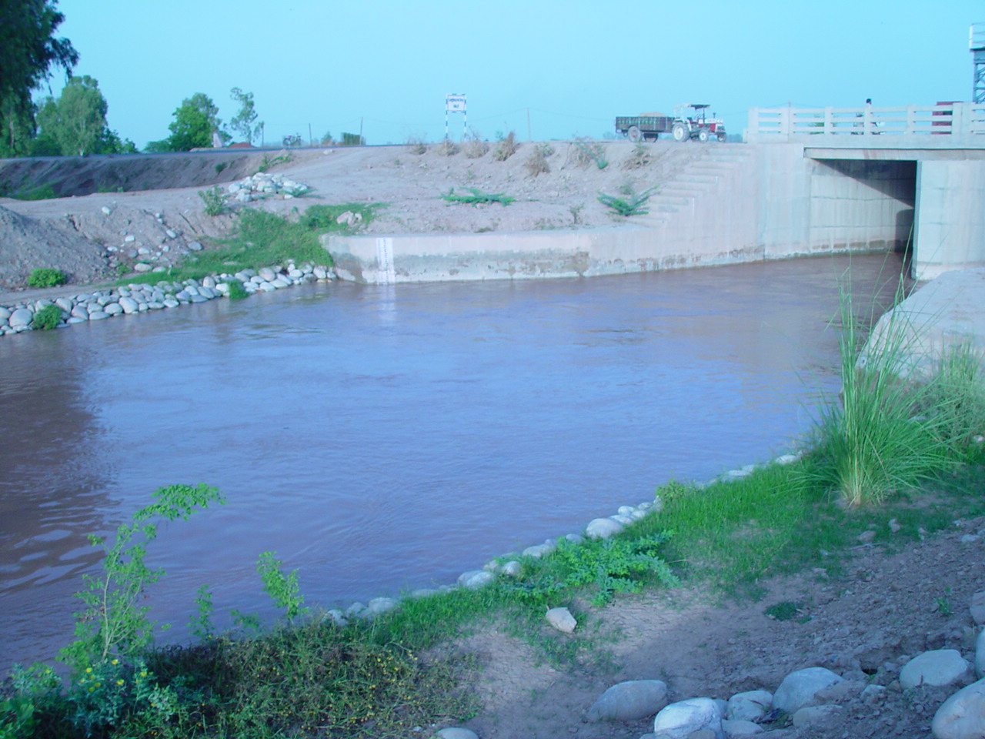
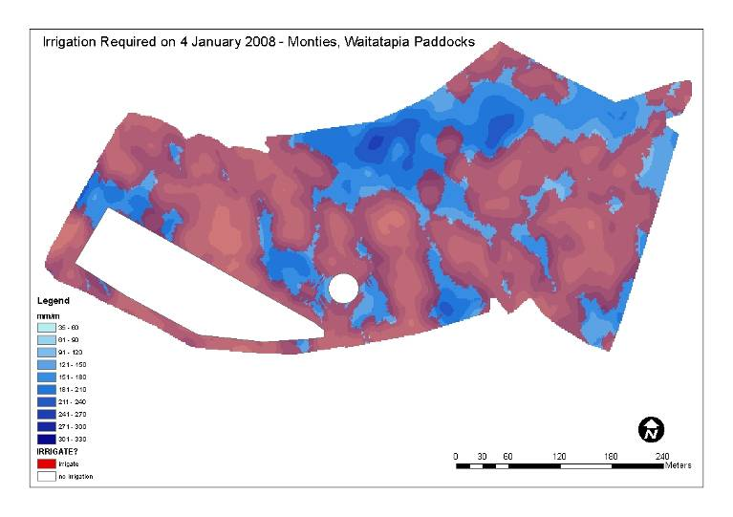
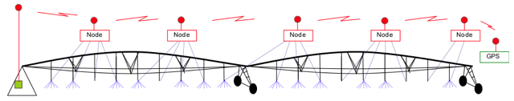
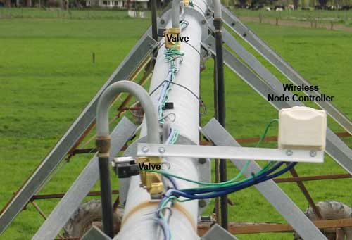
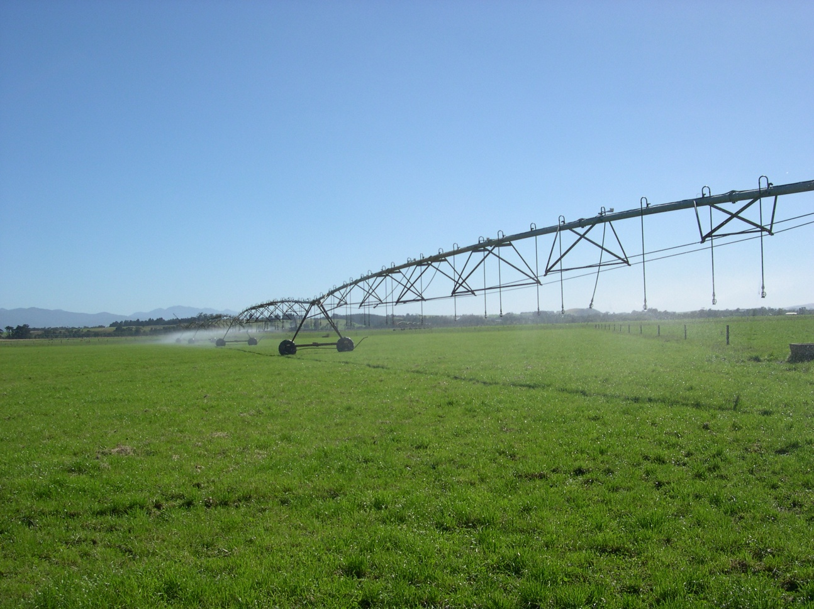
Technology to improve irrigation
Canal seepage and field percolation losses
Central controller
SD card
10 mm irrigation 5 mm irrigation
www.precisionirrigation.co.nz (Bradbury, 2009)

Slide 10
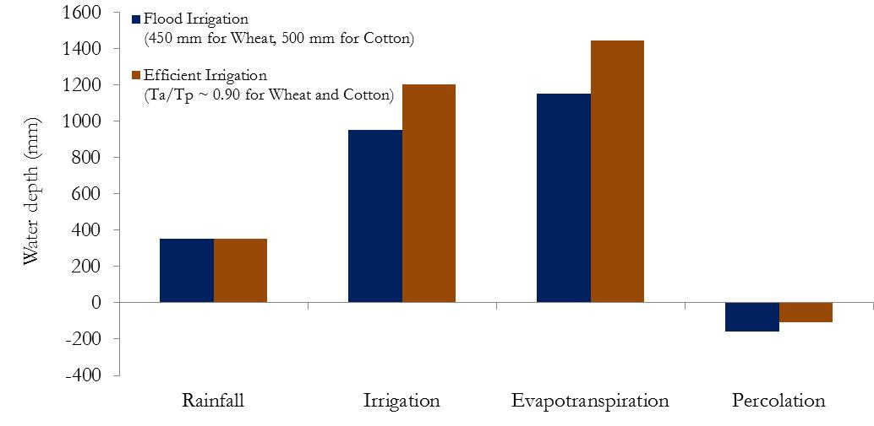
Potential effects of efficient irrigation
25%
26%
-32%
* Based on Soil-Water-Atmosphere-Plant (SWAP) model simulations of wheat-cotton cultivation over Sandy Loam/Loamy Sand soils in Sirsa district (Haryana) over a period of 12 years from 1990 to 2002

Slide 11
Sustainable water use requires
a combination of inefficient and efficient irrigation practices in the region
investment in science, technology, and infrastructure to increase rainwater recharge to groundwater resources

Slide 12
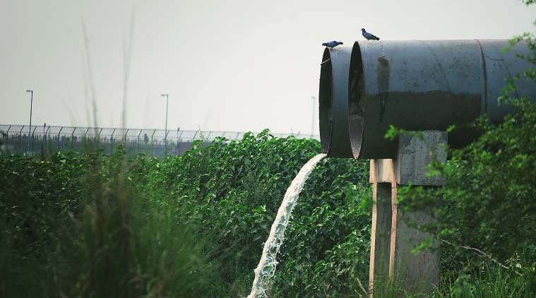
Wastewater discharges
Photo by Oinam Anand_The Indian Express, May 2015

Slide 13
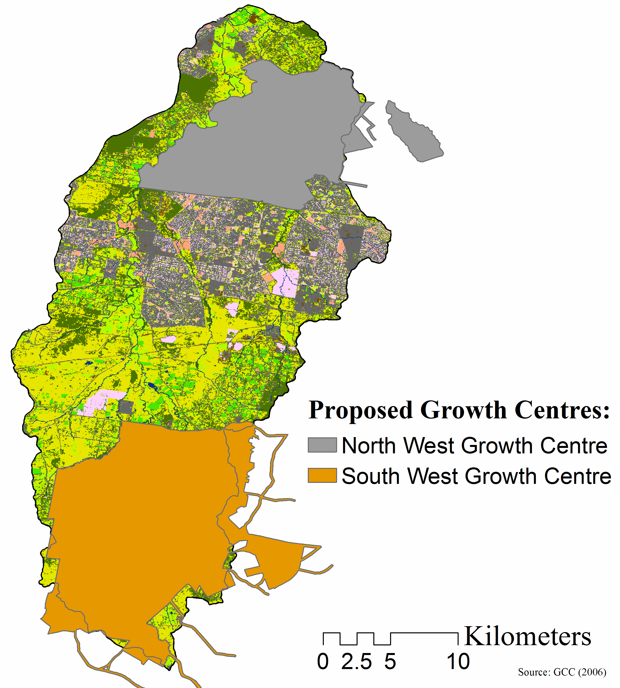
Use and reuse of water
Future Growth Centres in Western Sydney (Australia)
The proposed North West and South West Growth Centres have the long term target to accommodate 181,000 new dwellings by the end of year 2030…
Population ~ 1 million
23,000 lots released in 2006
16,500 lots released in 2006
Source: Growth Centres Commission 2006

Slide 14
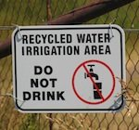
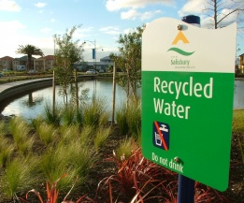
Use and reuse of water
Potential for Water Recycling
http://www.iwes.com.au/
* Replace potable water use with non-potable (recycled) water use for peri-urban agriculture, recreation space (golf courses and parks), residential outdoor (lawns and gardens), and residential indoor (laundry and toilet flushing) in South Creek catchment, Western Sydney (Australia)
http://www.iwes.com.au/
Singh, et al. (2014). Securing Water Supply in Western Sydney: An analysis of Water Use, Demand and Availability in the South Creek catchment. In B. Maheshwari et al. (eds), The Security of Water, Food, Energy and Liveability of Cities Challenges and Opportunities for Peri-Urban Futures; Water Science and Technology Library 71, pp 121-136, Springer Science, Dordrecht, The Netherlands.

Slide 15
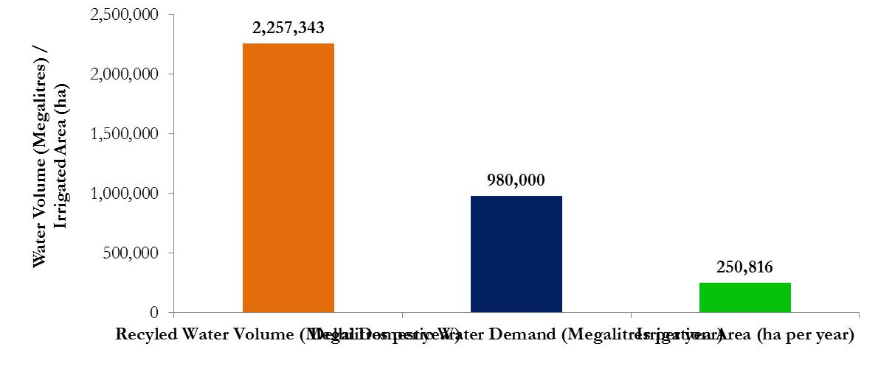
Potential for domestic wastewater recycling in the states of Delhi, Haryana, Punjab and Rajasthan*
Potential Recycle Water Volume (Megalitres/Yr)
Delhi Domestic Water Demand (Megalitres/Yr)
Potential Irrigation Area (ha) for green space/parks and/or peri-urban agriculture
*based on the back of envelope calculations

Slide 16
Use and reuse of water requires
a paradigm shift in which ‘wastewater is seen as a resource, not a waste’
investment in science and technology to develop cost-effective recycle water solutions

Slide 17
Water sensitive growth requires
a shift to high-value water efficient agriculture production in the region
a combination of inefficient and efficient irrigation practices in the region
a paradigm shift in which ‘wastewater is seen as a resource, not a waste’
investment in science, education, training and infrastructure to raise awareness and build capability and capacity

Slide 18
Thanks!
Photo: Sunil Ghosh/HT Photo, March 9 2016

