Slide 1
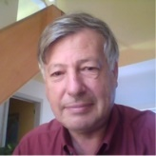
Sharing Knowledge, Creating Awareness, Networking River Advocates
+ 1100 River Basin Web Maps
+ 3000 geo-localised River Stories
Supporting Initiatives (e.g. Ramsar, Natura2000)
Interest to support this project ? Eric.Tilman@riversnetwork.org

