Slide 1
TAJ PALACE, NEW DELHI | 12 – 14 SEPTEMBER 2016
Eco-hydrological status of natural springs and their significance to environmental flows: A case from Akole and Sangamner, Ahmednagar, Maharashtra.
Authors: Renie Thomas, Geetu Thakur, Vijayasekaran Duraisamy
Watershed Organisation Trust, Pune
www.wotr.org

Slide 2
TAJ PALACE, NEW DELHI | 12 – 14 SEPTEMBER 2016
Video on Natural spring in the Western Ghats – (https://youtu.be/eNHBozQAWD4)
Duration: 2 min

Slide 3
CONTENTS
TAJ PALACE, NEW DELHI | 12 – 14 SEPTEMBER 2016
Introduction
Study area
Methodology
Observations
Identification of springs
Assessment of water quality of selected Springs
Assessment of Land Use Land Cover Changes
Results & Discussion
Conclusion

Slide 4
What are natural springs?
TAJ PALACE, NEW DELHI | 12 – 14 SEPTEMBER 2016
INTRODUCTION
Natural discharge of groundwater to the surface
Source of freshwater
Why are springs important?
Groups of springs contribute to downstream discharge
Supports diverse flora & fauna
Provides important environmental services
Provides sufficient drinking water for remote communities in times of climatic distress

Slide 5
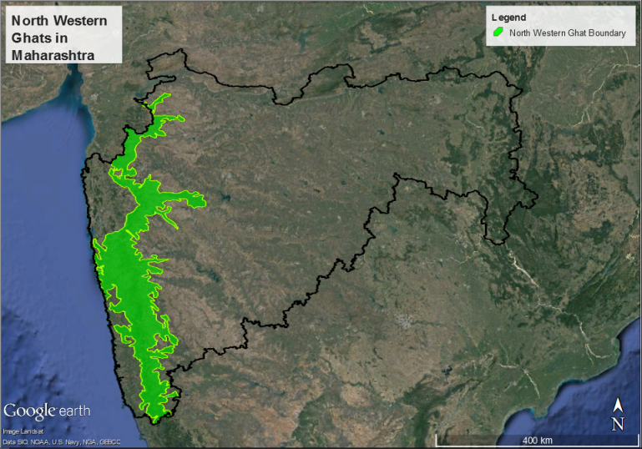
TAJ PALACE, NEW DELHI | 12 – 14 SEPTEMBER 2016
What do we know about Springs in North western Maharashtra???
One of the top eight top biodiversity hotspot*
6% of the vegetation remains intact *
Direct water supply for 120 million people, indirect >400 million**
Millions of springs exist along the Western Ghats but only few reported, many yet to be explored and documented.
Origin of many east and west flowing rivers providing water to 9 states
Water buckets of western Ghats
*Myers et. al. 2000
** Molur et. al. 2011
Current study area: Akole & Sangamner Area
Karjat Area
Pune Area
Wai Area (Buono et. al.)
Koyna Area (Naik et. al.)

Slide 6
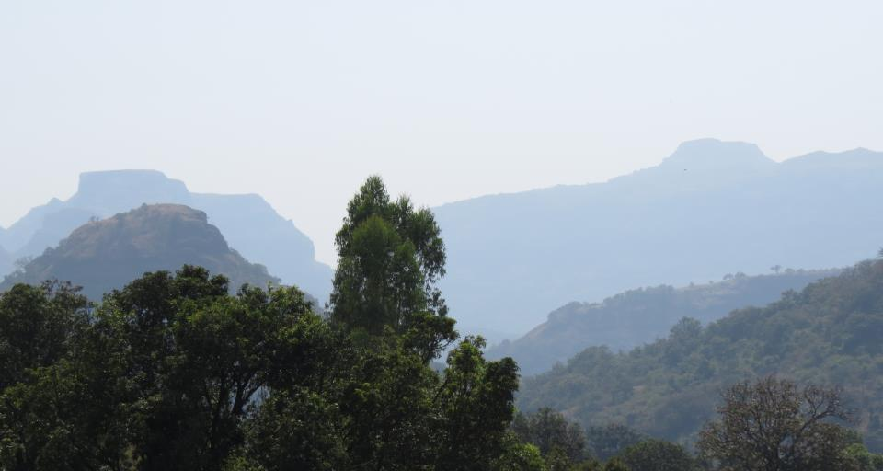
TAJ PALACE, NEW DELHI | 12 – 14 SEPTEMBER 2016
Akole – Forested, steep slopes, rich biodiversity

Slide 7
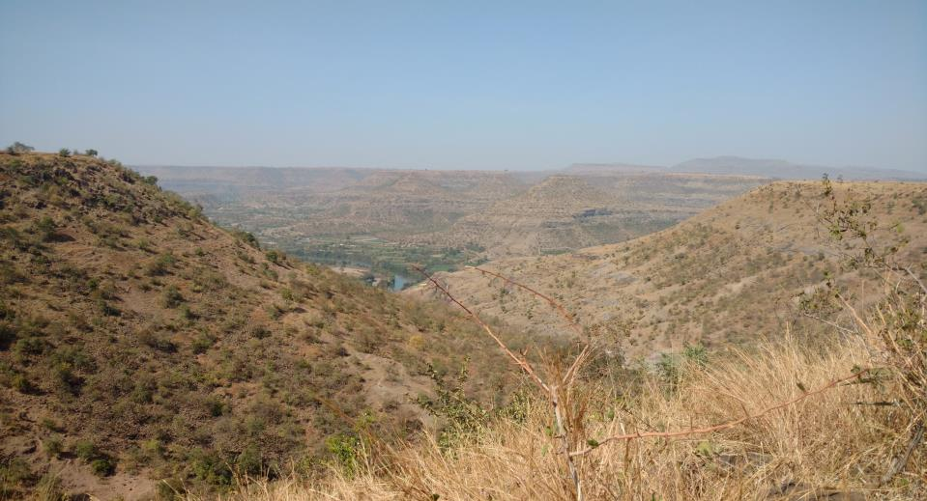
TAJ PALACE, NEW DELHI | 12 – 14 SEPTEMBER 2016
Sangamner – Semi-arid, moderate slopes, fallow land
Akole – Forested, steep slopes, rich biodiversity

Slide 8
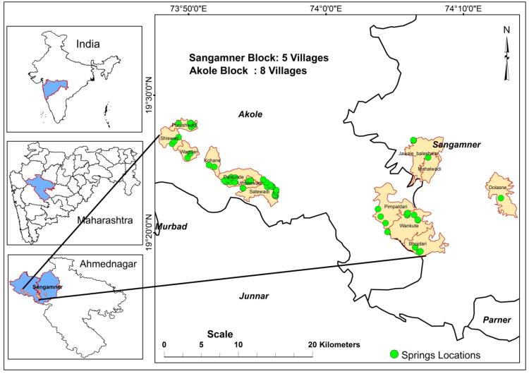
TAJ PALACE, NEW DELHI | 12 – 14 SEPTEMBER 2016
Location map of the Study area

Slide 9
Methodology
TAJ PALACE, NEW DELHI | 12 – 14 SEPTEMBER 2016
Phase 1: Data collection
Hydrogeological transect surveys – Springshed mapping, identification of recharge and discharge areas
Water quality of selected perennial springs
Discharge measurements (Grab samples)
Unstructured interview and focus group discussions (FGDs) with spring users
Phase 2: Data analysis
Imagery analysis – Land Use and Land Cover
Limitation:
Lack of ecological reference conditions for comparative study

Slide 10
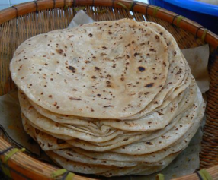
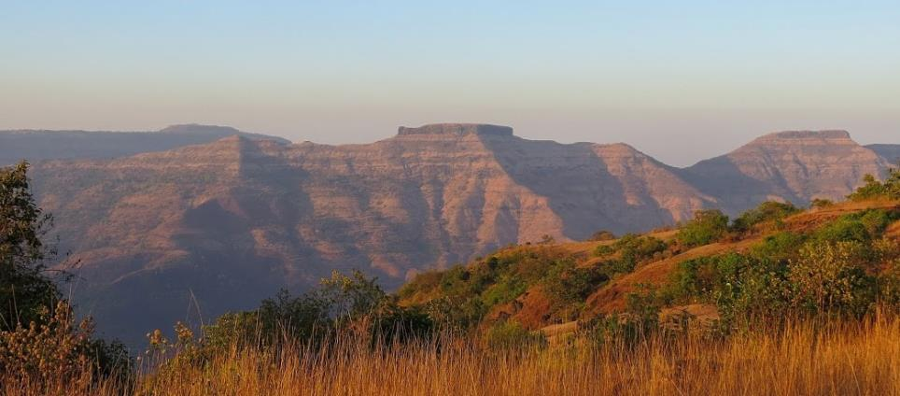
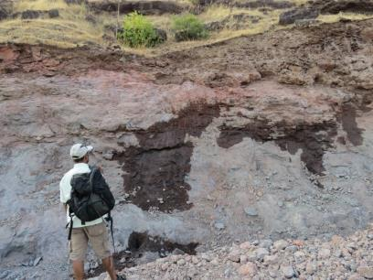
Architecture of lava flow layers and occurrence of groundwater
TAJ PALACE, NEW DELHI | 12 – 14 SEPTEMBER 2016

Slide 11
Criteria for identification of springs
TAJ PALACE, NEW DELHI | 12 – 14 SEPTEMBER 2016
Springs classified on the basis of:
Dominant aquifer rock type and structure – Contact type (Weathered, Vesicular & Massive Basalt type) and Fracture type
Structural controls
Elevation
Slope
Discharge

Slide 12
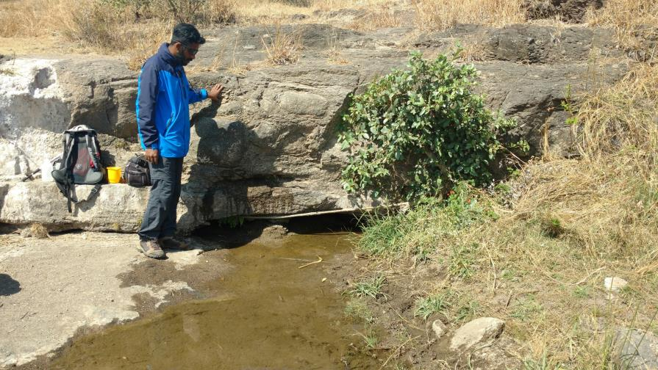
TAJ PALACE, NEW DELHI | 12 – 14 SEPTEMBER 2016
Upper Sheet (Pahoehoe) flow unit
Lower Sheet (Pahoehoe) flow unit
Flow contact spring type

Slide 13
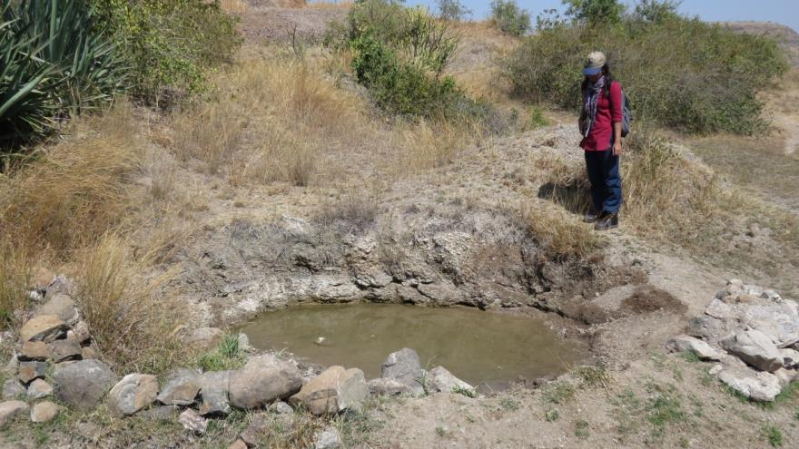
TAJ PALACE, NEW DELHI | 12 – 14 SEPTEMBER 2016
Weathered Vesicular basalt unit
Weathered (Vesicular basalt) spring type

Slide 14
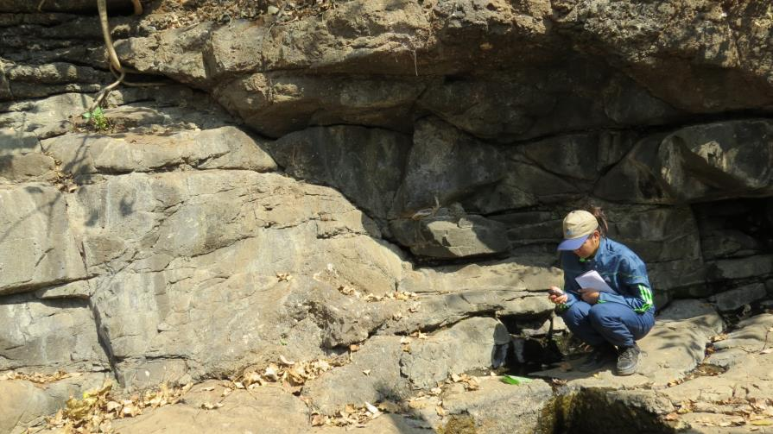
TAJ PALACE, NEW DELHI | 12 – 14 SEPTEMBER 2016
Fractured/sheet joints
Fractured/sheet joint spring type

Slide 15
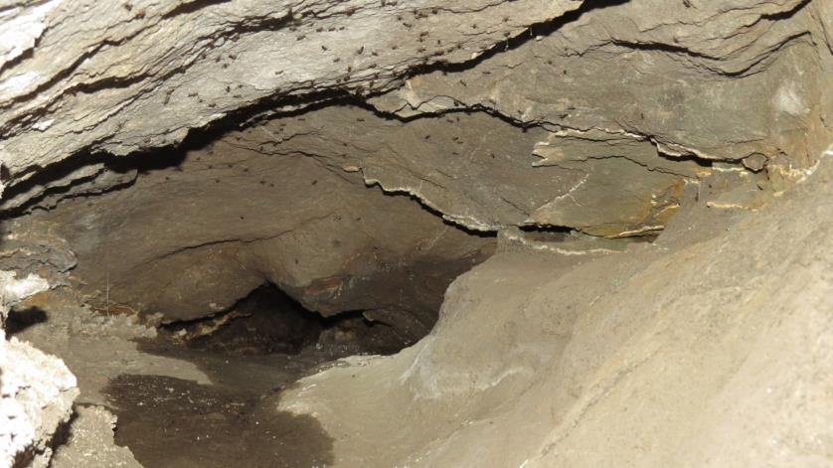
TAJ PALACE, NEW DELHI | 12 – 14 SEPTEMBER 2016
Weathered sheet vesicles
Weathered (Vesicular Basalt) Sheet vesicle spring type

Slide 16
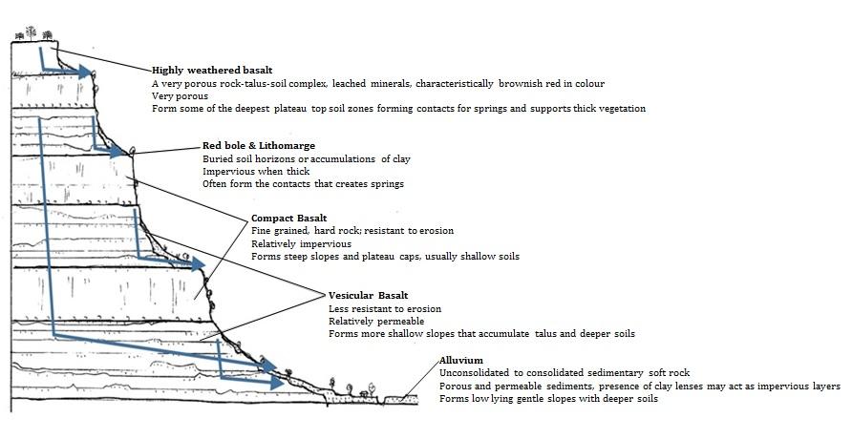
TAJ PALACE, NEW DELHI | 12 – 14 SEPTEMBER 2016
General anatomy of multi-layered basaltic lava flow units and emergence of springs at different elevations
Source : Modified and adopted after Buono et. al. 2015

Slide 17
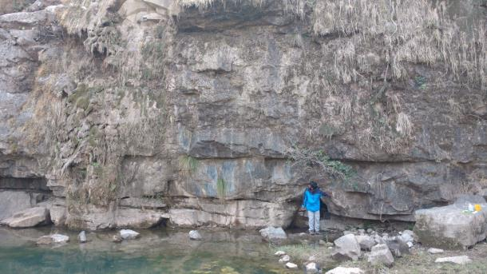
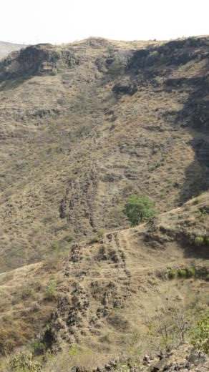
Occurrence of springs and structural controls
TAJ PALACE, NEW DELHI | 12 – 14 SEPTEMBER 2016
Highly fractured /jointed spring
Vertical jointed dyke

Slide 18
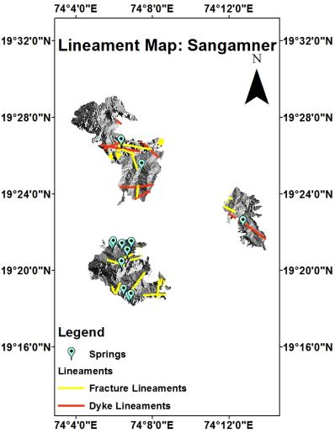
TAJ PALACE, NEW DELHI | 12 – 14 SEPTEMBER 2016
Spring location and lineaments

Slide 19
Types of springs identified
TAJ PALACE, NEW DELHI | 12 – 14 SEPTEMBER 2016
Total number of springs surveys - 63
Spring Type | Spring ID | Percent type | Villages
Flow contact | KNS-1,2, PSS-6,8,9, STWS-1,2.1,2.2,9,10,11,12,13,14,15,16,17,18,19, UWS1, WKS1,4,5,6 PDWS 1,2,3,4 BDS-1,2,3, JBS 1.1 | 51% | Kohane, Palsunde, Satewadi, Umbrewadi, Wankute, Pimpaldari, Bhojdari, Jawale Baleshwar
Weathered contact | STWS1,3 PWS1,2,3,4,6, STWS3,5,6,7,8, UWS-2,3, WKS2, 3 | 25% | Satewadi, Purushwadi, Umbrewadi, Wankute
Fractured /sheet joints | STWS-2, PWS-5, WDS1,2, PSS1,7, STWS4,20, DSS1, JBS1.2, MWS1 | 17% | Satewadi, Purushwadi, Waghdari, Palsunde, Dolasane, Jawale Baleshwar, Mahalwadi
Weathered Sheet vesicle | PSS-2,3,4,5 | 7% | Palsunde

Slide 20
Dicharge (m3/day) w.r.t Elevation (m)
TAJ PALACE, NEW DELHI | 12 – 14 SEPTEMBER 2016
Total number of springs surveyed – 63. Springs having prominent discharge - 26
Elevation (a.m.s.l) | No. of springs with discharge (m3/day)
 | <1.3 | 1.3-5.3 | 5.3-7.3 | 7.3-9.3 | 9.3-11.3 | Total No.
700-800 | 5 | 3 | 2 | 1 | 1 | 12
800-900 | 0 | 0 | 0 | 0 | 0 | 0
900-1000 | 0 | 0 | 0 | 0 | 0 | 0
1000-1100 | 1 | 0 | 0 | 0 | 0 | 1
1100-1200 | 0 | 0 | 0 | 0 | 0 | 0
1200-1300 | 0 | 0 | 0 | 0 | 0 | 0
Total No. | 6 | 3 | 2 | 1 | 1 | 13
Percentage of Springs | 46% | 23% | 15% | 8% | 8% | 100%

Slide 21
LULC analysis (2004)
TAJ PALACE, NEW DELHI | 12 – 14 SEPTEMBER 2016

Slide 22
LULC analysis (2016)
TAJ PALACE, NEW DELHI | 12 – 14 SEPTEMBER 2016

Slide 23
Water quality of selected Springs (Sangamner & Akole)
TAJ PALACE, NEW DELHI | 12 – 14 SEPTEMBER 2016
Total number of spring water samples collected representing Sangamner & Akole typology : 4
Naik et. al. (Koyna area) |  | Sangamner | Akole
Temperature (⁰C) | 17 - 22 | 20 - 28 | 16 - 24
pH | 7.3 – 8.3 | 7.5 – 8.9 | 7.3 – 8.35
TDS (mg/L) | 35 - 165 | 280 - 360 | 120 - 140
EC (µS) | 70 - 320 | 411 - 528 | 186 - 225
Hardness (mg/L) | 30 - 140 | 140 - 180 | 80 - 90
Na (mg/L) | 2 - 25 | 30 - 42 | 7 - 12
Ca² (mg/L) | 10 - 36 | 39 - 67 | 28 - 33
Mg² (mg/L) | 1 - 12 | 7 – 11 | 4 – 5
K (mg/L) | 0-2 | 0.2 – 1.7 | 0.2 – 0.8
HCO₃ (mg/L) | 31 - 177 | 232 - 246 | 47 - 132
Bacteriological contaminant | Nil | Present | Present

Slide 24
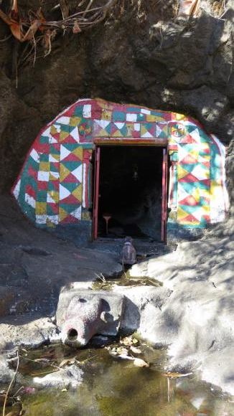
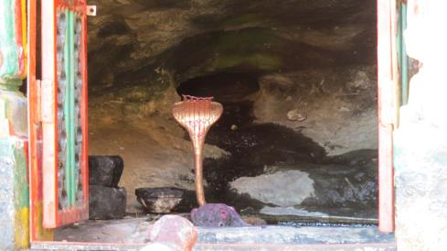
Historical & cultural relevance of springs in the study area
TAJ PALACE, NEW DELHI | 12 – 14 SEPTEMBER 2016
Many prominent rivers have their origins from springs
Very few remain protected in the form of spring sanctuary/ temple sanctuaries
Notes:
Krishnavati river

Slide 25
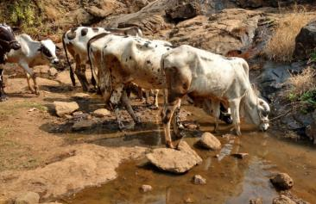
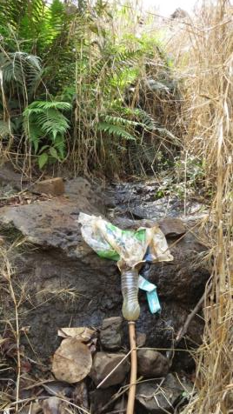
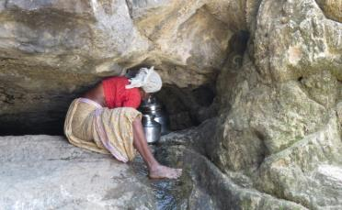
Environmental services offered by springs: Different uses/users of springs
TAJ PALACE, NEW DELHI | 12 – 14 SEPTEMBER 2016
Agriculture
Drinking (Humans and Animals)

Slide 26
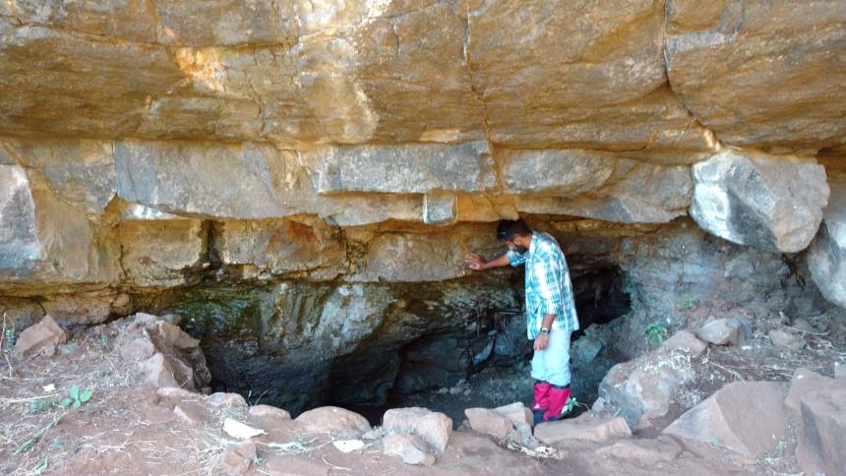
Environmental services offered by springs: Springs re-emerge as base flows in higher order streams (Akole Transect)
TAJ PALACE, NEW DELHI | 12 – 14 SEPTEMBER 2016
Compact Basalt
Vesicular Amygdaloidal Basalt
Spring
Stream channel
Flow contact spring type

Slide 27
Environmental services offered by Springs: Springs re-emerge as base flows in higher order streams (Sangamner Transect)
TAJ PALACE, NEW DELHI | 12 – 14 SEPTEMBER 2016
Spring
Spring
Stream Channel

Slide 28
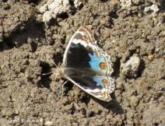
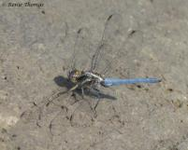
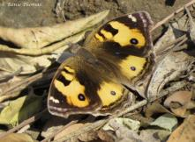
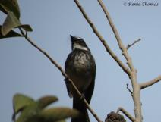
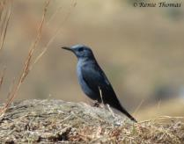
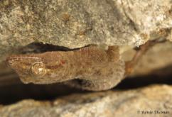
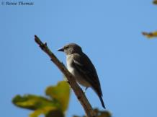
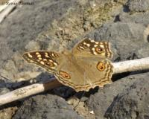
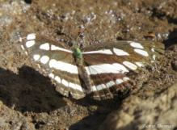
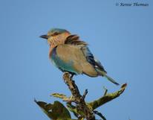
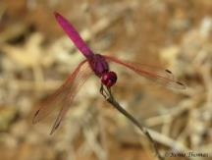
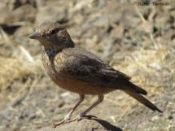
TAJ PALACE, NEW DELHI | 12 – 14 SEPTEMBER 2016
Environmental services offered by springs :Supports diverse fauna and provides micro-habitat to them.

Slide 29
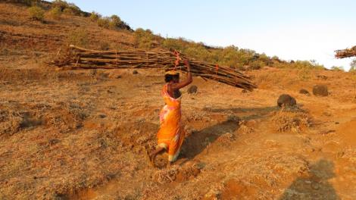
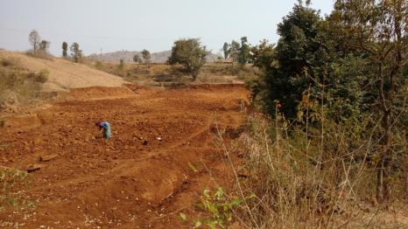
Threats to Natural Springs & their conservation
TAJ PALACE, NEW DELHI | 12 – 14 SEPTEMBER 2016
Deforestation in springshed and loss of flora & fauna
Changes in land-use and land cover (increasing land levelling for terrace farming)

Slide 30
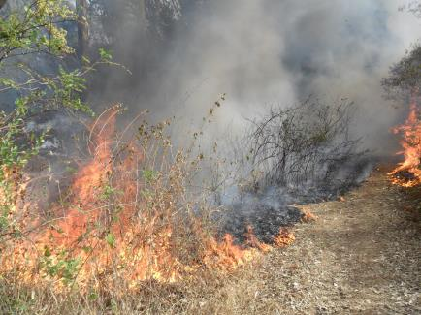
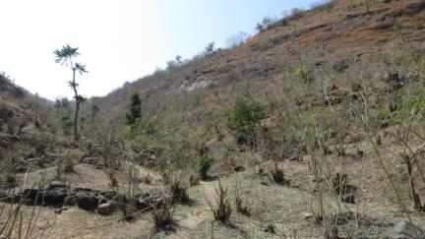
TAJ PALACE, NEW DELHI | 12 – 14 SEPTEMBER 2016
Uncontrolled anthropogenic fires in springshed.
Over grazing in the recharge areas
Invasion of exotic species (Eucalyptus and Lantana)
Climate variability: rainfall and recurring droughts

Slide 31
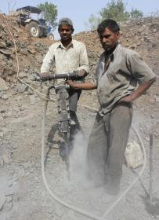
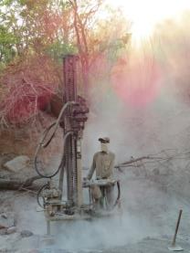
TAJ PALACE, NEW DELHI | 12 – 14 SEPTEMBER 2016
Excess runoff and reduced recharge resulting in transition of many springs from - perennial to seasonal and seasonal to extinct
Deep drilling and opening of springs for wells – resulting in total damage of springs and disorienting the natural flow
Groundwater overdraft (changes in hydraulic levels both upstream and downstream)

Slide 32
CONCLUSIONS
TAJ PALACE, NEW DELHI | 12 – 14 SEPTEMBER 2016
Natural springs:
Source of freshwater for drinking for many vulnerable and remote communities.
Provide crucial base flows to higher order stream channels downstream for their effective functioning and natural flow.
Harbour and support freshwater biodiversity (Insects, birds, fishes, rodents, reptiles, and large threatened species)
Significant changes in LULC in the upstream springshed catchments has far reaching impacts on the reduced flow discharge of springs.
Decline in the discharge of springs and their numbers can significantly alter micro-habitats and its micro-climate and impact downstream environmental flows.
Spring identification and its registration at the village, state and national natural resource inventory.
Conservation of springs should be based on three ecohydrological components – catchment, aquifer, and the spring outlet.
Adoption of spring box for providing safe drinking water for communities.
Demarcating and declaring areas around springs as spring sanctuaries.
SUGGESTIONS

Slide 33
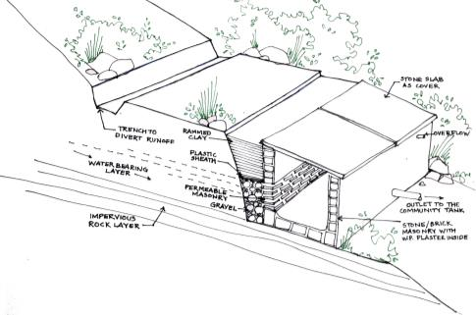
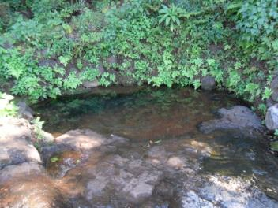
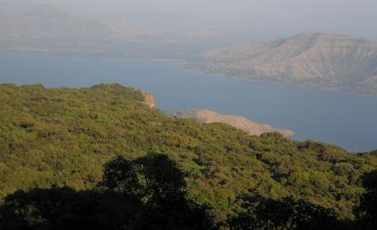
Way Forward: Restoration and Conservation
TAJ PALACE, NEW DELHI | 12 – 14 SEPTEMBER 2016
Image source: Spring box design (Grampari)

Slide 34
Questions
TAJ PALACE, NEW DELHI | 12 – 14 SEPTEMBER 2016
Thank you!
Supported by
For further details contact:
renie.thomas@wotr.org.in
info@wotr.org

