Slide 1
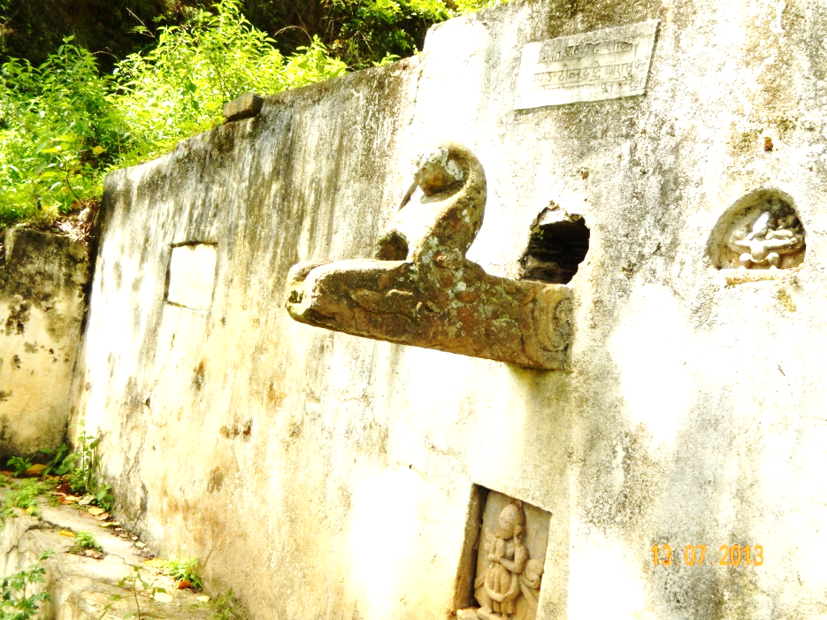
Traditional Water Sources in Nepal Status and climate resilience
TAJ PALACE, NEW DELHI | 12 – 14 SEPTEMBER 2016
By Thakur Pandit, Simon Tilleard (Alluvium International) and Jeremy Carew-Reid (ICEM - International Centre for Environmental Management)

Slide 2
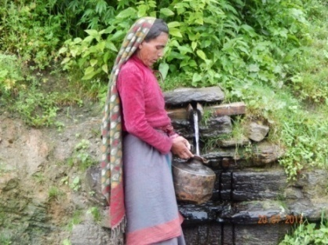
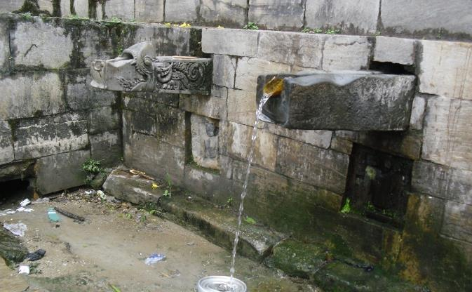
Traditional Water Sources
Natural springs or areas of shallow groundwater
Water supply for 1 to 100s of households
Social and cultural importance
Found across Nepal and India
Notes:
Natural springs or areas of shallow groundwater developed as sites for public water supply several hundred years ago
Serve as water supply facility for a cluster of households – from 1 to 100s of househoulds
Can have huge social and cultural importance
Important water supplies in countries such as Nepal and India
Traditional water sources (TWS) in Nepal are natural springs or areas of shallow groundwater developed hundreds of years ago as sites for public water consumption. As well as their huge social and cultural importance, TWS are essential water supply assets in a country where 17% of the population have poor water access. The need for protection of TWS and promotion of their use as alternative water sources and adaptation to climate change is being recognised, but a lack of information on TWS status and climate resilience has hampered efforts to date. In this study, the first of its kind in Nepal, we address the lack of TWS information by undertaking extensive consultations and field and climate vulnerability assessments for 33 TWS in nine districts covering the diverse cultural and ecological conditions of Nepal.

Slide 3
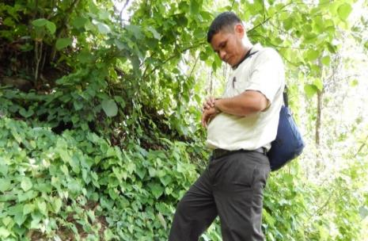
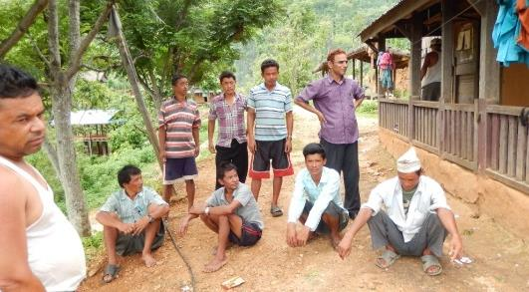
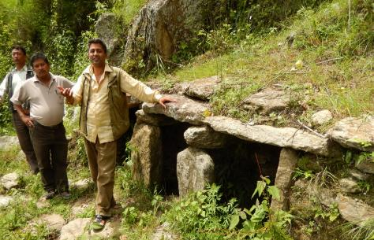
The study
Aim: To address the lack of information on TWS status in Nepal and assess their vulnerability to climate change
Approach: Assess the status and vulnerability of 33 TWS in nine districts covering the diverse cultural and ecological conditions of Nepal

Slide 4
Methods
Consultations
Community
Central and District
Condition Assessment
Component Condition Assessment
Source Yield Measurements
Analysis
TWS Data Analysis
Vulnerability Assessment
Identify Adaptation Measures
Identify Conservation Measures

Slide 5
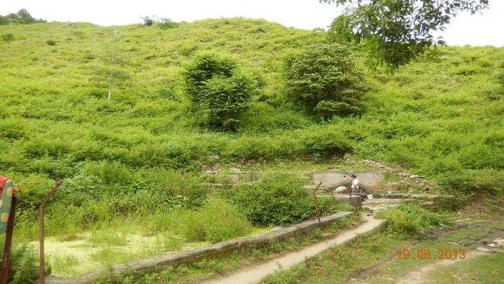
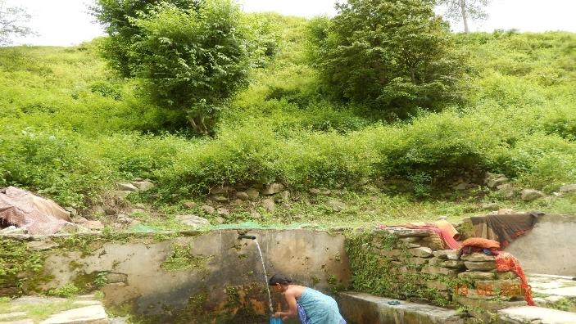
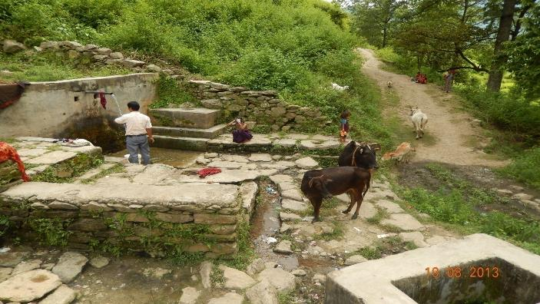
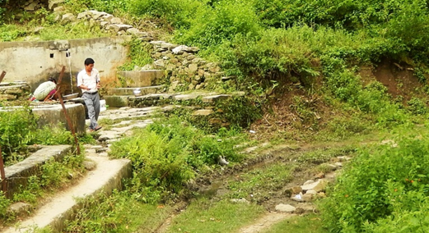
TWS System components
1. Catchment
2. Source
3. Water collection
4. Drainage
Notes:
Catchment
The catchment or contributing area is the large vegetated zone where water from rain and other natural springs infiltrates to the groundwater. The water then travels through the soil or as overland flow to reach the source point. The amount of water that reaches the source point, and its availability throughout the year, is a direct function of catchment conditions such as the wetness index, soil parameters, slope, vegetation cover and impermeable areas. The catchment is the primary TWS component influencing source sustainability.
Catchments can be categorised in terms of the level of encroachment.
The source is the point at which water becomes available for human use. In Nepal, there are two distinct types of sources which are characterised as springs and dug-wells.
Springs sources are sites where underground water flow naturally comes to the surface and discharges. Dug wells are holes dug into the ground to access ground water. It is even more difficult to demarcate the extent and location of the contributing catchment areas for dug wells because the water may travelled several kilometres through underground aquifers.
Water collection points for spring sources
Water collection points consist of built structures to facilitate collection and disposal of water. The structures may include spouts, taps, storage facilities and/or aprons to divert waste water. It is most useful to categorise the spring source water collection system according to spout types which vary depending on the area, culture and availability of materials.
Water collection points for dug wells
Dug-wells are popular in the Terai region of Nepal and many communities still use them as their main water supply. The dug wells are typically a cylindrical structure 5-18 meters deep made of brick, reinforced concrete rings or stone masonry.
Draiange
The drainage system of TWS is the physical component built by people or naturally existing for diversion of water and waste water after its use at the water collection point.

Slide 6
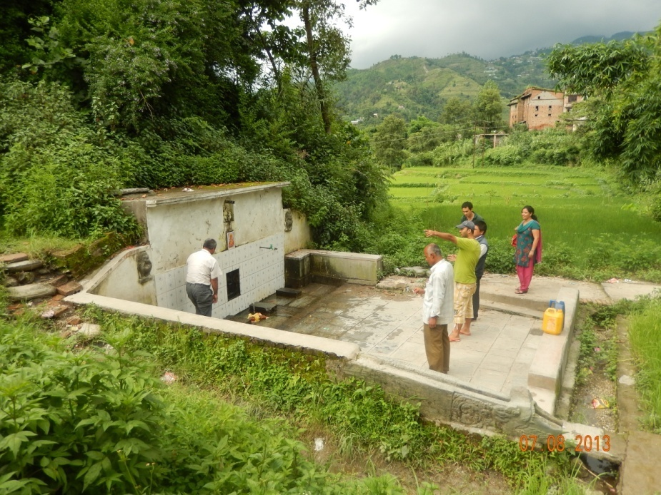
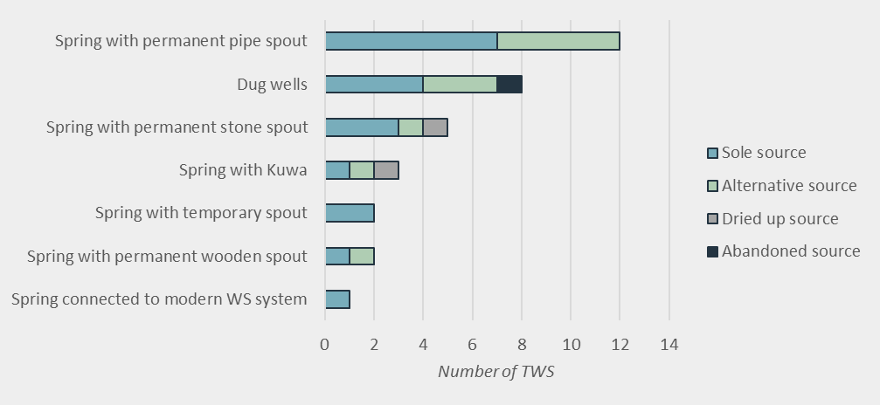
Findings – Type and use
Notes:
The TWS systems are important sole or alternative water sources for nearby communities. Over half of the TWS assessed (57%) are the sole source of water for the nearby communities (Figure 10). A quarter are used as alternative sources during failure of a modern water supply system. Only two were dried up and unusable and one had been abandoned by users moving to a more advanced technology.

Slide 7
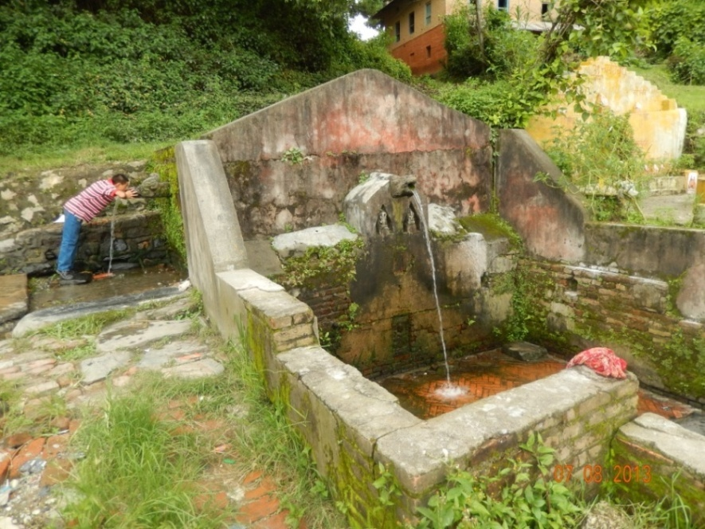
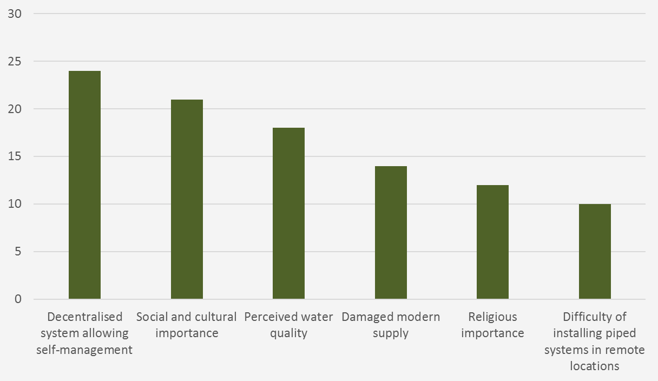
Findings – reason for use
Notes:
The primary reason communities use spring TWS is that the decentralised nature of TWS water supplies means they can manage their own access to water. Other common reasons for use of TWS systems are social and cultural importance and the perception that TWS systems provide better water quality compared to piped water.

Slide 8
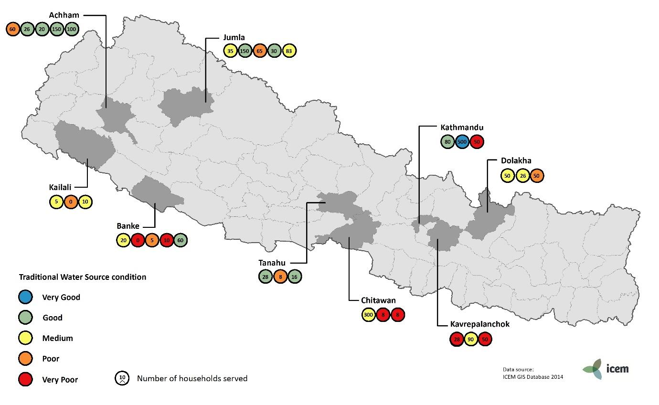
Findings - TWS condition
Notes:
There was no geographic pattern found in the status of TWS systems across Nepal (Figure 14). Even within a district there can be a wide range in the condition of TWS. For example, in Kathmandu one TWS system was found to be in very poor condition whilst one was found to be in very good condition. Of the districts assessed Achham district TWS are in the best condition, in this district four of the TWS are in good condition and only one is in poor condition. Chitwan and Kavre TWS were in the worst condition, the TWS in these districts were found to be in very poor and poor condition.

Slide 9
Findings – common issues
Notes:
The condition of TWS in Nepal is deteriorating and will continue to do so if their conservation is not prioritised. TWS conditions are deteriorating primarily due to lack of catchment protection to prevent contamination and encroachment; and limited platform space for users causing unhygienic conditions. Most of the catchments were found to be encroached by agriculture, grazing or a combination of both. The spring sources were generally found to be in poor condition due to lack of protection and maintenance. The condition of the water collection points for spring sources systems were generally found to be very poor. Issues identified include inadequate protection measures,
unclean and unhygienic practices, platform size and lack of water regulation.

Slide 10
Findings – Common issues

Slide 11
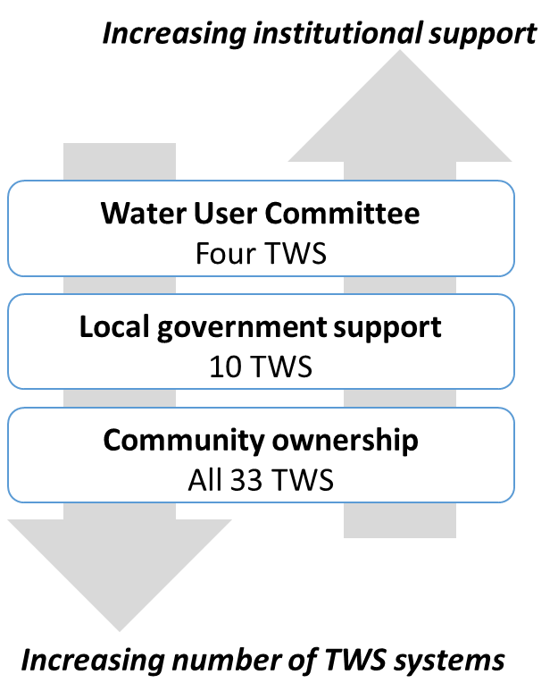
Findings – Institutional support
Notes:
Communities exhibit a strong feeling of ownership of the TWS and in the absence of government support they self-organise to collectively manage the systems through local informal bodies. At most of the TWS systems studied the community have a strong feeling of ownership of the TWS and spend their own time and resources in maintaining the system. These sources have been socially, culturally and environmentally important for the people for several decades or centuries so the communities are using their own knowledge and capacity to protect the TWS systems.
Existing community led TWS conservation and adaptation measures can inform planning for future works. Examples of successful existing measures include: fencing of the source area for Jhar Phunga TWS in Achhaam district; designation of the Pandu Gupha TWS as heritage site; construction of storage system; and improvement of the water collection area of the Magar Pani TWS in Tanahun district.

Slide 12
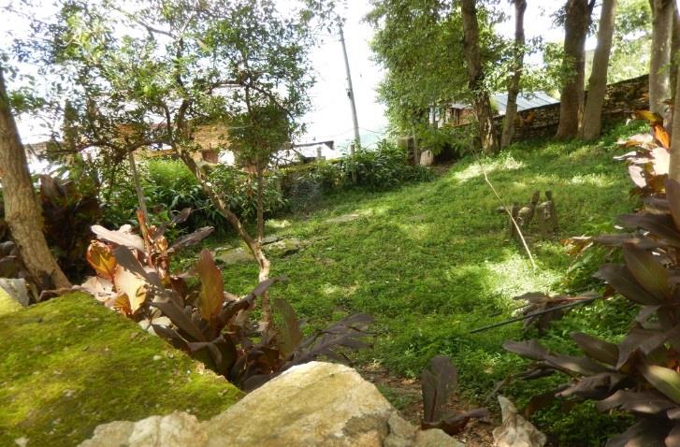
Findings – Existing conservation
Protected source at Jhar Phunga TWS, Achhaam District

Slide 13
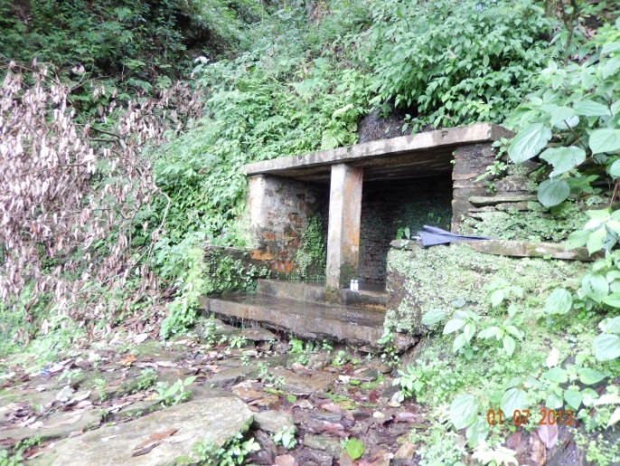
Findings – Existing conservation
Improved access infrastructure in Magar Pani, Tanahun district

Slide 14
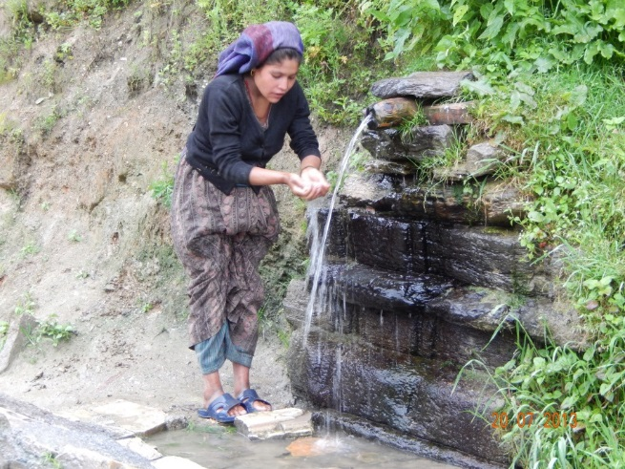
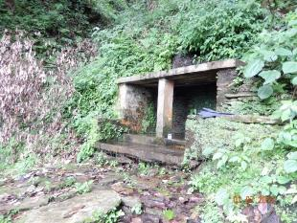
Findings – Existing conservation
Pandu Gupha TWS listed as a heritage site

Slide 15
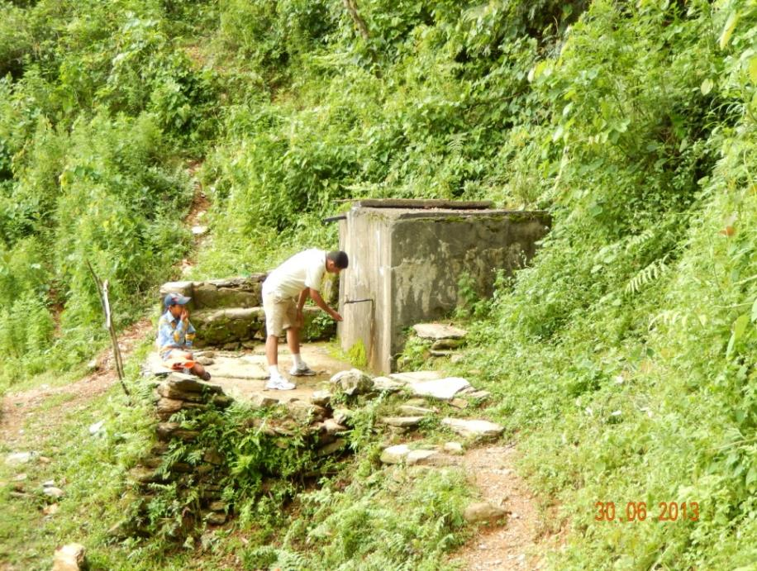
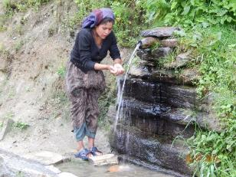
Findings – Existing conservation
Construction of storage system at Dharadi, Tanahun district

Slide 16
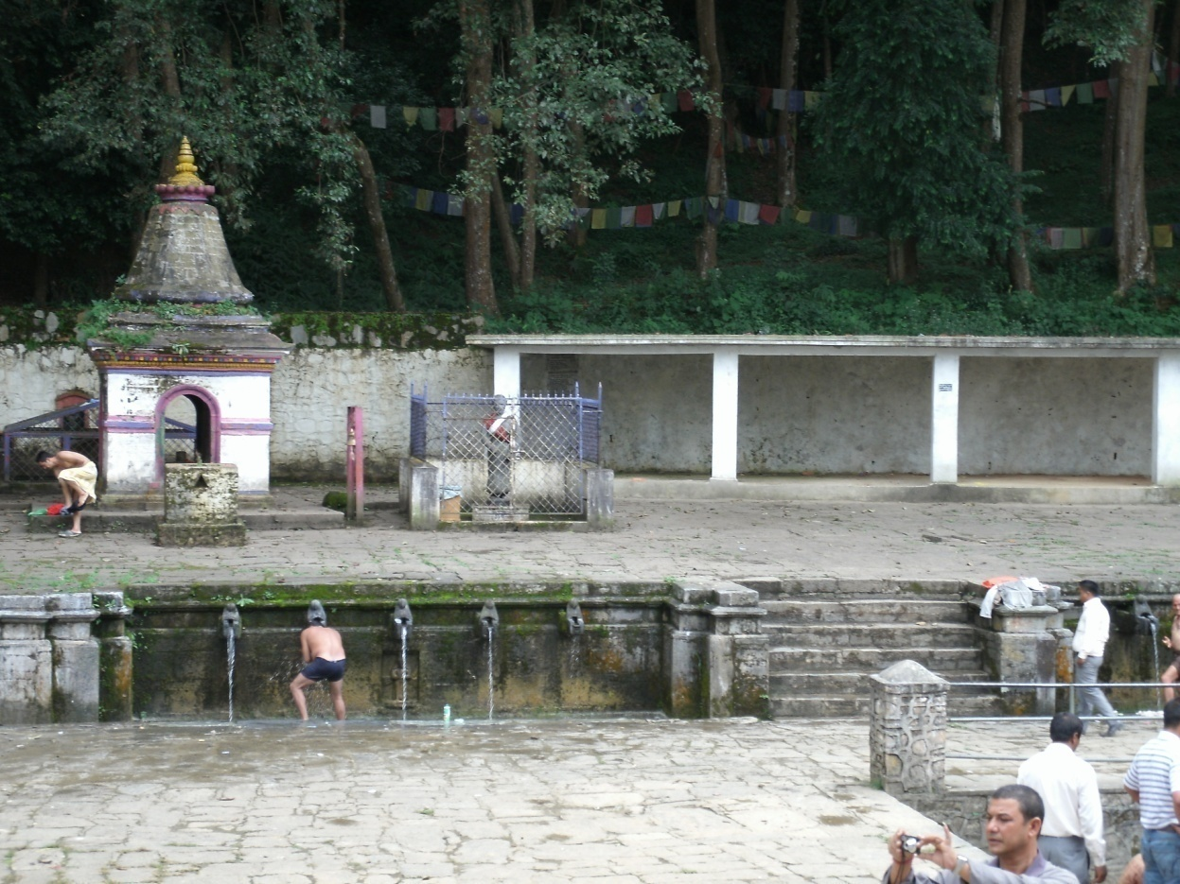
Climate change vulnerability assessment example
Mathathirth TWS, Kathmandu District
Key Threat in Kathmandu | Vulnerability Summary
Increasing average maximum temperature of up to 3⁰C | Moderate – reduction of water availability to source
Increasing intensity of rainfall | Low –protected from flash floods due to surrounding forest
Increasing flood magnitude | Low –not located near a river
Increasing landslide occurrence | Low –no transmission lines in landslide prone areas

Slide 17
Climate change vulnerability summary
District | Sources | Key threats (2000 to 2050) | Key impact | Vulnerability
Dolakha | Three spring | Increasing temperatures Increasing rainfall intensity Increasing flood occurrence and magnitude Increasing landslide risk (Dolakha only) Increasing risk of GLOF (Dolakha only) Increasing risk and severity of flash floods (Dolakha only) | Landslide damage | High
Kathmandu | Three spring |  | Drying of source | Medium
Banke | Four dug wells |  | Lowering ground water level Inundation of well | High
Chitwan | Three springs |  | Drying of source | Low
Achaam | Five springs |  | Drying of source | Medium
Notes:
TWS provide a cost efficient and decentralised opportunity to improve water supply services, particularly in the face of climate change. The larger size and complexity of piped systems make them more vulnerable to impacts such as landslides and flash floods. Comparatively, TWS are decentralized and small scale which are easier to operate, repair and maintain in proper physical and sanitary conditions. The proven long term resilience of TWS systems is encouragement to conserve them as a no-regret measure to protect critical water supply lifelines in the context of climate change.

Slide 18
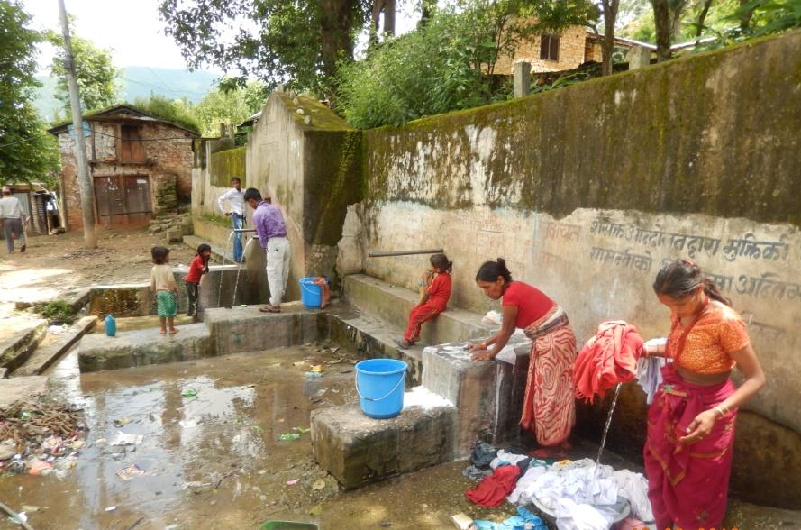
Summary of key findings
TWS condition is deteriorating
2. TWS may be resilient to climate change
3. Pilot interventions are needed
Notes:
TWS condition is deteriorating due to lack of catchment protection to prevent contamination and encroachment, and limited platform space for users causing unhygienic conditions
TWS may be resilient to climate change because the decentralised system is easier to maintain and manage and they have limited infrastructure that can be damaged by extreme events
Pilot interventions are needed to test TWS as a cost efficient and decentralised approach to improving water supply services in remote areas of Nepal in the face of climate change
Catchments for the sources tend to be fairly small and technologies traditional – the system is more readily managed and maintained by local users is a good one. That is local communities can managed the needed adaptation with local materials, labour and finance. Trad resources mean that communities are more self reliant in managing their water supply with climate change.
Pilot interventions are needed to test TWS as a cost efficient and decentralised approach to improving water supply services in remote areas of Nepal in the face of climate change. The study findings can inform these pilots by highlighting the causes of deterioration to be addressed and foundations of resilience to be built upon. In the absence of government support, remote communities have begun to self-organise to collectively manage the systems through local informal bodies, these existing community-led TWS conservation measures should inform future conservation planning.

Slide 19
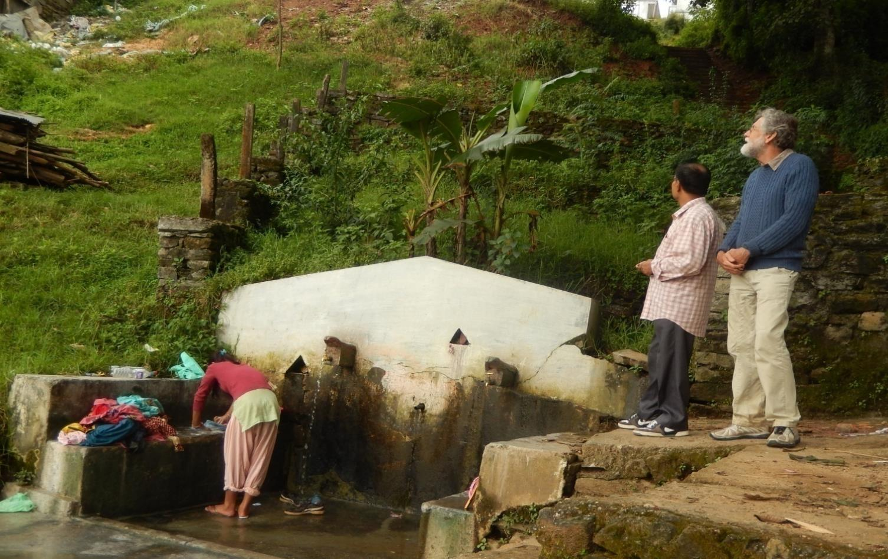
Thanks
This study was funded and implemented by ICEM - International Centre for Environmental Management with support from the Government of Nepal Ministry of Water Supply and Sewerage

